Slide 1


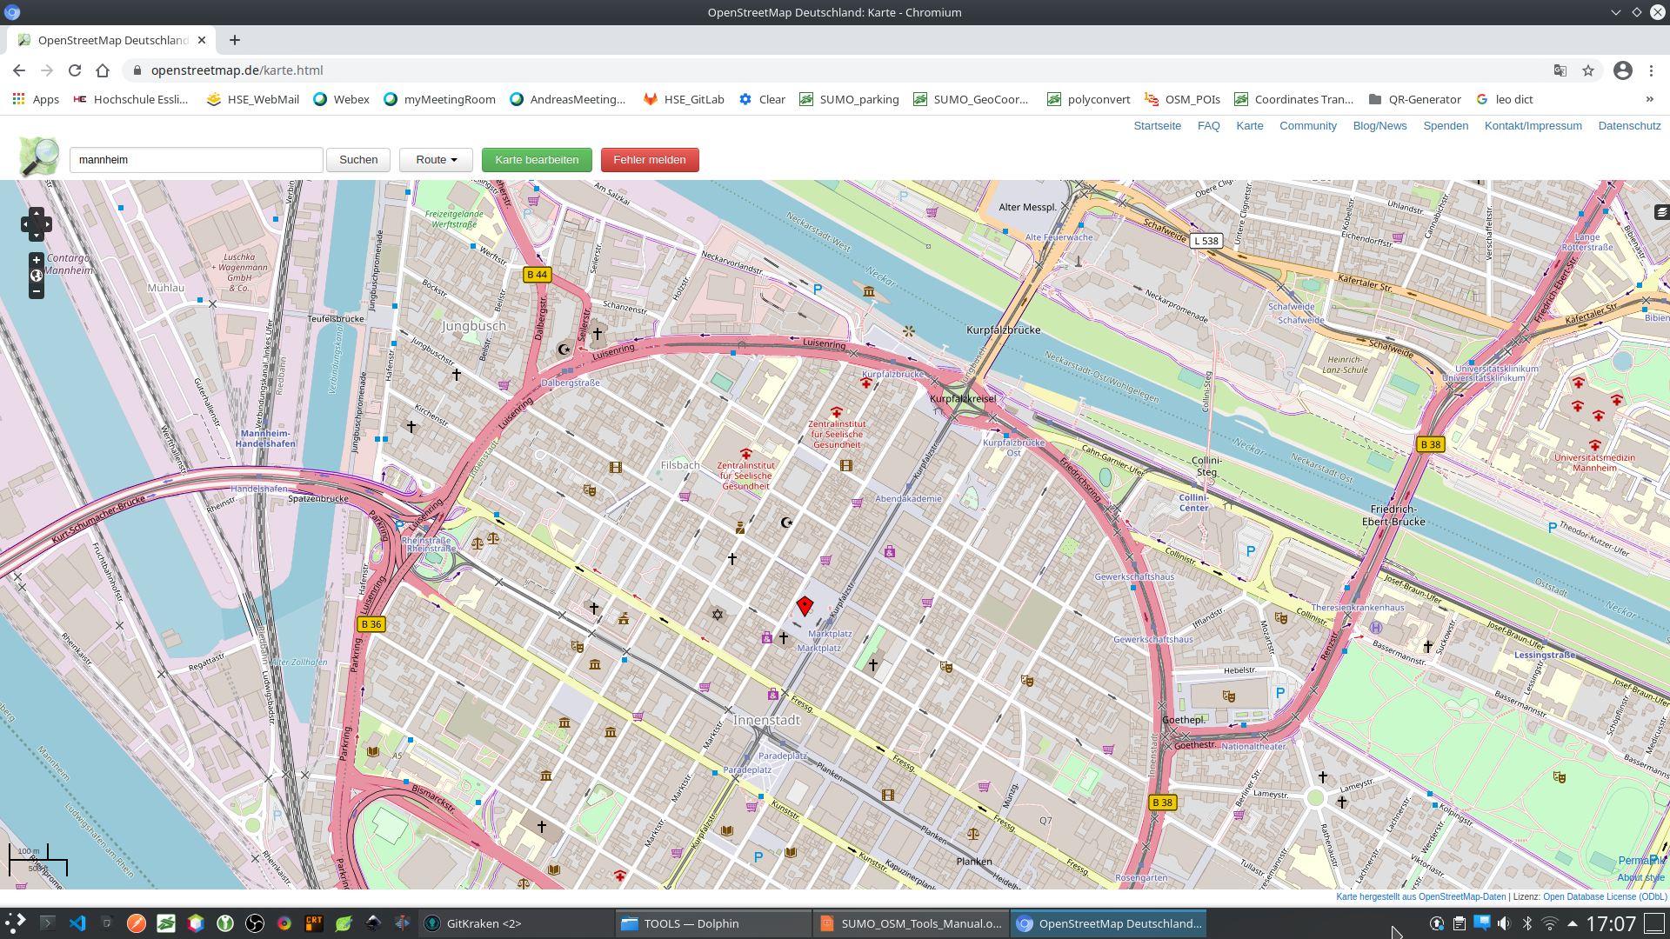
SUMO OSM POI Tools
This document describes some useful Tools to work with
Points of Interest (POIs) from Open Street Map (OSM) Data in SUMO Traffic Simulations.
Version: v0.1 December 2020
Contact: emanuel.reichsoellner@hs-esslingen.de

Slide 2
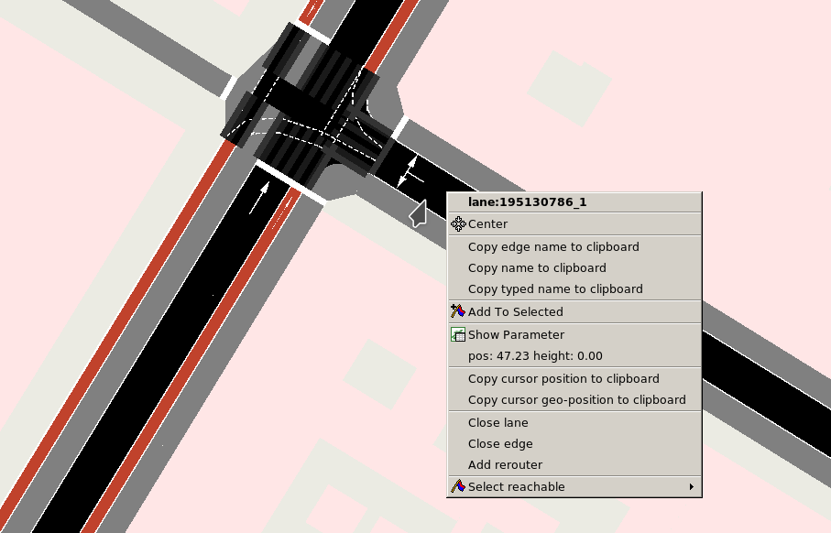
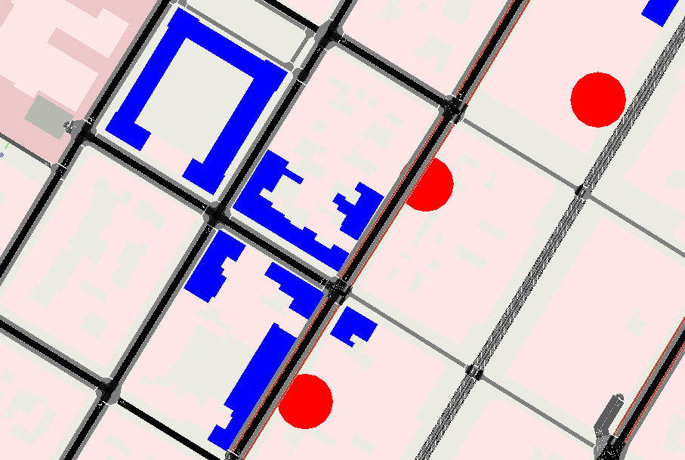
Motivation to develop the OSM POI Tools
POI
Polygon (poly)
In our research project “KI4ROBOFLEET” we faced the problem, that Routes can only be defined by Edges and Lanes in SUMO. Importing a map from Open Street Maps allows just to display the POIs (and Polygons), but an interaction between POIs (or Polygons) and vehicles is not possible in SUMO.
Therefore a workaround has to be found. Another issue was the import of parking Areas, which are exported by OSM but cannot be utilized in SUMO. Finally we also wanted to have a nice SUMO Map with customized colors of the POIs and Polygons. To get all this issues done automatically, we wrote some useful scripts with a GUI for a user friendly usage.

Slide 3
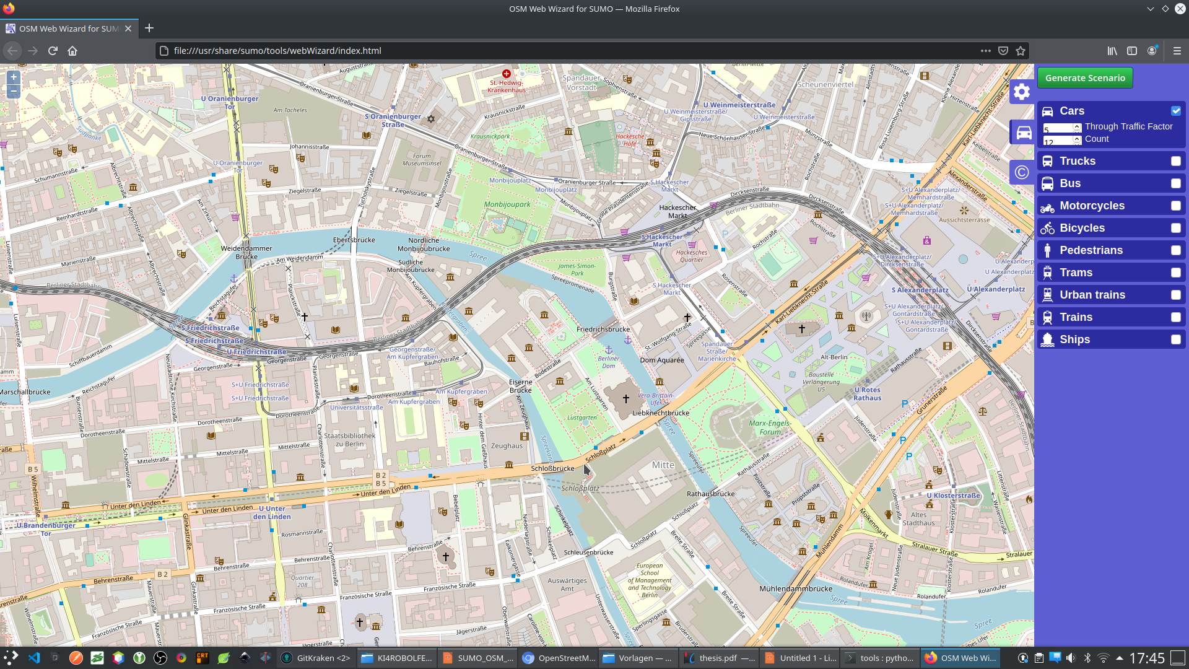
Step 1: Use the osmWebWizard
Change to your SUMO_HOME Directory (e.g. /usr/share/sumo)
Go to the subdirectory “tools” (e.g. /usr/share/sumo/tools)
Type “python osmWebWizard.py” and the browser starts
Pick a region on the Map and make settings for random traffic
Click the “Generate Scenario” Button and SUMO starts.

Slide 4
Step 2: inspect the created files
Check where the newly created files are stored (e.g. home/myname/Sumo/2020-12-03-17-58-39)
Following files should have been created by the OSM WebWizard:
build.bat
osm_bbox.osm.xml
osm.netccfg
osm.net.xml
osm.passenger.trips.xml
osm.polycfg
osm.poly.xml
osm.sumocfg
osm.view.xml
run.bat
The numer of created files depends on the settings in OSM WebWizard

Slide 5
Step 2: inspect the created files
Description of the created files:
build.bat | Microsoft batch file which we don’t use
osm_bbox.osm.xml
osm.netccfg | Configuration File for SUMO “netconvert” (not used)
osm.net.xml | The bare street-Net (without any buildings, etc.)
osm.passenger.trips.xml | List of random routes for random car traffic
osm.polycfg | Configzration File for SUMO “polyconvert”(not used)
osm.poly.xml | List of all POIs and Polygons of the Map
osm.sumocfg | SUMO Main file which loads all other files
osm.view.xml | View (and delay) Settings for the SUMO GUI
run.bat | Microsoft batch file which we don’t use

Slide 6


Step 3: Start the GUI for the SUMO OSM POI Tools
1. Chang to the directory “SumoOsmPoiTools”
You will find the following files:
This 2 dummy files should be replaced by your own osm.sumocfg file (with all required additional files)
Otherwise some functions won’t work properly
2. Replace this file with your own “osm.poly.xml” from Step 2
3. Run the python3 script:

Slide 7
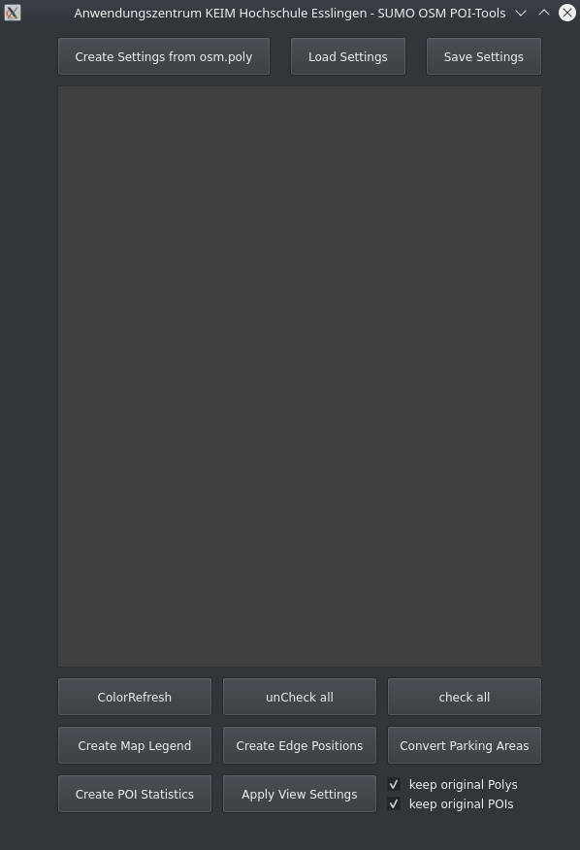
Step 4: create initial Settings
By pressing this button
all <poly> and <poi> Tags
are read from “osm.poly.xml”
and random colors are assigned
If you already have settings, you can load / save them here.
The settings are stored in the
file ./POI_View_Settings.xml

Slide 8
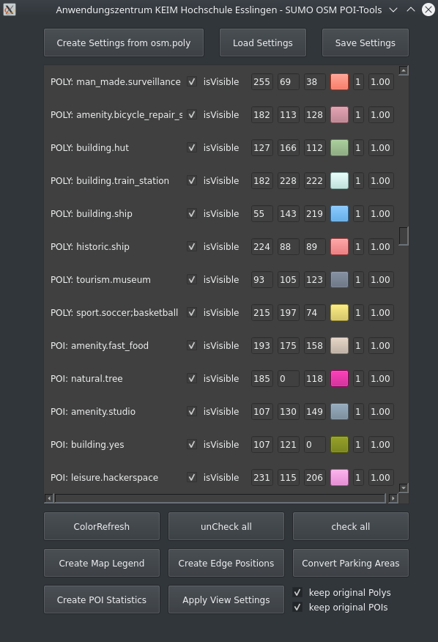
Step 5: adjust and apply Settings
Type
Name
visibility
RGB
fill polys
Layer
press here after changing RGB values to refresh the displayed colors
press here to (un)check all entries
Finally press here to apply the current settings to your osm.poly.xml
-> a new file “osm.poly.customized.xml” is created
To make the Settings visible in SUMO you have to
Replace the original osm.poly.xml with the osm.poly.customized.xml
Set here how to deal with entries in osm.poly.xml for which no settings are defined

Slide 9
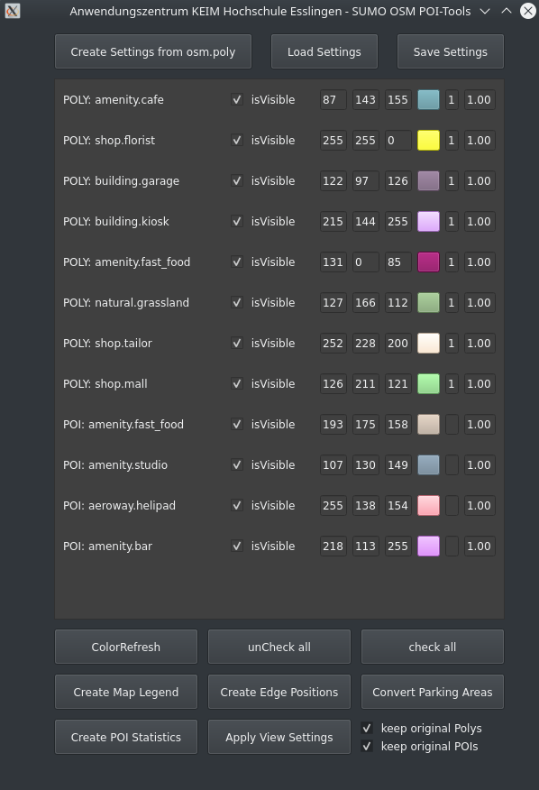
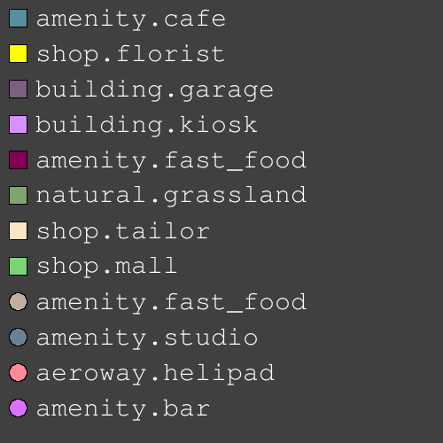
Step 6: (optionally) create a Map Legend
Squares for POLYs
Circles for POIs
Press here to create a Map Legend
Press here to create a Map Legend
The file ./POI_Legend.png is created

Slide 10
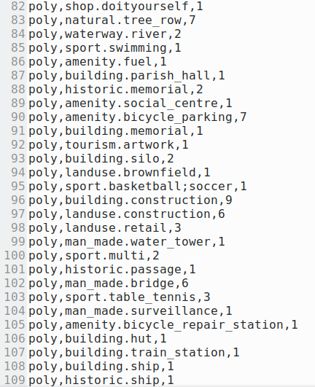
Step 7: (optionally) create POI Statistics
Press here to create POI Statistics
The file ./PoiStatistics.csv is created.
Each unique entry in osm.poly.xml is counted

Slide 11
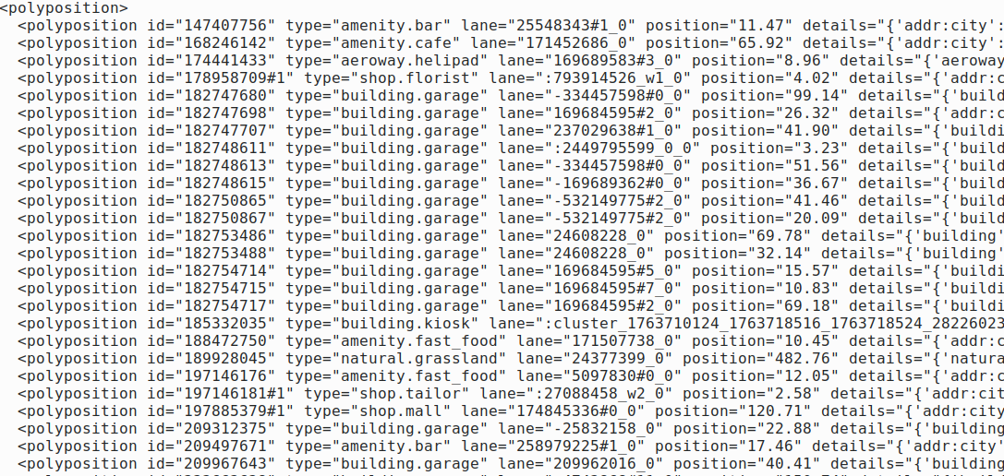
Step 8: create POI EdgePositions file
Press here to get the Edge Position for each POI (or POLY)
The file ./EdgePositions.xml is created.
The lane ID and the lanePosition can be used to define Start- and Endpoints for SUMO Routes (from one POI or POLY to another)

Slide 12
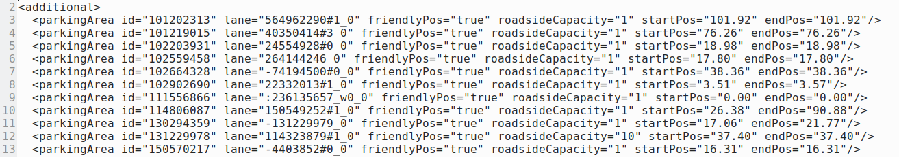
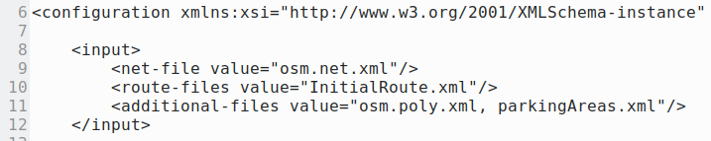
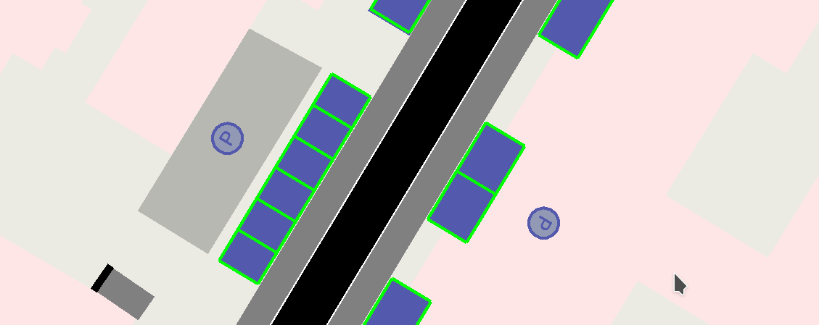
Step 9: convert Parking Areas
The file ./parkingAreas.xml is created.
Add parkingAreas.xml to osm.sumocfg
Press here to convert Parking Areas from osm.poly.xml
Now the Parking Areas are visible in the Map (and not just as an osm.poly.xml entry)
The Parking Areas can be utilized now by the vehicles.

