Slide 1


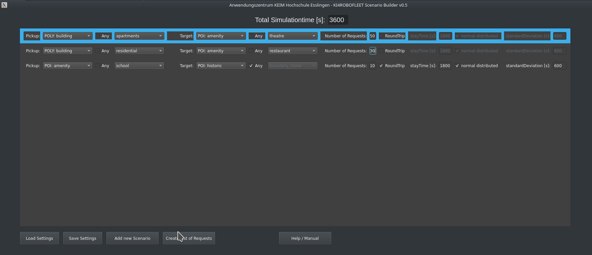
Scenario Builder
This document is a Manual for the SUMO Scenario Builder
developed by KEIM / Hochschule Esslingen
Version: v0.5 March 2021
Contact: emanuel.reichsoellner@hs-esslingen.de

Slide 2
Preparation Steps:
Copy the files
osm.poly.xml and
osm.net.xml
to the current directory (and overwrite the two existing) files.

Slide 3
Basic Functions
Timerange in seconds 3600 = 1hour
finally create the List of Requests
CustomerRequests.xml
The current settings can
be saved and loaded
Filename:
./Scenario_Settings.xml
add new Lines
opens this Manual

Slide 4
Scenario Settings
Pickup POIs
Target POIs
number
Roundtrip options
Number of requests for each scenario
POI Group
POI SubGroup
If the SubGroups should be choosed randomly for each request, then check Any

Slide 5
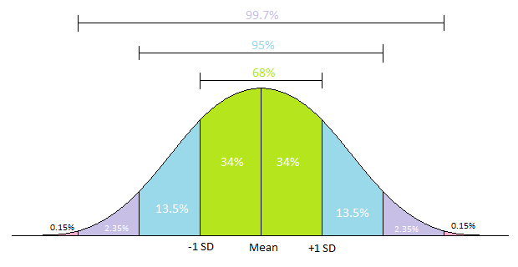
Scenario Settings: Roundtrip options
Roundtrip options
Standard Deviation (SD) for the normal distributed stayTime
Here is an explanation of SD:
If “RoundTrip” is checked, then for each request
a Retour- (Back) Request will be generated
The stayTime is the time between the ToRequest and the BackRequest (the driving time is not taken into account)
If the stayTime should not be a fixed value but a normal distributed value, then check “normal distributed”
Source: https://cetking.com/solving-standard-deviations-sums-without-formula/

