Slide 1
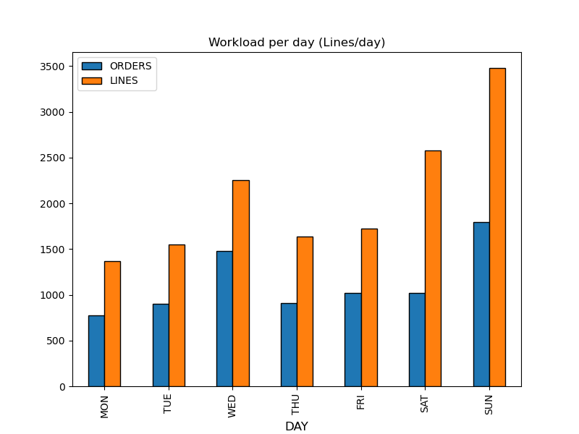
Click... text has been truncated due to evaluation version limitation.
Evaluation only.
Created with Aspose.Slides for .NET Standard 2.0 23.5.
Copyright 2004-2023Aspose Pty Ltd.

