Slide 1
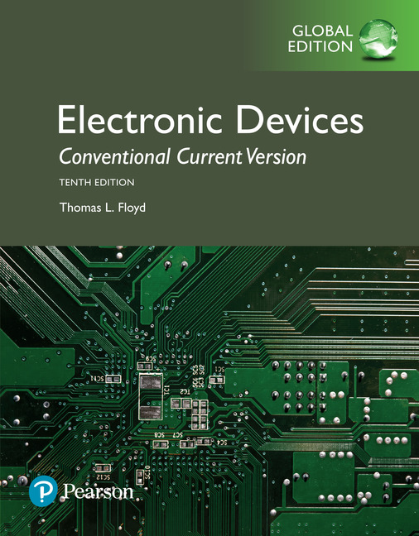
Electronic Devices
10th ed., Global Edition
Chapter 1
Introduction to Semiconductors

Slide 2
Electronic Devices
10th ed.
Objectives:
◆ Describe the structure of an atom
◆ Discuss insulators, conductors, and semiconductors and
how they differ
◆ Describe how current is produced in a semiconductor
◆ Describe the properties of n-type and p-type
semiconductors
◆ Describe how a pn junction is formed

Slide 3
Electronic Devices
Bohr model
The Bohr model of the atom is that electrons can circle the nucleus only in specific orbits, which correspond to discrete energy levels called shells.

Slide 4
Electronic Devices
Conductors
Materials can be classified by their ability to conduct electricity. This ability is related to the valence electrons.
Valence electrons are those electrons that occupy the outer shell.

Slide 5
Electronic Devices
Conductors
Materials can be classified by their ability to conduct electricity. This ability is related to the valence electrons.
Copper is an example of an excellent conductor. It has only one electron in its valence band, which can easily escape to the conduction band, leaving behind a positive ion (the core). Like all metals, copper has many free electrons which are loosely held by the attraction of the positive metal ions.

Slide 6

Electronic Devices
Insulators
Insulators have tightly bound electrons with few electrons available for conduction.
Nonmetals, such as glass, air, paper, and rubber are excellent insulators and widely used in electronics. Even these materials can break down and conduct
electricity if the voltage is high enough such as in the case of lightning, which breaks down air.

Slide 7
Electronic Devices
Semiconductors
Semiconductors are between conductors and insulators in their ability to conduct electricity.
Silicon is an example of a single element semiconductor. It has four electrons in its valence band.
Core (+4)
Unlike metals, silicon forms strong covalent bonds (shared electrons) with its neighbors. Intrinsic silicon is a poor conductor because most of the electrons are bound in the crystal and take part in forming the bonds between atoms.

Slide 8
Electronic Devices
Energy gap in semiconductors
In intrinsic silicon, a few electrons can jump the energy gap between the valence and conduction band. Having moved into the conduction band, a “hole” (vacancy) is left in the crystal structure.

Slide 9
Electronic Devices
Charge movement in semiconductors
Within the crystalline structure, there are two types of charge movement (current):
The conduction band electrons are free to move under the influence of an electric field.
The bound (valence) electrons move between atoms, effectively moving holes from one atom to another as illustrated. Holes act like positive charges, with their own mobility.
Holes Electrons

Slide 10
Electronic Devices
Impurities in semiconductors
Certain impurities will change the conductivity of silicon. An impurity such as Antimony has an electron that is not part of the bonding electrons so is free. This creates an n-material.
Question:
Where on the periodic table would you expect to find another element that could be used as an impurity to create an n-material?
Elements above or below Sb will have the same valence electron structure.

Slide 11
Electronic Devices
Vacancies in the crystal structure
An impurity such as boron leaves a vacancy in the valence band, creating a p-material. Both p- and n- materials have energy levels that are different than intrinsic silicon.

Slide 12
Electronic Devices
Formation of the pn junction
A p- and an n-material together form a pn junction.
When the junction is formed, conduction electrons move to the p- region, and fall into holes. Filling a hole makes a negative ion and leaves behind a positive ion in the n-region. This creates a thin region that is depleted of free charges at the boundary.
Question:
What process stops the migration of charge across the boundary?
A potential is built up (called the barrier potential) that prevents further charge migration.

Slide 13
Electronic Devices
Energy diagram for a pn junction
The energy diagram for the n-region shows a lower potential than for the p-region.
Question:
Why do you think that the energy level in the n- region is lower than the p-region?
The n-region tends to have filled valence shells; conduction electrons are shielded by these electrons, so they are further away from the nucleus and have less energy.

Slide 14
Electronic Devices
Diodes
A diode is a semiconductor device with a single pn junction and metal connections to leads. It has the ability to pass current in only one direction.

Slide 15
Electronic Devices
Forward bias
Forward bias is the condition which allows current in the diode. The bias voltage must be greater than the barrier potential.

Slide 16
Electronic Devices
Reverse bias
Reverse bias is the condition in which current is blocked.

Slide 17
Electronic Devices
Diode approximations
Three diode approximations are:
Ideal
Practical
Complete
In addition, the complete model includes the effect of a large reverse resistance that accounts for a tiny current when reverse-biased.

Slide 18
Electronic Devices
Example
Use the practical model to determine the current in the circuit:
Solution:
3.4 mA

Slide 19
Electronic Devices
Diode packages
Some common configurations are

Slide 20
Electronic Devices
Selected key terms-1
Electron
Valence
Free Electron
Conductor
Insulator
The basic particle of negative electrical charge.
Related to the outer shell of an atom.
An electron that has acquired enough energy to break away from the valence band of the parent atom; also called a conduction electron.
A material that easily conducts electrical current.
A material that does not normally conduct current.

Slide 21
Electronic Devices
Selected key terms-2
Semiconductor
Crystal
Hole
Diode
A material that lies between conductors and insulators in its conductive properties.
A solid material in which the atoms are arranged in a symmetrical pattern.
The absence of an electron in the valence band of an atom in a semiconductor crystal.
A semiconductor device with a single pn junction that conducts current in one direction only.

Slide 22
Electronic Devices
Quiz: Q1
1. A semiconductor is a crystalline material with
a. many free electrons held by the attraction of positive ions
b. strong covalent bonds between neighboring atoms
c. only one electron in its outer shell
d. a filled valence shell

Slide 23
Electronic Devices
Quiz: Q2
2. A metallic conductor has
a. many free electrons held by the attraction of positive ions
b. covalent bonds between neighboring atoms
c. four electrons in its outer shell
d. a filled valence shell

Slide 24
Electronic Devices
Quiz: Q3
3. In a semiconductor, the concept of an energy gap is used to show the difference between the energies of the
a. nucleus and outer shell electrons
b. nucleus and the free electrons
c. conduction band electrons and valence electrons
d. core electrons and valence electrons

Slide 25
Electronic Devices
Quiz: Q4
4. An impurity such as Antimony (Sb) has five electrons in its outer shell. When silicon has Sb impurities,
a. an n material is formed
b. the crystal will be negatively charged
c. both of the above
d. none of the above

Slide 26
Electronic Devices
Quiz: Q5
5. Compared to a p-material, the energy levels in an n-material are
a. the same
b. greater
c. lower

Slide 27
Electronic Devices
Quiz: Q6
6. When a pn junction is formed, electrons move across the junction and fill holes in the p-region. The filled hole is a
a. neutral atom
b. minority carrier
c. positive ion
d. negative ion

Slide 28
Electronic Devices
Quiz: Q7
7. The forward biased knee voltage in a semiconductor diode is approximately equal to the
a. bias supply voltage
b. breakdown voltage
c. output voltage
d. barrier potential

Slide 29
Electronic Devices
Quiz: Q8
8. Using the ideal diode model, the current in the circuit shown is
a. 0.73 mA
b. 0.80 mA
c. 0.87 mA
d. 1.2 mA

Slide 30
Electronic Devices
Quiz: Q9
9. Using the practical diode model, the current in the circuit shown is
a. 0.73 mA
b. 0.80 mA
c. 0.87 mA
d. 1.2 mA

Slide 31
Electronic Devices
Quiz: Q10
10. The diode model which includes the large reverse resistance is the
a. ideal model
b. practical model
c. complete model
d. all of the above

Slide 32
Quiz answers
Answers:
1. b
2. a
3. c
4. a
5. c
6. d
7. d
8. b
9. a
10. c

