Slide 1
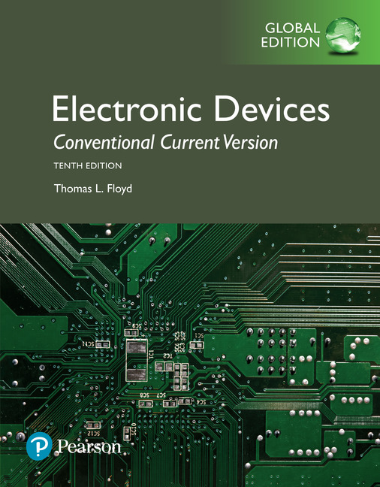
Electronic Devices
10th ed., Global Edition
Chapter 2
Diodes and Applications

Slide 2
Electronic Devices
10th ed.
Objectives:
◆ Use a diode in common applications
◆ Analyze the voltage-current (V-I) characteristic of a diode
◆ Explain how the three diode models differ
◆ Explain and analyze the operation of half-wave rectifiers
◆ Explain and analyze the operation of full-wave rectifiers
◆ Explain and analyze power supply filters and regulators
◆ Explain and analyze the operation of diode limiters and
clampers
◆ Explain and analyze the operation of diode voltage
multipliers
◆ Interpret and use diode datasheets
◆ Troubleshoot diodes and power supply circuits

Slide 3
Electronic Devices
Half-wave Rectifier
The diode conducts during the positive half cycle.

Slide 4
Electronic Devices
Half-Wave Rectifier
The diode conducts during the positive half cycle.
It does not conduct during the negative half cycle.
Question:
Question:
Question:
What is the output if the diode is reversed?
See drawing

Slide 5
Electronic Devices
Half-Wave Rectifier
PIV at t_{p}
The peak inverse voltage (PIV) is equal to the peak input voltage and is the maximum voltage across the diode when it is not conducting.
−V_{p(in)}
Notice that the PIV can be found by applying Kirchhoff’s Voltage Law. The load voltage is 0 V, so the input voltage is across the diode at t_{p}.

Slide 6
Electronic Devices
Full-Wave Rectifier
A center-tapped transformer is used with two diodes that conduct on alternating half-cycles.
During the positive half-cycle, the upper diode is forward-biased and the lower diode is reverse-biased.

Slide 7
Electronic Devices
Full-Wave Rectifier
A center-tapped transformer is used with two diodes that conduct on alternating half-cycles.
During the positive half-cycle, the upper diode is forward-biased and the lower diode is reverse-biased.
During the negative half-cycle, the lower diode is forward-biased and the upper diode is reverse-biased.

Slide 8
Electronic Devices
Full-Wave Rectifier
The PIV can be shown by applying KVL around the loop shown for the reverse-biased diode.
Apply KVL
Notice that one-half of the peak secondary voltage will be across the reverse-biased diode.

Slide 9
Electronic Devices
Bridge Full-Wave Rectifier
The Bridge Full-Wave rectifier uses four diodes connected across the entire secondary as shown.
Conduction path for the positive half-cycle.
Question:
Ideally, what is the PIV equal to?
PIV = V_{p(out)}
Conduction path for the negative half-cycle.

Slide 10
Electronic Devices
Bridge Full-Wave Rectifier - Example
Example:
Determine the peak output voltage and current in the 3.3 kΩ load resistor if V_{sec} = 24 V_{rms}. Use the practical diode model.
Solution:
The peak output voltage is:
= 32.5 V
Applying Ohm’s law,
I_{p(out)} = 9.8 mA

Slide 11
Electronic Devices
Power Supply Filters
Filtering is the process of smoothing the ripple from the rectifier.
(Ripple is exaggerated.)
The capacitor input filter is widely used. A half-wave rectifier and capacitor-input filter are shown:

Slide 12
Electronic Devices
Power Supply Filters
Question:
How is the ripple affected by the RC time constant?
Answer:
A longer time constant will have less ripple for the same input voltage and frequency.

Slide 13
Electronic Devices
Power Supply Regulators
A voltage regulator can furnish nearly constant output with excellent ripple rejection. Three-terminal regulators are require only external capacitors to complete the regulation portion of the circuit.

Slide 14
Electronic Devices
Power Supply Regulators
Regulation performance is specified in two ways. Line regulation specifies how much the dc output changes for a given change in regulator’s input voltage. The text formula is based on a dc input voltage change to the regulator due to a change in the ac line voltage.
Question:
Assume the dc input to a regulator changes by 1.0 V due to a change in the ac line voltage. If the output changes by 1.5 mV due to the change, what is the line regulation?
Answer:
0.15%

Slide 15
Electronic Devices
Power Supply Regulators
Load regulation specifies how much change occurs in the output voltage for a given range of load current values, usually from no load (NL) to full load (FL).
Question:
Assume the dc output of a regulator changes from 5.00 V to 4.96 V when the output is varies from no load to full load. What is the load regulation?
Answer:
0.8 %

Slide 16
Electronic Devices
Diode Limiting Circuits
A diode limiter is a circuit that limits (or clips) either the positive or negative part of the input voltage. A biased limiter is one that has a bias voltage in series with the diode, so that a specific voltage level can be selected for limiting.
A positive limiter is shown. R_{L} is normally >> R₁ to avoid loading effects. The output will be clipped when the input voltage overcomes the bias voltage and the forward voltage of the diode.

Slide 17
Electronic Devices
Diode Limiting Circuits - Example
Example-1:
What is the output of positive limiter shown?
3.0 V
Solution:
The diode is forward-biased when the output tries to go above +3.0 V. This causes the output to be limited to voltages less than +3.0 V.

Slide 18
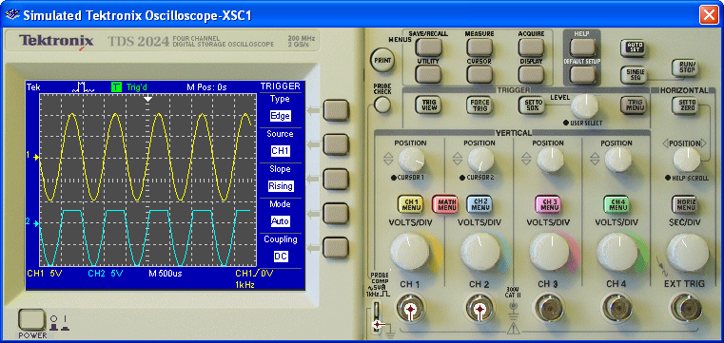
Electronic Devices
Diode Limiting Circuits - Example
As a check, you can simulate the circuit with Multisim. The scope shows the input and output voltage for the positive limiter circuit in Example-1.
V_{in}
V_{out}

Slide 19
Electronic Devices
Diode Limiting Circuits - Example
Example-2:
What happens in the previous circuit if the diode is reversed?
+1.6 V
Solution:
The diode is forward-biased when the output tries to go below +1.6 V. This causes the output to be limited to voltages greater than +1.6 V.

Slide 20
Electronic Devices
Diode Clamping Circuits
A clamper (dc restorer) is a circuit that adds a dc level to an ac signal. A capacitor is in series with the load. A positive clamper is shown. The capacitor is charged to a voltage that is one diode drop less than the peak voltage of the signal.
Question:
What happens if the diode and capacitor are reversed?

Slide 21
Electronic Devices
Diode Clamping Circuits
Solution:
Reversing the diode and capacitor forms a negative clamper.

Slide 22
Electronic Devices
Voltage Multipiers
Voltage multipliers use clamping action to increase peak rectified voltages. The full-wave voltage doubler works by charging a capacitor to the positive peak voltage on one cycle of the sine wave and a second capacitor on the negative peak voltage. The output is (ideally) doubled by taking it across both capacitors in series.

Slide 23
Electronic Devices
Diode Data Sheet
Diode data sheets include maximum ratings for current, voltage and temperature as well as other electrical parameters. Some voltage and current specifications are abbreviated as follows:
V_{RRM} The maximum peak reverse voltage that can be applied repetitively across the diode. This is the same as the PIV rating.
V_{R} The maximum reverse dc voltage that can be applied across the diode.
V_{RSM} The maximum peak value of nonrepetitive reverse voltage that can be applied across the diode.
I_{O} The maximum value of a 60 Hz rectified current.
I_{FSM} The maximum value of a nonrepetitive (one cycle) forward surge current.

Slide 24
Electronic Devices
Troubleshooting
Analysis:
Identify the symptoms of a faulted circuit and eliminate as many causes as possible. Analysis also includes finding out as much as possible about how the failure occurred.
Planning:
Decide on logical steps to narrow the possible causes. Frequently you will start with visual checks, looking for obvious defects before proceeding to measuring specific points.
Measurement:
Having thought about possible causes, you are ready to make measurements such as voltage and resistance readings. These results will usually isolate the problem to one or two components.

Slide 25
Electronic Devices
Selected Key Terms-1
Rectifier
Filter
Regulator
Ripple Voltage
An electronic circuit that converts ac into pulsating dc; one part of a power supply.
In a power supply, the capacitor used to reduce the variation of the output voltage from a rectifier.
An electronic device or circuit that maintains an essentially constant output voltage for a range of input voltage or load values; one part of a power supply.
The small variation in dc output voltage of a filtered rectifier caused by charging and discharging of the filter capacitor.

Slide 26
Electronic Devices
Selected Key Terms-2
Line Regulation
Load Regulation
Limiter
Clamper
The change in output voltage of a regulator for a given change in input voltage, normally expressed as a percentage.
The change in output voltage of a regulator for a given range of load currents, normally expressed as a percentage.
A diode circuit that clips off or removes part of a waveform above and/or below a specified level.
A circuit that adds a dc level to an ac voltage using a diode and a capacitor.

Slide 27
Electronic Devices
Quiz Q1
1. For the circuit shown, the PIV will occur when the input waveform is at point
a. A
b. B
c. C
d. D
B
C
A D

Slide 28
Electronic Devices
Quiz Q2
2. The circuit shown is a
a. half-wave rectifier
b. full-wave rectifier
c. bridge rectifier
d. none of the above

Slide 29
Electronic Devices
Quiz Q3
3. The PIV for the circuit shown is equal to
a. V_{p(sec)}/2
b. V_{p(sec)}
c. 2V_{p(sec)}
d. none of the above

Slide 30
Electronic Devices
Quiz Q4
4. During the positive input cycle shown, the conduction path is through diodes
a. D₁ and D₂
b. D₃ and D₄
c. D₁ and D₄
d. D₂ and D₃

Slide 31
Electronic Devices
Quiz Q5
5. The formula to calculate the load regulation is,
a.
b.
c.
d.

Slide 32
Electronic Devices
Quiz Q6
6. The bias voltage is set to +4.3 V. The output of the biased limiter shown will be clipped
a. above +3.6 V
b. below +3.6 V
c. above +5.0 V
d. below +5.0 V

Slide 33
Electronic Devices
Quiz Q7
7. The bias voltage is set to +4.3 V. The output of the biased limiter shown will be clipped
a. above +3.6 V
b. below +3.6 V
c. above +5.0 V
d. below +5.0 V

Slide 34
Electronic Devices
Quiz Q8
8. The circuit shown is a
a. negative clipping circuit
b. positive clipping circuit
c. negative clamping circuit
d. positive clamping circuit

Slide 35
Electronic Devices
Quiz Q9
9. The circuit shown is a
a. full-wave rectifier
b. full-wave voltage doubler
c. positive clamping circuit
d. negative clamping circuit

Slide 36
Electronic Devices
Quiz Q10
10. A diode abbreviation that means the same thing as the PIV is the
a. V_{RRM}
b. V_{RSM}
c. I_{O}
d. I_{FSM}

Slide 37
Electronic Devices
Answers
Answers:
1. d
2. b
3. a
4. a
5. d
6. c
7. b
8. c
9. b
10. a

