Slide 1
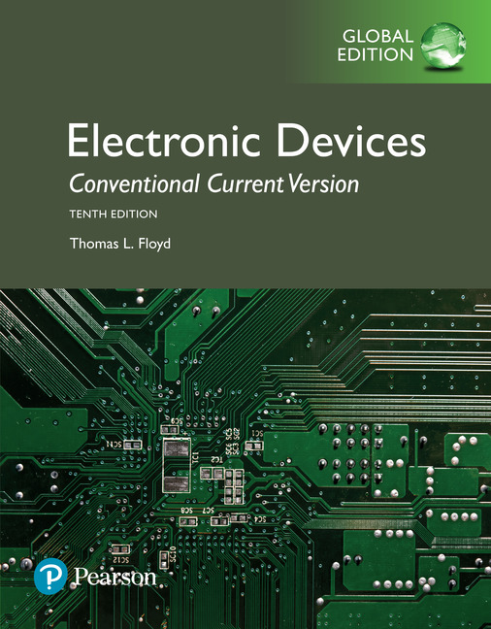
Electronic Devices
10th ed., Global Edition
Chapter 3
Special-Purpose Diodes

Slide 2
Electronic Devices
10th ed.
Objectives:
◆ Describe the characteristics of a zener diode and analyze
its operation
◆Apply a zener diode in voltage regulation
◆ Describe the varactor diode characteristic and analyze its
operation
◆ Discuss the characteristics, operation, and applications of
LEDs, quantum dots, and photodiodes
◆ Explain the basic operation of a solar cell
◆ Discuss the basic characteristics of several types of diodes
◆ Troubleshoot zener diode regulators

Slide 3
Electronic Devices
The Zener Diode
The zener diode is designed to operate in the reverse breakdown region.
Ideally, the reverse breakdown has a constant breakdown voltage. This makes it useful as a voltage reference, which is its primary application.
Symbol
Characteristic curve

Slide 4
Electronic Devices
The Zener Diode
The zener impedance, Z_{Z}, is the ratio of a change in voltage in the breakdown region to the corresponding change in current:
Example:
Practical model
What is the zener impedance if the zener diode voltage changes from 4.79 V to 4.94 V when the current changes from 5.00 mA to 10.0 mA?
Solution:
30 Ω

Slide 5
Electronic Devices
The Zener Diode
The temperature coefficient of a zener diode can be specified as the percent change in zener voltage for each degree Celsius change in temperature:
where TC has units of %/ºC.
Alternatively, it can be specified in terms of change in voltage per degree Celsius change in temperature.
where TC has units of mV/ºC.

Slide 6
Electronic Devices
The Zener Diode - Example
The temperature coefficient can be positive or negative, depending on the zener voltage. Above 5.6 V, zeners generally have a positive temperature coefficient; below about 5.6 V, they have a negative temperature coefficient.
Example:
A 1N756 is an 8.2 V zener diode (8.2 V at 25º C) with a positive temperature coefficient of 5.4 mV/ºC. What is the output voltage if the temperature rises to 50º C?
Solution:
8.389 V
V_{Z} = 8.2 V + 0.189 V =

Slide 7
Electronic Devices
The Zener Diode - Application
In low current applications, a zener diode can be used as a basic regulator.
Example:
A 1N756 (8.2 V at 25º C) is used as an 8.2 V regulator in the circuit shown. What is the smallest load resistor that can be used before losing regulation? Assume an ideal zener diode model.
Solution:
The no load zener current is
This is the maximum load current in regulation. Therefore,
837 Ω

Slide 8
Electronic Devices
Zener Diode Application
Zeners are embedded in three-terminal regulators to establish a reference voltage. These circuits are capable of much larger load currents than the basic zener regulator shown previously.

Slide 9
Electronic Devices
Zener Diode Application
Zeners can also be used as limiters. The back-to-back zeners in this circuit limit the output to the breakdown voltage plus one diode drop.
Question:
What are the maximum positive and negative voltages if the zener breakdown voltage is 5.6 V?
± 6.3 V

Slide 10
Electronic Devices
Varactor Diodes
A varactor diode is a special purpose diode operated in reverse-bias to form a voltage-controlled capacitor. The width of the depletion region increases with reverse-bias.
Question:
If the depletion widens, does the capacitance increase or decrease?
Hint:
Notice that as the effective plate separation widens, the capacitance will decrease.

Slide 11
Electronic Devices
Varactor Diodes
Capacitance tolerance range are the range of values of capacitance for a given varactor. The data sheet will show the minimum nominal and maximum values, which are often plotted on a graph.
For example, you can use this graph to read the capacitance as a function of reverse voltage for various diodes.

Slide 12
Electronic Devices
Varactor Diodes
The capacitance ratio is the ratio of the diode’s capacitance at the minimum reverse voltage (largest C) to the diode’s capacitance at the maximum reverse voltage (smallest C).
Data sheets also include parameters such as maximum ratings for current, power and temperature.

Slide 13
Electronic Devices
Varactor Diodes
Varactor diodes are used in tuning applications. The applied voltage controls the capacitance and hence the resonant frequency.
By varying R₂, the reverse bias on D is changed. This changes the capacitance, and hence the resonant frequency.

Slide 14
Electronic Devices
Optical Diodes
Diodes can be made to emit light (electroluminescence) or sense light. Light-emitting diodes (LEDs) vary widely in size and brightness – from small indicating lights and displays to high-intensity LEDs that are used in traffic signals, outdoor signs, automobile lighting and general illumination. LEDs are much more efficient than incandescent lamps and are rapidly replacing older heated filament lamps for general lighting..

Slide 15
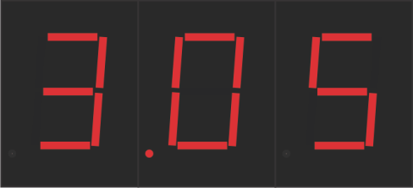
Electronic Devices
Optical Diodes
Diodes can be made to emit light (electroluminescence) or sense light. Light-emitting diodes (LEDs) vary widely in size and brightness – from small indicating lights and displays to high-intensity LEDs that are used in traffic signals, outdoor signs, automobile lighting and general illumination. LEDs are much more efficient than incandescent lamps and are rapidly replacing older incandescent and fluorescent lighting.
An example of an LED display light is the familiar seven-segment display. It uses LEDs in a special arrangement to display numbers.

Slide 16
Electronic Devices
Optical Diodes
LEDs emit a specific range of wavelengths which depend on the construction and dye material used. The wavelength is given on the specification sheet. LEDs are available for visible light and infrared.
Question:
What is the peak wavelength of a green LED?
540 nm

Slide 17
Electronic Devices
Optical Diodes
Another characteristic shown in specification sheets is the radiation pattern for the LED. This plot is an example of a typical pattern in which light is concentrated in one direction.
A wider viewing angle will show a wider pattern such as the TLDR5400:

Slide 18
Electronic Devices
Optical Diodes
The forward voltage drop can vary from about 1.5 V to over 3 V depending on the type of diode, its color, and the amount of forward current. You need to take into account the specified maximum current allowed and the diode’s forward drop when choosing a limiting resistor.
Example:
A certain bright red LED drops 2.2 V at a maximum current of 20 mA. What series resistor is required to limit the current to 20 mA from a 5.0 V source?
Solution:
180 Ω

Slide 19
Electronic Devices
Optical Diodes
Other specifications, such as maximum power dissipation are given on the manufacturer’s specification sheet. To determine the power dissipated by the LED, multiply the forward voltage by the forward current.
Example:
A certain bright red LED drops 2.2 V at 20 mA. What power is dissipated by the LED?
Solution:
44 mW

Slide 20
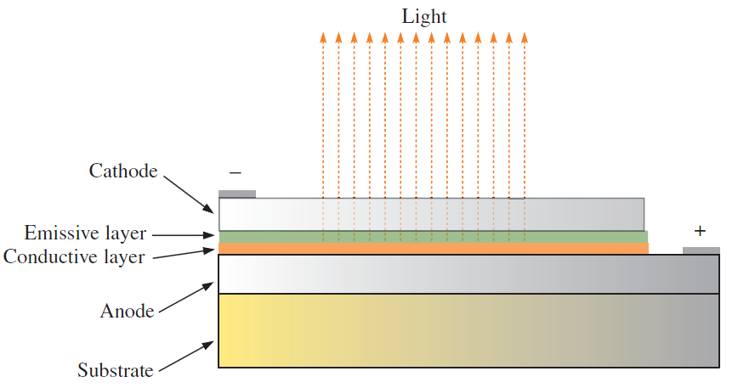
Electronic Devices
Optical Diodes
An organic LED (OLED) is a device that consists of two or three layers of materials composed of organic molecules or polymers that emit light with the application of voltage.
The type of organic molecule or polymer in the emissive layer determines the color emitted. The main application is in displays.

Slide 21
Electronic Devices
Optical Diodes
Another optical diode is the photodiode, which is a special light sensitive diode with a clear window to the pn junction. It is operated with reverse bias. Reverse current increases with greater incident light.
Dark current
The tiny current that is present when the diode is not exposed to light is called dark current.

Slide 22
Electronic Devices
Other Types of Diodes
A laser diode converts an electrical signal into coherent (monochromatic) light. It produces an intense narrow beam of light from the recombination of electrons and holes in the depletion region.
The process is similar to the process that occurs in an LED, but a laser diode differs because the light emission is stimulated by a nearby photon to produce light that is “in-step” and occurs within an optical cavity.

Slide 23
Electronic Devices
Other Types of Diodes
Each photon produced in a laser diode is identical to the other photons in energy level, phase relationship, and frequency. So a single wavelength of intense light emerges from the laser diode. Laser diodes are the most common form of lasers made. They are used in applications such as bar code readers, fiber optic transmitters, CD readers, laser pointers, and instruments such as rangefinders.

Slide 24
Electronic Devices
Other Types of Diodes
A Schottky diode is a metal-to-semiconductor contact diode that is used primarily in high frequency and fast-switching applications. It has a low forward voltage drop and high efficiency but rather low reverse voltage rating.

Slide 25
Electronic Devices
Other Types of Diodes
A PIN diode is a three layer diode consisting of a p and n layers separated by a narrow intrinsic layer. In microwave applications, the pin diode acts as a voltage-controlled resistor. Certain types are used as photodetectors in fiber optic systems.

Slide 26
Electronic Devices
Other Types of Diodes
A tunnel diode has a characteristic curve that shows a negative resistance reading between B and C with a small forward voltage. The negative resistance region is unstable. Taking advantage of this characteristic, the tunnel diode can be used in an oscillator
circuit at microwave
frequencies.

Slide 27
Electronic Devices
Other Types of Diodes
A current-regulator diode is a specialized diode that maintains a constant current when operated within a specific region. It is never operated with reverse bias. The constant current region is the horizontal portion of the characteristic curve.

Slide 28
Electronic Devices
Diode Symbols
Some common diode symbols are shown:

Slide 29
Electronic Devices
Selected Key Terms-1
Zener diode
Varactor
Light-emitting diode
Electroluminescence
A diode designed for limiting the voltage across its terminals in reverse bias.
A variable capacitance diode.
A type of diode that emits light when there is forward current.
The process of releasing light energy by the recombination of electrons in a semiconductor.

Slide 30
Electronic Devices
Selected Key Terms-2
Pixel
Photodiode
Laser
In an LED display screen, the basic unit for producing colored light and consisting of red, green and blue LEDs.
A diode in which the reverse current varies directly with the amount of light.
Light amplification by stimulated emission of radiation.

Slide 31
Electronic Devices
Quiz Q1
1. A zener diode can be used as a
a. constant current source
b. voltage reference
c. both of the above
d. none of the above

Slide 32
Electronic Devices
Quiz Q2
2. The zener current for the circuit shown is
a. 3.0 mA
b. 6.0 mA
c. 7.5 mA
d. 9.0 mA

Slide 33
Electronic Devices
Quiz Q3
3. The load current for the circuit shown is
a. 3.0 mA
b. 6.0 mA
c. 7.5 mA
d. 9.0 mA

Slide 34
Electronic Devices
Quiz Q4
4. If each of the zener diodes have a zener voltage of 5.0 V, the positive output will be limited to
a. +4.3 V
b. +5.0 V
c. +5.7 V
d. +10 V

Slide 35
Electronic Devices
Quiz Q5
5. A varactor is a diode used as a voltage-controlled
a. current source
b. light sensor
c. resistor
d. capacitor

Slide 36
Electronic Devices
Quiz Q6
6. The peak wavelength of an LED is related to
a. the viewing angle
b. the maximum power dissipated
c. the color
d. all of the above

Slide 37
Electronic Devices
Quiz Q7
7. The forward voltage drop for an LED depends on
a. the type of diode
b. the forward current
c. the color
d. all of the above

Slide 38
Electronic Devices
Quiz Q8
8. You would expect to find a laser diode in a
a. automobile tail light
b. bright sign board
c. bar-code reader
d. all of the above

Slide 39
Electronic Devices
Quiz Q9
9. A diode with a negative resistance region in its characteristic curve is a
a. tunnel diode
b. Schottly diode
c. varactor
d. photodiode

Slide 40
Electronic Devices
Quiz Q10
10. A photodiode
a. has three layers
b. operates with reverse bias
c. is a light emitter
d. all of the above

Slide 41
Electronic Devices
Answers
Answers:
1. b
2. a
3. b
4. c
5. d
6. c
7. d
8. c
9. a
10. b

