Slide 1
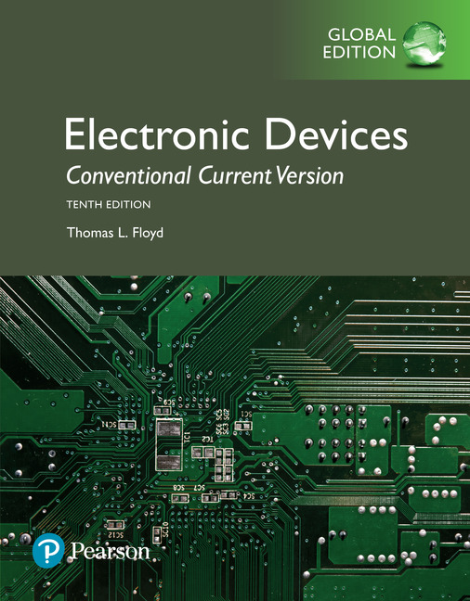
Electronic Devices
10th ed., Global Edition
Chapter 4
Bipolar Junction Transistors

Slide 2
Electronic Devices
10th ed.
Objectives:
◆ Describe the structure of the BJT
◆ Discuss basic BJT operation
◆ Discuss important BJT parameters and characteristics and
analyze transistor circuits
◆ Discuss how a BJT is used as a voltage amplifier
◆ Discuss how a BJT is used as a switch
◆ Discuss the phototransistor and its operation
◆ Identify various types of transistor packages
◆ Troubleshoot faults in transistor circuits

Slide 3
Electronic Devices
BJT Structure
The BJT has three regions called the emitter, base, and collector. Between the regions are junctions as indicated.
The base is a thin lightly doped region compared to the heavily doped emitter and moderately doped collector regions.
npn
pnp

Slide 4
Electronic Devices
BJT Operation
In normal operation, the base-emitter is forward-biased and the base-collector is reverse-biased.
For the npn type, the collector is more positive than the base, which is more positive than the emitter.
npn

Slide 5
Electronic Devices
BJT Operation
In normal operation, the base-emitter is forward-biased and the base-collector is reverse-biased.
For the pnp type, the voltages are reversed to maintain the forward-reverse bias.
pnp

Slide 6
Electronic Devices
BJT Characteristics
The collector characteristic curves show the relationship of the three transistor currents. The curve shown is for a fixed based current
Breakdown region
The first region from A to B is the saturation region. As V_{CE} is increased, I_{C} increases until B.
Active region
After reaching B, the curve flattens between points B and C, which is the active region.
Saturation region
After C, is the breakdown region.

Slide 7
Electronic Devices
BJT Characteristics
The collector characteristic curves illustrate the relationship of the three transistor currents.
By setting up other values of base current, a family of collector curves is developed.
β_{DC} is the ratio of collector current to base current.
It can be read from the curves. The value of β_{DC} is nearly the same wherever it is read.

Slide 8
Electronic Devices
BJT Characteristics - Example
Example:
What is the β_{DC} for the transistor shown?
Solution:
Choose a base current near the center of the range – in this case I_{B3} which is 30 μA.
Read the corresponding collector current – in this case, 5.0 mA. Calculate the ratio of collector current to base current.
167

Slide 9
Electronic Devices
BJT Cutoff
In a BJT, cutoff is the condition in which there is no base current, which results in only an extremely small leakage current (I_{CEO}) in the collector circuit. For practical work, this current is assumed to be zero.
In cutoff, neither the base-emitter junction, nor the base-collector junction are forward-biased.

Slide 10
Electronic Devices
BJT Saturation
In a BJT, saturation is the condition in which there is maximum collector current. The saturation current is determined by the external circuit (V_{CC} and R_{C} in this case) because the collector-emitter voltage is minimum (≈ 0.2 V)
In saturation, an increase of base current has no effect on the collector circuit and the relation I_{C} = β_{DC}I_{B} is no longer valid.

Slide 11
Electronic Devices
BJT Load Line
The DC load line represents the circuit that is external to
the transistor. It is drawn by connecting the saturation and cutoff points.
The transistor characteristic curves are shown superimposed on the load line. The region between the saturation and cutoff points is called the active region.

Slide 12
Electronic Devices
BJT Load Line - Example
Example:
What is the saturation current and the cutoff voltage for the circuit? Assume V_{CE} = 0.2 V in saturation.
Solution:
4.48 mA
15 V
Follow-up:
Is the transistor saturated?
I_{C} = β I_{B} = 200 (10.45 μA) =
2.09 mA
Since I_{C} < I_{SAT}, it is not saturated.

Slide 13
Electronic Devices
BJT Data Sheets
Data sheets give manufacturer’s specifications for maximum operating conditions, thermal, and electrical characteristics. For example, an electrical characteristic is β_{DC}, which is given as h_{FE}. The 2N3904 shows a range of β’s on the data sheet from 100 to 300 for I_{C} = 10 mA.

Slide 14
Electronic Devices
DC and AC Quantities
The text uses capital letters for both AC and DC currents and voltages with rms values assumed unless stated otherwise.
DC Quantities use upper case roman subscripts. Example: V_{CE}. (The second letter in the subscript indicates the reference point.)
AC Quantities and time varying signals use lower case italic subscripts. Example: V_{ce}.
Internal transistor resistances are indicated as lower case quantities with a prime and an appropriate subscript. Example: r_{e}’.
External resistances are indicated as capital R with either a capital or lower case subscript depending on if it is a DC or ac resistance. Examples: R_{C} and R_{c}.

Slide 15
Electronic Devices
BJT Amplifiers
A BJT amplifies AC signals by converting some of the DC power from the power supplies to AC signal power. An ac signal at the input is superimposed in the dc bias by the capacitive coupling. The output ac signal is inverted and rides on a dc level of V_{CE}.

Slide 16
Electronic Devices
BJT Switches
A BJT can be used as a switching device in logic circuits to turn on or off current to a load. As a switch, the transistor is normally in either cutoff (load is OFF) or saturation (load is ON).
In cutoff, the transistor looks like an open switch.
In saturation, the transistor looks like a closed switch.

Slide 17
Electronic Devices
Phototransistors
A phototransistor produces base current when light strikes the exposed photosensitive base region, which is the active area. Phototransistors have high gain and are more sensitive to light than photodiodes.
In a typical circuit the base lead is left open. In the circuit shown, the output voltage is maximum with no light and drops with increasing light.

Slide 18
Electronic Devices
Phototransistors
The characteristic curves for a phototransistor are based on light flux (mW/cm²) to the base rather than base current in an ordinary transistor.

Slide 19
Electronic Devices
Phototransistors
The output from the phototransistor can be used to activate or deactivate a relay. In this case, the phototransistor is part of a switching circuit.
Question:
Is either transistor ON for the circuit when there is no incident light?
Answer:
With no incident light, Q₁ will be biased OFF. Q₂ will be forward-biased through R and is ON. Collector current in Q₂ causes the relay to be energized.

Slide 20
Electronic Devices
Optocouplers
An optocoupler is a single package containing an LED and a phototransistor. Optical couplers transfer a signal from one circuit to another while providing a high degree of isolation.
A key specification for optocouplers is the current transfer ratio or CTR, which is a measure of efficiency. The CTR is the ratio of output current to input current. Typically values are from 50% to 110% for standard optocouplers.

Slide 21
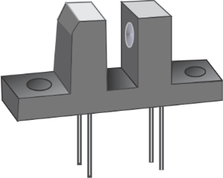
Electronic Devices
Optocouplers
Optocouplers are used when data or signals need to be transferred from a control circuit to a power circuit without making electrical connections between the circuits. For example, the logic circuits in a traffic light controller need to be isolated from the lights themselves.
Another application for optocouplers is as a transducer to detect a light path such as a hole in a rotating disk. In this case, the LED and phototransistor are separated by a gap.
Optocouplers are also useful for isolating patients from the monitoring instruments.

Slide 22
Electronic Devices
Common Transistor Packages
TO-92
SOT-23
TO-18
TO-3
TO-220AB
TO-225AA

Slide 23
Electronic Devices
Basic Transistor Test
A basic test for a BJT is to use the Diode Test function of your DMM.
To test the base-emitter junction of a BJT, connect the positive lead to the base and the negative lead to the emitter. You should see a voltage close to 0.7 V for an npn transistor.

Slide 24
Electronic Devices
Basic Transistor Test
A basic test for a BJT is to use the Diode Test function of your DMM.
To test the base-emitter junction of a BJT, connect the positive lead to the base and the negative lead to the emitter. You should see a voltage close to 0.7 V for an npn transistor.
Reversing the leads will show OL for “overload”.
The procedure is repeated to test the base-collector junction.

Slide 25
Electronic Devices
Selected Key Terms-1
BJT (bipolar junction transistor)
Emitter
Base
Collector
a transistor constructed with three doped semiconductor regions separated by two pn junctions.
the most heavily doped of the three semiconductor regions of a BJT.
one of the three semiconductor regions of a BJT. The base is thin and lightly doped compared to the other regions.
the largest of the three semiconductor regions of a BJT.

Slide 26
Electronic Devices
Selected Key Terms-2
Beta
Saturation
Cutoff
Phototransistor
the ratio of dc collector current to the dc base current in a BJT; current gain from base to collector.
the state of a BJT in which the collector current has reached a maximum and is independent of the base current.
the nonconducting state of a transistor.
a transistor in which base current is produced when like strikes the photosensitive semiconductor base region.

Slide 27
Electronic Devices
Quiz Q1
1. The region on the characteristic curve in which the current changes only slightly with an increase in V_{CE} is called the
a. saturation region
b. cutoff region
c. breakdown region
d. active region

Slide 28
Electronic Devices
Quiz Q2
2. β_{DC} is defined as the ratio of
a. collector current to base current
b. collector current to emitter current
c. emitter current to base current
d. emitter current to collector current

Slide 29
Electronic Devices
Quiz Q3
3. When a BJT is in saturation, the
a. collector current does not change with an
increase in base current
b. base current cannot increase
c. collector to emitter voltage is maximum
d. all of the above

Slide 30
Electronic Devices
Quiz Q4
4. When a BJT is cutoff, the
a. voltage from collector to emitter is near zero
b. collector current is near zero
c. base-emitter junction is forward-biased
d. none of the above

Slide 31
Electronic Devices
Quiz Q5
5. The lower end of the dc load line touches the x-axis at
a. saturation
b. cutoff
c. breakdown
d. 0.7 V

Slide 32
Electronic Devices
Quiz Q6
6. For the circuit shown, the base current is
a. 1.0 μA
b. 1.16 μA
c. 10 μA
d. 11.6 μA

Slide 33
Electronic Devices
Quiz Q7
7. For the circuit shown, the saturation current is
a. 200 μA
b. 2.0 mA
c. 3.79 mA
d. 14.8 mA

Slide 34
Electronic Devices
Quiz Q8
8. For the phototransistor circuit, assume there is sufficient light to saturate Q₁. In this condition,
a. Q₂ is also saturated
b. the diode is conducting
c. the relay is energized
d. none of the above

Slide 35
Electronic Devices
Quiz Q9
9. An optocoupler is a single package containing
a. two transistors
b. an LED and a phototransistor
c. a phototransistor and a relay
d. an LED and a relay

Slide 36
Electronic Devices
Quiz Q10
10. The transistor package that is a TO-3 case is
a. b.
c. d.

Slide 37
Electronic Devices
Answers
Answers:
1. d
2. a
3. a
4. d
5. b
6. c
7. c
8. d
9. b
10. c

