Slide 1
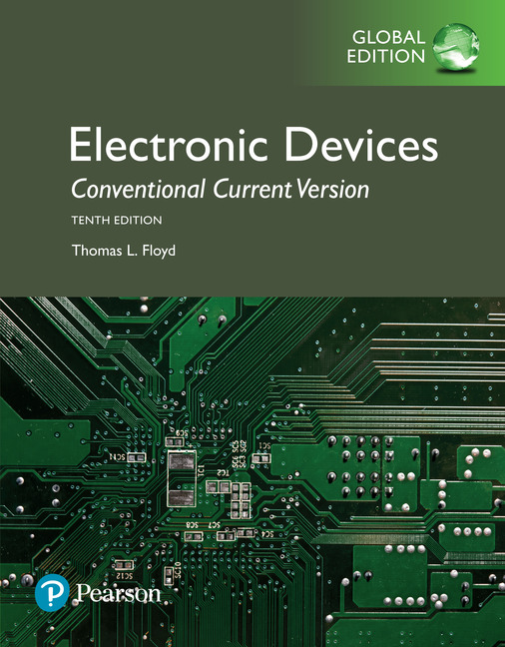
Electronic Devices
10th ed., Global Edition
Chapter 5
Transistor Bias Circuits

Slide 2
Electronic Devices
10th ed.
Objectives:
◆ Discuss and determine the dc operating point of a linear
amplifier
◆ Analyze a voltage-divider biased circuit
◆ Analyze an emitter bias circuit, a base bias circuit, an
emitter-feedback bias circuit, and a collector-feedback
bias circuit
◆ Troubleshoot faults in transistor bias circuits

Slide 3
Electronic Devices
The DC Operating Point
Bias establishes the operating point (Q-point) of a transistor amplifier; the ac signal
moves above and below
this point.
Load line
For this example, the dc base current is 300 μA. When the input causes the base current to vary between 200 μA and 400 μA, the collector current varies between 20 mA and 40 mA.

Slide 4
Electronic Devices
The DC Operating Point
A signal that swings outside the active region will be clipped.
For example, the bias has established a low Q- point. As a result, the signal is will be clipped because it is too close to cutoff.

Slide 5
Electronic Devices
Voltage-Divider Bias - Example
A practical way to establish a Q-point is to form a voltage-divider from V_{CC}.
R₁ and R₂ are selected to establish V_{B}. If the divider is stiff, I_{B} is small compared to I₂. Then,
I_{B}
Example:
Determine the base voltage for the circuit.
I₂
Solution:
4.62 V

Slide 6
Electronic Devices
Voltage-Divider Bias - Example
Follow-up:
What is the emitter voltage, V_{E}, and current, I_{E}?
Solution:
V_{E} is one diode drop less than V_{B}:
4.62 V
V_{E} = 4.62 V – 0.7 V =
3.92 V
3.92 V
Applying Ohm’s law:
5.76 mA

Slide 7
Electronic Devices
Voltage-Divider Bias
The unloaded voltage divider approximation for V_{B} gives reasonable results. A more exact solution is to Thevenize the input circuit.
V_{TH} = V_{B(no load)}
= 4.62 V
R_{TH} = R₁||R₂ =
= 8.31 kΩ
The Thevenin input circuit can be drawn and used to determine a more precise value of I_{E}.

Slide 8
Electronic Devices
Voltage-Divider Bias
Write KVL around the base emitter circuit and solve for I_{E}.
Substituting and solving,
5.43 mA
and V_{E} = I_{E}R_{E} = (5.43 mA)(0.68 kΩ)
=
3.69 V

Slide 9
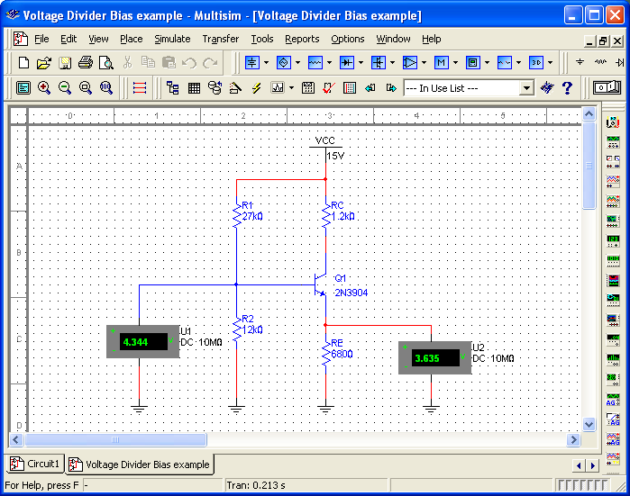
Electronic Devices
Multisim Check
Multisim allows you to do a quick check of your result.

Slide 10
Electronic Devices
Voltage-Divider Biasing of pnp Transistors
A pnp transistor can be biased from either a positive or negative supply. Notice that (b) and (c) are the same circuit; both with a positive supply.
(a) (b) (c)

Slide 11
Electronic Devices
Voltage-Divider Biasing of pnp Transistors - Example
Example:
Determine I_{E} for the pnp circuit. Assume a stiff voltage divider (no loading effect).
Solution:
10.4 V
11.1 V
5.74 mA

Slide 12
Electronic Devices
Emitter Bias
Emitter bias has excellent stability but requires both a positive and a negative DC source.

Slide 13
Electronic Devices
Emitter Bias
Emitter bias has excellent stability but requires both a positive and a negative DC source.
For troubleshooting analysis, assume that V_{E} for an npn transistor is about −1 V.
−1 V

Slide 14
Electronic Devices
Emitter Bias
Emitter bias has excellent stability but requires both a positive and a negative DC source.
For troubleshooting analysis, assume that V_{E} for an npn transistor is about −1 V.
Example:
Assuming that V_{E} is −1 V, what is I_{E}?
−1 V
Solution:
−1.87 mA

Slide 15
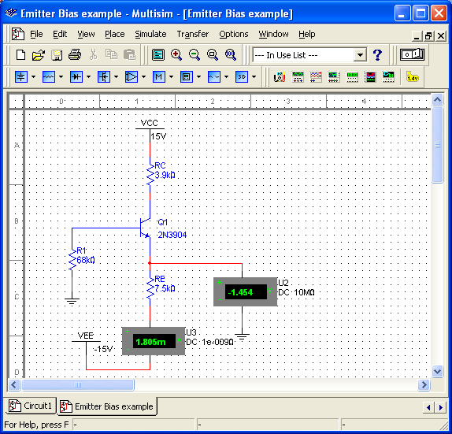
Electronic Devices
Emitter Bias – Multisim
A check with Multisim shows that the assumption for troubleshooting purposes is reasonable.
For detailed analysis work, you can include the effect of β_{DC}. In this case,

Slide 16
Electronic Devices
Base Bias
Base bias is used in switching circuits because of its simplicity, but not widely used in linear applications because the Q-point is β dependent.
Base current is derived from the collector supply through a large base resistor.
Example:
What is I_{B}?
Solution:
25.5 μA

Slide 17
Electronic Devices
Base Bias
Follow up:
Compare V_{CE} for the case where β = 100 and β = 200.
Solution:
For β = 100:
10.4 V
For β = 300:
1.23 V

Slide 18
Electronic Devices
Emitter-Feedback Bias
An emitter resistor changes base bias into emitter-feedback bias, which is more predictable. The emitter resistor is a form of negative feedback.
The equation for emitter current is found by writing KVL around the base circuit. The result is:

Slide 19
Electronic Devices
Collector-Feedback Bias
Collector feedback bias uses another form of negative feedback to increase stability. Instead of returning the base resistor to V_{CC}, it is returned to the collector.
The equation for collector current is found by writing KVL around the base circuit. The result is

Slide 20
Electronic Devices
Collector-Feedback Bias - Example
Example:
Compare I_{C} for the case when β = 100 with the case when β = 300.
Solution:
When β = 100,
2.80 mA
When β = 300,
4.93 mA

Slide 21
Electronic Devices
Troubleshooting Bias Problems
Troubleshooting requires a basic understanding of circuit operation and logical thinking. The first step is to analyze the problem and understanding the conditions that caused the failure?
Assuming you have determined that a specific transistor is not functioning correctly, plan steps that isolate the problem. For example, a good starting point is to check that power is connected and a good ground is present.
Make measurements following a logical sequence to isolate the specific problem.

Slide 22
Electronic Devices
Troubleshooting - Example
Example:
Assume you have analyzed a failure of a basic amplifier using a pnp transistor with voltage divider bias. You have checked the power supply and ground and found they are okay.
What would you plan to check next?
Solution:
Answers can vary. A good next step is to check the base voltage at the base itself. This will check for open or shorted bias resistors and a good connection to the transistor. Note that a bad reading here is NOT proof the fault is in the bias circuit but requires further checking.

Slide 23
Electronic Devices
Selected Key Terms
Q-point
DC load line
Linear region
Stiff voltage divider
Feedback
The dc operating (bias) point of an amplifier specified by voltage and current values.
A straight line plot of I_{C} and V_{CE} for a transistor circuit.
The region of operation along the load line between saturation and cutoff.
A voltage divider for which loading effects can be ignored.
The process of returning a portion of a circuit’s output back to the input in such a way as to oppose or aid a change in the output.

Slide 24
Electronic Devices
Quiz Q1
1. A signal that swings outside the active area will be
a. clamped
b. clipped
c. unstable
d. all of the above

Slide 25
Electronic Devices
Quiz Q2
2. A stiff voltage divider is one in which
a. there is no load current
b. divider current is small compared to load current
c. the load is connected directly to the source voltage
d. loading effects can be ignored

Slide 26
Electronic Devices
Quiz Q3
3. Assuming a stiff voltage-divider for the circuit shown, the emitter voltage is
a. 4.3 V
b. 5.7 V
c. 6.8 V
d. 9.3 V

Slide 27
Electronic Devices
Quiz Q4
4. For the circuit shown, the dc load line will intersect the y-axis at
a. 5.0 mA
b. 10.0 mA
c. 15.0 mA
d. none of the above

Slide 28
Electronic Devices
Quiz Q5
5. If you Thevenize the input voltage divider, the Thevenin resistance is
a. 5.0 kΩ
b. 6.67 kΩ
c. 10 kΩ
d. 30 kΩ

Slide 29
Electronic Devices
Quiz Q6
6. For the circuit shown, the emitter voltage is
a. less than the base voltage
b. less than the collector voltage
c. both of the above
d. none of the above

Slide 30
Electronic Devices
Quiz Q7
7. Emitter bias
a. is not good for linear circuits
b. uses a voltage-divider on the input
c. requires dual power supplies
d. all of the above

Slide 31
Electronic Devices
Quiz Q8
8. With the emitter bias shown, a reasonable assumption for troubleshooting work is that the
a. base voltage = +1 V
b. emitter voltage = +5 V
c. emitter voltage = −1 V
d. collector voltage = V_{CC}

Slide 32
Electronic Devices
Quiz Q9
9. The circuit shown is an example of
a. base bias
b. collector-feedback bias
c. emitter bias
d. voltage-divider bias

Slide 33
Electronic Devices
Quiz Q10
10. The circuit shown is an example of
a. base bias
b. collector-feedback bias
c. emitter bias
d. voltage-divider bias

Slide 34
Electronic Devices
Answers
Answers:
1. b
2. d
3. a
4. a
5. b
6. d
7. c
8. c
9. a
10. b

