Slide 1
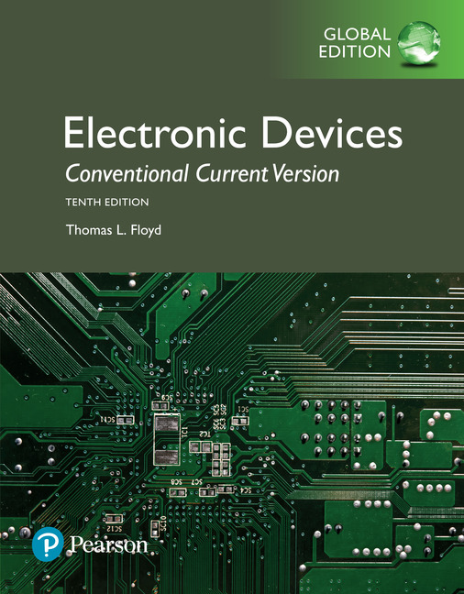
Electronic Devices
10th ed., Global Edition
Chapter 6
BJT Amplifiers

Slide 2
Electronic Devices
10th ed.
Objectives:
◆ Describe amplifier operation
◆ Discuss transistor models
◆ Describe and analyze the operation of common-emitter
amplifiers
◆ Describe and analyze the operation of common-collector
amplifiers
◆ Describe and analyze the operation of common-base
amplifiers
◆ Describe and analyze the operation of multistage
amplifiers
◆ Discuss the differential amplifier and its operation
◆ Troubleshoot amplifier circuits

Slide 3
Electronic Devices
AC Quantities
Recall that AC quantities are indicated with a italic subscript; rms values are assumed unless otherwise stated.
The figure shows an example of a specific waveform for the collector-emitter voltage. Notice the DC component is V_{CE} and the ac component is V_{ce}.
Resistance is also identified with a lower case italic subscript when analyzed from an ac standpoint.

Slide 4
Electronic Devices
Linear Amplifiers
A linear amplifier produces an replica of the input signal at the output.
For the amplifier shown, notice that the voltage waveform is inverted between the input and output but has the same shape.

Slide 5
Electronic Devices
AC Load Line
Operation of the linear amplifier can be illustrated using an ac load line.
The ac load line is different than the dc load line because a capacitor looks open to dc but effectively acts as a short to ac. Thus, in the previous circuit, the collector resistor appears to be in parallel with the load resistor.

Slide 6
Electronic Devices
Transistor AC Model
The five resistance parameters (r-parameters) can be used for detailed analysis of a BJT circuit. For most analysis work, the simplified r-parameters give good results.
The simplified r-parameters are shown in relation to the transistor model.
An important r-parameter is r_{e}'. It appears as a small ac resistance between the base and emitter.

Slide 7
Electronic Devices
Common-Emitter Amplifier
In the common-emitter (CE) amplifier, the input signal is applied to the base and the inverted output is taken from the collector. The emitter is common to ac signals.

Slide 8
Electronic Devices
Common-Emitter Amplifier - Example
Example:
What is r_{e}' for the CE amplifier? Assume stiff voltage-divider bias.
Solution:
4.26 V
V_{E} = 4.26 V – 0.7 V = 3.56 V
1.62 mA
15.4 Ω

Slide 9
Electronic Devices
Half-wave Rectifier
Follow-up:
Notice that the ac resistance of the collector circuit is R_{C}||R_{L}.
What is the gain of the amplifier?
Solution:
127
The gain will be a little lower if the input loading effect is accounted for.

Slide 10
Electronic Devices
Common-Emitter Amplifier
Greater gain stability can be achieved by adding a swamping resistor to the emitter circuit of the CE amplifier. The gain will be lower as a result.

Slide 11
Electronic Devices
Common-Emitter Amplifier
Greater gain stability can be achieved by adding a swamping resistor to the emitter circuit of the CE amplifier. The gain will be lower as a result.
Question:
What is the gain with the addition of the swamping resistor? (Ignore the small effect on r_{e}'.)
38.2

Slide 12
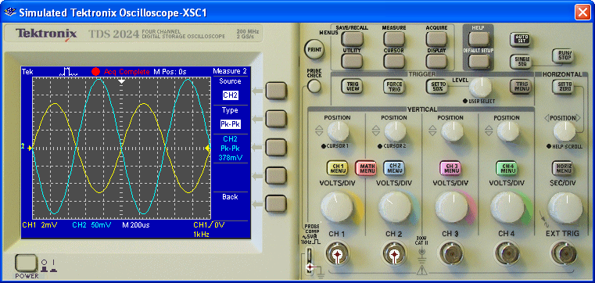
Electronic Devices
Common-Emitter Amplifier - Multisim
Multisim is a good way to check your calculation. For an input of 10 mV_{pp}, the output is 378 mV_{pp} as shown on the oscilloscope display for the swamped CE amplifier.
input
output

Slide 13
Electronic Devices
Common-Emitter Amplifier
In addition to gain stability, swamping has the advantage of increasing the ac input resistance of the amplifier. For this amplifier, R_{in(tot)} is given by
R_{in(tot)} = R₁||R₂||β_{ac}(r_{e}' + R_{E1})
Question:
What is R_{in(tot)} for the amplifier if β_{ac} = 200?
R_{in(tot)} = R₁||R₂||β_{ac}(r_{e}' + R_{E1})
= 68 kΩ||27 kΩ||200(15.4 Ω + 33 Ω)
=
6.45 kΩ

Slide 14
Electronic Devices
Common-Collector Amplifier
The common-collector amplifier (emitter-follower) has a voltage gain of approximately 1, but can have high input resistance and current gain. The input is applied to the base and taken from the emitter.

Slide 15
Electronic Devices
Common-Collector Amplifier
The power gain is the ratio of the power delivered to the input resistance divided by the power dissipated in the load. This is approximately equal to the current gain. That is, A_{p} ≈A_{i}.
You can also write power gain as a ratio of resistances:
The next slide is an example…

Slide 16
Electronic Devices
Common-Collector Amplifier - Example
Example:
Calculate the power gain to the load for the CC amplifier using a ratio of resistances. Assume A_{v} = 1 and β_{ac} = 200. Use r_{e}' = 2 Ω.
Solution:
R_{in(tot)} = R₁||R₂||β_{ac}(r_{e}' + R_{E}||R_{L})
= 39 kΩ||220 kΩ||200(2 Ω + 500 Ω)
=
24.9 kΩ
R_{L} = 1.0 kΩ
24.9

Slide 17
Electronic Devices
Common-Collector Amplifier
The input voltage-divider in the previous example is not “rock-solid” but the overall power gain is good. A “rock solid” stiff voltage-divider is not always the best design. Can you spot the problem illustrated here?
R_{in(tot)} = R₁||R₂||β_{ac}(r_{e}' + R_{E}||R_{L})
= 10 kΩ||10 kΩ||200(25 Ω + 3.0 kΩ)
=
4.96 kΩ
R_{L} = 10 kΩ
0.496!
The problem is the power gain is less than 1!

Slide 18
Electronic Devices
Darlington Pair
A Darlington pair is two transistors connected as shown. The two transistors act as one “super β” transistor. Darlington transistors are available in a single package. Notice there are two diode drops from base to emitter.
CE Amplifier
Darlington CC amplifier
Load

Slide 19
Electronic Devices
The Sziklai Pair
Another high β pair is the Sziklai pair (sometimes called a complementary Darlington), in which a pnp and npn transistor are connected as shown. This configuration has the advantage of only one diode drop between base and emitter.
Question:
What is the relation between I_{E2} and I_{B1}?
Answer:
The DC currents are:
I_{C1} is β_{DC1} x I_{B1} and is equal to I_{B2}
I_{E2} is approximately equal to β_{DC2} x I_{C1}
Therefore, I_{E2} ≈ β_{DC1}β_{DC2}I_{B1}

Slide 20
Electronic Devices
Common-Base Amplifier
The common-base (CB) amplifier is used in applications where a low input impedance is acceptable. It does not invert the signal, an advantage for higher frequencies as you will see later when you study the Miller effect.
Question:
What is the purpose of C₂?
Answer:
C₂ forces the base to be at ac ground.

Slide 21
Electronic Devices
Multistage Amplifiers
To improve amplifier performance, stages are often cascaded where the output of one drives another. This an example of a two-stage direct-coupled
amplifier in which the input and output signals are capacitively coupled.

Slide 22
Electronic Devices
Differential Amplifiers
A differential amplifier (diff-amp) has two inputs. It amplifies the difference in the two input voltages. This circuit is widely used as the input stage to operational amplifiers. Differential-mode inputs are illustrated.

Slide 23
Electronic Devices
Differential Amplifiers
The same amplifier as in the last slide now is shown with common-mode inputs. Diff-amps tend to reject common-mode signals, which are usually due to noise. Ideally, the outputs are zero with common-mode inputs.

Slide 24
Electronic Devices
Selected Key Terms-1
r-parameter
Common-emitter
ac ground
Input resistance
One of a set of BJT characteristic parameters that include α_{ac}, β_{ac}, r_{e}', r_{b}', and r_{c}'.
A BJT configuration in which the emitter is the common terminal to an ac signal.
A point in a circuit that appears as a ground to ac signals only.
The resistance seen by an ac source connected to the amplifier input.

Slide 25
Electronic Devices
Selected Key Terms-2
Output Resistance
Common Collector
Decibel
Differential Amplifier
CMRR
The ac resistance looking in at the amplifier output.
A BJT configuration in which the collector is the common terminal to an ac signal.
A logarithmic measure the ratio of one power to another or one voltage to another
An amplifier in which the input is a function of the difference between two input voltages.
Common-mode rejection ratio: the ratio of open-loop gain to common-mode gain.

Slide 26
Electronic Devices
Quiz Q1
1. The equation for finding the ac emitter resistance of a BJT is
a.
b.
c.
d.

Slide 27
Electronic Devices
Quiz Q2
2. For a CE amplifier, a swamping resistor will
a. increase the input resistance
b. increase the gain
c. both of the above
d. none of the above

Slide 28
Electronic Devices
Quiz Q3
3. A well-designed CC amplifier has
a. voltage gain > 1
b. current gain > 1
c. both of the above
d. none of the above

Slide 29
Electronic Devices
Quiz Q4
4. In a CC amplifier, the power gain is approximately
a. one
b. equal to the voltage gain
c. equal to the current gain
d. none of the above

Slide 30
Electronic Devices
Quiz Q5
5. The amplifier shown is a
a. differential amplifier
b. CE amplifier
c. CC amplifier
d. CB amplifier

Slide 31
Electronic Devices
Quiz Q6
6. An advantage to this amplifier is that it
a. has high current gain
b. has high input resistance
c. is non-inverting
d. all of the above

Slide 32
Electronic Devices
Quiz Q7
7. Together, Q₁ and Q₂ form a
a. Swamped amplifier
b. Differential pair
c. Sziklai pair
d. none of the above

Slide 33
Electronic Devices
Quiz Q8
8. A CC amplifier with a power gain less than 1 is
a. a buffer
b. an inverting amplifier
c. unstable
d. an example of poor design

Slide 34
Electronic Devices
Quiz Q9
9. An npn and a pnp transistor acting together as a single high β transistor is a
a. Darlington pair
b. Sziklai pair
c. Differential pair
d. cascaded amplifier

Slide 35
Electronic Devices
Quiz Q10
10. If identical signals are applied to both inputs of a differential amplifier, ideally the output will be
a. zero
b. equal to one of the signals
c. equal to the sum of the two signals
d. very large

Slide 36
Electronic Devices
Answers
Answers:
1. b
2. a
3. b
4. c
5. d
6. c
7. d
8. d
9. b
10. a

