Slide 1
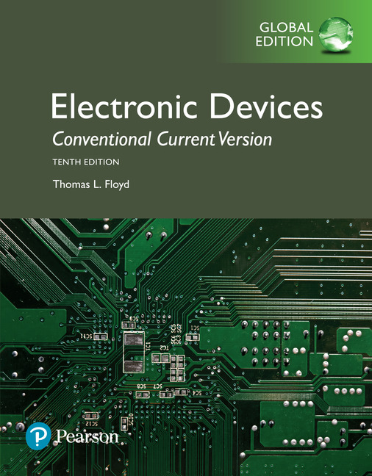
Electronic Devices
10th ed., Global Edition
Chapter 7
BJT Power Amplifiers

Slide 2
Electronic Devices
10th ed.
Objectives:
◆ Explain and analyze the operation of class A amplifiers
◆ Explain and analyze the operation of class B and class AB
amplifiers
◆ Explain and analyze the operation of class C amplifiers
◆ Troubleshoot power amplifiers

Slide 3
Electronic Devices
Power Amplifiers
A power amplifier is a large signal amplifier that produces a replica of the input signal on its output. In the case shown here, the output is an inverted replica of the input.
Generally power amplifiers are defined as those in which it is necessary to consider the problem of heat dissipation (about 1 W or more).

Slide 4
Electronic Devices
Class-A Power Amplifiers
A class A power amplifier is a large signal amplifier that operates in the linear region. Ideally, a class A amplifier is
designed to operate in the center of the ac load line.
Notice that a class A amplifier dissipates dc power even with no signal. The dc power dissipated is the product of I_{CQ} and V_{CEQ}.

Slide 5
Electronic Devices
Class-A Power Amplifier Efficiency
Power gain is the ratio of the power delivered to the load to the input power. The maximum signal power delivered to a load cannot be greater than 0.5 I_{CQ}V_{CEQ}.
Class A power amplifiers are not particularly efficient, so they are restricted to low power applications. The maximum theoretical efficiency for a class A amplifier is 0.25 (or 25%) and usually they are considerably less.
Question:
What is the efficiency of an amplifier that delivers 200 mW to a load if the power supply is 12 V at 400 mA?
6.7%

Slide 6
Electronic Devices
Class-A Power Amplifier - Example
Example:
(a) If a 3 V_{pp} signal is applied to the input, what voltage do you expect to see at the speaker? (b) What power is delivered?
Solution:
(a) The CC amplifier has a gain of nearly 1. The output voltage is nearly equal to the input = 3 V_{pp}.
(b) The power delivered to the speaker is:
= 140 mW

Slide 7
Electronic Devices
Class-A Power Amplifier - Example
Follow-up:
For the 3 V_{pp} input, what is the input power and what is the power gain? Assume the Darlington β = 10,000.
Solution:
= 0.183 mW
The power gain is:
= 769
Note that this is approximately 140 mW/0.183 mW

Slide 8
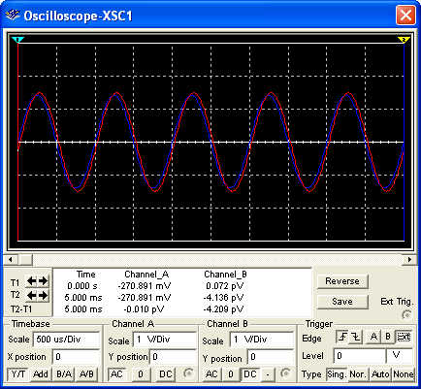
Electronic Devices
Class-A Power Amplifier - Multisim
The circuit in the previous example can be simulated in Multisim as a check.
The input trace (red) and output trace (blue) are nearly on top of each other as expected.

Slide 9
Electronic Devices
Push-Pull Amplifiers
Push-pull amplifiers use two transistors working together. One conducts on the positive half cycle; the other conducts on the negative half cycle. This is class B operation.

Slide 10
Electronic Devices
Push-Pull Amplifiers
By adding a forward biased diode, the base-emitter drop of the transistors does not need to be overcome by the signal. This is class AB operation. Notice that both transistors are npn types.

Slide 11
Electronic Devices
Push-Pull Amplifiers
A complementary symmetry push-pull amplifier uses an npn and a pnp transistor working together on alternate half-cycles.
The two diodes cause the transistors to be biased into slight conduction. Because of the slight conduction, this is also class AB operation and the transistors conduct slightly more than ½ of the input cycle.
Question:
What is the advantage of class AB operation over class B operation?
Cross-over distortion is eliminated.

Slide 12
Electronic Devices
Push-Pull Amplifiers
The ac load line for the npn transistor of a complementary push-pull amplifier is shown.
Notice that the Q point is near the right end of the load line.
I_{c(sat)} is determined by the load resistor and is given by:

Slide 13
Electronic Devices
Push-Pull Amplifiers - Example
Example:
Draw the ac load line for the npn transistor.
Solution:
The ac load line is drawn between I_{c(sat)} and V_{CC}.
I_{C}
0.5 A
V_{CE}
+15 V

Slide 14
Electronic Devices
Push-Pull Amplifiers
The maximum peak output voltage is always less than the power supply voltage. For the amplifier shown, the maximum peak output will be about ±13 V because at the peak of the input, maximum bias current is required.
For a given load resistor, you can enable a larger output by using smaller bias resistors, higher beta transistors (such as Darlington transistors), or increasing the power supply voltages.

Slide 15
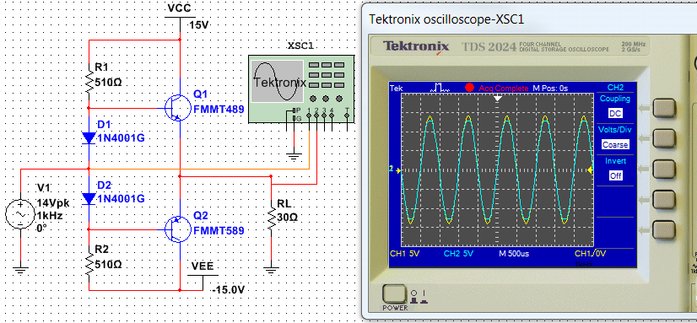
Electronic Devices
Push-Pull Amplifiers - Multisim
A Multisim simulation of the previous circuit shows clipping on the output when the input exceeds ±13 V. The input is the ±14 V yellow trace; the output is the blue trace and is clipped at ±13 V.

Slide 16
Electronic Devices
Push-Pull Amplifiers
Question:
Why is the voltage gain of the previous circuit less than 1?
Each transistor is configured as a CC amplifier.

Slide 17
Electronic Devices
Push-Pull Amplifiers
Darlington transistors have replaced the single transistors in the previous circuit. The bias resistor are larger (less power dissipation) and two more diodes are added. The maximum output can be larger due to the Darlington transistors despite the larger bias resistors.
Question:
Why are four diodes used in this circuit?
There are two base-emitter drops for each polarity of the input.

Slide 18
Electronic Devices
Push-Pull Amplifiers
The circuit shown is in the lab manual and uses a dc coupled CE amplifier stage to drive the push-pull stage. In this case, the CE amplifier is in the bias path for the push-pull stage.

Slide 19
Electronic Devices
Push-Pull Amplifiers
The circuit shown is in the lab manual and uses a dc coupled CE amplifier stage to drive the push-pull stage. In this case, the CE amplifier is in the bias path for the push-pull stage.
Question:
How would you adjust R₅ for an optimum setting?
0 V
Monitor the dc output voltage and adjust it for 0 V using R₅.

Slide 20
Electronic Devices
Class-C Amplifiers
Class C amplifiers are biased into conduction much less than 180º. They are usually used in RF applications, such as RF oscillators and modulators.
The transistor is on when the input signal exceeds |V_{BB}| + V_{BE}. Because class C amplifiers are biased on for a small percentage of time, they can be very efficient.

Slide 21
Electronic Devices
Class-C Amplifiers
Class C operation is useful in oscillators. The collector circuit has a parallel resonant circuit (“tank”) and oscillations are sustained by the short pulse of collector current on each cycle.

Slide 22
Electronic Devices
Class-C Amplifiers
The circuit can be set up with clamping bias, where the bias resistor is connected to ground. C₁ will charge (through the base-emitter diode) to 0.7 V less than the positive peak.
Clamping action causes the transistor to be cut off except at the positive peak of the input. The R₁C₁ time constant needs to be long compared to the period of the signal.

Slide 23
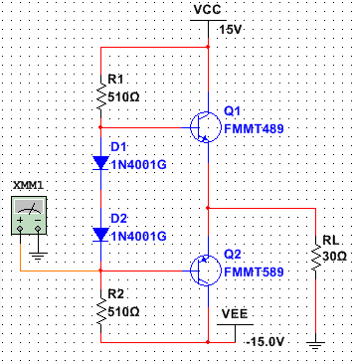
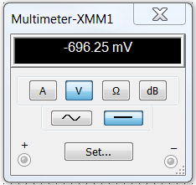
Electronic Devices
Push-Pull Amplifier -Troubleshooting
If there are no faults in the push-pull amplifier shown, what DC voltage do you expect to read on meter XXM1?
You should see a forward diode drop. If diodes and transistors are matched, the point between the diodes should be at 0 V and the cathode of D2 is one diode drop less.

Slide 24

Electronic Devices
Push-Pull Amplifier -Troubleshooting
Assume Diode D2 is open. What do you expect to see on the meter now? Explain your answer.
You will still see a forward diode drop. This is because there is a path from ground, through the emitter-base junction of Q2, and through R2 to VEE.
With a signal source on, the rectified signal will cause a DC voltage to be superimposed.

Slide 25
Electronic Devices
Key Terms-1
Class A
Power gain
Efficiency
Class B
A type of amplifier that operates entirely in its linear (active) region.
The ratio of output power to the input power of an amplifier.
The ratio of the signal power delivered to a load to the power from the power supply of an amplifier.
A type of amplifier that operates in the linear region for 180º of the input cycle because it is biased at cutoff.

Slide 26
Electronic Devices
Key Terms-2
Push-pull
Class AB
Class C
A type of class B amplifier with two transistors in which one transistor conducts for one half-cycle and the other conducts for the other half-cycle.
A type of amplifier that is biased into slight conduction.
A type of amplifier that operates only for a small portion of the input cycle.

Slide 27
Electronic Devices
Quiz Q1
1. A class A amplifier is designed to operate in the linear region
a. for only a small portion of the input cycle
b. for ½ of the input cycle
c. for slightly more than ½ of the input cycle
d. all of the time

Slide 28
Electronic Devices
Quiz Q2
2. A class AB amplifier is designed to operate in the linear region
a. for slightly less than ½ of the input cycle
b. for exactly ½ of the input cycle
c. for slightly more than ½ of the input cycle
d. all of the time

Slide 29
Electronic Devices
Quiz Q3
3. Class A power amplifiers
a. are not subject to cross-over distortion
b. are more efficient than class B amplifiers
c. are biased into slight conduction
d. all of the above

Slide 30
Electronic Devices
Quiz Q4
4. In a class AB power amplifier, the Q point is ideally
a. in the center of the load line
b. near the left side of the load line
c. near the right side of the load line

Slide 31
Electronic Devices
Quiz Q5
5. The class of operation for the amplifier shown is
a. A
b. B
c. C
d. AB

Slide 32
Electronic Devices
Quiz Q6
6. If R₁ and R₂, are made smaller, the maximum peak output voltage will be
a. smaller
b. larger
c. unchanged

Slide 33
Electronic Devices
Quiz Q7
7. The amplifier shown has
a. voltage gain
b. current gain
c. both of the above
d. none of the above

Slide 34
Electronic Devices
Quiz Q8
8. The amplifier shown has the advantage of
a. high voltage gain
b. no input loading
c. excellent power gain
d. all of the above

Slide 35
Electronic Devices
Quiz Q9
9. Ideally the dc voltage at the load with no input signal should be
a. −9.0 V
b. 0 V
c. +4.5 V
d. +9.0 V

Slide 36
Electronic Devices
Quiz Q10
10. The bias type shown is
a. clamping bias
b. clipping bias
c. emitter bias
d. base bias

Slide 37
Electronic Devices
Answers
Answers:
1. d
2. c
3. a
4. c
5. b
6. b
7. b
8. c
9. b
10. a

