Slide 1
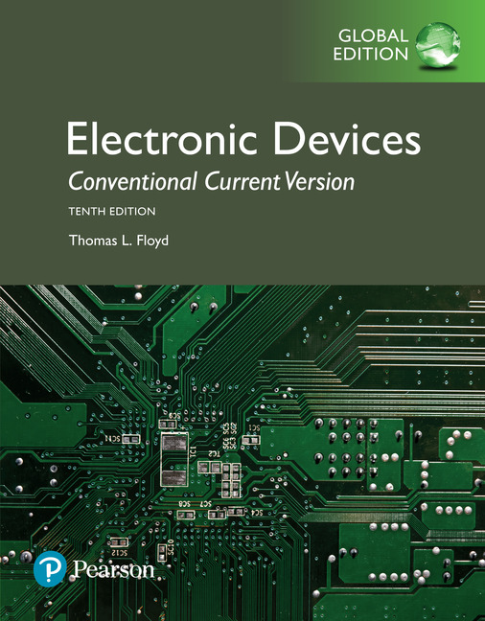
Electronic Devices
10th ed., Global Edition
Chapter 8
Field-Effect Transistors
(FETs)

Slide 2
Electronic Devices
10th ed.
Objectives:
◆ Discuss the JFET and how it differs from the BJT
◆ Discuss, define, and apply JFET characteristics and
parameters
◆ Discuss and analyze JFET biasing
◆ Discuss the ohmic region on a JFET characteristic curve
◆ Explain the operation of MOSFETs
◆ Discuss and apply MOSFET parameters
◆ Describe and analyze MOSFET bias circuits
◆ Discuss the IGBT
◆ Troubleshoot FET circuits

Slide 3
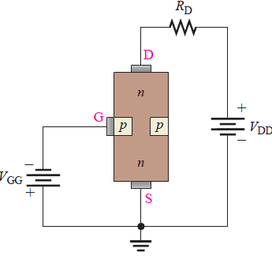
Electronic Devices
The JFET
The JFET (or Junction Field Effect Transistor) is a normally ON device. For the n-channel device illustrated, when the drain is positive with respect to the source and there is no gate-source voltage, there is current in the channel.
When a negative gate voltage is applied to the FET, the electric field causes the channel to narrow, which in turn causes current to decrease.

Slide 4
Electronic Devices
The JFET
As in the base of bipolar transistors, there are two types of JFETs: n-channel and p-channel. The dc voltages are opposite polarities for each type.
The symbol for an n-channel JFET is shown, along with the proper polarities of the applied dc voltages. For an n-channel device, the gate is always operated with a negative (or zero) voltage with respect to the source.
Drain
Gate
Source

Slide 5
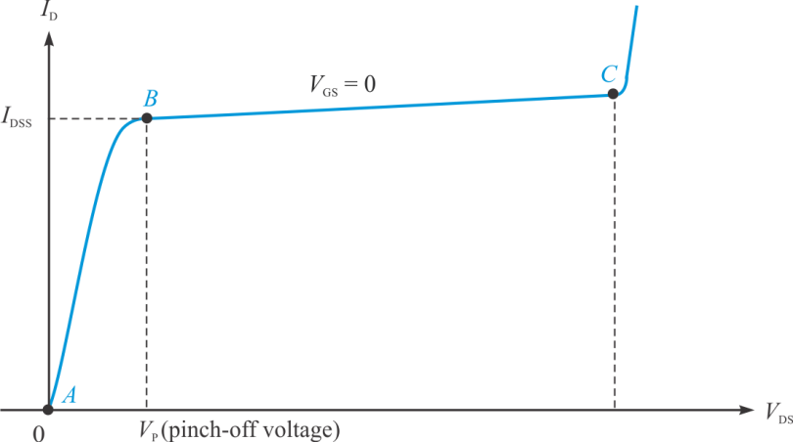
Electronic Devices
The JFET
There are three regions in the characteristic curve for a JFET as illustrated for the case when V_{GS} = 0 V.
Between A and B is the Ohmic region, where current and voltage are related by Ohm’s law.
Ohmic region

Slide 6
Electronic Devices
The JFET
There are three regions in the characteristic curve for a JFET as illustrated for the case when V_{GS} = 0 V.
Between A and B is the Ohmic region, where current and voltage are related by Ohm’s law.
From B to C is the active (or constant-current) region where current is essentially independent of V_{DS}.
Active region
(constant current)

Slide 7
Electronic Devices
The JFET
There are three regions in the characteristic curve for a JFET as illustrated for the case when V_{GS} = 0 V.
Between A and B is the Ohmic region, where current and voltage are related by Ohm’s law.
From B to C is the active (or constant-current) region where current is essentially independent of V_{DS}.
Beyond C is the breakdown region. Operation here can damage the FET.
Breakdown

Slide 8
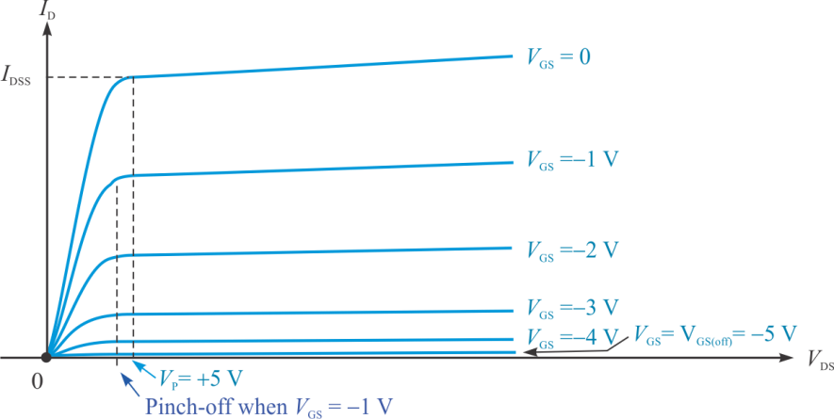
Electronic Devices
The JFET
As V_{GS} is varied, a family of characteristic curves is developed that shows the relationship between V_{DS}, I_{D} and V_{GS}.
Note that he pinch-off voltage varies with V_{GS}.
The characteristic curves for an n-channel device are illustrated. Notice that V_{p} is positive and has the same magnitude as V_{GS(off)}.

Slide 9
Electronic Devices
The JFET
A plot of V_{GS} to I_{D} is called the transfer or transconductance curve. The transfer curve is a is a plot of the output current (I_{D}) to the input voltage (V_{GS}).
The transfer curve is the graphical representation of the equation:
I_{DSS}
2
By substitution, you can find other points on the curve for plotting the universal curve.
I_{DSS}
4
0.3 V_{GS(off)}
0.5 V_{GS(off)}

Slide 10
Electronic Devices
The JFET - Example
Example:
A certain 2N5458 JFET has I_{DSS} = 6.0 mA and V_{GS(off)} = – 3.5 V.
(a) Show the values of the these end points on the transfer curve.
= 6.0 mA
= −3.5 V

Slide 11
Electronic Devices
The JFET - Example
Example:
A certain 2N5458 JFET has I_{DSS} = 6.0 mA and V_{GS(off)} = – 3.5 V.
(a) Show the values of the these end points on the transfer curve.
= 6.0 mA
(b) Show the point for the case when I_{D} = 3.0 mA.
Solution:
3.0 mA
(b) When I_{D} = ½ I_{DSS}, V_{GS} = 0.3 V_{GS(off)}. Therefore, V_{GS} = −1.05 V
= −3.5 V
−1.05 V

Slide 12
Electronic Devices
The JFET
The transconductance is the ratio of a change in output current (ΔI_{D}) to a change in the input voltage (ΔV_{GS}).
This definition is
The following approximate formula is useful for calculating gm if you know g_{m0}.
ΔI_{D}
ΔV_{GS}
The value of g_{m0} can be found from

Slide 13
Electronic Devices
The JFET - Example
Because the slope changes at every point along the curve, the transconductance is not constant, but depends on where it is measured.
Example:
What is the transconductance for the JFET at the point shown?
5.7
Solution:
3.7
3.33 mS
−1.3
−0.7

Slide 14
Electronic Devices
The JFET - Example
The input resistance of a JFET is given by:
where I_{GSS} is the current into the reverse biased gate.
JFETs have very high input resistance, but it drops when the temperature increases.
Example:
Compare the input resistance of a 2N5485 at 25 ºC and at 100 ºC. The specification sheet shows that for V_{GS} = −20 V, I_{GSS} – 1 nA at 25 ºC and 0.2 μA at 100 ºC.
Solution:
At 25 ºC,
20 GΩ!
At 100 ºC,
100 MΩ

Slide 15
Electronic Devices
JFET Biasing - Examplw
Self-bias is simple and effective, so it is the most common biasing method for JFETs. With self bias, the gate is essentially at 0 V.
= +12 V
An n-channel JFET is illustrated. The current in R_{S} develops the necessary reverse bias that forces the gate to be less than the source.
1.5 kΩ
Example:
Assume the resistors are as shown and the drain current is 3.0 mA. What is V_{GS}?
Solution:
330 Ω
1.0 MΩ
V_{G} = 0 V; V_{S} = (3.0 mA)(330 Ω) = 0.99 V
V_{GS} = 0 – 0.99 V =
− 0.99 V

Slide 16
Electronic Devices
JFET Biasing - Example
You can use the transfer curve to obtain a reasonable value for the source resistor in a self-biased circuit.
Example:
What value of R_{S} should you use to set the Q point as shown?
Solution:
The Q point is approximately at I_{D} = 4.0 mA and V_{GS} = −1.25 V.
Q
375 Ω

Slide 17
Electronic Devices
JFET Biasing
Voltage-divider biasing is a combination of a voltage-divider and a source resistor to keep the source more positive than the gate.
V_{G} is set by the voltage-divider and is independent of V_{S}. V_{S} must be larger than V_{G} in order to maintain the gate at a negative voltage with respect to the source.
Voltage-divider bias helps stabilize the bias for variations between transistors.

Slide 18
Electronic Devices
JFET Biasing
A graphical analysis of voltage-divider biasing is illustrated. A typical transconductance curve for the 2N5485 is shown with I_{DSS} = 6.5 mA and V_{GS(off)} = −2.2 V.
Start with V_{G}:
V_{G} = 2.79 V
V_{G}/R_{S} = 2.79 mA
2.79 V

Slide 19
Electronic Devices
JFET Biasing
A graphical analysis of voltage-divider biasing is illustrated. A typical transconductance curve for the 2N5485 is shown with I_{DSS} = 6.5 mA and V_{GS(off)} = −2.2 V.
Start with V_{G}:
The Q-point is read from the plot. It is 3.3 mA and −0.7 V.
V_{G} = 2.79 V
V_{G}/R_{S} = 2.79 mA
Connect the points to establish the load line.
2.79 V
Q

Slide 20
Electronic Devices
JFET Biasing
An even more stable form of bias is current-source bias. The current-source can be either a BJT or another FET. With current-source biasing, the drain current is essentially independent of V_{GS}.
In this circuit Q₂ serves as a current source for Q₁. An advantage to this particular circuit is that the output can be adjusted (using R_{S2}) for 0 V DC.

Slide 21
Electronic Devices
JFET Ohmic Region
As described before, the ohmic region is between the origin and the active region. A JFET operated in this region can act as a variable resistor.
Data from an actual FET is shown. The slopes (which represent conductance) of successive V_{GS} lines are different in the ohmic region. This difference is exploited for use as a voltage controlled resistance.
Ohmic region

Slide 22
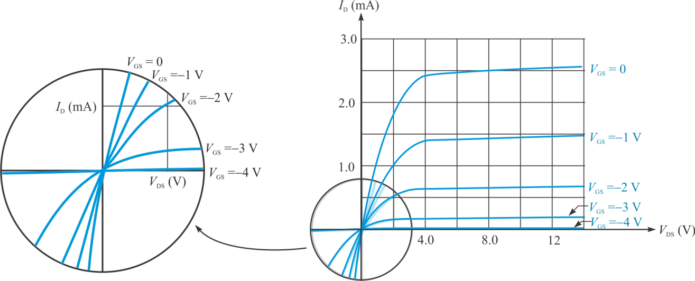
Electronic Devices
JFET Ohmic Region
When used as a variable resistor, the load line is set to intersect in the Ohmic region. The value of R_{DS} varies depending on which V_{GS} curve is intersected. Notice that the ohmic region extends into the third quadrant, so zero bias is an option.

Slide 23
Electronic Devices
JFET Ohmic Region
Here is a circuit in which the JFET is used as a variable resistor. Notice that that the drain is connected through a capacitor, which means the JFET’s Q-point is at the origin.
The gain of the BJT depends on the dc voltage setting of V_{GG}.

Slide 24
Electronic Devices
The MOSFET
MOSFETs are another type of field-effect transistor in which the gate is insulated from the channel by a silicon dioxide layer. The D-MOSFET has a channel that is controlled by applying a gate voltage and comes as either an n-channel or a p-channel device.
D-MOSFET
For an n-channel type, a negative voltage depletes the channel (D-mode); a positive voltage enhances the channel (E-mode).
D-MOSFETs can operate in either mode.
operating in D-mode
operating in E-mode

Slide 25
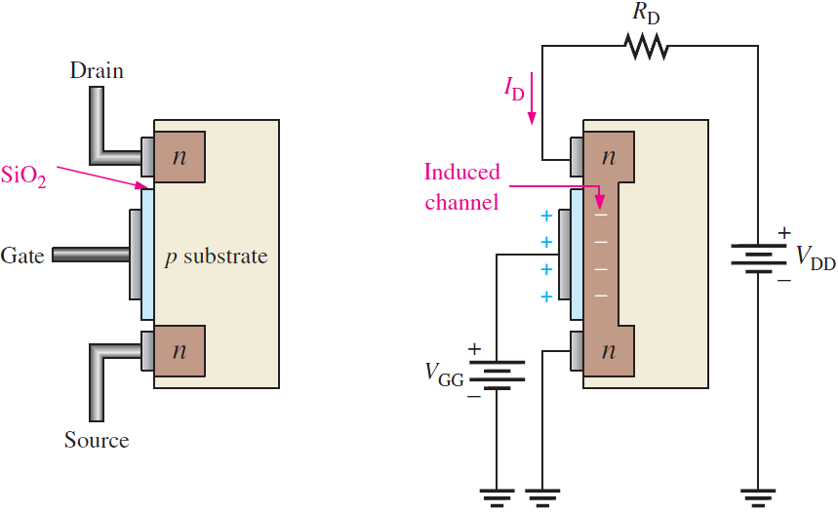
Electronic Devices
The MOSFET
The E-MOSFET differs from the D-MOSFET in that in has no structural conduction channel. A channel is induced by the application of a gate voltage. E-MOSFETs can only operate in enhancement mode.
For an n-channel type, a positive voltage applied to the gate induces a conduction channel.
With no gate voltage, there is no channel.
Induced channel

Slide 26
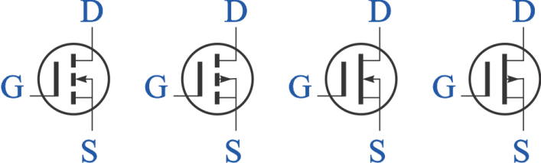
Electronic Devices
MOSFET Symbols
MOSFET symbols are shown. Notice the broken line representing the E-MOSFET that has an induced channel. The n channel has an inward pointing arrow.
E-MOSFETs
D-MOSFETs
n-channel p-channel
n-channel p-channel

Slide 27
Electronic Devices
The MOSFET
Question:
Why can’t an E-MOSFET operate in depletion mode?
Answer:
There is no conduction channel in depletion mode.
Follow-up:
What polarity is required on the gate of a p-channel E-MOSFET to cause a conduction channel to be induced?.
Answer:
Negative.

Slide 28
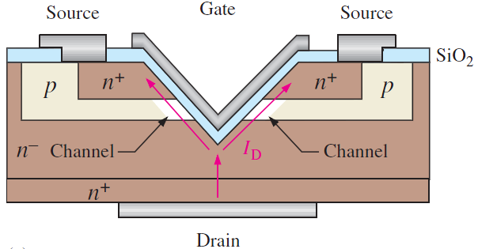
Electronic Devices
Power MOSFETs
MOSFETs are widely used in power applications. One structure is a large array of low-power MOSFETs that are connected in parallel and act as one. By selecting matched MOSFETs with a negative temperature coefficient, thermal runaway is avoided.
Another structure has the insulated gate in the shape of a V or U. VMOSFETs and UMOSFETs are designed for power handling by creating a shorter and wider channel that can handle higher current.
VMOSFET structure

Slide 29
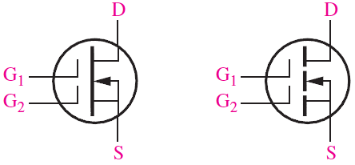
Electronic Devices
Dual-Gate MOSFETs
The dual-gate MOSFET has two gates, which have advantages in certain applications. The schematic symbol for an n-channel depletion and an n-channel enhancement mode device is shown. Dual-gate devices are useful in high-frequency RF amplifiers and in certain automatic gain control (AGC) circuits.
Dual-gate D-MOSFET symbol Dual-gate D-MOSFET symbol

Slide 30
Electronic Devices
The E-MOSFET Transfer Curve
The transfer curve for a MOSFET is has the same parabolic shape as the JFET but the position is shifted along the x-axis. The transfer curve for an n-channel E-MOSFET is entirely in the first quadrant as shown.
The curve starts at V_{GS(th)}, which is a nonzero voltage that is required to have channel conduction. The equation for the drain current is
Transfer curve for E-MOSFET

Slide 31
Electronic Devices
The D-MOSFET Transfer Curve
Recall that the D-MOSFET can be operated in either mode. For the n-channel device illustrated, operation to the left of the y-axis means it is in depletion mode; operation to the right means is in enhancement mode.
As with the JFET, I_{D} is zero at V_{GS(off)}. When V_{GS} = 0, the drain current is I_{DSS}, which for this device is not the maximum current. The equation for drain current is
Transfer curve for D-MOSFET

Slide 32
Electronic Devices
MOSFET Handling
MOSFETs require special handling; see text for details. Summarizing these handling requirements:
MOSFETs are static sensitive and are shipped in special conductive foam or conductive bags. If there is wire ring around the leads, it is removed prior to installation.
All instruments and metal benches used in assembly or test should be connected to earth ground.
The assembler’s or handler’s wrist should be connected to a commercial grounding strap, which has a high-value series resistor for safety.
MOSFETs should not be removed from a circuit that has power on.
Signals should not be applied to a MOS device while the dc power supply is off.

Slide 33
Electronic Devices
MOSFET Handling
Question:
Why is it necessary to have a high value resistor in series with a grounding strap?
Answer:
In case the user contacts an electrical source, the high value resistor limits the current that can flow through the body, avoiding a dangerous shock.

Slide 34
Electronic Devices
MOSFET Limiting Parameters
All transistors have limits of operation; see text for details of MOSFET limiting parameters. Summarizing these parameters:
Drain Source Breakdown Voltage, V_{(BR)DSS}, is the voltage that will do irreparable damage if it is exceeded between drain and source).
Blocking voltage, BV_{DSS}, is maximum drain to source voltage that can be applied to the MOSFET.
On-resistance, R_{DS(on)}, is the ratio of drain voltage to drain current. Continuous drain current, I_{D}, is the maximum current that can safely be carried by a FET continuously.
Power dissipation, P_{D}, is the maximum power allowed for safe operation and is based on junction to case temperature.

Slide 35
Electronic Devices
E-MOSFET Biasing
E-MOSFETs can be biased using bias methods like the BJT methods studied earlier. Voltage-divider bias and drain-feedback bias are illustrated for n-channel devices.
Voltage-divider bias Drain-feedback bias

Slide 36
Electronic Devices
D-MOSFET Biasing
The simplest way to bias a D-MOSFET is with zero bias. This works because the device can operate in either depletion or enhancement mode, so the gate can go above or below 0 V.
Zero bias, which can only be used for the D-MOSFET

Slide 37
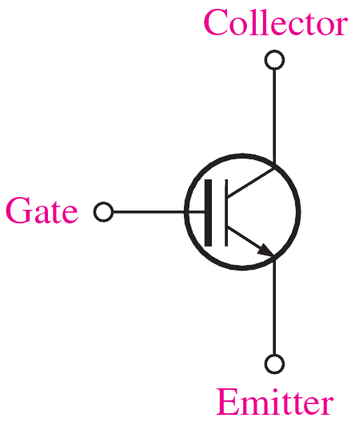
Electronic Devices
The IGBT
The IGBT is a device that has the output conduction characteristics of a BJT but is voltage controlled like a MOSFET; it is an excellent choice for many high-voltage switching applications. The IGBT has three terminals: gate, collector, and emitter. It has the input characteristics of a MOSFET (very high input impedance)
and BJT output characteristics. It is mainly used in high voltage (>1000 V), medium-frequency switching applications such as in motor control.

Slide 38
Electronic Devices
Selected Key Terms-1
JFET
Drain
Source
Gate
Junction field-effect transistor; one of two major types of field-effect transistors.
One of three terminals of a FET analogous to the collector of a BJT.
One of three terminals of a FET analogous to the emitter of a BJT.
One of three terminals of a FET analogous to the base of a BJT.

Slide 39
Electronic Devices
Selected Key Terms-2
Transconductance (g_{m})
MOSFET
Depeletion
Enhancement
The ratio of a change in drain current to a change in gate-to-source voltage in a FET.
Metal oxide semiconductor field effect transistor; one of two major types of FETs; sometimes called IGFET.
In a MOSFET, the process of removing or depleting the channel of charge carriers and thus decreasing the channel conductivity.
In a MOSFET, the process of creating a channel or increasing the conductivity of the channel by the addition of charge carriers.

Slide 40
Electronic Devices
Quiz Q1
1. If an n-channel JFET has a positive drain voltage and the gate-source voltage is zero, the drain current will be
a. zero
b. I_{DSS}
c. I_{GSS}
d. none of the above

Slide 41
Electronic Devices
Quiz Q2
2. For a JFET, two voltages with the same magnitude but opposite signs are
a. V_{D} and V_{p}
b. V_{D} and V_{S}
c. V_{GS(th)} and V_{cutoff}
d. V_{p} and V_{GS(off)}

Slide 42
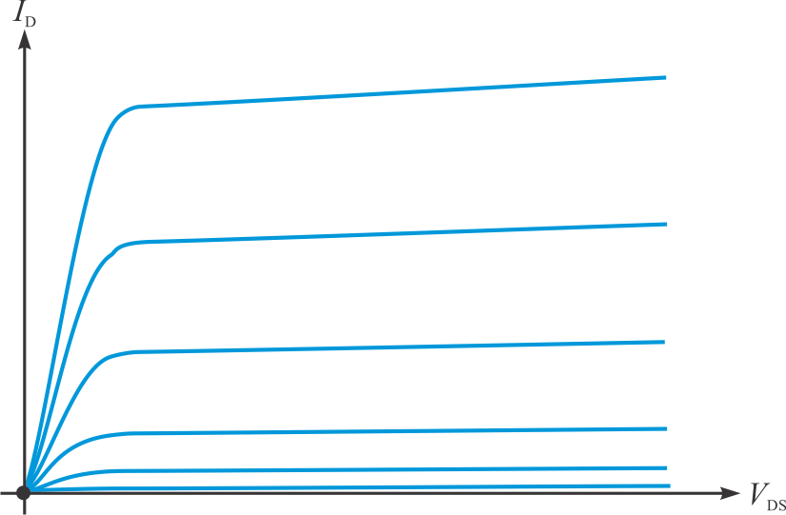
Electronic Devices
Quiz Q3
3. A set of characteristic curves for a JFET are shown. The blue lines represent different values of
a. V_{DS}
b. V_{GS}
c. V_{S}
d. V_{TH}

Slide 43
Electronic Devices
Quiz Q4
4. Transconductance can be expressed as
a.
b.
c.
d.

Slide 44
Electronic Devices
Quiz Q5
5. Q₁ is biased using
a. self-bias
b. voltage-divider bias
c. current-source bias
d. zero bias

Slide 45
Electronic Devices
Quiz Q6
6. The JFET operating point in the circuit shown is
a. at the origin
b. at I_{sat}
c. at V_{CC}
d. undefined

Slide 46
Electronic Devices
Quiz Q7
7. The JFET in this circuit acts like a(n)
a. voltage source
b. amplifier
c. capacitor
d. resistor

Slide 47
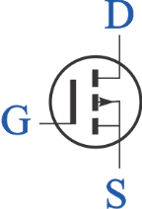
Electronic Devices
Quiz Q8
8. The symbol shown is for
(a) an n-channel D-MOSFET
(b) a p-channel D-MOSFET
(c) an n-channel E-MOSFET
(d) a p-channel E-MOSFET

Slide 48
Electronic Devices
Quiz Q9
9. The transfer curve shown is for an n-channel
a. E-MOSFET
b. D-MOSFET
c. JFET
d. all of the above

Slide 49
Electronic Devices
Quiz Q10
10. The symbol shown is for
a. an IGBT
b. a D-MOSFET
c. an E-MOSFET
d. a JFET

Slide 50
Electronic Devices
Answers
Answers:
1. b
2. d
3. b
4. a
5. c
6. a
7. d
8. d
9. a
10. a

