Slide 1
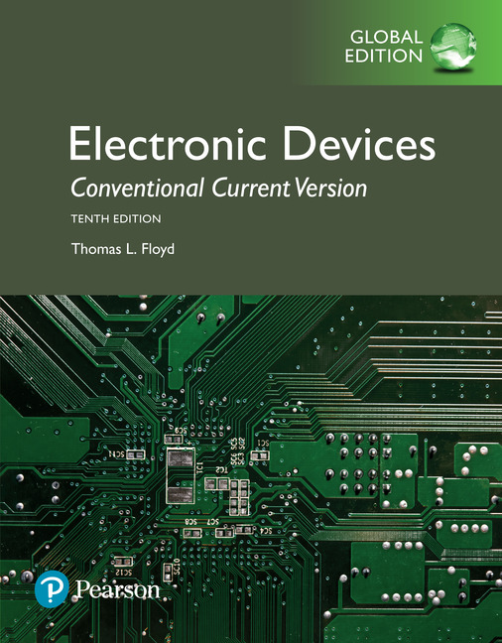
Electronic Devices
10th ed., Global Edition
Chapter 9
FET Amplifiers and
Switching Circuits

Slide 2
Electronic Devices
10th ed.
Objectives:
◆ Explain and analyze the operation of common-source FET
amplifiers
◆ Explain and analyze the operation of common-drain FET
amplifiers
◆ Explain and analyze the operation of common-gate FET
amplifiers
◆ Discuss the operation of a class D amplifier
◆ Describe how MOSFETs can be used in analog switching
applications
◆ Describe how MOSFETs are used in digital switching
applications
◆ Troubleshoot FET amplifiers

Slide 3
Electronic Devices
The Common-Source Amplifier
In a CS amplifier, the input signal is applied to the gate and the output signal is taken from the drain. The amplifier has higher input resistance and lower gain than the equivalent CE amplifier.
The voltage gain is given by the equation A_{v} = g_{m}R_{d}.

Slide 4
Electronic Devices
The Common-Source Amplifier
Recall that conductance is the reciprocal of resistance and admittance is the reciprocal of impedance. Data sheets typically specify the forward transfer admittance, y_{fs} rather than transconductance, g_{m}. The definition of y_{fs} is
An alternate gain expression for a CS amplifier is A_{v} = y_{fs}R_{d}.

Slide 5
Electronic Devices
The Common-Source Amplifier
You can estimate what the transfer characteristic looks like from values on the specification sheet, but keep in mind that large variations are common with JFETs. For example, the range of specified values for a 2N5458 is shown.

Slide 6
Electronic Devices
The Common-Source Amplifier
To analyze the CS amplifier. you need to start with dc values. It is useful to estimate I_{D} based on typical values; specific circuits will vary from this estimate.
Example:
For a typical 2N5458, what is the drain current?
Solution:
2N5458
From the specification sheet, the typical I_{DSS} = 6.0 mA and V_{GS(off)} = −4 V. These values can be plotted along with the load line to obtain a graphical solution. as shown in the next slide.

Slide 7
Electronic Devices
The Common-Source Amplifier
Solution:
(continued)
A graphical solution is illustrated. On the transconductance curve, plot the load line for the source resistor.
Load line for 470 Ω resistor
Then read the current and voltage at the Q-point.
Q
2.8 mA
I_{D} = 2.8 mA and V_{GS} = −1.3 V
−1.3 V

Slide 8
Electronic Devices
The Common-Source Amplifier
Solution:
(continued)
Alternatively, you can obtain I_{D} using Equation 9-2:
The solution to this quadratic equation is simplified using a calculator that can handle quadratic equations.
After entering the equation, enter the known values, but leave I_{D} open.
For the typical values for the 2N5458, (I_{DSS} = 6 mA and V_{GS(off)} = −4 V) with a source resistance of 470 Ω, we find 2.75 mA.
.0027494671581759
.006
470
4.0
press the function button under SOLVE

Slide 9
Electronic Devices
The Common-Source Amplifier
Example:
Assume I_{DSS} is 6.0 mA, V_{GS(off)} is −4 V, and V_{GS} = −1.3 V as found previously. What is the expected gain?
Output is inverted
Solution:
2N5458
A_{v} = g_{m}R_{d} = (2.02 mS)(2.7 kΩ) = 5.45

Slide 10
Electronic Devices
The Common-Source Amplifier
The gain is reduced when a load is connected to the amplifier because the total ac drain resistance (R_{d}) is reduced.
Example:
How does the addition of the 10 kΩ load affect the gain?
Solution:
2N5458
A_{v} = g_{m}R_{d} = (2.02 mS)(2.13 kΩ) = 4.29

Slide 11
Electronic Devices
The D-MOSFET
In operation, the D-MOSFET has the unique property in that it can be operated with zero bias, allowing the signal to swing above and below ground. This means that it can operate in either D-mode or E-mode.

Slide 12
Electronic Devices
The E-MOSFET
The E-MOSFET is a normally off device. The n-channel device is biased on by making the gate positive with respect to the source. A voltage-divider biased E-MOSFET amplifier is shown.

Slide 13
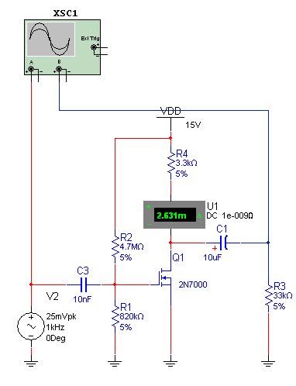
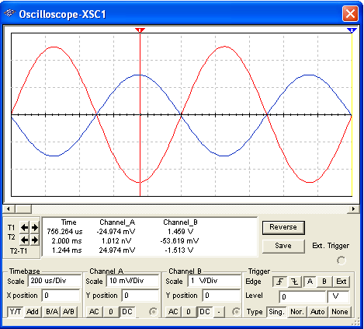
Electronic Devices
E-MOSFET Example
The E-MOSFET amplifier in text Example 9-9 is illustrated with Multisim using a 2N7000 MOSFET.

Slide 14
Electronic Devices
The Common-Drain Amplifier
In a CD amplifier, the input signal is applied to the gate and the output signal is taken from the source. There is no drain resistor, because it is common to the input and output signals.
The voltage gain is given by the equation
The voltage gain is always < 1, but the power gain is not.

Slide 15
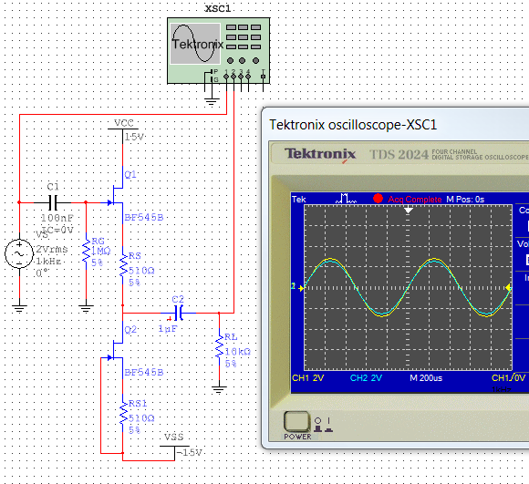
Electronic Devices
Common-Drain Amplifier with Current-Source Biasing
The common-drain amplifier with current source biasing provides improved linearity. The current source, consisting of Q₂, has extremely high internal resistance, so has very little loading effect on Q₁. A Multisim simulation shows how the output is nearly an identical replica of the input.

Slide 16
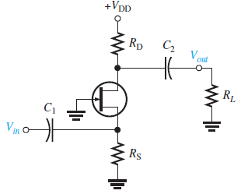
Electronic Devices
The Common-Gate Amplifier
For the common-gate amplifier , the input is applied to the source and the output is taken from the drain. As in the case of the common-source amplifier, the voltage gain equation is:
A_{v} = g_{m}R_{d}
The current gain is very close to 1. The CG amplifier has low input resistance and high output resistance, so is a good current buffer. This means it can transform the effective resistance of a current source into one with higher resistance.
Applications include high-frequency receivers and applications where matching the source impedance is important. Notice that the output signal is in phase with the input, an advantage at high-frequencies.

Slide 17
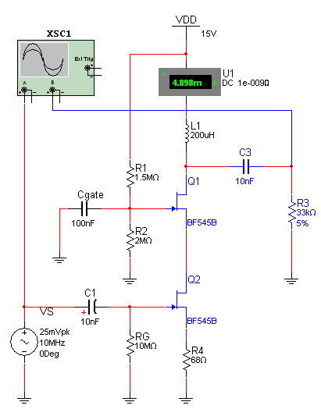
Electronic Devices
The Cascode Amplifier
The cascode connection combines the CS and CG amplifiers. This forms a good high-frequency amplifier. The input and output signals at 10 MHz are shown for this circuit on the following slide…

Slide 18
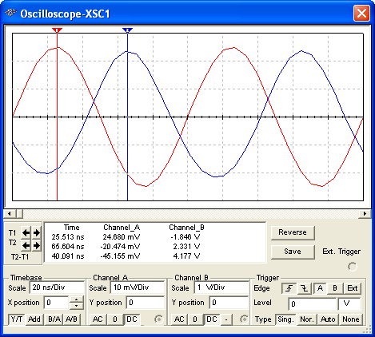
Electronic Devices
The Cascode Amplifier
Example:
The input signal for the cascode amplifier is shown in red; the output is blue. What is the gain?
Solution:
The peak of the input is 24.7 mV.
The peak of the output is 2.33 V.
A_{V} = 94.3

Slide 19
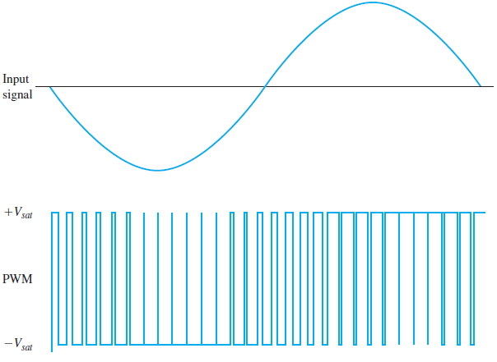
Electronic Devices
The Class-D Amplifier
MOSFETs are useful as class-D amplifiers, which are very efficient because they operate as switching amplifiers. They use pulse width modulation, a process in which the input signal is converted to a series of pulses an amplified by switching MOSFETs. The pulse width varies proportionally to the amplitude
of the input signal.
Notice that the pulse width has a larger duty cycle when the input signal is positive and a smaller duty cycle when the input signal is negative.
The following slide shows a simulation of a pulse width modulator.

Slide 20
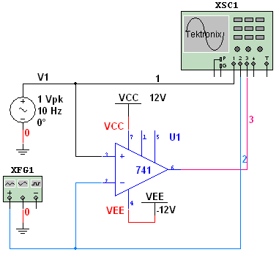
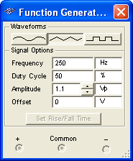
Electronic Devices
The Class-D Amplifier
Here is a Multisim circuit that illustrates pulse width modulation in action. The 741 is set up as a comparator that compares the input signal with a triangle wave. The scope display is shown on the following slide…
Op-amp set up as a comparator

Slide 21
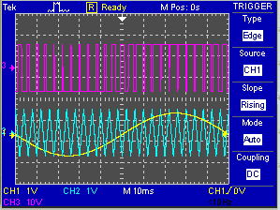
Electronic Devices
The Class-D Amplifier
The signal is the yellow sine wave and is compared repeatedly to the triangle (cyan). The result of the comparison is the output (magenta).

Slide 22
Electronic Devices
The Class-D Amplifier
The modulated signal is amplified by class-B complementary MOSFET transistors. The output is filtered by a low-pass filter to recover the original signal and remove the higher modulation frequency.
PWM is also useful in control applications such as motor controllers. MOSFETs are widely used in these applications because of fast switching time and low on-state resistance.

Slide 23
Electronic Devices
MOSFET Analog Switching
MOSFETs are also used as analog switches to connect or disconnect an analog signal. Analog switches are available in IC form – for example the CD4066 is a quad analog switch that used parallel n- and p-channel MOSFETs. The configuration shown allows signals to be passed in either direction.
MOSFET switches have low on-state resistance and they can be used at high frequencies, such as found in video applications.
Simplified internal construction of a bidirectional IC analog switch.
Question:
What happens with a positive Control signal?
Both transistors are turned on by a positive control signal and an input signal on either side will appear at the output (like a SPST switch).

Slide 24
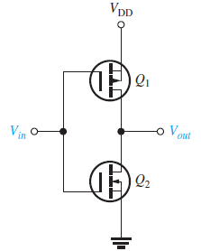
Electronic Devices
MOSFET Digital Switching
MOSFETs are widely used in digital logic circuits. CMOS (Complementary MOS) combines n-channel and p-channel E-MOSFETs in a series arrangement as shown for a basic logic inverter. The input voltage at the gates is either 0 V or V_{DD}. The term V_{DD} is used for the positive voltage, which is on the p-channel device’s source terminal.
When V_{in} = 0 V, Q₁ is on and Q₂ is off, Because Q₁ is acting as a closed switch, the output is approximately V_{DD}, which is the inverse of the input.
When V_{in} = V_{DD}, V_{in} is on and Q₁ is off. Because Q₂ is acting as a closed switch, the output is essentially
connected to ground (0 V). Again the output is the inverse of the input.

Slide 25
Electronic Devices
Selected Key Terms-1
Common-source
Common-drain
Source-follower
Common-gate
A FET amplifier configuration in which the source is the (ac) grounded terminal.
A FET amplifier configuration in which the drain is the (ac) grounded terminal.
The common-drain amplifier.
A FET amplifier configuration in which the gate is the (ac) grounded terminal.

Slide 26
Electronic Devices
Selected Key Terms-2
Class-D amplifier
Pulse-width modulation
Analog switch
CMOS
A nonlinear amplifier in which the transistors are operated as switches.
A process in which a signal is converted to a series of pulses with widths that vary proportionally to the signal amplitude.
A device that switches an analog signal on and off.
Complementary MOS.

Slide 27
Electronic Devices
Quiz Q1
1. Compared to a common-emitter amplifier, a common-source amplifier generally will have
a. higher gain and higher input resistance
b. higher gain and lower input resistance
c. lower gain and higher input resistance
d. lower gain and lower input resistance

Slide 28
Electronic Devices
Quiz Q2
2. The abbreviation y_{fs} means
a. forward transfer admittance
b. forward on-state resistance
c. reverse transfer susceptance
d. reverse on-state conductance

Slide 29
Electronic Devices
Quiz Q3
3. The plot shown is a graphical solution for a self-biased FET amplifier. The red line represents the
a. gate resistor
b. source resistor
c. drain resistor
d. none of the above

Slide 30
Electronic Devices
Quiz Q4
4. The resistance represented by the red line is
a. 150 Ω
b. 240 Ω
c. 470 Ω
d. 666 Ω

Slide 31
Electronic Devices
Quiz Q5
5. The gain equation is used to calculate the gain of
a. a CS amplifier
b. a CD amplifier
c. a CG amplifier
d. any of the above

Slide 32
Electronic Devices
Quiz Q6
6. A FET that can be biased with zero bias is a
a. an n-channel JFET
b. a D-MOSFET
c. an E-MOSFET
d. all of the above

Slide 33
Electronic Devices
Quiz Q7
7. The cascode amplifier shown uses
a. A CS and a CD stage
b. Two CS stages
c. Two CD stages
d. none of the above

Slide 34
Electronic Devices
Quiz Q8
8. The principle circuit used in creating a pulse width modulator is a
a. peak detector
b. clipper
c. comparator
d. low-pass filter

Slide 35
Electronic Devices
Quiz Q9
9. The circuit is an amplifier for a pulse width modulated signal. The load has the demodulated signal. The yellow box represents a
a. peak detector
b. clipper
c. comparator
d. low-pass filter

Slide 36
Electronic Devices
Quiz Q10
10. When the control signal is active, the output of an analog switch should look like
a. the input signal
b. a square wave
c. a modulated pulse
d. a dc level

Slide 37
Electronic Devices
Answers
Answers:
1. c
2. a
3. b
4. d
5. b
6. b
7. d
8. c
9. d
10. a

