Slide 1
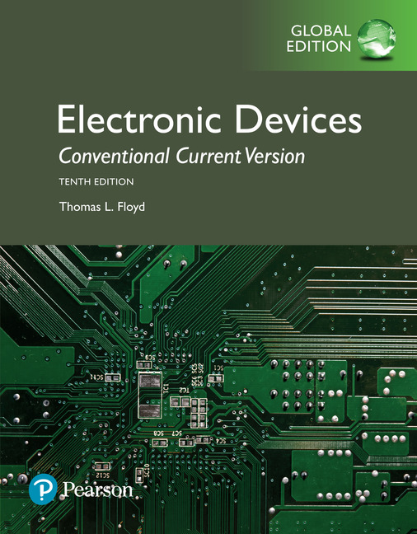
Electronic Devices
10th ed., Global Edition
Chapter 10
Amplifier Frequency Response

Slide 2
Electronic Devices
10th ed.
Objectives:
◆ Explain how circuit capacitances affect the frequency
response of an amplifier
◆ Use the decibel (dB) to express amplifier gain
◆ Analyze the low-frequency response of an amplifier
◆ Analyze the high-frequency response of an amplifier
◆ Analyze an amplifier for total frequency response
◆ Analyze multistage amplifiers for frequency response
◆ Explain how to measure the frequency response of an amplifier

Slide 3
Electronic Devices
Effect of Coupling Capacitors
Coupling capacitors are in series with the signal and are part of a high-pass filter network. They affect the low-frequency response of the amplifier.
The equivalent circuit for C₁ is a high-pass filter:
C₃ and (R_{C} + R_{L}) form another high-pass filter.

Slide 4
Electronic Devices
Effect of Coupling Capacitors
With FETs, the input coupling capacitor is almost always smaller because of the high input resistance. The output capacitor may be smaller or larger depending on the drain and load resistor size.
For the circuit shown, the equivalent low-pass filter for the input is simply C₁ in series with R_{G} because the gate input resistance is so high and can be ignored.

Slide 5
Electronic Devices
Effect of Bypass Capacitors
A bypass capacitor causes reduced gain at low-frequencies and has a high-pass filter response. The resistors “seen” by the bypass capacitor include R_{E}, r_{e}’, and the bias resistors.
The equivalent high-pass filter for C₂ is:
Question:
How would an emitter swamping resistor affect the response?
f_{c} would be lower due to increased R.

Slide 6
Electronic Devices
Internal Capacitances
The high-frequency response of an amplifier is determined by internal junction capacitances. These capacitances form low-pass filters with the external resistors.
Sometimes a designer will add an external parallel capacitor to deliberately reduce the high frequency response.

Slide 7
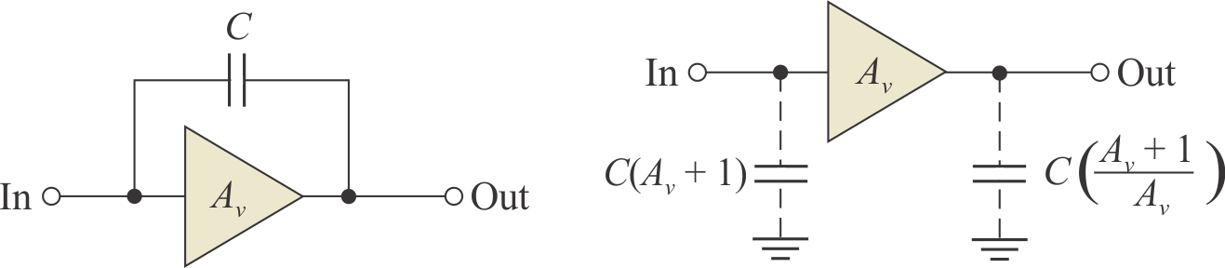
Electronic Devices
Miller’s Theorem
Miller’s theorem states that, for inverting amplifiers, the capacitance between the input and output is equivalent to separate input and output capacitances to ground.
A_{v} is the absolute value of the gain. For the input capacitance, the gain has a large effect on the equivalent capacitance, which is an important consideration when using inverting amplifiers.

Slide 8
Electronic Devices
Miller’s Theorem
Notice that the effect of Miller’s theorem is an equivalent capacitance to ground, which shunts high frequencies to ground and reduces the gain as frequency is increased.
Example:
What is the input capacitance for a 2N3904 inverting amplifier with a gain of 25? Assume the values of C_{bc} = 4 pF and C_{be} = 6 pF.
Solution:
C_{in} = C_{bc}(A_{v} + 1) + C_{be}
C_{in} = 4 pF(25 + 1) + 6 pF =
110 pF

Slide 9
Electronic Devices
The Decibel
Recall that the decibel was defined in Chapter 6 as a logarithmic measure the ratio of one power to another or one voltage to another. The decibel is used in electronics work in gain or attenuation measurements. Decibels can be expressed as a voltage ratio when the voltages are measured in the same impedance.
To express power gain in decibels, the formula is
A_{p(dB)} = 10 log A_{p}
To express voltage gain in decibels, the formula is
A_{v(dB)} = 20 log A_{v}

Slide 10
Electronic Devices
The Decibel
Sometimes, 0 dB is assigned as a convenient reference level for comparison. Then, other power or voltage levels are shown with respect to 0 dB.
Some useful decibel ratios to remember are:
Ratio | Power gain, A_{p} | Voltage gain, A_{v}
0.1 | −10 dB | −20 dB
0.5 | −3 dB | −6 dB
1 | 0 dB | 0 dB
2 | 3 dB | 6 dB
10 | 10 dB | 20 dB
The −3 dB power gain corresponds to a power reduction of one-half. The frequency at which this occurs is referred to as the critical frequency.

Slide 11
Electronic Devices
Low-Frequency Response
In capacitively coupled amplifiers, the coupling and bypass capacitors affect the low frequency cutoff. These capacitors form a high-pass filter with circuit resistances. A typical BJT amplifier has three high-pass filters.
For example, the input coupling capacitor forms a high-pass filter with the input resistance of the amplifier:

Slide 12
Electronic Devices
Low-Frequency Response
The output RC circuit is composed of the series combination of the collector and load resistors with the output capacitor. The cutoff frequency due to the output circuit is

Slide 13
Electronic Devices
Low-Frequency Response
Example:
What is the lower cutoff frequency due to C₁?
Assume r_{e}’ = 3.5 Ω and β = 200.
Solution:
R_{E1} is not bypassed, so it is added to r_{e}’. Then:
= 2.77 kΩ

Slide 14
Electronic Devices
Low-Frequency Response
The bypass RC circuit response can be found by observing the charge/discharge paths.
For this circuit, there is one path through R_{E2} as shown in blue.
A second path goes through R_{E1}, r_{e}’, and the parallel combination of bias and source resistances as shown in red (source resistance not shown).
The total resistance of the paths can be found by:

Slide 15
Electronic Devices
Low-Frequency Response
Example:
What is the critical frequency due to the bypass RC circuit?
(Assume R_{s} = 600 Ω and β = 200 and r_{e}’ = 2.6 Ω).
Solution:
= 79.7 Ω
42.5 Hz

Slide 16
Electronic Devices
Low-Frequency Response
The input RC circuit for a FET is a basic high-pass filter consisting of the bias resistor (or resistors) and the input coupling capacitor. The FET gate circuit has such high resistance, it can be ignored.
Example:
What is the critical frequency due to the input RC circuit?
Solution:
1.6 Hz

Slide 17
Electronic Devices
The Bode Plot
The Bode plot is a plot of decibel voltage gain verses frequency. The frequency axis is logarithmic; the decibel gain is plotted on a linear scale. The −3dB point is the critical frequency.

Slide 18
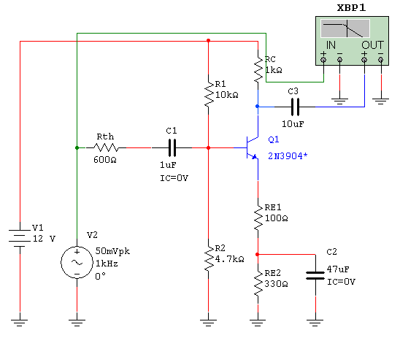
Electronic Devices
The Bode Plot
Connect the IN of the plotter to a constant level to the left of the Thevenin source.
Multisim has a fictitious instrument called the Bode plotter. This is the previous BJT amplifier.

Slide 19
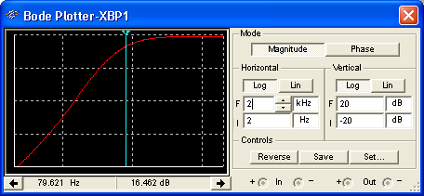
Electronic Devices
The Bode Plot
Multisim has a fictitious instrument called the Bode plotter. This is the previous BJT amplifier.
The Bode plotter allows you to see the Bode plot directly. By selecting the proper scales, you can magnify the response. Move the cursor to the point where the total response is – 3dB from midband and read f_{c} as shown here.
Set the cursor 3dB below the midband gain and read f_{c}.

Slide 20
Electronic Devices
High-Frequency Response
The high frequency response of inverting amplifiers is primarily determined by the transistor’s internal capacitance and the Miller effect. The equivalent high-frequency ac circuit is shown for a voltage-divider biased CE amplifier with a fully bypassed emitter resistor.

Slide 21
Electronic Devices
High-Frequency Response
If there is an unbypassed emitter resistor, such as R_{E1} in the earlier example, it is shown in the emitter circuit and acts to increase r_{e}’ and thus reduce f_{c}.

Slide 22
Electronic Devices
High-Frequency Response
For the fully bypassed case, such as the one shown in the text in Example 10-11, the ac emitter resistance (r_{e}’) is multiplied by β_{ac} to obtain the equivalent input resistance at the transistor’s base.

Slide 23
Electronic Devices
High-Frequency Response
Combining the capacitors in parallel and Thevenizing forms an equivalent basic RC low-pass filter:

Slide 24
Electronic Devices
High-Frequency Response
If there is an unbypassed emitter resistor (R_{E1} in this case), the Thevenin resistance is modified to

Slide 25

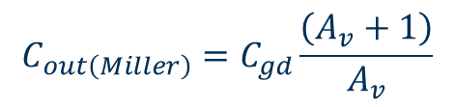
Electronic Devices
High-Frequency Response
The high frequency analysis of FETs is similar to that of BJTs. Like the CE amplifier, the CS amplifier inverts the signal, so the Miller effect must be taken into account. You may see special circuits such as cascode connections in very high frequency applications to minimize the Miller effect.
$$C_{out\left(Miller\right)}=C_{gd}\frac{\left(A_{v}+1\right)}{A_{v}}$$
A high frequency ac model of a CS amplifier is:
$$C_{in\left(Miller\right)}=C_{gd}\left(A_{v}+1\right)$$

Slide 26
Electronic Devices
Total Amplifier-Frequency Response
In general, the overall frequency response is the combination of three lower critical frequencies due to coupling and bypass capacitors and two upper critical frequencies due to internal capacitances.
The ideal Bode plot for a typical amplifier is:
The bandwidth is measured between the dominant critical frequencies.
BW

Slide 27
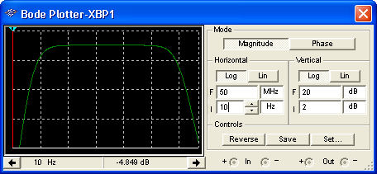
Electronic Devices
Total Amplifier-Frequency Response
The overall response can be viewed on the Bode plotter by choosing the appropriate scales. The overall response for the BJT example given previously is shown.

Slide 28
Electronic Devices
Total Amplifier-Frequency Response
For multistage amplifiers, the individual stages have an effect on the overall response.
In general, with different cutoff frequencies, the dominant lower cutoff frequency is equal to the highest f_{cl}; the dominant upper critical frequency is equal to lowest f_{cu}.
When the critical frequencies for multistage amplifiers are equal, the lower critical frequency is higher than any one as given by
and the upper critical frequency is given by

Slide 29
Electronic Devices
Key Terms-1
Midrange gain
Critical frequency
Roll-off
The gain that occurs for the range of frequencies between the lower and upper critical frequencies.
The frequency at which the response of an amplifier or filter is 3 dB less than at midrange.
The rate of decrease in the gain of an amplifier above or below the critical frequencies.

Slide 30
Electronic Devices
Key Terms-2
Decade
Bode Plot
Bandwidth
A ten times increase or decrease in the value of a quantity such as frequency.
An idealized graph of the gain in dB verses frequency used to graphically illustrate the response of an amplifier or filter.
The characteristic of certain types of electronic circuits that specifies the usable range of frequencies that pass from input to output.

Slide 31
Electronic Devices
Quiz Q1
1. For a CE amplifier, the emitter bypass capacitor affects the
a. low-frequency response
b. high-frequency response
c. both of the above
d. none of the above

Slide 32
Electronic Devices
Quiz Q2
2. For a CS amplifier, the gate-drain capacitance affects the
a. low-frequency response
b. high-frequency response
c. both of the above
d. none of the above

Slide 33
Electronic Devices
Quiz Q3
3. For an inverting amplifier, the Miller effect causes the equivalent capacitance to ground to appear
a. smaller for both C_{in} and C_{out}
b. smaller for C_{in} and larger for C_{out}
c. larger for C_{in} and smaller for C_{out}
d. larger for both C_{in} and C_{out}

Slide 34
Electronic Devices
Quiz Q4
4. For the CE amplifier shown, the output low-frequency response is determined by
a. (R_{C}||R_{L}) C₃
b. (R_{C}||R_{L}) + C₃
c. (R_{C}+R_{L}) C₃
d. (R_{C}+R_{L}) + C₃

Slide 35
Electronic Devices
Quiz Q5
5. For the CE amplifier shown, the resistor that is not part of the RC charge and discharge path for (C₂) is
a. R₁
b. R₂
c. R_{C}
d. R_{E}

Slide 36
Electronic Devices
Quiz Q6
6. The decibel is a ratio of two powers; for this reason the measurement unit is
a. the volt
b. the watt
c. the volt-amp
d. dimensionless

Slide 37
Electronic Devices
Quiz Q7
7. At the cutoff frequency for an amplifier, the power output compared to the midband power output is
a. −2 dB
b. −3 dB
c. +2 dB
d. +3 dB

Slide 38
Electronic Devices
Quiz Q8
8. The effect of an unbypassed emitter resistor on the upper cutoff frequency in a CE amplifier is
a. to increase f_{cu}
b. to decrease f_{cu}
c. no effect

Slide 39
Electronic Devices
Quiz Q9
9. The y-axis of a Bode Plot is used for the
a. frequency scale
b. power scale
c. voltage scale
d. decibel scale

Slide 40
Electronic Devices
Quiz Q10
10. The term bandwidth refers to those frequencies
a. between the lower and upper critical frequencies
b. above the upper critical frequency
c. below the lower critical frequency
d. none of the above

Slide 41
Electronic Devices
Answers
Answers:
1. a
2. b
3. d
4. c
5. c
6. d
7. b
8. b
9. d
10. a

