Slide 1
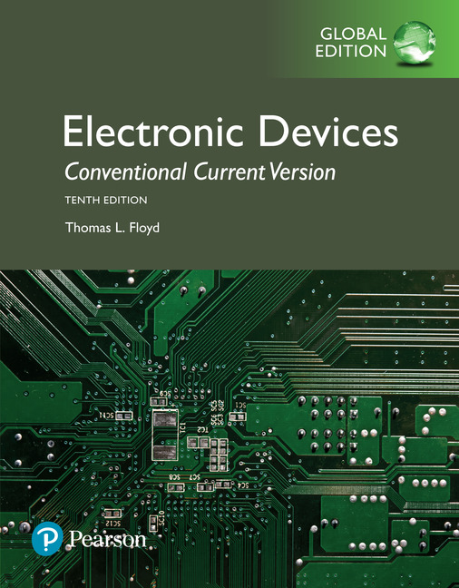
Electronic Devices
10th ed., Global Edition
Chapter 11
Thyristors

Slide 2
Electronic Devices
10th ed.
Objectives:
◆ Describe the basic structure and operation of a four-layer diode
◆ Describe the basic structure and operation of an SCR
◆ Discuss several SCR applications
◆ Describe the basic structure and operation of the diac and triac
◆ Describe a silicon-controlled switch (SCS)
◆ Describe the basic structure and operation of the unijunction transistor
◆ Describe the basic structure and operation of the programmable UJT

Slide 3
Electronic Devices
The Four-Layer Diode
The four-layer diode is a fundamental building block for a class of semiconductors known as thyristors. The original four-layer diode had only two terminals and is now obsolete but forms a good starting point to study other four layer devices. Thyristors are 4 layer devices consisting of alternating p- and n-material. These devices act as switches; for this reason, they are most frequently used in control applications.
Some thyristors and their symbols are

Slide 4
Electronic Devices
The Four-Layer Diode
The concept of 4-layer devices is usually shown as an equivalent circuit of a pnp and an npn transistor. Ideally, these devices would not conduct, but when forward biased, if there is sufficient leakage current in the upper pnp device, it can act as base current to the lower npn device causing it to conduct and bringing both transistors into saturation.

Slide 5
Electronic Devices
The Four-Layer Diode
The original 4-layer diode (or Shockley diode) acts something like an ordinary diode but conducts in the forward direction only after a certain anode to cathode voltage called the forward-breakover voltage is reached.
The 4-layer diode had only two leads, labeled the anode (A) and the cathode (K). The symbol reminds you that it acts like a diode. It does not conduct when it is reverse-biased.

Slide 6
Electronic Devices
The Four-Layer Diode
The characteristic curve for a 4-layer diode shows the forward blocking region. When the anode-to-cathode voltage exceeds V_{BR}, conduction occurs. The switching current at this point is I_{S}.
Once conduction begins, it will continue until anode current is reduced to less than the holding current (I_{H}). This is the only way to stop conduction.

Slide 7
Electronic Devices
The SCR
The Silicon Controlled Rectifier (SCR) is essentially the original 4-layer diode but with a gate connection. The SCR can be triggered into conduction by gate current. This improvement made a much more useful device than the 4-layer diode.
The SCR can be turned on by exceeding the forward breakover voltage or by gate current. Notice that the gate current controls the amount of forward breakover voltage required for turning it on.

Slide 8
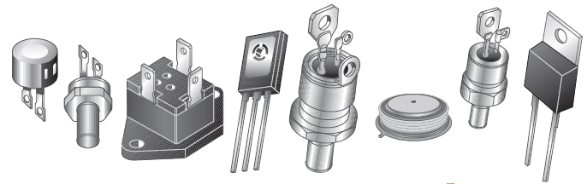
Electronic Devices
The SCR
SCRs have a greater variety of packages than transistors; a few examples are shown. Most SCRs are designed to handle relatively high currents. For example, a typical medium power SCR in a TO-220 case (far right) can be rated for a sinusoidal current of up to 25 A and much higher pulsed current.

Slide 9
Electronic Devices
The SCR
Like the 4-layer diode, the SCR will conduct as long as forward current exceeds I_{H}. There are two ways to drop the SCR out of conduction: 1) anode current interruption and 2) forced commutation.
Anode current can be interrupted by breaking the anode current path (shown here), providing a path around the SCR, or dropping the anode voltage to the point that I_{A} < I_{H}.
Forced commutation uses an external circuit to momentarily force current in the opposite direction to forward conduction.
SCRs are commonly used in ac circuits, which forces the SCR out of conduction when the ac reverses.

Slide 10
Electronic Devices
SCR
Three important SCR specifications are:
1) Forward-breakover voltage, V_{BR(F)}: This is the voltage at which the SCR enters the forward-conduction region.
Characteristic for I_{G} = 0
2) Holding current, I_{H}: This is the value of anode current below which the SCR switches from the forward-conduction region to the forward-blocking region.
3) Gate trigger current, I_{GT}: This is the value of gate current necessary to switch the SCR from the forward-blocking region to the forward-conduction region under specified conditions.

Slide 11
Electronic Devices
SCR Applications
SCRs are used in a variety of power control applications. One of the most common applications is to use it in ac circuits to control a dc motor or appliance because the SCR can both rectify and control.
The SCR is triggered on the positive cycle and turns off on the negative cycle. A circuit like this is useful for speed control for fans or power tools and other related applications.

Slide 12
Electronic Devices
SCR Applications
Another application for SCRs is in crowbar circuits (which get their name from the idea of putting a crowbar across a voltage source and shorting it out!)
The purpose of a crowbar circuit is to shut down a power supply in case of over-voltage. Once triggered, the SCR latches on. The SCR can handle a large current, which causes the fuse (or circuit breaker) to open.

Slide 13
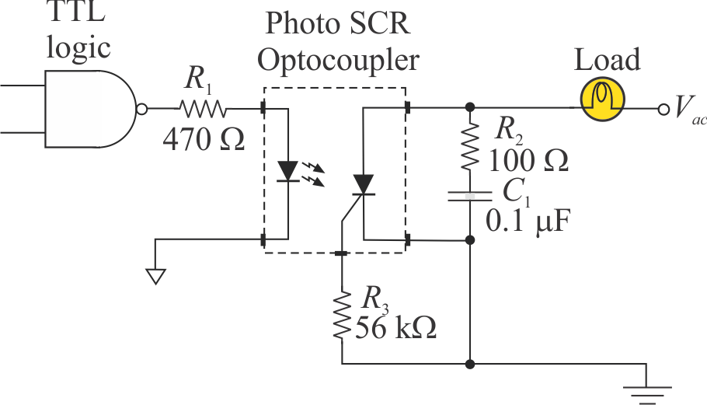
Electronic Devices
The LASCR
The Light-Activated SCR (LASCR) is also called a Photo SCR. It is essentially a light sensitive SCR that uses a small lens to focus light onto a light-sensitive gate. As with any SCR, the LASCR will latch and continue to conduct until current falls below a specified level.
Here a photo SCR is used as output portion of an optocoupler to interface a logic gate to a load.

Slide 14
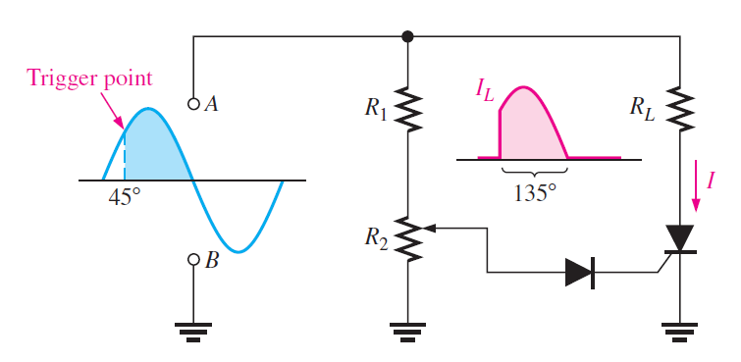
Electronic Devices
SCR Applications
SCRs are frequently used in ac circuits to convert the ac to a half-wave phase control circuit such as used with light dimmers or to control the speed of a dc motor.
The SCR can be triggered on any part of the leading edge of the sine wave depending on the setting of R₂.

Slide 15
Electronic Devices
The Diac
The diac is a thyristor that acts like two back-to-back 4-layer diodes. It can conduct current in either direction. Because it is bidirectional, the terminals are equivalent and labeled A₁ and A₂.
The diac conducts current after the breakdown voltage is reached. At that point, the diac goes into avalanche conduction, creating a current pulse sufficient to trigger another thyristor (an SCR or triac). The diac remains in conduction as long as the current is above the holding current, I_{H}.

Slide 16
Electronic Devices
The Triac
The triac is essentially a bidirectional SCR but the anodes are not interchangeable. Triggering is done by applying a current pulse to the gate; breakover triggering is not normally used.
When the voltage on the A₁ terminal is positive with respect to A₂, a gate current pulse will cause the left SCR to conduct. When the anode voltages are reversed, the gate current pulse will cause the right SCR to conduct.

Slide 17
Electronic Devices
Triac Applications
Triacs are used for control of ac in applications like electric range heating controls, light dimmers, and small motors.
Like the SCR, the triac latches after triggering and turns off when the current is below the I_{H}, which happens at the end of each alteration.

Slide 18
Electronic Devices
The Silicon-Controlled Switch
The Silicon-Controlled Switch (SCS) is similar to an SCR but with two gates. It can be triggered on with a positive pulse on the cathode gate, and can be triggered off with a positive pulse on the anode gate.
In this example, the SCS is controlling a dc source. The load is in the cathode circuit, which has the advantage of one side of the load being on circuit ground.

Slide 19
Electronic Devices
The Unijunction Transistor
The Unijunction Transistor (UJT) consists of a block of lightly-doped (high resistance) n-material with a p-material grown into its side. It is often used as a trigger device for SCRs and triacs.
The UJT is a switching device; it is not an amplifier. When the emitter voltage reaches V_{P} (the peak point), the UJT “fires”, going through the unstable negative resistance region to produce a fast current pulse.

Slide 20
Electronic Devices
The Unijunction Transistor
The equivalent circuit for a UJT shows that looks like a diode connected to a voltage divider. The resistance of the lower divider (r’_{B1}) is inversely proportional to the emitter current. When the pn junction is first
forward-biased, the junction
resistance of r’_{B1} suddenly appears
to drop, and a rush of current occurs.
An important parameter is η, which is the intrinsic standoff ratio. It represents the ratio of r’_{B1} to the interbase resistance r’_{BB} with no current.

Slide 21
Electronic Devices
The Programmable Unijunction Transistor (PUT)
The Programmable Unijunction Transistor (PUT) is a 4-layer thyristor with a gate. It is primarily used as a sensitive switching device. The gate pulse can trigger a sharp increase in current at the output.
The characteristic of a PUT is similar to a UJT, but the PUT intrinsic standoff ratio can be “programmed” with external resistors and the UJT has a fixed ratio.

Slide 22
Electronic Devices
The Programmable Unijunction Transistor (PUT)
The principle application for a PUT is for driving SCRs and triacs, but, like the UJT, can be used in relaxation oscillators.
For the circuit to oscillate, R₁ must be large enough to limit current to less than the valley current (I_{V}). The period of the oscillations is given by:
where

Slide 23
Electronic Devices
The Programmable Unijunction Transistor (PUT)
Example:
What is intrinsic standoff ratio, and the period of the circuit?
Solution:
0.33
0.89 ms
Follow-up:
What is the frequency?
1.12 kHz

Slide 24
Electronic Devices
Selected Key Terms-1
4-layer diode
Thyristor
SCR
The type of 2-terminal thyristor that conducts current when the anode-to-cathode voltage reaches a specified “breakover” value.
A class of four-layer (pnpn) semiconductor devices.
Silicon-controlled rectifier; a type of three terminal thyristor that conducts current when triggered by a voltage at the single gate terminal and remains on until anode current falls below a specified value.

Slide 25
Electronic Devices
Selected Key Terms-2
LASCR
Diac
Triac
Light-activated silicon-controlled rectifier; a four layer semiconductor device (thyristor) that conducts current in one direction when activated by a sufficient amount of light and continues to conduct until the current falls below a specified value.
A two-terminal four-layer semiconductor device (thyristor) that can conduct current in either direction when properly activated.
A three-terminal thyristor that can conduct current in either direction when properly activated.

Slide 26
Electronic Devices
Selected Key Terms-3
SCS
UJT
PUT
Silicon-controlled switch; a type of four-terminal thyristor that has two gate terminals that are used to trigger the device on and off.
Unijunction transistor; a three terminal single pn junction device that exhibits a negative resistance characteristic.
Programmable unijunction transistor; a type of three terminal thyristor (physically more like an SCR than a unijunction) that is triggered into conduction when the voltage at the anode exceeds the voltage at the gate.

Slide 27
Electronic Devices
Quiz Q1
1. The 4-layer (Shockley) diode can conduct current if
a. the anode-to-cathode voltage exceeds V_{BR}
b. a current pulse is applied to the gate
c. both a and b are correct
d. none of the above

Slide 28
Electronic Devices
Quiz Q2
2. The SCR can conduct current if
a. the anode-to-cathode voltage exceeds V_{BR}
b. a current pulse is applied to the gate
c. both a and b are correct
d. none of the above

Slide 29
Electronic Devices
Quiz Q3
3. A bidirectional thyristor is the
a. 4-layer diode
b. SCR
c. triac
d. silicon-controlled switch

Slide 30
Electronic Devices
Quiz Q4
4. A thyristor that looks like two back-to-back 4-layer diodes is the
a. SCR
b. triac
c. SCS
d. diac

Slide 31
Electronic Devices
Quiz Q5
5. An SCR turns off when the
a. gate trigger current drops below a specified level
b. anode current drops below the holding current
c. both a and b are true
d. none of the above

Slide 32
Electronic Devices
Quiz Q6
6. The purpose of a crowbar circuit is to protect a load from
a. excessive ripple
b. low-voltage
c. over-voltage
d. all of the above

Slide 33
Electronic Devices
Quiz Q7
7. A diac and triac are similar in that both devices
a. can use breakover triggering
b. can be used in ac circuits
c. are bidirectional
d. all of the above

Slide 34
Electronic Devices
Quiz Q8
8. A device that has an unstable negative resistance region is the
a. UJT
b. diac
c. triac
d. SCS

Slide 35
Electronic Devices
Quiz Q9
9. The symbol for a silicon-controlled switch (SCS) is
(a) (b) (c) (d)

Slide 36
Electronic Devices
Quiz Q10
10. A programmable unijunction transistor (PUT) is “programmed” by choosing the
a. RC time constant
b. gate resistors
c. power supply voltage
d. cathode resistor

Slide 37
Electronic Devices
Answers
Answers:
1. a
2. c
3. c
4. d
5. b
6. c
7. d
8. a
9. d
10. b

