Slide 1
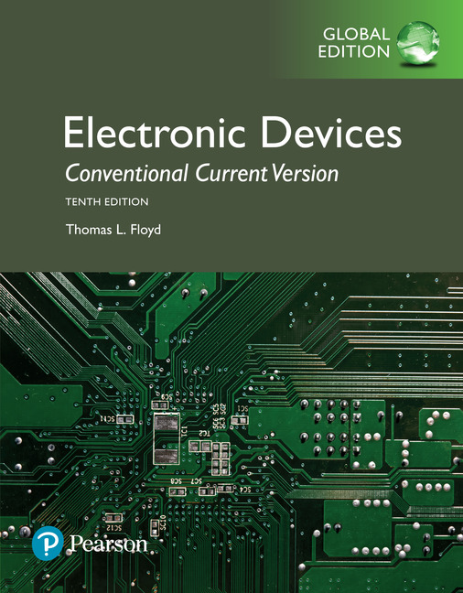
Electronic Devices
10th ed., Global Edition
Chapter 12
The Operational Amplifier

Slide 2
Electronic Devices
10th ed.
Objectives:
◆ Describe the basic operational amplifier and its characteristics
◆ Discuss op-amp modes and several parameters
◆ Explain negative feedback in op-amps
◆ Analyze op-amps with negative feedback
◆ Describe how negative feedback affects op-amp impedances
◆ Discuss bias current and offset voltage
◆ Analyze the open-loop frequency response of an op-amp
◆ Analyze the closed-loop frequency response of an op-amp
◆ Troubleshoot op-amp circuits

Slide 3
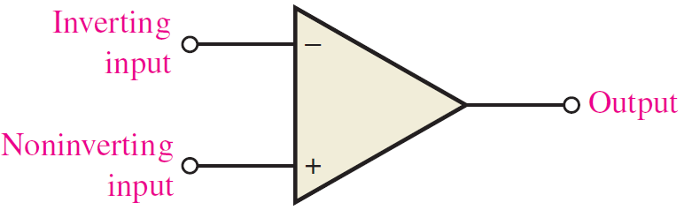
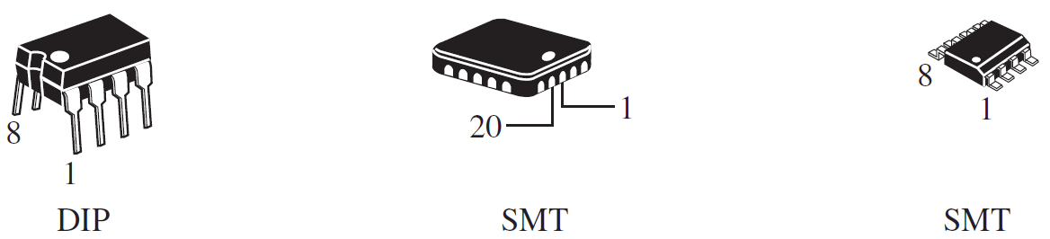
Electronic Devices
Operational Amplifiers (op-amp)
Operational amplifiers (op-amps) are very high gain dc coupled amplifiers with differential inputs. One of the inputs is called the inverting input (−); the other is called the noninverting input. Usually there is a single output.
Most op-amps operate from plus and minus supply voltages, which may or may not be shown on the schematic symbol.
Typical packages:

Slide 4
Electronic Devices
The Ideal Op-amp
The ideal op-amp has characteristics that simplify analysis of op-amp circuits. Ideally, op-amps have infinite voltage gain, infinite bandwidth, and infinite input impedance. In addition, the ideal op-amp has zero output impedance.

Slide 5
Electronic Devices
The Practical Op-amp
Practical op-amps have characteristics that often can be treated as ideal for certain situations, but can never actually attain ideal characteristics. In addition to finite gain, bandwidth, and input impedance, they have other limitations.

Slide 6
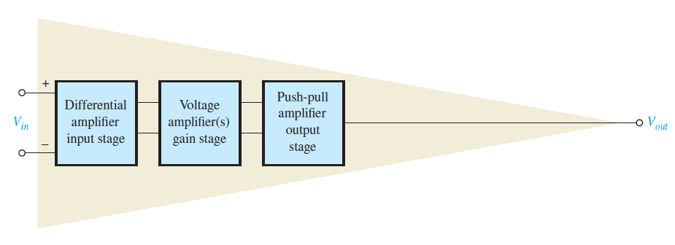
Electronic Devices
Op-amp Block Diagram
Internally, the typical op-amp has a differential input, a voltage amplifier, and a push-pull output. Recall from the discussion in Section 6-7 of the text that the differential amplifier amplifies the difference in the two inputs.

Slide 7
Electronic Devices
Op-amp Signal Modes
The input signal can be applied to an op-amp in differential-mode or in common-mode. (Recall that these terms were introduced in Section 6-7 with differential amplifiers. They are reviewed in this chapter.)
Differential-mode signals are applied either as single-ended (one side on ground) or double-ended (opposite phases on the inputs).
Differential signals

Slide 8
Electronic Devices
Op-amp Signal Modes
Common-mode signals are applied to both sides with the same phase on both.
Usually, common-mode signals are from unwanted sources, and affect both inputs in the same way. The result is that they are essentially cancelled at the output.
Common-mode signals

Slide 9
Electronic Devices
Common-mode Rejection Ratio
Common-mode rejection ratio (CMRR) was introduced in Chapter 6 with respect to differential amplifiers and is an important parameter for op-amps. Recall that common-mode rejection ratio (CMRR) is defined as the ability of an amplifier to amplify differential signals and reject common-mode signals. In equation form:
where A_{ol} is the open-loop differential-gain and A_{cm} is the common-mode gain.
CMRR can also be expressed in decibels as

Slide 10
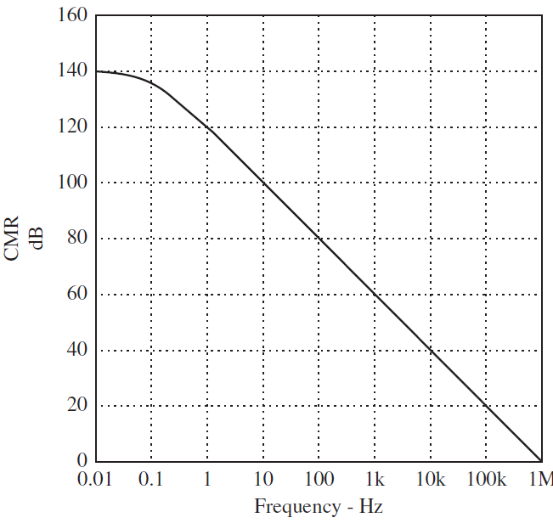
Electronic Devices
Common-mode Rejection Ratio
Common-mode rejection is frequency dependent. Low frequency common-mode signals are rejected better than high-frequency signals.
Manufacturers will publish a graph of this with the data sheet for an op-amp. A sample is shown here.

Slide 11
Electronic Devices
Common-mode Rejection Ratio
Example:
What is CMRR in decibels for a typical 741C op-amp?
The typical open-loop differential gain for the 741C is 200,000 and the typical common-mode gain is 6.3.
Solution:
90 dB
(The minimum specified CMRR is 70 dB.)

Slide 12
Electronic Devices
Voltage and Current Parameters
V_{O(p-p)}: The maximum output voltage swing is determined by the op-amp and the power supply voltages
V_{OS}: The input offset voltage is the differential dc voltage required between the inputs to force the output to zero volts
I_{BIAS}: The input bias current is the average of the two dc currents required to bias the differential amplifier
I_{OS}: The input offset current is the difference between the two dc bias currents

Slide 13
Electronic Devices
Impedance Parameters
Z_{IN(d)} : The differential input impedance is the total resistance between the inputs
Z_{IN(cm)} : The common-mode input impedance is the resistance between each input and ground
Z_{out}: The output impedance is the resistance viewed from the output of the circuit.

Slide 14
Electronic Devices
Slew Rate
Slew rate: The slew rate is the maximum rate of change of the output voltage in response to a step input voltage
Example:
Determine the slew rate for the output response to a step input as shown here:
Solution:
= 6 V/μs

Slide 15
Electronic Devices
Negative Feedback
Negative feedback is the process of returning a portion of the output signal to the input with a phase angle that opposes the input signal.
The advantage of negative feedback is that precise values of amplifier gain can be set. In addition, bandwidth and input and output impedances can be controlled.

Slide 16
Electronic Devices
Noninverting Amplifier
A noninverting amplifier is a configuration in which the signal is on the noninverting input and a portion of the output is returned to the inverting input.
Feedback forces V_{f} to be equal to V_{in}, hence V_{in} is across R_{i}. With basic algebra, you can show that the closed-loop gain of the noninverting amplifier is

Slide 17
Electronic Devices
Noninverting Amplifier
Example:
Determine the gain of the noninverting amplifier shown.
Solution:
= 25.8

Slide 18
Electronic Devices
Inverting Amplifier
An inverting amplifier is a configuration in which the noninverting input is grounded and the signal is applied through a resistor to the inverting input.
Feedback forces the inputs to be nearly identical; hence the inverting input is very close to 0 V. The closed-loop gain of the inverting amplifier is
0 V (virtual ground)

Slide 19
Electronic Devices
Inverting Amplifier
Example:
Determine the gain of the inverting amplifier shown.
Solution:
= −24.8
The minus sign indicates inversion.

Slide 20
Electronic Devices
Impedances
Noninverting amplifier:
Generally, assumed to be ∞
Generally, assumed to be 0
Inverting amplifier:
Generally, assumed to be R_{i}
Generally, assumed to be 0
Note that the output impedance has the same form for both amplifiers.

Slide 21
Electronic Devices
Bias Current Compensation
For op-amps with a BJT input stage, bias current can create a small output error voltage. To compensate for this, a resistor equal to R_{i}||R_{f} is added to one of the inputs.
Noninverting amplifier
Inverting amplifier

Slide 22
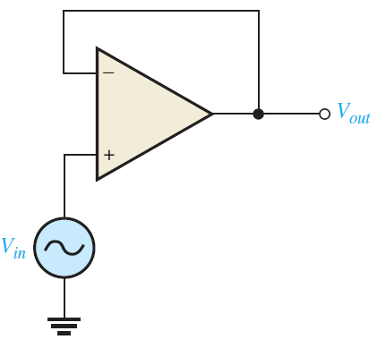
Electronic Devices
Voltage Follower
A special case of the inverting amplifier is when R_{f} =0 and R_{i} = ∞. This forms a voltage follower or unity gain buffer with a gain of 1.
The input impedance of the voltage follower is very high, producing an excellent circuit for isolating one circuit from another, which avoids "loading" effects.

Slide 23
Electronic Devices
Bandwidth Limitations
Many op-amps have a roll off rate determined by a single low-pass RC circuit, giving a constant −20 dB/decade down to unity gain.
Op-amps with this characteristic are called compensated op-amps. The blue line represents the open-loop frequency characteristic (Bode plot) for the op-amp.

Slide 24
Electronic Devices
Bandwidth Limitations
For op-amps with a −20 dB/decade open-loop gain, the closed-loop critical frequency is given by f_{c(cl)} = f_{c(ol)}(1 + BA_{ol(mid)}). As mentioned, a constant roll-off rate means that a single pole dominates the frequency response.
The closed-loop critical frequency is higher than the open-loop critical frequency by the factor (1 + BA_{ol(mid)}). This means that you can achieve a higher BW by accepting less gain. For a compensated op-amp, A_{cl} f_{(cl)} = A_{ol} f_{c(ol)}.

Slide 25
Electronic Devices
Bandwidth Limitations
The equation, A_{cl} f_{(cl)} = A_{ol} f_{c(ol)} shows that the product of the gain and bandwidth are constant for op-amps with a constant roll off rate of −20dB/decade. The gain-bandwidth product is also equal to the unity gain frequency. That is f_{T} = A_{cl} f_{c(cl)}, where f_{T} is the unity-gain bandwidth.
Example:
The f_{T} for a 741C op amp is 1 MHz. What is the BW_{cl} for the amplifier?
Solution:
38.8 kHz

Slide 26
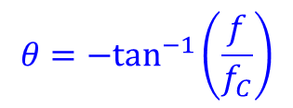
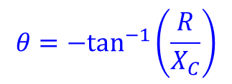
Electronic Devices
Phase Shift
An RC lag circuit such as found in an op-amp stage causes the output signal voltage to lag the input. The phase shift is caused by an equivalent RC circuit from input to output and is given by the equation:
$$θ=−\tan^{−1}\left(\frac{R}{X_{C}}\right)$$
Since R/X_{C} = f/f_{c},
$$θ=−\tan^{−1}\left(\frac{f}{f_{C}}\right)$$
Notice that as f increases, the output phase shift increases. This effect changes the feedback and under certain conditions can cause the circuit to oscillate.

Slide 27
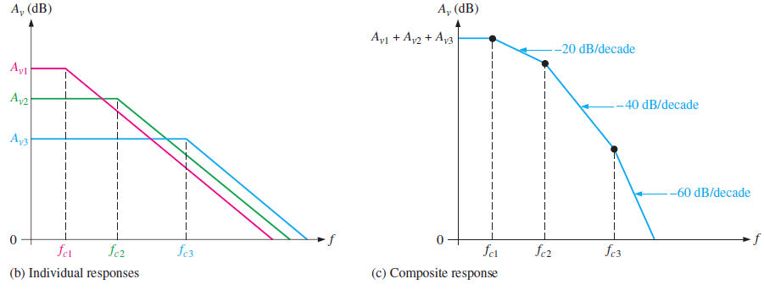
Electronic Devices
Overall Frequency Response
Some op-amps do not have a constant roll-off of −20 dB/decade in order to optimize bandwidth or slew rate. In this case, the gain-bandwidth product is not constant for all frequencies and will have more than one break frequency. In this case, care must be taken to avoid oscillations.

Slide 28
Electronic Devices
Selected Key Terms-1
Operational amplifier
Differential mode
Slew rate
A type of amplifier that has very high voltage gain, very high input impedance, very low output impedance and good rejection of common-mode signals.
A mode of op-amp operation in which two opposite-polarity signals voltages are applied to the two inputs (double-ended) or in which a signal is applied to one input and ground to the other input (single-ended).
The rate of change of the output voltage of an op-amp in response to a step input.

Slide 29
Electronic Devices
Selected Key Terms-2
Open-loop voltage gain
Negative feedback
Closed-loop voltage gain
Gain-bandwidth product
The voltage gain of an op-amp without external feedback.
The process of returning a portion of the output signal to the input of an amplifier such that it is out of phase with the input.
The voltage gain of an op-amp with external feedback.
A constant parameter which is always equal to the frequency at which the op-amp’s open-loop gain is unity (1).

Slide 30
Electronic Devices
Quiz Q1
1. The ideal op-amp has
a. zero input impedance and zero output impedance
b. zero input impedance and infinite output impedance
c. infinite input impedance and zero output impedance
d. infinite input impedance and infinite output impedance

Slide 31
Electronic Devices
Quiz Q2
2. The type of signal represented in the figure is a
a. single-ended common-mode signal
b. single-ended differential signal
c. double-ended common-mode signal
d. double-ended differential signal

Slide 32
Electronic Devices
Quiz Q3
3. CMRR can be expressed in
a. amps
b. volts
c. ohms
d. none of the above

Slide 33
Electronic Devices
Quiz Q4
4. The difference in the two dc currents required to bias the differential amplifier in an op-amp is called the
a. differential bias current
b. input offset current
c. input bias current
d. none of the above

Slide 34
Electronic Devices
Quiz Q5
5. To measure the slew rate of an op-amp, the input signal is a
a. pulse
b. triangle wave
c. sine wave
d. none of the above

Slide 35
Electronic Devices
Quiz Q6
6. The input impedance of a noninverting amplifier is
a. nearly 0 ohms
b. approximately equal to R_{i}
c. approximately equal to R_{f}
d. extremely large

Slide 36
Electronic Devices
Quiz Q7
7. The noninverting amplifier has a gain of 11. Assume that V_{in} = 1.0 V. The approximate value of V_{f} is
a. 0 V
b. 100 mV
c. 1.0 V
d. 11 V

Slide 37
Electronic Devices
Quiz Q8
8. The inverting amplifier has a gain of −10. Assume that V_{in} = 1.0 V. The approximate value of the voltage at the inverting terminal of the op-amp is
a. 0 V
b. 100 mV
c. 1.0 V
d. 10 V

Slide 38
Electronic Devices
Quiz Q9
9. To compensate for bias current, the value of R_{c} should be equal to
a. R_{i}
b. R_{f}
c. R_{i}||R_{f}
d. R_{i} + R_{f}

Slide 39
Electronic Devices
Quiz Q10
10. Given a noninverting amplifier with a gain of 10 and a gain-bandwidth product of 1.0 MHz, the expected high critical frequency is
a. 100 Hz
b. 1.0 kHz
c. 10 kHz
d. 100 kHz

Slide 40
Electronic Devices
Answers
Answers:
1. c
2. d
3. d
4. b
5. a
6. d
7. c
8. a
9. c
10. d

