Slide 1

Electronic Devices
10th ed., Global Edition
Chapter 13
Basic Op-Amp Circuits

Slide 2
Electronic Devices
10th ed.
Objectives:
◆ Describe and analyze the operation of several types of
comparator circuits
◆ Describe and analyze the operation of several types of
summing amplifiers
◆ Describe and analyze the operation of integrators and
differentiators
◆ Troubleshoot op-amp circuits

Slide 3
Electronic Devices
Comparators
A comparator is a specialized nonlinear op-amp circuit that compares two input voltages and produces an output state that indicates which one is greater. Comparators are designed to be fast and frequently have other capabilities to optimize the comparison function.
An example of a comparator application is shown. The circuit detects a power failure in order to take an action to save data. As long as the comparator senses V_{in}, the output will be a dc level.

Slide 4
Electronic Devices
Comparator with Hysteresis
Sometimes the input signal to a comparator may vary due to noise superimposed on the input. The result can be an unstable output. To avoid this, hysteresis can be used.
Hysteresis is incorporated by adding regenerative (positive) feedback, which creates two switching points: the upper trigger point (UTP) and the lower trigger point (LTP). After one trigger point is crossed, it becomes inactive and the other one becomes active.

Slide 5
Electronic Devices
Comparator with Hysteresis
A comparator with hysteresis is also called a Schmitt trigger. The trigger points are found by applying the voltage-divider rule:
and
Example:
What are the trigger points for the circuit if the maximum output is ±13 V?
Solution:
= 2.28 V
By symmetry, the lower trigger point = −2.28 V

Slide 6
Electronic Devices
Output Bounding
Some applications require a limit to the output of the comparator (such as a digital circuit). The output can be limited by using one or two zener diodes in the feedback circuit.
The circuit shown here is bounded as a positive value equal to the zener breakdown voltage.

Slide 7
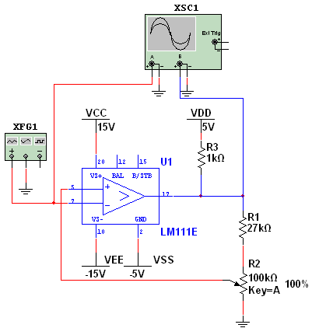
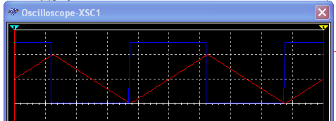
Electronic Devices
Comparator Applications
A comparator with hysteresis can produce a pulse with a variable duty cycle. For the circuit shown, V_{out(max)} ranges from 0 V to +5 V because of the GND and V_{DD} connections on the LM311.
The input is the red triangle wave (0 to 4 V). The duty cycle is varied with R₂.
With R₂ set to 100%, a 50% duty cycle is the result.

Slide 8
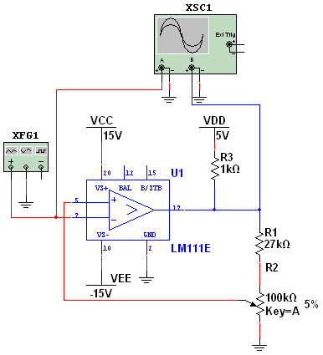
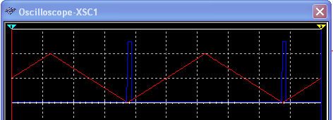
Electronic Devices
Comparator Applications
A comparator with hysteresis can produce a pulse with a variable duty cycle. For the circuit shown, V_{out(max)} ranges from 0 V to +5 V because of the GND and V_{DD} connections on the LM311.
The input is the red triangle wave (0 to 4 V). The duty cycle is varied with R₂.
With R₂ set to 5%, a short pulse is the result.

Slide 9
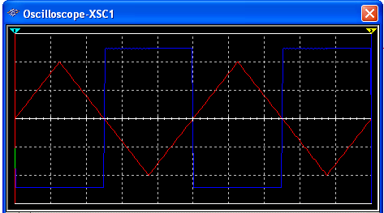
Electronic Devices
Comparator Applications
Question:
What will happen when R₂ is set to zero?
Answer:
When R₂ is set at 0%, the comparator has no hysteresis, and the output is positive when the input triangle is negative.

Slide 10
Electronic Devices
Comparator Applications
By changing the GND ref to −5 V, another useful circuit is formed. The input is a 4 V_{p} triangle wave (−4 V to +4 V). The output is a square wave that is delayed by an amount that depends on the setting of R₂.
Question:
What are the upper and lower trigger points when R₂ is set to maximum?
Answer:
= +3.94 V
By symmetry, V_{LTP} = −3.94 V

Slide 11
Electronic Devices
Comparator Applications
Simultaneous or flash analog-to-digital converters use 2^{n}-1 comparators to convert an analog input to a digital value for processing. Flash ADCs are a series of comparators, each with a slightly different reference voltage. The priority encoder produces an output equal to the highest value input.
In IC flash converters, the priority encoder usually includes a latch that holds the converter data constant for a period of time after the conversion.

Slide 12
Electronic Devices
Summing Amplifier
A summing amplifier has two or more inputs; normally all inputs have unity gain. The output is proportional to the negative of the algebraic sum of the inputs.
Example:
What is V_{OUT} if the input voltages are +5.0 V, −3.5 V and +4.2 V and all resistors = 10 kΩ?
Solution:
10 kΩ
V_{OUT} = −(V_{IN1} + V_{IN2} + V_{IN3})
= −(+5.0 V − 3.5 V + 4.2 V)
= −5.7 V

Slide 13
Electronic Devices
Averaging Amplifier
An averaging amplifier is basically a summing amplifier with the gain set to R_{f} /R = 1/n (n is the number of inputs). The output is the negative average of the inputs.
Example:
What is V_{OUT} if the input voltages are +5.0 V, −3.5 V and +4.2 V? Assume R₁ = R₂ = R₃ = 10 kΩ and R_{f} = 3.3 kΩ?
Solution:
3.3 kΩ
V_{OUT} = −⅓(V_{IN1} + V_{IN2} + V_{IN3})
= −⅓(+5.0 V − 3.5 V + 4.2 V)
= −1.9 V

Slide 14
Electronic Devices
Scaling Amplifier
A scaling adder has two or more inputs with each input having a different gain. The output represents the negative scaled sum of the inputs.
Example:
Assume you need to sum the inputs from three microphones. The first two microphones require a gain of −2, but the third microphone requires a gain
of −3. What are the values of the
input R’s if R_{f} = 10 kΩ?
Solution:
10 kΩ
5.0 kΩ
3.3 kΩ

Slide 15
Electronic Devices
Scaling Amplifier DAC
An application of a scaling adder is the D/A converter circuit shown here. The resistors are inversely proportional to the binary column weights. Because of the precision required of resistors, the method is useful only for small DACs.

Slide 16
Electronic Devices
R/2R Ladder DAC
A more widely used method for D/A conversion is the R/2R ladder. The gain for D₃ is −1. Each successive input has a gain that is half of previous one. The output represents a weighted sum of all of the inputs (similar to the scaling adder).
An advantage of the R/2R ladder is that only two values of resistors are required to implement the circuit.

Slide 17
Electronic Devices
The Integrator
The ideal integrator is an inverting amplifier that has a capacitor in the feedback path. The output voltage is proportional to the negative integral (running sum) of the input voltage.
Ideal
Integrator
Op-amp integrating circuits must have extremely low dc offset and bias currents, because small errors are equivalent to a dc input. The ideal integrator tends to accumulate these errors, which moves the output toward saturation. The practical integrator overcomes these errors– the simplest method is to add a relatively large feedback resistor.
Practical
Integrator

Slide 18

Electronic Devices
The Integrator
If a constant level is the input, the current is constant. The capacitor charges from a constant current and produces a ramp. The slope of the output is given by the equation:
Example:
Sketch the output wave:
V_{in}
220 kΩ
Solution:
0.1μF
$$\text{2 }\text{V}\text{/}\text{ms}$$
10 kΩ
V_{out}

Slide 19
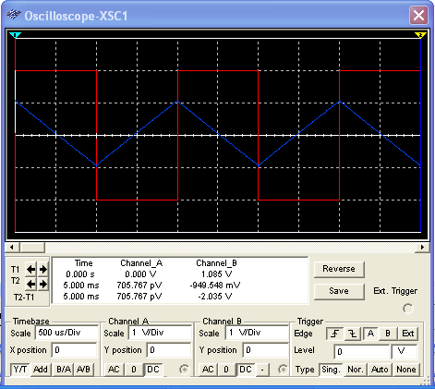
Electronic Devices
The Integrator
The result from the previous example can be confirmed with Multisim.
This is the portion shown on the previous slide.
220 kΩ
0.1μF
10 kΩ

Slide 20
Electronic Devices
The Differentiator
The ideal differentiator is an inverting amplifier that has a capacitor in the input path. The output voltage is proportional to the negative rate of change of the input voltage.
Ideal
Differentiator
The small reactance of C at high frequencies means an ideal differentiator circuit has very high gain for high-frequency noise. To compensate for this, a small series resistor is often added to the input. This practical differentiator has reduced high frequency gain and is less prone to noise.
Practical
Differentiator

Slide 21
Electronic Devices
The Differentiator
The output voltage of a differentiator is given by
Example:
Given the input below, sketch the output wave for the differentiator.
V_{in}
Solution:
10 kΩ
220 Ω
0.1μF
2 V
10 kΩ
V_{out}

Slide 22
Electronic Devices
Selected Key Terms
Hysteresis
Schmitt trigger
Bounding
Integrator
Differentiator
Characteristics of a circuit in which two different trigger levels produce an offset or lag in the switching action.
A comparator with built-in hysteresis.
The process of limiting the output range of an amplifier or other circuit.
A circuit that produces an output that approximates the area under the curve of the input function.
A circuit that produces an output that approximates the instantaneous rate of change of the input function.

Slide 23
Electronic Devices
Quiz Q1
1. The signal that you would expect at the output of the comparator (arrow) is a
a. series of alternating positive and negative triggers
b. sine wave
c. square wave
d. dc level

Slide 24
Electronic Devices
Quiz Q2
2. Hysteresis is incorporated in a comparator by adding
a. a capacitor in series with the input
b. capacitors from the power supply to ground
c. a small resistor in series with the input
d. positive feedback

Slide 25
Electronic Devices
Quiz Q3
3. To find the trigger points for a Schmitt trigger, you can
a. divide the saturation voltage by two
b. apply Kirchhoff’s Voltage Law
c. apply the voltage-divider rule
d. calculate the rate of change of the input

Slide 26
Electronic Devices
Quiz Q4
4. A comparator output can be limited (bounded) by
a. reversing the power supply voltages
b. putting a zener diode in a feedback path
c. decreasing the input resistance
d. connecting the inverting input to ground

Slide 27
Electronic Devices
Quiz Q5
5. Assume all resistors in the circuit shown here have the same value. The circuit is a
a. summing amplifier
b. averaging amplifier
c. scaling adder
d. none of the above

Slide 28
Electronic Devices
Quiz Q6
6. Assume all resistors in the circuit shown here have different values. The circuit is a
a. summing amplifier
b. averaging amplifier
c. scaling adder
d. none of the above

Slide 29
Electronic Devices
Quiz Q7
7. The circuit shown is an
a. A/D converter
b. R/2R ladder
c. both of the above
d. none of the above

Slide 30
Electronic Devices
Quiz Q8
8. A practical integrator has a feedback resistor in parallel with C. The purpose of this resistor is to
a. avoid noise
b. increase the gain
c. both of the above
d. none of the above
Practical
Integrator

Slide 31
Electronic Devices
Quiz Q9
9. A certain circuit has the input and output signals shown. The circuit is
a. a differentiator
b. an integrator
c. a scaling amplifier
d. none of the above
V_{in}
V_{out}

Slide 32
Electronic Devices
Quiz Q10
10. A differentiator circuit produces an output that is proportional to the negative of the
a. sum of the inputs
b. rate of change of the input
c. area under the curve of the input
d. none of the above

Slide 33
Electronic Devices
Answers
Answers:
1. c
2. d
3. c
4. b
5. a
6. c
7. b
8. d
9. a
10. b

