Slide 1
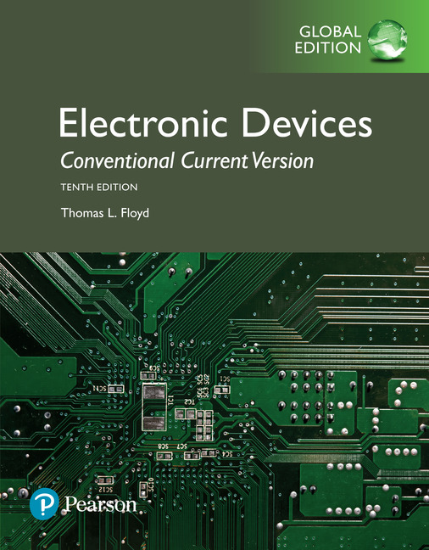
Electronic Devices
10th ed., Global Edition
Chapter 14
Special-Purpose
Integrated Circuits

Slide 2
Electronic Devices
10th ed.
Objectives:
◆ Explain and analyze the operation of an instrumentation
amplifier
◆ Explain and analyze the operation of an isolation
amplifier
◆ Explain and analyze the operation of an operation
transconductance amplifier (OTA)
◆ Explain and analyze the operation of log and antilog
amplifiers
◆ Explain and analyze other types of integrated circuits

Slide 3
Electronic Devices
Instrumentation Amplifiers
An instrumentation amplifier (IA) amplifies the voltage difference between its terminals. It is optimized for small differential signals that may be riding on a large common mode voltages.

Slide 4
Electronic Devices
Instrumentation Amplifiers
An instrumentation amplifier (IA) amplifies the voltage difference between its terminals. It is optimized for small differential signals that may be riding on a large common mode voltages.
The gain is set by a single resistor that is supplied by the user.
The output voltage is the closed loop gain set by R_{G} multiplied by the voltage difference in the inputs.

Slide 5
Electronic Devices
Instrumentation Amplifiers
An IA that is based on the three op-amp design is the AD622. The formula for choosing R_{G} is:
Example:
What value of R_{G} will set the gain to 35?
Solution:
= 1.5 kΩ

Slide 6
Electronic Devices
Instrumentation Amplifiers
The bandwidth of any IA (or op-amp for that matter) is lower for higher gain. The graph shows the BW for various gains for the AD622.
Question:
What is the BW for a gain of 35?
Answer:
Reading the graph, the BW is approximately 200 kHz.

Slide 7
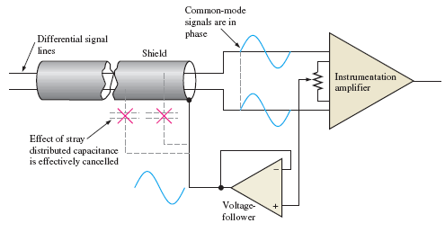
Electronic Devices
Instrumentation Amplifiers
Guarding is available in some IAs to reduce noise effects. By driving the shield with the common-mode signal, effects of stray capacitance are effectively cancelled.
Guarding is useful in applications such as transducer interfacing, and microphone preamps where very small signals need to be transmitted.

Slide 8
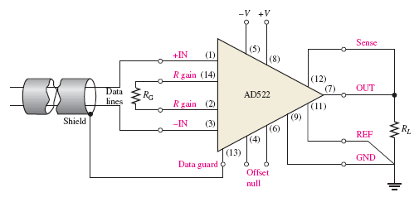
Electronic Devices
Instrumentation Amplifiers
The AD522 is a low-noise IA that has a Data guard output, which is connected to the shield as shown. The AD522 has a programmed gain from 1 to 1000 depending on R_{G}. The frequency response rolls off at −20 dB/decade.
Frequency response of AD522

Slide 9
Electronic Devices
Isolation Amplifiers
An isolation amplifier is designed to provide an electrical barrier between the input and output in order to provide protection in applications where hazardous conditions exist.
A typical isolation amplifier uses a high frequency modulated carrier frequency to pass a lower frequency signal through the barrier.

Slide 10
Electronic Devices
Isolation Amplifiers
The ISO124 is a capacitively-coupled isolation amplifier that uses pulse width modulation to transmit data across the barrier.
The ISO124 has fixed unity gain and is rated to 1500 V_{rms} of isolation. The frequency response is specified to 50 kHz, but high-frequency ripple due to the PW modulation may be observed on the output at higher frequencies.
For example, the output may show ripple with a high frequency sine wave input.

Slide 11
Electronic Devices
Isolation Amplifiers
The 3656KG is a transformer coupled isolation amplifier that uses pulse width modulation to transmit data across the barrier.
The 3656KG can have gain for both the input and output stages. The 3656KG is suited for patient monitoring applications, such as an ECG amplifier. The manufacture’s data sheet shows detailed connection diagrams for various applications¹.
¹see : http://focus.ti.com/lit/ds/symlink/3656.pdf

Slide 12
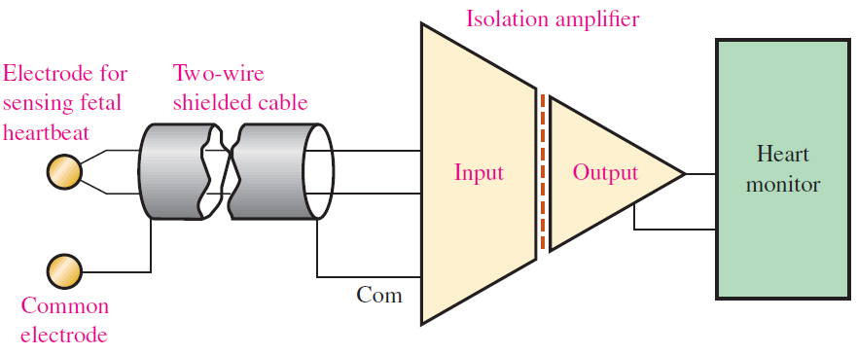
Electronic Devices
Isolation Amplifiers
Isolation amplifiers are common in patient monitoring applications to avoid potential shock from the monitoring equipment. Here is an isolation amplifier used to isolate the electrodes placed in the mother from the monitor.

Slide 13
Electronic Devices
The Operational Transconductance Amplifier
The operational transconductance amplifier (OTA) is a voltage-to-current amplifier. As in the case of FETs, the conductance is output current divided by input voltage. Thus,
Like FETs, the gain of an amplifier is written in terms of g_{m}:
Unlike FETs, the OTA has a g_{m} that can be “programmed” by the amount of bias current. Thus gain can be changed electronically by varying a dc voltage.

Slide 14
Electronic Devices
The Operational Transconductance Amplifier
The OTA adds a measure of control to circuits commonly implemented with conventional op-amps. Applications for OTAs include voltage controlled low-pass or high-pass filters, voltage controlled waveform generators and amplifiers, modulators, comparators, and Schmitt triggers.
In this example from the text, an amplitude modulator is shown.
V_{out}

Slide 15
Electronic Devices
The Logarithmic Amplifier
A diode has the characteristic in which voltage across the diode is proportional to the log of the current in the diode. Compare data for an actual diode on linear and logarithmic plots:

Slide 16
Electronic Devices
The Logarithmic Amplifier
When a diode is placed in the feedback path of an inverting op-amp, the output voltage is proportional to the log of the input voltage. The gain decreases with increasing input voltage; therefore the amplifier is said to compress signals.
Many sensors, particularly photo-sensors, have a very large dynamic range outputs. Current from photodiodes can range over 5 decades. A log amp will amplify the small current more than the larger current to effectively compress the data for further processing.

Slide 17
Electronic Devices
The Logarithmic Amplifier
For the circuit shown, the equation for V_{out} is
(I_{R} is a constant for a given diode.)
Example:
What is V_{out}? (Assume I_{R} = 50 nA.)
Solution:
= −307 mV

Slide 18
Electronic Devices
The Logarithmic Amplifier
When a BJT is used in the feedback path, the output is referred to the ground of the base connection rather than the virtual ground. This eliminates offset and bias current errors. For the BJT, I_{EBO} replaces I_{R} in the equation for V_{out}:
Log amplifiers are available in IC form with much better performance than the basic log amp shown here. For example, the TI LOG114 can operate over 8 decades from 100 pA to 10 mA and avoids temperature issues has improved bandwidth.

Slide 19
Electronic Devices
The Antilog Amplifier
An antilog amplifier produces an output proportional to the input raised to a power. In effect, it is the reverse of the log amp. The equation for V_{out} for the basic BJT antilog amp is:
Integrated circuits are available that can do both the log and antilog functions on the same IC. The AD538 is an example; it can do a variety of computations including log, log ratios, squaring, square roots, trig functions, and more.

Slide 20
Electronic Devices
Converters and Other Integrated Circuits
Constant-current source
Current-to-voltage converter
Voltage-to-current converter
Peak detector

Slide 21
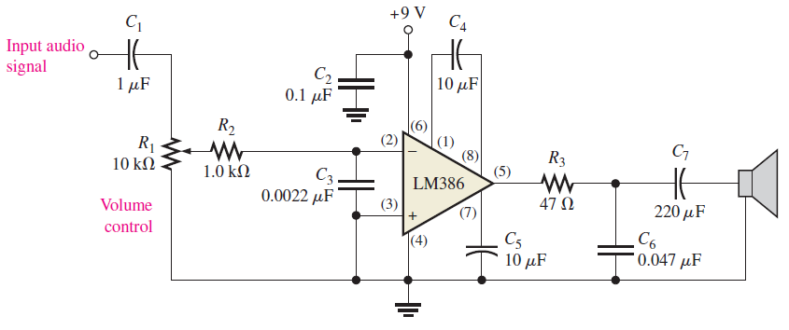
Electronic Devices
Audio Amplifiers
Audio amplifiers are available as a complete system in integrated circuits. One such device is the LM386 that can have a voltage gain from 20 to 200 set by external components. An example of an LM386 used as an audio amplifier in the last stage of a radio receiver is shown here.

Slide 22
Electronic Devices
Selected Key Terms
Instrumentation amplifier
Isolation amplifier
Operational transconductance
amplifier
Transconductance
An amplifier used for amplifying small signals riding on large common-mode voltages.
An amplifier with electrically isolated internal stages.
A voltage-to-current amplifier.
In an electronic device, the ratio of the output current to the input voltage.

Slide 23
Electronic Devices
Quiz Q1
1. A typical instrumentation amplifier has
a. high CMRR
b. unity gain
c. low input impedance
d. all of the above

Slide 24
Electronic Devices
Quiz Q2
2. When an instrumentation amplifier uses guarding, the shield is driven by a
a. low-impedance differential source
b. low-impedance common-mode source
c. high-impedance differential source
d. high-impedance common-mode source

Slide 25
Electronic Devices
Quiz Q3
3. You can achieve a higher bandwidth for an instrumentation amplifier if you
a. use guarding
b. use a larger gain setting resistor
c. capacitively couple the input signal
d. none of the above

Slide 26
Electronic Devices
Quiz Q4
4. An application where an isolation amplifier is particularly useful is when
a. the input signal has very large dynamic range
b. control of the frequency response is necessary
c. voltages could present a hazard
d. all of the above

Slide 27
Electronic Devices
Quiz Q5
5. For an OTA, the gain is determined by
a. a ratio of two resistors
b. bias current
c. a single gain setting resistor
d. the amplitude of the input signal

Slide 28
Electronic Devices
Quiz Q6
6. Transconductance is the ratio of
a. output current to input voltage
b. input current to output voltage
c. output resistance to input resistance
d. output voltage to input current

Slide 29
Electronic Devices
Quiz Q7
7. A circuit that is useful for signal compression is a
a. instrumentation amplifier
b. OTA
c. logarithmic amplifier
d. antilog amplifier

Slide 30
Electronic Devices
Quiz Q8
8. The circuit shown here is a
a. peak detector
b. current-to-voltage converter
c. voltage-to-current converter
d. isolation amplifier

Slide 31
Electronic Devices
Quiz Q9
9. The circuit shown here is a
a. current-to-voltage converter
b. constant current source
c. logarithmic amplifier
d. antilog amp

Slide 32
Electronic Devices
Quiz Q10
10. The circuit shown here is a
a. current-to-voltage converter
b. voltage-to-current converter
c. constant current source
d. peak detector

Slide 33
Electronic Devices
Answers
Answers:
1. a
2. b
3. d
4. c
5. b
6. a
7. c
8. c
9. d
10. d

