Slide 1
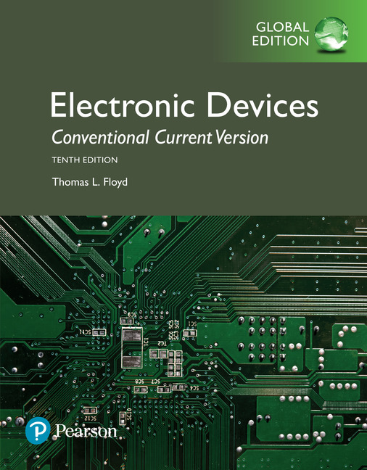
Electronic Devices
10th ed., Global Edition
Chapter 15
Active Filters

Slide 2
Electronic Devices
10th ed.
Objectives:
◆ Describe and analyze the gain-versus-frequency responses of basic types of filters
◆ Describe three types of filter response characteristics and other parameters
◆ Identify and analyze active low-pass filters
◆ Identify and analyze active high-pass filters
◆ Analyze basic types of active band-pass filters
◆ Describe basic types of active band-stop filters
◆ Discuss two methods for measuring frequency response

Slide 3
Electronic Devices
Basic Filter Responses
A filter is a circuit that passes certain frequencies and rejects all others. The passband is the range of frequencies allowed through the filter. The critical frequency defines the end (or ends) of the passband.
Basic filter responses are:
Low-pass High-pass Band-pass Band-stop

Slide 4
Electronic Devices
Basic Low-Pass Filter
The low-pass filter allows frequencies below the critical frequency to pass and rejects other. The simplest low-pass filter is a passive RC circuit with the output taken across C.

Slide 5
Electronic Devices
Basic High-Pass Filter
The high-pass filter passes all frequencies above a critical frequency and rejects all others. The simplest high-pass filter is a passive RC circuit with the output taken across R.

Slide 6
Electronic Devices
Basic Band-Pass Filter
A band-pass filter passes all frequencies between two critical frequencies. The bandwidth is defined as the difference between the two critical frequencies. The simplest band-pass filter is an RLC circuit.

Slide 7
Electronic Devices
Band-Stop Filter
A band-stop filter rejects frequencies between two critical frequencies; the bandwidth is measured between the critical frequencies. The simplest band-stop filter is an RLC circuit.

Slide 8
Electronic Devices
Filter Response Characteristics
Active filters include one or more op-amps in the design. These filters can provide much better responses than the passive filters illustrated. Active filter designs optimize various parameters such
as amplitude response,
roll-off rate, or phase
response.
Butterworth: flat amplitude response

Slide 9
Electronic Devices
Filter Response Characteristics
Active filters include one or more op-amps in the design. These filters can provide much better responses than the passive filters illustrated. Active filter designs optimize various parameters such
as amplitude response,
roll-off rate, or phase
response.
Bessel: linear phase response

Slide 10
Electronic Devices
Filter Response Characteristics
Active filters include one or more op-amps in the design. These filters can provide much better responses than the passive filters illustrated. Active filter designs optimize various parameters such
as amplitude response,
roll-off rate, or phase
response.
Chebyshev: rapid roll-off characteristic

Slide 11
Electronic Devices
The Damping Factor
The damping factor primarily determines if the filter will have a Butterworth, Chebyshev, or Bessel response.
The term pole has mathematical significance with the higher level math used to develop the DF values. For our purposes, a pole is the number of non-redundant reactive elements in a filter. For example, a one-pole filter has one resistor and one capacitor.

Slide 12
Electronic Devices
The Damping Factor
Parameters for Butterworth filters up to four poles are given in the following table. (See text for larger order filters).
Butterworth filter values
Order | Roll-off dB/decade | 1st stage |  |  | 2nd stage
 |  | Poles | DF | R₁ /R₂ | Poles | DF | R₁ /R₂
1 | −20 | 1 | Optional
2 | −40 | 2 | 1.414 | 0.586
3 | −60 | 2 | 1.00 | 1.00 | 1 | 1.00 | 1.00
4 | −80 | 2 | 1.848 | 0.152 | 2 | 0.765 | 1.235
Notice that the gain is 1 more than this resistor ratio. For example, the gain implied by this ratio is 1.586 (4.0 dB).

Slide 13
Electronic Devices
Two-Pole Low-Pass Butterworth Design
As an example, a two-pole VCVS Butterworth filter is designed in this and the following slides. Assume the f_{c} desired is 1.5 kHz. A basic two-pole low-pass filter is shown.
Step 1: Choose R and C for the desired cutoff frequency based on the equation
By choosing R = 22 kΩ, then C = 4.8 nF, which is close to a standard value of 4.7 nF.
4.7 nF
22 kΩ
22 kΩ
4.7 nF

Slide 14
Electronic Devices
Two-Pole Low-Pass Butterworth Design
Step 2: Using the table for the Butterworth filter, note the resistor ratios required.
Butterworth filter values
Order | Roll-off dB/decade | 1st stage |  |  | 2nd stage
 |  | Poles | DF | R₁ /R₂ | Poles | DF | R₁ /R₂
1 | −20 | 1 | Optional
2 | −40 | 2 | 1.414 | 0.586
3 | −60 | 2 | 1.00 | 1.00 | 1 | 1.00 | 1.00
4 | −80 | 2 | 1.848 | 0.152 | 2 | 0.765 | 1.235

Slide 15
Electronic Devices
Two-Pole Low-Pass Butterworth Design
Butterworth filter values
Order | Roll-off dB/decade | 1st stage |  |  | 2nd stage
 |  | Poles | DF | R₁ /R₂ | Poles | DF | R₁ /R₂
1 | −20 | 1 | Optional
2 | −40 | 2 | 1.414 | 0.586
3 | −60 | 2 | 1.00 | 1.00 | 1 | 1.00 | 1.00
4 | −80 | 2 | 1.848 | 0.152 | 2 | 0.765 | 1.235
Step 3: Choose resistors that are as close as practical to the desired ratio. Through trial and error, if R₁ = 33 kΩ, then R₂ = 56 kΩ.

Slide 16
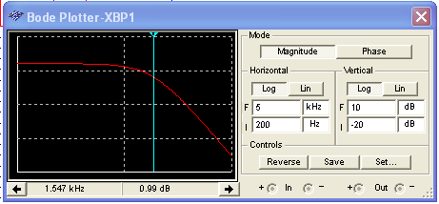
Electronic Devices
Two-Pole Low-Pass Butterworth Design
The design is complete and the filter can now be tested.
4.7 nF
You can check the design using Multisim. The Multisim Bode plotter is shown with the simulated response from Multisim.
22 kΩ
22 kΩ
4.7 nF
33 kΩ
56 kΩ
To read the critical frequency, set the cursor for a gain of 1 dB, which is −3 dB from the midband gain of 4.0 dB. The critical frequency is found by Multisim to be 1.547 kHz.

Slide 17
Electronic Devices
Four-pole Low-Pass Butterworth Design
Question:
What changes need to be made to change the two-pole low-pass design to a four-pole design?
Answer:
Add an identical section except for the gain setting resistors. Choose R₁-R₄ based on the table for a 4-pole design.
Butterworth filter values
Order | Roll-off dB/decade | 1st stage |  |  | 2nd stage
 |  | Poles | DF | R₁ /R₂ | Poles | DF | R₁ /R₂
1 | −20 | 1 | Optional
2 | −40 | 2 | 1.414 | 0.586
3 | −60 | 2 | 1.00 | 1.00 | 1 | 1.00 | 1.00
4 | −80 | 2 | 1.848 | 0.152 | 2 | 0.765 | 1.235

Slide 18
Electronic Devices
Four-pole Low-Pass Butterworth Design
Question:
What changes need to be made to change the two-pole low-pass design to a four-pole design?
Answer:
Add an identical section except for the gain setting resistors. Choose R₁-R₄ based on the table for a 4-pole design.
The resistor ratio for the 1st section needs to be 0.152 (gain = 1.152); the 2nd section needs to be 1.235 (gain = 2.235). Use standard values if possible.
3.3 kΩ
15 kΩ
22 kΩ
12 kΩ

Slide 19
Electronic Devices
Four-pole High-Pass Butterworth Design
The low-pass filter can be changed to a high-pass filter by simply reversing the R’s and C’s in the frequency-selective circuit. For the four-pole design, the gain setting resistors are unchanged.
3.3 kΩ
15 kΩ
Low-pass
22 kΩ
12 kΩ

Slide 20
Electronic Devices
Four-pole High-Pass Butterworth Design
The low-pass filter can be changed to a high-pass filter by simply reversing the R’s and C’s in the frequency-selective circuit. For the four-pole design, the gain setting resistors are unchanged.
3.3 kΩ
15 kΩ
High-pass
22 kΩ
12 kΩ

Slide 21
Electronic Devices
Bessel Filter Design
Butterworth VCVS filters are the simplest to implement. Chebychev and Bessel filters require an additional correction factor to the frequency to obtain the correct f_{c}. Bessel filter parameters are shown here. The frequency determining R’s are divided by the correction factors shown with the gains set to new values. The following slide illustrates a design.
Bessel filters
Order | Roll-off dB/decade | 1st stage |  |  | 2nd stage
 |  | Correction | DF | R₁ /R₂ | Correction | DF | R₁ /R₂
2 | −40 | 1.272 | 1.732 | 0.268
4 | −80 | 1.432 | 1.916 | 0.084 | 1.606 | 1.241 | 0.759

Slide 22
Electronic Devices
Bessel Filter Design
Example:
Modify the 4-pole low-pass Butterworth design for a Bessel response.
Solution:
Divide the R’s by the correction factors on the Bessel table and change the gain setting resistors to the ratios on the table.
Bessel filters
Order | Roll-off dB/decade | 1st stage |  |  | 2nd stage
 |  | Correction | DF | R₁ /R₂ | Correction | DF | R₁ /R₂
2 | −40 | 1.272 | 1.732 | 0.268
4 | −80 | 1.432 | 1.916 | 0.084 | 1.606 | 1.241 | 0.759

Slide 23
Electronic Devices
Bessel Filter Design
Example:
Modify the 4-pole low-pass Butterworth design for a Bessel response.
Solution:
Divide the R’s by the correction factors on the Bessel table and change the gain setting resistors to the ratios on the table.
3.3 kΩ
15 kΩ
Bessel Low-pass
Butterworth Low-pass
22 kΩ
12 kΩ

Slide 24

Electronic Devices
Bessel Filter Design
You can test the design with Multisim. Although the roll-off is not as steep as other designs, the Bessel filter is superior for its pulse response. The Bode plotter illustrates the response.
3.3 kΩ
15 kΩ
Bessel Low-pass
Butterworth Low-pass
22 kΩ
12 kΩ

Slide 25
Electronic Devices
Active Band-Pass Filters
One implementation of a band-pass filter is to cascade high-pass and low-pass filters with overlapping responses. These filters are simple to design, but are not good for high Q designs.

Slide 26
Electronic Devices
Active Band-Pass Filters
The multiple-feedback band-pass filter is also more suited to low-Q designs (<10) because the gain is a function of Q² and may overload the op-amp if Q is too high.
Resistors R₁ and R₃ form an input attenuator network that affect Q and are an integral part of the design.
Key equations are:

Slide 27
Electronic Devices
Active Band-Pass Filters
The state-variable filter is suited to high Q band-pass designs. It is normally optimized for band-pass applications but also has low-pass and high-pass outputs available.
The Q is given by

Slide 28
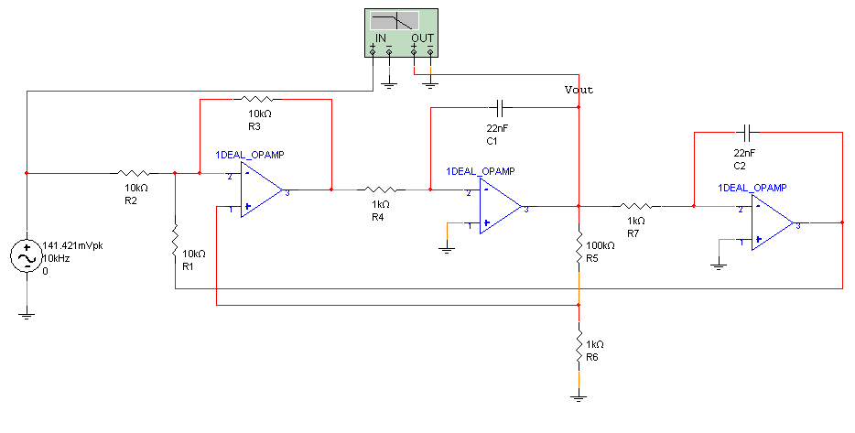
Electronic Devices
Active Band-Pass Filters
This is a Multisim run for the circuit from the text Example 15-7. The Bode plotter indicates the frequency response.
Note the high-Q response on the next slide...

Slide 29
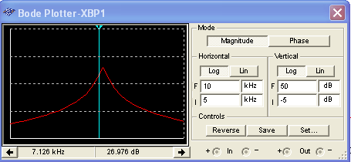
Electronic Devices
Active Band-Pass Filters
This is a Multisim run for the circuit from the text Example 15-7. The Bode plotter indicates the frequency response.
The cursor is set very close to the lower cutoff frequency.

Slide 30
Electronic Devices
Active Band-Stop Filters
A band-stop (notch) filter can be made from a multiple feedback circuit or a state-variable circuit. By summing the LP and HP outputs from a state-variable filter, a band-stop filter is formed.

Slide 31
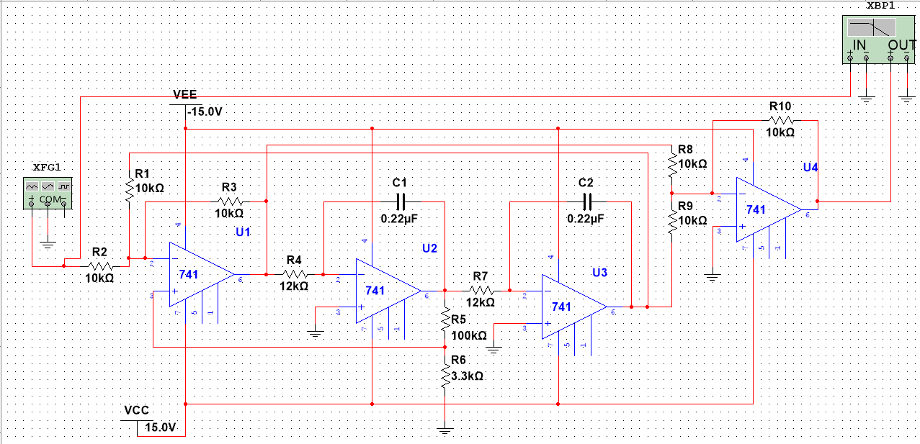
Electronic Devices
Active Band-Stop Filters
This circuit is the 60 Hz band-stop (notch) filter. From Example 15-8. The response using the Bode plotter is shown on the next slide.

Slide 32
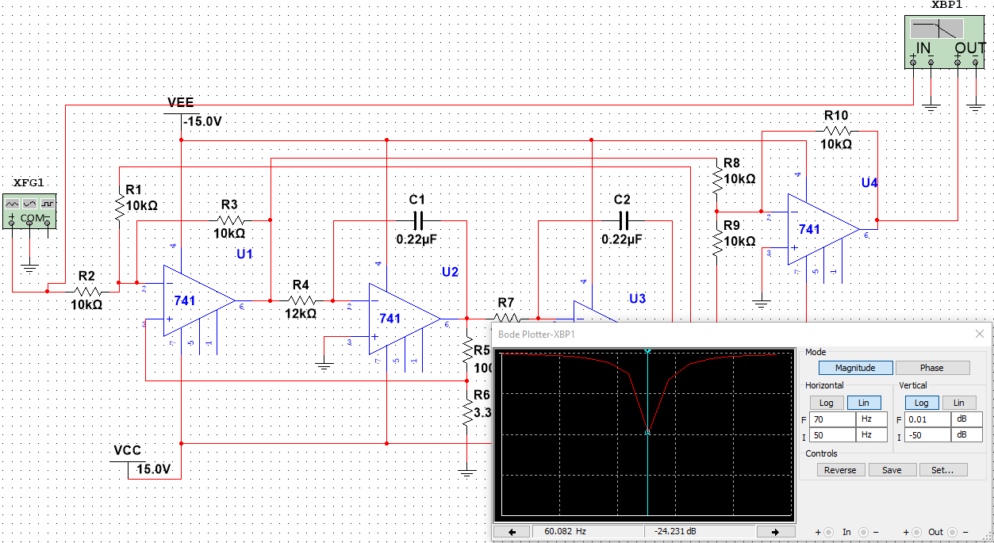
Electronic Devices
Active Band-Stop Filters
Multisim result showing Bode Plotter for Example 15-8:
The cursor is shown on the center frequency of the response (60.08 Hz).

Slide 33
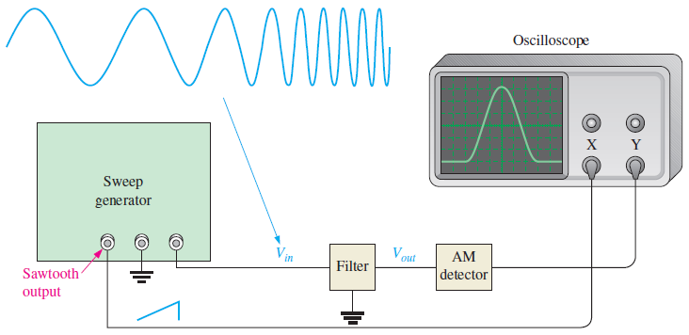
Electronic Devices
Filter Responses
In actual circuits, a filter response can be observed with a swept frequency measurement using a sweep generator and an oscilloscope. The test setup is shown here.
The sawtooth output synchronizes the oscilloscope with the sweep generator’s frequency.

Slide 34
Electronic Devices
Selected Key Terms
Pole
Roll-off
Damping factor
A circuit containing one resistor and one capacitor that contributes −20 dB/decade to a filter’s roll-off.
The rate of decrease in gain below or above the critical frequencies of a filter.
A filter characteristic that determines the type of response.

Slide 35
Electronic Devices
Quiz Q1
1. The green line represents the response for a
a. Butterworth filter
b. Chebychev filter
c. Bessel filter

Slide 36
Electronic Devices
Quiz Q2
2. The blue line represents the response for a
a. Butterworth filter
b. Chebychev filter
c. Bessel filter

Slide 37
Electronic Devices
Quiz Q3
3. The filter that is superior for its pulse response is the
a. Butterworth filter
b. Chebychev filter
c. Bessel filter

Slide 38
Electronic Devices
Quiz Q4
4. From the table for a 4-pole Butterworth filter, the gain required for the second stage is
a. 0.765 b. 1.235
c. 1.765 d. 2.235
Butterworth filter values
Order | Roll-off dB/decade | 1st stage |  |  | 2nd stage
 |  | Poles | DF | R₁ /R₂ | Poles | DF | R₁ /R₂
1 | −20 | 1 | Optional
2 | −40 | 2 | 1.414 | 0.586
3 | −60 | 2 | 1.00 | 1.00 | 1 | 1.00 | 1.00
4 | −80 | 2 | 1.848 | 0.152 | 2 | 0.765 | 1.235

Slide 39
Electronic Devices
Quiz Q5
5. For a 2-pole Butterworth filter, assume that R₁ = 39 kΩ. From the choices given, the best value for R₂ is
a. 22 kΩ b. 27 kΩ
c. 56 kΩ d. 68 kΩ
Butterworth filter values
Order | Roll-off dB/decade | 1st stage |  |  | 2nd stage
 |  | Poles | DF | R₁ /R₂ | Poles | DF | R₁ /R₂
1 | −20 | 1 | Optional
2 | −40 | 2 | 1.414 | 0.586
3 | −60 | 2 | 1.00 | 1.00 | 1 | 1.00 | 1.00
4 | −80 | 2 | 1.848 | 0.152 | 2 | 0.765 | 1.235

Slide 40
Electronic Devices
Quiz Q6
6. The type of active filter shown is a
a. two-pole, low-pass
b. two-pole, high-pass
c. four-pole, low-pass
d. four-pole, high-pass

Slide 41
Electronic Devices
Quiz Q7
7. The approximately roll-off for the filter shown is
a. −20 dB/decade b. −40 dB/decade
c. −60 dB/decade d. −80 dB/decade
3.3 kΩ
15 kΩ
22 kΩ
12 kΩ

Slide 42
Electronic Devices
Quiz Q8
8. A good choice for a high-Q active band-pass filter is
a. cascaded high-pass and low-pass filters
b. a multiple-feedback band-pass filter
c. a state-variable band-pass filter
d. an inverting amplifier with a resonant filter

Slide 43
Electronic Devices
Quiz Q9
9. The filter shown forms a
a. band-stop filter
b. band-pass filter
c. low-pass filter
d. high-pass filter

Slide 44
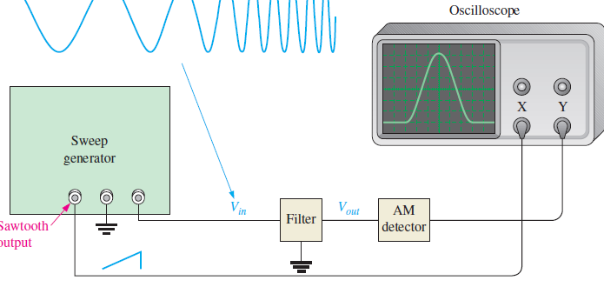
Electronic Devices
Quiz Q10
10. For the swept-frequency measurement, the signal on the X-channel of the oscilloscope is a
a. sine wave that changes frequency
b. sawtooth wave
c. square wave
d. dc level

Slide 45
Electronic Devices
Answers
Answers:
1. b
2. c
3. c
4. d
5. d
6. a
7. d
8. c
9. a
10. b

