Slide 1
Informal to Formal Text Conversion(Telugu)
By Mentored By
Mancha Vinay(17046/244) Dr.Sanjay Chatterji
Chintam Ravi Chandra(17029/227)
Khasha Pavan Kalyan Raju(17043/241) Project Code-(CS-614)

Slide 2
Aim
In Social Media, Many people use code mixed sentences. Consequently, there is a growing need for translating code-mixed hybrid language into standard languages. However, due to the lack of good parallel data, existing machine translation systems fail to properly translate code-mixed text. In an effort to initiate the task of machine translation of code-mixed content, we present a newly created parallel corpus of codemixed English-Telugu and Telugu. With the help of the created parallel corpus, we analyzed the structure of English-Telugu codemixed data and present a technique seq2seq encoder decoder model with attention for machine translation (MT) approaches that can help achieve superior translations of code mixed hybrid language into standard language.

Slide 3
Intro
What Is Code-Mixing ?
Code mixed sentences are sentences which contain two or more languages or even scripts within them, these kind of sentences are mostly used in the current social media.
In the social media, people use english script to simulate their own language along with some native english words which may be also accompained by words written in their own script.

Slide 4
What is Telugu ?
Telugu is a language which is mostly used by the people of Andhra Pradesh and Telangana,it is derived from sanskrit the same as hindi and many other languages.
It is the 4th Most spoken language in India and around 69.7 million speakers around the world, because of its prominence and usage we are taking this as a base language for our project.

Slide 5
Procedure

Slide 6
Data Collection
We prepared a dataset of chat messages which are exported from WhatsApp.
It contains around 30k sentences extracted from 7 individual chats.
These sentences are of Code Mixed words which are mixed words of English, Telugu in English and Telugu in UTF format.
We removed the special characters embedded within.

Slide 7
Data Preparation
The English words are identified by using a bag of words (around 57000 English words) and are translated to their respective Telugu UTF format using Google translation..
The words which are not in English are identified as Telugu words and are transliterated to their respective Telugu UTF format using Google transliterate api.
We removed the NULL, empty sentences, Media omitted tags etc., from the resulted data.
The Data Obtained is further cleaned manually which resulted in size of 31966.

Slide 8
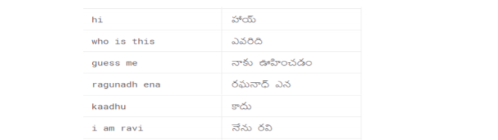
Data
https://www.kaggle.com/dataset/dfcc693efdfa57062c373565adfd9174551befeb3102711b710d5ec2cd7fbaf2
Sample

Slide 9
Data Pre-Processing
We add the SOS and EOS tokens to each sentence as follows:
sentence = "[SOS] " +sentence +" [EOS]"
We generated two tokenizers, one for Input language (Code-Mixed Sentences) and one for target language (Converted Telugu sentences).
We tokenized the input sentences and target sentences.
We further padded the sentences such that their length is the same.
This Data is then split into Train Data and Validation Data with 15% of Validation data.

Slide 10
Model Architecture
We have used an Encoder-Decoder model with attention to train our Data.
The encoder-decoder architecture for recurrent neural networks is proving to be powerful on a host of sequenceto-sequence prediction problems in the field of natural language processing such as machine translation.
In this model we have initialized the encoder with GRU(Gated Recurrent Unit) layer of 1024 units with batch size of 64.
We have initialized the decoder with GRU(Gated Recurrent Unit) layer of 1024 units with batch size of 64 followed by a dense layer and Bahdanau Attention

Slide 11
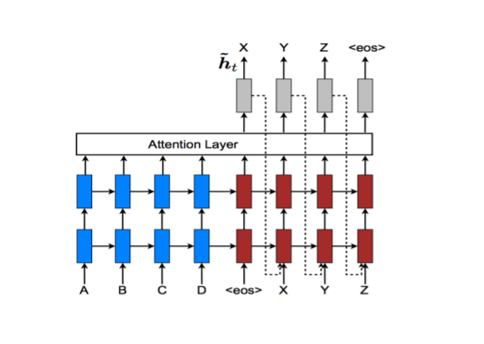
We have used adam optimizer and Sparse Categorical Crossentropy for loss.

Slide 12
Training
1. Pass the input through the encoder which return encoder output and the encoder hidden state.
2. The encoder output, encoder hidden state and the decoder input (which is the start token) is passed to the decoder.
3. The decoder returns the predictions and the decoder hidden state.

Slide 13
Training
4. The decoder hidden state is then passed back into the model and the predictions are used to calculate the loss.
5. We use teacher forcing to decide the next input to the decoder.
6. Teacher forcing is the technique where the target word is passed as the next input to the decoder.
7. The final step is to calculate the gradients and apply it to the optimizer and backpropagate.

Slide 14
Results
We have used word error rate(WER) to calculate the loss of model predictions
We got loss of 0.2402

Slide 15
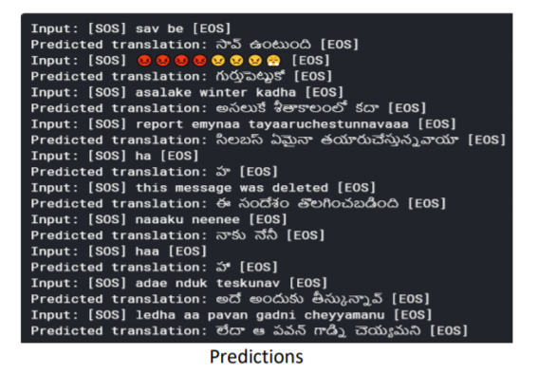
Link to model: https://www.kaggle.com/vinaymancha/processing-codemixed

Slide 16
Conclusion
In this project we have created a set of 31000 (Approx.) English-Telugu code mixed words and monolingual Telugu gold standard parallel sentences to act as a dataset to our model.
We use an NMT model, because other traditional phrasebased translation models split the source sentences and then translate them phrase by phrase, but using an NMT model is like mimicking the human ability to understand the sentence and translating it.
The NMT model that we use here is the Encoder-Decoder Model which is trained by the created dataset.

Slide 17
Challenging Things
There is too little data to train the model with a reliable accuracy and also the data available to train contains too much noise in it.

Slide 18
Future Work
We have achieved translating code-mixed English-Telugu words to their respective Telugu words which are rendered formally.
We can take this project further by:
1) Training the Model with more Data and increasing the accuracy of it.
2) Adding different languages to the model i.e. being able to convert languages other than Telugu into the respective selected language.

Slide 19
References
Google Transliteration API:
https://www.google.com/inputtools/try/
English Bag of Words:
http://www.mieliestronk.com/wordlist.html
Google Translate:
https://translate.google.co.in/
Enocer Decoder with attention:
https://www.tensorflow.org/tutorials/text/nmt_with_attention
Bahdanau attention:
https://arxiv.org/pdf/1409.0473.pdf

Slide 20
Thank You
Thank You for letting us be a part in this project.
Dr. Sanjay Chatterji

