Slide 1
Neuromorphic
Computing
By:Keira Jameson

Slide 2
Overview
Slides…
Title and Subtitle
Overview
History - Who and When it was Conceived
History - Who and When it was Conceived
Plan and Implementation - Who or What it will Impact
Neuromorphic computing vs. Biological synapses
Fps Chart
Plan and Implementation - Who or What will it Impact
Pros
Cons
Summary
References

Slide 3
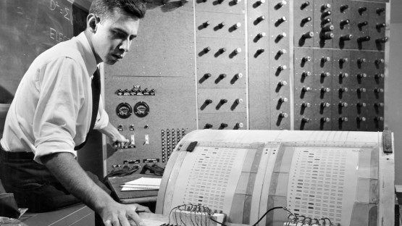
History - Who and When It Was Conceived
Who discovered Neuromorphic computing?
In 1958, the US navy developed a perceptron which is essentially a single layer neural network. This was developed to interpret data much like the human brain. This was the first step towards what is now known as neuromorphic computing or neuromorphic engineering.
Early perceptron
Notes:
Computers based on brain were first conceptualized in order to process data faster, these were called neural networks. Because of how fast and efficient our brain is scientists decided to model a computer off of it. The first artificial neural network was called a perceptron and it was developed by the US navy in the middle of the 20th century. The perceptron itself failed but inspired many others to then pursue the idea of creating a computer that works like a brain.

Slide 4

History - Who and When It Was Conceived
In the 1980’s a professor named Carver Mead first proposed the idea of neuromorphic computing. He used the idea of biological synapses, where a neuron sends a message to another neuron. He applied this and developed a model where ions flow to two electrodes(Bottom and Top) much like how neurotransmitters flow between either neuron in biological synapses.
Carver Mead
Notes:
Carver mead, an American scientist and engineer, was the first to propose neuromorphic computing (or engineering). He based his model off of something called synapses which is how some neurons send messages to their target neurons. His goal was to create a more faster better computer. His model consisted of ions flowing between two electrodes acting as the neurons in this situation.

Slide 5
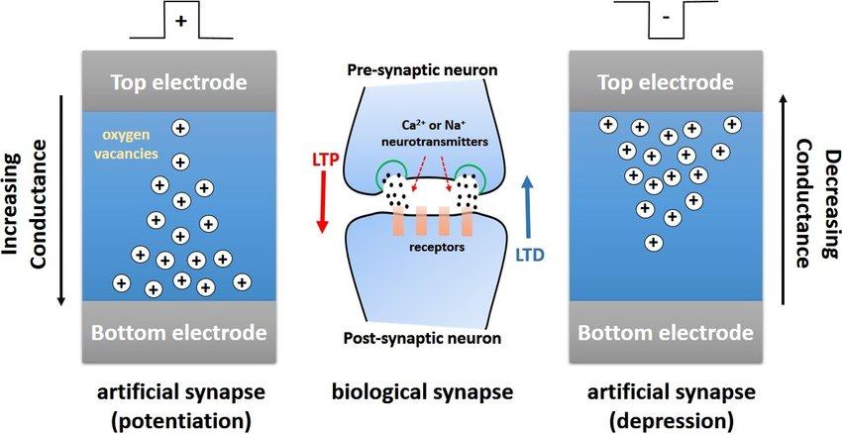
Neuromorphic Computing VS. Biological Synapses

Slide 6
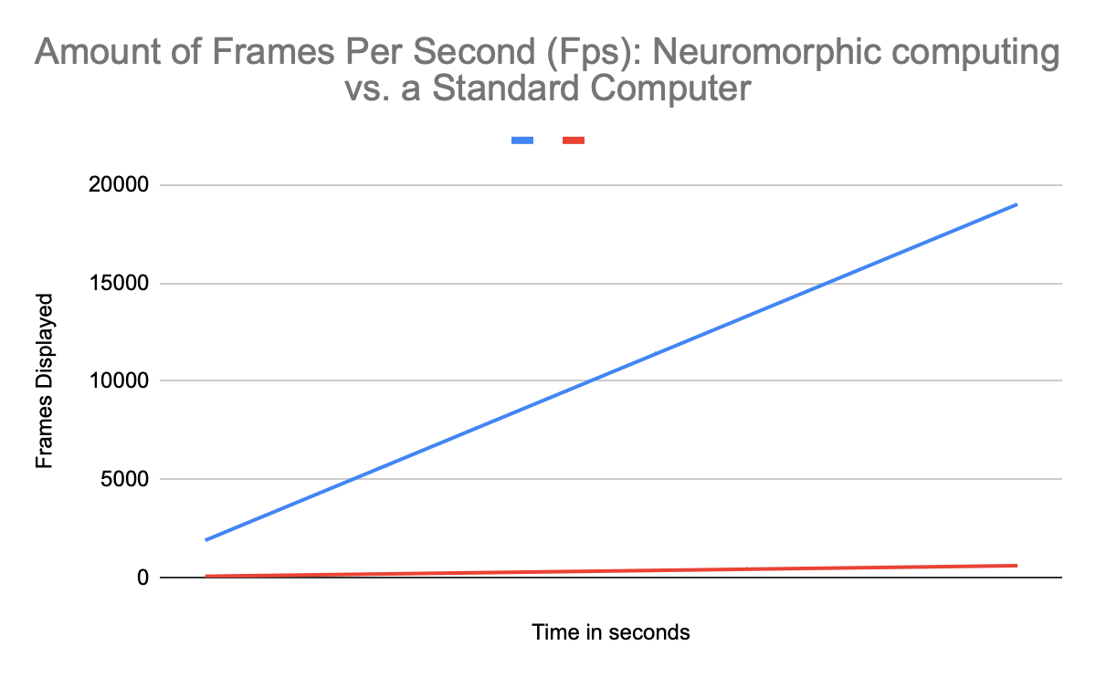
Neuromorphic computing Standard computer

Slide 7

Plan and Implementation - Who or What Will It Impact
This could impact many jobs especially those that are of low technical difficulty. The ability to process information quickly and efficiently could threaten employment of people. However, it could take the danger out of many jobs that use people. It will especially affect those who work in assembly lines due to its quick nature and ability to process and correct mistakes. It could also advance companies allowing them to hold more data and process data quickly and accurately.

Slide 8
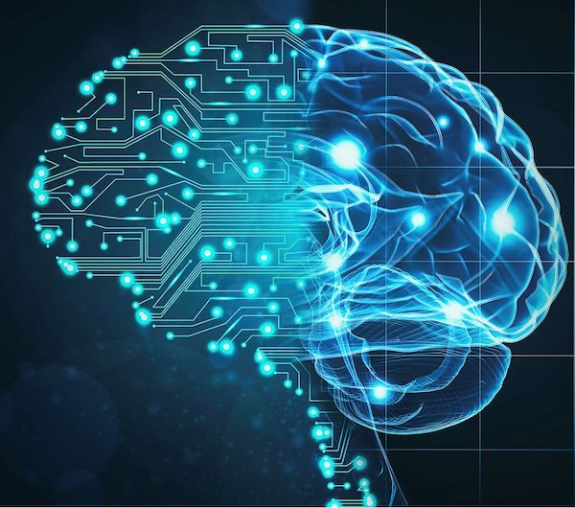
Pros
Neuromorphic engineering could create an even more efficient and compact computer than the ones we have today, condensing many servers into just one chip. The ability to process information just as fast as a human brain could create for extremely advanced technology to be created and even human like AI to be developed. This could greatly revolutionize industries creating greater societal advancement.

Slide 9

Cons
With this new technology there could be mass amounts of unemployment. Because of how efficient and smart it is it could completely take over majority of jobs even those that require skill. This advancement could cause a great mass unemployment, effecting even those who have gone through extensive training to be able to perform their jobs.

Slide 10
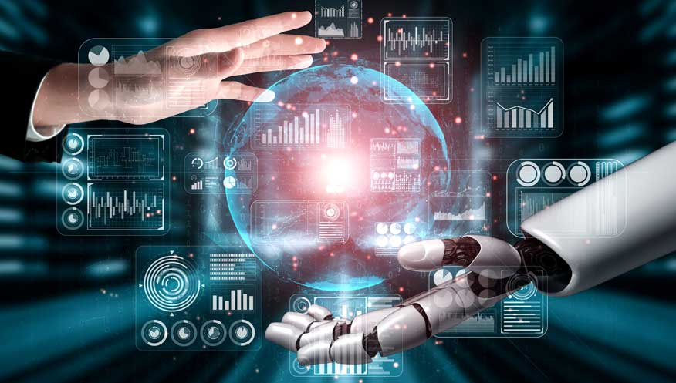
Summary
I think neuromorphic computing is a good thing. The advancement that this technology could potentially cause is unimaginable. Our industries, businesses, etc will be faster, more reliable, and smarter. The chance of mass unemployment could also be offset by the possibility of this invention creating more jobs.

Slide 11
References
What is Neuromorphic Computing by TechTarget
What the Hell is Perceptron by Sagar Sharma
What is Neuromorphic Computing and How Could it Impact Enterprise IT by Turn Key Technologies

