Slide 1


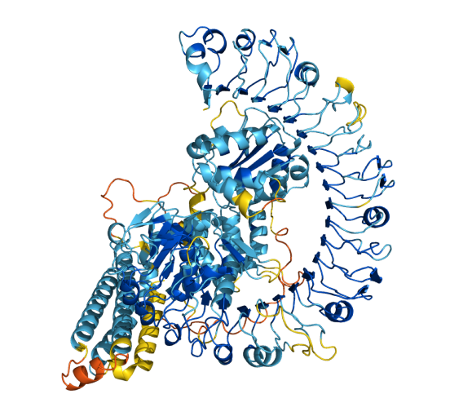


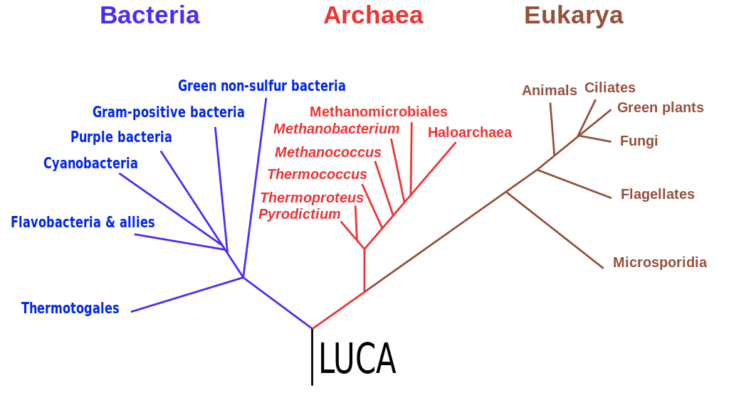
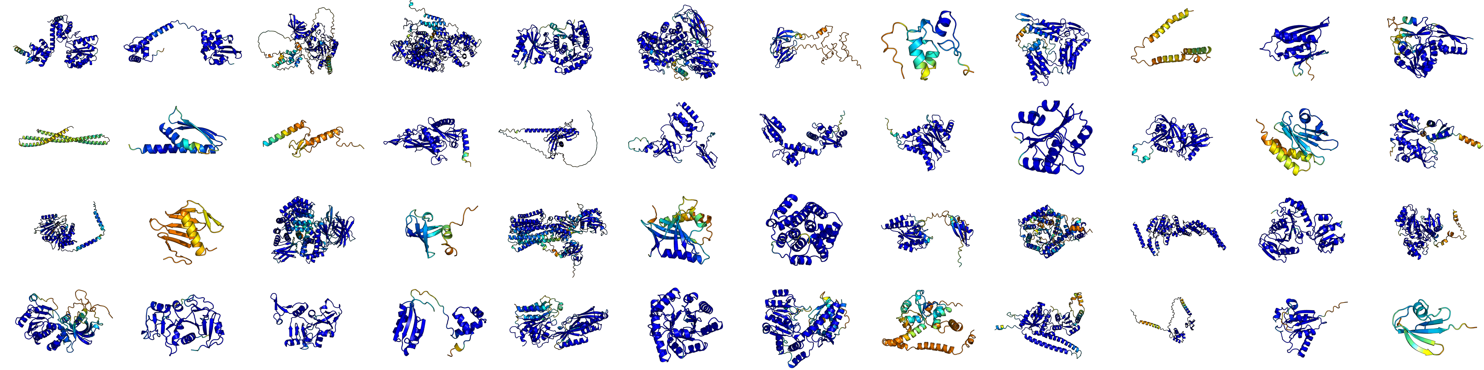

Folding Entire Proteomes
Predict a molecular inventory of your organism
Proteomics bioinformatics Community Meeting - 2024 Dec 02
Dr Keiran Rowell
Sequence genome
Evo-AI methods
Struct search
4544 proteins
4544 structures
AlphaFoldDB

Slide 2

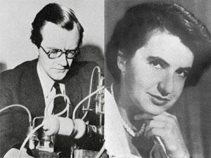
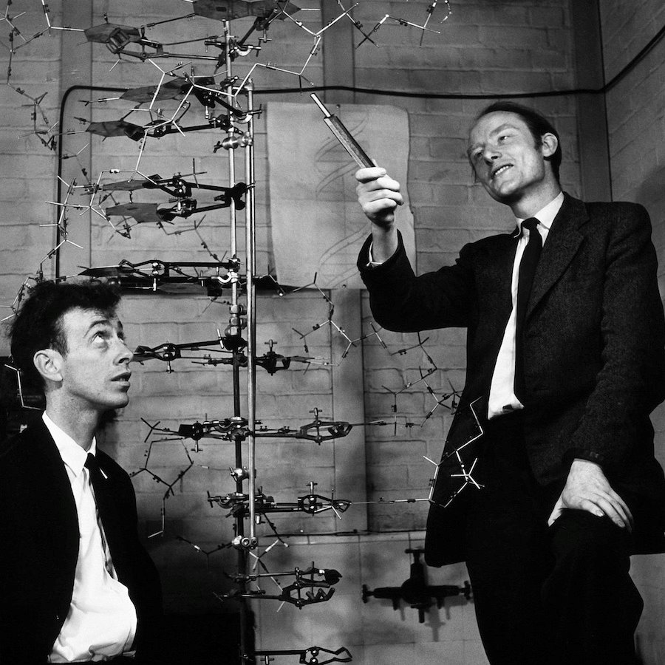
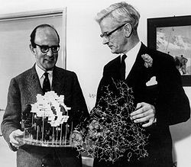
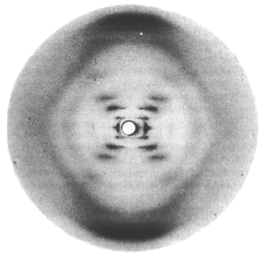
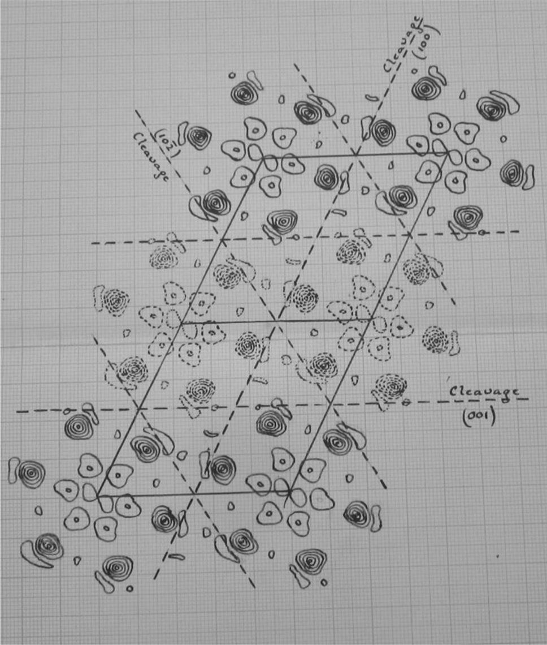
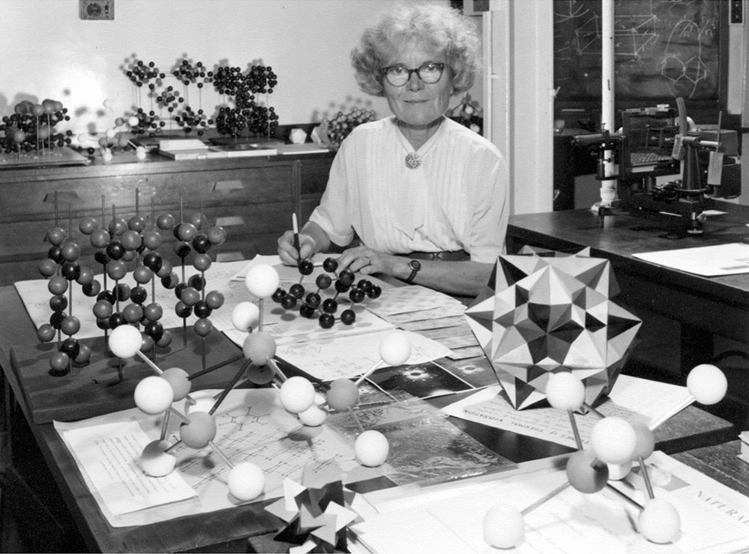
Models in Chemical Biology - function follows chemical form
Schrödinger speculates on
the molecules of life 1944
Perutz & Kendrew's model of the 3D structure of a protein (myoglobin) 1957 ​
Watson & Crick's DNA double-helix model 1953
Wilkins & Fraklin's X-ray diffraction images of DNA 1953
Kathleen Lonsdale resolves the structure of benzene 1924

Slide 3
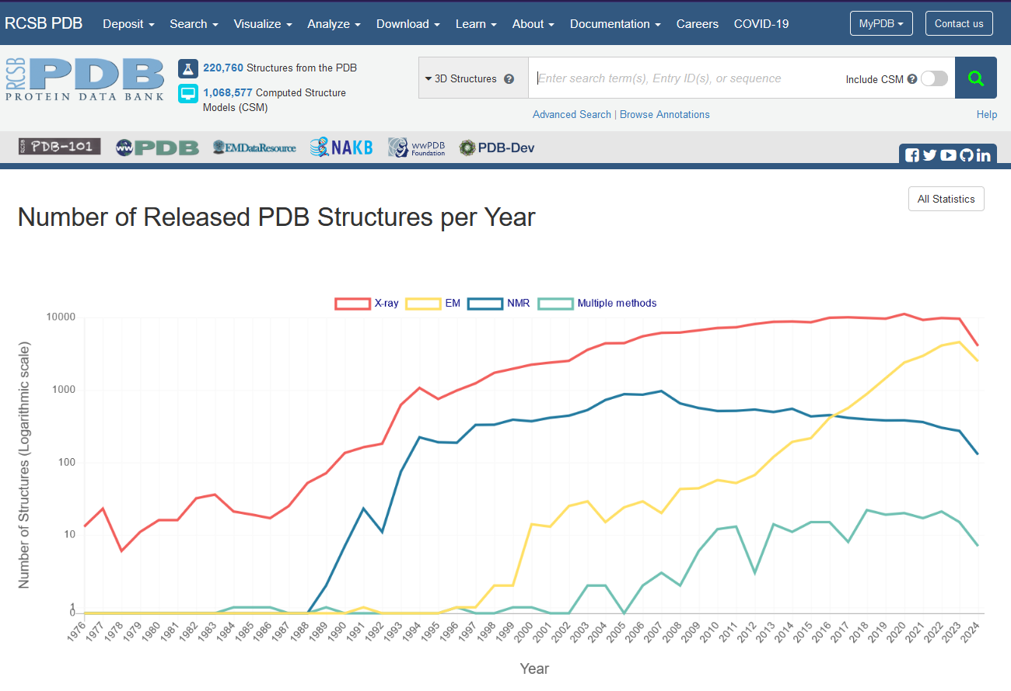
X-rays ruled 20thC – CryoEM & Calcs the 21st
Compute power – Moore's law +
DNA Sequencing – super-Moore's law +
Deep Learning – context scaling laws
=
Comp.Struct.Bio. - 1000x in 2 years

Slide 4
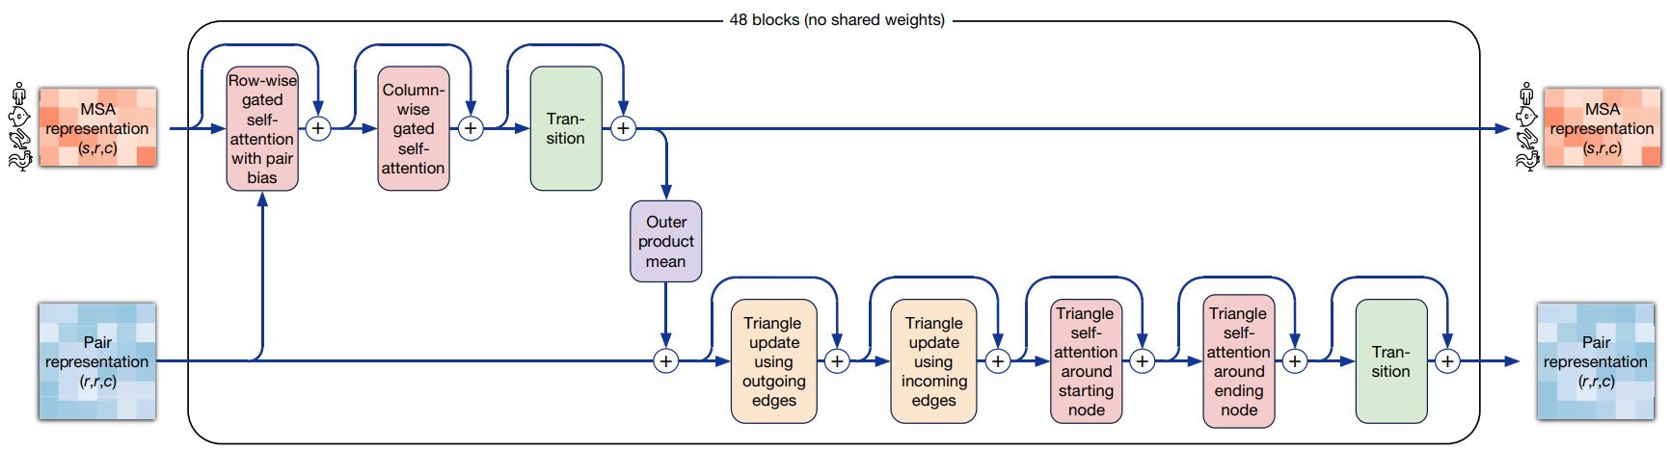
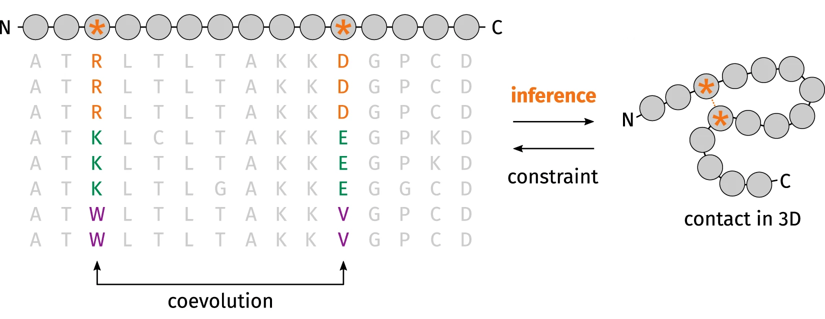
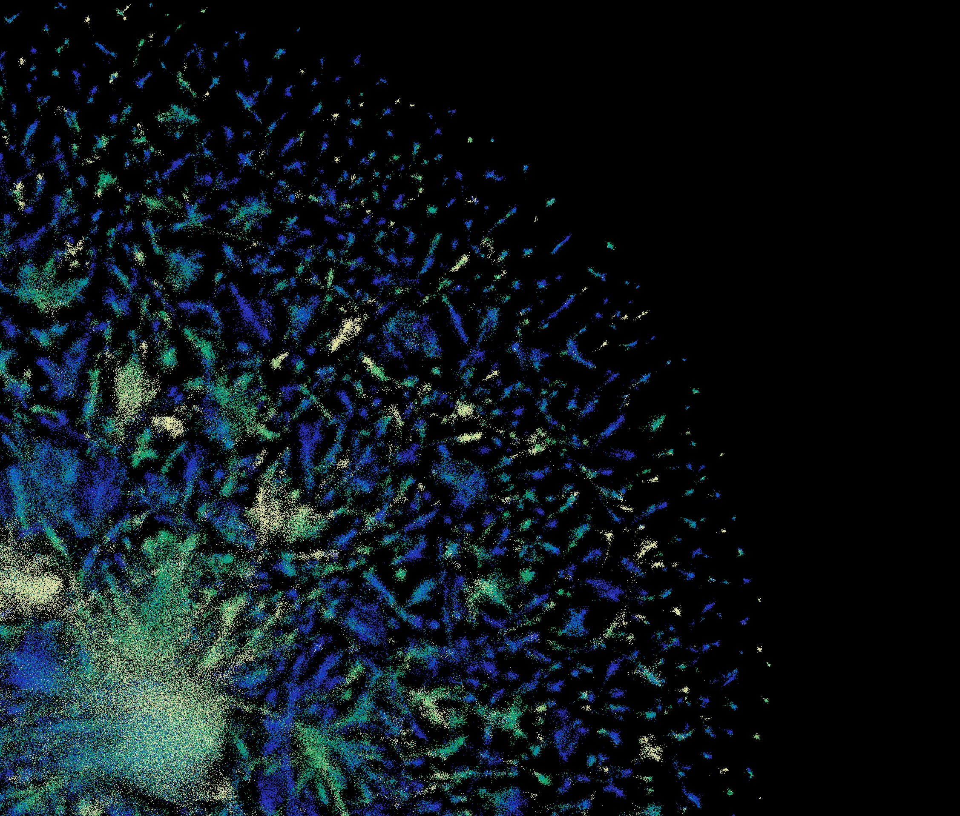


X'Fold' programs - co-evolution DeepLearning
DL: No physics of folding – Transformers – 1D sequence -> 3D structure
'Evo'formers (GPU+CPU+DBs)
Protein-LMs (GPU)
Struct Alignment (DBs)
(Alpha|Open|RoseTTA|Ab)Fold
ESMFold, ProtTrans
Foldseek, Foldmason

Slide 5


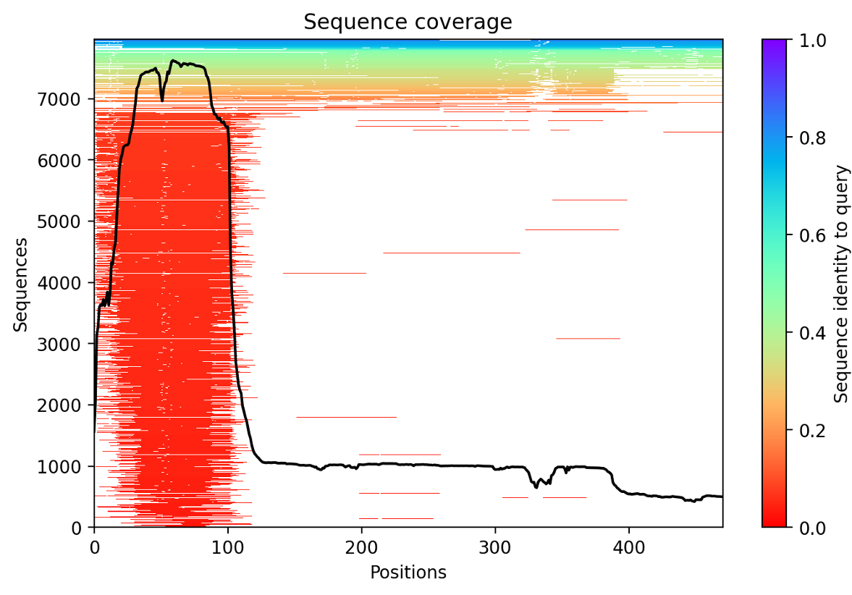
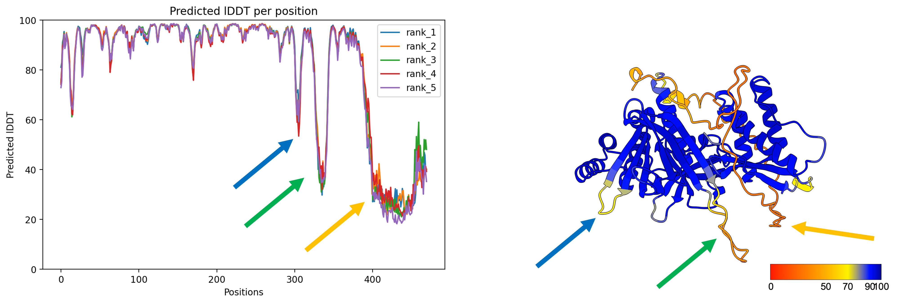
X'Fold' programs - No Physics
Supplementary Videos: Ahdritz, G., Bouatta, N., Floristean, C. et al. OpenFold: retraining AlphaFold2 yields new insights into its learning mechanisms and capacity for generalization. Nat Methods 21, 1514–1524 (2024). https://doi.org/10.1038/s41592-024-02272-z
PDB ID: 7RDT
PDB ID: 7B3A
Confidence metrics: Dr Michael Healy, 'AlphaFold2 How-To Guide'

Slide 6
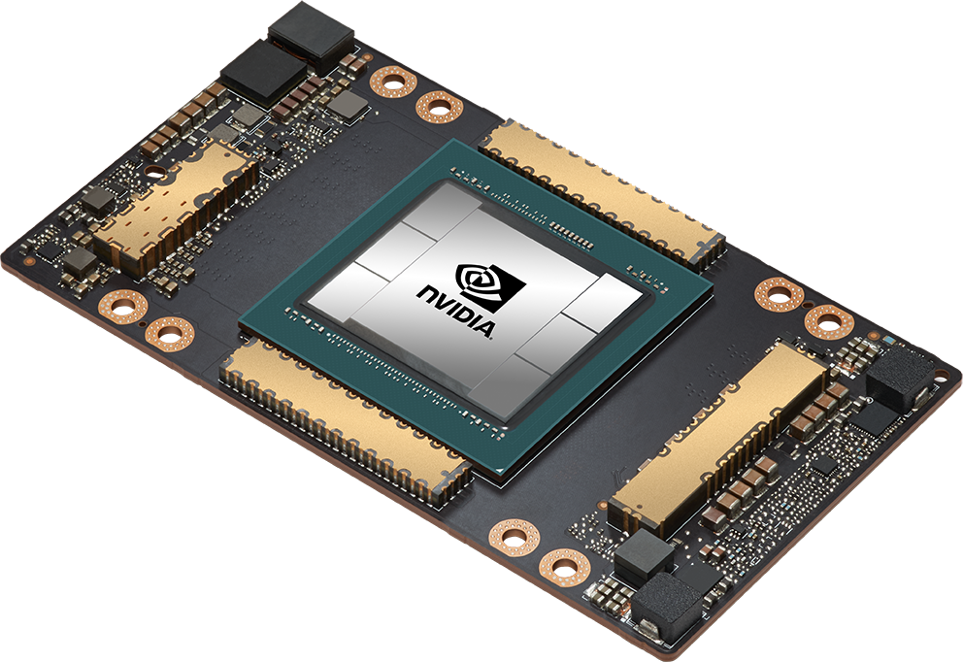
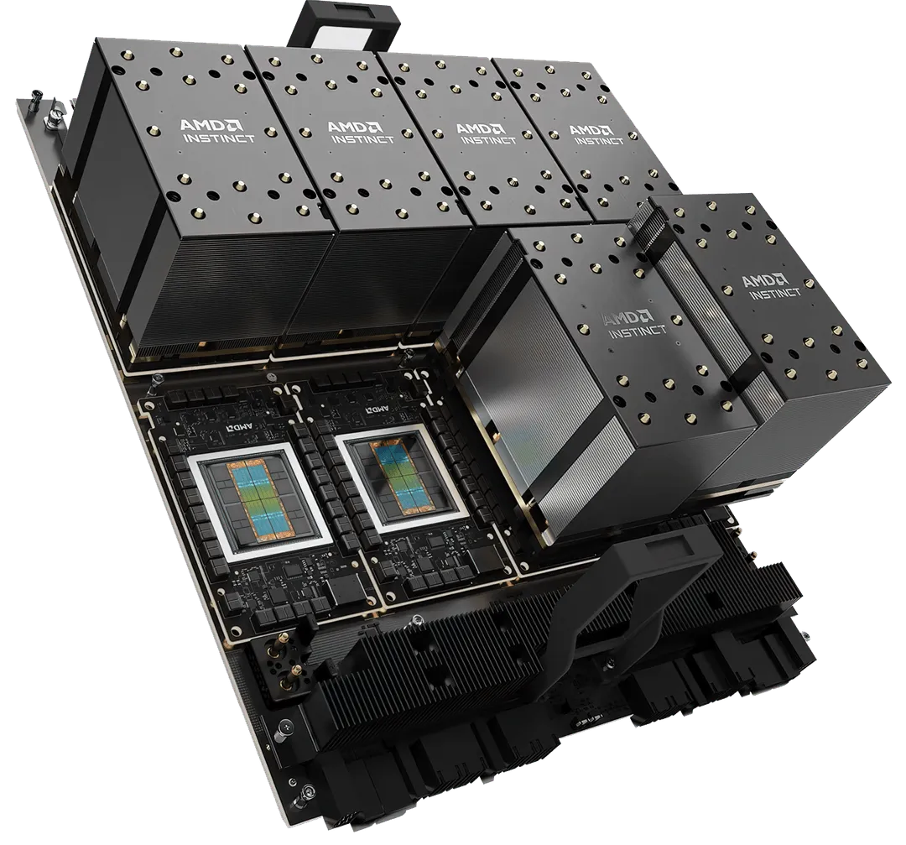
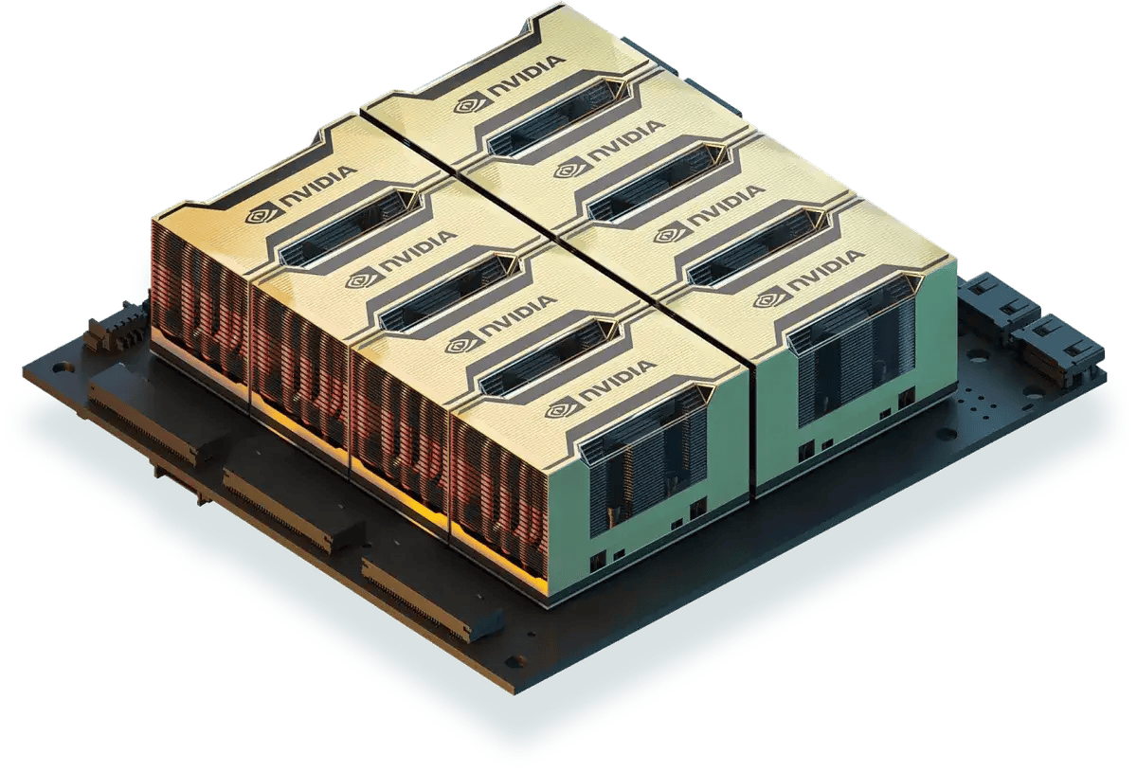

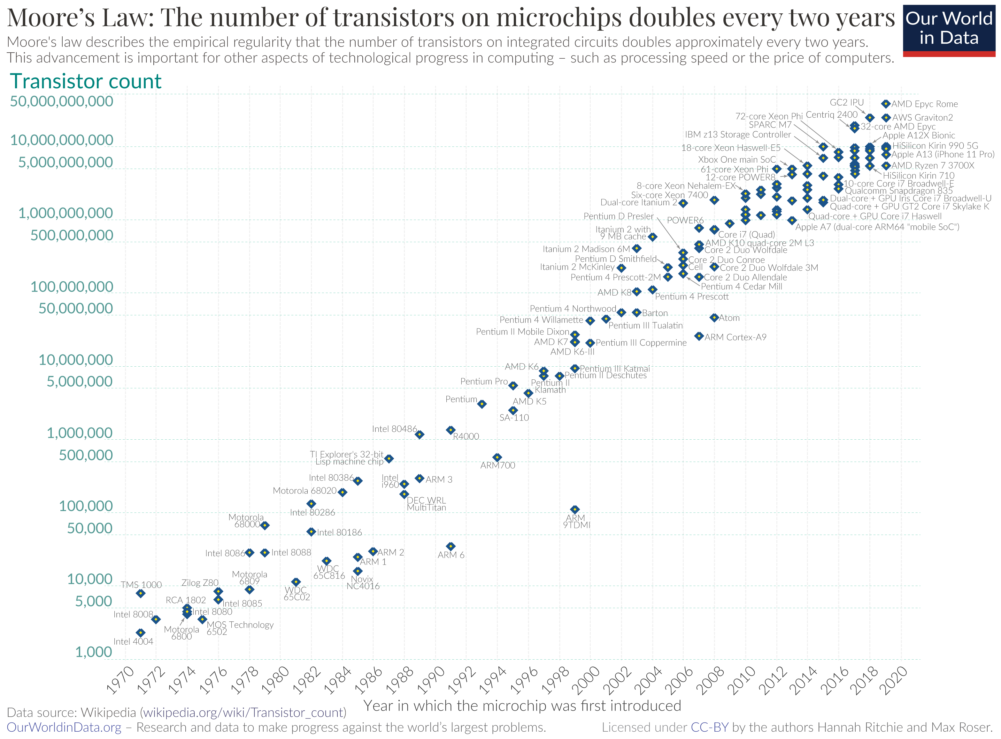
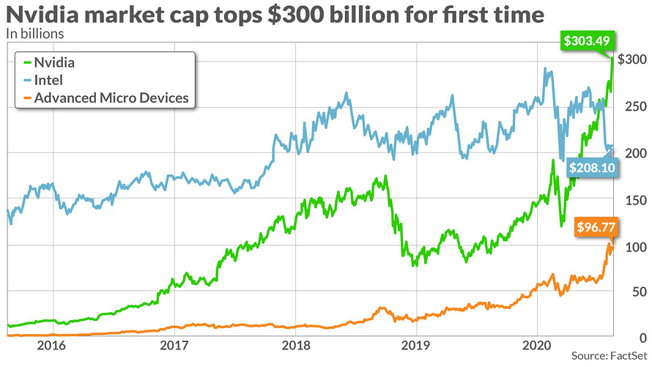
GPUs – Multiply things really fast
Now 100 billion transistors in each GPU
100s of trillions multiplies each second
93 million parameter network less scary
NVIDIA - AMD
Both design GPUs
½ of NVIDIA are
software engineers
We can't keep GPUs busy! They are so fast
GPU calculations x50 faster than CPU. 2 hrs vs 5 days
ESMFold is pure GPU. AlphaFold GPU+CPU+file retrival.
  613 proteome 8 hrs vs 22 days. 4,622 protoeome 10 days vs ?? (2 years)

Slide 7
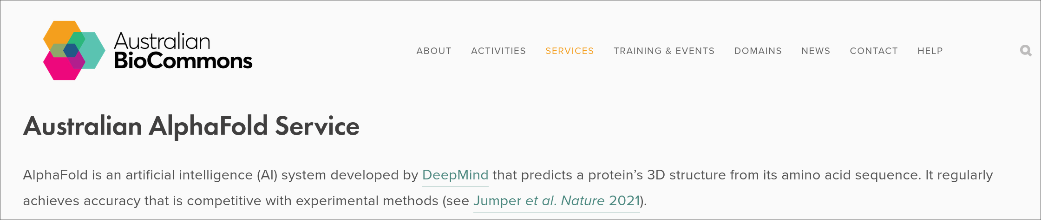
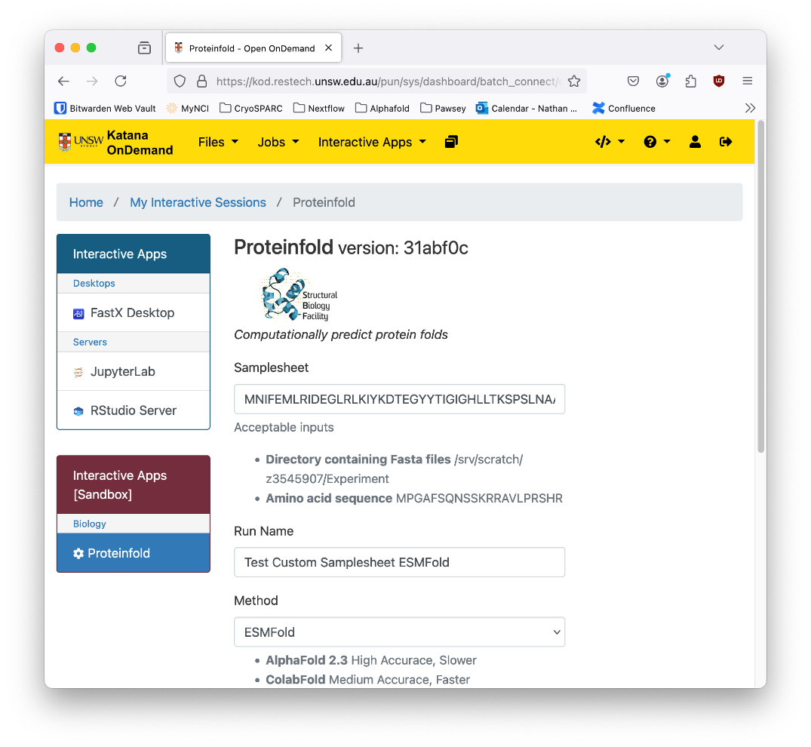
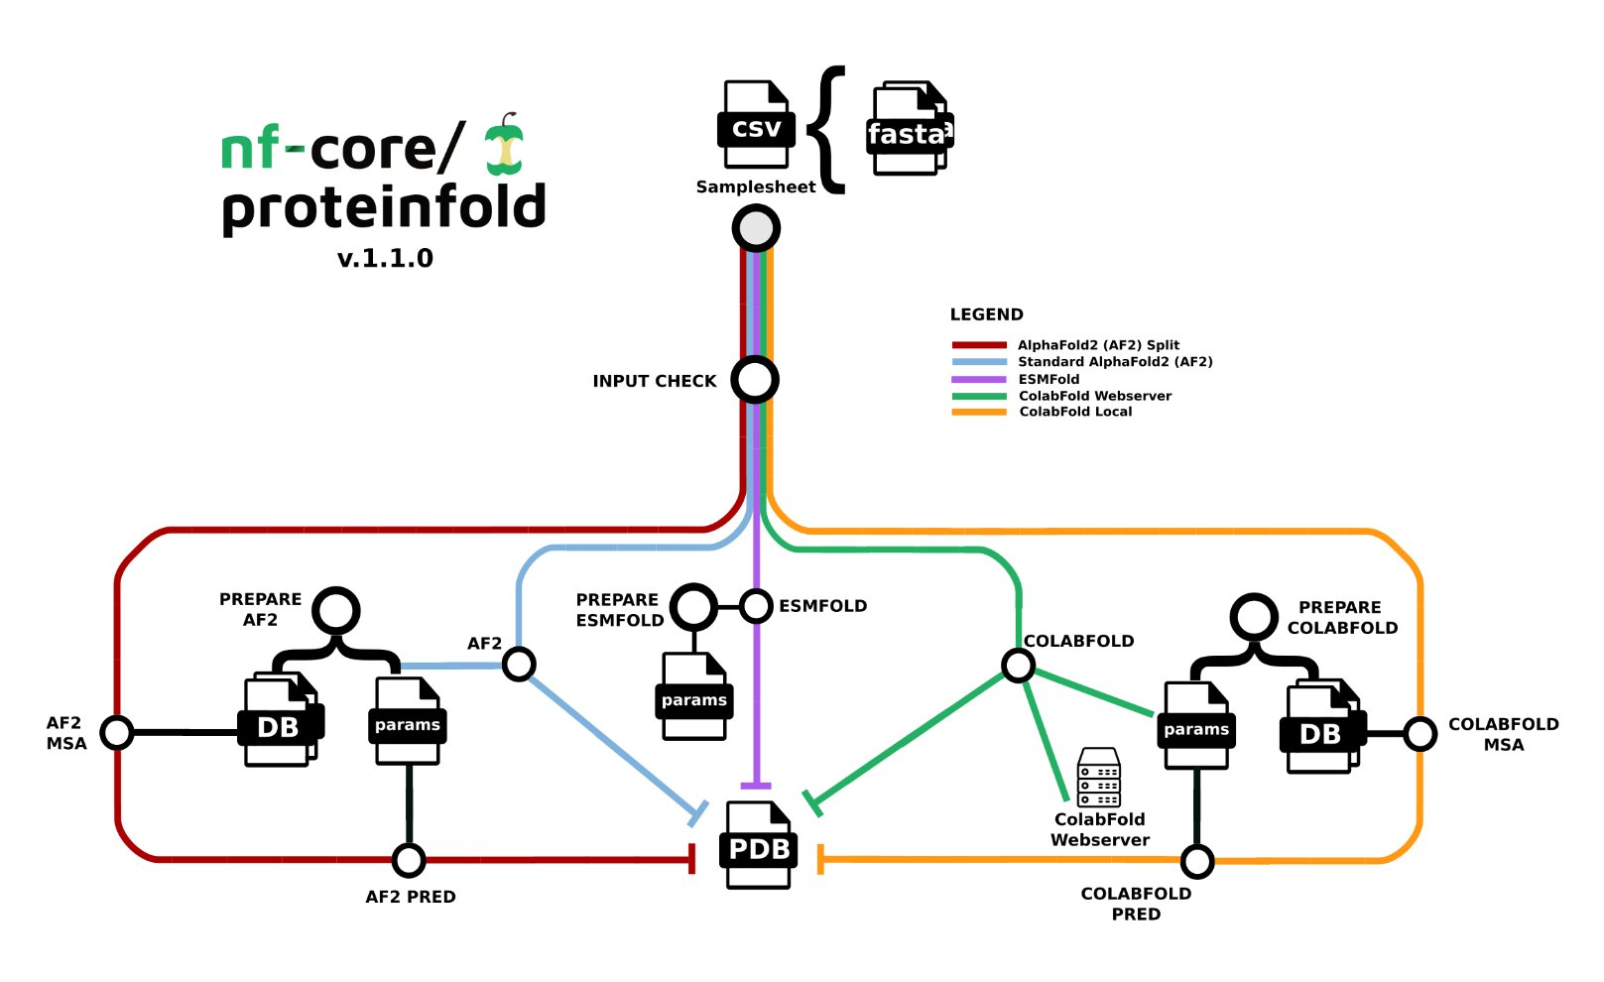
Where to turn? - Galaxy, Uni compute cluster, proteinfold

Slide 8
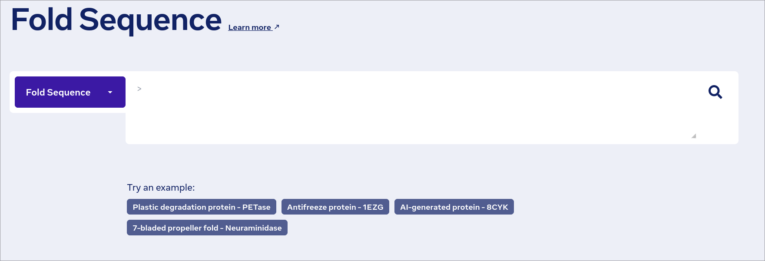
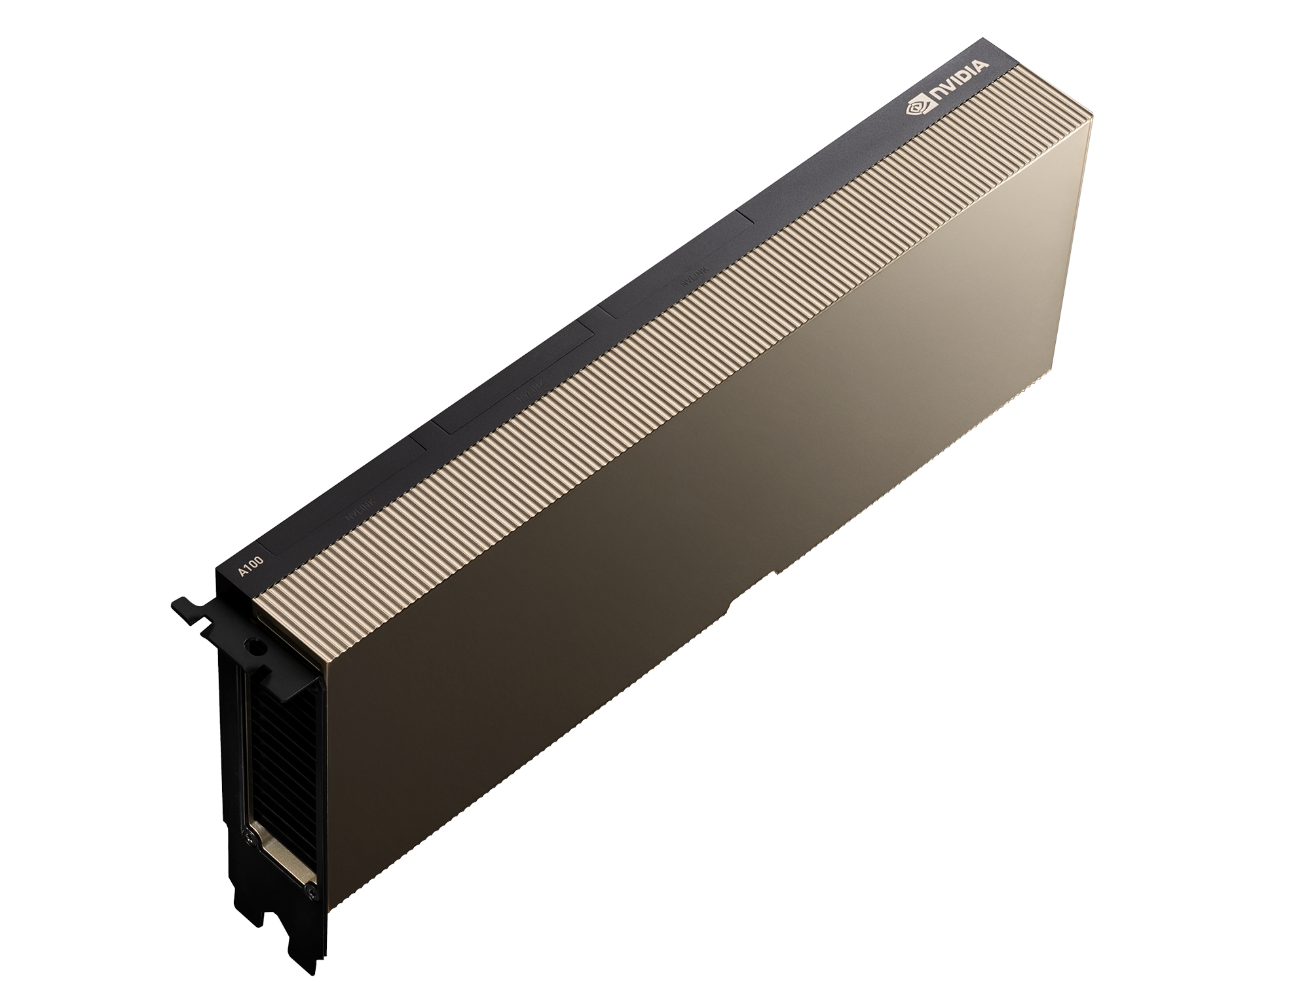
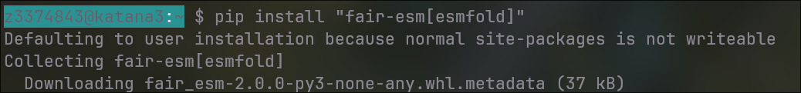
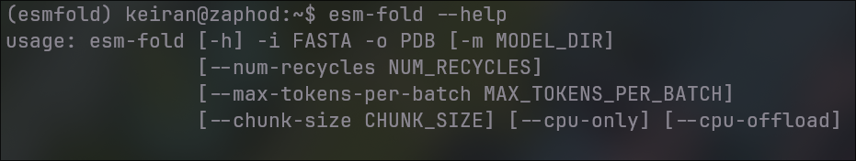
How to run? - Install ESMFold, point at FASTA file
A) Use website (1-10 prots)
esmatlas.com/resources?action=fold
B) Use website on the command line (10-100 prots) ​
C) Install on a GPU server (100-1,000s prots) [~10 minutes] ​​

Slide 9
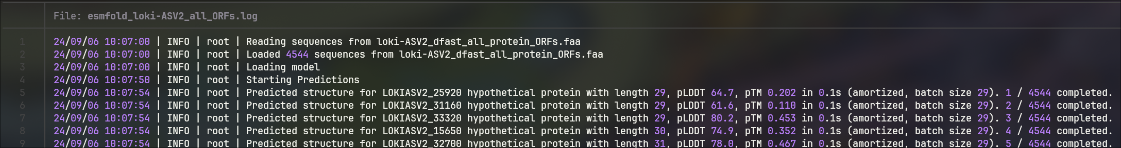
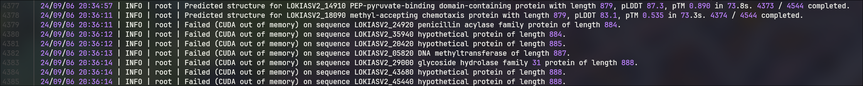
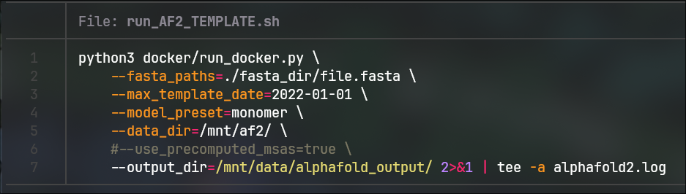
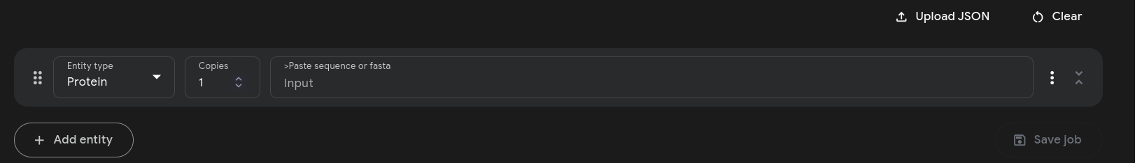
Whole proteome?
All seqs ESMFold (<900), AlphaFold2 (900-3,000), AlphaFold3 (3,000+)
github.com/keiran-rowell-unsw/Loki-ASV2_in_silico
ESMFold – 4378 prots, 10.5 hrs
AlphaFold2.3 – 160 prots, 10.5 hrs
AlphaFold3 – 6 prots, pretty quick

Slide 10
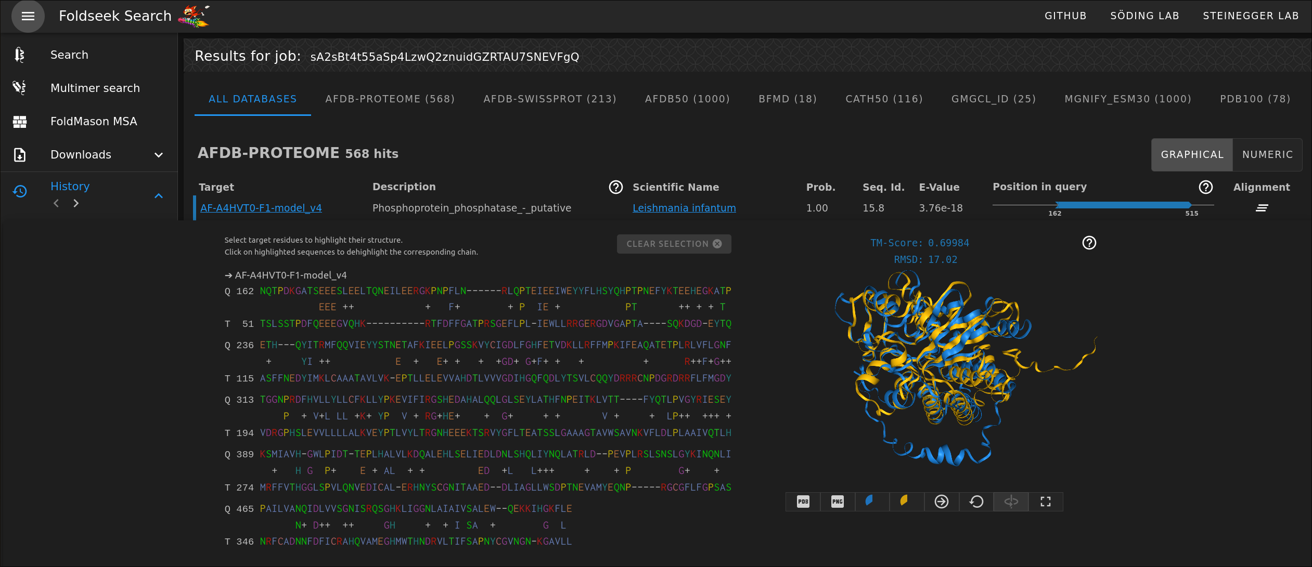
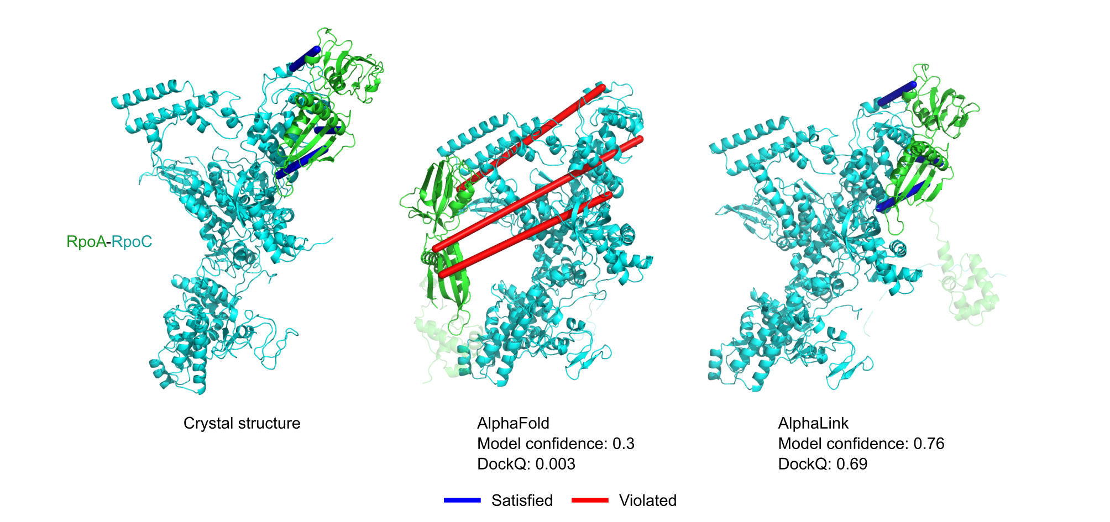
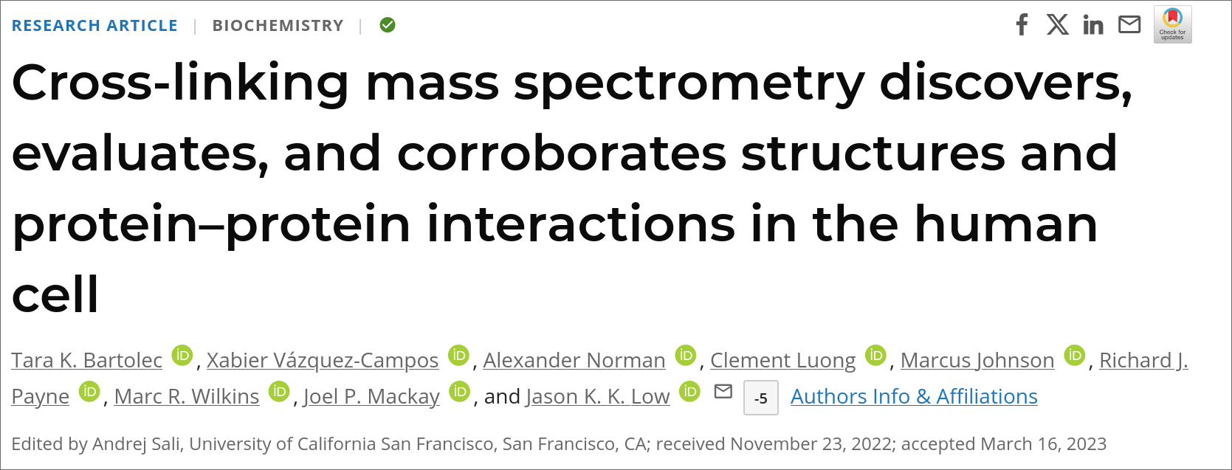
What to do? - Pull up Homologues, compare w/ MS
^{search.foldseek.com}
github.com/Rappsilber-Laboratory/AlphaLink2

Slide 11
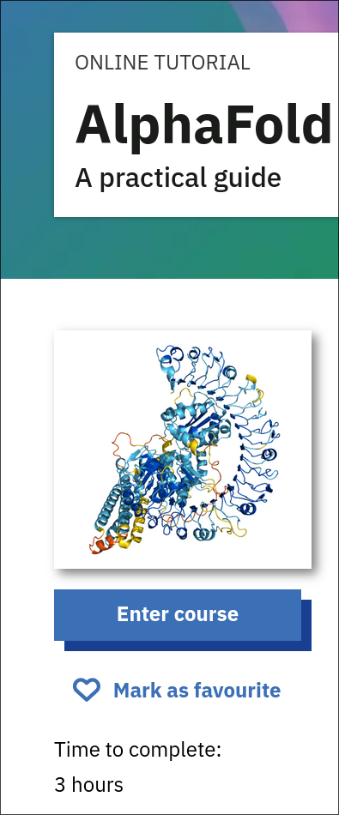


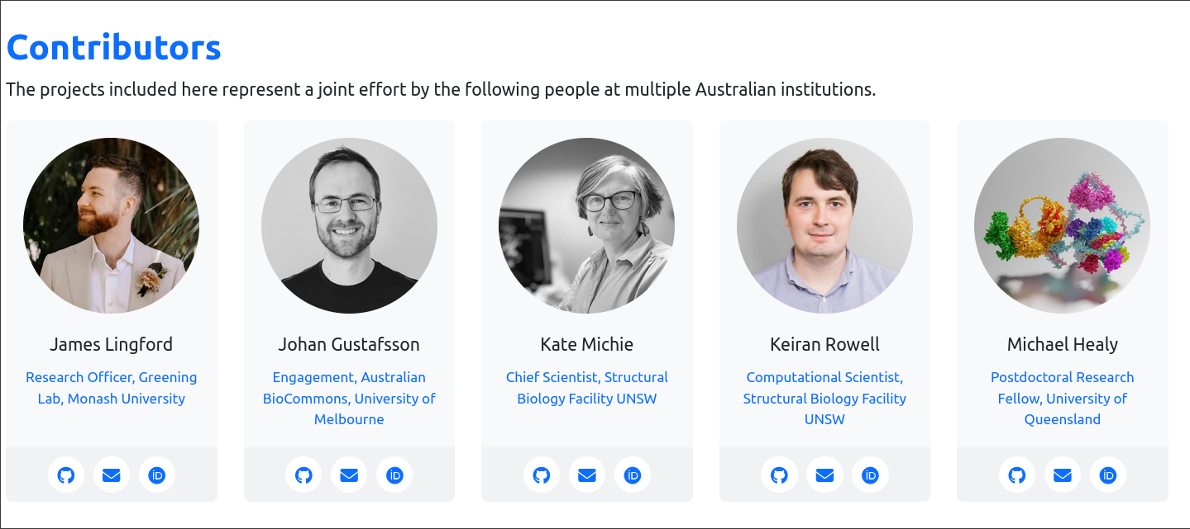
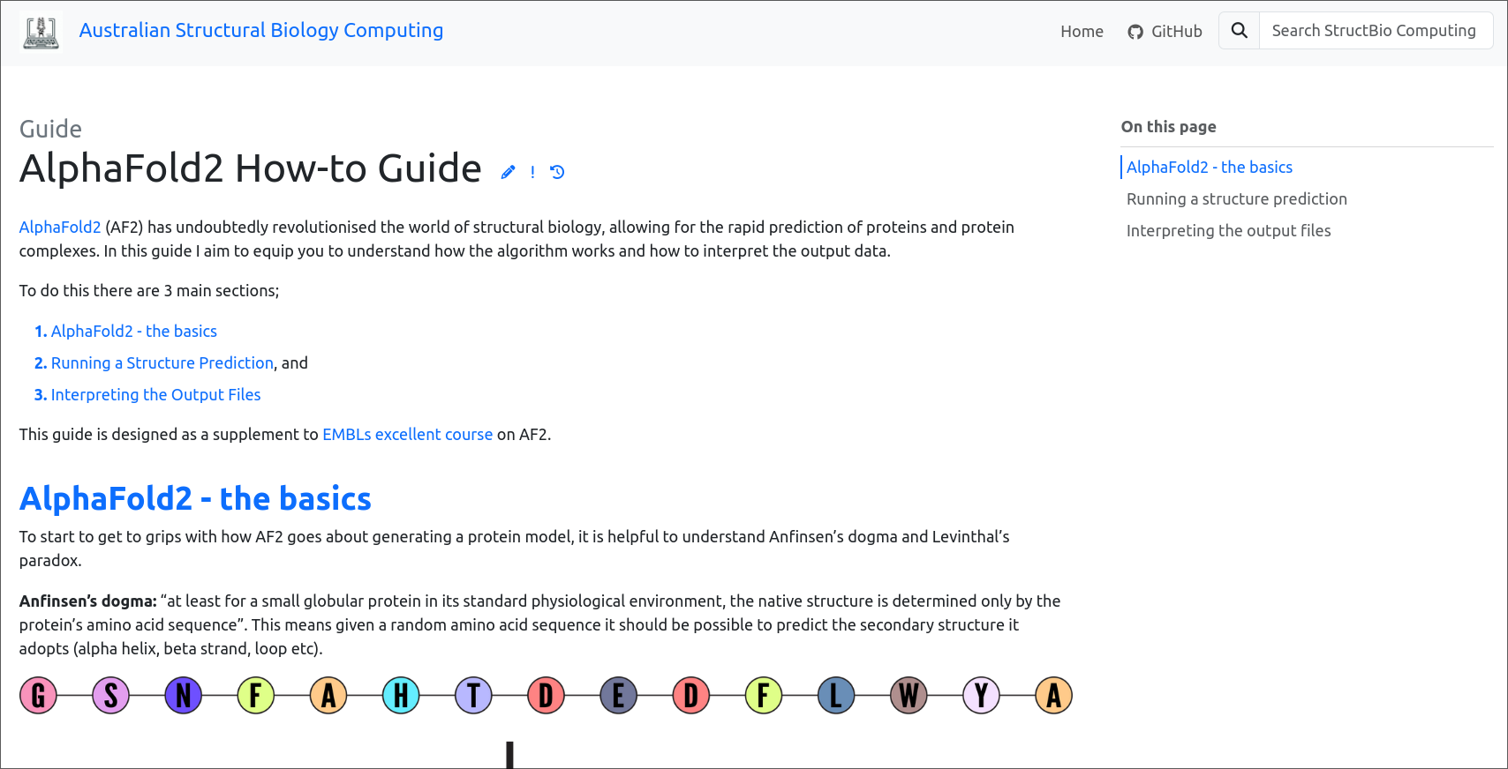

AlphaFold Practical Guide European Bioinformatics Institute Community
ebi.ac.uk/training/online/courses/alphafold
Australian Computational Structural Biology Community
australian-structural-biology-computing.github.io/website/

Slide 12
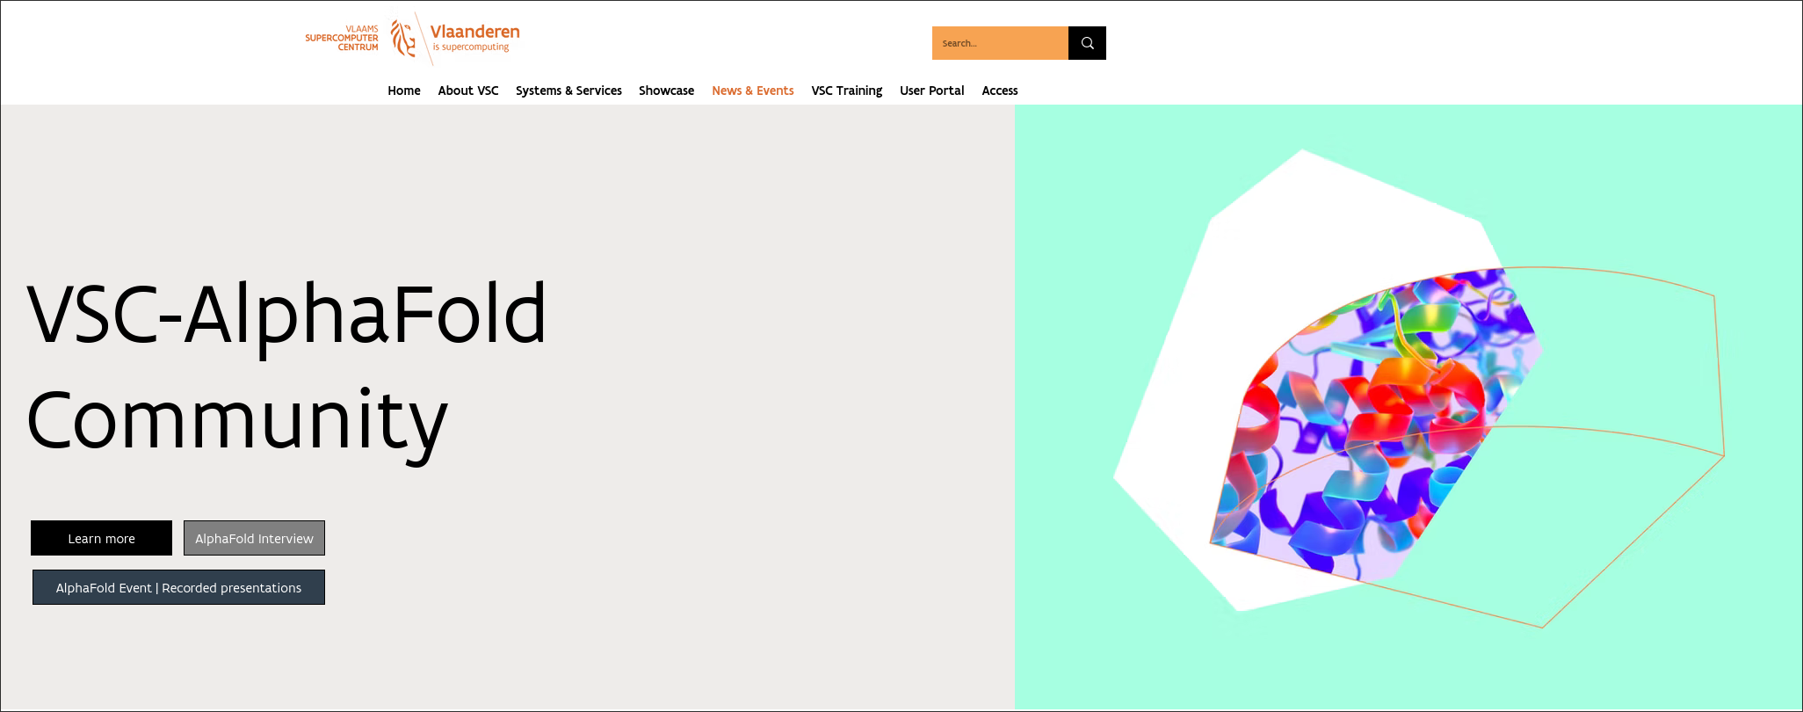
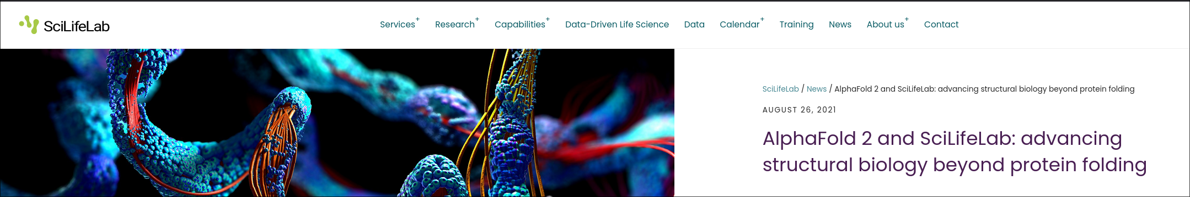
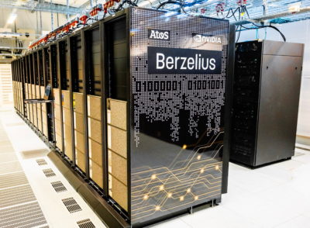
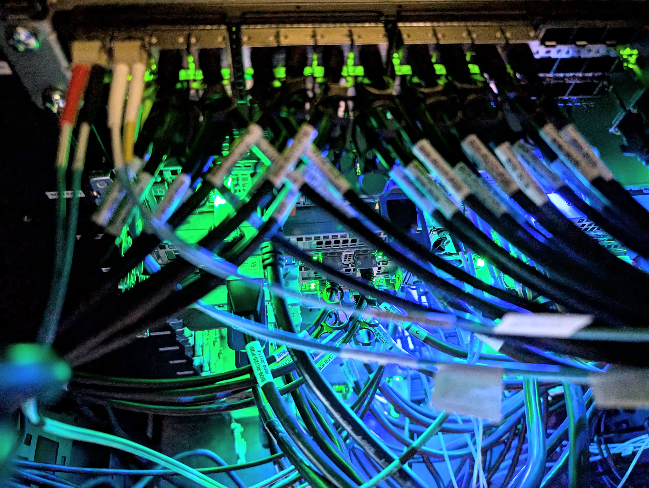
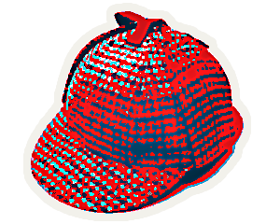
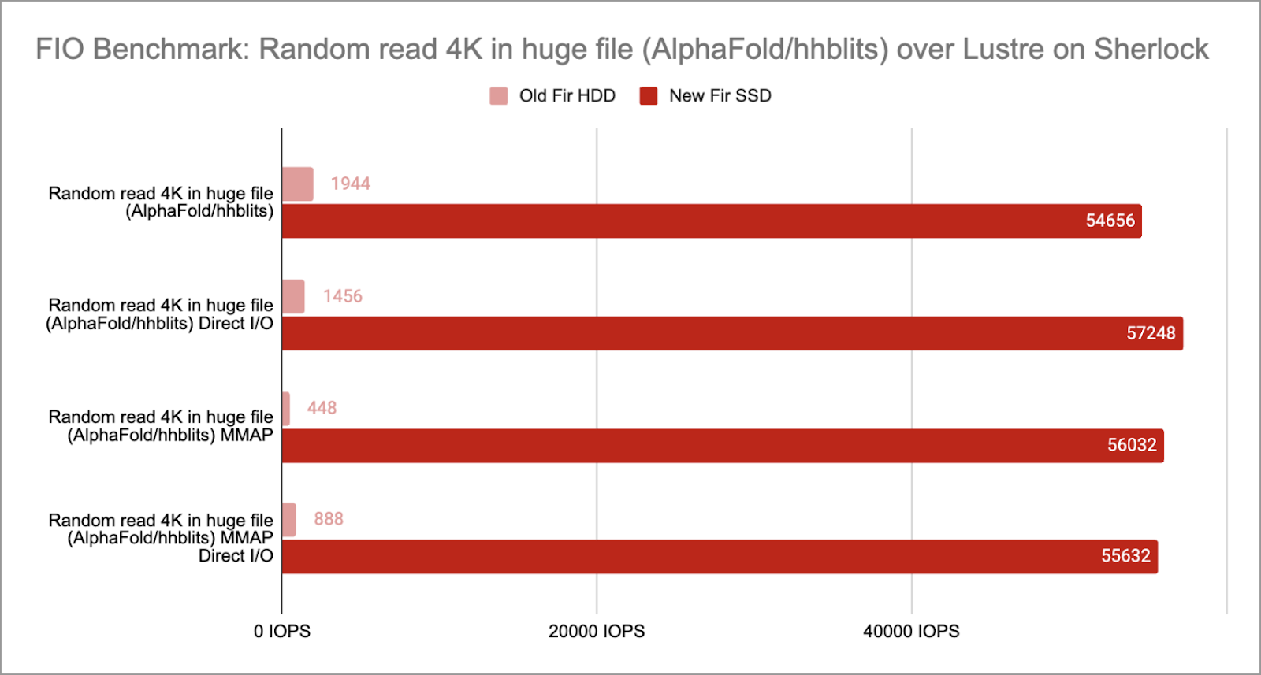




The world is doing this

Slide 13
Questions / Discussion

