Slide 1

UXID 111
10/02/25
KEIRA VAUGHAN
KAV77

Slide 2
Elevator Pitch
“The Sisters of Mercy have been helping those in need around the world for 200 years. However with technology growing they have struggled to keep up with younger audiences. I believe by updating their website, creating more engaging social media content, and researching younger audiences they can grow their volunteer base. Consider looking into their social media, volunteer events, or donating to help strengthen their cause.”

Slide 3
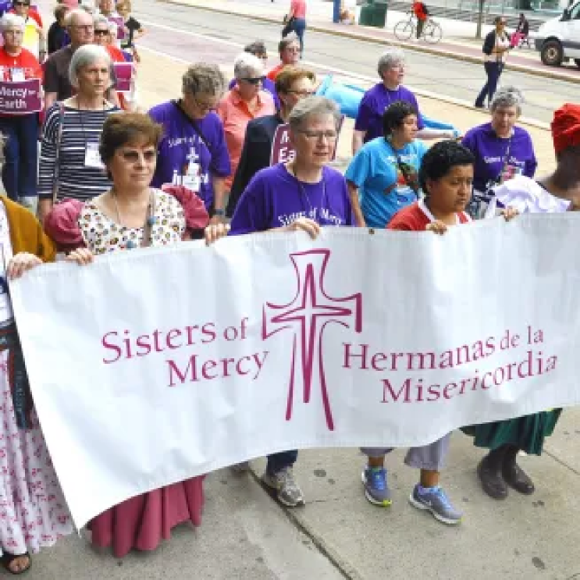

Purpose
The purpose of this research report is to present findings from my study and discuss future changes for the Sisters of Mercy future UX strategy.

Slide 4
Purpose
Executive Summary
Backgrounds & Overview
Agenda
Methodology
Key Findings
Opportunities & Recommendations

Slide 5
TOPIC
ANOTHER TOPIC
Background & Overview
About The Sisters of Mercy,

Slide 6
Background
The Sisters of Mercy were founded in 1847 by an Irish woman named Catherine McAuley, who opened a shelter for women. Now they are a religious based organization that provide social services, rehabilitation and support.
They connect with schools to make Mercy schools, centered in the Sisters of Mercy’s values.
Their 5 main critical concerns are
Earth
Immigration
Nonviolence
Racism
Women

Slide 7
Key Partners
Key Resources
Mercy based organizations
Institutional Partnerships
Social Justice Partnerships
Faith Driven Supporters
Human Resources
Financial Assets
Intellectual Property
Physical Assets
Activities
Revenue Streams
Marketing
Community Advocacy and Outreach
Program Development
Running Campaigns
Investment income
Donations and Legacies
Fundraising Events
Service Fees
Value propositions
Customer Segments
Advocacy/ Charity
Founded by women
Faith based Organization
Legacy & Donors
Service Users
Volunteers & Activists
Cost Structures
Channels
Service Collaboration
Educational Institutions
Human Resources
Property Maitenence
Media/ Press
Partnerships/ Collaborations
Events
Email Newsletters

Slide 8
Key Partners
Key Resources
Mercy based organizations
Institutional Partnerships
Social Justice Partnerships
Faith Driven Supporters
Human Resources
Financial Assets
Intellectual Property
Physical Assets
Activities
Revenue Streams
Marketing
Community Advocacy and Outreach
Program Development
Running Campaigns
Investment income
Donations and Legacies
Fundraising Events
Service Fees
Value propositions
Customer Segments
Advocacy/ Charity
Founded by women
Faith based Organization
Legacy & Donors
Service Users
Volunteers & Activists
Cost Structures
Channels
Service Collaboration
Educational Institutions
Human Resources
Property Maitenence
Media/ Press
Partnerships/ Collaborations
Events
Email Newsletters

Slide 9
Begining Changes
Adding Personalization to the Website: Creating a section where you can create an account. They can list topics they are passionate on to create an algorithm for events and articles
Creating a meaningful experience for Donors: S Sending notifications of impact updates on the cause they donated to will keep the users engaged post donation.
Increasing Youth engagement: Creating a strong brand identity, and adding new processes on social media will attract younger users.Like creating video articles on social media.
Notes:
issues that could be improved

Slide 10
TOPIC
TESTING
Stakeholder Interview
KPI’s/7Ps
User Interviews
User Personas
Empathy Mapping
Survey
Methodology
How I conducted the testing
Notes:
Kpis

Slide 11
Summary:
Younger and Older audiences respond to real stories.
People don’t know where to start on the website.
Trying to engage with younger audiences
There are dIfferent needs for different ages.
Want to create a cohesive experience that is clear to understand.
Stakeholder Interview

Slide 12
KPI’s
Volunteer Retention Rate – % of returning Volunteers.
Pages per Session- Number of pages visited per session to show depth of engagement.
Volunteer Sign-Ups- The number of new volunteers joining new programs or signing up for events.
Engagement Rate- Number of likes, comments, shares in comparison to followers.

Slide 13
7P’s
Product Price Place Promotion People Process Physical Evidence
Housing, Meals, Counseling, Eduaction Programs, 200 organizations
Non-profit, Donations, Volunteers, Mercy schools fund as well
Mercy Centers, Hospitals, Schools, Retreat Facilities, locations around the world
Social media, newsletters, emails, events
Staff: Sisters, Social Workers, educators
Volunteers: students of mercy schools, alumni,
Donors
Learn through social media, “Our work” tab, look into values
Stories online, Mercy archives (past stories), digital presence for sign-ups and donations

Slide 14
SWOT Analysis
Strengths: Clear mission, trusted reputation, Integrated Educational Outreach
Weaknesses: Outdated Design, Lack of Visual Hierarchy, Inconsistent Posting,
Opportunities: Public awareness, Advocacy influencers on social media, donation journeys
Threats: Changing User Behaviors, other non profit organizations

Slide 15
User Interviews Summary
Grace
Kristine
Grace feels disconnected with The Sisters of Mercy after she graduated
Her preferred source of content is social media like instagram
She wishes there was more volunteer work after graduation
Preffers text updates instead of emails
Wants more involvement with Mercy School families
Think there could be some adjustments made to the website
Prefers emails and texts
Likes to read story articles
Donates every so often

Slide 16
User Journey mapping
User Goals
Experience:
Struggled to find where to volunteer because of unclear taps
Clicked through many tabs until getting to the right section
Felt frustrated by the time she found the tab
Once she found the tabs about volunteering she was happier
Easier Volunteer sign up process
Be able to do one time volunteering
More engaged donating process
User Needs
Easy donation process
Close volunteering
Know where to find information on website
One-time Volunteering
Clear to read for font size and style
Trouble with newer technology

Slide 17
Interviews and Surveys
Demographics:
How old are you?
What sections of the Website are most important to you?
If you have any Accessibility needs, are those needs met? If so what are the tools that help you?
How often do you access the Sisters of Mercy’s website?
How easy is it to find specific things you are looking for on the website?
How visually appealing do you find the website?
Do you engage with posts, or follow The Sisters of Mercy on social media
How do you feel about their social media presence?
What kind of content do you feel are the most engaging on their social media?
Are there any problems you run into on the Website or Social Media?
Yes( please describe below)
No
If yes, please explain what is hard to use.
If you could change one thing about the website what would it be?
Would you be willing to participate in a brief follow-up interview (by video) to help us better understand your experience? If yes, please leave your contact info below. We will only use it to reach out for scheduling.
Interview Questions
To start, can you tell me a little bit about how you first heard about The Sisters of Mercy or their work in your area?
How often did you volunteer in High school.
How do you stay connected with The Sisters of Mercy?
If you were to need a service from The Sisters of Mercy, how easy/ difficult would it be to find one?
What kind of services made you feel the most fulfilled?
Do you donate to the Sisters of Mercy?
How do you prefer to get updates or information from The Sisters of Mercy?
Have you ever contacted The Sisters of Mercy with a question or concern? If so, how was that experience?
What’s one thing The Sisters of Mercy could do that would make your experience better or easier?
Is there anything else you’d like to share about your experience—positive or negative—that we haven’t covered yet?

Slide 18
SURVEYS
INTERVIEWS
Key Findings
Answers from Surveys

Slide 19
Findings
User Survey/Interview:
Users feel disconnected,
prefered source of content is social media,
wishes there was more connection after graduation from mercy schools,
prefers texts over emails.
Interviews
Survey
Empathy Mapping
User Journey
Empathy Mapping
Lack of engagement on social media
Doesn’t enjoy the email newsletters
Wishes there were more volunteering events
User Journey Map
Section names are unclear
Some sections are not updated
Donating is at the bottom of the donation page, easily missed
Volunteer page takes you to a different website

Slide 20
FEATURES
Opportunities & Recommendations
Based on our recomendations
Notes:
Based on

Slide 21

Opportunities
Make name changes to tabs to make them more clear
Post more on social media
like video stories about volunteering
Post more about events
Alumni events on social media
campaigns
Donation Journey
Send information about what the donor helped to do
Personalize the donation journey
Personalization to Website
Log-in page to set up an algorithim for articles of interest.

Slide 22

Reccomendations
Expand to texts about current events instead of just email newsletters
Connects both younger and older audiences
Make volunteer signup on same website for easier process
Make important information pop more on website so things are easier to find

Slide 23
Thank you!

