Slide 1
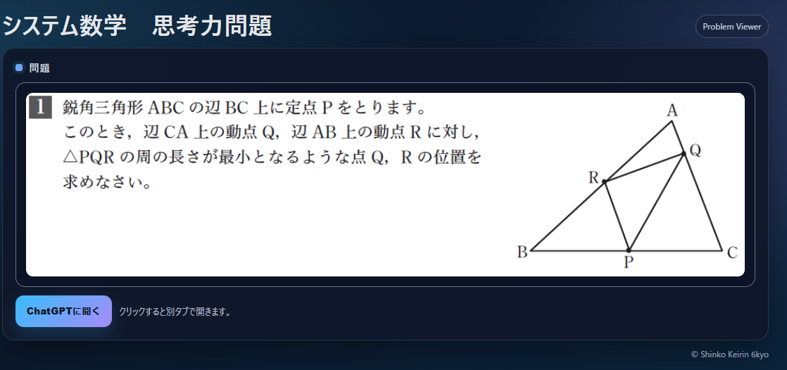
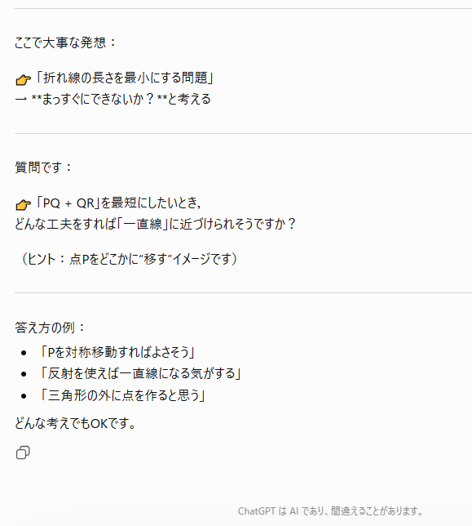
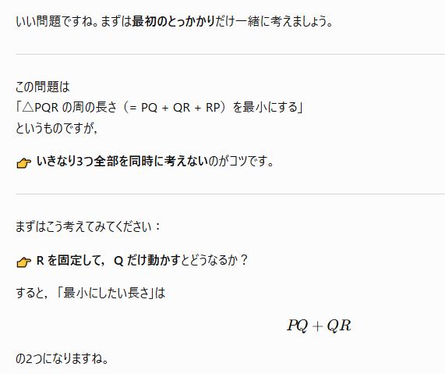

https://keirin6hen.github.io/sys-shikoryoku-daisu01/kangaekata.html?id=51

Slide 2
