Slide 1
Success and Fame: A Lesson from Yu Qing
Exploring how dedication and self-improvement lead to true recognition

Slide 2
Content
1. Introduction
2. Yu Qing’s Initial Success and Fame
3. Yu Qing’s Choice of Loyalty Over Wealth
4. The Consequences of His Choices
5. Legacy Through Literature
6. Conclusion
7. Questions

Slide 3
Introduction

Slide 4
Introduction
Success is not just about recognition; it's about personal growth and self-improvement.
Success
self-improvement
self-discipline

Slide 5
Yu Qing’s Initial Success and Fame

Slide 6
Yu Qing’s Initial Success and Fame
Yu Qing was recognized as a loyal and upright minister, not just a persuasive advisor.
“Yu Qing was a loyal minister, not a persuasive speaker. He humbly approached the King of Zhao, and upon their first meeting, he was granted one hundred taels of gold and a pair of white jades. On his second visit, he became the highest-ranking official of Zhao, hence he was called Yu Qing.”
From The Collection of Books: Loyal Ministers with Integrity – Yu Qing, the Lord of Pingyuan

Slide 7
Yu Qing’s Initial Success and Fame
Become minister
Recognition in Zhao
Diplomacy with Qin

Slide 8
Yu Qing’s Choice of Loyalty Over Wealth

Slide 9
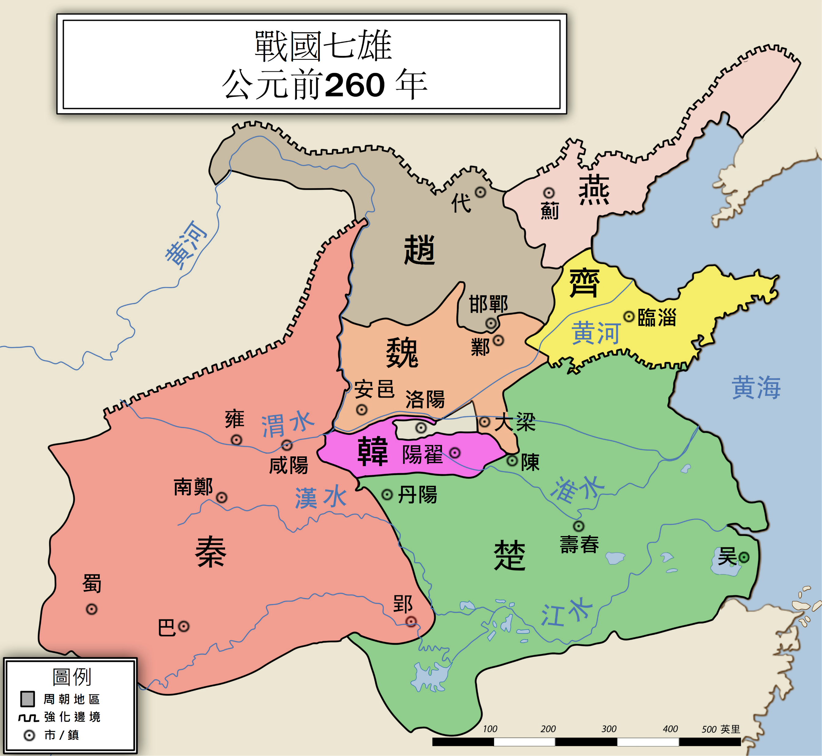
Yu Qing’s Choice of Loyalty Over Wealth
Yu Qing chose friendship and loyalty over the fleeting power of wealth.
He left Zhao because Wei Qi was being pursued for offending Fan Ju.

Slide 10
Yu Qing’s Choice of Loyalty Over Wealth
Power and Wealth
Loyalty and Friendship
OR
Loyalty and Friendship
Power and Wealth

Slide 11
The Consequences of His Choices

Slide 12
The Consequences of His Choices
?
Why would someone choose loyalty over the allure of power?
“Yu Qing, who was adept at predicting events and understanding emotions,
devised strategies for Zhao. How skillful he was! When he could no longer tolerate
Wei Qi’s treatment, he ultimately became trapped in Daliang. Even an ordinary
man would know this was unwise, let alone a wise one.’’
From Records of the Grand Historian

Slide 13
The Consequences of His Choices
Yu Qing’s actions might seem puzzling at first, but they reveal deeper values.
Choices
Principles
Dedication to his values

Slide 14
Legacy Through Literature

Slide 15
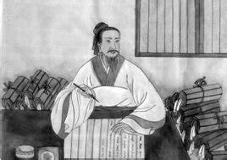
Legacy Through Literature
Through writing, Yu Qing expressed his dedication to loyalty and righteousness.

Slide 16
Conclusion

Slide 17
Conclusion
Yu Qing ultimately gained lasting fame and admiration for his principles.
Core Idea: Success and fame do not require deliberate pursuit;
they come from self-discipline and continuous improvement.
Eternal success
Wisdom left for Future Generations
Leaving a Name in History
Temporary success
High Officialdom
Rich Rewards

Slide 18

Success and fame are the byproducts of self-improvement.

Slide 19
Thank you for listening
计算机2408班 王云瑜

