Slide 1

PRIVACY

Slide 2
National Security Agency (NSA)
The National Security Agency (NSA), an intelligence agency of the U.S. government, is responsible for the making and breaking of codes used to encrypt sensitive communications, and for the interception of signals on behalf of the federal government.
The NSA has established a comprehensive telecommunications network capable of monitoring billions of emails and phone calls-whether they originated within the United States or overseas.
The Advanced Encryption Standard (AES) algorithm is the current state-of-the-art standard for encrypting top-secret communications

Slide 3
PRIVACY PROTECTION AND THE LAW

Slide 4
Information about people is gathered, stored, analyzed, and reported because organizations can use it to make better decisions.
A combination of approaches—new laws, technical solutions, and privacy policies—is required to balance the scales.
The Fourth Amendment is as follows:
The right of the people to be secure in their persons, houses, papers, and effects, against unreasonable searches and seizures, shall not be violated, and no Warrants shall issue, but upon probable cause, supported by Oath or affirmation, and particularly describing the place to be searched, and the persons or things to be seized.

Slide 5

INFORMATION PRIVACY

Slide 6
A broad definition of the right of privacy is “the right to be left alone—the most comprehensive of rights, and the right most valued by a free people.”
Information privacy is the combination of communications privacy (the ability to communicate with others without those communications being monitored by other persons or organizations) and data privacy (the ability to limit access to one’s personal data by other individuals and organizations in order to exercise a substantial degree of control over that data and its use).

Slide 7

PRIVACY LAWS, APPLICATIONS AND COURT RULINGS
Financial Data, Fair Credit Reporting Act, Right to Financial Privacy Act, Gramm-Leach-Bliley Act

Slide 8
FINANCIAL DATA
Financial data consists of pieces or sets of information related to the financial health of a business. The pieces of data are used by internal management to analyze business performance and determine whether tactics and strategies must be altered.

Slide 9
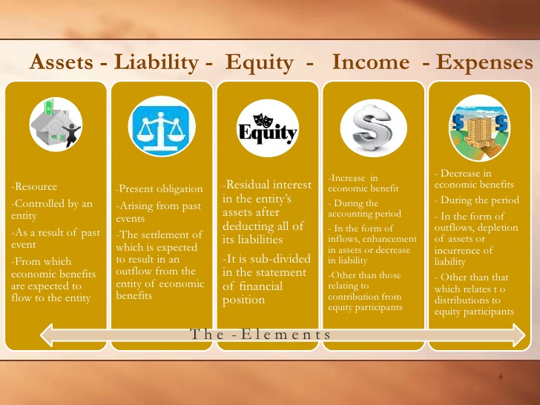

Slide 10
FAIR CREDIT REPORTING ACT (1970)
regulates the operations of credit-reporting bureaus, including how they collect, store, and use credit information.
designed to ensure the accuracy, fairness, and privacy of information gathered by the credit-reporting companies and to check those systems that gather and sell information about people.

Slide 11
RIGHT TO FINANCIAL PRIVACY ACT (1978)
The Right to Financial Privacy Act protects the records of financial institution customers from unauthorized scrutiny by the federal government.

Slide 12
to gain access to a customer’s financial records, the government must obtain one of the following:
an authorization signed by the customer that identifies the records, the reasons the records are requested, and the customer’s rights under the act,
an appropriate administrative or judicial subpoena or summons,
a qualified search warrant, or
a formal written request by a government agency (can be used only if no administrative summons or subpoena authority is available)

Slide 13
Gramm-Leach-Bliley Act (1999)
The Gramm-Leach-Bliley Act (GLBA) establishes guidelines for the collection and disclosure of personal financial information; requires financial institutions to document their data security plan; and encourages institutions to implement safeguards against pretexting.

Slide 14
Three key rules that affect personal privacy
Financial Privacy Rule
- established mandatory guidelines for the collection and disclosure of personal financial information by financial organizations
Safeguards Rule
- requires each financial institution to document a data security plan describing the company’s preparation and plans for the ongoing protection of clients’ personal data.
Pretexting Rule
- addresses attempts by people to access personal information without proper authority by such means as impersonating an account holder or phishing

Slide 15
Fair and Accurate Credit Transactions Act (2003)
The Fair and Accurate Credit Transaction Act allows consumers to request and obtain a free credit report once each year from each of the three primary consumer credit reporting companies (Equifax, Experian, and TransUnion)

Slide 16
HEALTH INFORMATION
Health Insurance Portability and Accountability Act ,The American Recovery and Reinvestment Act

Slide 17
Health Insurance Portability and Accountability Act (1996)
designed to improve the portability and continuity of health insurance coverage; to reduce fraud, waste, and abuse in health insurance and healthcare delivery; and to simplify the administration of health insurance.
HIPPA requires healthcare organizations to employ standardized electronic transactions, codes and identifiers to enable them to fully digitize medical records, thus making it impossible to exchange medical data over the internet
Healthcare providers must obtain written consent from patients prior to disclosing any information in their medical records

Slide 18
The American Recovery and Reinvestment Act (2009)
Is a wide-ranging act passed in 2009 that authorized $787 billion in spending and tax cuts over a 10-year period.
Title XIII, Subtitle D of this act (known as the Health Information Technology for Economic and Clinical Health Act, or HITECH) included strong privacy provisions for electronic health records, including banning the sale of health information, promoting the use of audit trails and encryption, and providing rights of access for patients

Slide 19
CHILDREN’S PERSONAL DATA
Family Educational Rights and Privacy Act , Children’s Online Privacy Protection Act

Slide 20
Norton Online Living reports that 40 percent of teens have received an online request for personal information. In addition, an estimated 16 percent of U.S. children have been approached online by a stranger.
Many people feel that there is a need to protect children from being exposed to inappropriate material and online predators; becoming the target of harassment; divulging personal data; and becoming involved in gambling or other inappropriate behavior.

Slide 21
Family Educational Rights and Privacy Act (1974)
is a federal law that assigns certain rights to parents regarding their children’s educational records. These rights transfer to the student once the student reaches the age of 18 or if he or she attends a school beyond the high school level.
These rights include
• the right to access educational records maintained by a school;
• the right to demand that educational records be disclosed only with student consent;
• the right to amend educational records; and
• the right to file complaints against a school for disclosing educational records in violation of FERPA

Slide 22
FERPA was implemented before the birth of the Internet and the widespread use of databases at various agencies, institutions, and organizations that attempt to service young people

Slide 23
Children’s Online Privacy Protection Act (1998)
any Web site that caters to children must offer comprehensive privacy policies, notify parents or guardians about its data collection practices, and receive parental consent before collecting any personal information from children under 13 years of age
COPPA was implemented in 1998 in an attempt to give parents control over the collection, use, and disclosure of their children’s personal information; it does not cover the dissemination of information to children.

Slide 24
ELECTRONIC SURVEILLANCE
Communications Act , The Foreign Intelligence Surveillance Act, Title III of the Omnibus Crime Control and Safe Street Act, Electronic Communications Privacy Act, Communications Assistance for Law Enforcement Act, USA PATRIOT Act, Foreign Intelligence Surveillance Act Amendments Act

Slide 25
1. Communications Act (1934)
established the Federal Communications Commission and gave it responsibility for regulating all non-federal-government use of radio and television broadcasting and all interstate telecommunications as well as all international communications.

Slide 26
2. The Foreign Intelligence Surveillance Act (FISA, 1978)
describes procedures for the electronic surveillance and collection of foreign intelligence information in communications between foreign powers and the agents of foreign powers.

Slide 27
3. Title III of the Omnibus Crime Control and Safe Streets Act (1986)
also known as the Wiretap Act, regulates the interception of wire (telephone) and oral communications.

Slide 28
4. The Electronic Communications Privacy Act (ECPA, 1986)
deals with three main issues:
(1) the protection of communications while in transfer from sender to receiver;
(2) the protection of communications held in electronic storage; and
(3) the prohibition of devices from recording dialing, routing, addressing, and signaling information without a search warrant.

Slide 29
5. Communications Assistance for Law Enforcement Act (1994)
The Communications Assistance for Law Enforcement Act (CALEA) required the telecommunications industry to build tools into its products that federal investigators can use—after gaining a court order—to eavesdrop on conversations and intercept electronic communications.

Slide 30
6. USA PATRIOT Act (2001)
The USA PATRIOT Act modified 15 existing statutes and gave sweeping new powers both to domestic law enforcement and to international intelligence agencies, including increasing the ability of law enforcement agencies to eavesdrop on telephone communication, intercept email messages, and search medical, financial, and other records; the act also eased restrictions on foreign intelligence gathering in the United States

Slide 31
7. Foreign Intelligence Surveillance Act Amendments Act (2008)
describes procedures for the electronic surveillance and collection of foreign intelligence information in communications between foreign powers and agents of foreign powers. It also created a special court which meets in secret to hear applications for orders approving electronic surveillance anywhere within the United States.

Slide 32
FAIR INFORMATION PRACTICES
Organization for Economic Co-operation and Development Guidelines, European Union Data Protection

Slide 33
Fair information practices is a term for a set of guidelines that govern the collection and use of personal data. Various organizations as well as countries have developed their own set of such guidelines and call them by different names.
Fair information practices are important because they form the underlying basis for many national laws addressing data privacy and data protection issues.

Slide 34
Organization for Economic Co-operation and Development Guidelines for the Protection of Privacy and Transborder Flows of Personal Data (1980)
The Organization for Economic Co-operation and Development (OECD) is an international organization currently consisting of 34 member countries, including Australia, Canada, France, Germany, Italy, Japan, Mexico, New Zealand, the United Kingdom, and the United States.
Its goals are to set policy and to come to agreement on topics for which multilateral consensus is necessary in order for individual countries to make progress in a global economy.
The OECD’s fair information practices, established in 1980

Slide 35
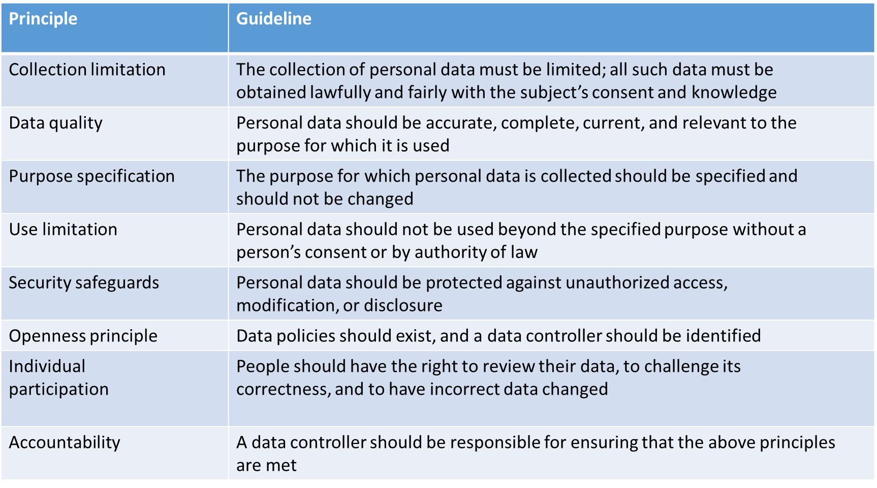
These guidelines are composed of the eight principles summarized in Table 4-2

Slide 36
European Union Data Protection Directive (1995)
The European Union Data Protection Directive (officially known as Directive 95/46/EC) requires any company doing business within the borders of the countries comprising the European Union to implement a set of privacy directives on the fair and appropriate use of information.
The following list summarizes the basic tenets of the directive:
Notice—An individual has the right to know if his or her personal data is being collected, and any data must be collected for clearly stated, legitimate purposes.
Choice—An individual has the right to elect not to have his or her personal data collected.

Slide 37
Use — An individual has the right to know how personal data will be used and the right to restrict its use.
Security—Organizations must “implement appropriate technical and organizations measures” to protect personal data, and the individual has the right to know what these measures are.
Correction—An individual has the right to challenge the accuracy of the data and to provide corrected data.
Enforcement—An individual has the right to seek legal relief through appropriate channels to protect privacy rights.
In 2012, the European Commission proposed a new European Data Protection Regulation to replace the 1995 Data Protection Directive

Slide 38
ACCESS TO GOVERNMENT RECORDS
Freedom of Information Act (FOIA) (1966, amended 1974) , Privacy Act (1974)

Slide 39
Freedom of Information Act (FOIA) (1966, amended 1974)
The Freedom of Information Act (FOIA) grants citizens the right to access certain information and records of federal, state, and local governments upon request. FOIA is a powerful tool that enables journalists and the public to acquire information that the government is reluctant to release.

Slide 40
There are two basic requirements for filing a FOIA request:
(1) the request must not require wide-ranging, unreasonable, or burdensome searches for records
(2) the request must be made according to agency procedural regulations published in the Federal Register.
The use of the FOIA to access information can lead to a dispute between those who feel it is important to reveal certain information and those who feel certain government data should not be made public, including, in some cases, those whose privacy is being impacted.

Slide 41
Privacy Act (1974)
The Privacy Act establishes a code of fair information practices that sets rules for the collection, maintenance, use, and dissemination of personal data that is kept in systems of records by federal agencies.
The law also outlines 12 requirements that each record-keeping agency must meet, including issues that address openness, individual access, individual participation, collection limitation, use limitation, disclosure limitation, information management, and accountability.
The purpose of the act is to provide safeguards for people against invasion of personal privacy by federal agencies.

Slide 42
KEY PRIVACY AND ANONYMITY ISSUES
Data Breaches, Electronic Discovery, Consumer Profiling, Workplace Monitoring, Advanced Surveillance Monitoring,

Slide 43
Data Breaches
- caused by hackers breaking into databases involving personal information.
Electronic discovery (e-discovery)
- is the collection, preparation, review, and production of electronically stored information for use in criminal and civil actions and proceedings.
Consumer Profiling
- collection of personal information about users when they register at Web sites, complete surveys, fill out forms, or enter contests online.

Slide 44
Workplace Monitoring
Plenty of data exists to support the conclusion that many workers waste large portions of their work time doing non-work-related activity.
In a recent survey by an IT staffing firm, 54 percent of companies reported they were banning the use of social networking sites such as Facebook, Twitter, MySpace, and LinkedIn to help reduce waste at work

Slide 45
Advanced Surveillance Technology
A number of advances in information technology—such as surveillance cameras and satellite-based systems that can pinpoint a person’s physical location—provide amazing new data-gathering capabilities. However, these advances can also diminish individual privacy and complicate the issue of how much information should be captured about people’s private lives.

Slide 46
Camera Surveillance
Surveillance cameras are used in major cities around the world in an effort to deter crime and terrorist activities.
There are 4.2 million closed circuit TV cameras (CCTV) in operation throughout Great Britain—which amounts to 1 CCTV camera for every 14 people.
China, by way of comparison, has 2.75 million cameras, or 1 camera for every 472,000 citizens.
The number of cameras in London was greatly expanded during the 2012 Olympics, and a system called DYVINE enables all London CCTV cameras to be monitored and controlled from the New Scotland Yard

Slide 47
Vehicle Event Data Recorders
A vehicle event data recorder (EDR) is a device that records vehicle and occupant data for a few seconds before, during, and after any vehicle crash that is severe enough to deploy the vehicle’s air bags.
One purpose of the EDR is to capture and record data that can be used by the manufacturer to make future changes to improve vehicle performance in the event of a crash. Another purpose is for use in a court of law to determine what happened during a vehicle accident.

Slide 48
Stalking Apps
Stalking apps can be downloaded onto a person’s cell phone, making it possible to perform location tracking, record calls and conversations, view every text and photograph sent or received, and record the URLs of any Website visited on that phone.

Slide 49
Thank You for Listening !

