Slide 1
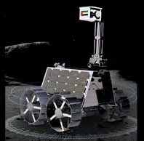
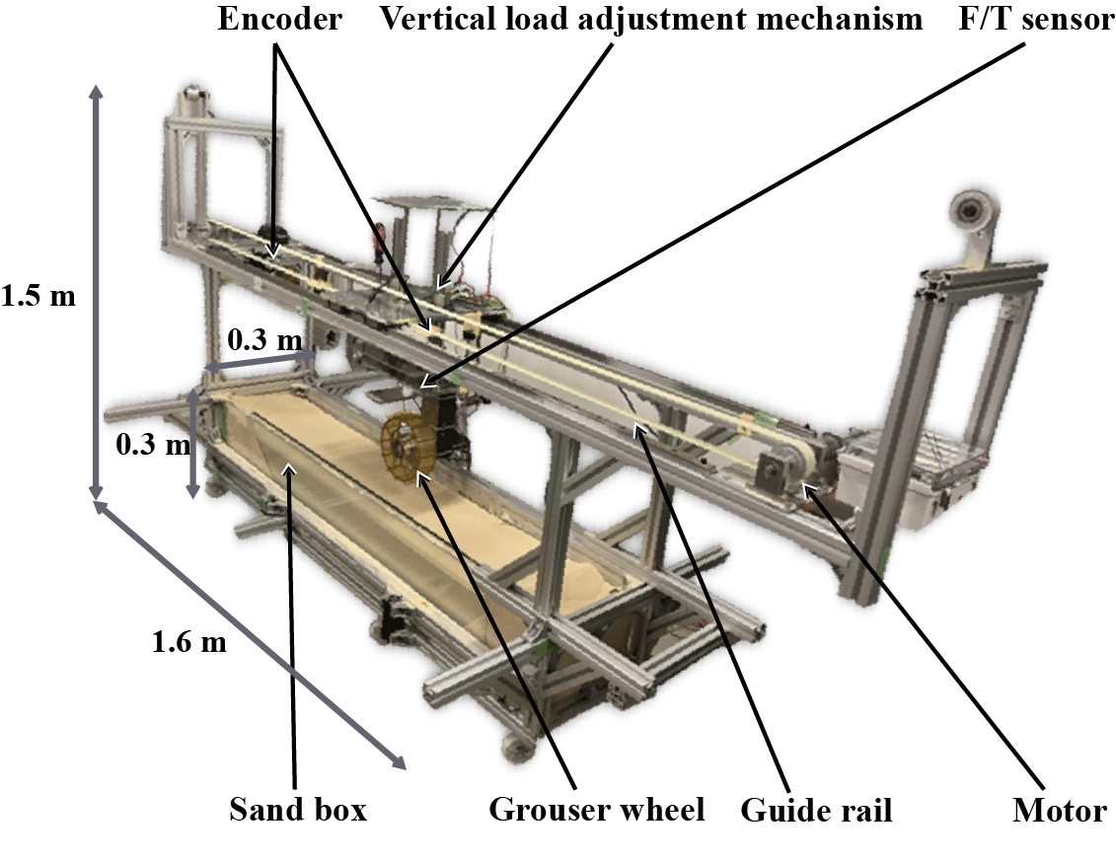
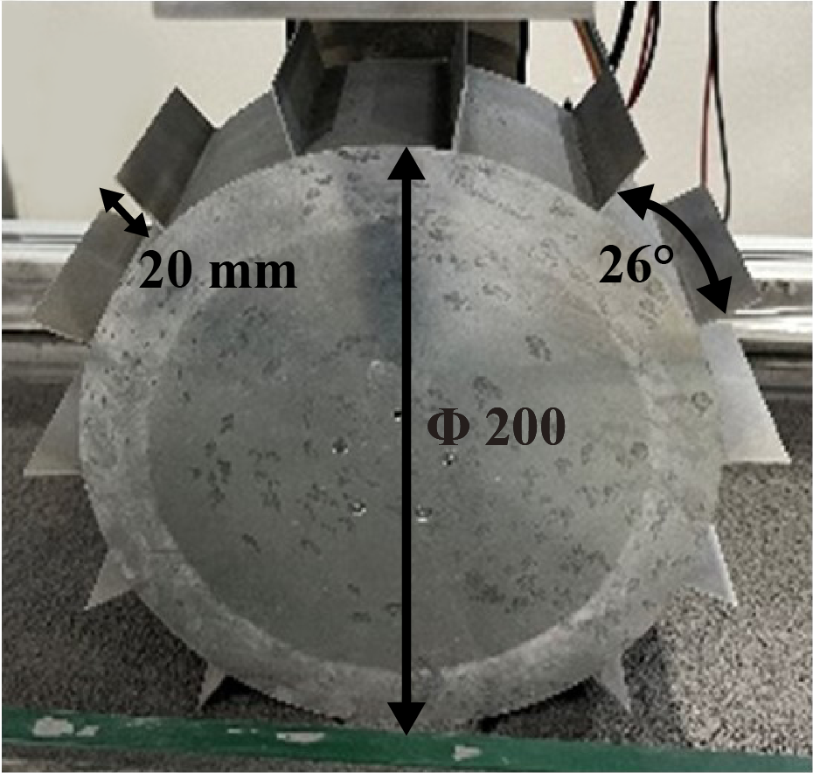
Experiment (single-wheel test)
©MBRSC
Design the wheel with the same type as the lunar Exploration rover
Driving experiment using single-wheel testbed
on Toyoura sand and regolith simulant

