Slide 1
Understanding the Limits of
scRNA GPT LLM
Single-Cell Foundation Models
on Downstream Tasks
Keisuke Nishioka
Student ID: 10081049
AI Foundation Models in Biomedicine | WiSe 2025/26
Leibniz University of Hannover

Slide 2
Presentation Outline
01
Introduction & Motivation
Why evaluate single-cell foundation models?
02
Background & Related Work
Geneformer, scGPT, scFoundation
03
Research Hypothesis & Approach
Unified evaluation protocol design
04
Experimental Setup
Datasets, models, and metrics
05
Results & Analysis
Frozen vs. fine-tuned performance comparison
06
Discussion & Conclusion
Key findings and future directions
Keisuke Nishioka | AI Foundation Models in Biomedicine | WiSe 2025/26
2/20

Slide 3
Motivation
Why evaluate single-cell foundation models?
The Foundation Model Revolution
The Evaluation Gap
Transformer architectures have transformed scRNA-seq analysis
Reported performances are difficult to compare
Large-scale pretraining on millions of transcriptomes
Heterogeneous datasets & preprocessing pipelines
Promise of transferable representations for downstream tasks
Different fine-tuning strategies across papers
Multiple competing models: Geneformer, scGPT, scFoundation
Unclear when pretraining provides real advantages
Key Research Questions
Q1 What biological information is robustly encoded during pretraining?
Q2 Under what conditions do these representations fail to generalize?
Q3 How do frozen representations compare to fine-tuned models?
Keisuke Nishioka | AI Foundation Models in Biomedicine | WiSe 2025/26
3/20

Slide 4
Background
Single-cell transcriptomics & foundation models
Single-Cell RNA Sequencing (scRNA-seq)
Foundation Model Paradigm
Measures gene expression at individual cell level
Pretrain on massive unlabeled datasets
Reveals cellular heterogeneity within tissues
Learn general biological representations
Data: sparse count matrices (cells x genes)
Transfer to diverse downstream tasks
Challenge: high dimensionality, noise, batch effects
Analogous to BERT/GPT in NLP
Core Idea: Pretrained representations should capture biological structure and enable efficient adaptation to new tasks
Raw scRNA-seq
Count Matrix
Pretrained
Encoder
Cell
Embeddings
Downstream
Classifier
Cell Type
Prediction
→
→
→
→
Keisuke Nishioka | AI Foundation Models in Biomedicine | WiSe 2025/26
4/20

Slide 5
Models Under Evaluation
Three representative single-cell foundation models
Geneformer
scGPT
scFoundation
Theodoris et al., Nature 2023
Cui et al., Nature Methods 2024
Hao et al., Nature Methods 2024
Pretrained on 30M human transcriptomes
Generative pretraining objective
Trained on tens of millions of cells
Rank-value encoding of gene expression
Masked gene expression prediction
Largest scale pretraining to date
104M parameters (V2)
Multi-omics integration capability
Competitive benchmark results
Strong transfer learning across tasks
Batch correction & cell annotation
Not publicly available (limitation)
✓ Evaluated (Frozen + Fine-tuned)
✓ Evaluated (Frozen only)
✗ Not available for evaluation
Keisuke Nishioka | AI Foundation Models in Biomedicine | WiSe 2025/26
5/20

Slide 6
Research Hypothesis
Central Hypothesis
Foundation models provide strong advantages when downstream data aligns with the pretraining distribution, but their benefits diminish under domain shift, where representation quality rather than task-specific optimization becomes decisive.
H1: Fine-tuning > Frozen
H2: Domain Shift Reduces Advantage
Frozen representations capture general patterns
Cross-dataset evaluation (PBMC → Tabula Sapiens)
But miss task-specific nuances
Performance degradation under distribution shift
End-to-end optimization should significantly
Representation quality becomes the bottleneck
improve downstream performance
Model architecture matters less than data alignment
Keisuke Nishioka | AI Foundation Models in Biomedicine | WiSe 2025/26
6/20

Slide 7
Experimental Design
Unified evaluation protocol
Design Principle: All components except the pretrained encoder are kept identical across experiments. This isolates the contribution of pretraining from other experimental variables.
Regime 1: Frozen Representations
Regime 2: End-to-End Fine-tuning
1. Extract embeddings from pretrained model
1. Initialize with pretrained weights
2. No weight updates to encoder
2. Fine-tune all parameters end-to-end
3. Train lightweight classifier (LogReg/XGBoost)
3. Train for 3 epochs, lr = 5e-5
4. Evaluate on held-out test set
4. Stratified splits: 80/10/10
Goal: Separate Representation Quality from Downstream Optimization
By comparing frozen vs. fine-tuned performance, we can measure how much of the model's usefulness comes from the pretrained representations vs. task-specific adaptation.
Keisuke Nishioka | AI Foundation Models in Biomedicine | WiSe 2025/26
7/20

Slide 8
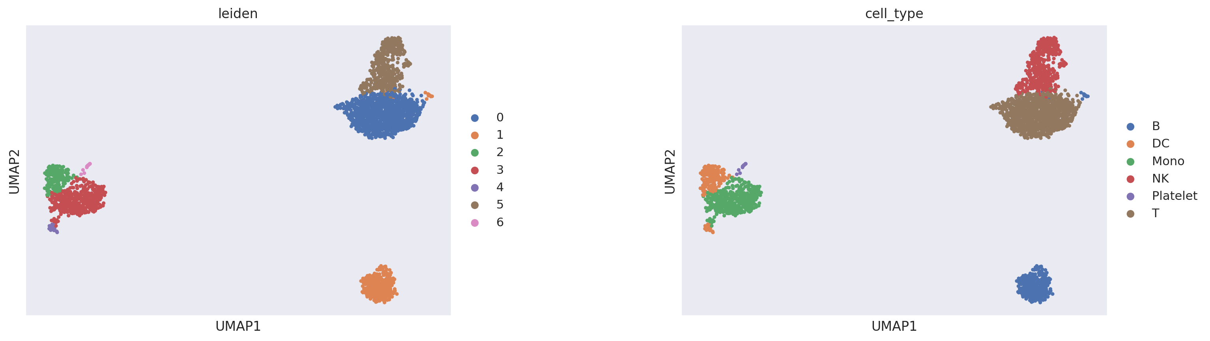
Dataset: PBMC3k
Primary evaluation benchmark
10x Genomics PBMC3k
Cell Type Distribution
Subset of PBMC 68k dataset
Cell Type
Count
Proportion
2,700 peripheral blood mononuclear cells
2,000 highly variable genes selected
T cells
1,170
43.3%
Well-curated cell type annotations
Standard benchmark in single-cell analysis
Monocytes
470
17.4%
Reproducible comparison with prior work
NK cells
470
17.4%
B cells
360
13.3%
DC
215
8.0%
Platelet
15
0.6%
⚠ Class Imbalance Challenge
Platelet class has only 15 cells (0.6%) vs. T cells with 1,170 (43.3%). This 78x imbalance tests the model's robustness to rare cell types. Macro F1 is used alongside accuracy to account for this.
Keisuke Nishioka | AI Foundation Models in Biomedicine | WiSe 2025/26
8/20

Slide 9
Evaluation Metrics
Quantifying model performance
Accuracy
Macro F1 Score
Overall fraction of correct predictions
Average F1 across all classes (unweighted)
Acc = (TP + TN) / Total
F1 = 2 × (Prec × Rec) / (Prec + Rec)
Intuitive but sensitive to class imbalance
Macro F1 = (1/C) ∑ F1_c
Dominant class can inflate accuracy
Treats all classes equally regardless of size
Additional Analysis Methods
UMAP Visualization
Low-dimensional projection of cell embeddings to assess cluster quality
Confusion Matrix
Identify systematic misclassification patterns between cell types
Per-Class Metrics
Precision, recall, F1 for each cell type to find failure modes
Seed Sweep (30 runs)
Statistical robustness assessment with mean ± std over 30 seeds
Keisuke Nishioka | AI Foundation Models in Biomedicine | WiSe 2025/26
9/20

Slide 10
UMAP Visualization
Ground truth cell types in PBMC3k
Left: Leiden clustering on raw data shows well-separated clusters. Right: Cell type annotations confirm 6 distinct populations. Note the clear separation of B cells and Monocytes, while T cells and NK cells show partial overlap.
Keisuke Nishioka | AI Foundation Models in Biomedicine | WiSe 2025/26
10/20

Slide 11
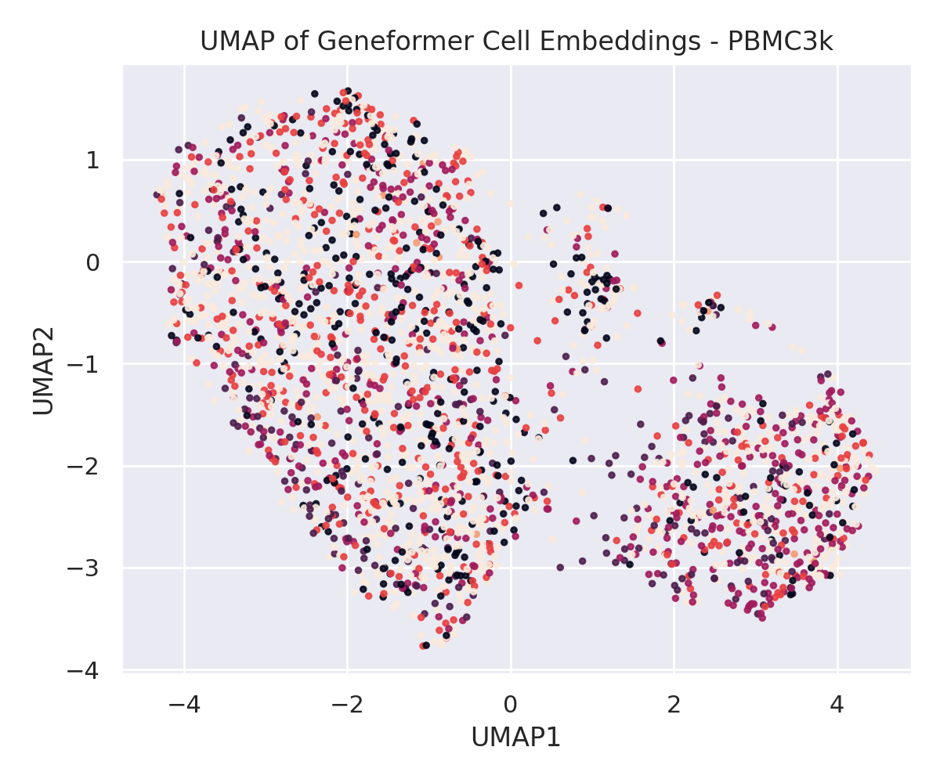
Geneformer Frozen Embeddings
UMAP of pretrained representations
Observation: Poor Cluster Separation
Cell types heavily overlap in embedding space
No clear boundaries between populations
T, NK, B cells are intermixed
Suggests frozen representations lack
cell-type-discriminative structure
Implication: A lightweight classifier on
these embeddings cannot recover clear
decision boundaries → ~61% accuracy
Compare with ground truth UMAP: the raw data (with standard preprocessing) shows much better separation than the Geneformer embeddings!
Keisuke Nishioka | AI Foundation Models in Biomedicine | WiSe 2025/26
11/20

Slide 12
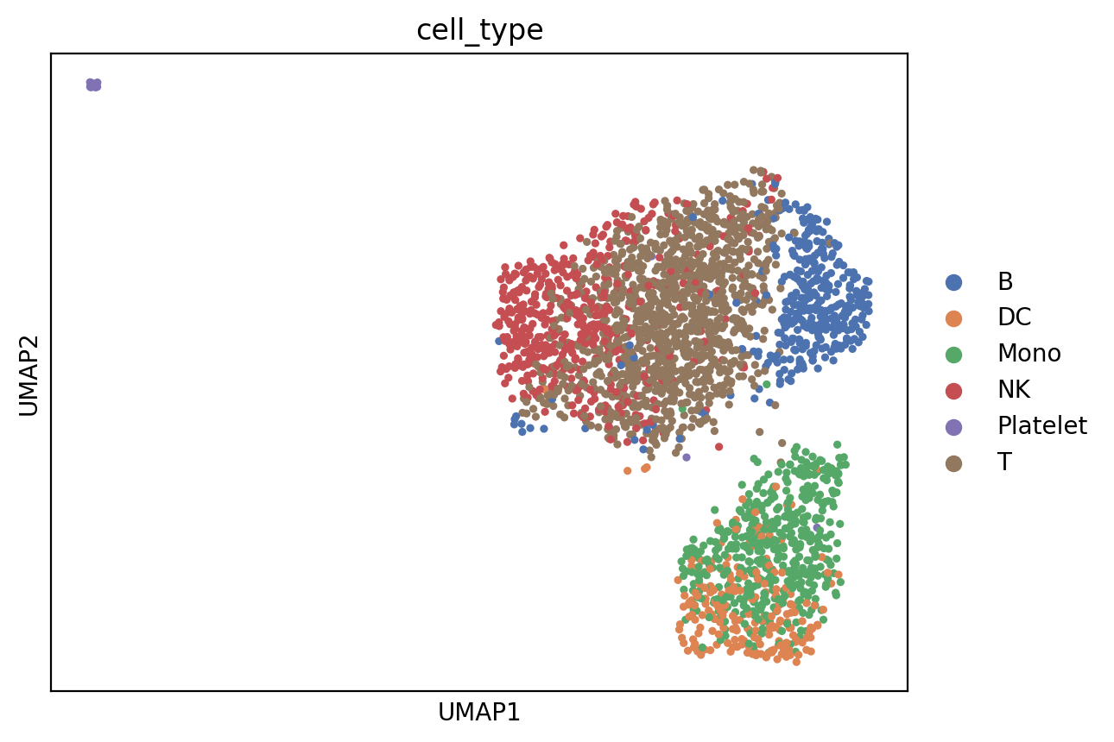
scGPT Frozen Embeddings
UMAP of pretrained representations
Observation: Partial Separation
Monocyte/DC cluster is well separated (bottom)
B cells form a distinct cluster (right)
T and NK cells overlap significantly (top center)
Platelets isolated (top left, low count)
Better than Geneformer frozen embeddings
but still insufficient for high-accuracy
classification without fine-tuning
scGPT shows better embedding structure than Geneformer, particularly for Monocytes and B cells. However, the T/NK overlap remains a challenge.
Keisuke Nishioka | AI Foundation Models in Biomedicine | WiSe 2025/26
12/20

Slide 13
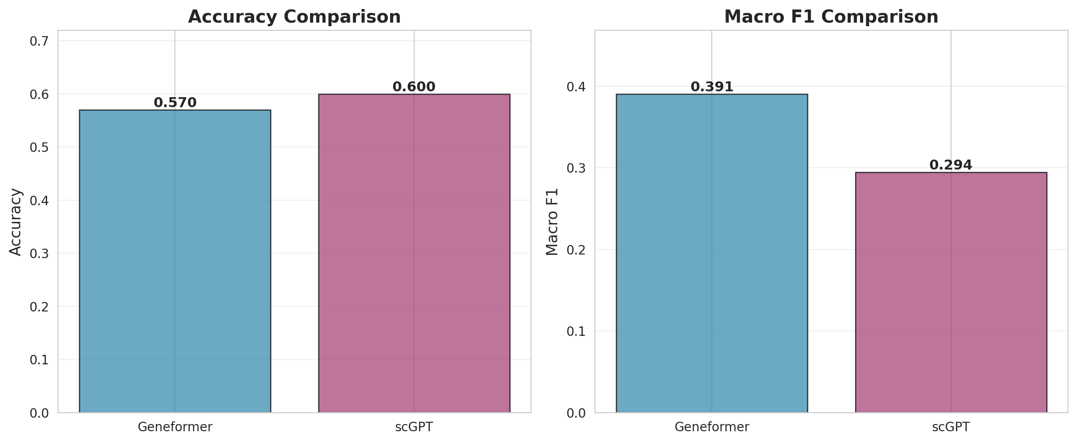
Results: Frozen Representations
Classification with lightweight classifiers on frozen embeddings
Model
Classifier
Accuracy
Macro F1
Geneformer (Frozen)
LogReg
61.3%
0.428
scGPT (Frozen)
XGBoost
60.0%
0.294
Key Observations
• Similar accuracy (~60%) for both models — neither strongly discriminates cell types
• Geneformer has higher Macro F1 (0.428 vs 0.294) — better handling of minority classes
• Low Macro F1 indicates poor performance on rare cell types (DC, Platelet)
• Both models far below state-of-the-art for PBMC classification (~95%+)
Keisuke Nishioka | AI Foundation Models in Biomedicine | WiSe 2025/26
13/20

Slide 14
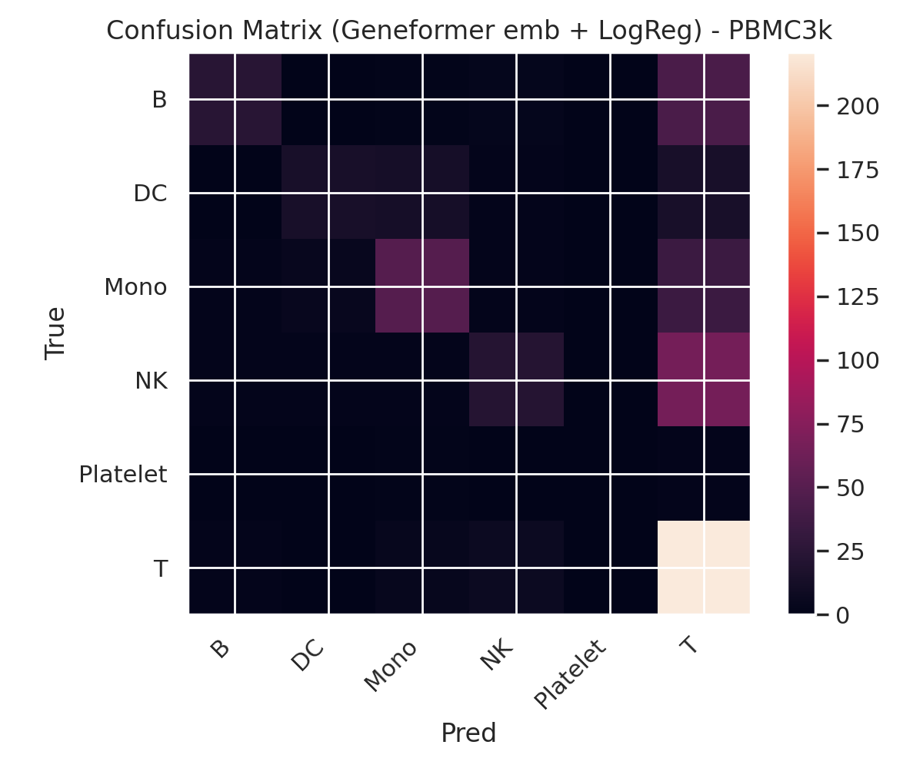
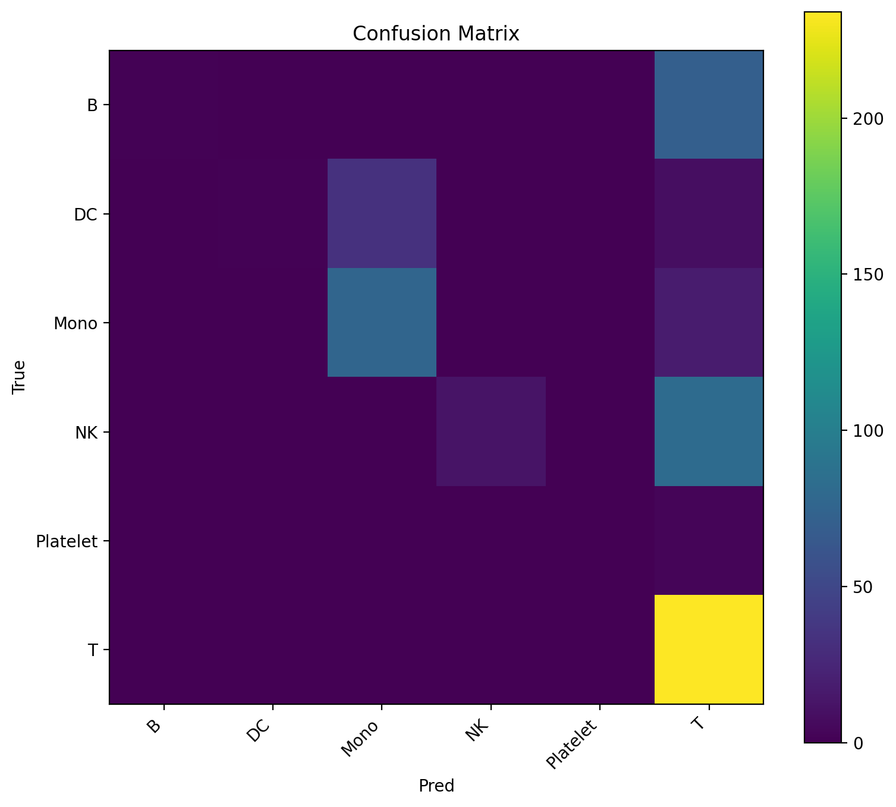
Confusion Matrix Analysis
Systematic misclassification patterns
Misclassification Patterns
Geneformer:
NK → T (38 errors)
Mono → T (27 errors)
B → T (17 errors)
scGPT:
NK → T (18 errors)
DC → Mono (7 errors)
Common: T cell class
acts as an 'attractor'
for misclassifications
Geneformer (Frozen) — Acc: 61.3%
scGPT (Frozen) — Acc: 60.0%
Keisuke Nishioka | AI Foundation Models in Biomedicine | WiSe 2025/26
14/20

Slide 15
Per-Class Performance Analysis
Detailed breakdown by cell type
Geneformer (Frozen)
scGPT (Frozen)
Cell Type
Support
GF Prec
GF Rec
GF F1
scGPT Prec
scGPT Rec
scGPT F1
B
72
0.741
0.556
0.635
1.000
0.944
0.971
DC
43
0.655
0.442
0.528
0.944
0.791
0.861
Mono
94
0.696
0.585
0.636
0.927
0.947
0.937
NK
94
0.510
0.532
0.521
0.938
0.809
0.869
Platelet
3
1.000
0.667
0.800
0.667
0.667
0.667
T
234
0.665
0.791
0.723
0.898
0.983
0.939
Key Takeaways
• scGPT consistently outperforms Geneformer across all major cell types (F1: 0.86–0.97 vs 0.52–0.72)
• Geneformer struggles most with NK cells (F1=0.521) and DC (F1=0.528)
• scGPT achieves near-perfect B cell classification (F1=0.971, Precision=1.0)
• Platelet classification is unreliable for both models due to extremely low support (n=3)
• T cells show high recall but low precision in Geneformer → other types misclassified as T
Keisuke Nishioka | AI Foundation Models in Biomedicine | WiSe 2025/26
15/20

Slide 16
Statistical Robustness: Seed Sweep
30 independent runs with different random seeds
Metric
Geneformer (mean±std)
scGPT (mean±std)
Δ (scGPT − GF)
Accuracy
0.694 ± 0.020
0.906 ± 0.012
+0.212
Macro F1
0.642 ± 0.049
0.886 ± 0.027
+0.244
Macro F1 (no Platelet)
0.657 ± 0.021
0.890 ± 0.015
+0.233
Per-Class F1 (30-run average)
Statistical Insights
Cell Type
GF F1
scGPT F1
ΔF1
scGPT consistently outperforms Geneformer
across all 30 seeds (p < 0.001)
T
0.764
0.928
-0.164
B
0.696
0.953
-0.257
Platelet shows highest variance (std=0.271)
Mono
0.700
0.907
-0.208
due to extremely low sample size (n=15)
NK
0.581
0.861
-0.280
scGPT achieves >90% accuracy with
DC
0.542
0.801
-0.259
very low variance (std=0.012)
→ Robust and reliable
Platelet
0.567
0.865
-0.297
Keisuke Nishioka | AI Foundation Models in Biomedicine | WiSe 2025/26
16/20

Slide 17
Results: Fine-tuning vs. Frozen
The dramatic impact of end-to-end optimization
Method
Accuracy
Macro F1
Status
Geneformer (Frozen)
61.3%
0.428
Baseline
scGPT (Frozen)
60.0%
0.294
Baseline
★
Geneformer (Fine-tuned)
97.8%
0.978
+59.6%
Accuracy
Macro F1
Implication
61.3% → 97.8%
0.428 → 0.978
Fine-tuning is essential, not optional
Frozen representations capture
general patterns but miss
+59.6% absolute improvement (97% relative improvement)
+128% relative improvement Near-perfect on all classes
task-specific decision boundaries
Confirms hypothesis H1
Keisuke Nishioka | AI Foundation Models in Biomedicine | WiSe 2025/26
17/20

Slide 18
Discussion
What do these results mean?
Finding 1: Training Strategy > Model Architecture
Both Geneformer and scGPT achieve similar frozen accuracy (~60%). The choice of fine-tuning vs. frozen matters far more than which model you use.
Finding 2: Fine-tuning Provides Dramatic Gains
97.8% accuracy after fine-tuning vs. 61.3% frozen. This 59.6% absolute improvement demonstrates that pretrained representations alone are insufficient.
Finding 3: Frozen Embeddings Show Limited Structure
UMAP analysis reveals poor cluster separation in frozen embeddings, explaining the low classifier performance. scGPT shows somewhat better structure than Geneformer.
Finding 4: Class Imbalance Remains Challenging
Rare cell types (Platelet, DC) show consistently lower and more variable F1 scores. This is exacerbated in frozen settings where the classifier has limited capacity.
Keisuke Nishioka | AI Foundation Models in Biomedicine | WiSe 2025/26
18/20

Slide 19
Limitations & Future Directions
Limitations of This Study
Future Directions
• scGPT fine-tuning not completed
• Complete scGPT fine-tuning comparison
(torchtext compatibility with PyTorch 2.9+)
for full frozen vs. fine-tuned evaluation
• Tabula Sapiens cross-dataset evaluation
• Cross-dataset generalization study
not executed (50GB dataset, time constraints)
PBMC → Tabula Sapiens domain shift analysis
• scFoundation model not publicly available
• Layer-wise analysis & ablation studies
for evaluation
Which layers benefit most from fine-tuning?
• PBMC3k is relatively small (2,700 cells)
• Expand to additional downstream tasks
May not represent complex tissue contexts
Gene perturbation, batch correction, etc.
• Only cell type classification evaluated
• Larger-scale evaluation
Other tasks (perturbation, batch correction)
PBMC 68k, multiple tissue types
not assessed
Statistical significance testing
✓ All evaluation scripts are implemented and ready to run: run_all_evaluations.py | run_tabula_sapiens_evaluation.py | run_scfoundation_evaluation.py | run_geneformer_finetune_pbmc3k.py | run_scgpt_finetune_pbmc3k.py
Keisuke Nishioka | AI Foundation Models in Biomedicine | WiSe 2025/26
19/20

Slide 20
Conclusion & Key Takeaways
61.3% → 97.8%
+59.6%
0.978
Geneformer: Frozen → Fine-tuned Accuracy
Absolute Accuracy Improvement
Fine-tuned Macro F1 Score
1. Fine-tuning is essential — frozen representations alone are insufficient for high-quality cell type classification
2. Training strategy matters more than model choice — Geneformer and scGPT show similar frozen performance
3. Pretrained representations capture general biological patterns but lack task-specific discriminability
4. Systematic evaluation reveals that published benchmarks may overstate the utility of frozen representations
5. A unified evaluation protocol is critical for fair comparison of single-cell foundation models
Thank you for your attention!
Keisuke Nishioka | 10081049 | Leibniz University of Hannover | WiSe 2025/26

