Slide 1
Parameter Estimation for a
5-Species Biofilm Model via
FOM, ROM, and TMCMC
Keisuke Nishioka
Institute of Continuum Mechanics, Leibniz University Hannover
February 2026
Notes:
This talk presents a free-energy-based FOM for a 5-species biofilm and a ROM+TMCMC framework for Bayesian parameter estimation. We focus on the model structure and algorithm design.

Slide 2
Outline
1. Background and Objectives
2. 5 Species and Interaction Network
3. Application to Biofilm Growth
4. FOM — State Variables and Constraints
5. FOM — Free-Energy-Based Governing Equations
6. FOM — Strong Form Structure (Overview)
7. FOM — Residual Equations (φᵢ)
8. FOM — Residual Equations (ψᵢ, γ)
9. Parameters — Interaction Matrix A and Decay Matrix B
10. Biological Constraints and Parameter Reduction
11. Hill-Function Gating Mechanism
12. Observation Model and Likelihood
13. ROM — TSM with Linearization Update
14. TMCMC — Algorithm Details
15. 4-Stage Sequential Estimation and Experimental Conditions
16. Summary and Outlook
Backup: From Hamilton Principle to Implementation
2
Notes:
This slide provides an overview of the talk. We start with the FOM structure based on free energy, then introduce biological constraints and parameter reduction, ROM for speed-up, TMCMC for Bayesian estimation, and finally the 4-stage sequential estimation with experimental conditions.

Slide 3
Background and Objectives
Background
Oral biofilms are complex microbial communities with multiple co-existing species.
Inter-species interactions (cooperation / competition) govern biofilm structure and pathogenicity.
Quantitative estimation of these interactions from experimental data is key to clinical applications.
Objectives
Construct a free-energy-based full-order model (FOM) for 5-species biofilm dynamics.
Combine ROM speed-up with TMCMC Bayesian estimation to infer the
inter-species interaction parameter θ from experimental data in a probabilistic framework.
Approach (3 stages)
1. FOM: nonlinear dissipative dynamics based on free energy → accurate but expensive
2. ROM: low-dimensional approximation of FOM → fast forward evaluation
3. TMCMC: fast likelihood via ROM → sample the posterior p(θ|y)
3
Notes:
Here we outline the research background and objectives. Oral biofilms involve multiple species whose interactions determine pathogenicity. The key challenge is to quantitatively estimate these interactions from experimental data. Our approach combines FOM, ROM, and TMCMC in three stages.

Slide 4
5 Species and Interaction Network
Species (Heine et al., 2025)
1. S. oralis — early colonizer
2. A. naeslundii — early colonizer
3. Veillonella spp. — metabolic bridge (lactate consumer)
4. F. nucleatum — bridge organism
5. P. gingivalis — late colonizer (periodontal pathogen)
Interaction network (Figure 4C)
S.o ↔ A.n: co-aggregation
S.o ↔ Vei: lactate production / consumption (lactate handover)
S.o ↔ F.n: formate / acetate symbiosis
Vei ↔ P.g: pH rise support
F.n ↔ P.g: co-aggregation and peptide supply
4
5 species pairs with no observed interaction → locked to zero (parameter reduction)
Notes:
This slide introduces the five bacterial species and their biological roles. S. oralis and A. naeslundii are early colonizers, Veillonella is a metabolic bridge, F. nucleatum is the bridge organism, and P. gingivalis is the late colonizer (pathogen). The interaction network is based on Heine et al. (2025) Figure 4C. Five active interaction pairs and five absent pairs have been experimentally confirmed. The absent pairs form the basis for our parameter reduction.

Slide 5
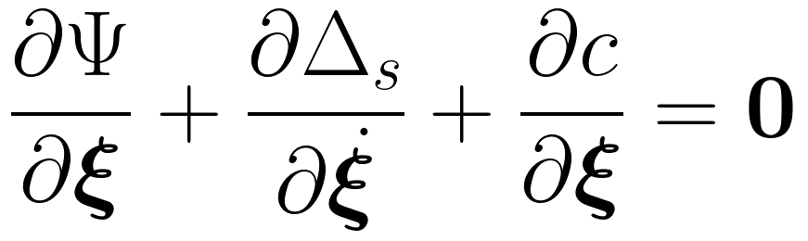
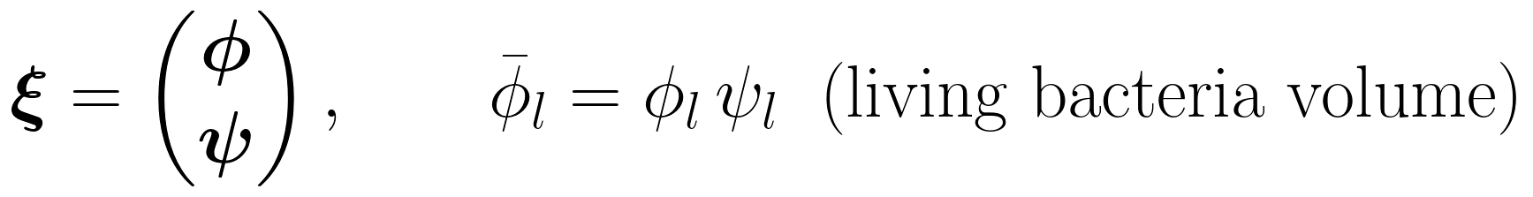
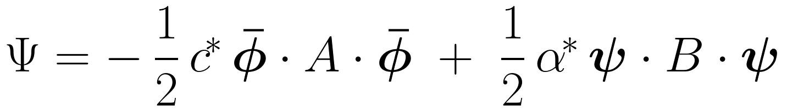
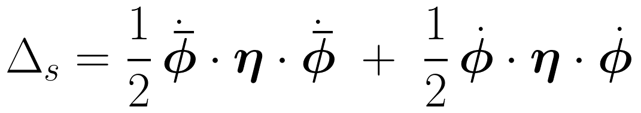
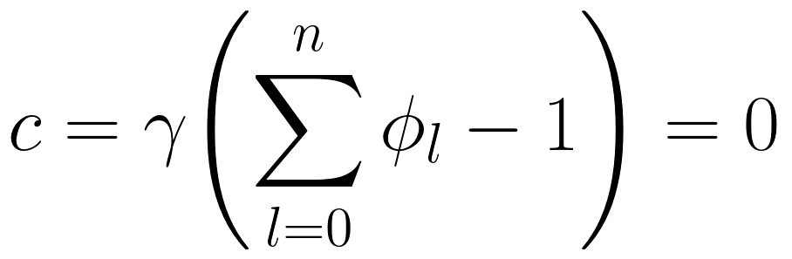
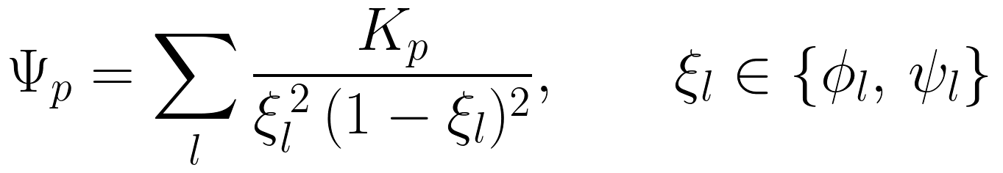
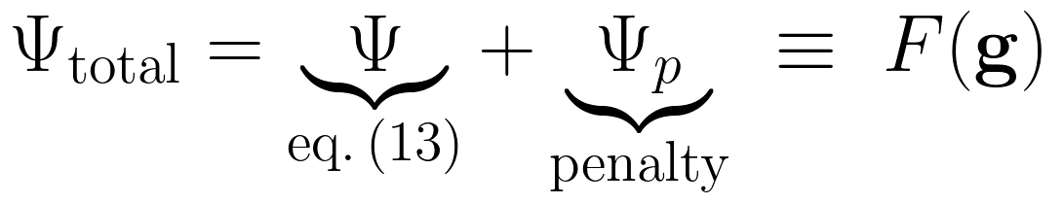
Application to Biofilm Growth
Biofilm model based on the extended Hamilton principle (Klempt et al.):
Extended Hamilton principle (local, quasi-static, isothermal)
Energy density function Ψ (eq.13)
Term 1: nutrients c* promote living bacteria growth — matrix A describes coupling
Term 2: antibiotics α* reduce viability — matrix B describes susceptibility
Dissipation Δs (eq.16) and constraint c (eq.18)
5
Penalty barrier Ψ_p (ensures ξ ∈ [0,1])
→ Dissipation defined via φ̄ = φψ rate leads to deeply coupled φ-ψ system.
Notes:
This slide presents the theoretical foundation of the biofilm model by Klempt et al. Starting from the extended Hamilton principle for a local, quasi-static, isothermal system, we define three constitutive functions: energy density Psi, dissipation Delta_s, and constraint c. Nutrients c-star promote growth through the interaction matrix A, while antibiotics alpha-star cause decay through matrix B. The key complexity arises from modelling dissipation via the rate of living bacteria volume phi-bar equals phi times psi, which deeply couples the phi and psi equations.

Slide 6
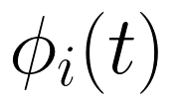
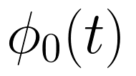
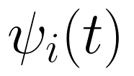
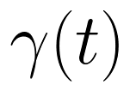
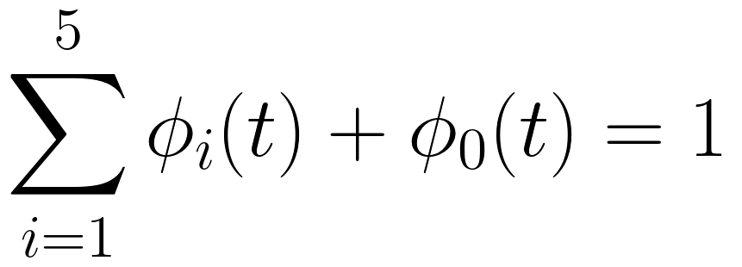
FOM — State Variables and Constraints
Notation bridge: ξ → g
Augmented with φ₀ (matrix volume fraction) and γ (Lagrange multiplier).
State vector
Volume fraction of species i (i = 1, …, 5)
Volume fraction of the matrix / aqueous phase
Internal structure / density variable of species i
Lagrange multiplier enforcing volume conservation
Volume conservation constraint
6
→ The sum of all volume fractions is always unity.
Notes:
We present the FOM state vector g(t) with 12 components: five species volume fractions, matrix volume fraction, five internal structure variables, and a Lagrange multiplier for volume conservation.

Slide 7
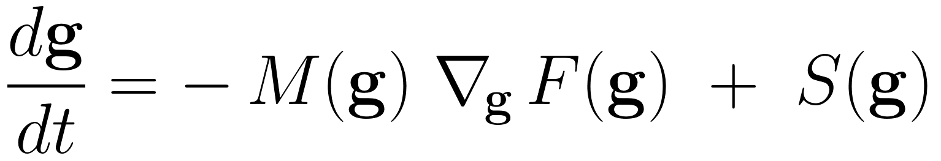
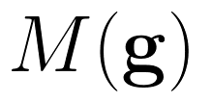
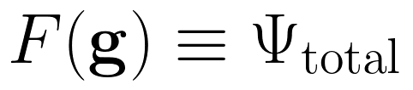
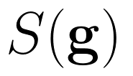
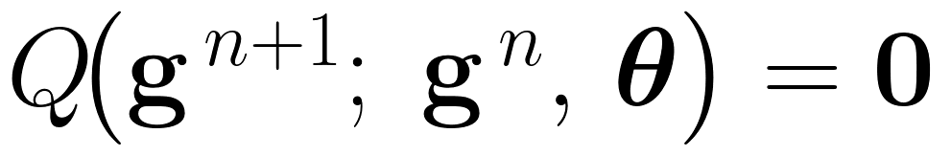
FOM — Free-Energy-Based Governing Equations
Dissipative dynamics driven by Ψ_total ≡ F(g)
Mobility matrix — encodes φ̄ = φψ coupling (not simply η⁻¹)
Total energy = interaction Ψ + penalty Ψ_p
Source term — growth, washout, and other non-conservative forces
Time discretisation — implicit Euler method
→ Nonlinear system solved by Newton's method at each time step.
→ Ensures stable integration for the stiff biofilm dynamics.
7
Notes:
The FOM is formulated as a dissipative system driven by free energy F(g). The mobility matrix M encodes the phi-bar coupling, F is the total energy Psi_total, and S captures growth and washout. When S=0, F decreases monotonically, ensuring thermodynamic consistency. We use implicit Euler with Newton's method for stable time integration.

Slide 8
FOM — Strong Form Structure (Overview)
Strong form for volume fraction φᵢ — colour-coded by physical role:
Volume conservation constraint
Penalty gradient: ∂Ψ_p/∂φᵢ — barrier ensuring ξ ∈ (0,1)
Dissipation: viscous damping via (η_φ, ηᵢ)
Constraint: Lagrange multiplier γ enforces volume conservation
Interaction: nutrients c* × matrix A × (φ⊙ψ) inter-species coupling
8
Notes:
This slide presents the strong form for phi_i in a single colour-coded equation. Black is the penalty barrier gradient, orange highlights the viscous dissipation terms, green marks the Lagrange multiplier gamma for volume conservation, and blue shows the inter-species interaction via the matrix A. The next slides expand each term in mathematical detail.

Slide 9
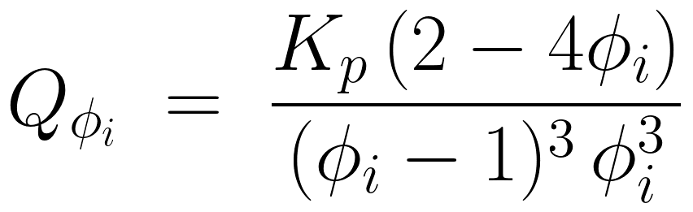
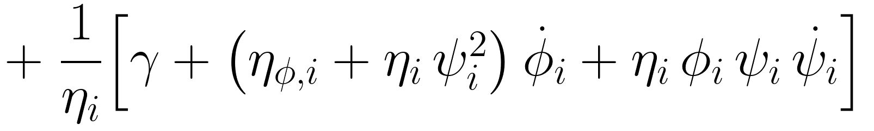
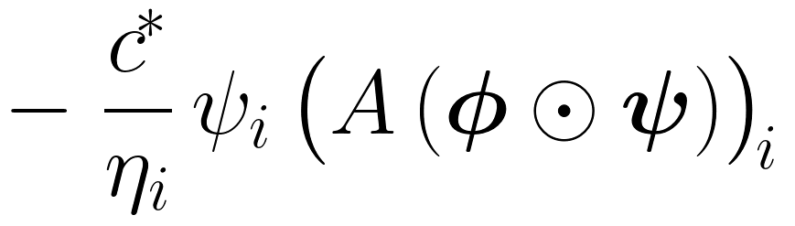
Residual Equations — φᵢ
Residual equation for the volume fraction φᵢ :
Physical interpretation of each term
Term 1: Penalty barrier ∂Ψ_p/∂φᵢ — ensures ξ ∈ (0,1)
Term 2: Dissipation — Lagrange multiplier γ and viscosity (η_φ, ηᵢ)
Term 3: Inter-species interaction — nutrients c* and matrix A (φ⊙ψ)
9
Notes:
This slide shows the residual equation for the volume fraction phi_i. Term 1 is the penalty barrier gradient (ensures xi stays in (0,1)), Term 2 is dissipation (Lagrange multiplier and viscous damping), Term 3 is the inter-species interaction via matrix A with Hadamard product.

Slide 10
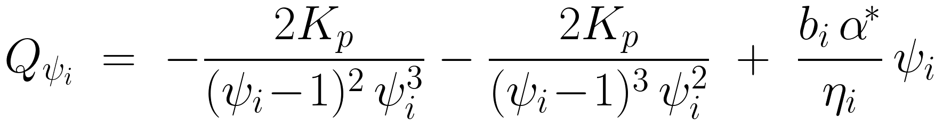
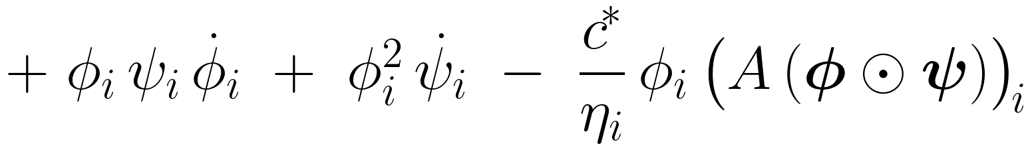
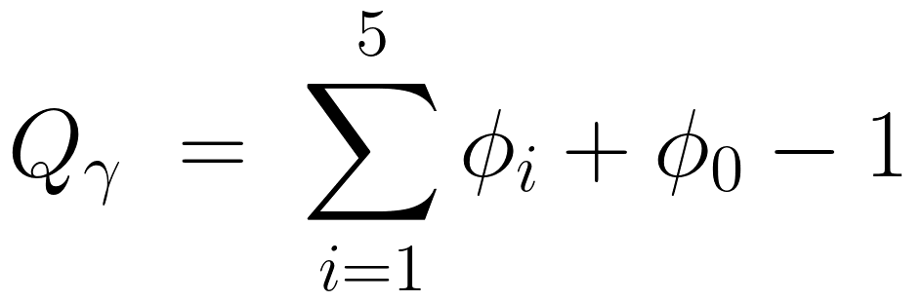
Residual Equations — ψᵢ, γ
Residual for ψᵢ
Terms 1–2: Penalty barrier ∂Ψ_p/∂ψᵢ — ensures ψ ∈ (0,1)
Term 3: Decay — antibiotics α* and rate bᵢ reduce viability
Terms 4–5: Coupling with φᵢ + nutrients c* inter-species interaction via A
Volume conservation constraint residual
10
Notes:
Here we show the residual equations for the internal variable psi_i and the volume conservation constraint gamma. The decay rate b_i drives relaxation of the internal variable.

Slide 11
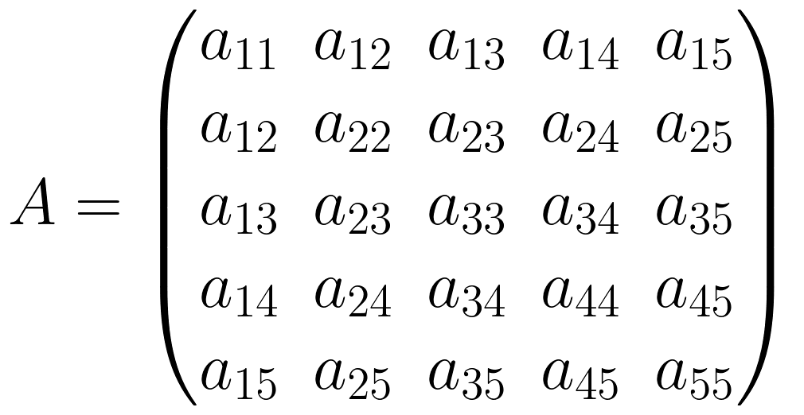
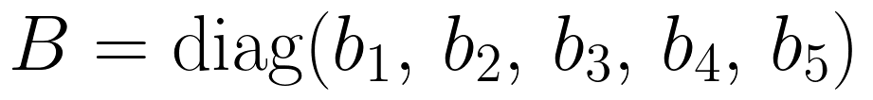
Parameters — Interaction Matrix A and Decay Matrix B
Parameter vector θ ∈ R²⁰ (5-block structure)
A is symmetric (aᵢⱼ = aⱼᵢ): 15 independent upper-triangular entries
aᵢⱼ > 0: cooperation between species i and j; aᵢⱼ < 0: competition
B is diagonal: decay rate bᵢ for each species → 5 parameters
Total: 20 parameters organized in 5 blocks (M1–M5)
11
Notes:
The parameter vector theta is organized into 5 blocks (M1 through M5). This block structure directly corresponds to the 4-stage sequential estimation. A is symmetric with 15 independent entries, B is diagonal with 5 entries, totalling 20 parameters.

Slide 12
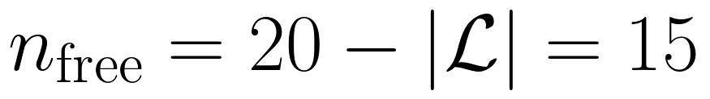
Biological Constraints and Parameter Reduction
Experiment-based parameter locking (Nishioka Algorithm)
Lock 5 interaction parameters to zero where no interaction was observed (Heine et al., Fig. 4C):
a₃₄ = 0: Vei ↔ F.n — no direct metabolic pathway
a₂₃ = 0: A.n ↔ Vei — no direct metabolic link
a₂₄ = 0: A.n ↔ F.n — no direct interaction
a₁₅ = 0: S.o ↔ P.g — no direct interaction
a₂₅ = 0: A.n ↔ P.g — no direct interaction
Effective parameter dimension
→ Improved sampling efficiency + exclusion of biologically implausible estimates.
12
Notes:
This is the core of the Nishioka Algorithm. We lock 5 interaction parameters to zero based on absent biological interactions confirmed by Heine et al. (2025). This reduces the effective dimension from 20 to 15, improving sampling efficiency and excluding biologically implausible estimates. The lock set varies by experimental condition, as explained later.

Slide 13

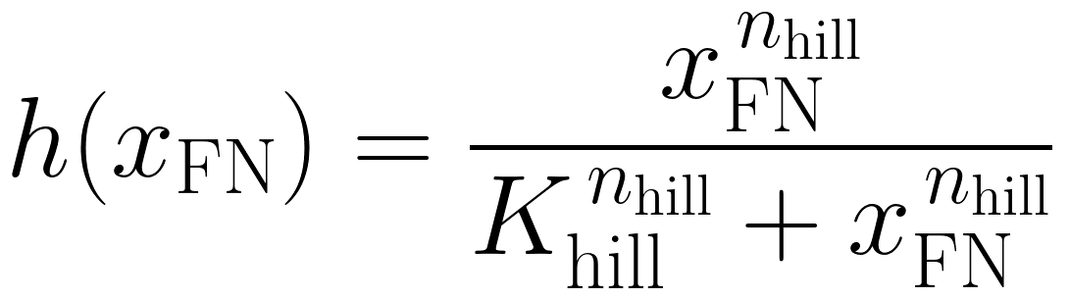


Hill-Function Gating Mechanism
F. nucleatum (species 4) acts as a bridging organism for P. gingivalis (species 5).
Without sufficient F. nucleatum, interactions of P. gingivalis are suppressed.
Effective biomass of F. nucleatum
Hill function
Half-saturation constant — concentration at 50% gating
Hill coefficient — controls steepness of the switch
Effective interaction
13
Notes:
The Hill function encodes the biological knowledge that F. nucleatum acts as a bridge organism for P. gingivalis. The effective biomass x_FN gates the 5th row of the interaction matrix A.

Slide 14

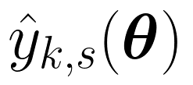

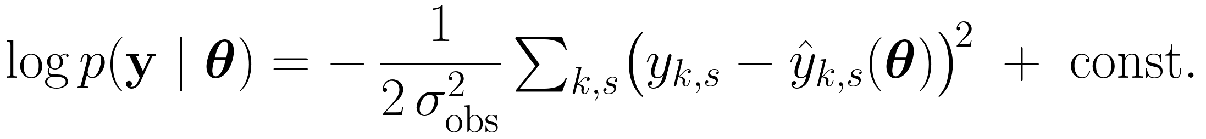
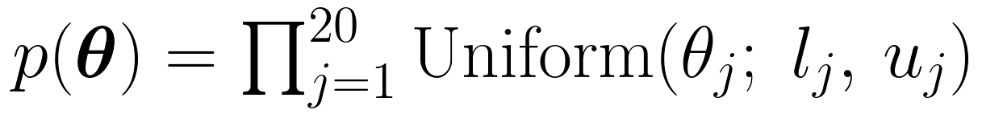
Observation Model and Likelihood
Observation model
Observation at time t_k, species s
Model prediction via ROM
Standard deviation of the observation noise
Log-likelihood
Prior distribution
14
Notes:
We define the observation model with additive Gaussian noise and the corresponding log-likelihood. The prior is independent uniform on each parameter component.

Slide 15
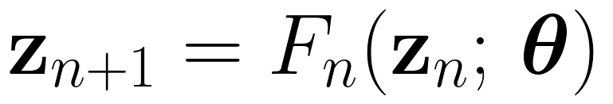
ROM — TSM with Linearization Update
Dimension reduction
V is constructed from POD (Proper Orthogonal Decomposition) of FOM snapshots.
Linearisation of FOM → time-stepping map
Linearization point update during TMCMC
At each TMCMC stage, update the linearization point θ₀ to the current MAP:
ROM accuracy improves as the posterior concentrates
Skip update when ROM error is below threshold → reduces FOM evaluation cost
15
Notes:
The ROM uses POD-based dimension reduction and time-structured mapping. A key improvement is the adaptive linearization point update during TMCMC: after each stage, we update theta_0 to the current MAP estimate, progressively improving ROM accuracy as the posterior concentrates. ROM error checks determine whether FOM evaluation is needed.

Slide 16
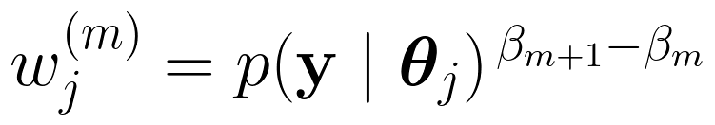
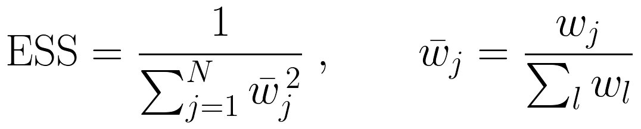
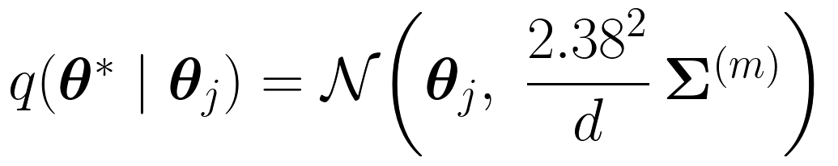
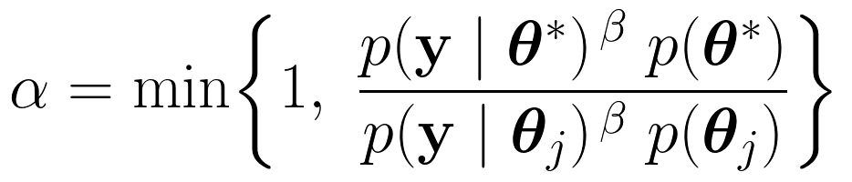
TMCMC — Algorithm Details
Tempered posterior distribution
1) Weight computation
2) Adaptive β schedule
Select β_{m+1} via bisection to maintain target ESS (N/2):
3) Resampling + MCMC mutation
Proposal distribution (Gelman optimal scaling 2.38²/d):
4) MH acceptance probability
16
Notes:
We present the full TMCMC algorithm in four steps. The beta schedule is adaptively determined via bisection to maintain ESS at N/2. The proposal covariance uses Gelman et al. optimal scaling 2.38^2/d with tempered scaling and adaptive adjustment based on acceptance rate. K-step MH mutation reduces particle correlation after resampling.

Slide 17
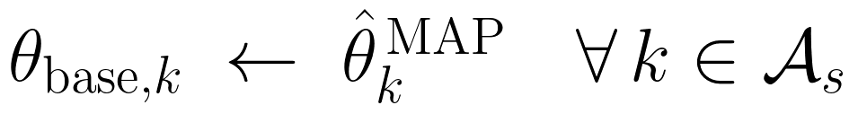
4-Stage Sequential Estimation and Experimental Conditions
4-stage sequential estimation
Stage 1 (M1): S.o + A.n → 5 params (a₁₁, a₁₂, a₂₂, b₁, b₂)
Stage 2 (M2): Vei + F.n → 5 params (a₃₃, a₃₄, a₄₄, b₃, b₄)
Stage 3 (M3+M4): Cross + P.g self → 6 params (a₁₃, a₁₄, a₂₃, a₂₄, a₅₅, b₅)
Stage 4 (M5): P.g cross → 4 params (a₁₅, a₂₅, a₃₅, a₄₅)
After each stage, fix MAP estimates in θ_base and proceed:
4 experimental conditions (Heine et al.)
Commensal Static: lock 9 / estimate 11 — pathogen-free baseline
Dysbiotic Static: lock 5 / estimate 15 — pathogens present, static culture
Commensal HOBIC: lock 8 / estimate 12 — flow culture, S.o growth estimated
Dysbiotic HOBIC: lock 0 / estimate 20 — all unlocked (Surge reproduction)
17
→ Lock set varies per condition to ensure biologically valid estimation space.
Notes:
The 4-stage sequential estimation is a key algorithmic design. Stage 1 estimates early colonizer parameters, Stage 2 bridge organisms, Stage 3 cross-terms plus P. gingivalis self-interaction, Stage 4 P. gingivalis cross-terms. After each stage, MAP estimates are fixed in theta_base. The four experimental conditions vary the lock set: Commensal Static locks 9 parameters, Dysbiotic HOBIC unlocks all 20 to discover the minimal interaction set driving the pathogen surge.

Slide 18
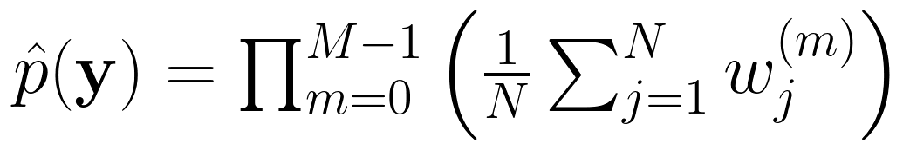
Summary and Outlook
Summary
FOM: Nonlinear dissipative system for 5-species biofilm based on free energy.
Parameter reduction: biological constraints reduce 20 → 15 free parameters.
ROM (TSM): Low-dim approximation + adaptive linearization point update.
TMCMC: Adaptive β schedule, optimal proposal covariance, K-step mutation.
4-stage sequential estimation: biologically-grouped stages for stable inference.
Outlook
Application to experimental data and validation of estimation accuracy.
Model evidence: Bayes factor comparison via TMCMC at no extra cost.
Uncertainty quantification: credible intervals from the posterior.
Multi-condition estimation: all 4 conditions (commensal/dysbiotic × static/HOBIC).
Model evidence (TMCMC byproduct)
18
Notes:
We summarize the five main contributions: FOM structure, parameter reduction, ROM with adaptive linearization, TMCMC with adaptive beta and optimal proposal, and 4-stage sequential estimation. The model evidence formula is a natural byproduct of TMCMC, enabling Bayesian model comparison via Bayes factors at no extra cost.

Slide 19
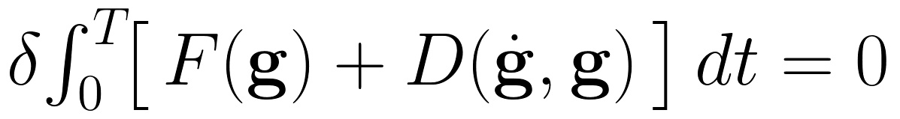
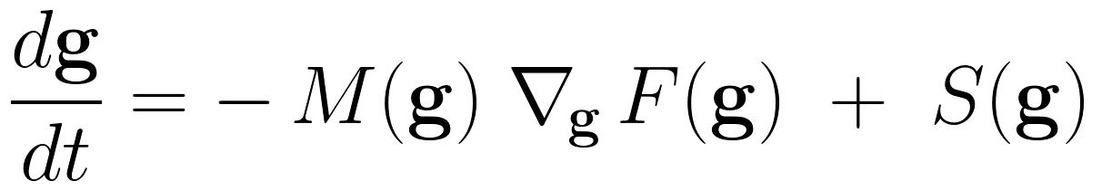
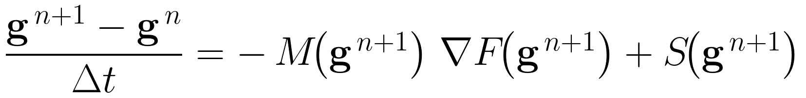
Backup: From Hamilton Principle to Implementation
Step 1: Variational principle (Hamilton)
Step 2: Strong form (Euler-Lagrange)
Step 3: Time discretisation (implicit Euler)
Step 4: Residual equation + Newton iteration
→ Paper eqs. (16)-(18) correspond to these 4 steps.
→ The Q in Step 4 is the colour-coded equation from the earlier slide.
19
Notes:
This backup slide shows the four-step mathematical correspondence from the Hamilton variational principle to the Newton-based residual solver. Step 1: Hamilton's principle gives the variational form. Step 2: Euler-Lagrange equations yield the strong form. Step 3: Implicit Euler discretisation in time. Step 4: The residual Q=0 is solved by Newton iteration. The colour-coded equation from the earlier slide is the explicit form of Q.

