Slide 1
Biologically-Constrained Parameter Reduction
for 5-Species Oral Biofilm Model
生物学的制約に基づく5菌種バイオフィルムモデルのパラメータ削減
Comprehensive Bayesian Uncertainty Quantification under Commensal & Dysbiotic Conditions
Keisuke Nishioka │ Institut für Kontinuumsmechanik, Leibniz Universität Hannover │ February 2026
Nishioka | 5-Species Biofilm | TMCMC | IKM, LUH
1

Slide 2
Outline / 目次
① Introduction & Biological Background
はじめに・生物学的背景
② 5-Species Biofilm Model
5菌種バイオフィルムモデル
③ Biologically-Constrained Parameter Reduction
生物学的制約パラメータ削減
④ Bayesian Inference Framework
ベイズ推定の枠組み
⑤ TMCMC Algorithm
TMCMCアルゴリズム
⑥ 4-Stage Sequential Estimation
4段階逐次推定
⑦ Results: Commensal Static
結果：健康・静的
⑧ Results: Dysbiotic Static
結果：疾患・静的
⑨ Results: Commensal HOBIC
結果：健康・流動
⑩ Results: Dysbiotic HOBIC (Surge)
結果：疾患・流動 (Surge)
⑪ Comparative Analysis
比較分析
⑫ Conclusion & Future Work
結論・今後の課題
Nishioka | 5-Species Biofilm | TMCMC | IKM, LUH
2

Slide 3
① Introduction
はじめに・生物学的背景
Nishioka | 5-Species Biofilm | TMCMC | IKM, LUH
3

Slide 4
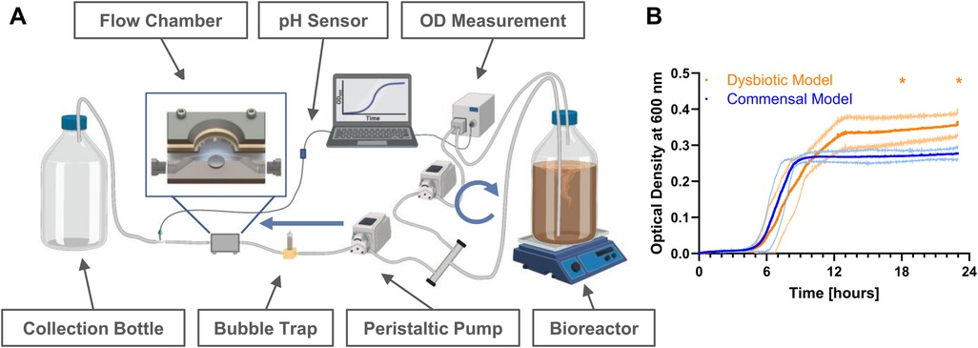
Biological Background
Peri-implantitis & Multi-species Biofilm / インプラント周囲炎と多菌種バイオフィルム
Peri-implantitis
Inflammatory disease around dental implants caused by
dysbiotic shift in the oral microbiome.
歯科インプラント周囲の炎症性疾患。口腔マイクロバイオームの
ディスバイオティックシフトにより引き起こされる。
5 Key Bacterial Species (Heine et al.)
Sp 0: Streptococcus oralis (S.o)
Early colonizer — initiates biofilm formation
Sp 1: Actinomyces naeslundii (A.n)
Early colonizer — co-aggregation partner
Sp 2: Veillonella spp. (Vei)
Metabolic bridge — lactate consumer
Sp 3: Fusobacterium nucleatum (F.n)
Bridging organism — connects early & late colonizers
Sp 4: Porphyromonas gingivalis (P.g)
Late colonizer (pathogen) — key in dysbiosis
Heine et al. (2021) — Biofilm architecture
Nishioka | 5-Species Biofilm | TMCMC | IKM, LUH
4

Slide 5
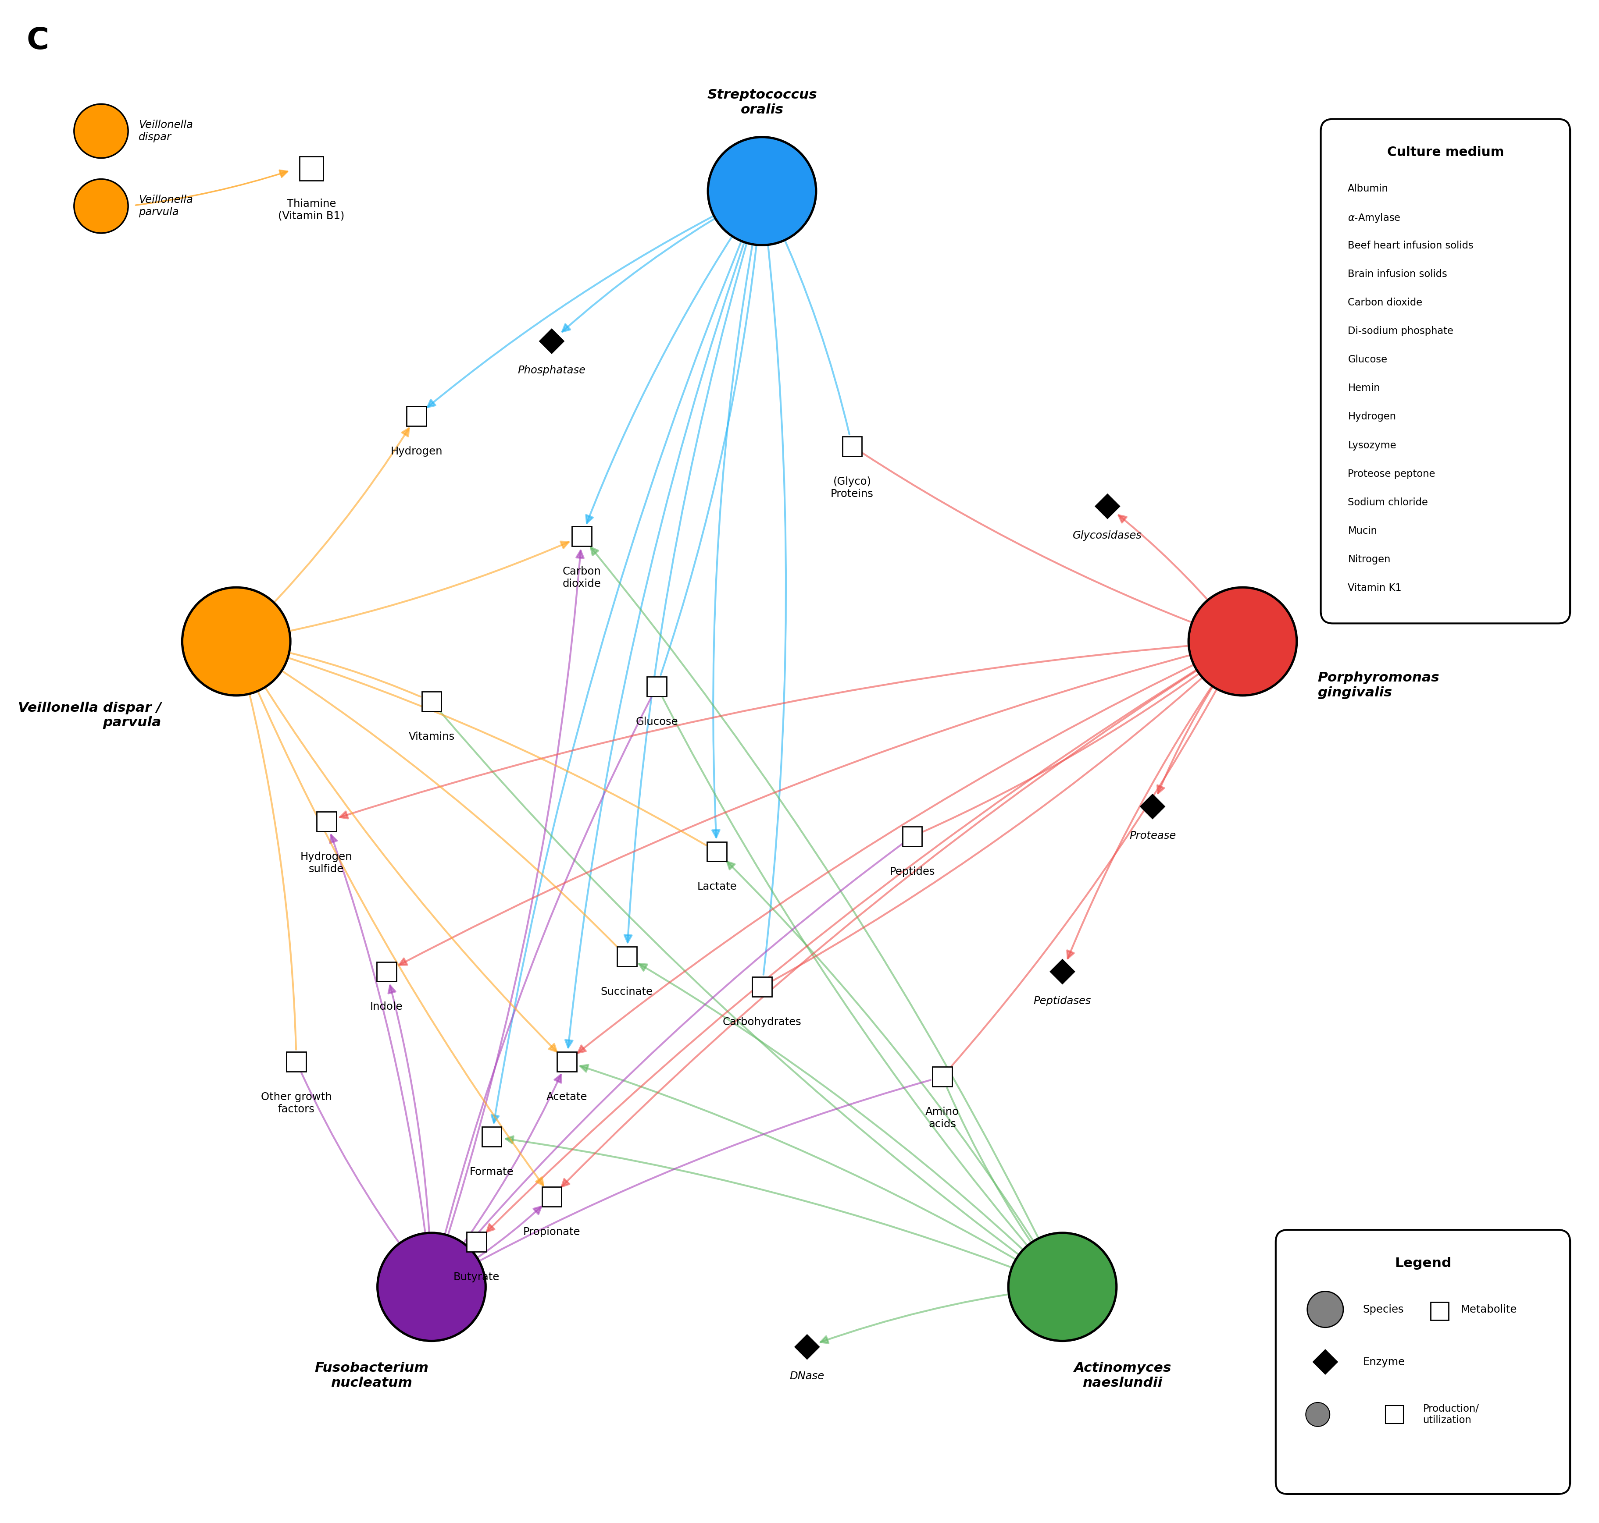
Interaction Network (Figure 4C)
相互作用ネットワーク
Known Species Interactions
Based on co-culture experiments by Heine et al.,
the following interactions are established:
✔ S.o ↔ A.n (co-aggregation)
✔ S.o ↔ Vei (lactate cross-feeding)
✔ S.o ↔ F.n (co-aggregation)
✔ A.n ↔ P.g — NO interaction
✔ Vei ↔ F.n — NO interaction
✔ A.n ↔ Vei — NO interaction
✔ A.n ↔ F.n — NO interaction
✔ S.o ↔ P.g — NO interaction
→ 5 pairs locked to zero
→ Free parameters: 20 → 15
Reproduced interaction network from Heine et al. Figure 4C
Nishioka | 5-Species Biofilm | TMCMC | IKM, LUH
5

Slide 6
② 5-Species Biofilm Model
5菌種バイオフィルムモデル
Nishioka | 5-Species Biofilm | TMCMC | IKM, LUH
6

Slide 7

Governing Equations
支配方程式 — Extended Hamilton Principle
Volume Fraction Dynamics φᵢ(t)
Survival Fraction Dynamics ψᵢ(t)
体積分率の動態
生存分率の動態
φᵢ : volume fraction of species i
rᵢ, dᵢ : growth and death rates
ψᵢ : survival fraction of species i
aᵢⱼ : interaction coefficient (j → i), K : half-saturation
Parameter Space Overview / パラメータ空間の概要
5×5 Interaction matrix A : 25 entries
→ Symmetry Aᵢⱼ = Aⱼᵢ : 15 unique entries (5 diagonal + 10 off-diagonal)
→ Lock 5 absent interactions : 10 free interaction parameters
5 Decay rates b = [b₁, b₂, b₃, b₄, b₅] : always free
Nishioka | 5-Species Biofilm | TMCMC | IKM, LUH
7

Slide 8
③ Parameter Reduction
生物学的制約に基づくパラメータ削減
Nishioka | 5-Species Biofilm | TMCMC | IKM, LUH
8

Slide 9
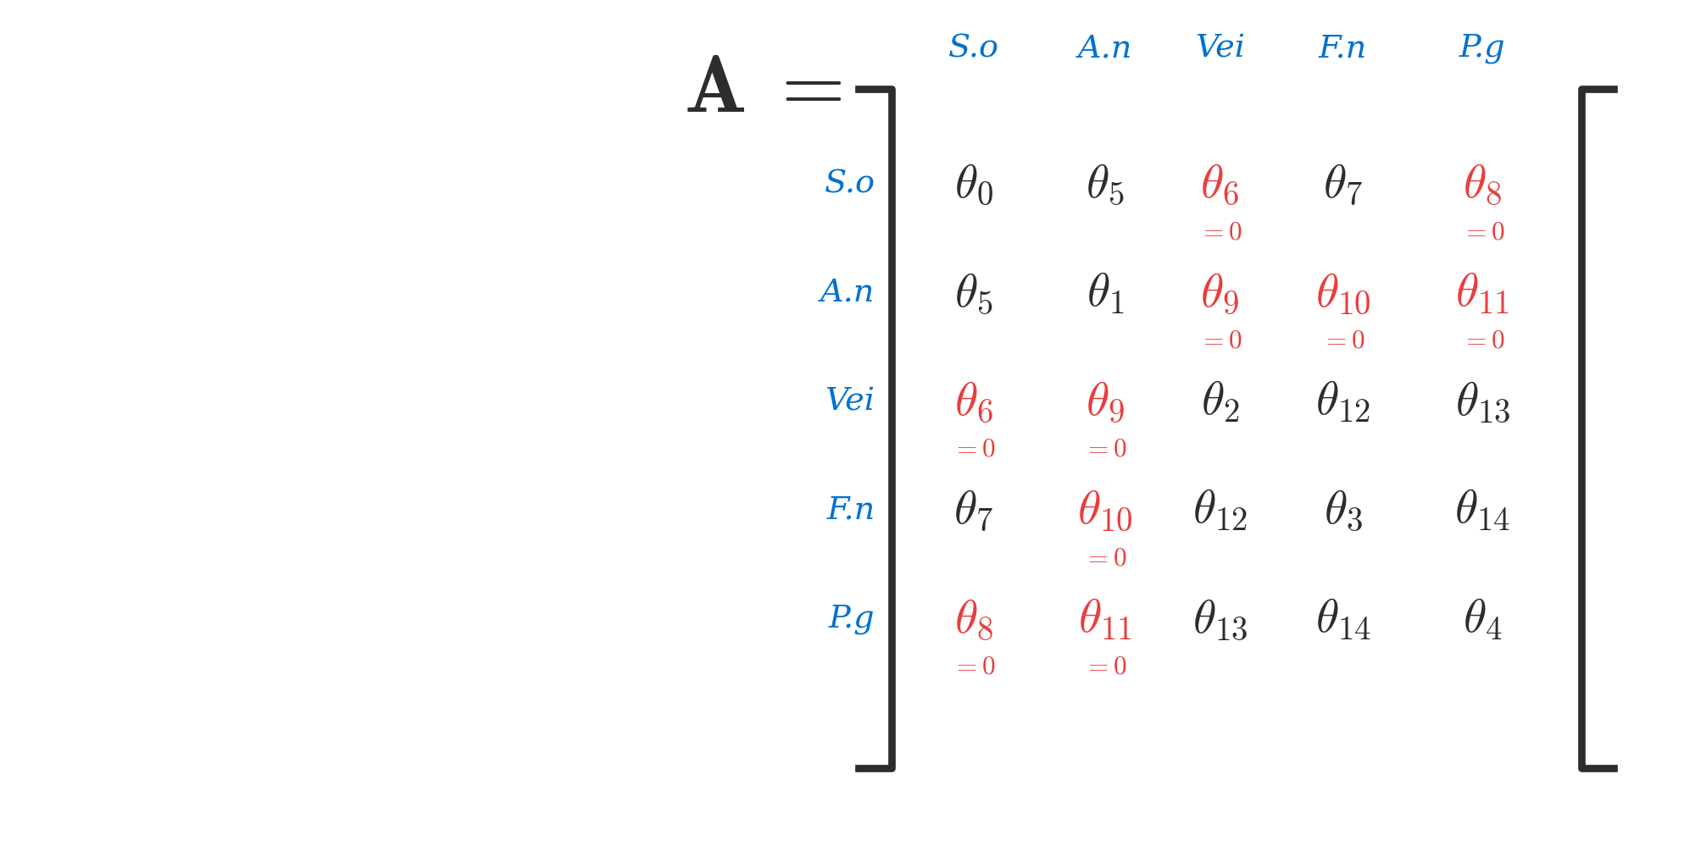
Symmetric Interaction Matrix
対称相互作用行列とパラメータ写像
5×5 Symmetric Matrix A (Aᵢⱼ = Aⱼᵢ)
Condition-Specific Lock Rules
条件別ロックルール
1. Commensal Static (N_locked = 9)
Standard 5 + pathogen interactions locked
Additional: a₃₅(F.n↔P.g), a₄₅(Vei↔P.g),
b₄(P.g decay), b₃(F.n decay)
2. Dysbiotic Static (N_locked = 5)
Standard biological locks only
Base 5 absent interactions
3. Commensal HOBIC (N_locked = 8)
Strict locks, S. oralis growth allowed
Similar to CS but HOBIC-adapted
4. Dysbiotic HOBIC (N_locked = 0)
★ UNLOCK ALL — Discovery Mode
All 20 parameters free for Surge detection
Locked Indices (set to 0):
Idx 6: Vei↔F.n Idx 12: A.n↔Vei Idx 13: A.n↔F.n
Idx 16: S.o↔P.g Idx 17: A.n↔P.g
Nishioka | 5-Species Biofilm | TMCMC | IKM, LUH
9

Slide 10
④ Bayesian Inference Framework
ベイズ推定の枠組み
Nishioka | 5-Species Biofilm | TMCMC | IKM, LUH
10

Slide 11






Bayesian Inverse Problem
ベイズ逆問題
Bayes' Theorem / ベイズの定理
Likelihood / 尤度関数
Prior / 事前分布
Evidence / エビデンス
Gaussian noise model:
With biological constraints:
Marginal likelihood:
dᵢⱼ : observed data
gᵢ(tⱼ,θ) : model prediction
σ² : noise variance
Estimated as by-product
of TMCMC algorithm.
Used for Bayes factor
model comparison.
δ(θ_k) : Dirac delta for locked params L = set of locked indices
Nishioka | 5-Species Biofilm | TMCMC | IKM, LUH
11

Slide 12
⑤ TMCMC Algorithm
Transitional Markov Chain Monte Carlo
Nishioka | 5-Species Biofilm | TMCMC | IKM, LUH
12

Slide 13

TMCMC: Algorithm Overview
TMCMCアルゴリズムの概要
Core Idea: Adaptive Tempering
核心: 適応的テンパリング
Tempered distribution sequence:
TMCMC Stage Flow
┌───────────────────┐
│ Stage 0: β=0 │
│ Prior samples │
└───────────────────┘
↓ weight + resample + MCMC
┌───────────────────┐
│ Stage 1: β=β₁ │
│ Intermediate │
└───────────────────┘
↓ weight + resample + MCMC
⋮
↓ weight + resample + MCMC
┌───────────────────┐
│ Stage m: β=1.0 │
│ Full posterior │
└───────────────────┘
β = 0 : samples from prior p(θ)
β = 1 : samples from full posterior p(θ|D)
Adaptive β selection: CoV target:
Advantages over standard MCMC:
• No burn-in • Multimodal • Evidence • Parallel
Nishioka | 5-Species Biofilm | TMCMC | IKM, LUH
13

Slide 14



Algorithm 1: TMCMC Procedure
TMCMCアルゴリズムの擬似コード
Algorithm 1: Transitional Markov Chain Monte Carlo
───────────────────────────────────────────────────────
Input: N particles, prior p(θ), likelihood p(D|θ), data D
Output: Posterior samples {θ⁽¹⁾,...,θ⁽ᴺ⁾}, evidence p̂(D)
1: Initialize: Draw θ⁽ⁱ⁾ ~ p(θ) for i = 1,...,N
2: Set β₀ = 0, j = 0, p̂(D) = 1
3: while βⱼ < 1 do
4: Solve for Δβ such that CoV(w) = 1.0
5: βⱼ₊₁ = min(βⱼ + Δβ, 1)
6: Compute weights: w⁽ⁱ⁾ = p(D|θ⁽ⁱ⁾)^Δβ
7: Normalize: W⁽ⁱ⁾ = w⁽ⁱ⁾ / ∑ₖ w⁽ᵏ⁾
8: Update evidence: p̂(D) ×= (1/N) ∑ᵢ w⁽ⁱ⁾
9: Resample N particles ~ Multinomial(W)
10: Compute Σⱼ = β² · Cov_w(θ) (adapted proposal)
11: for each particle i = 1,...,N do
12: Metropolis-Hastings step with N(θ⁽ⁱ⁾, Σⱼ)
13: end for
14: j = j + 1
15: end while
16: Return {θ⁽ⁱ⁾}, p̂(D)
Key Equations / 主要な数式
Step 6-7: Importance Weights
Step 10: Proposal Covariance
Step 12: MH Acceptance
Step 8: Evidence update
accumulated as by-product
Step 9: Multinomial
resampling eliminates
low-weight particles
Nishioka | 5-Species Biofilm | TMCMC | IKM, LUH
14

Slide 15


Model Evidence & Bayes Factor
モデルエビデンスとベイズ因子
Model Evidence (TMCMC by-product)
Bayes Factor for Model Selection
モデルエビデンス (TMCMC副産物)
モデル選択のためのベイズ因子
Accumulated product of average weights
across all tempering stages.
BF > 10 : Strong evidence for M₁
BF > 100 : Decisive evidence
Compare: 15-param vs 20-param
Practical Significance / 実用的意義
• TMCMC produces model evidence automatically — no additional computation needed
TMCMCはモデルエビデンスを自動的に算出 — 追加計算不要
• Enables principled comparison between constrained (15-param) and full (20-param) models
制約付き(15パラメータ)と全(20パラメータ)モデルの原理的比較が可能
• Quantitative justification for biological parameter locking
生物学的パラメータロックの定量的正当化
Nishioka | 5-Species Biofilm | TMCMC | IKM, LUH
15

Slide 16
⑥ 4-Stage Sequential Estimation
4段階逐次推定アルゴリズム
Nishioka | 5-Species Biofilm | TMCMC | IKM, LUH
16

Slide 17
Algorithm 2: Sequential Estimation
逐次推定アルゴリズム
Algorithm 2: 4-Stage Sequential Parameter Estimation
───────────────────────────────────────────────────────
Input: 4 datasets {D_k}, lock rules {L_k} for k=1,...,4
Output: Condition-specific posteriors {p(θ|D_k)}
Stage 1: Commensal Static [N_locked = 9]
• Prior: Uniform[−100, 100] for interactions
• Lock: standard 5 + pathogen interactions
• Run TMCMC(D₁, L₁) → θ₁ posterior
Stage 2: Dysbiotic Static [N_locked = 5]
• Prior: Uniform[−100, 100]
• Lock: standard 5 biological locks
• Run TMCMC(D₂, L₂) → θ₂ posterior
Stage 3: Commensal HOBIC [N_locked = 8]
• Strict locks with S.o growth allowed
• Run TMCMC(D₃, L₃) → θ₃ posterior
Stage 4: Dysbiotic HOBIC (Surge) [N_locked = 0]
★ UNLOCK ALL — Discovery Mode
• All 20 parameters free
• Run TMCMC(D₄, ∅) → θ₄ posterior
Design Rationale
設計の根拠
① Start with most
constrained condition
(CS: 9 locks = easiest)
② Progressively relax
constraints as model
complexity increases
③ Each stage provides
independent posterior
for that condition
④ Final stage: Discovery
Mode captures complex
Surge dynamics with
all parameters free
N_particles = 1000
per condition
Nishioka | 5-Species Biofilm | TMCMC | IKM, LUH
17

Slide 18
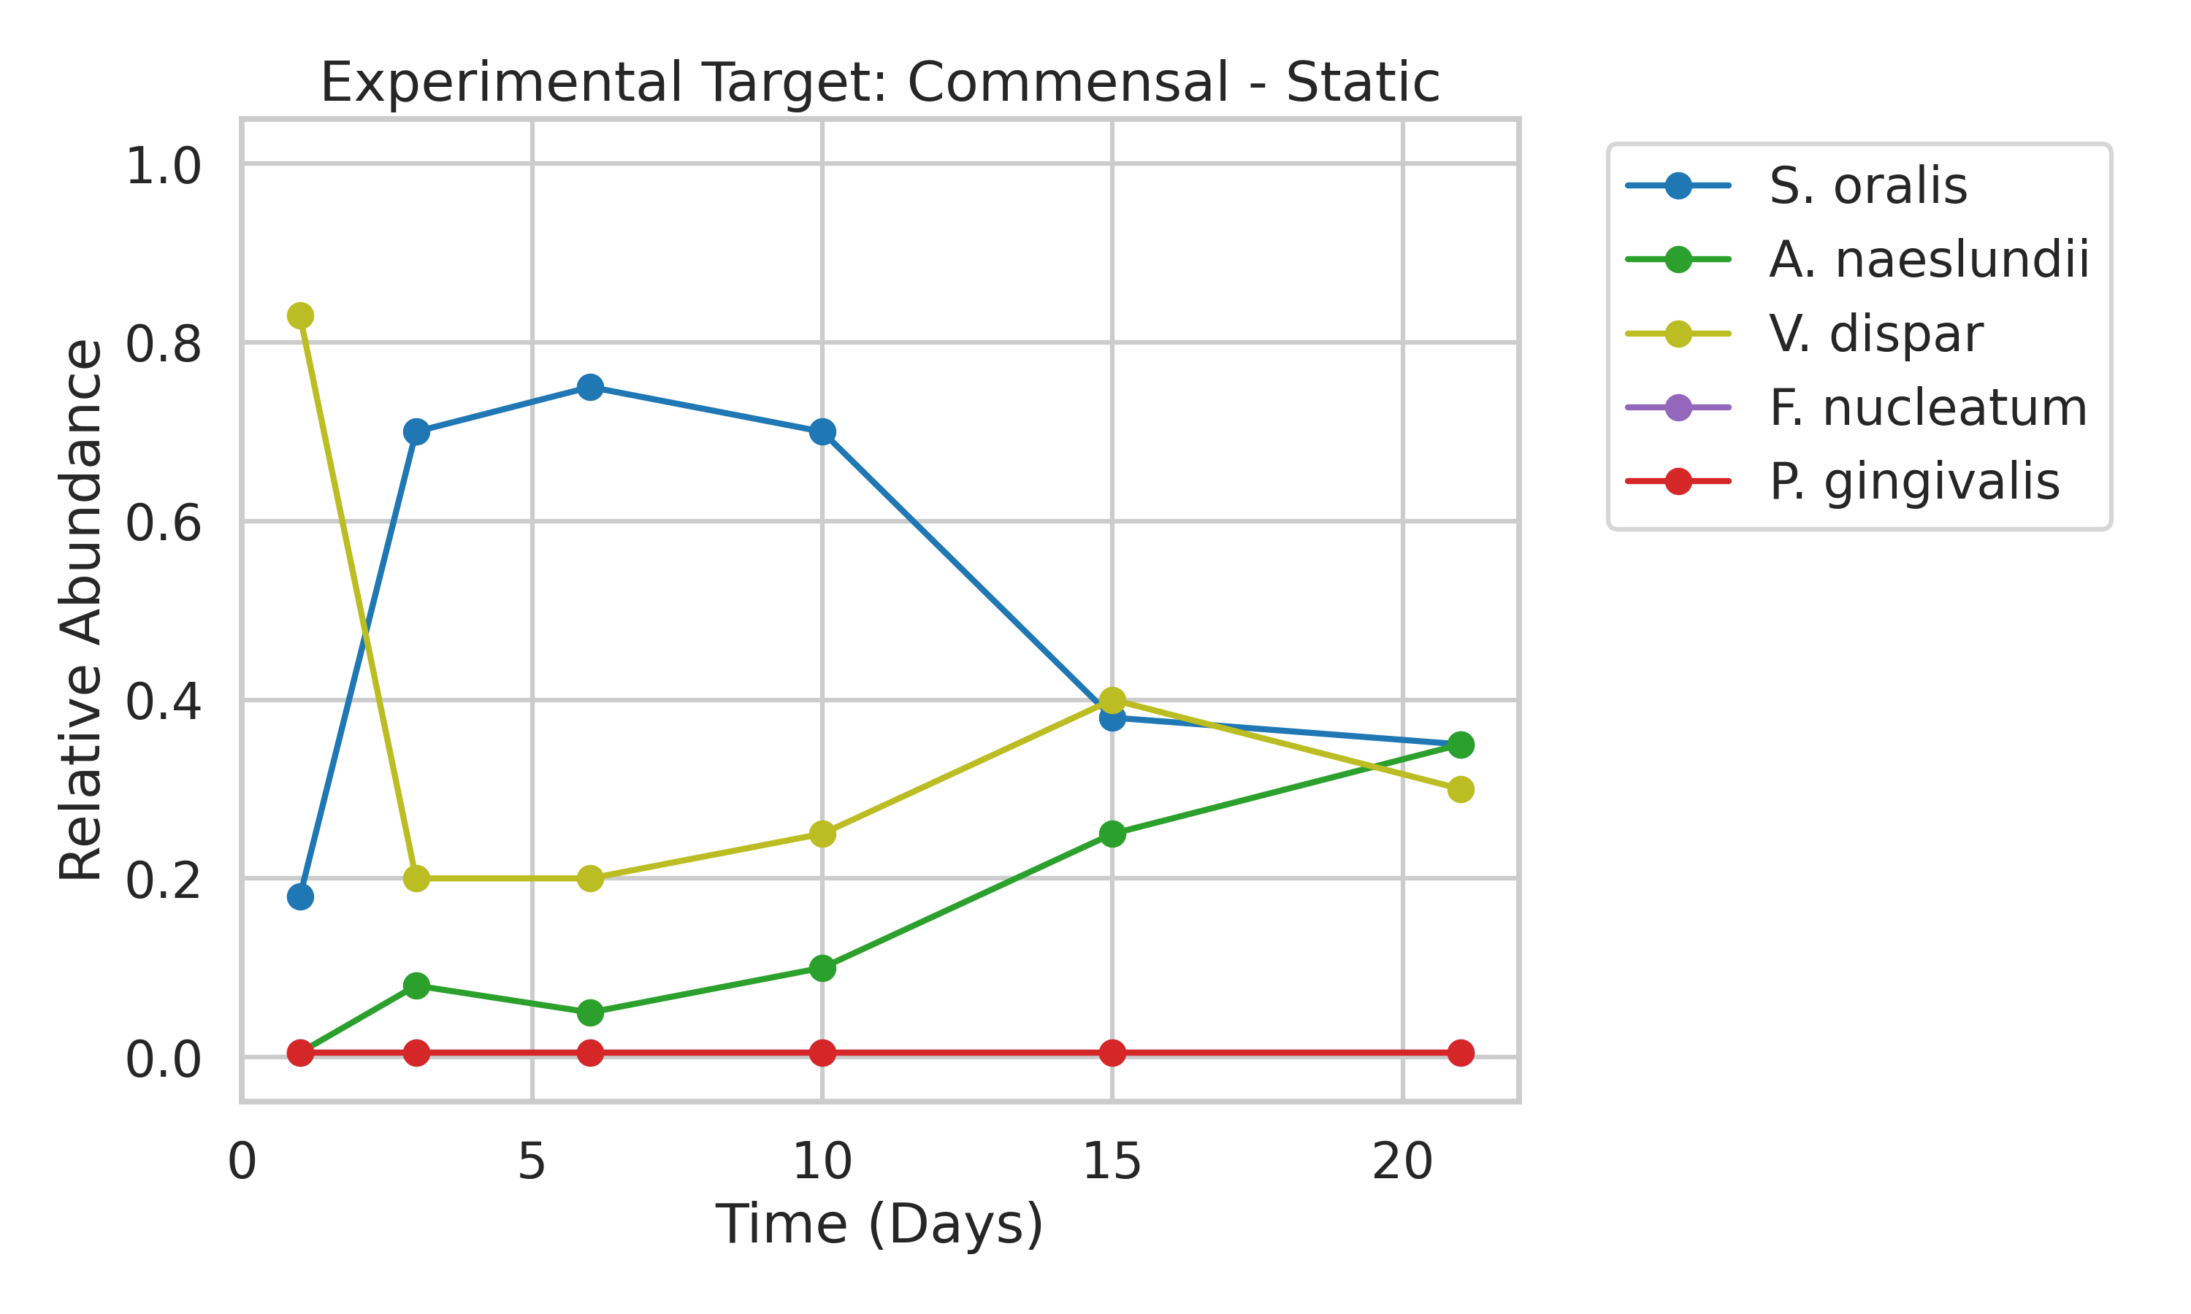
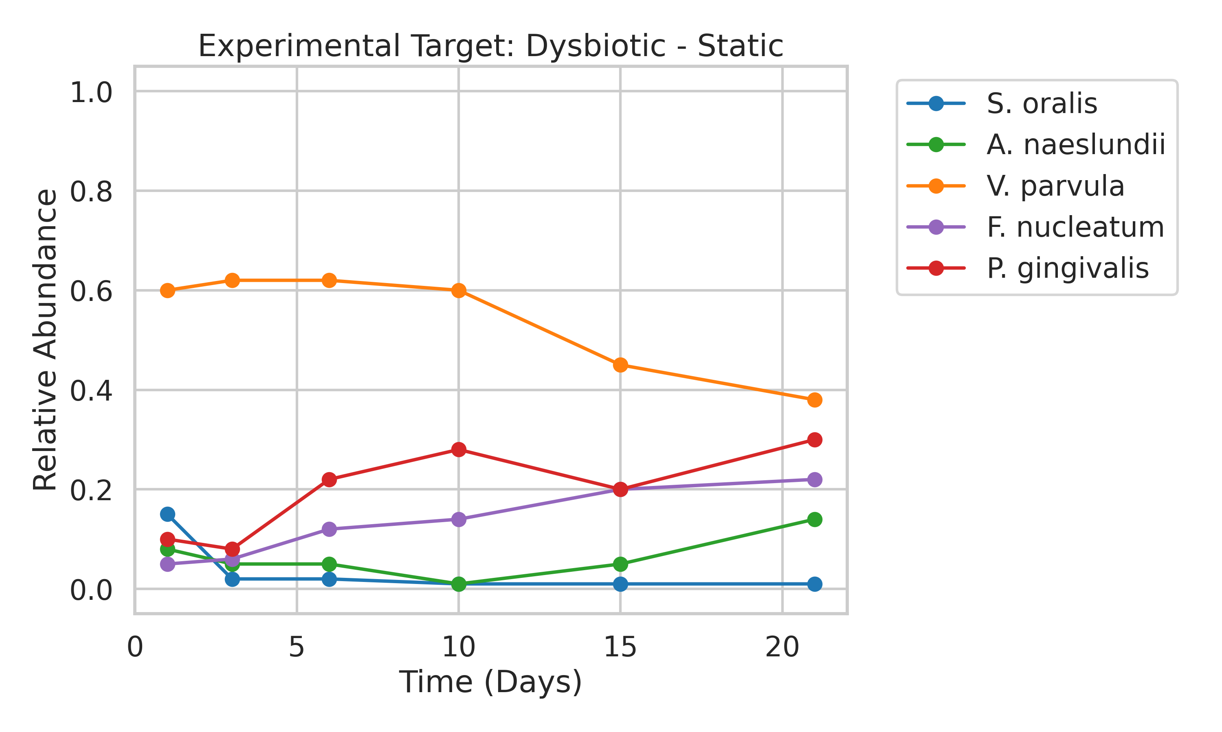
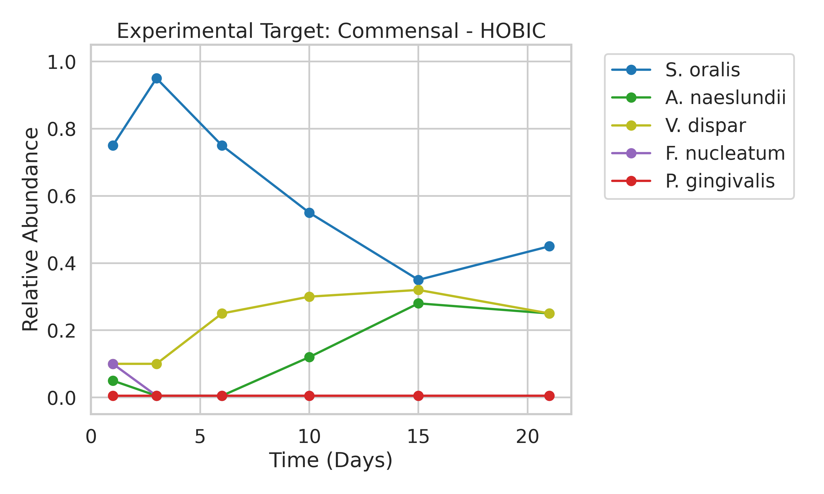
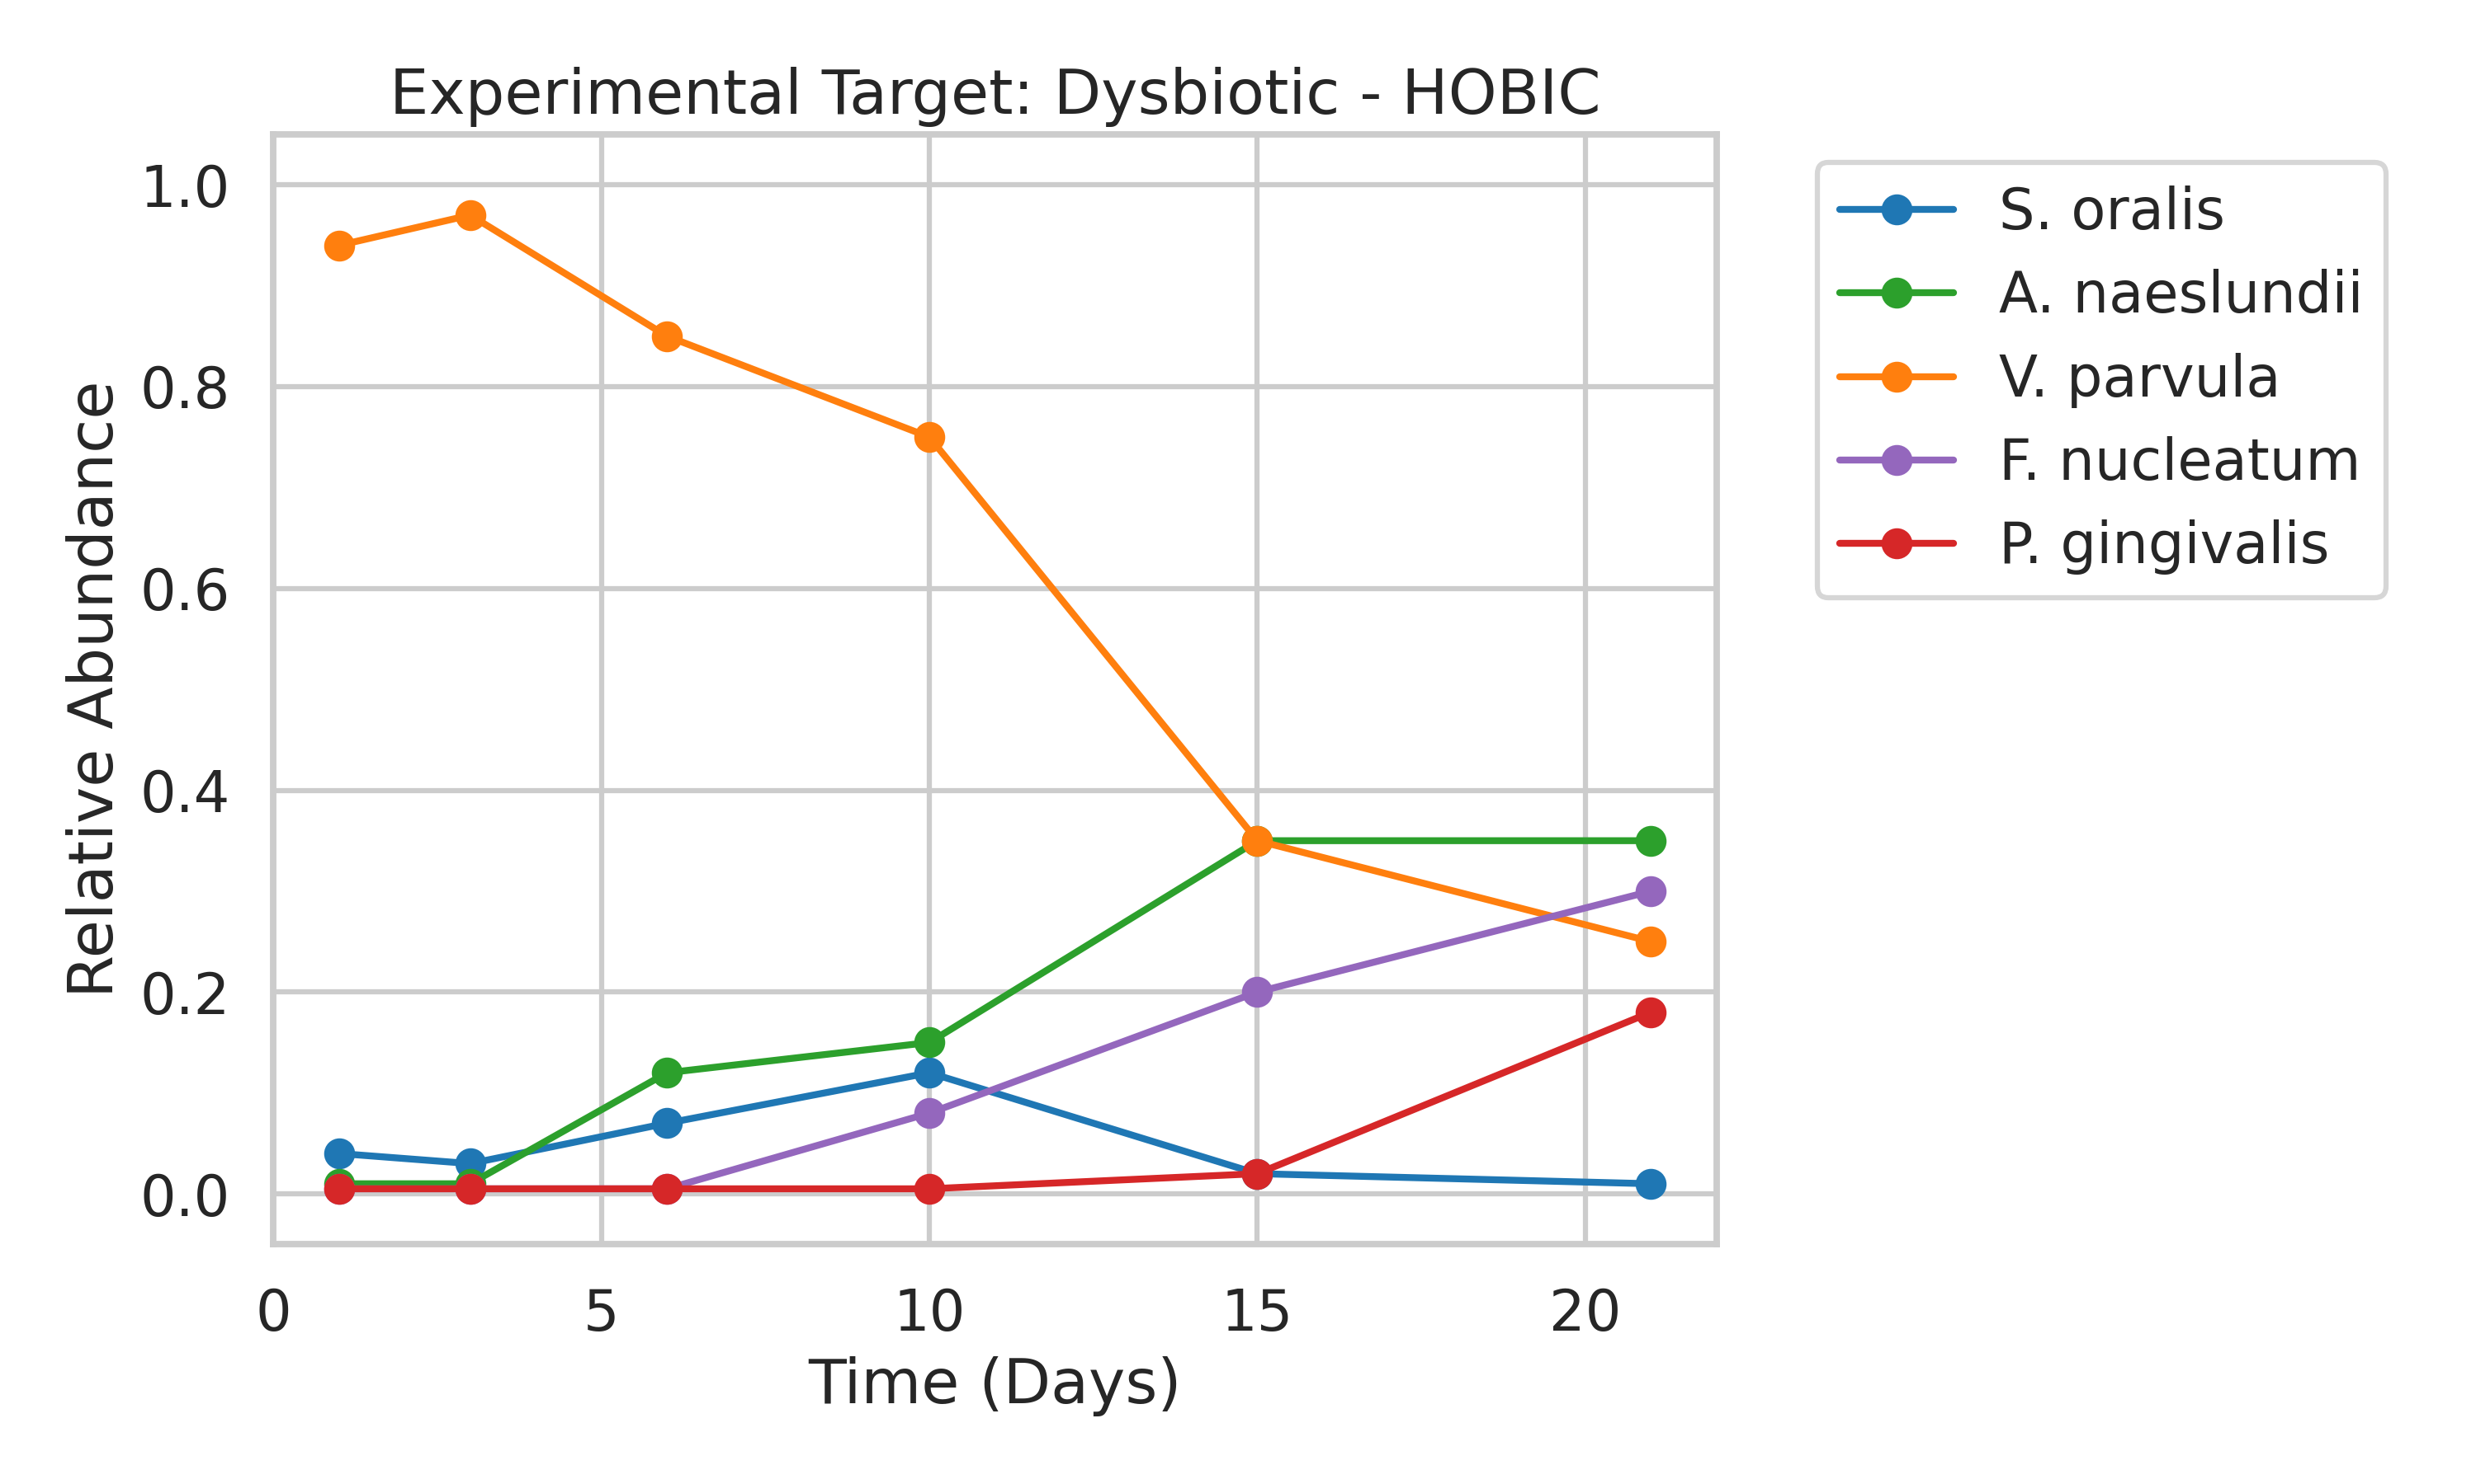
Experimental Target Data
実験ターゲットデータ — 4条件
Commensal Static
N_locked=9
Dysbiotic Static
N_locked=5
Commensal HOBIC
N_locked=8
Dysbiotic HOBIC (Surge)
N_locked=0
Nishioka | 5-Species Biofilm | TMCMC | IKM, LUH
18

Slide 19
⑦ Results: Commensal Static
健康・静的
Nishioka | 5-Species Biofilm | TMCMC | IKM, LUH
19

Slide 20
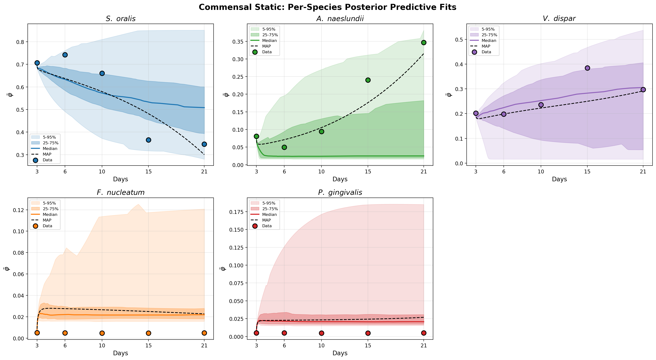
Commensal Static — Posterior Predictive Fit
健康・静的 — 事後予測適合
Condition
Healthy state under static culture. Nutrient-limited environment leads to stable, low biomass. Strict parameter locks (N_locked = 9) enforce pathogen suppression, reflecting the clinically observed stable symbiotic community.
静的培養下の健康な状態。栄養制限環境により安定的な低バイオマスとなる。厳格なパラメータロック (N_locked = 9) により病原菌の増殖が抑制され、臨床的に観察される安定した共生群集を反映。
N_locked = 9
Key Finding
Strict locks prevent pathogen growth. The model accurately reproduces the stable commensal state observed in static experiments. Early colonizers (S.o, A.n) maintain dominance throughout.
厳格なロックにより病原菌の増殖が防がれ、静的実験で観察された安定した共生状態を正確に再現。初期定着菌(S.o, A.n)が終始優位を維持。
Per-species posterior predictive fit with 95% credible interval / 菌種別事後予測適合 (95%信用区間)
Nishioka | 5-Species Biofilm | TMCMC | IKM, LUH
20

Slide 21
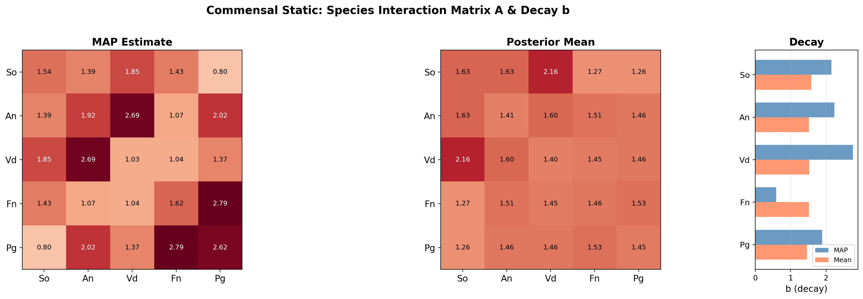
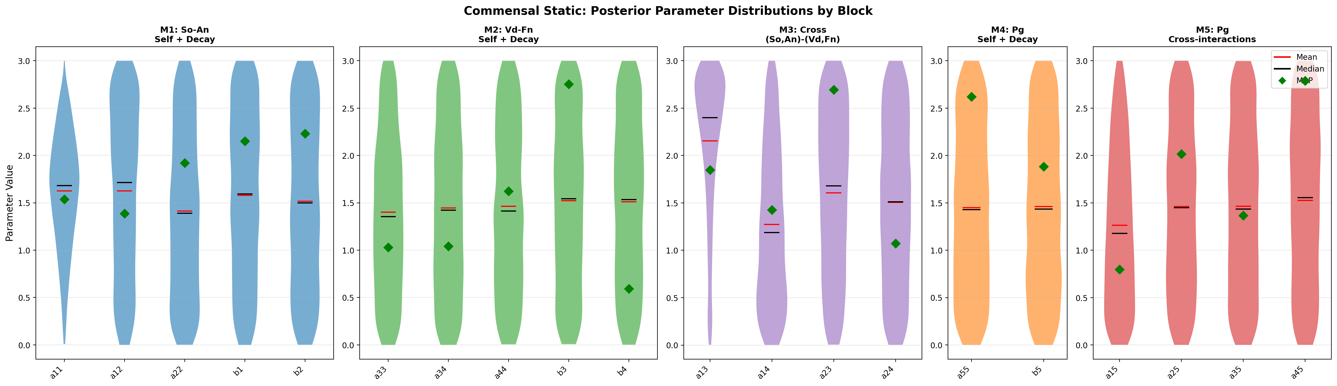
Commensal Static — Interaction Matrix & Parameter Uncertainty
健康・静的 — 相互作用行列 & パラメータ不確実性
Estimated interaction matrix A (MAP) / 推定相互作用行列
Parameter posterior distributions (violin) / パラメータ事後分布 (バイオリン)
Nishioka | 5-Species Biofilm | TMCMC | IKM, LUH
21

Slide 22
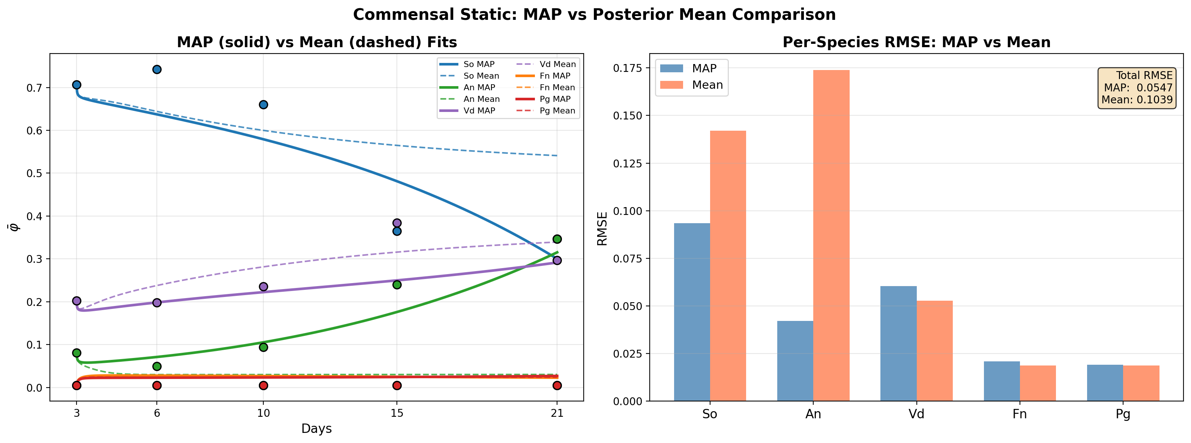
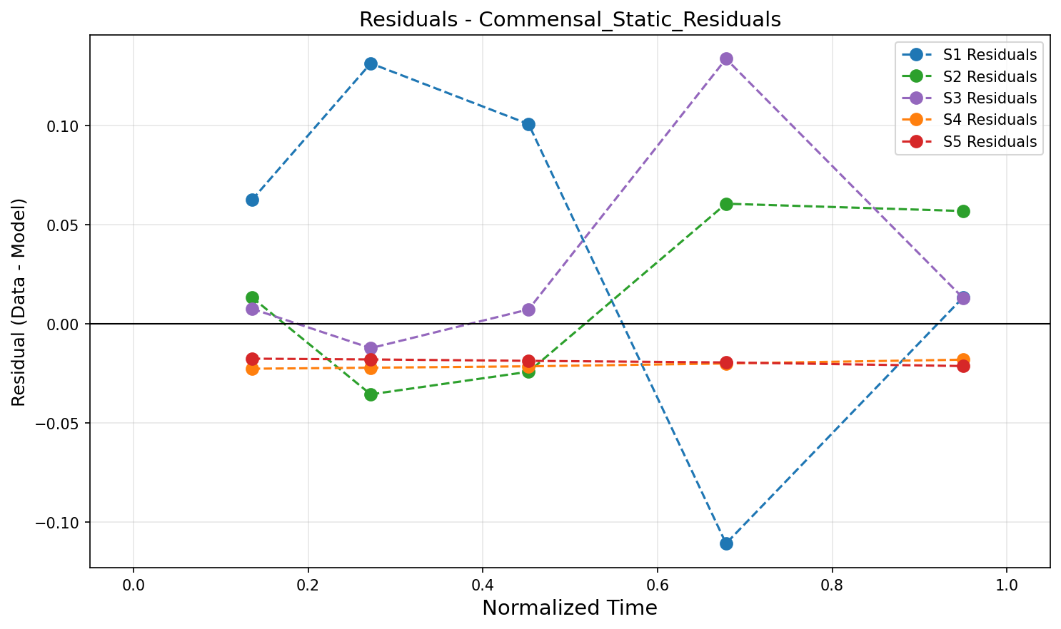
Commensal Static — MAP vs Mean & Residuals
健康・静的 — MAP vs 平均推定 & 残差分析
MAP vs Mean parameter comparison / MAP vs 平均パラメータ比較
Residual analysis / 残差分析
Nishioka | 5-Species Biofilm | TMCMC | IKM, LUH
22

Slide 23
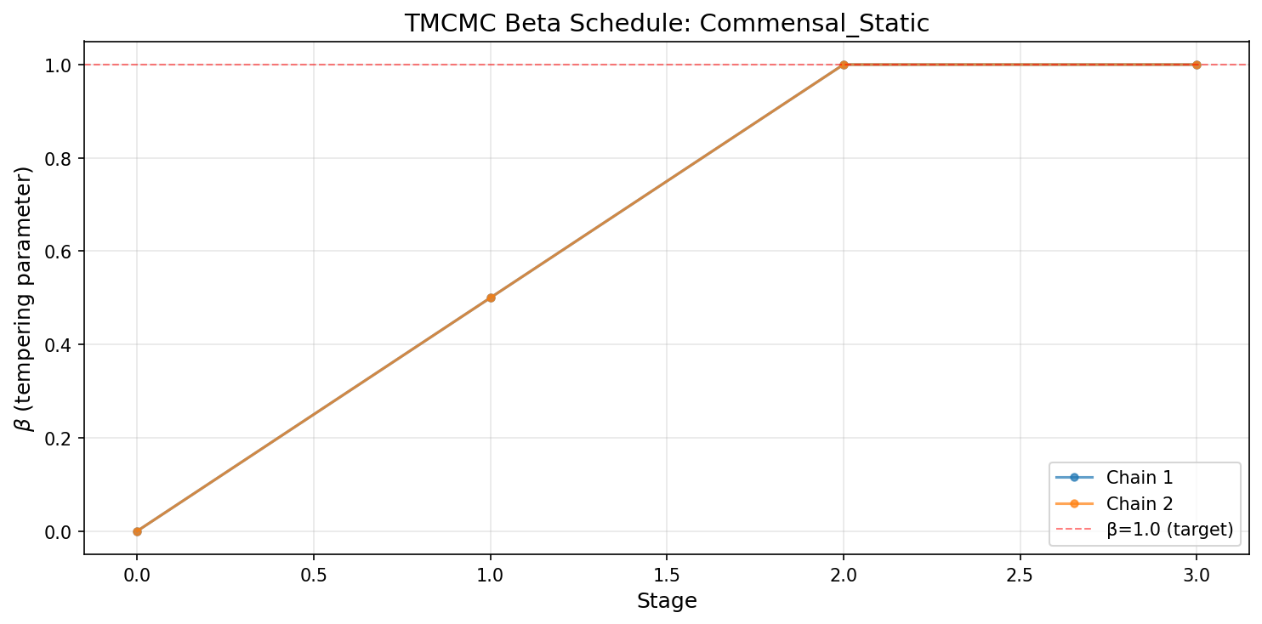
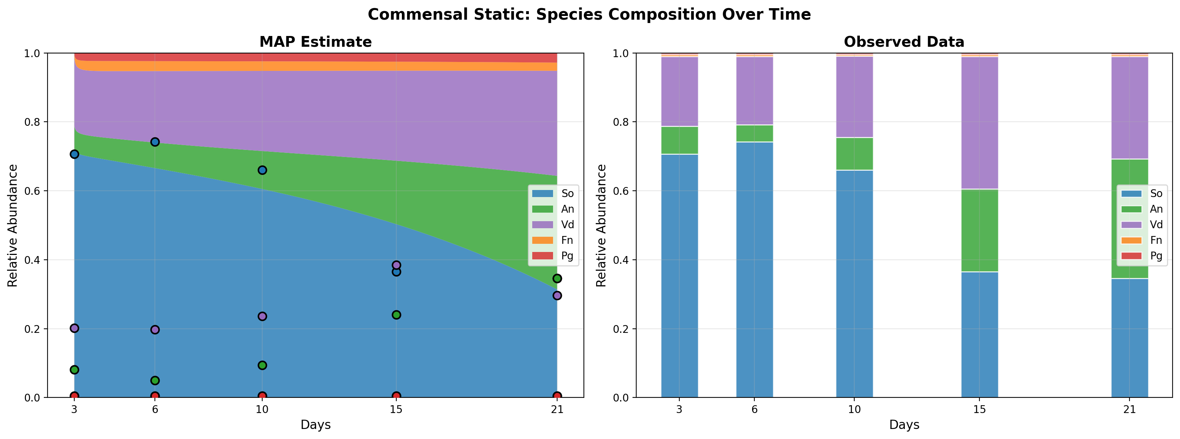
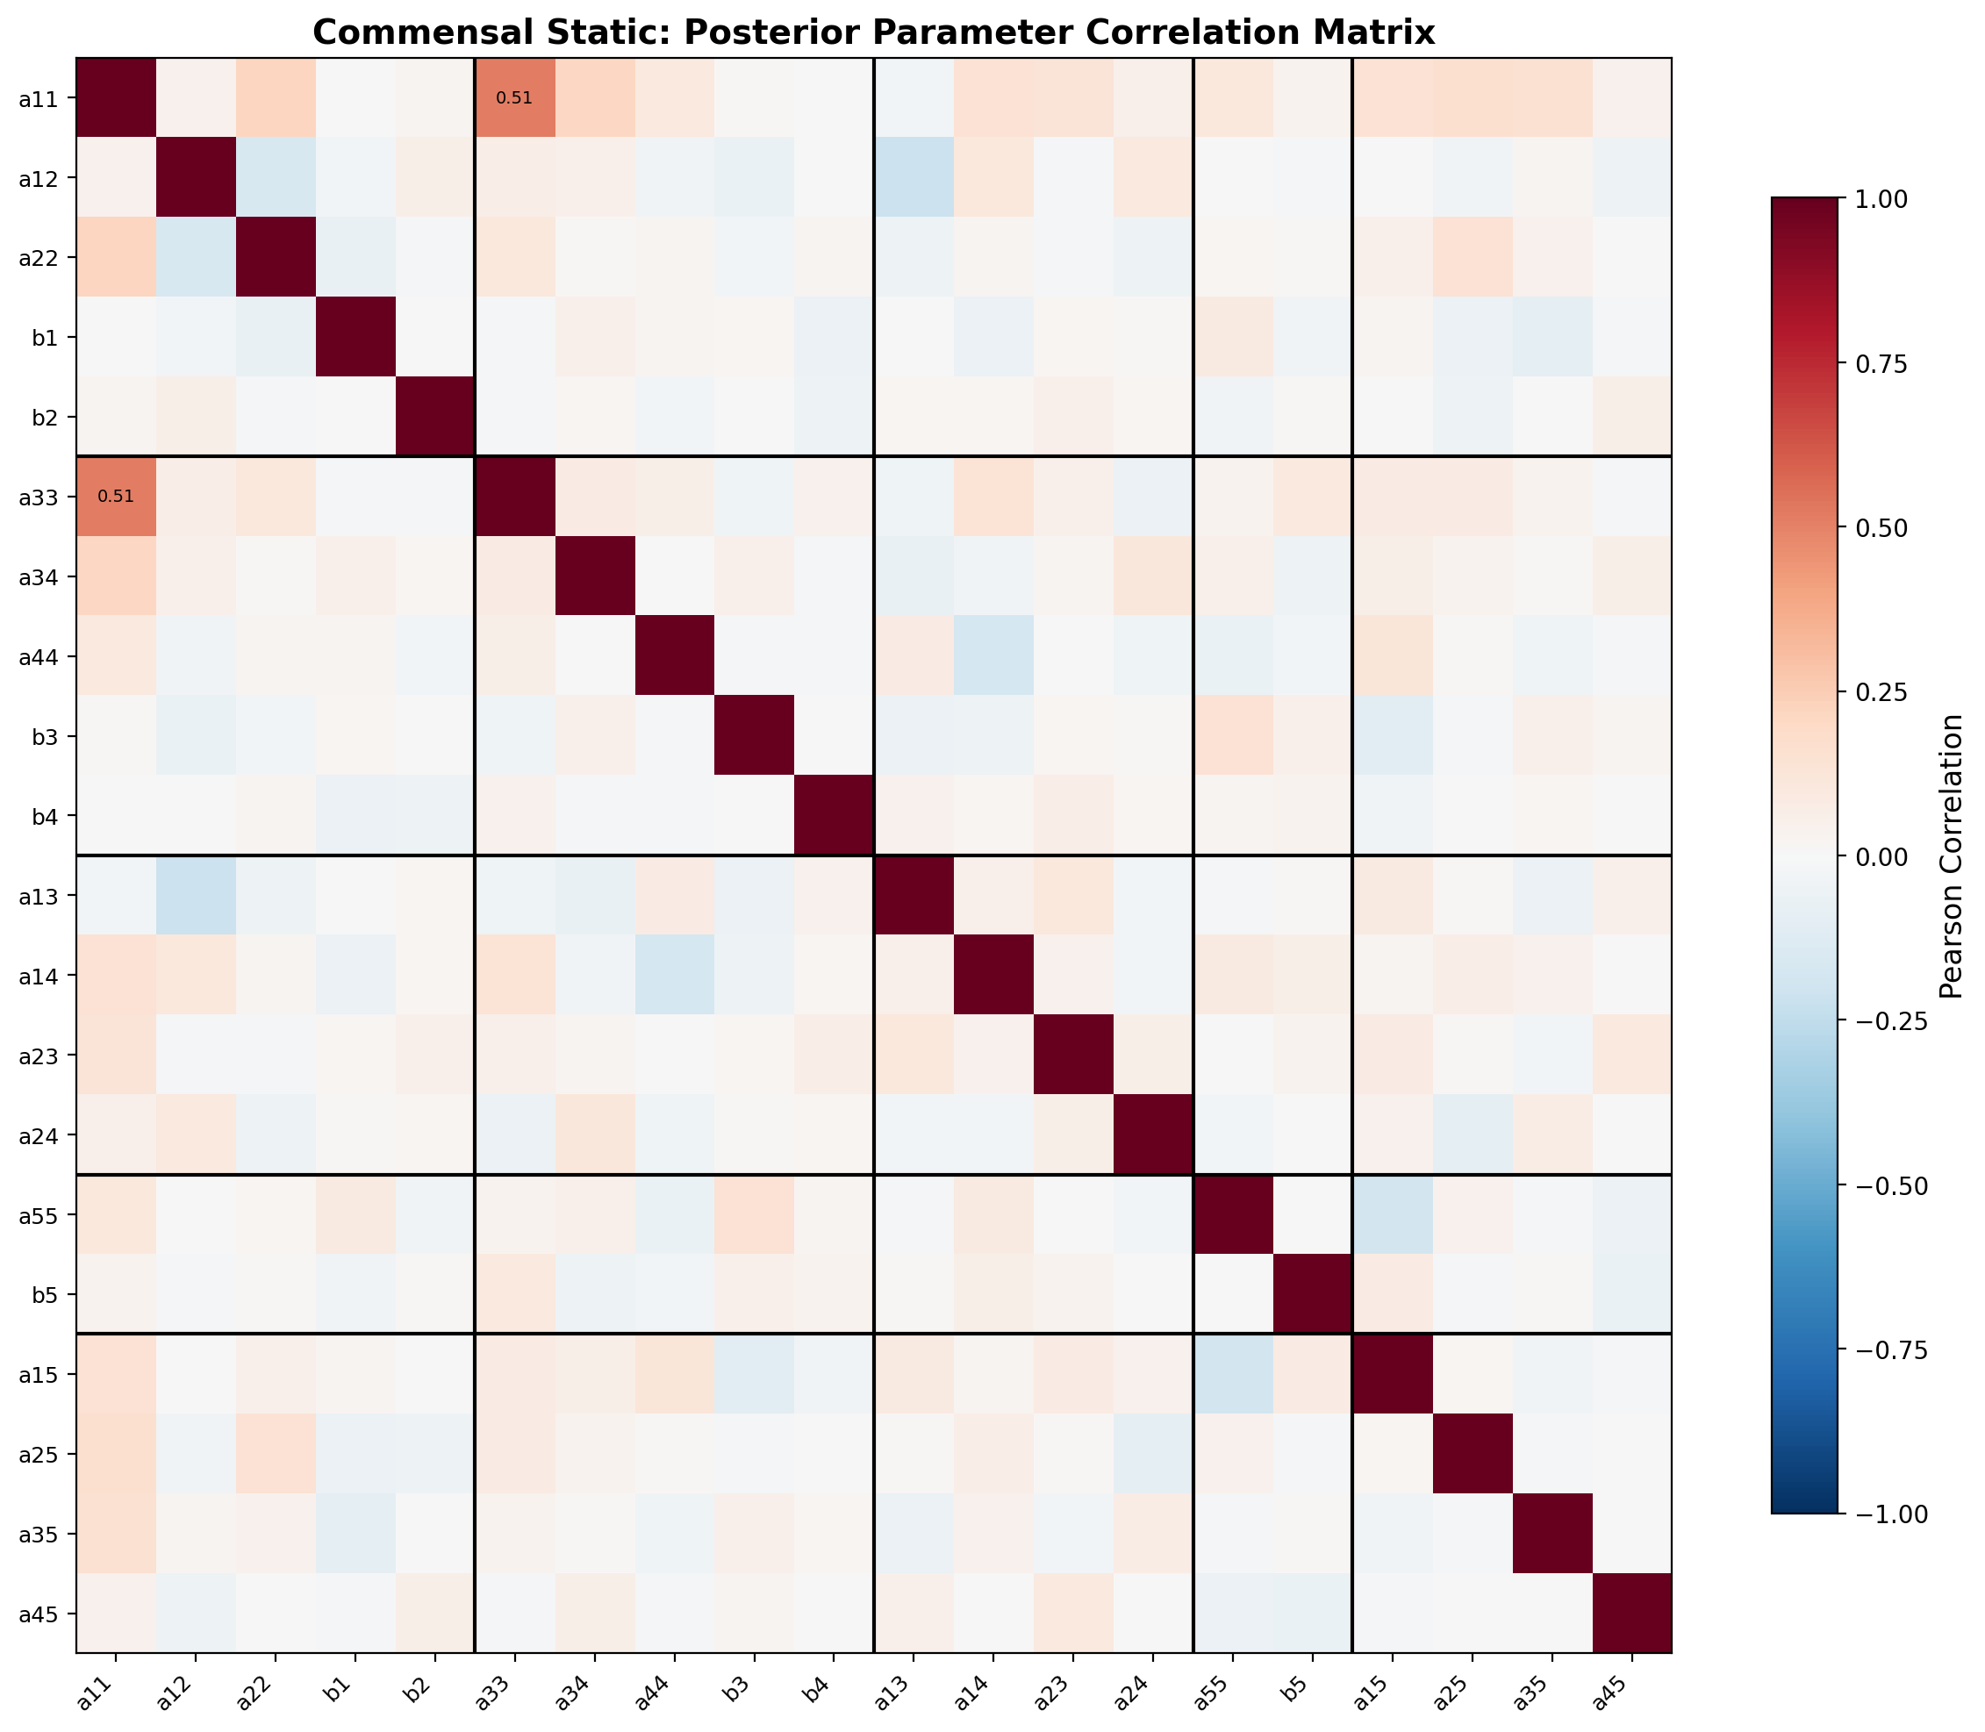
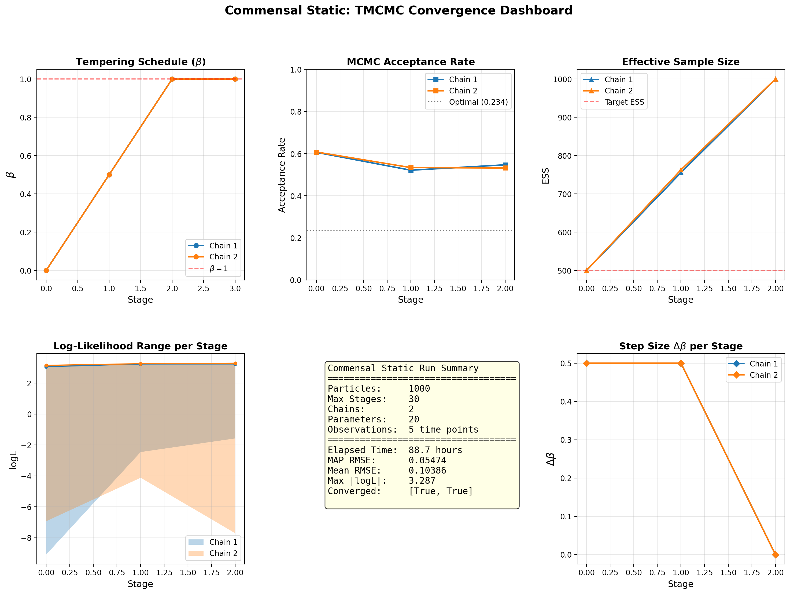
Commensal Static — Convergence & Diagnostics
健康・静的 — 収束診断
TMCMC β schedule
Species composition / 菌種構成
Parameter correlation / パラメータ相関
Convergence dashboard / 収束ダッシュボード
Nishioka | 5-Species Biofilm | TMCMC | IKM, LUH
23

Slide 24
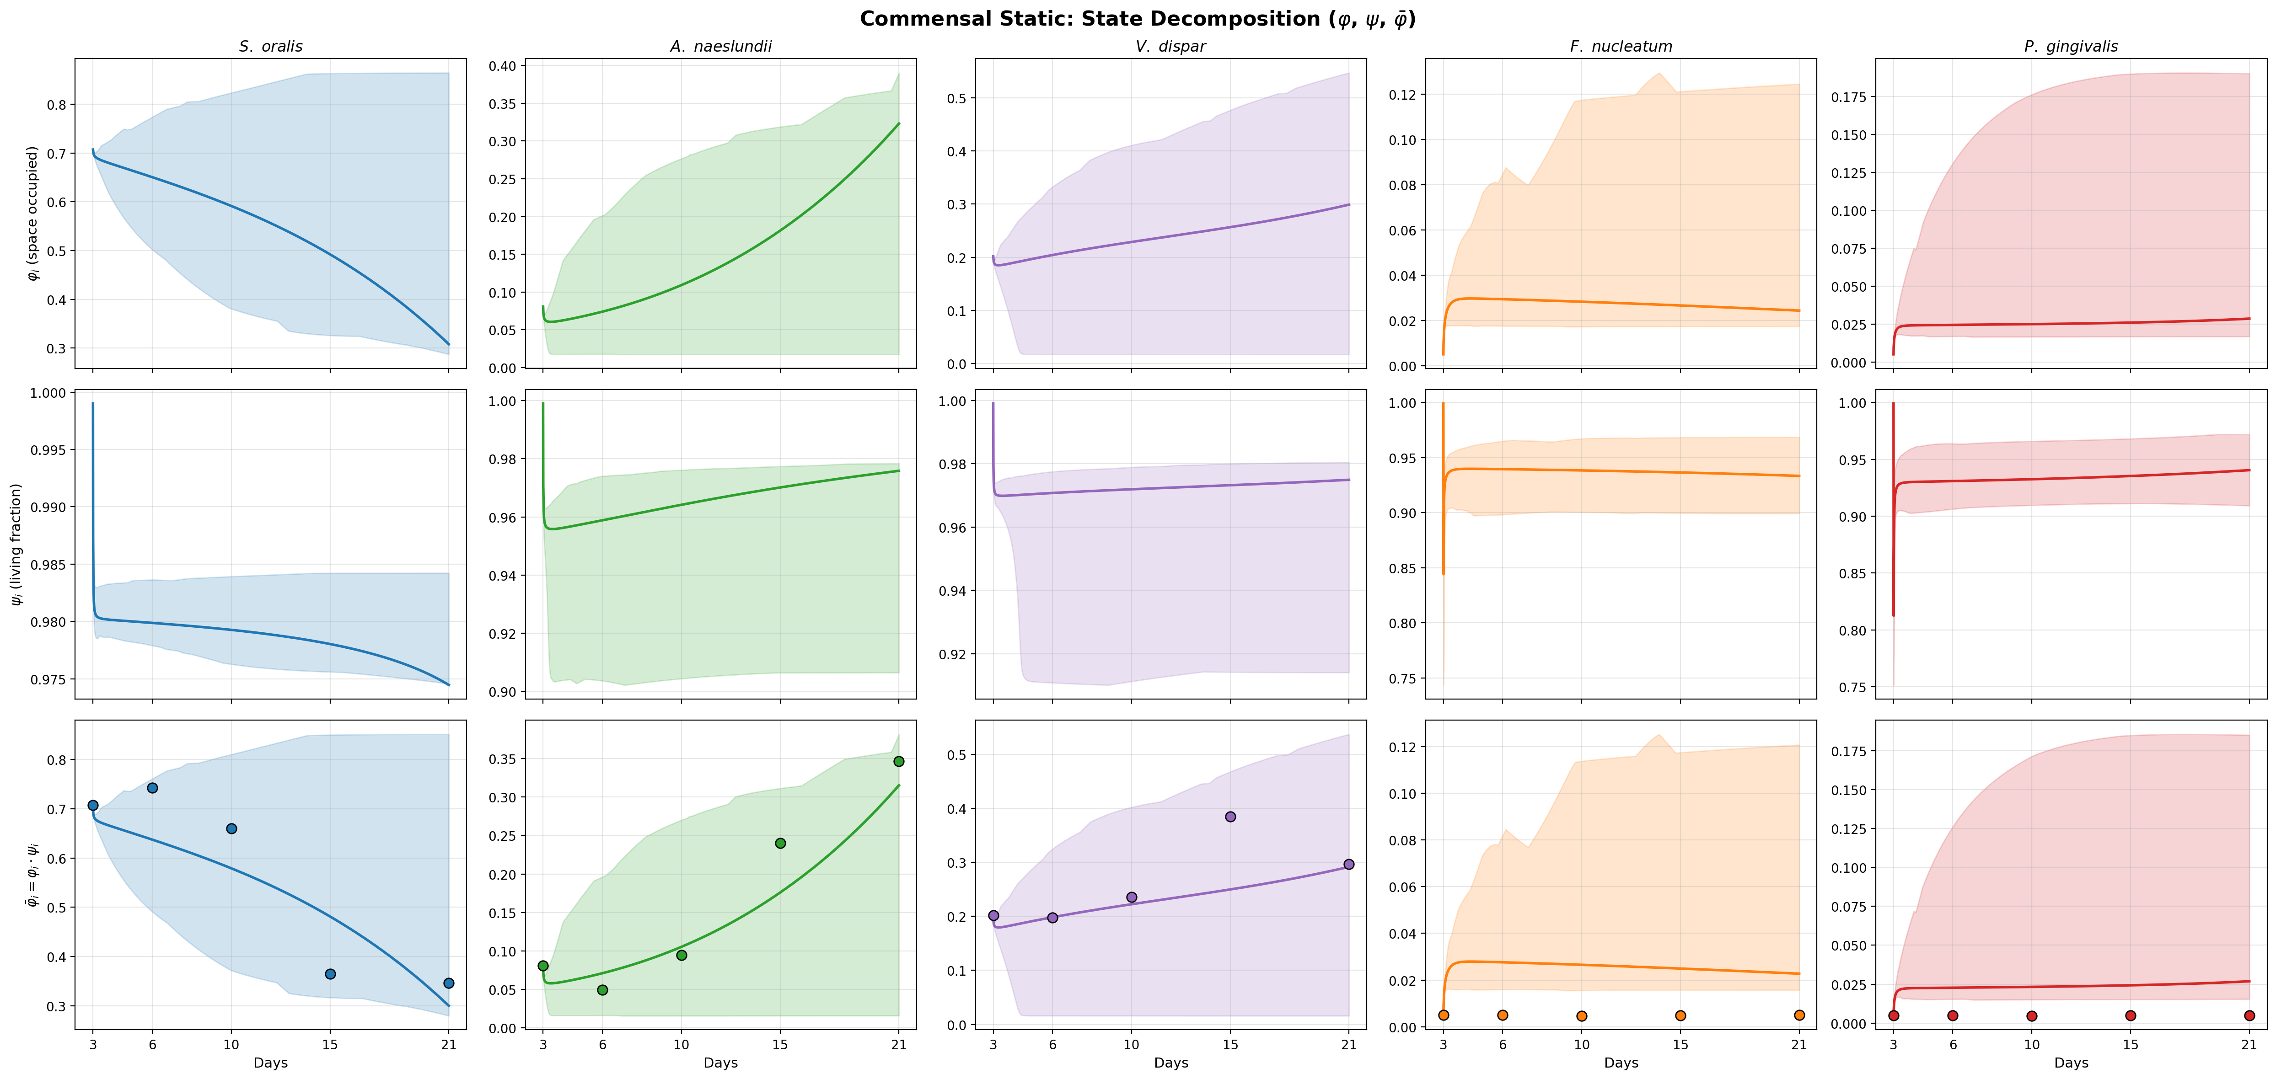
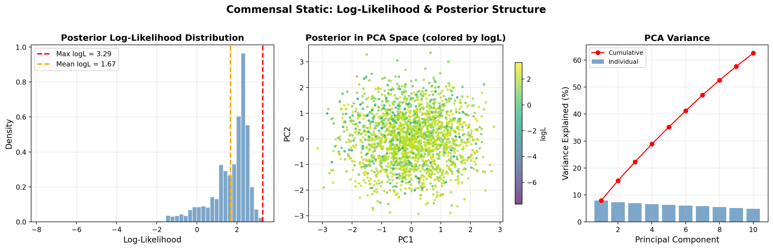
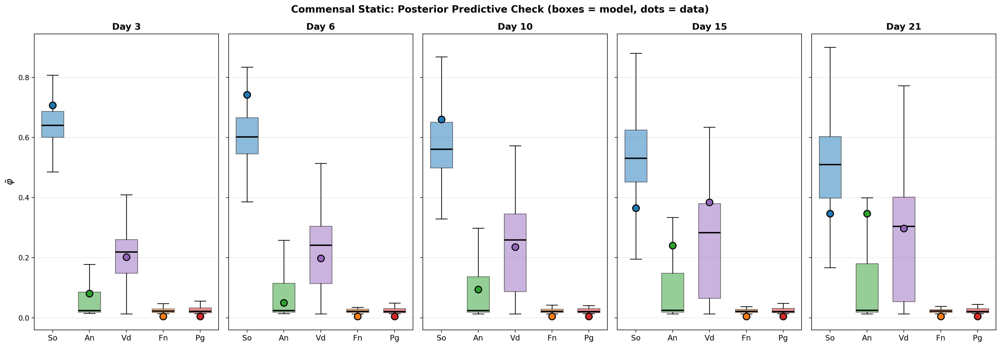
Commensal Static — Additional Diagnostics
健康・静的 — 追加診断
State decomposition (φ, ψ) / 状態分解
Log-likelihood landscape / 対数尤度
Posterior predictive check / 事後予測チェック
Nishioka | 5-Species Biofilm | TMCMC | IKM, LUH
24

Slide 25
⑧ Results: Dysbiotic Static
疾患・静的
Nishioka | 5-Species Biofilm | TMCMC | IKM, LUH
25

Slide 26
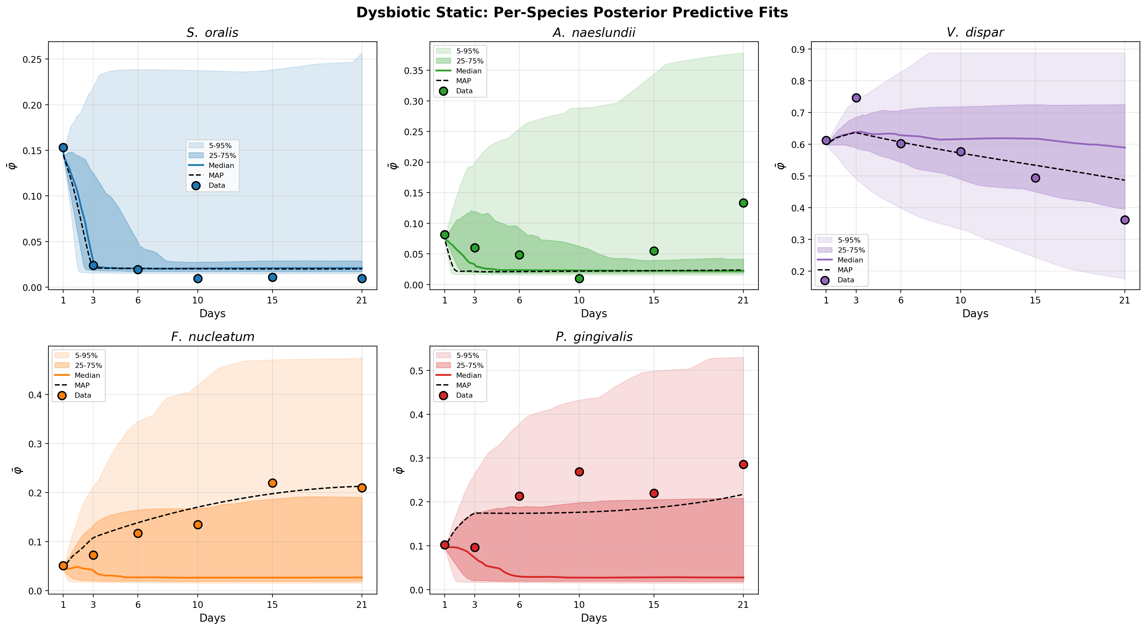
Dysbiotic Static — Posterior Predictive Fit
疾患・静的 — 事後予測適合
Condition
Disease state under static culture. Pathogens are present but limited by metabolite accumulation. Standard biological locks (N_locked = 5) are applied.
静的培養下の疾患状態。病原菌は存在するが代謝産物の蓄積により制限。標準的な生物学的ロック (N_locked = 5) を適用。
N_locked = 5
Key Finding
Pathogen interactions are estimated but their magnitude is smaller compared to HOBIC conditions. This confirms that saliva flow is essential for full dysbiosis progression.
病原菌の相互作用は推定されたがHOBIC条件と比較して規模が小さく、完全なディスバイオシスの進行には流れ(Flow)が不可欠であることを裏付け。
Per-species posterior predictive fit with 95% credible interval / 菌種別事後予測適合 (95%信用区間)
Nishioka | 5-Species Biofilm | TMCMC | IKM, LUH
26

Slide 27
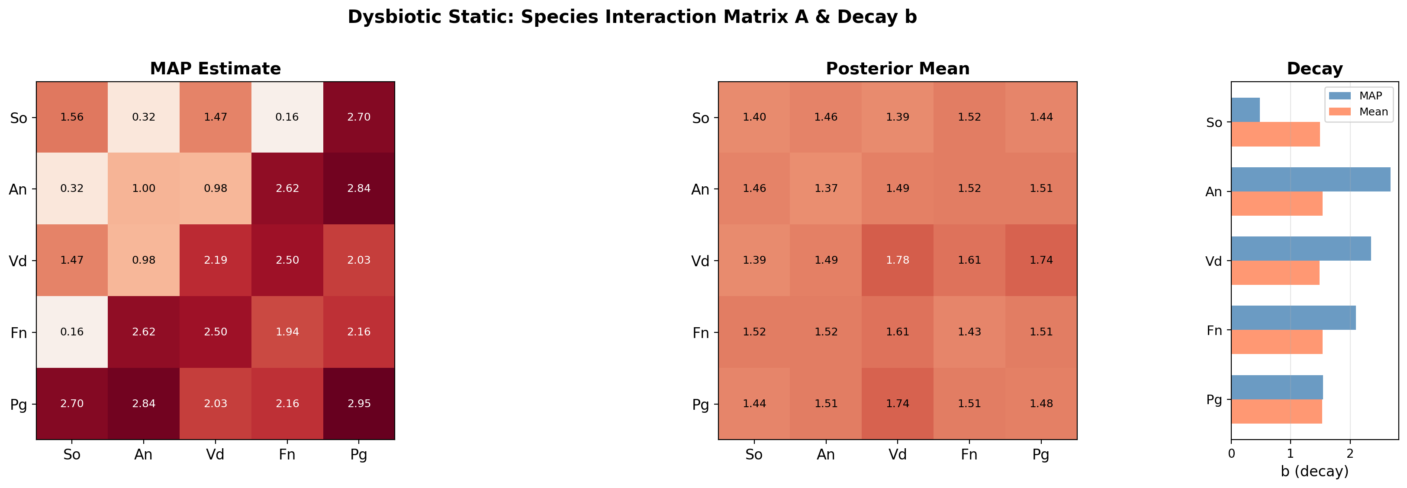
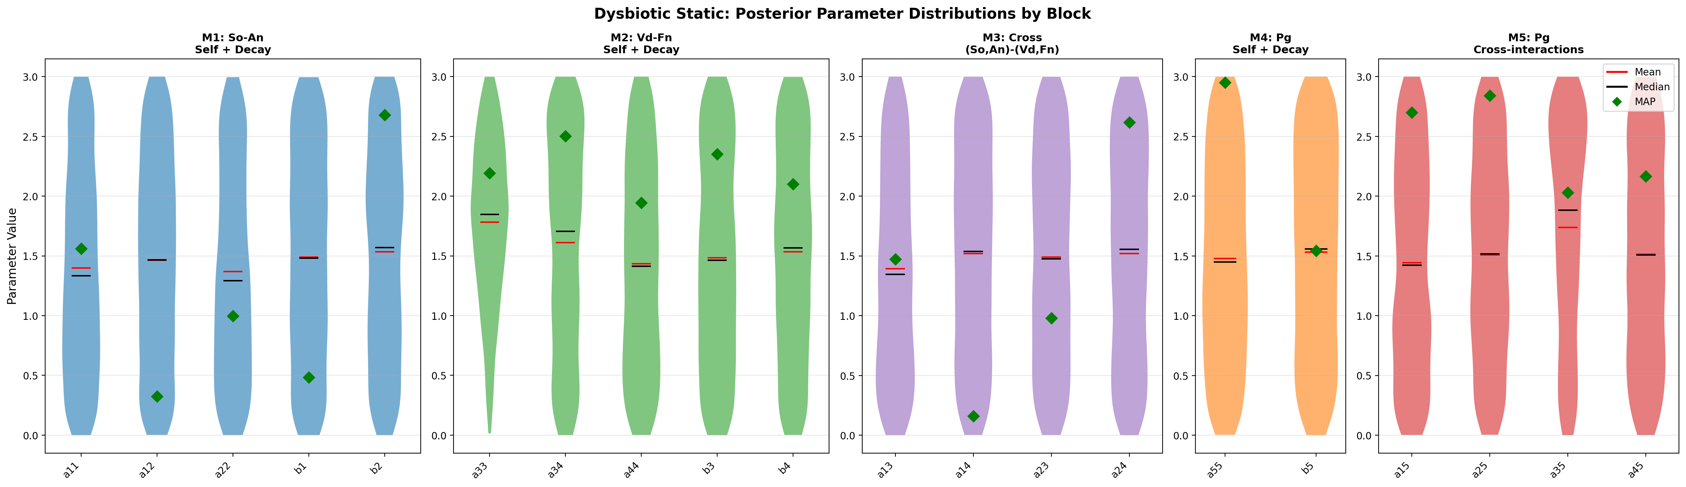
Dysbiotic Static — Interaction Matrix & Parameter Uncertainty
疾患・静的 — 相互作用行列 & パラメータ不確実性
Estimated interaction matrix A (MAP) / 推定相互作用行列
Parameter posterior distributions (violin) / パラメータ事後分布 (バイオリン)
Nishioka | 5-Species Biofilm | TMCMC | IKM, LUH
27

Slide 28
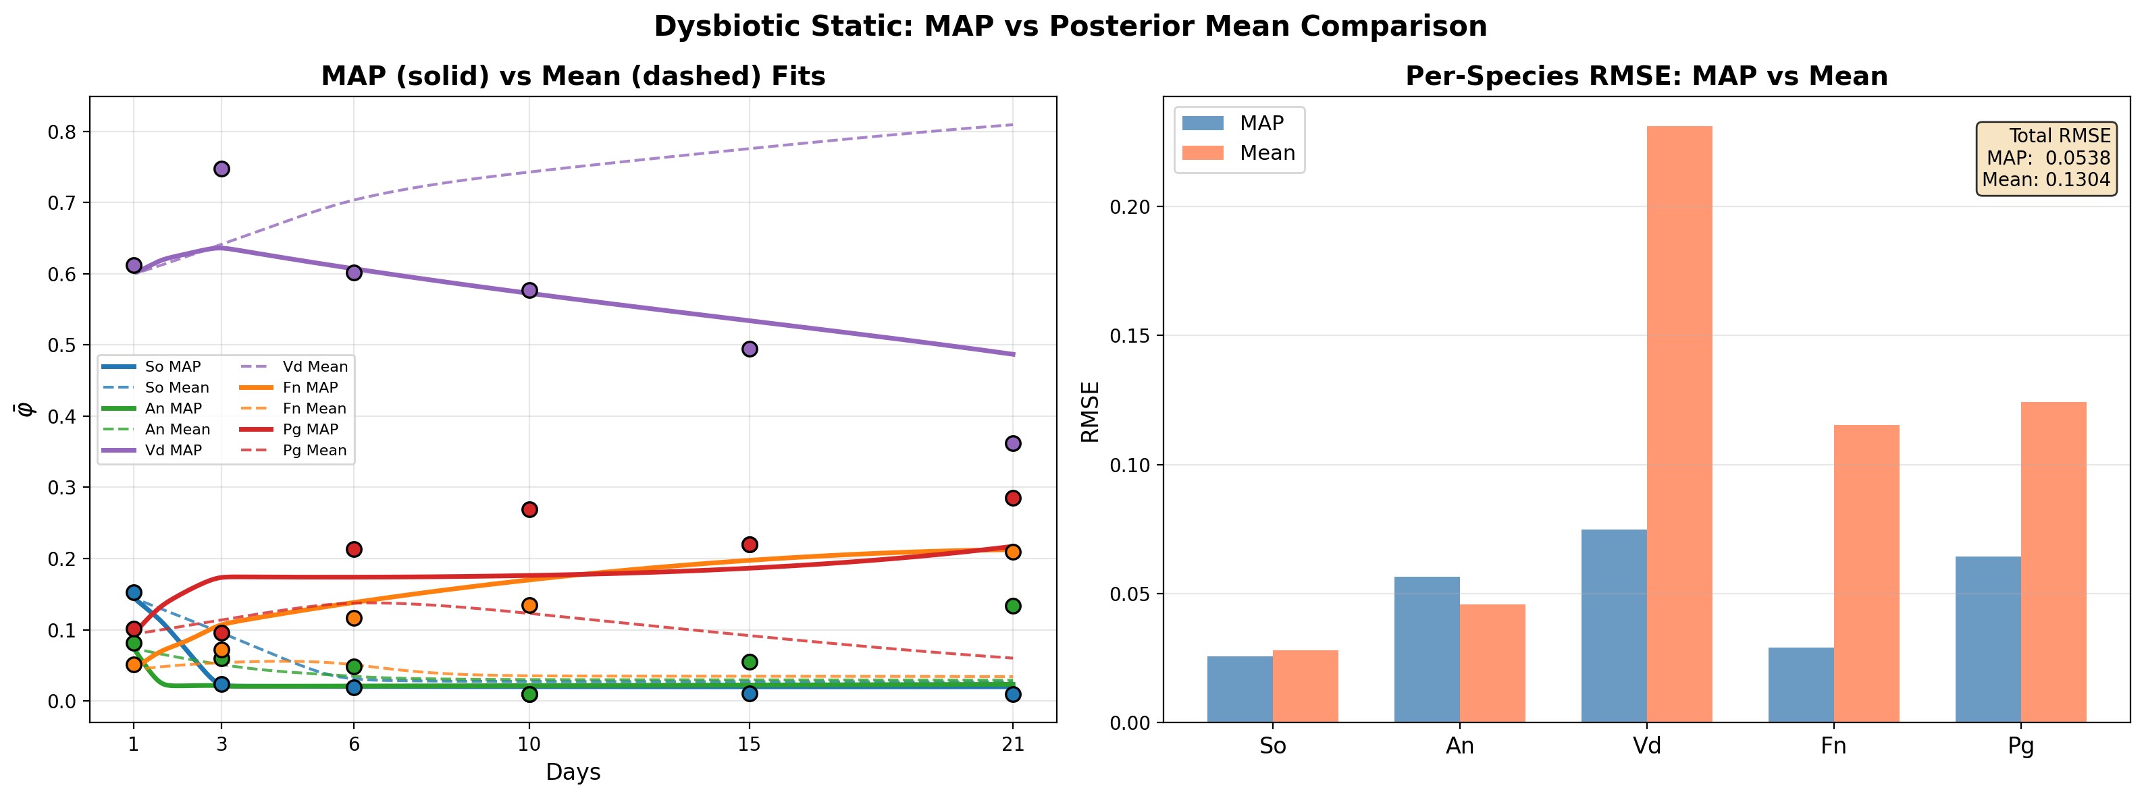
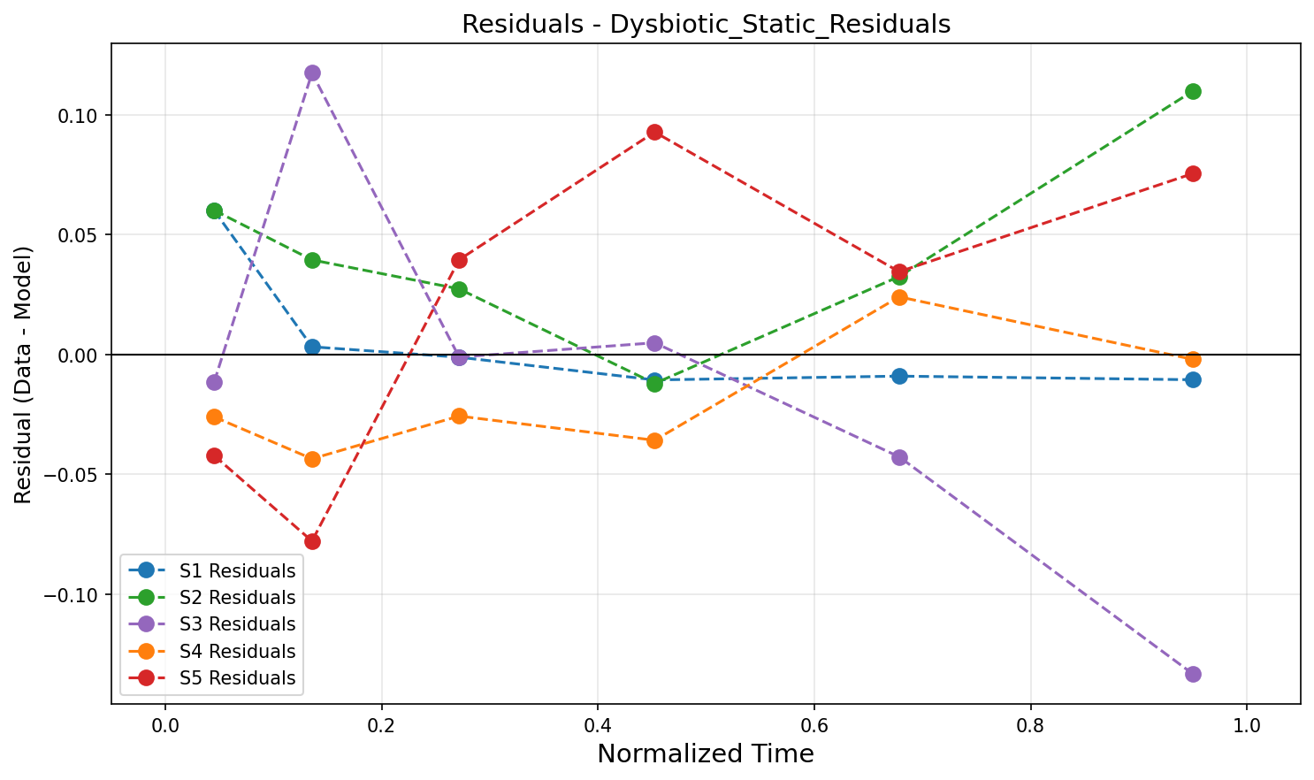
Dysbiotic Static — MAP vs Mean & Residuals
疾患・静的 — MAP vs 平均推定 & 残差分析
MAP vs Mean parameter comparison / MAP vs 平均パラメータ比較
Residual analysis / 残差分析
Nishioka | 5-Species Biofilm | TMCMC | IKM, LUH
28

Slide 29

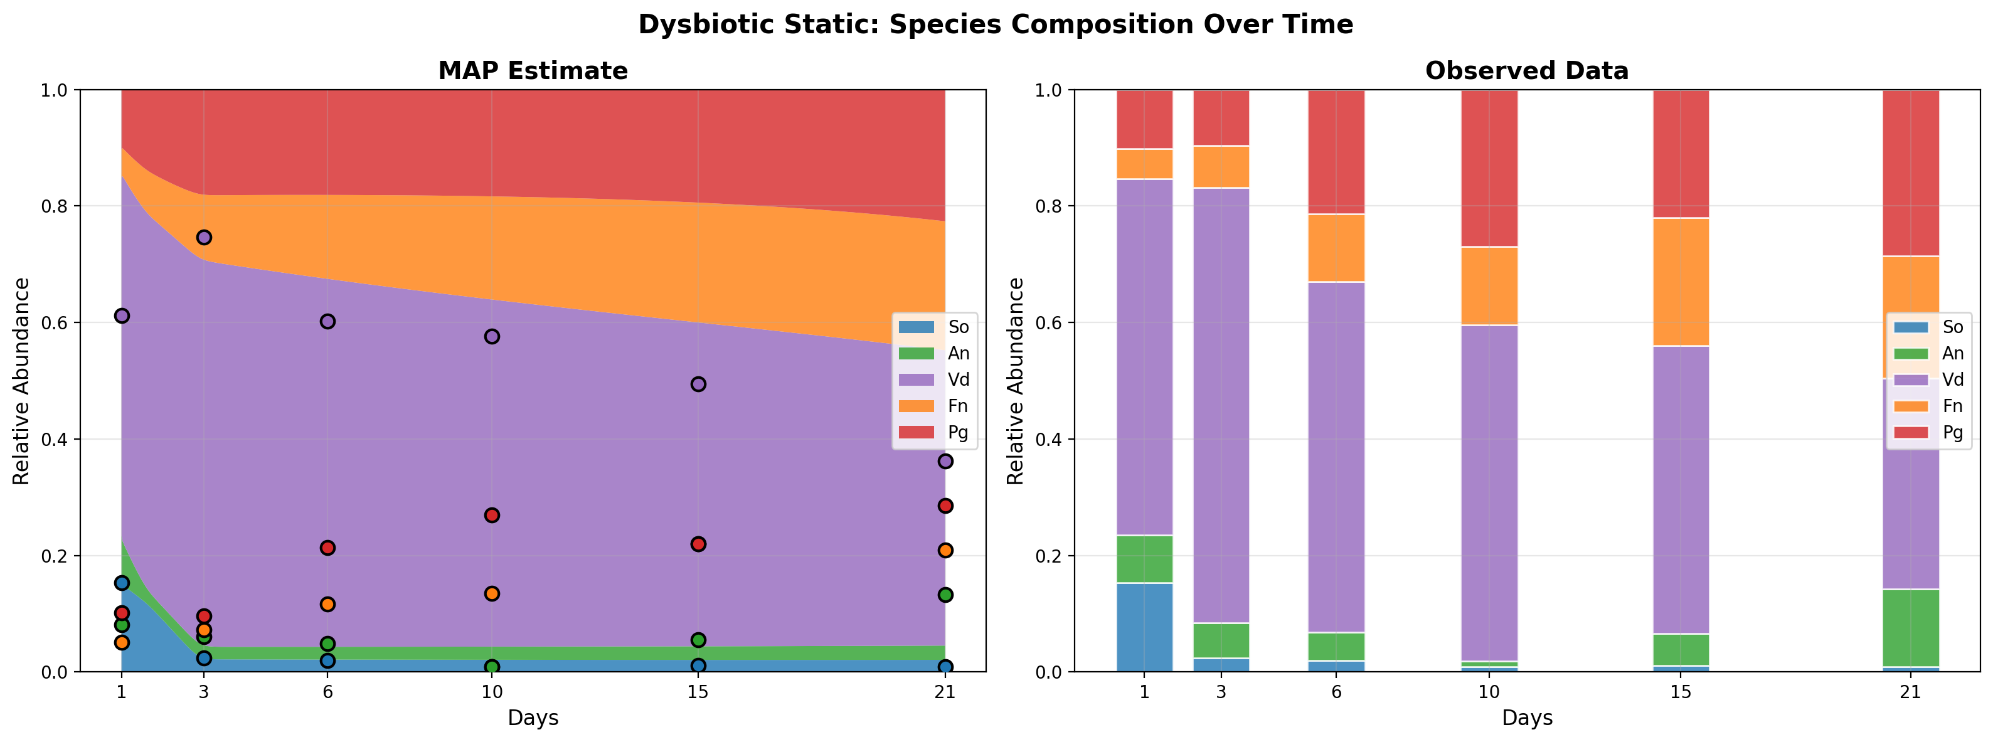
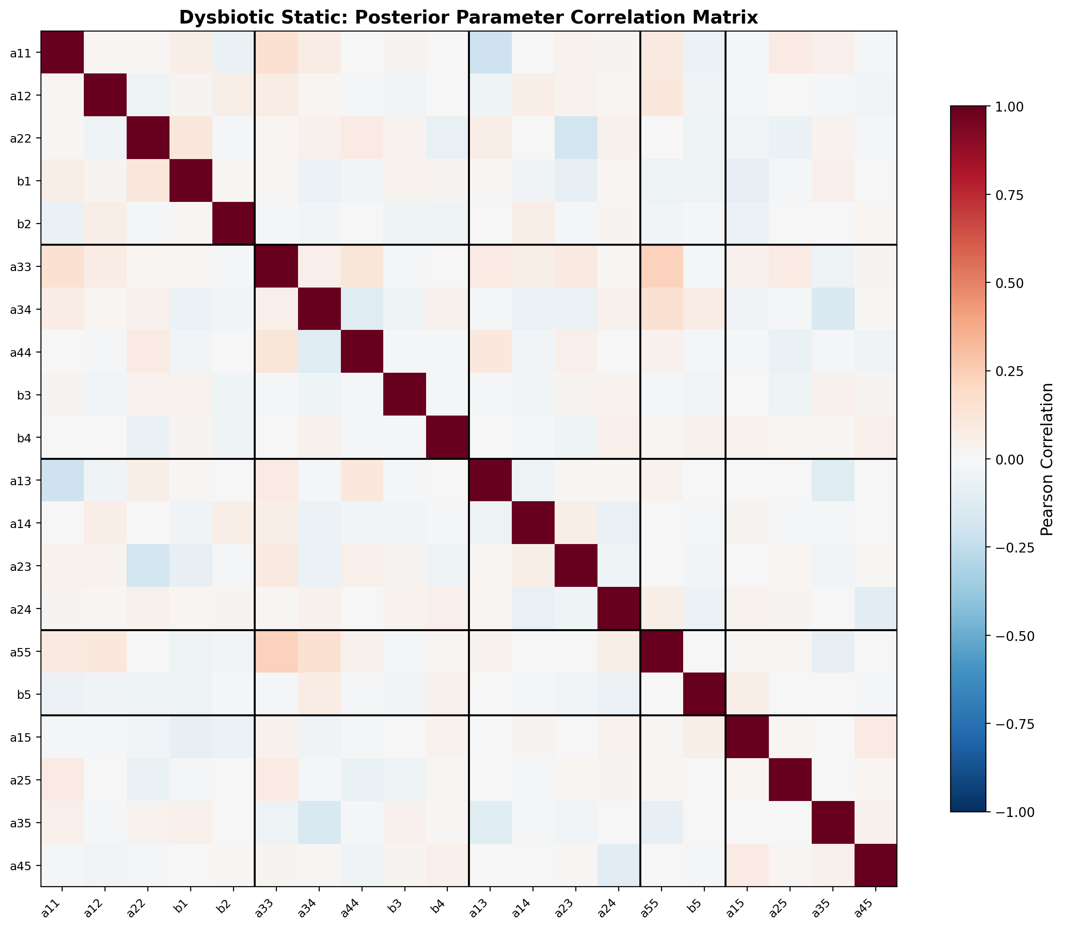
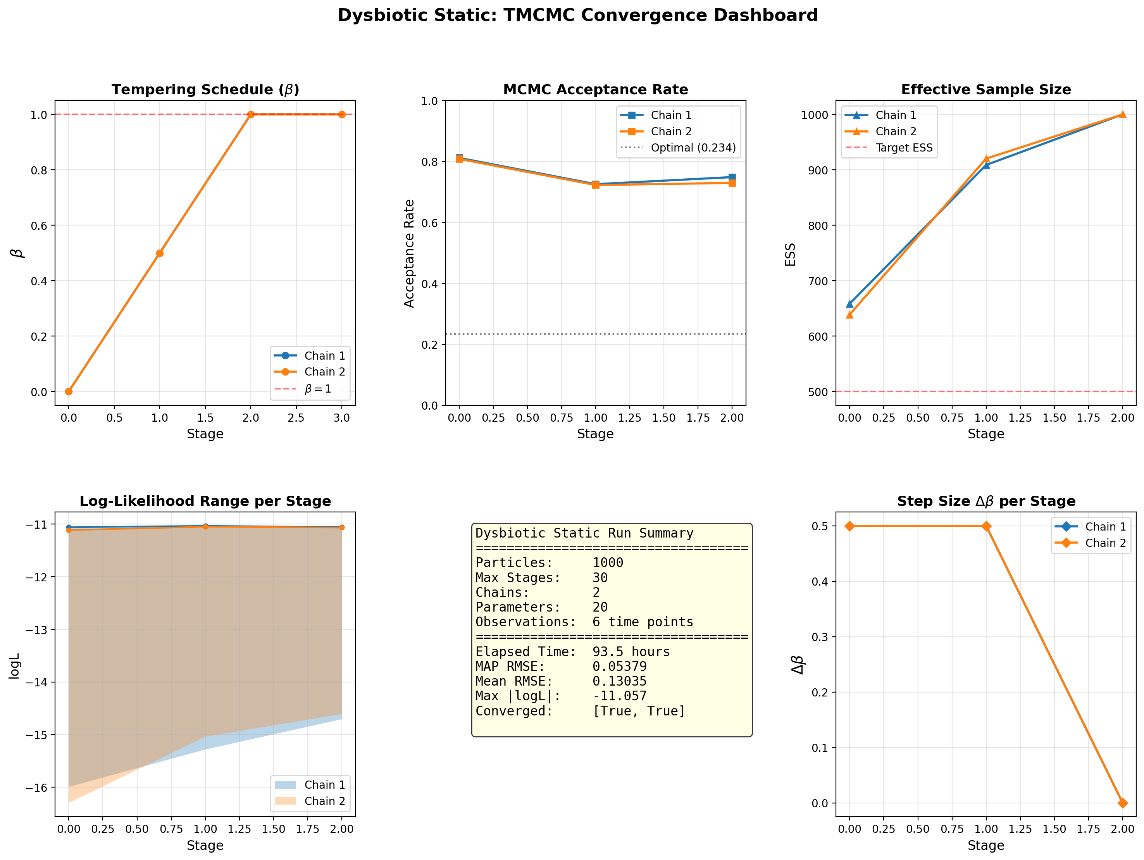
Dysbiotic Static — Convergence & Diagnostics
疾患・静的 — 収束診断
TMCMC β schedule
Species composition / 菌種構成
Parameter correlation / パラメータ相関
Convergence dashboard / 収束ダッシュボード
Nishioka | 5-Species Biofilm | TMCMC | IKM, LUH
29

Slide 30
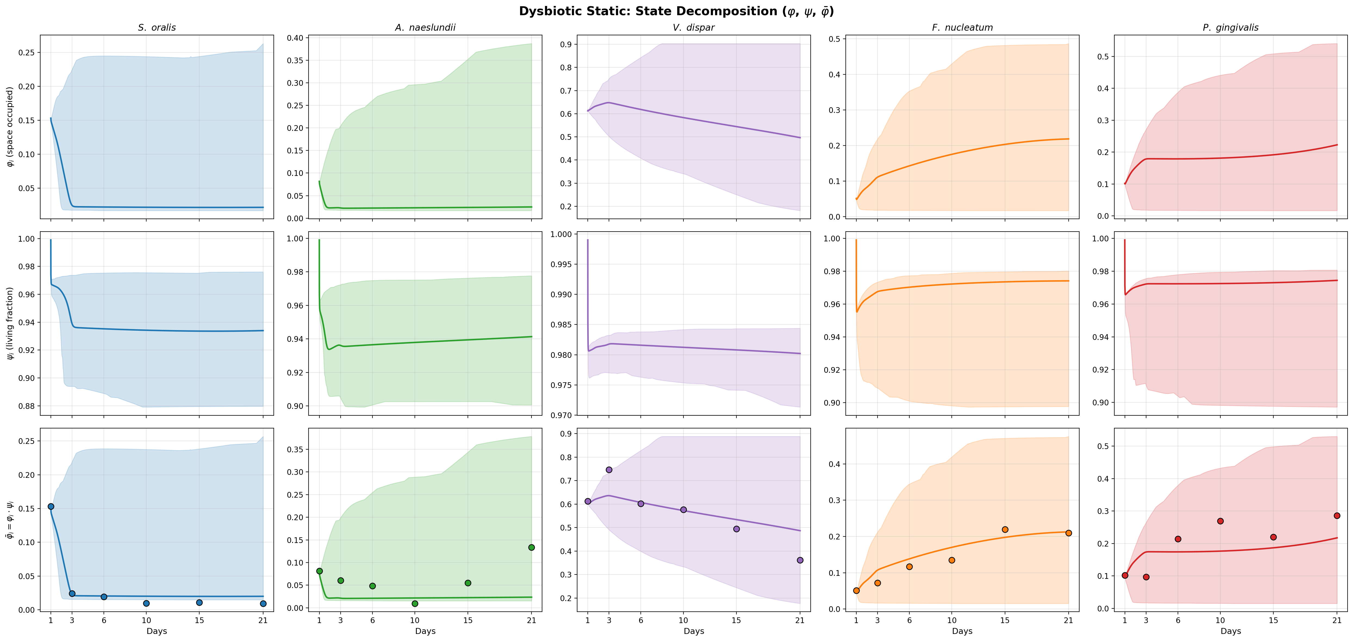
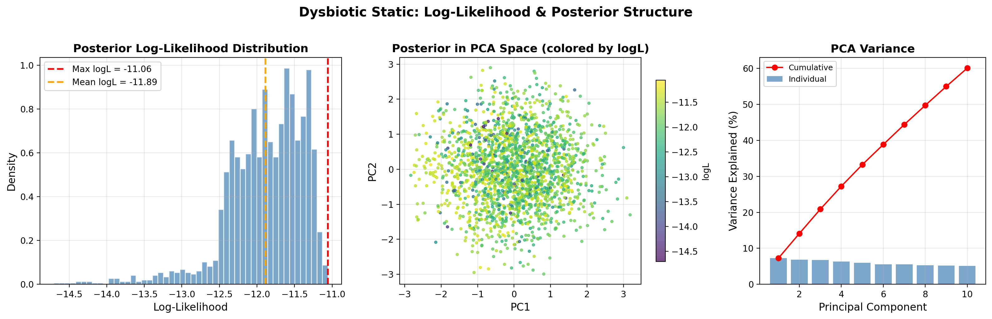
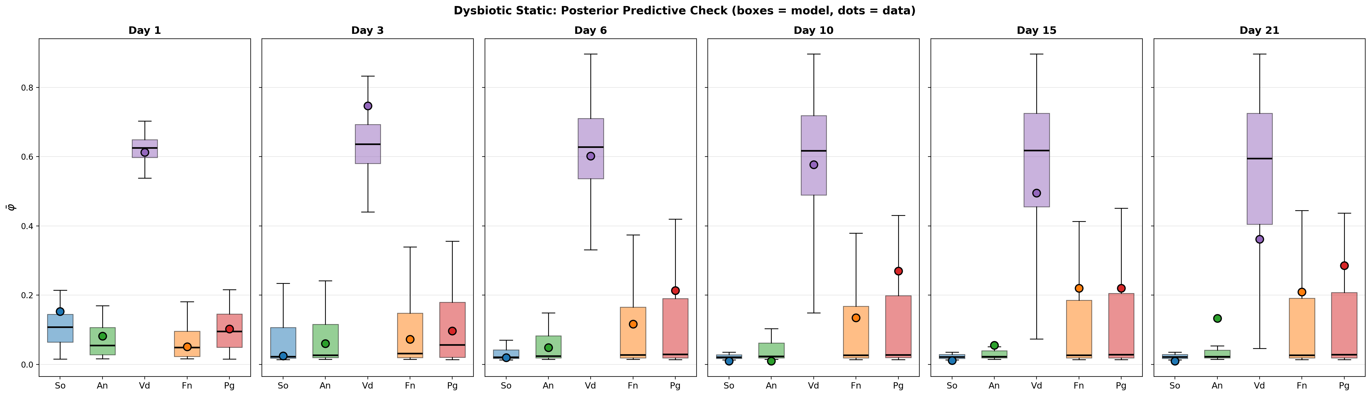
Dysbiotic Static — Additional Diagnostics
疾患・静的 — 追加診断
State decomposition (φ, ψ) / 状態分解
Log-likelihood landscape / 対数尤度
Posterior predictive check / 事後予測チェック
Nishioka | 5-Species Biofilm | TMCMC | IKM, LUH
30

Slide 31
⑨ Results: Commensal HOBIC
健康・流動 (HOBIC)
Nishioka | 5-Species Biofilm | TMCMC | IKM, LUH
31

Slide 32
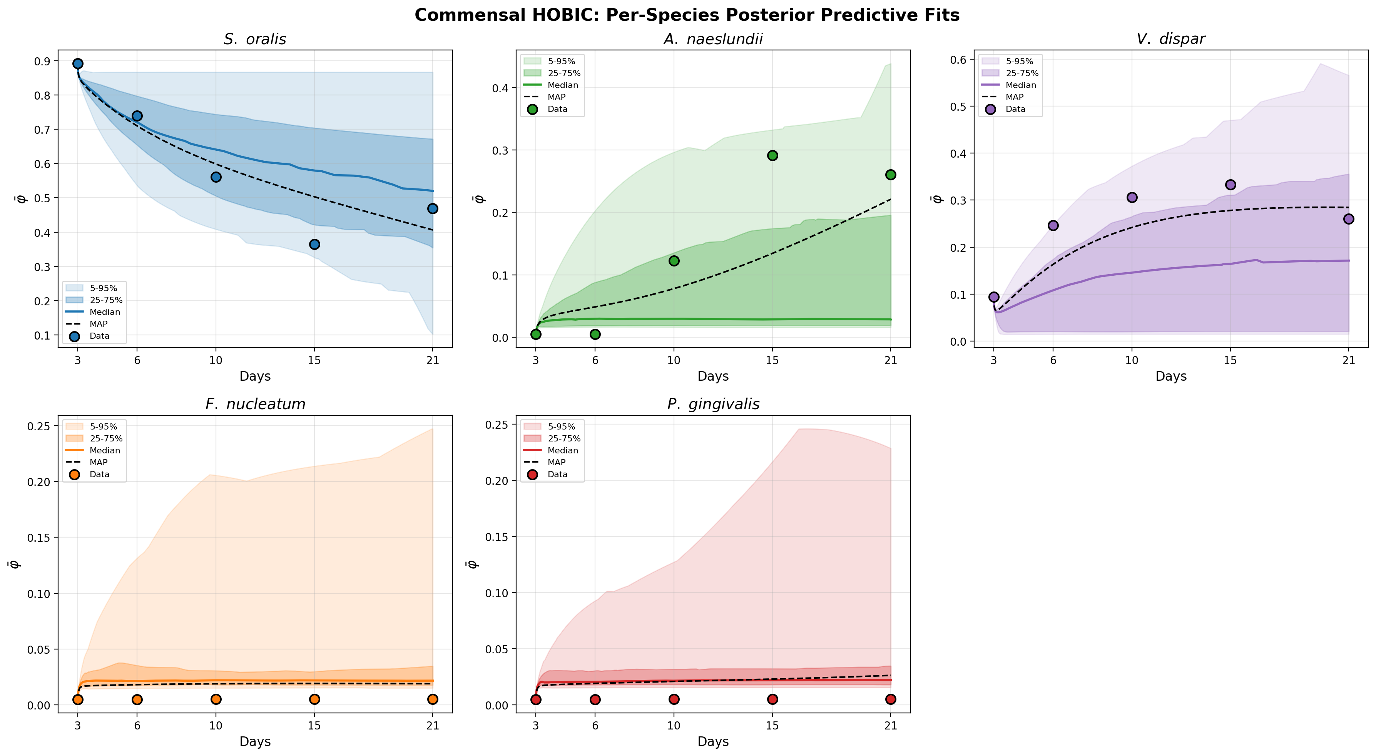
Commensal HOBIC — Posterior Predictive Fit
健康・流動 (HOBIC) — 事後予測適合
Condition
Healthy state with saliva flow (HOBIC). Characterized by S. oralis 'Blue Bloom' — high proliferation of early colonizers under flow. Strict locks (N_locked = 8) allow S. oralis growth while suppressing pathogens.
流れのある健康な状態 (HOBIC)。S. oralisの高い増殖 ('Blue Bloom') が特徴。厳格なロック (N_locked = 8) がS. oralisの増殖を許容しつつ病原菌を抑制。
N_locked = 8
Key Finding
The model correctly identifies early colonizer dominance while suppressing pathogen populations. The 'Blue Bloom' observation is quantitatively reproduced by the MAP estimate.
初期定着菌の優位性を正しく特定しつつ病原菌集団を低く抑制。'Blue Bloom' の観察結果をMAP推定値により定量的に再現。
Per-species posterior predictive fit with 95% credible interval / 菌種別事後予測適合 (95%信用区間)
Nishioka | 5-Species Biofilm | TMCMC | IKM, LUH
32

Slide 33
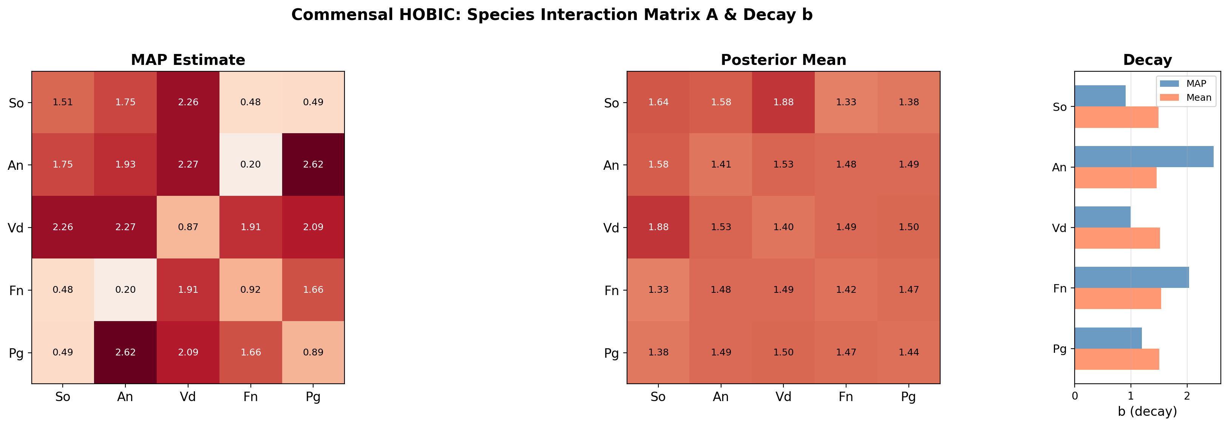
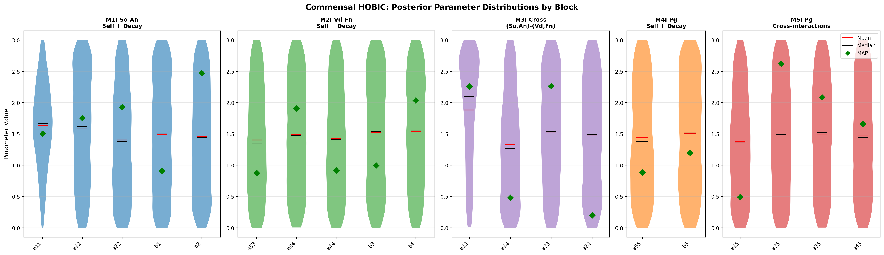
Commensal HOBIC — Interaction Matrix & Parameter Uncertainty
健康・流動 (HOBIC) — 相互作用行列 & パラメータ不確実性
Estimated interaction matrix A (MAP) / 推定相互作用行列
Parameter posterior distributions (violin) / パラメータ事後分布 (バイオリン)
Nishioka | 5-Species Biofilm | TMCMC | IKM, LUH
33

Slide 34
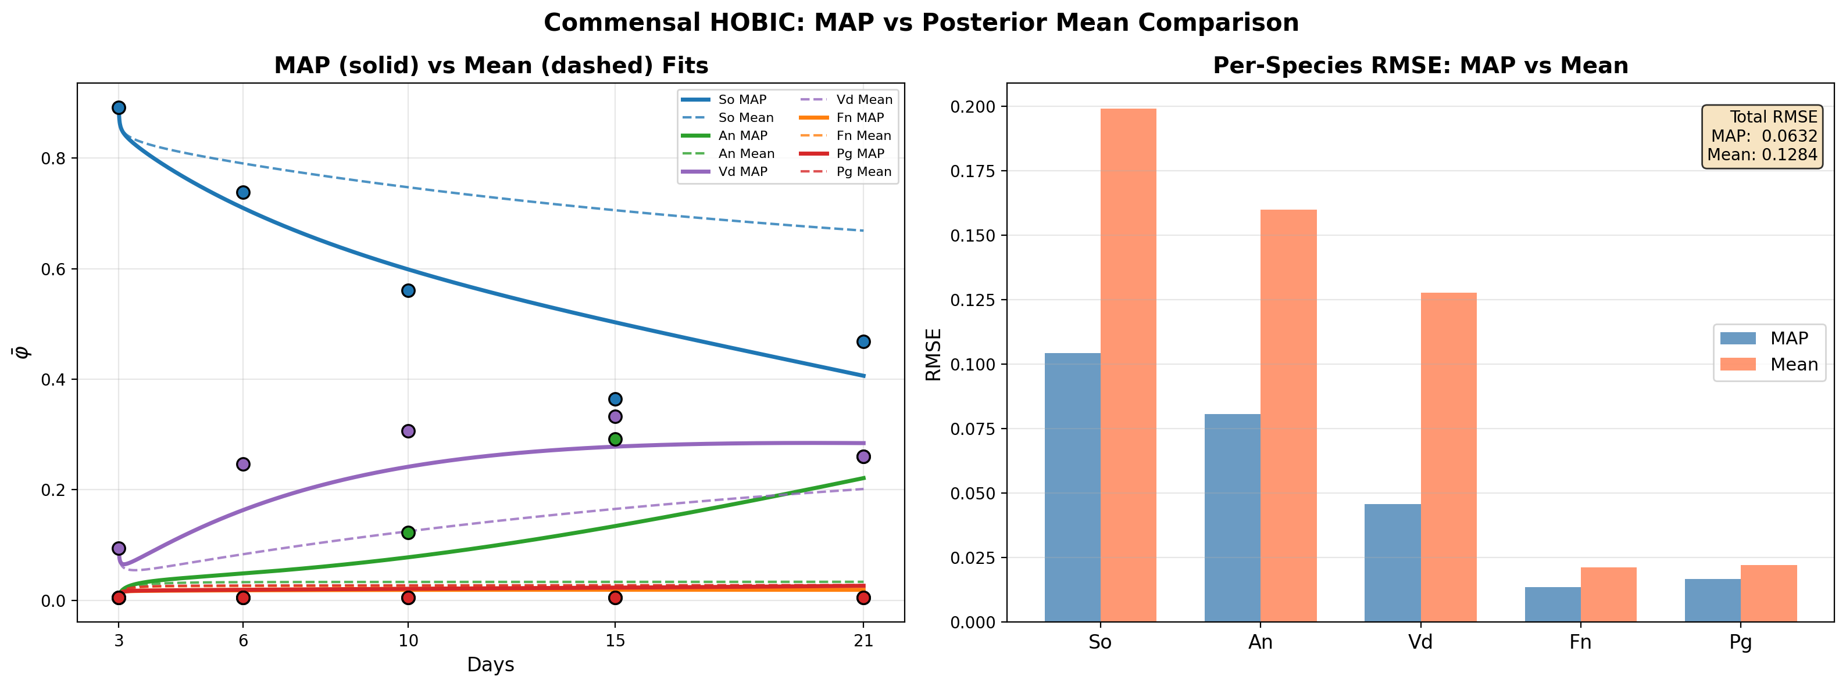
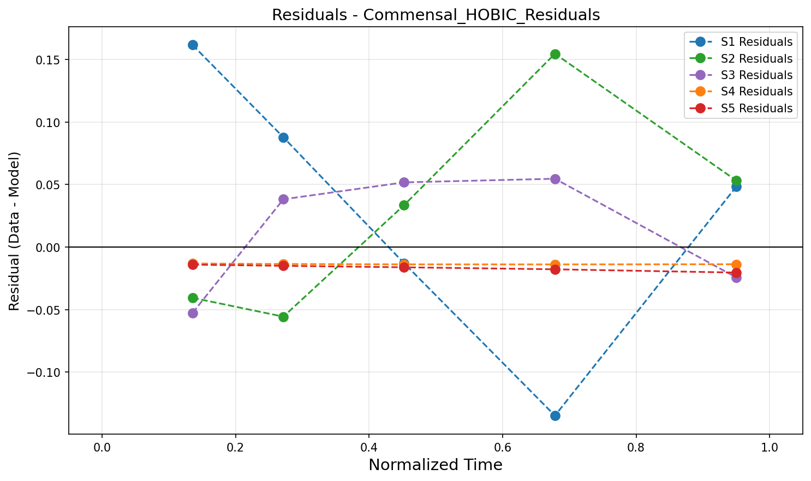
Commensal HOBIC — MAP vs Mean & Residuals
健康・流動 (HOBIC) — MAP vs 平均推定 & 残差分析
MAP vs Mean parameter comparison / MAP vs 平均パラメータ比較
Residual analysis / 残差分析
Nishioka | 5-Species Biofilm | TMCMC | IKM, LUH
34

Slide 35
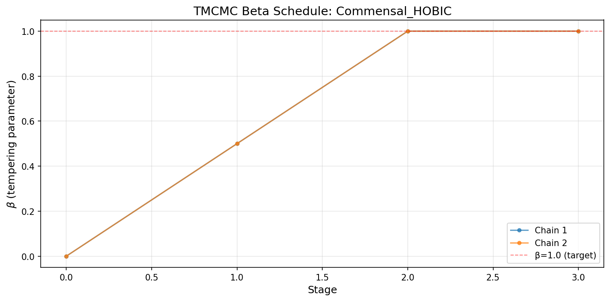
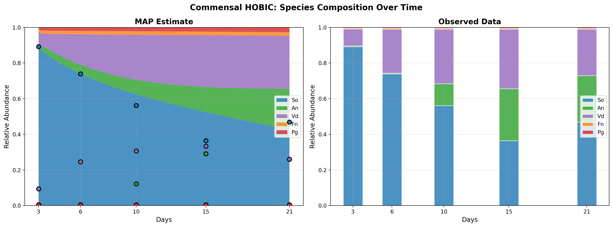
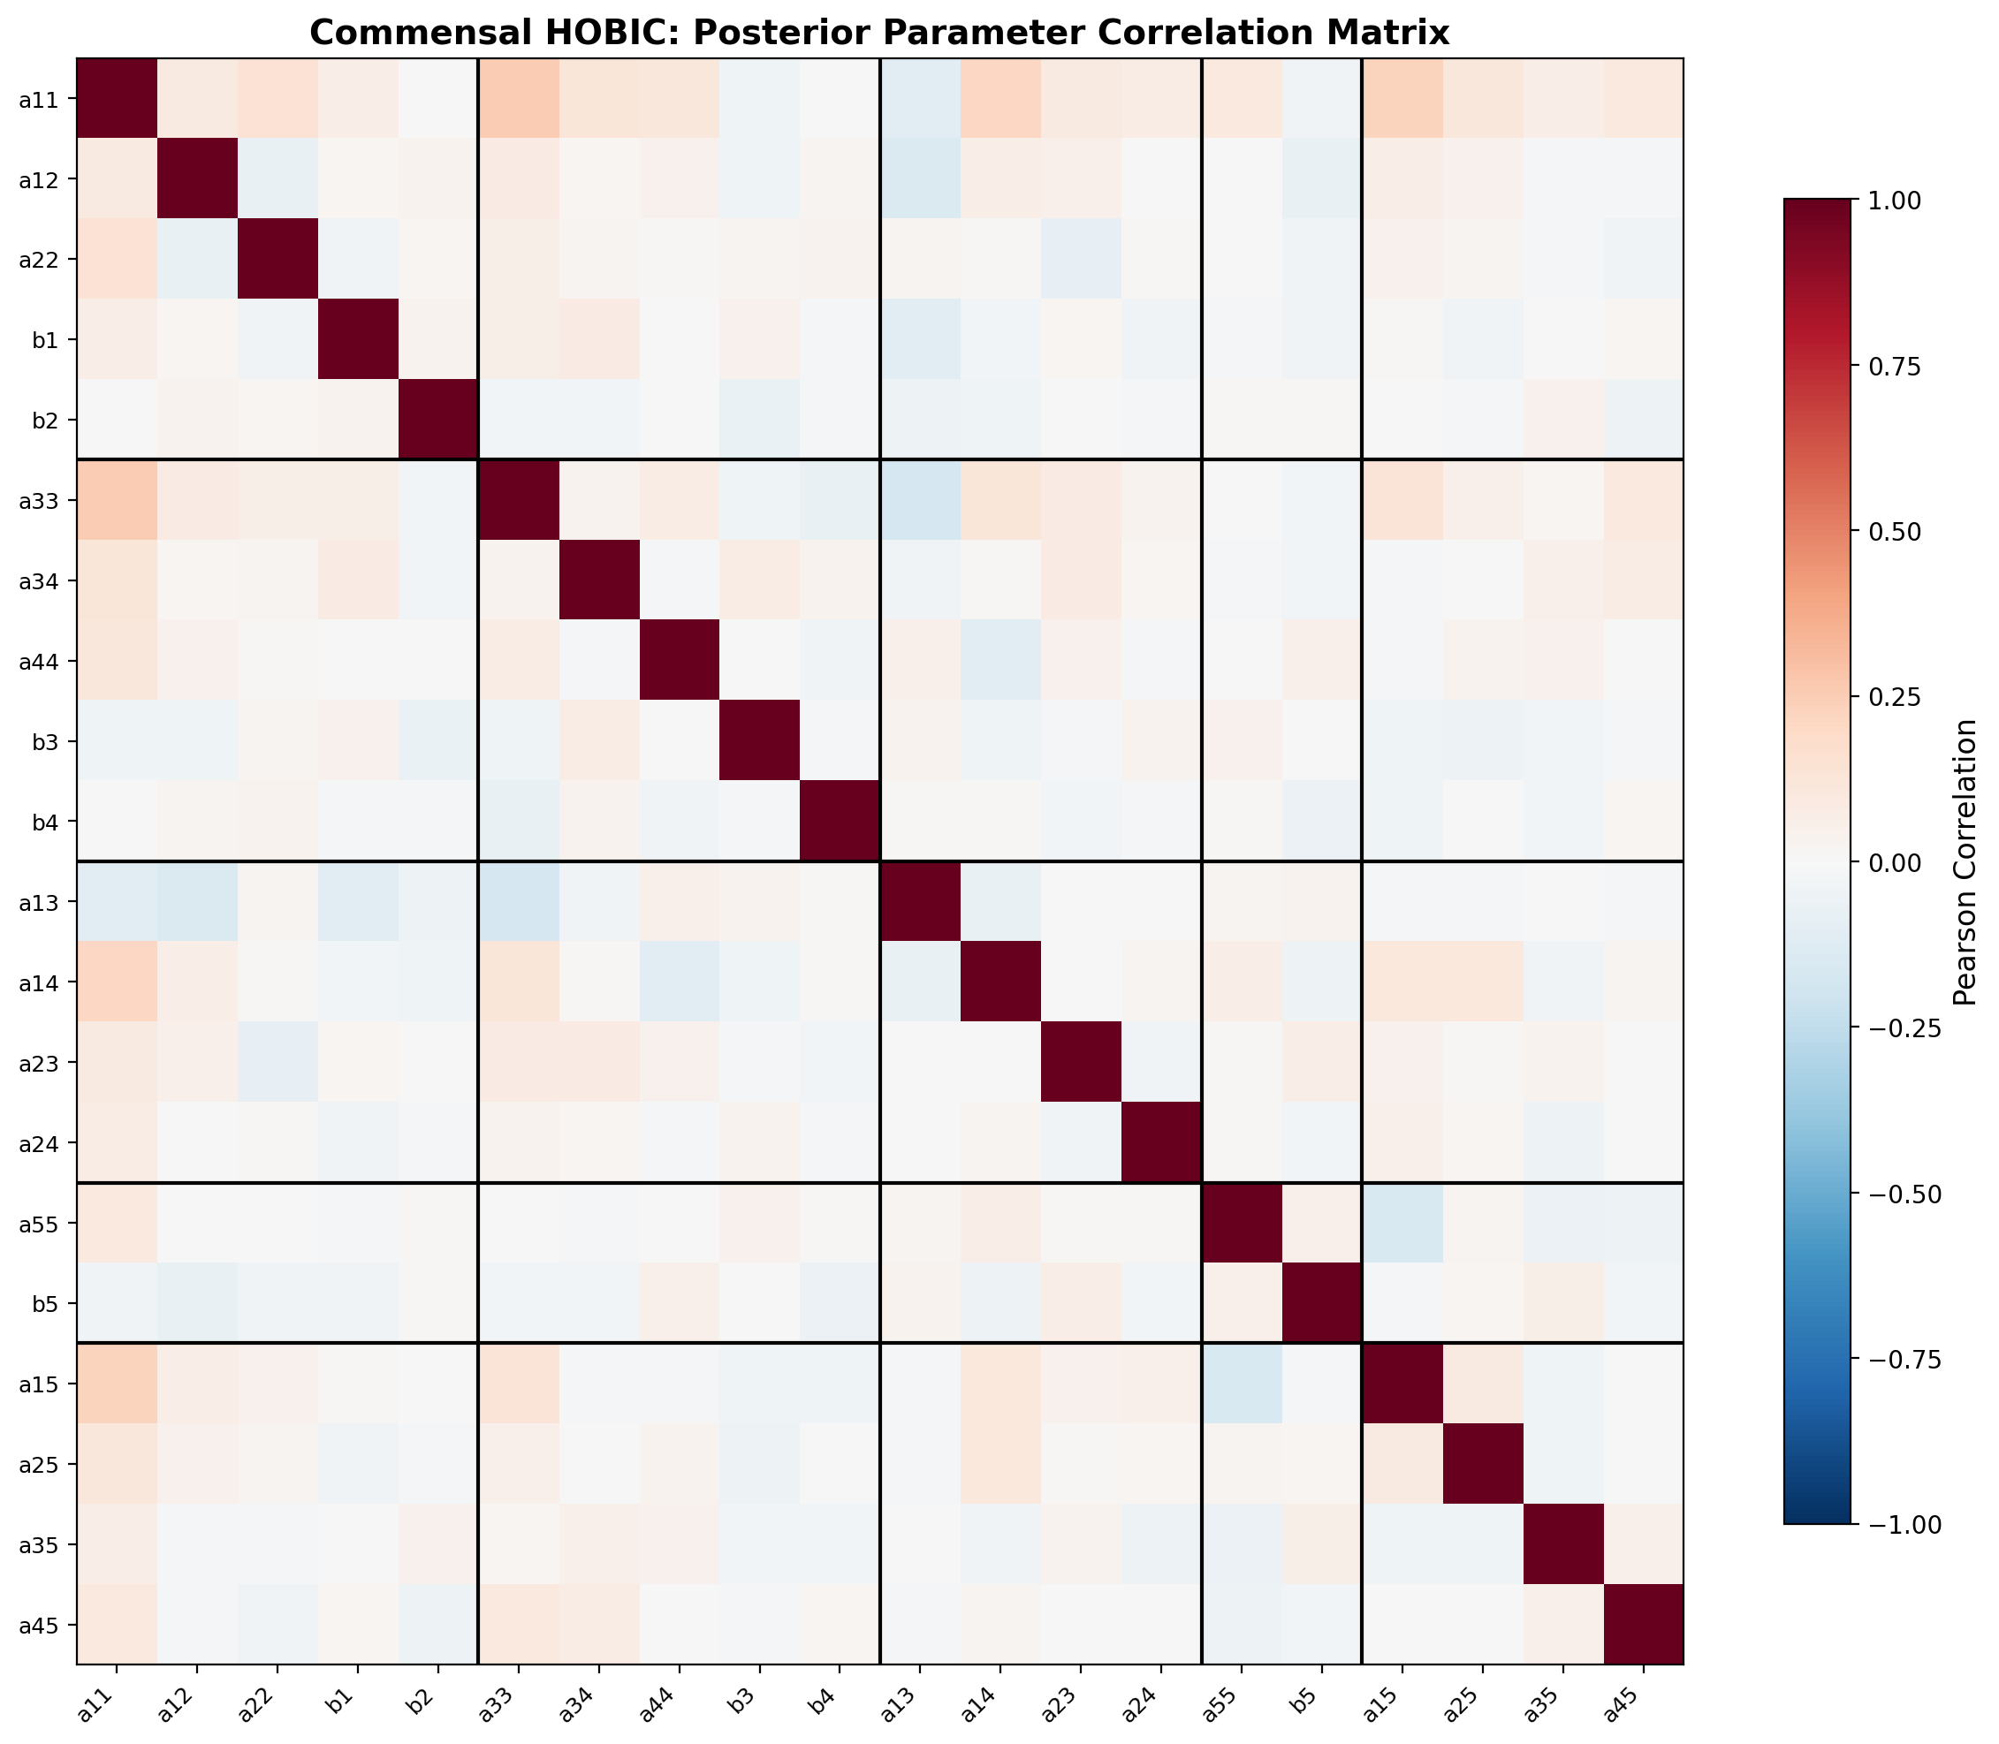
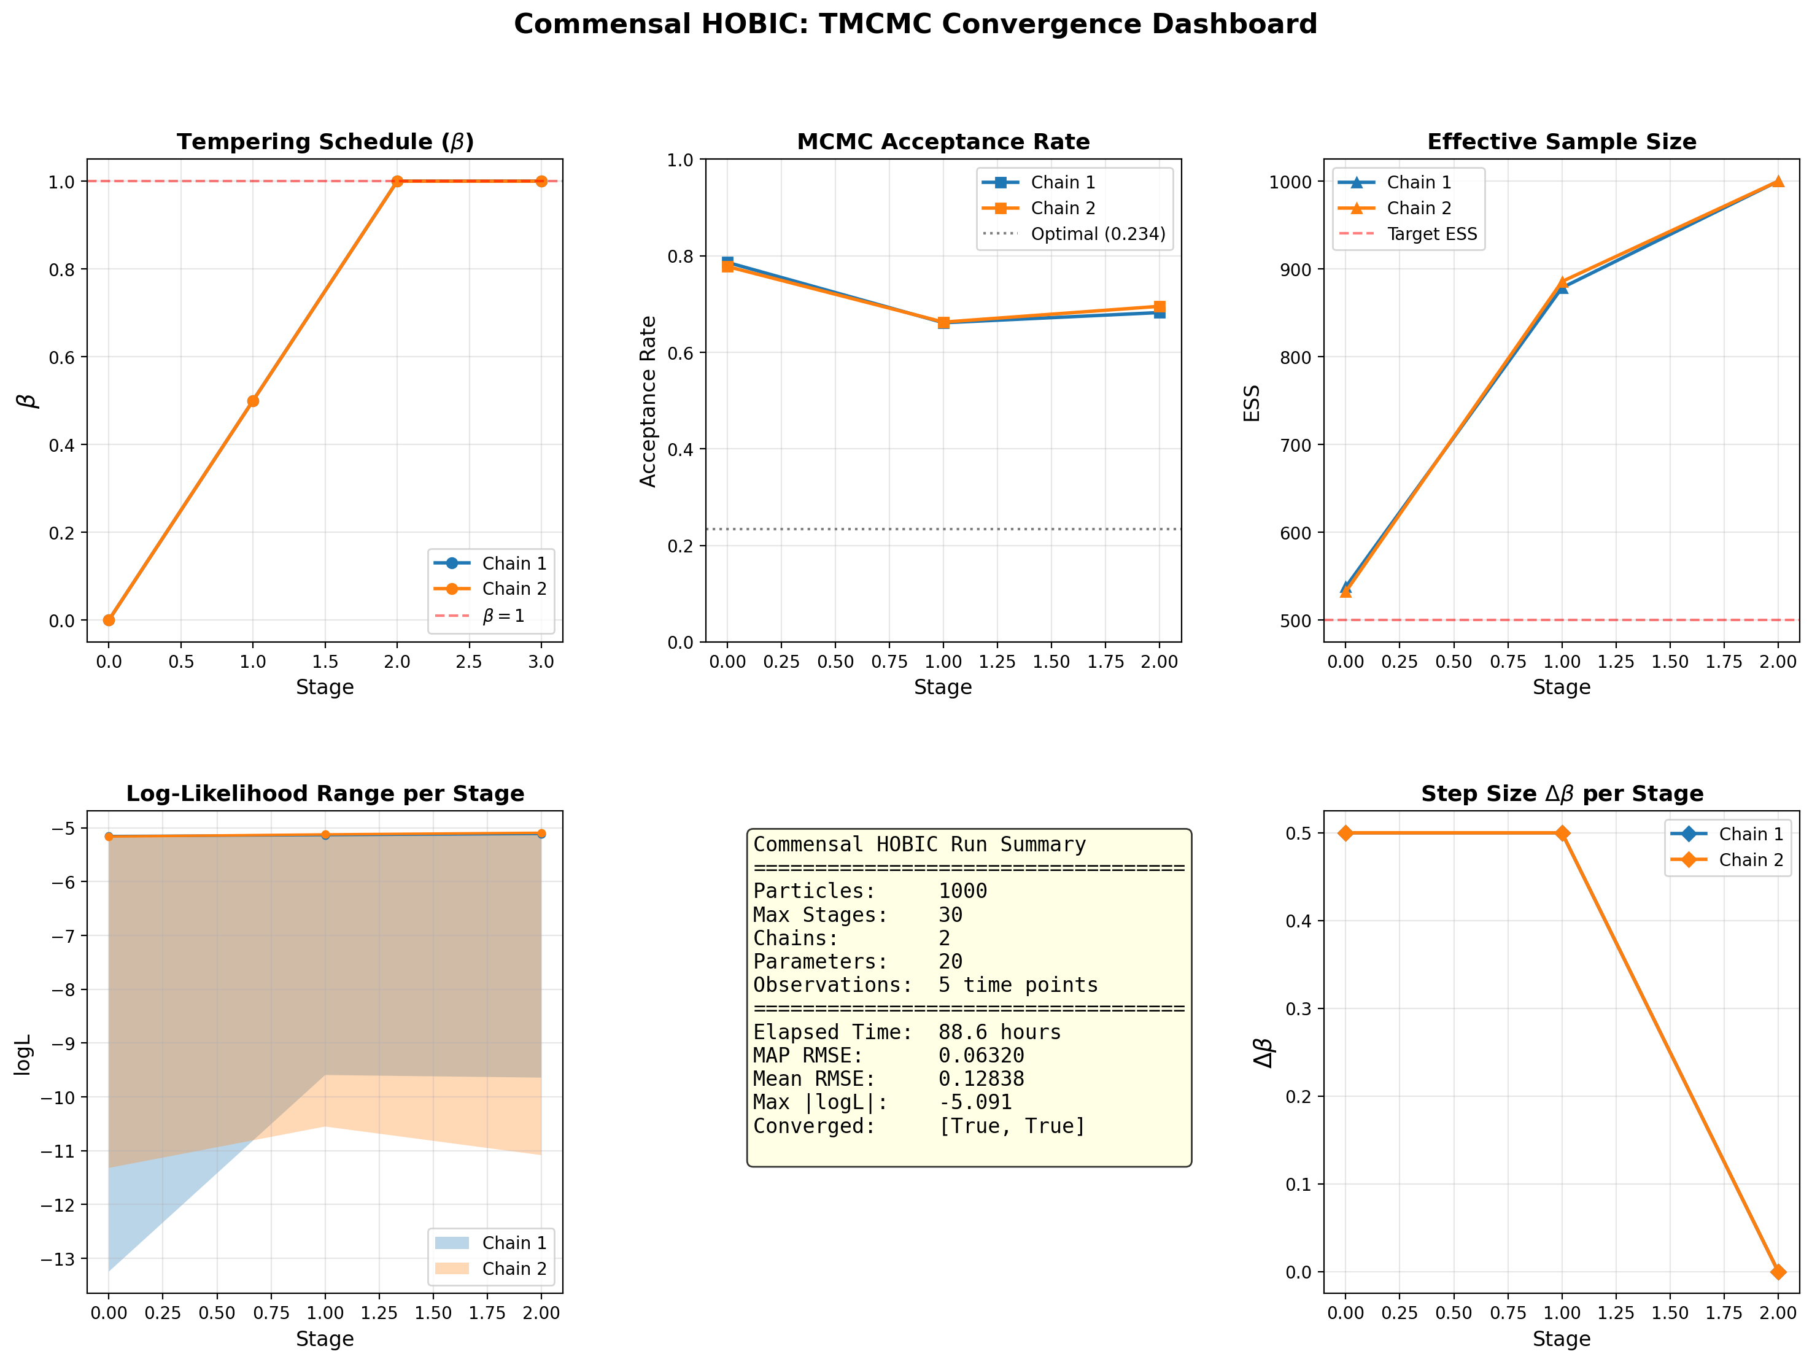
Commensal HOBIC — Convergence & Diagnostics
健康・流動 (HOBIC) — 収束診断
TMCMC β schedule
Species composition / 菌種構成
Parameter correlation / パラメータ相関
Convergence dashboard / 収束ダッシュボード
Nishioka | 5-Species Biofilm | TMCMC | IKM, LUH
35

Slide 36
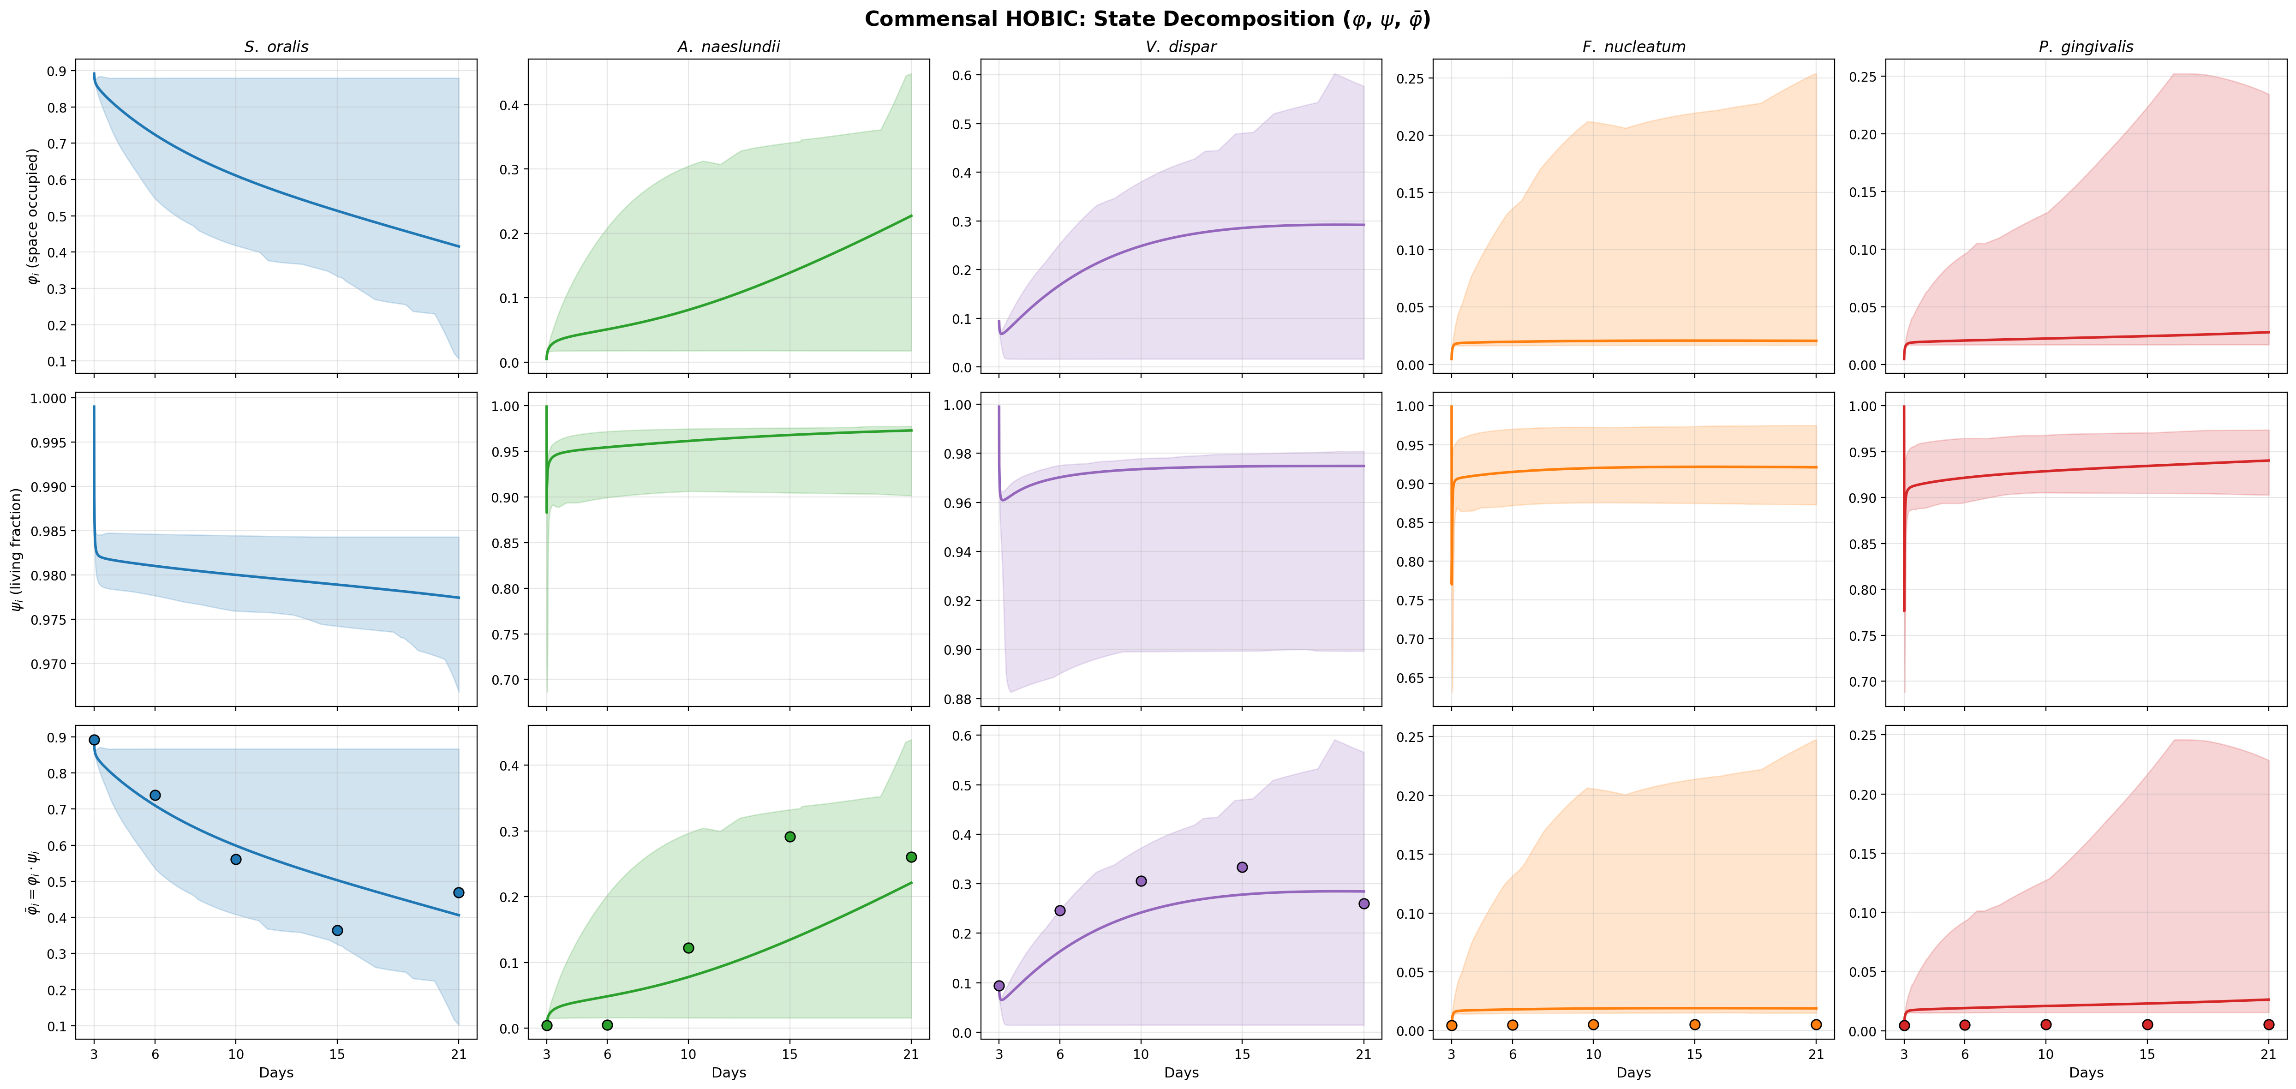
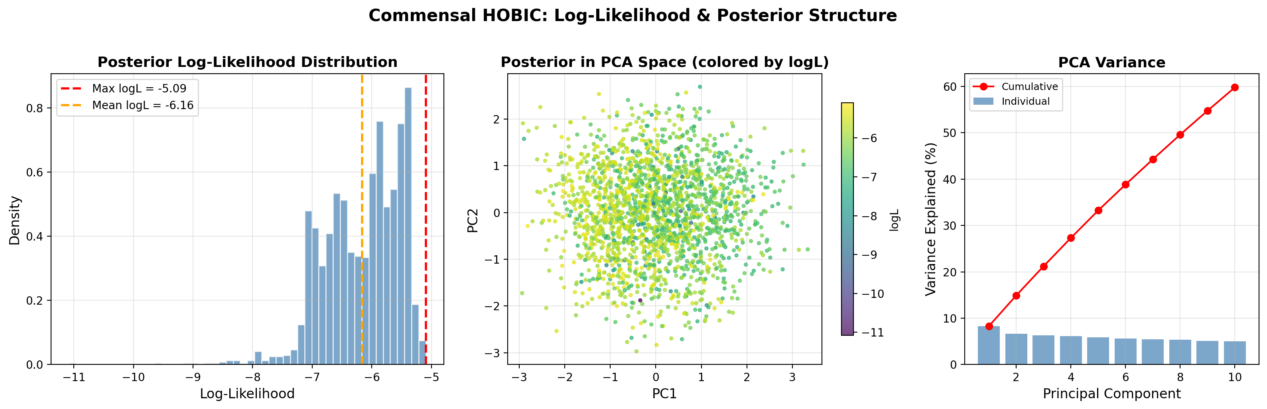
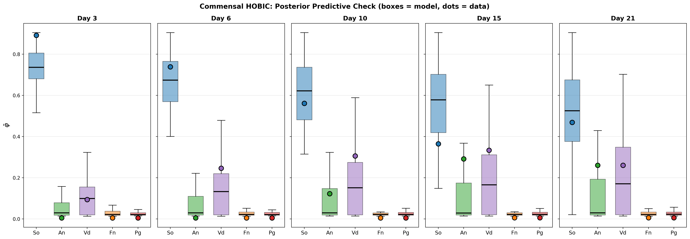
Commensal HOBIC — Additional Diagnostics
健康・流動 (HOBIC) — 追加診断
State decomposition (φ, ψ) / 状態分解
Log-likelihood landscape / 対数尤度
Posterior predictive check / 事後予測チェック
Nishioka | 5-Species Biofilm | TMCMC | IKM, LUH
36

Slide 37
⑩ Results: Dysbiotic HOBIC (Surge)
疾患・流動 (Surge)
Nishioka | 5-Species Biofilm | TMCMC | IKM, LUH
37

Slide 38
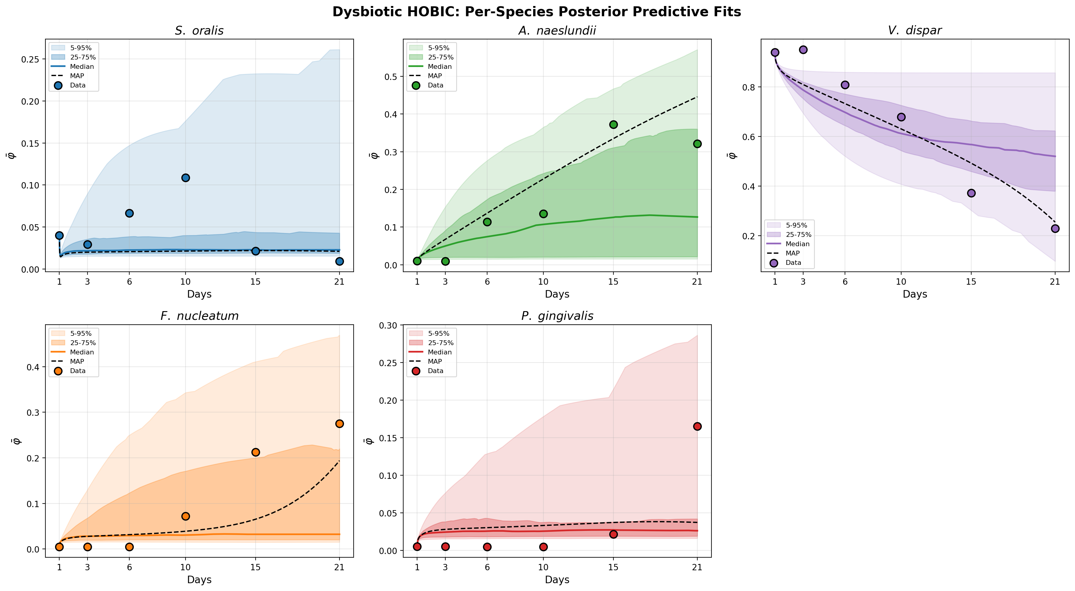
Dysbiotic HOBIC (Surge) — Posterior Predictive Fit
疾患・流動 (Surge) — 事後予測適合
Condition
Disease state with saliva flow (HOBIC). Characterized by the explosive 'Surge' of Veillonella and P. gingivalis. All parameter locks are released (N_locked = 0, Discovery Mode) to capture complex cross-feeding dynamics.
流れのある疾患状態 (HOBIC)。VeillonellaとP. gingivalisの爆発的な 'Surge (急増)' が特徴。複雑なクロスフィーディング動態を捕捉するため全パラメータロックを解除 (N_locked = 0, Discovery Mode)。
N_locked = 0
Key Finding
Unlock All (Discovery Mode) successfully captures the non-linear Surge via strong Vei–P.g positive feedback. TMCMC identifies the critical cross-feeding loop (Index 18) as the driver of explosive P.g growth.
全ロック解除 (Discovery Mode) により、Vei–P.g間の強い正のフィードバックを介した非線形な急増 (Surge) を再現に成功。TMCMCがP.gの爆発的増殖の駆動因子であるクロスフィーディングループ (Index 18) を特定。
Per-species posterior predictive fit with 95% credible interval / 菌種別事後予測適合 (95%信用区間)
Nishioka | 5-Species Biofilm | TMCMC | IKM, LUH
38

Slide 39
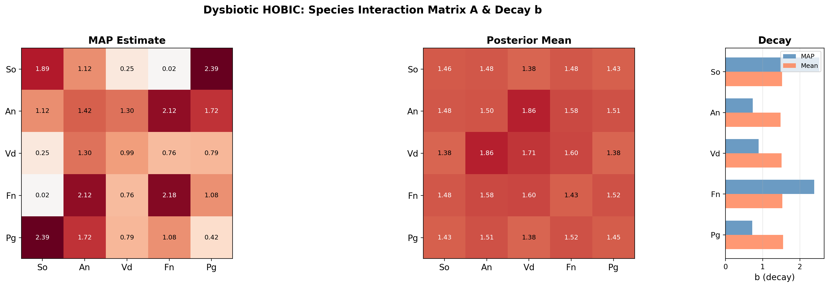
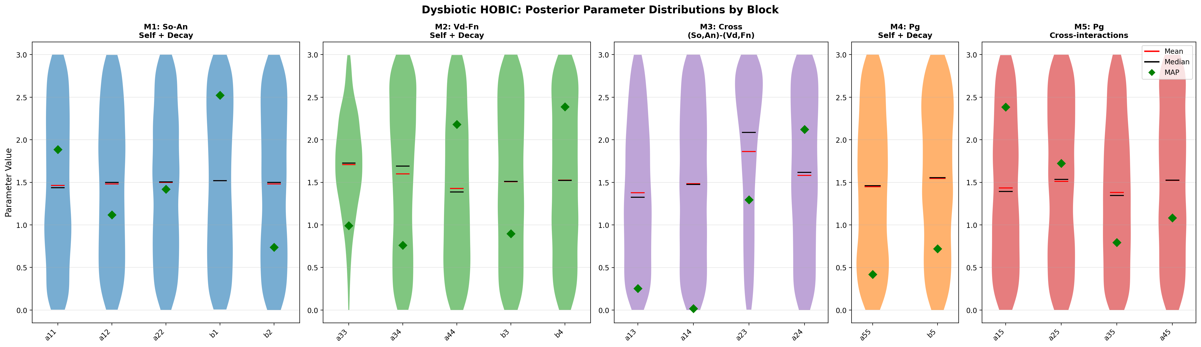
Dysbiotic HOBIC (Surge) — Interaction Matrix & Parameter Uncertainty
疾患・流動 (Surge) — 相互作用行列 & パラメータ不確実性
Estimated interaction matrix A (MAP) / 推定相互作用行列
Parameter posterior distributions (violin) / パラメータ事後分布 (バイオリン)
Nishioka | 5-Species Biofilm | TMCMC | IKM, LUH
39

Slide 40
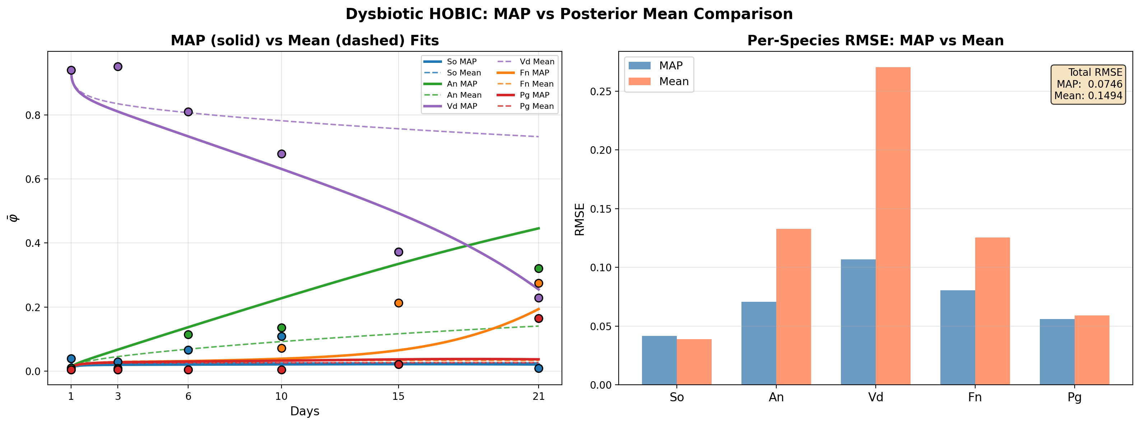
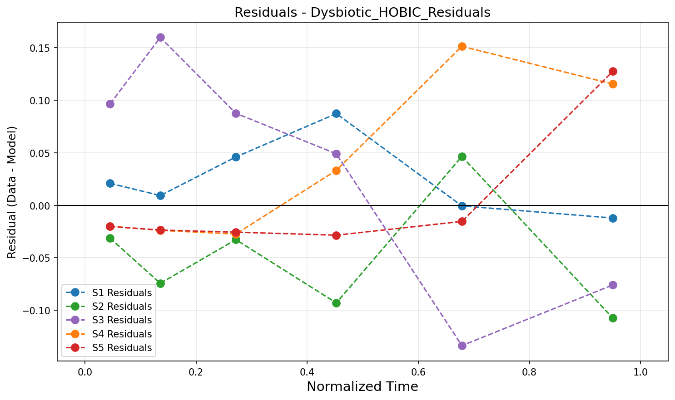
Dysbiotic HOBIC (Surge) — MAP vs Mean & Residuals
疾患・流動 (Surge) — MAP vs 平均推定 & 残差分析
MAP vs Mean parameter comparison / MAP vs 平均パラメータ比較
Residual analysis / 残差分析
Nishioka | 5-Species Biofilm | TMCMC | IKM, LUH
40

Slide 41

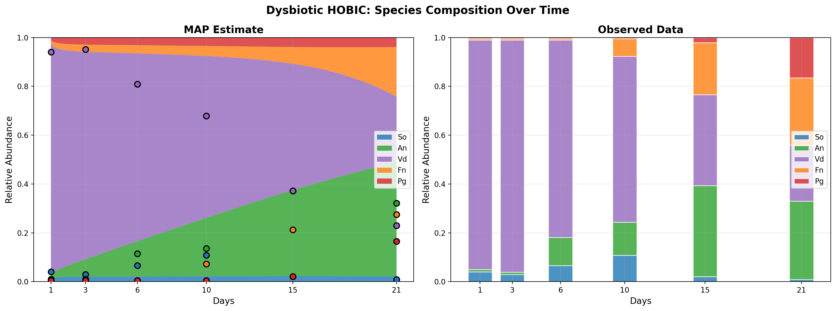
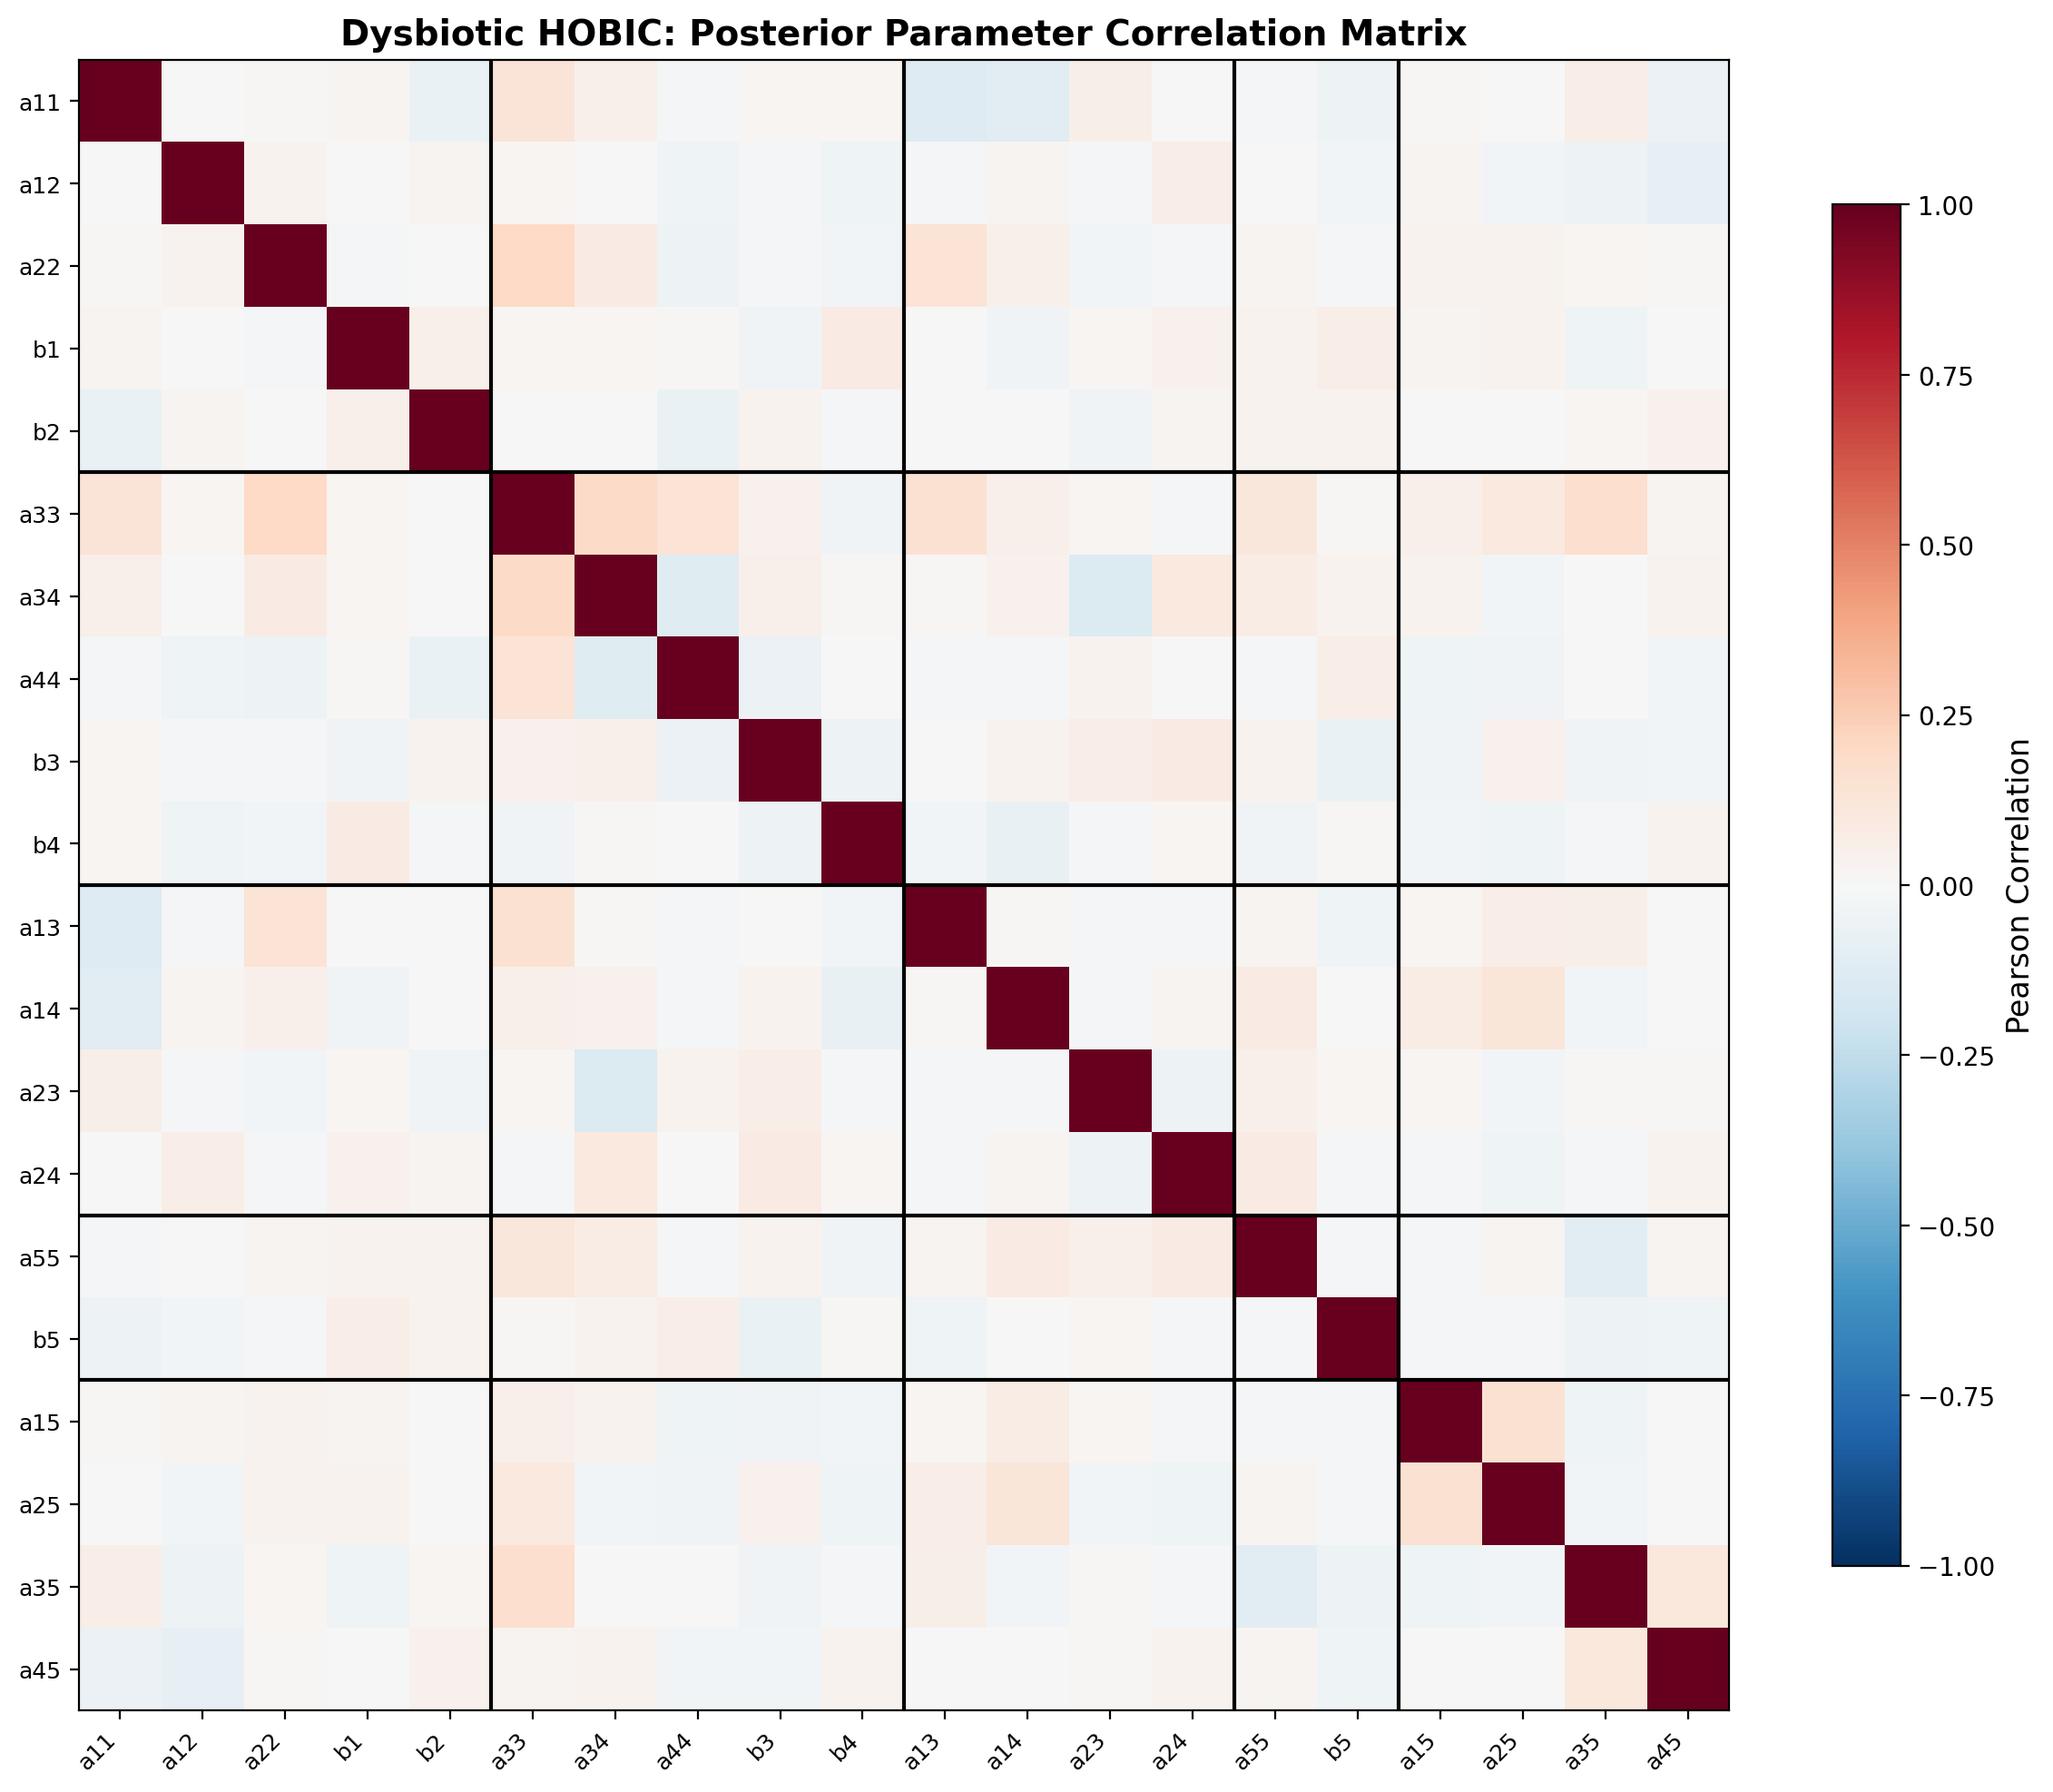
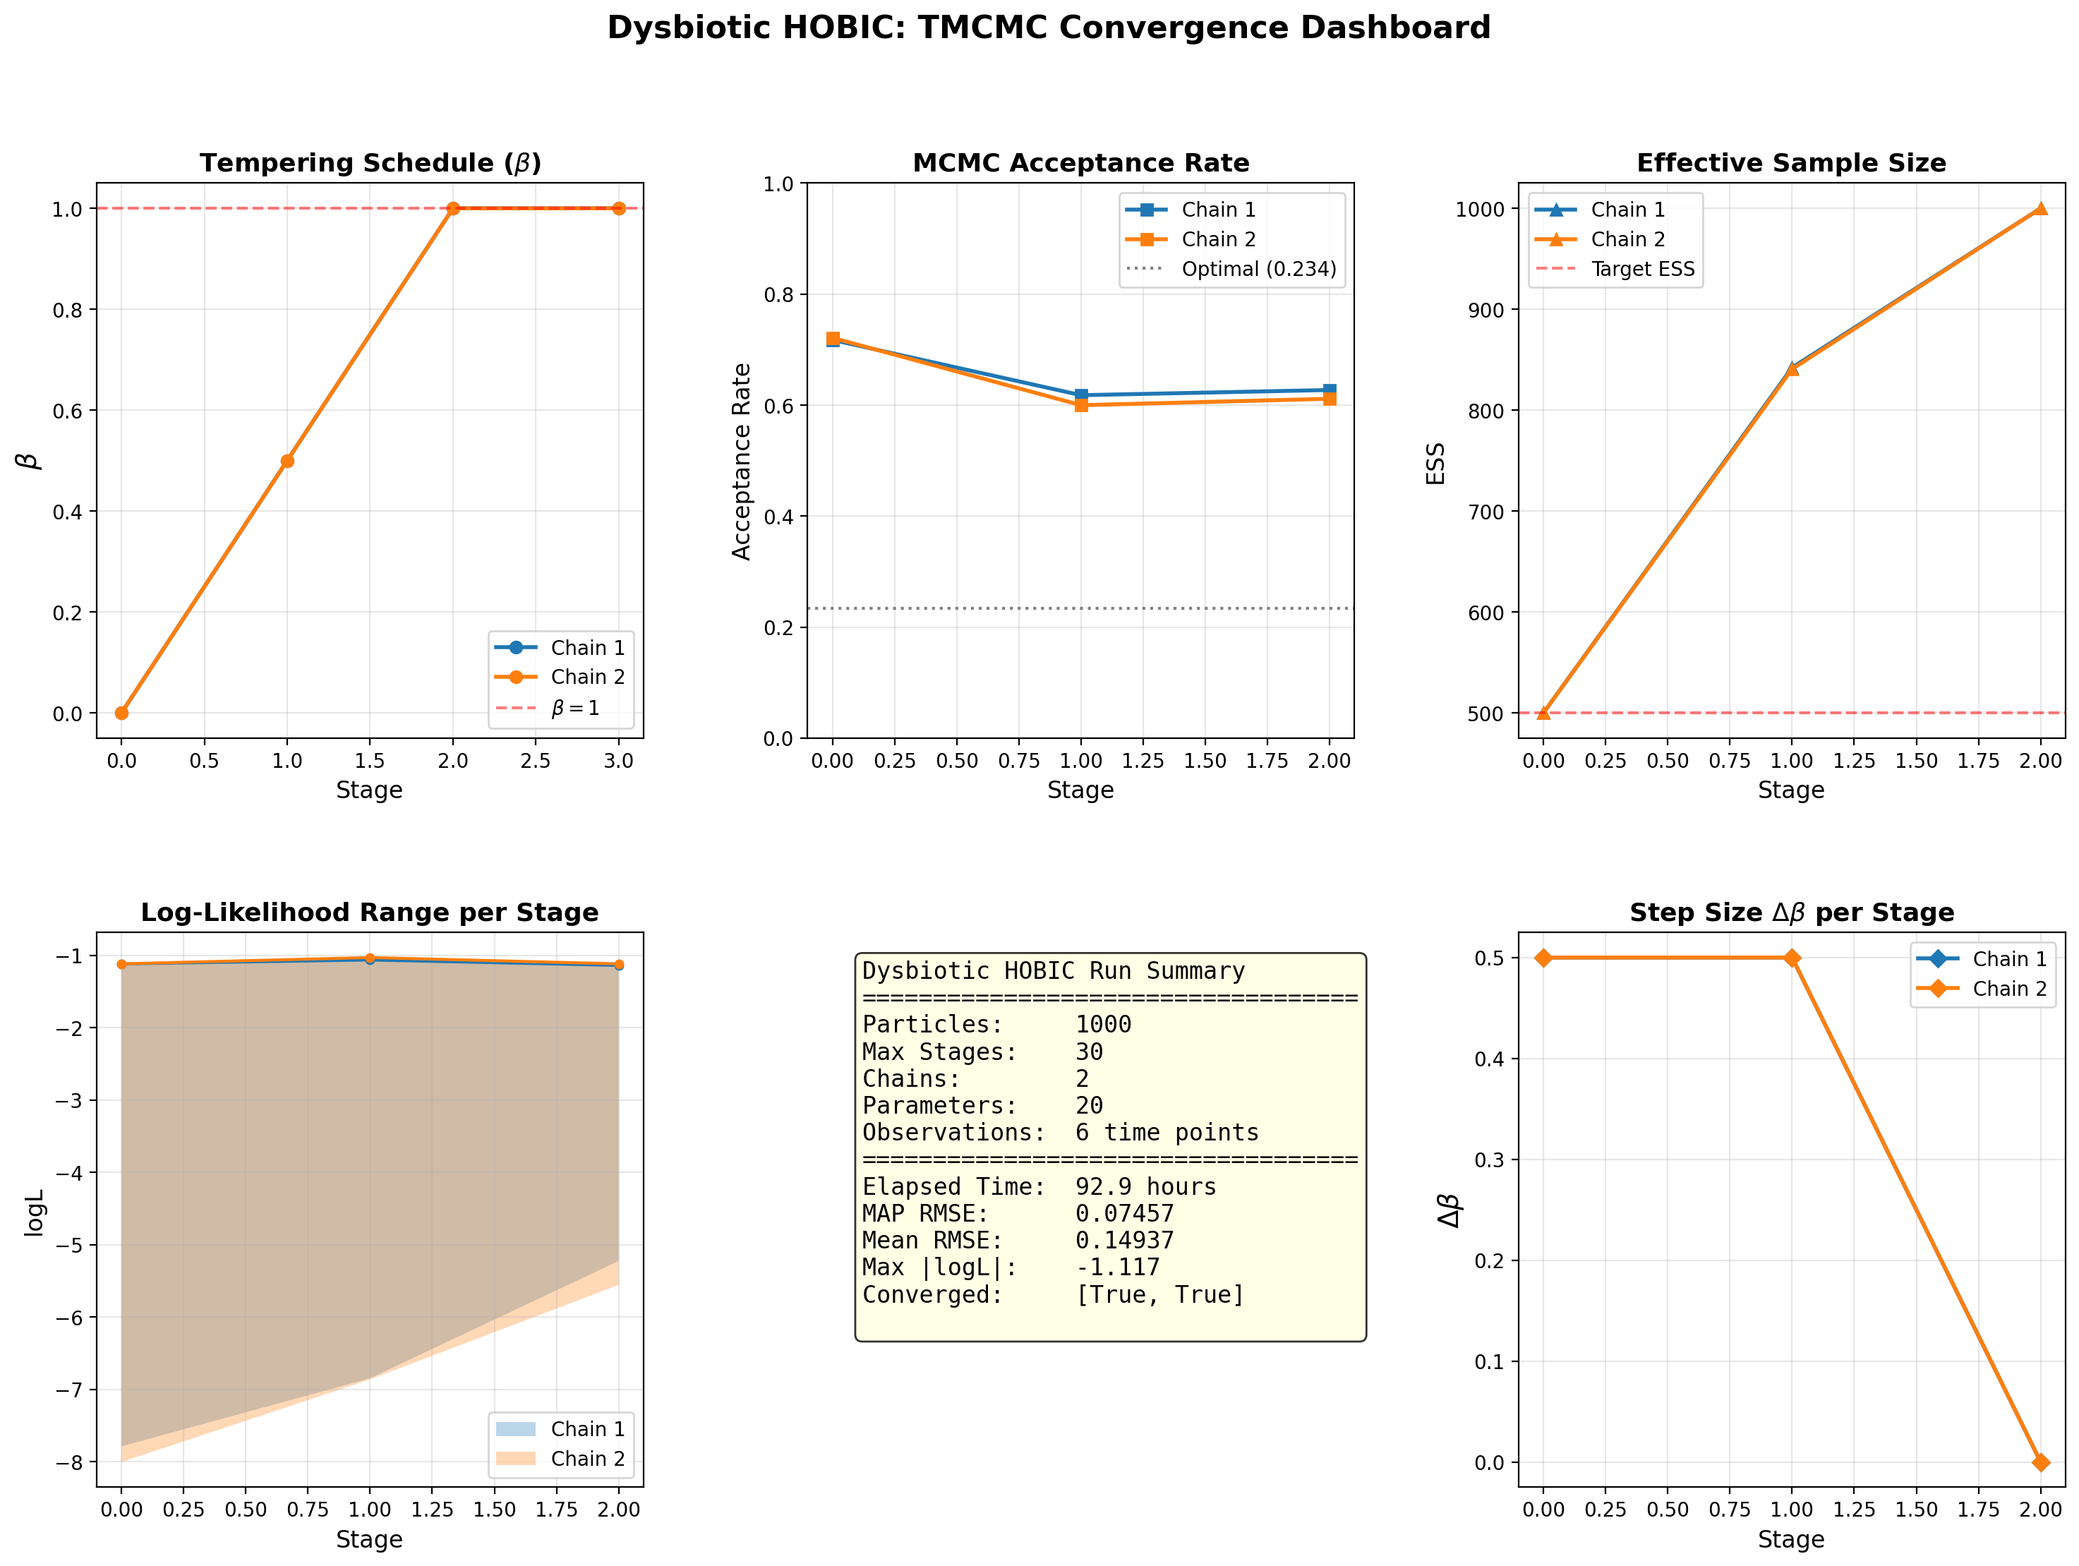
Dysbiotic HOBIC (Surge) — Convergence & Diagnostics
疾患・流動 (Surge) — 収束診断
TMCMC β schedule
Species composition / 菌種構成
Parameter correlation / パラメータ相関
Convergence dashboard / 収束ダッシュボード
Nishioka | 5-Species Biofilm | TMCMC | IKM, LUH
41

Slide 42



Dysbiotic HOBIC (Surge) — Additional Diagnostics
疾患・流動 (Surge) — 追加診断
State decomposition (φ, ψ) / 状態分解
Log-likelihood landscape / 対数尤度
Posterior predictive check / 事後予測チェック
Nishioka | 5-Species Biofilm | TMCMC | IKM, LUH
42

Slide 43
⑪ Comparative Analysis
比較分析
Nishioka | 5-Species Biofilm | TMCMC | IKM, LUH
43

Slide 44
Interaction Matrix Comparison (All 4 Conditions)
相互作用行列の比較 — 全4条件
Commensal Static (N_locked=9)
Dysbiotic Static (N_locked=5)
Commensal HOBIC (N_locked=8)
Dysbiotic HOBIC (Surge) (N_locked=0)
• Commensal: competitive (blue) blocks dominate • Dysbiotic: cooperative (red) blocks emerge around P.g
• 健康: 競合的(青)ブロックが支配 • 疾患: P.g周辺に協力的(赤)ブロックが出現
Nishioka | 5-Species Biofilm | TMCMC | IKM, LUH
44

Slide 45
Posterior Predictive Fit Comparison (All 4 Conditions)
事後予測適合の比較 — 全4条件
Commensal Static
Dysbiotic Static
Commensal HOBIC
Dysbiotic HOBIC (Surge)
Nishioka | 5-Species Biofilm | TMCMC | IKM, LUH
45

Slide 46
Parameter Uncertainty Comparison (All 4 Conditions)
パラメータ不確実性の比較 — 全4条件
Commensal Static
Dysbiotic Static
Commensal HOBIC
Dysbiotic HOBIC (Surge)
Nishioka | 5-Species Biofilm | TMCMC | IKM, LUH
46

Slide 47
Commensal vs. Dysbiotic — Key Differences
健康 vs 疾患 — 主な違い
Commensal (Healthy)
健康状態
• Early colonizers (S.o, A.n) dominate
初期定着菌 (S.o, A.n) が優位
• Pathogen (P.g) interactions suppressed
病原菌 (P.g) の相互作用が抑制
• Interaction matrix: competitive (blue)
相互作用行列: 競合的 (青) ブロックが支配
• Narrow posteriors = high identifiability
狭い事後分布 = 高い識別性
• Strict locks reinforce biological knowledge
厳格なロックが生物学的知識を強化
Dysbiotic (Disease)
疾患状態
• P. gingivalis interactions become positive
P.g の相互作用が正 (協力的) に転換
• Veillonella–P.g cross-feeding emerges
Vei–P.g クロスフィーディングが出現
• Full dysbiosis requires flow (HOBIC)
完全な疾患にはHOBIC (流れ) が必要
• 'Surge' in HOBIC: explosive P.g growth
HOBIC での 'Surge': P.g の爆発的増殖
• Discovery Mode essential to capture dynamics
Discovery Mode が動態の捕捉に不可欠
Nishioka | 5-Species Biofilm | TMCMC | IKM, LUH
47

Slide 48
Static vs. HOBIC — Effect of Saliva Flow
静的 vs 流動 — 唾液流の影響
Static Culture
静的培養
• Nutrient-limited environment
栄養制限環境
• Stable but low biomass steady states
安定だが低バイオマスの定常状態
• Metabolite accumulation limits pathogens
代謝産物蓄積が病原菌を制限
• Narrower posterior distributions
より狭い事後分布
• Less complex dynamics → easier estimation
より単純な動態 → 容易な推定
HOBIC (Flow)
流動培養 (HOBIC)
• Simulates oral saliva flow
口腔の唾液流を模倣
• More dynamic steady states
より動的な定常状態
• Higher variance in decay rate posteriors
減衰率事後分布の分散が増大
• Enables 'Blue Bloom' (Commensal)
'Blue Bloom' を可能にする (健康)
• Enables 'Surge' (Dysbiotic)
'Surge' を可能にする (疾患)
Nishioka | 5-Species Biofilm | TMCMC | IKM, LUH
48

Slide 49



Publication-Quality Comparison Figures
論文品質の比較図
MAP fit comparison
Interaction heatmap comparison
Fit comparison
Nishioka | 5-Species Biofilm | TMCMC | IKM, LUH
49

Slide 50
⑫ Conclusion & Future Work
結論・今後の課題
Nishioka | 5-Species Biofilm | TMCMC | IKM, LUH
50

Slide 51
Conclusion / 結論
Key Contributions / 主な貢献
① Biologically-constrained parameter reduction: 30 → 20 → 15 free parameters
生物学的制約に基づくパラメータ削減: 30 → 20 → 15 自由パラメータ
② TMCMC successfully applied to all 4 experimental conditions with 1000 particles
TMCMCを1000粒子で4つの全実験条件に適用成功
③ Unlock All (Discovery Mode) essential for Dysbiotic HOBIC 'Surge' detection
全ロック解除 (Discovery Mode) がDysbiotic HOBIC 'Surge' の検出に不可欠
④ Inferred interaction matrices provide quantitative health → disease transition map
推定相互作用行列が健康 → 疾患遷移の定量的マップを提供
⑤ 4-stage sequential estimation enables condition-specific Bayesian inference
4段階逐次推定が条件特異的ベイズ推論を実現
Future Work / 今後の課題
• Increase particle count (N > 5000)
粒子数の増加 (N > 5000)
• Time-varying interaction parameters
時間変化する相互作用パラメータ
• In silico therapeutic testing
治療介入のin silicoテスト
Clinical Impact / 臨床的インパクト
• Quantitative dysbiosis biomarkers
定量的ディスバイオシスバイオマーカー
• Personalized peri-implantitis risk
個別化インプラント周囲炎リスク
• Framework for multi-species analysis
多菌種解析の枠組み
Nishioka | 5-Species Biofilm | TMCMC | IKM, LUH
51

Slide 52
Thank You
ご清聴ありがとうございます
Keisuke Nishioka Institut für Kontinuumsmechanik (IKM) Leibniz Universität Hannover
February 2026
Nishioka | 5-Species Biofilm | TMCMC | IKM, LUH
52

