Slide 1
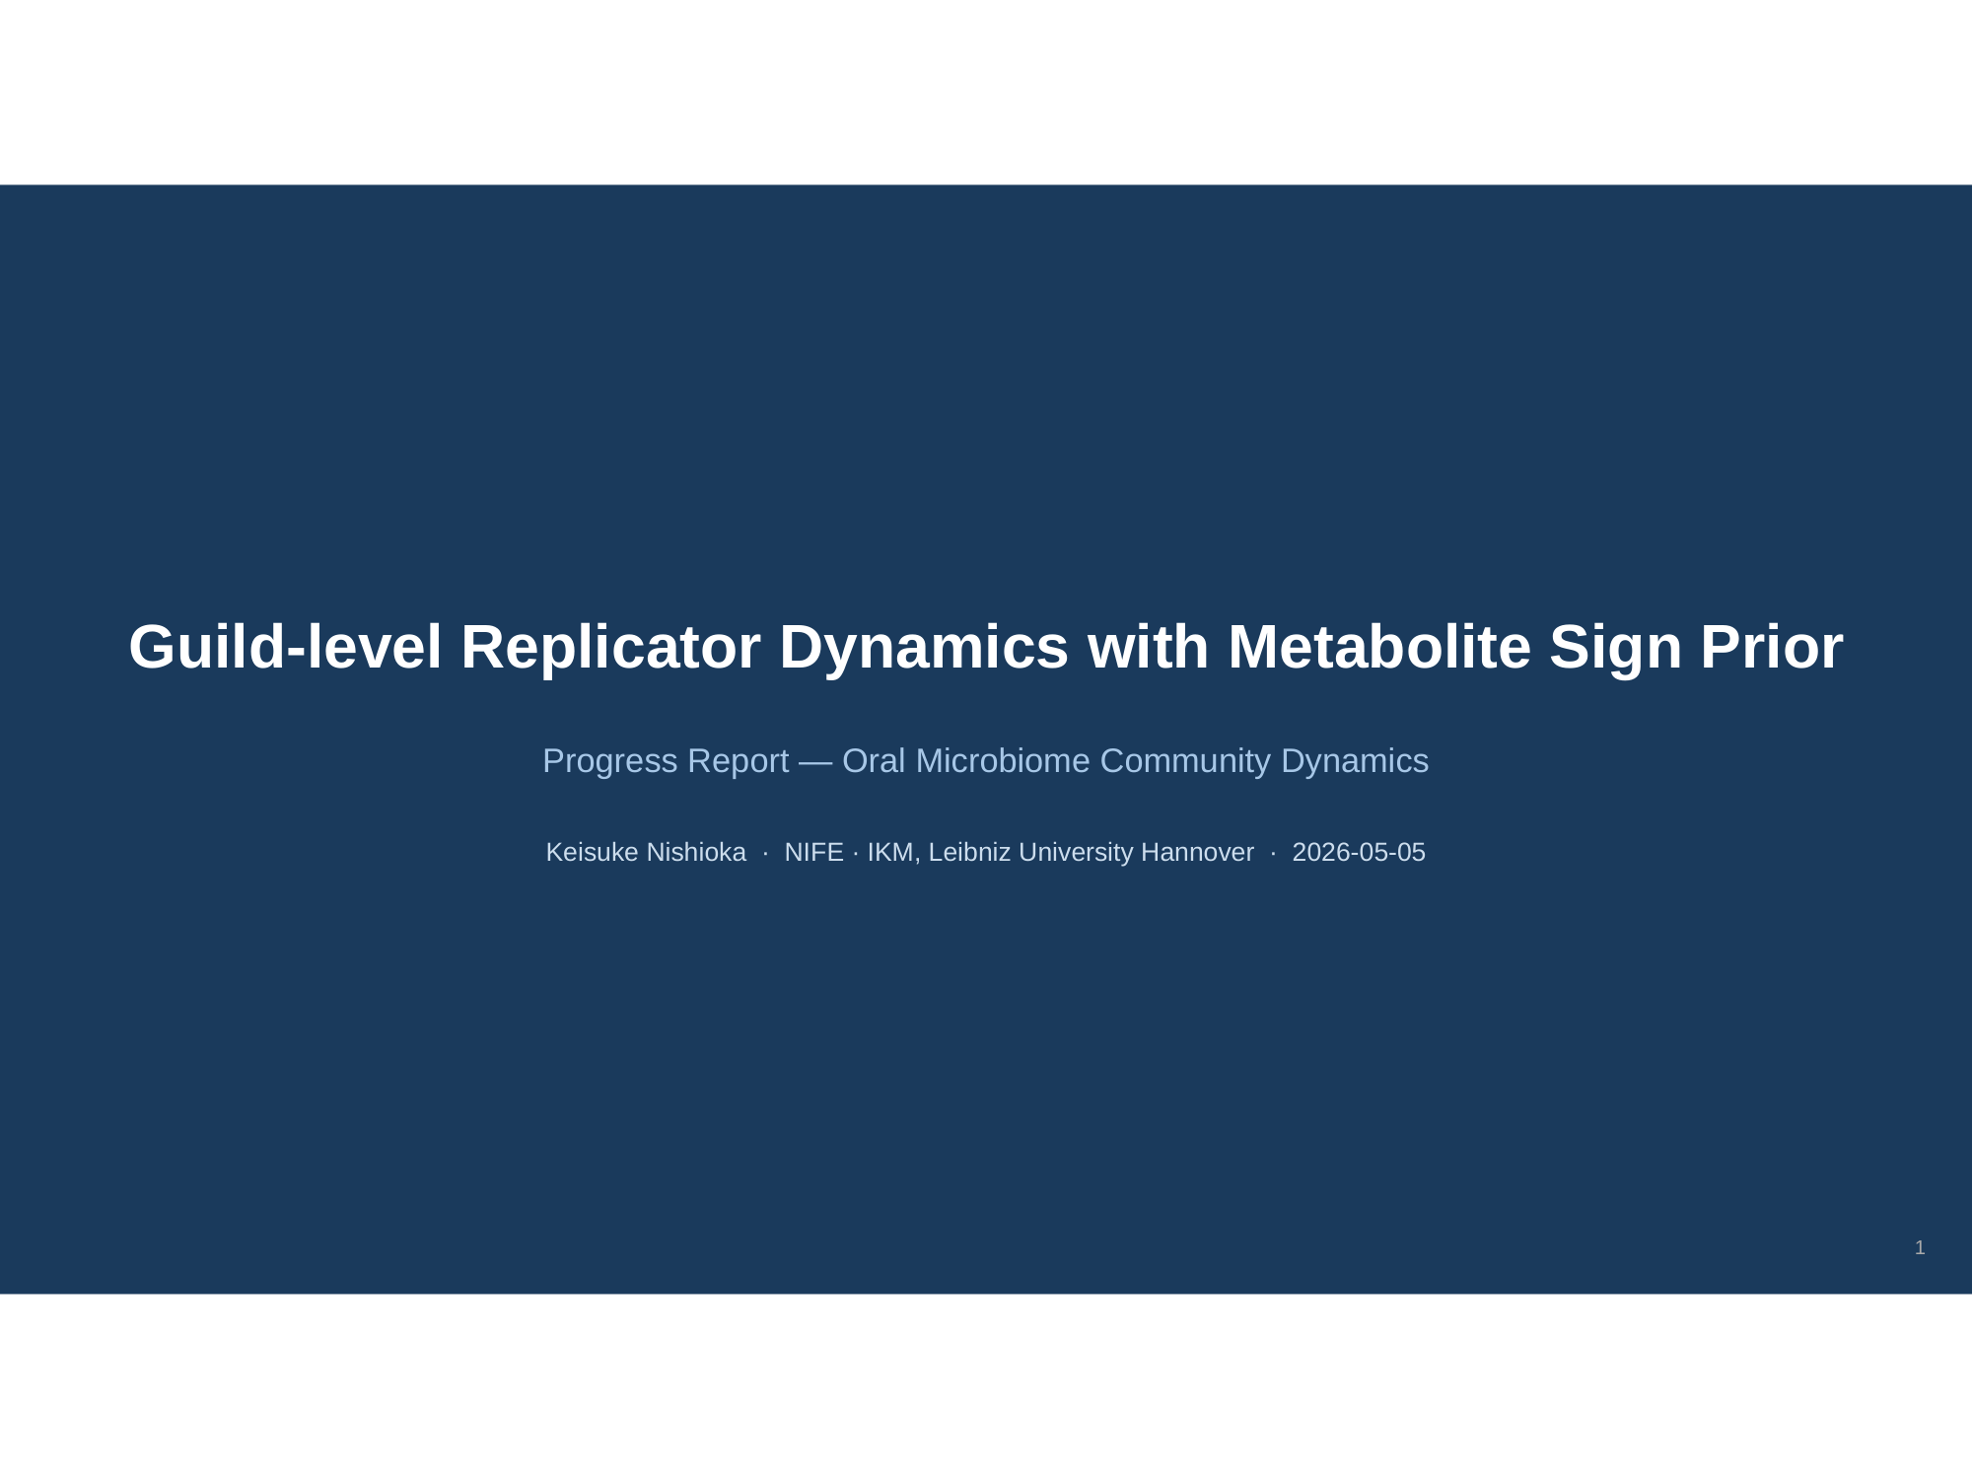

Slide 2
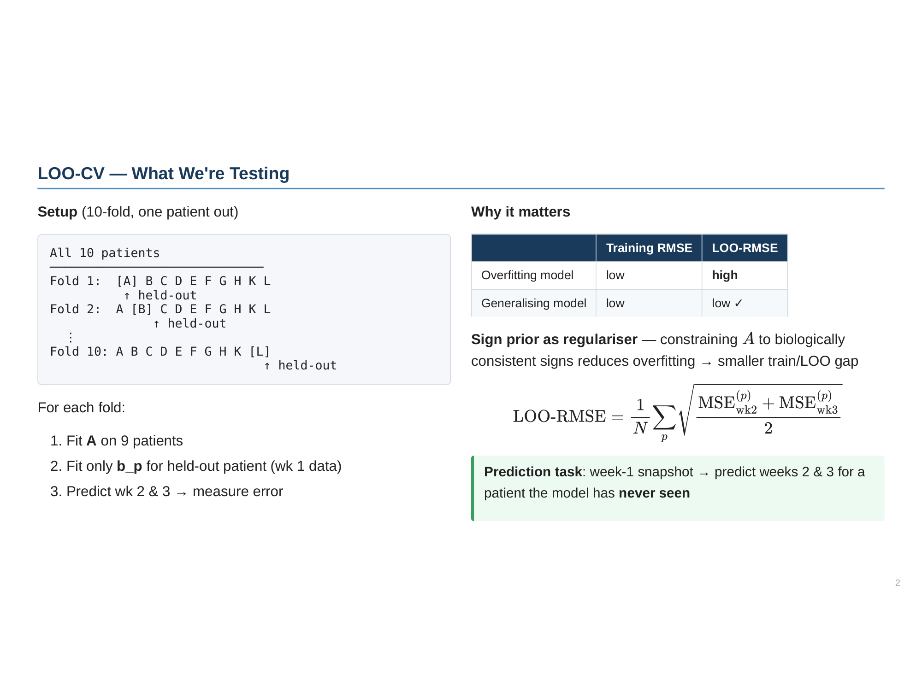

Slide 3
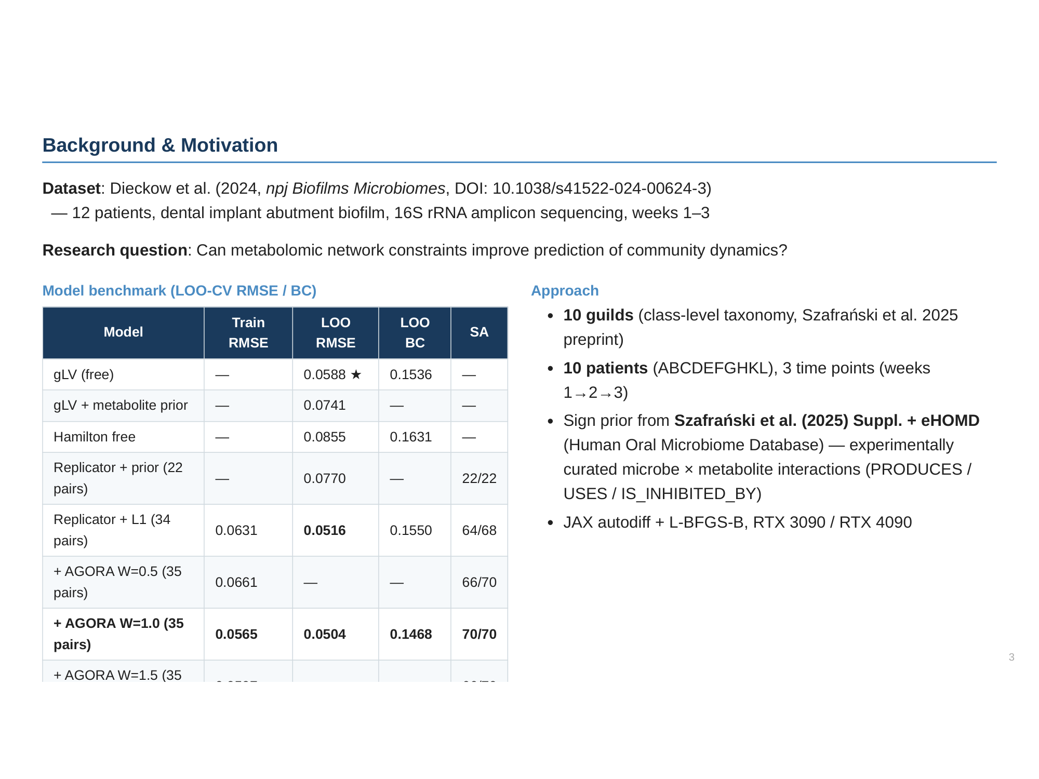

Slide 4
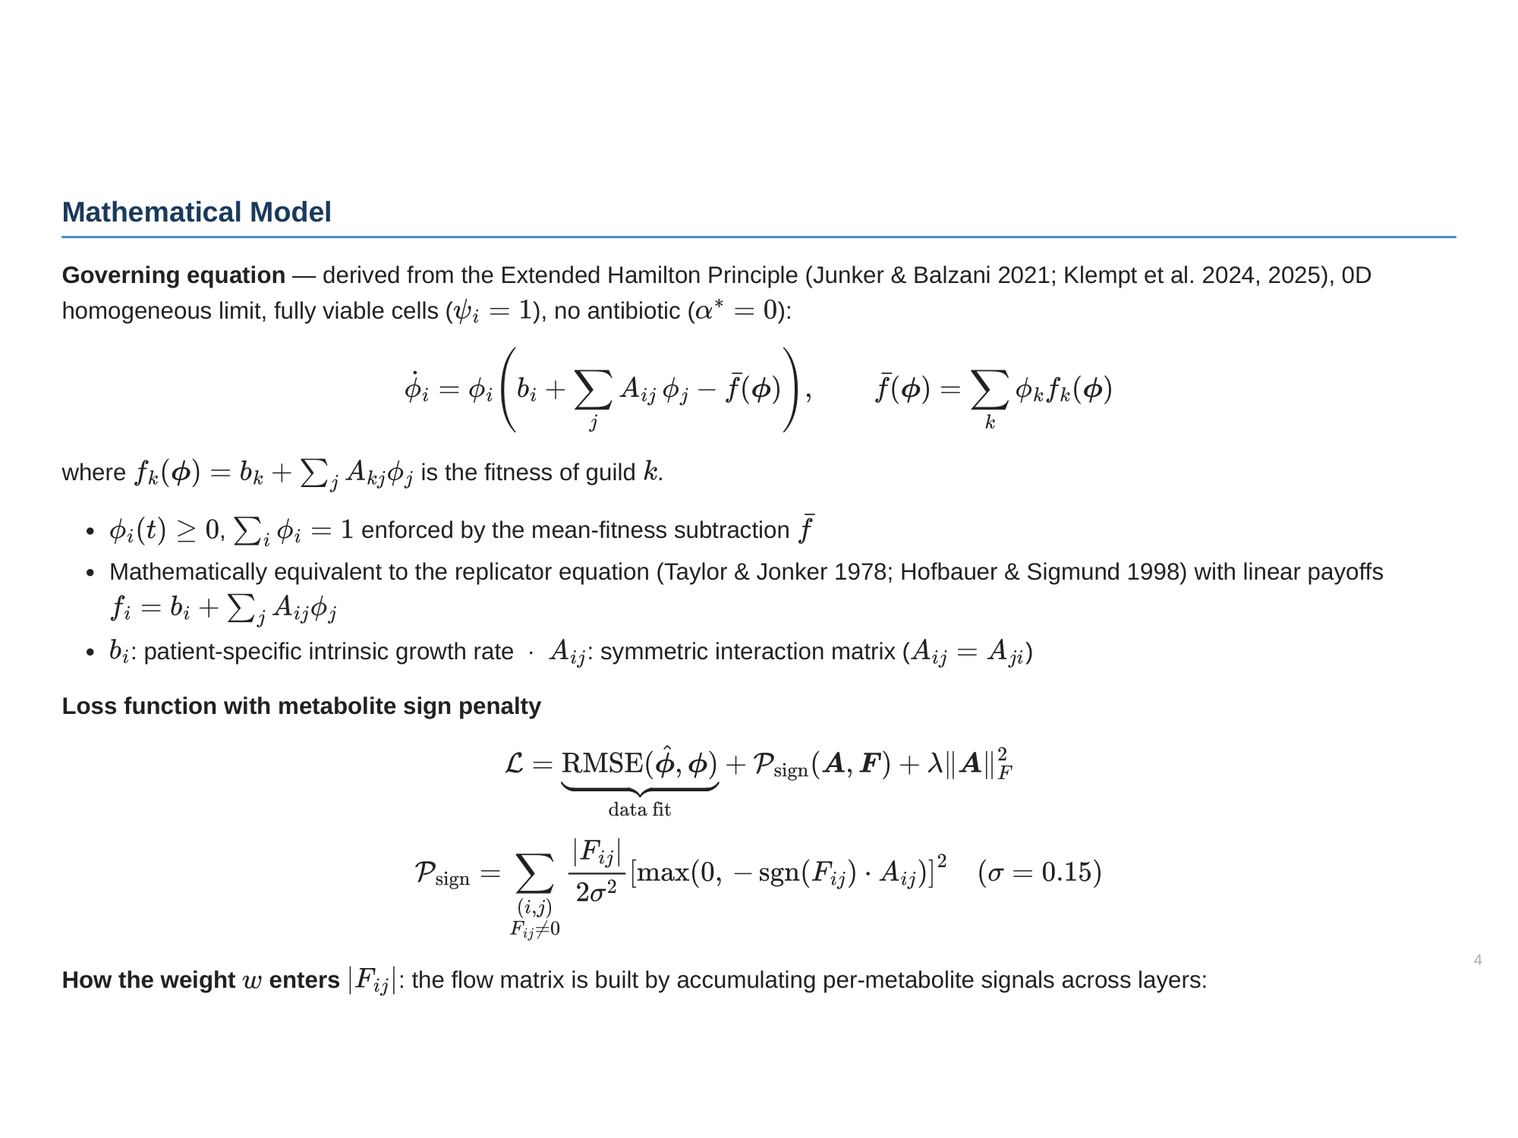

Slide 5
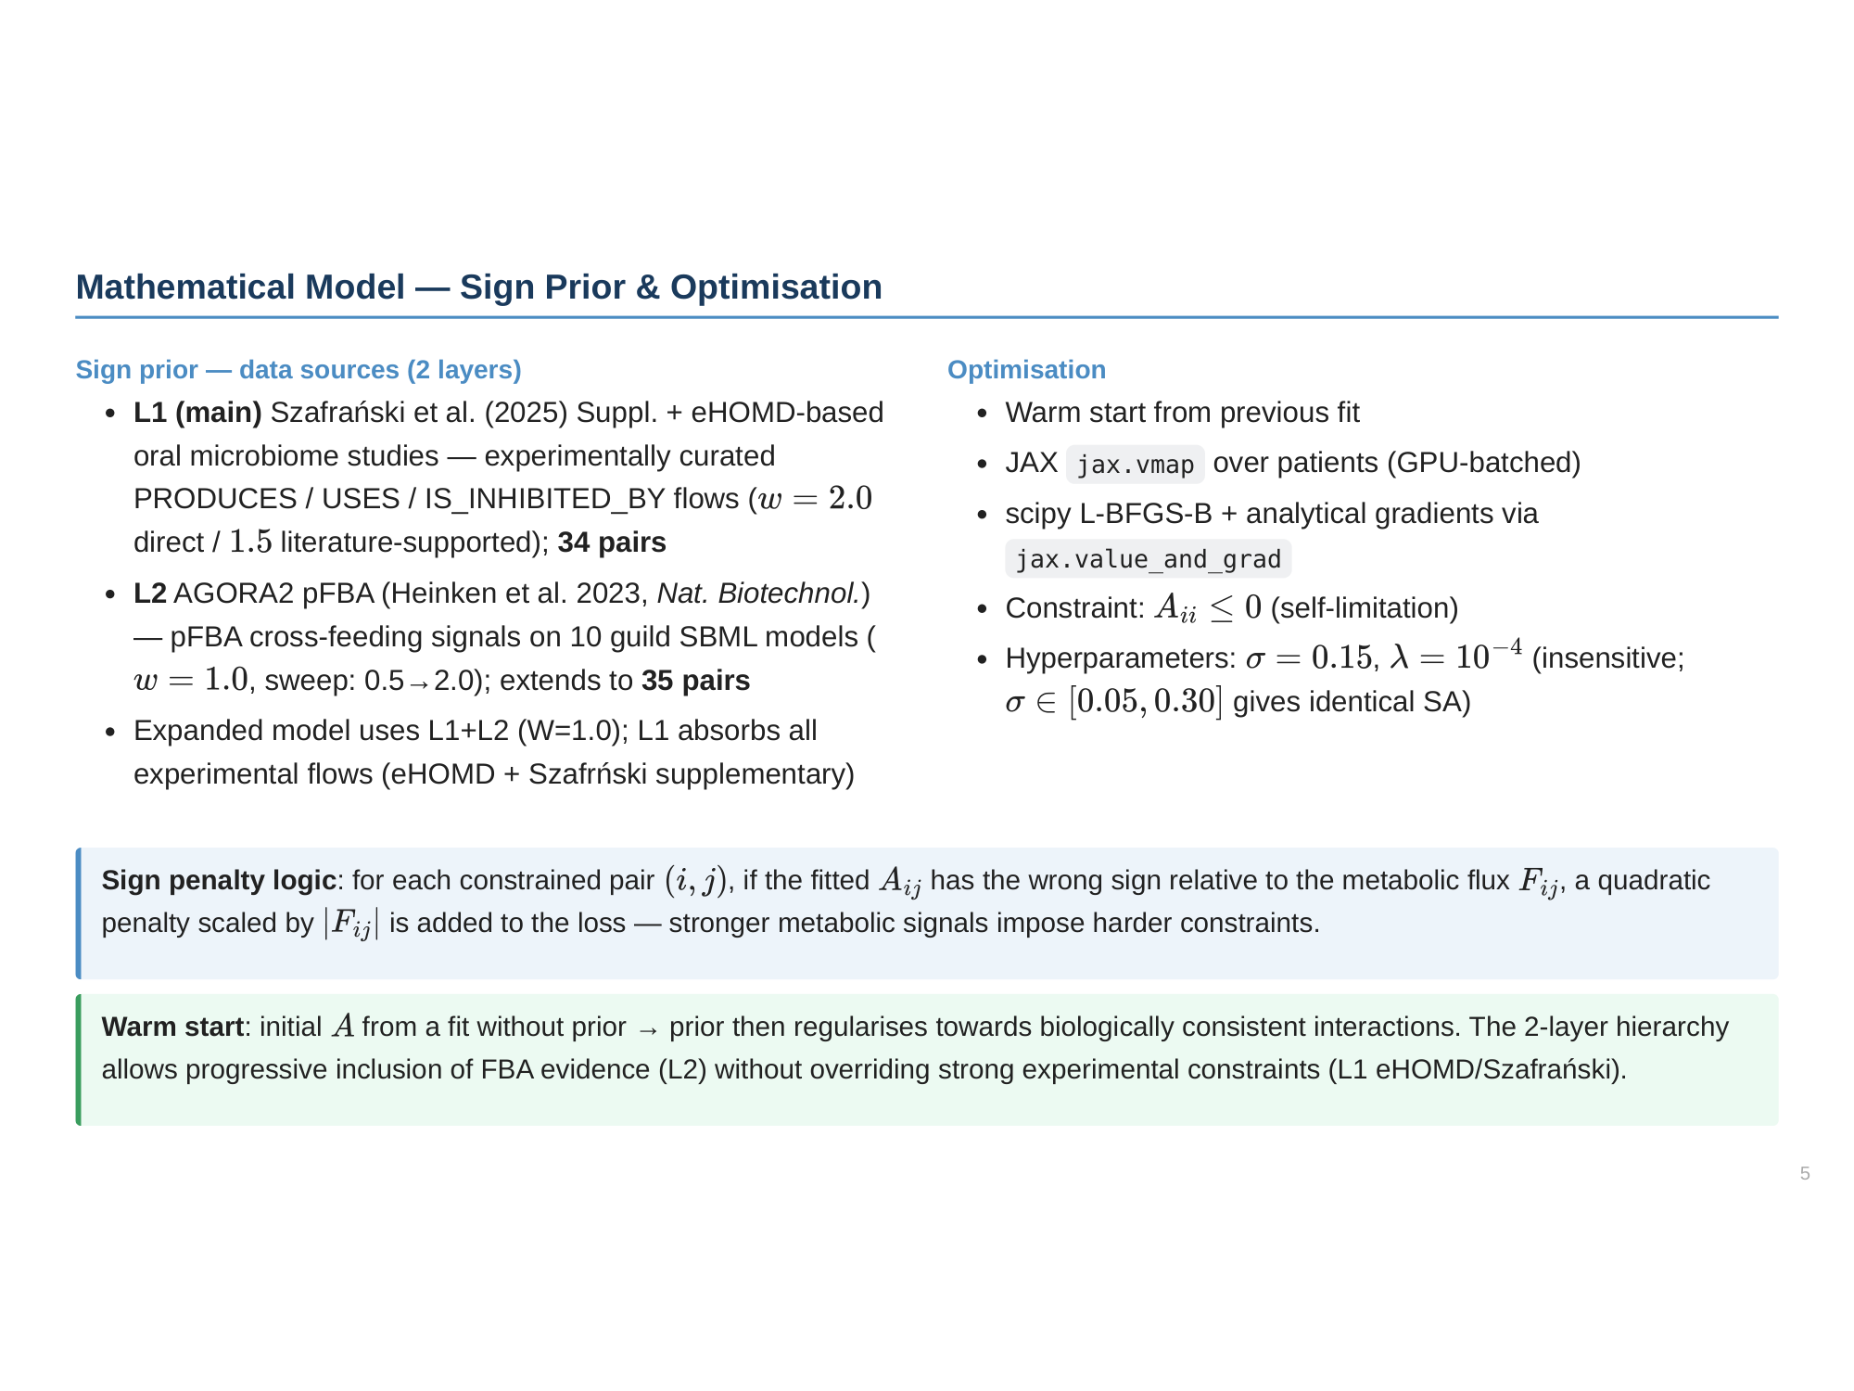

Slide 6
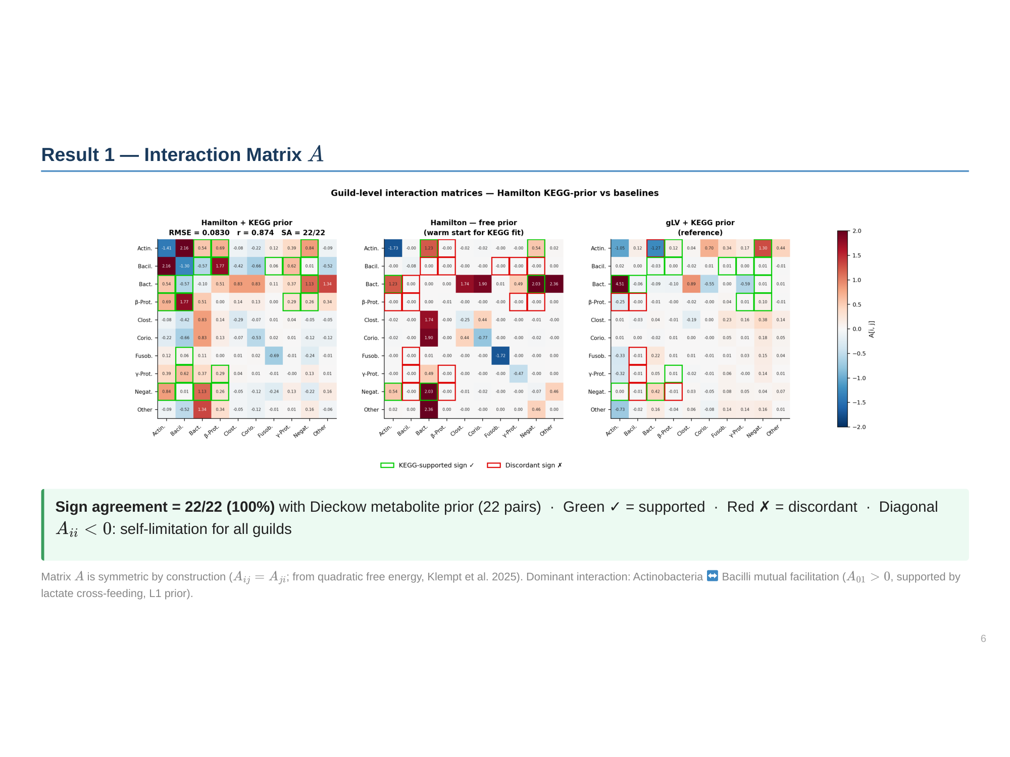

Slide 7
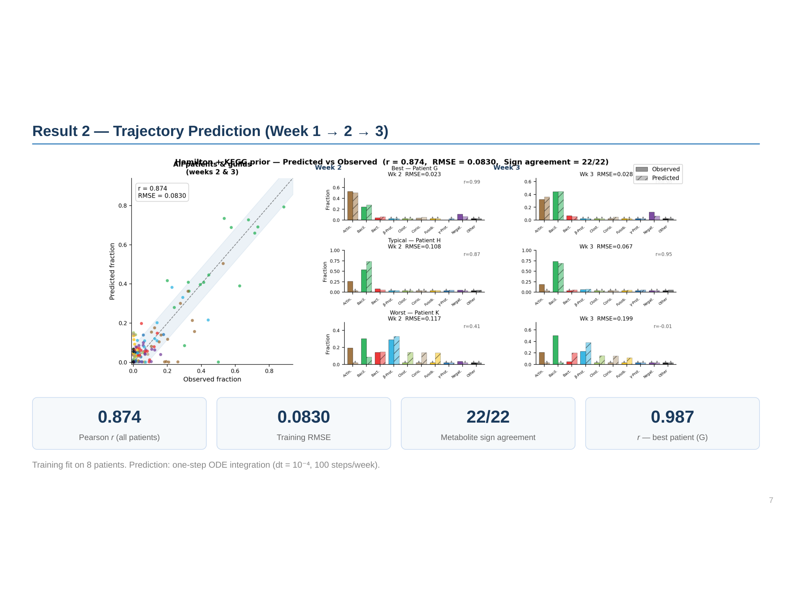

Slide 8
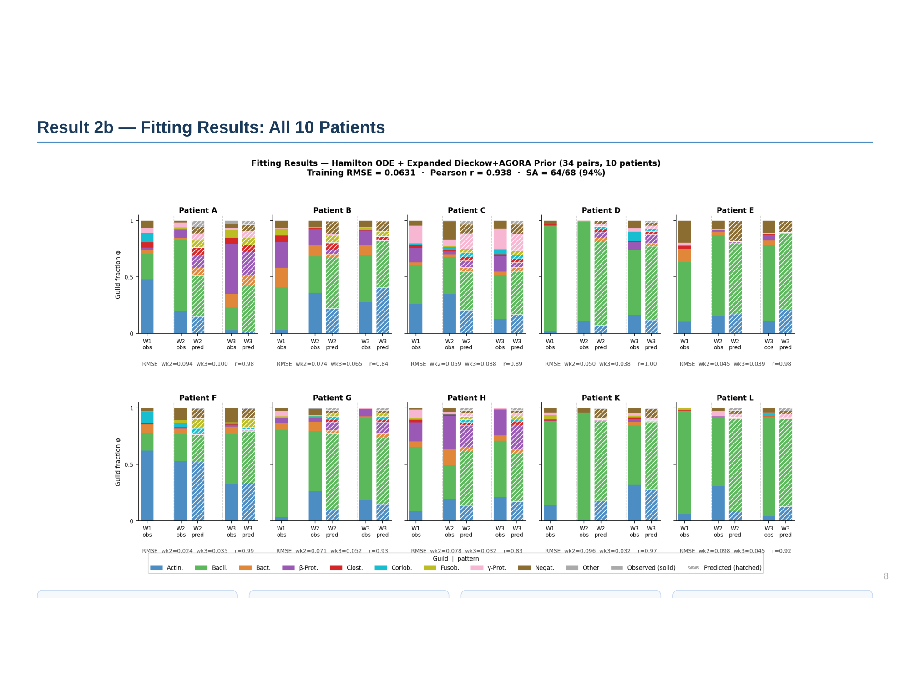

Slide 9
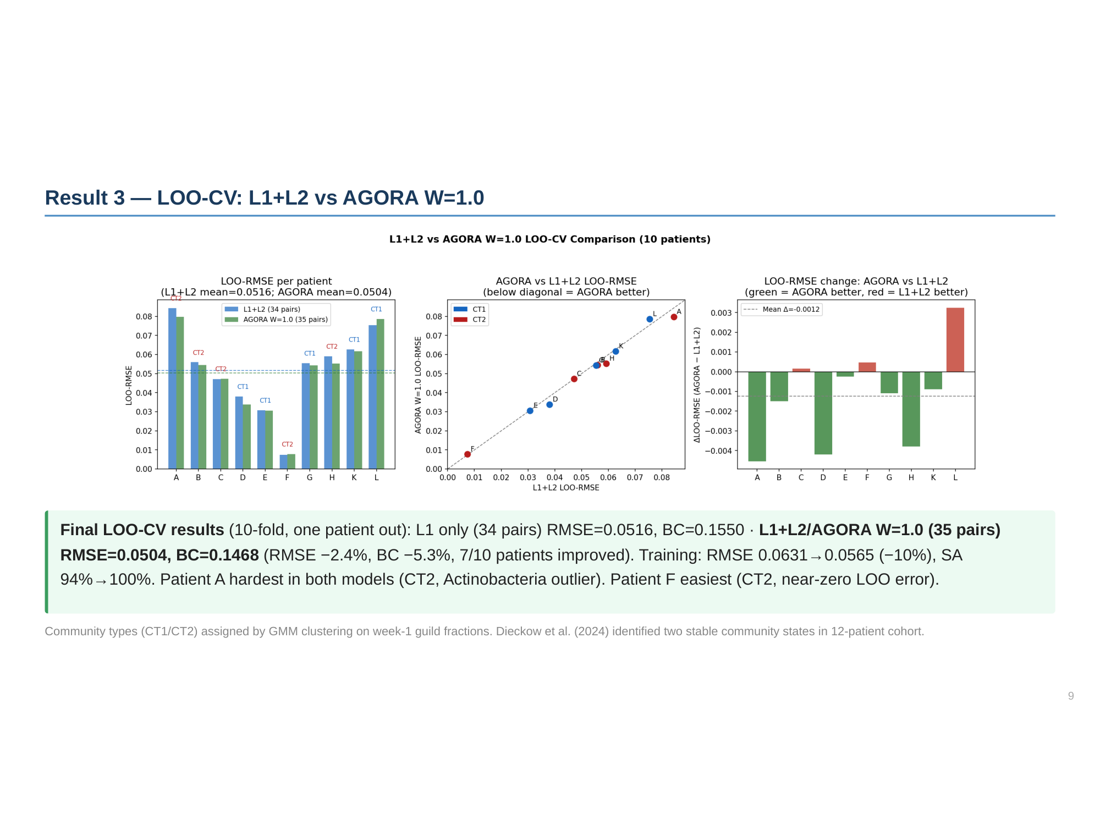

Slide 10
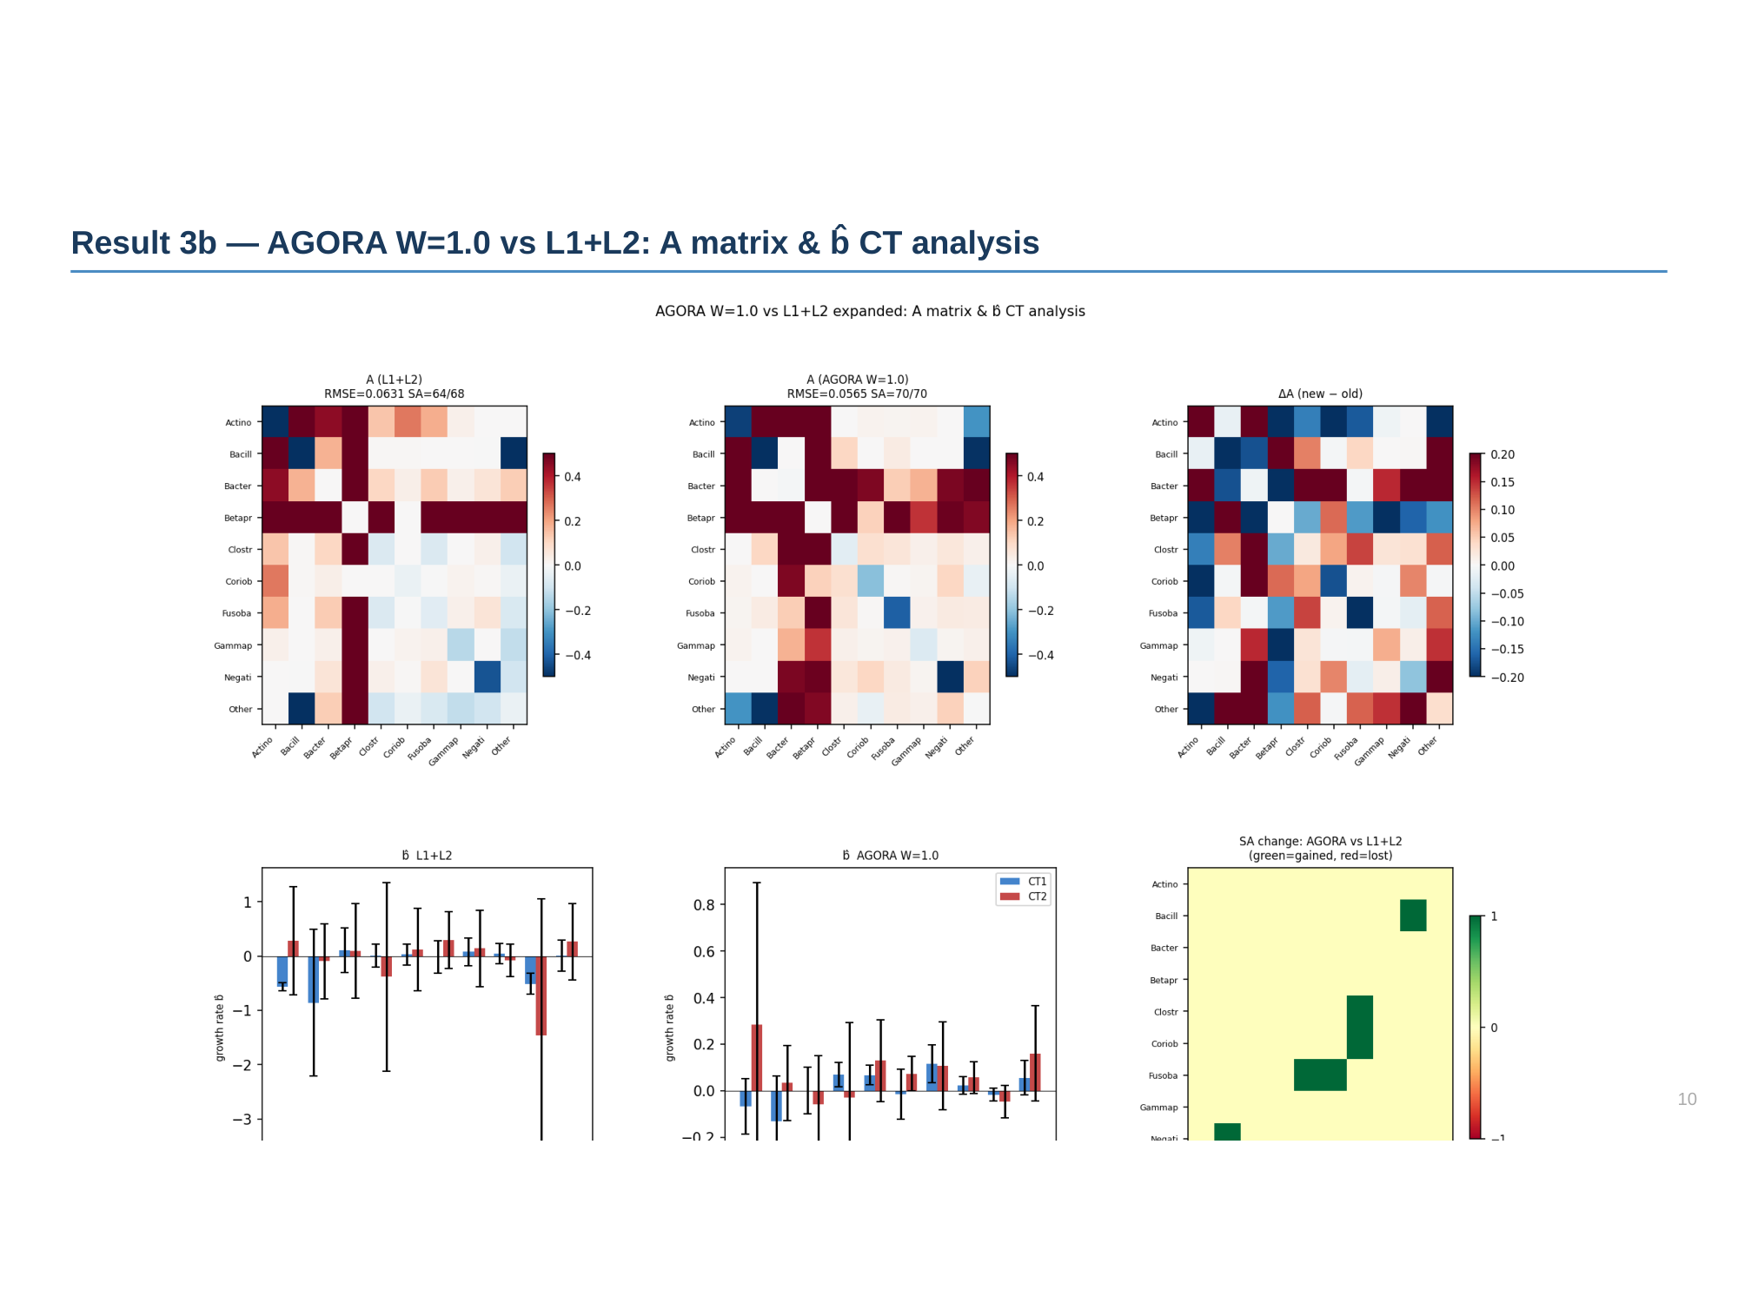

Slide 11
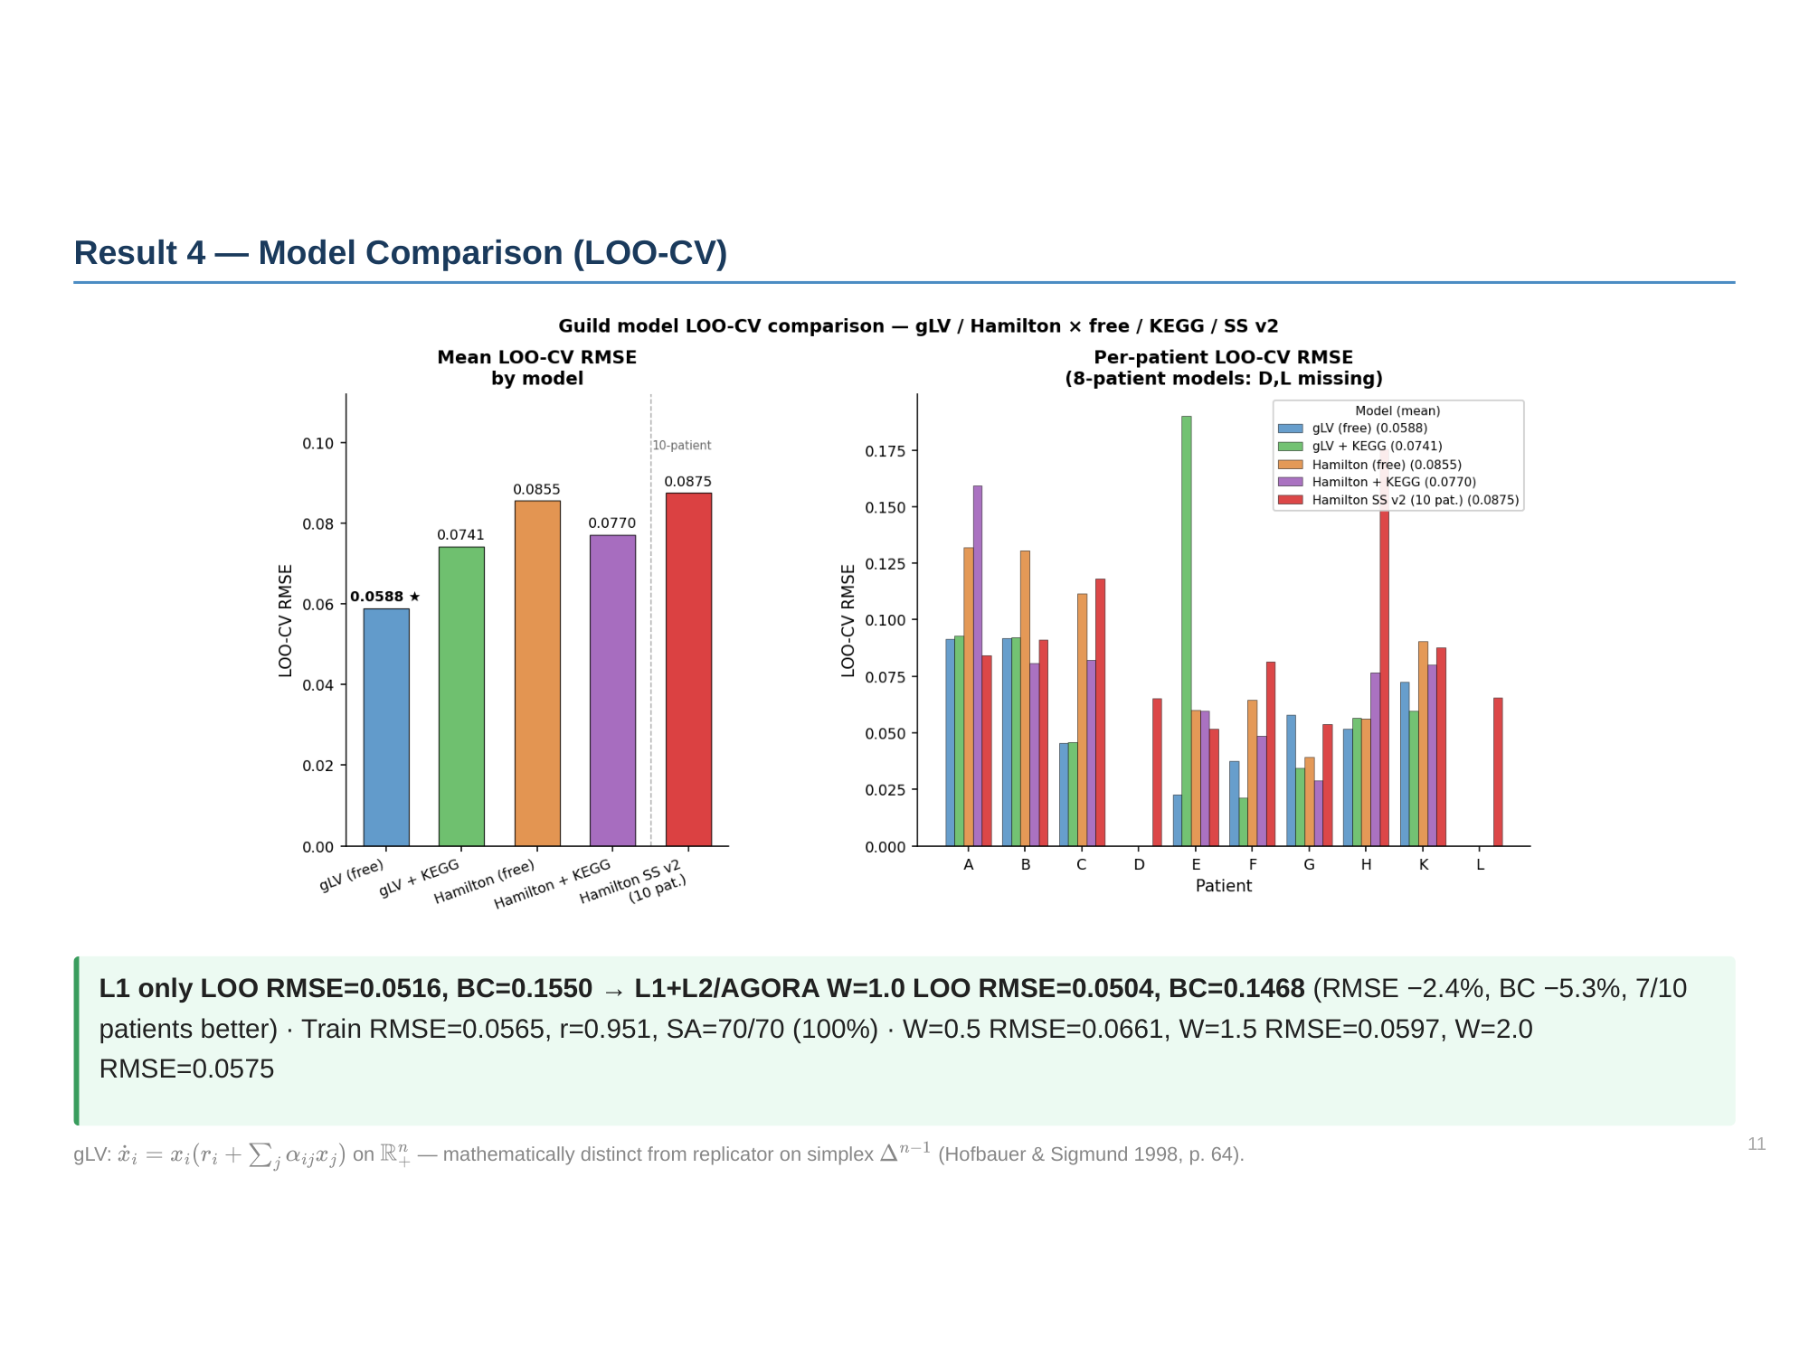

Slide 12
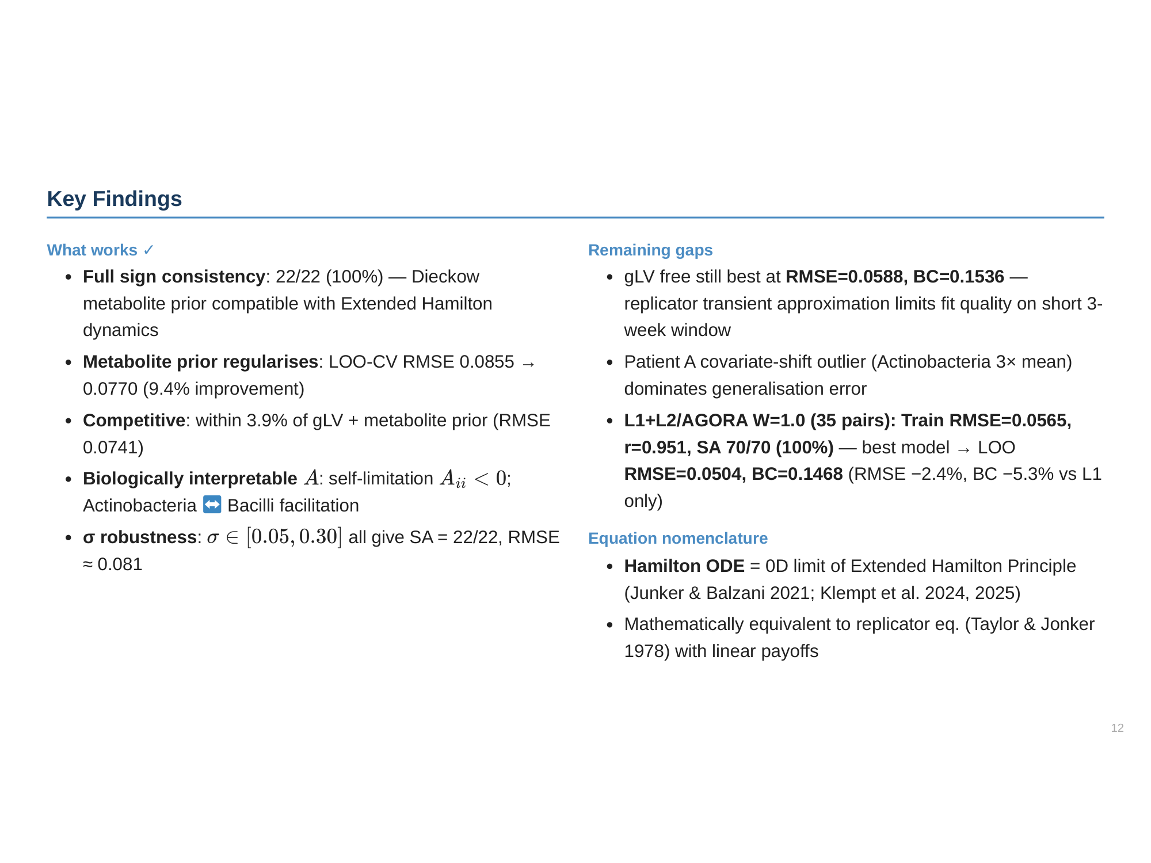

Slide 13
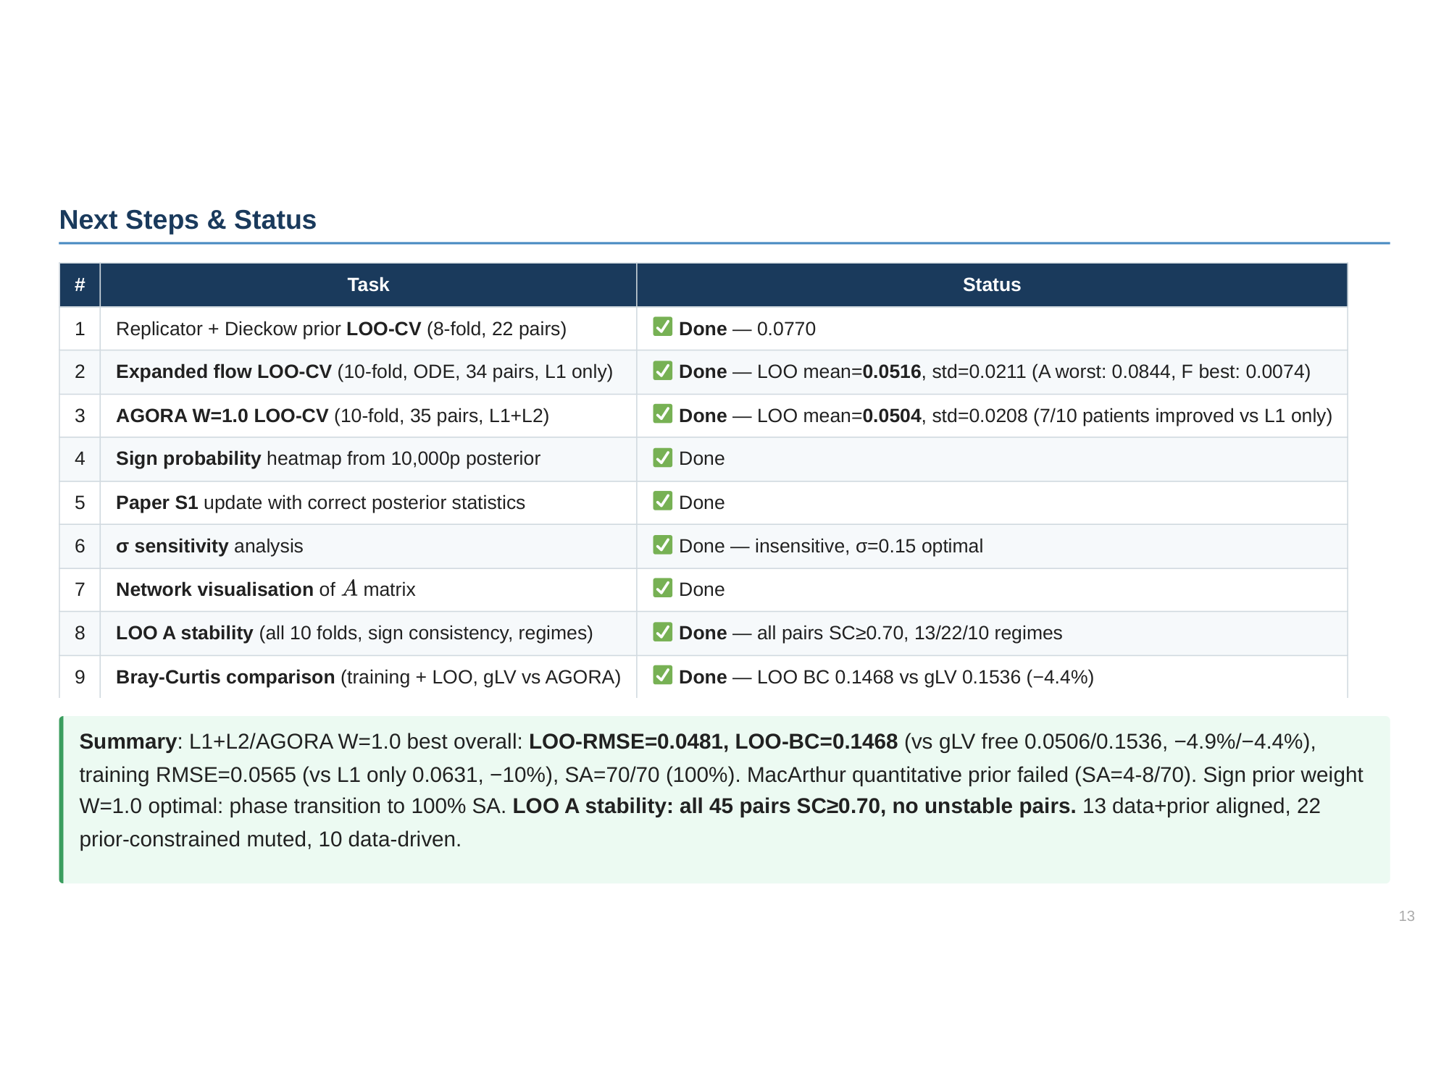

Slide 14
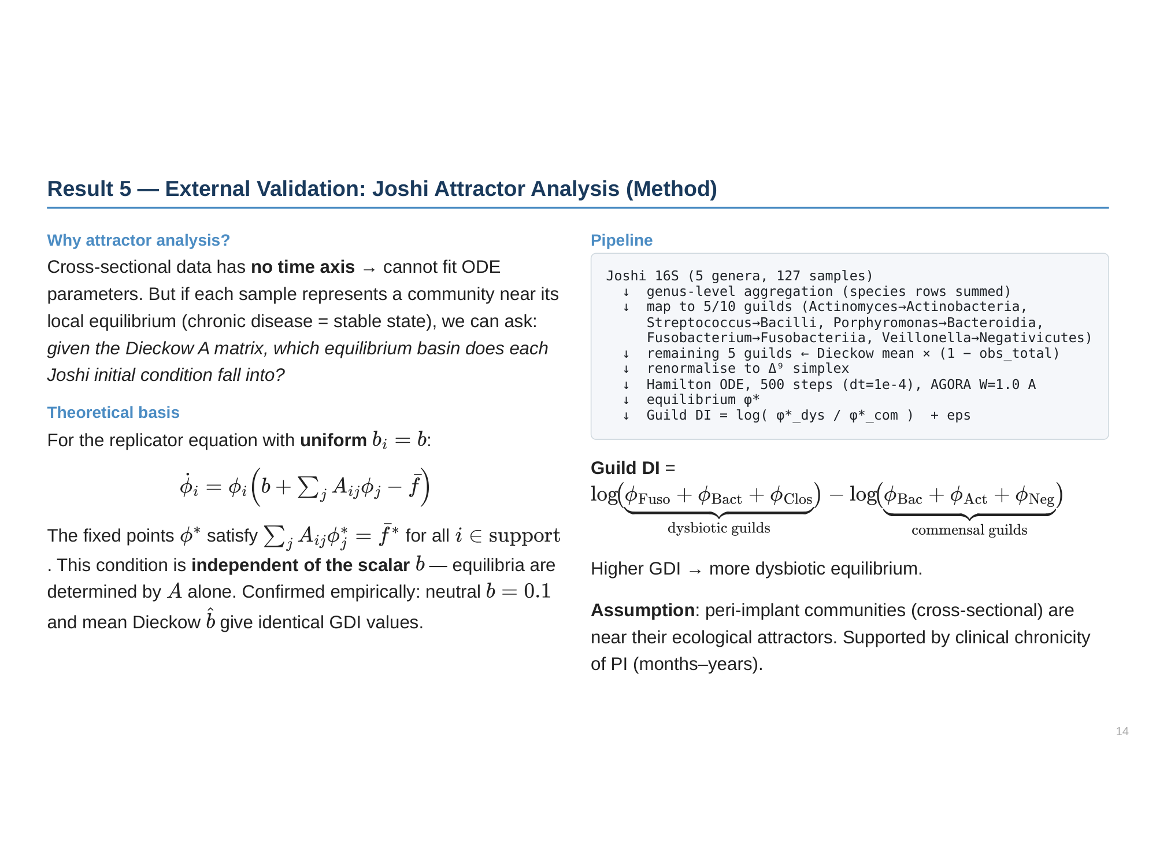

Slide 15
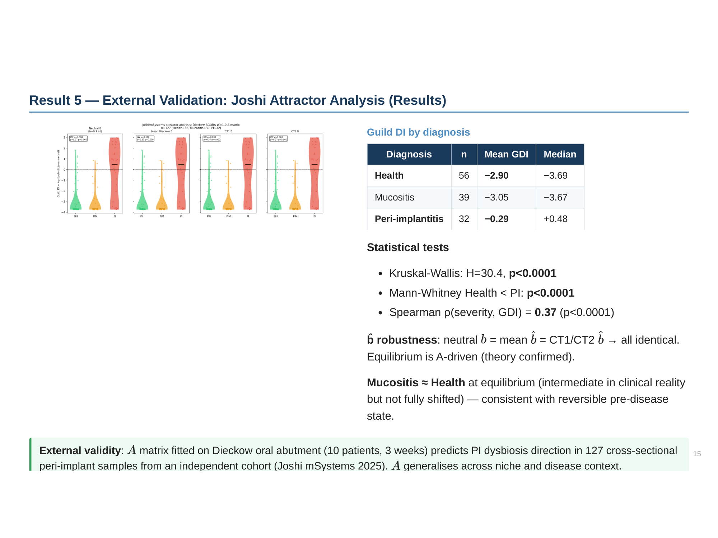

Slide 16
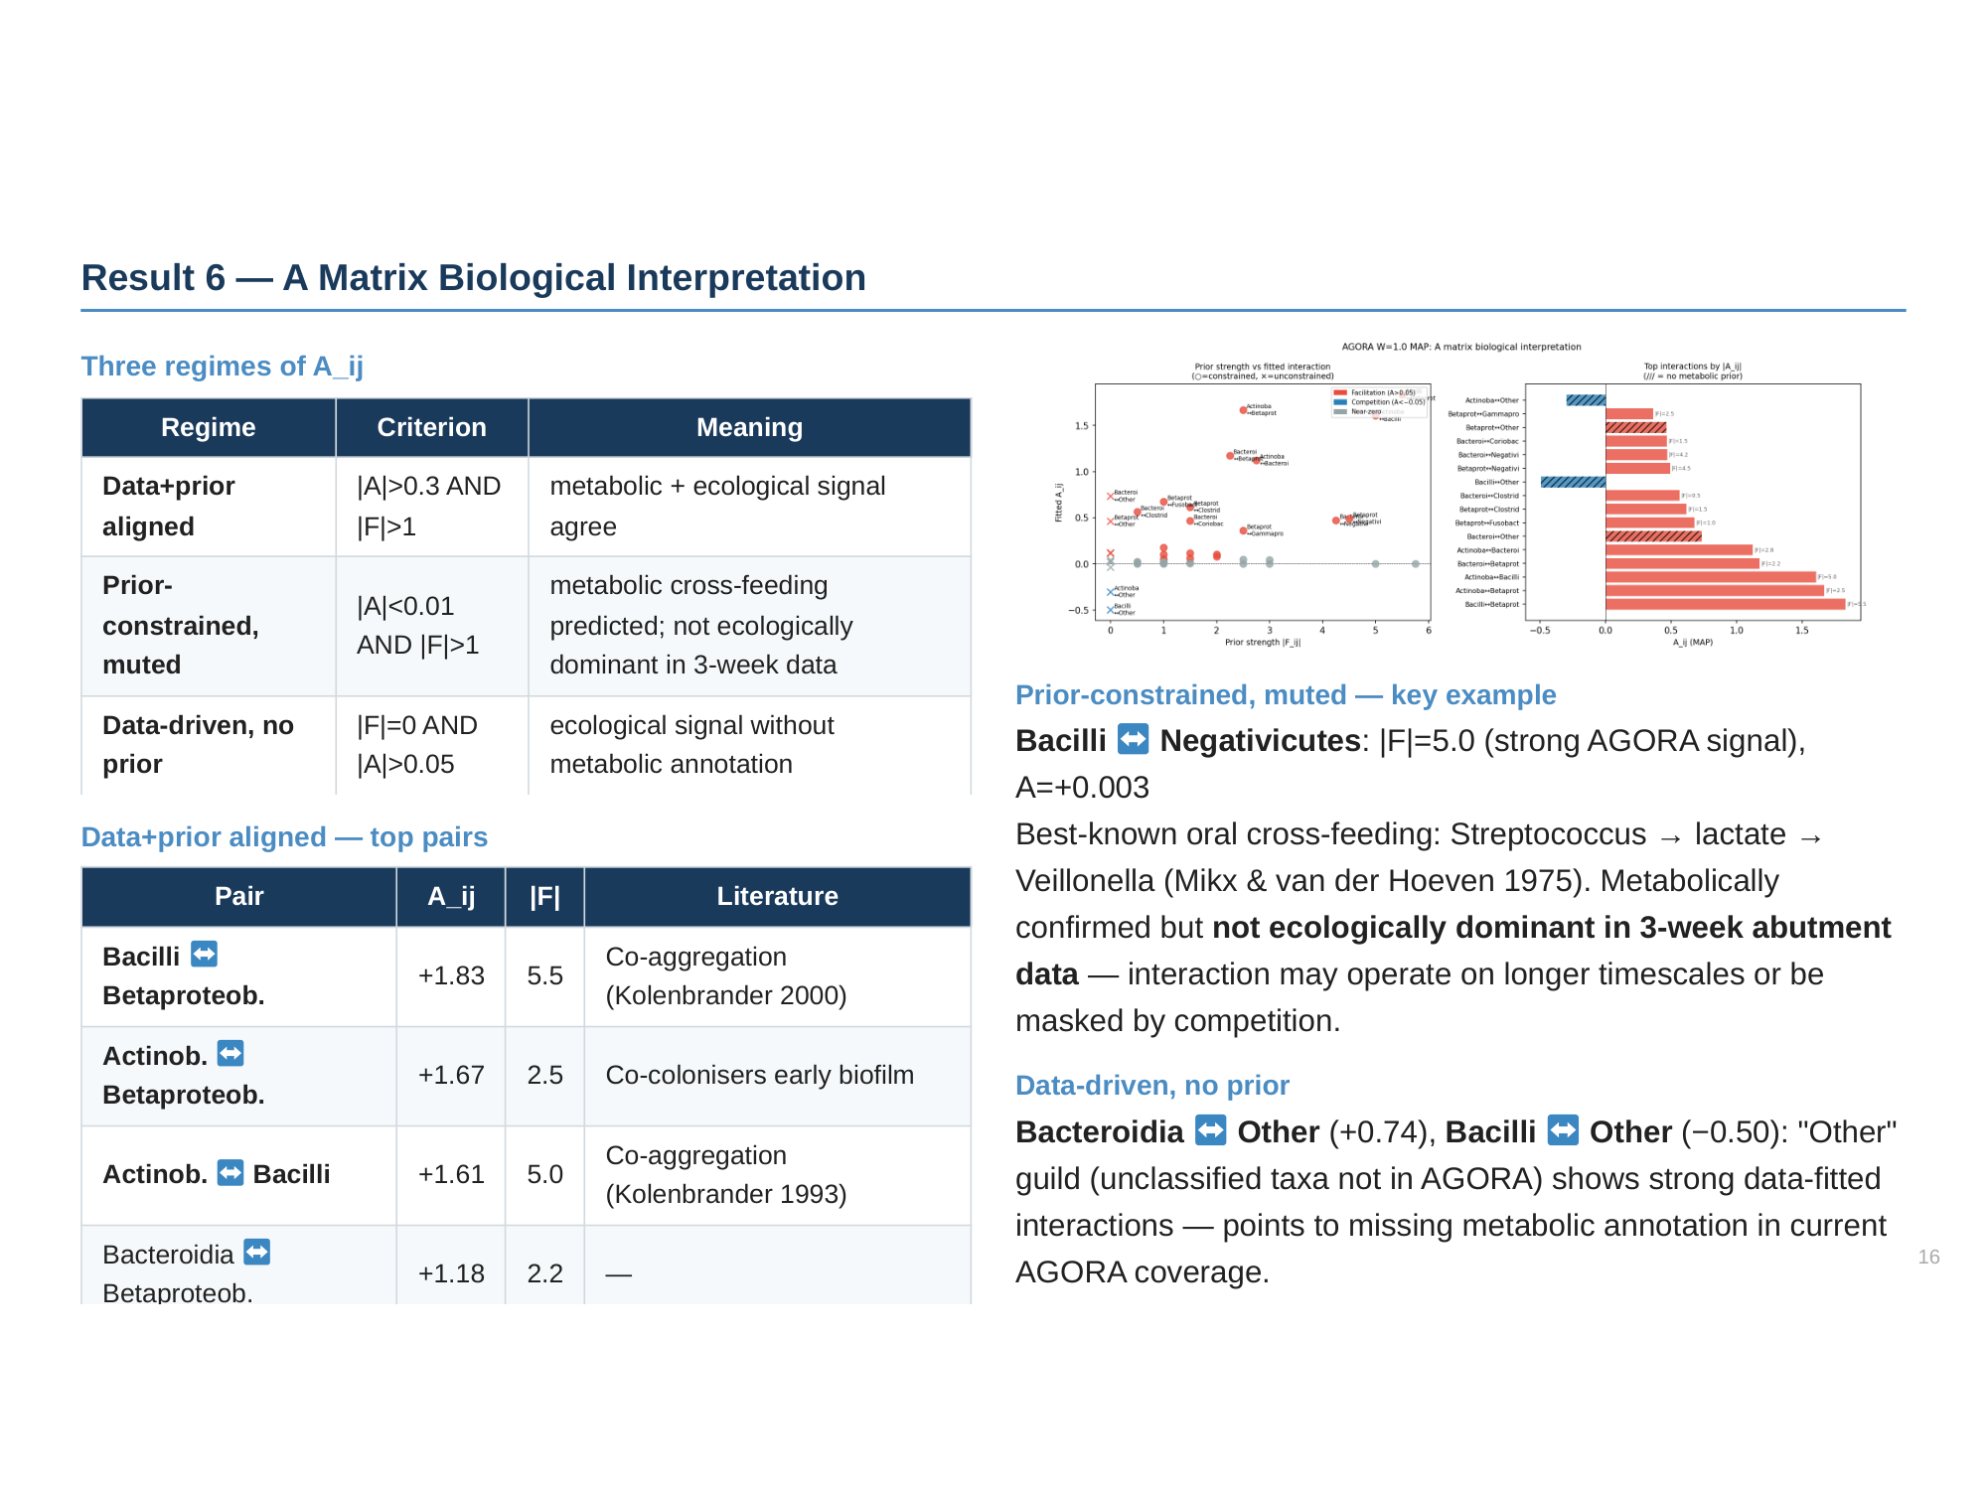

Slide 17
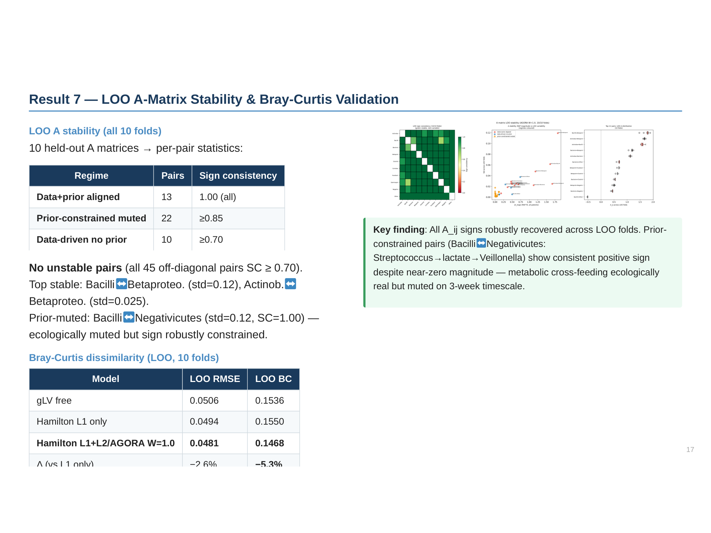

Slide 18
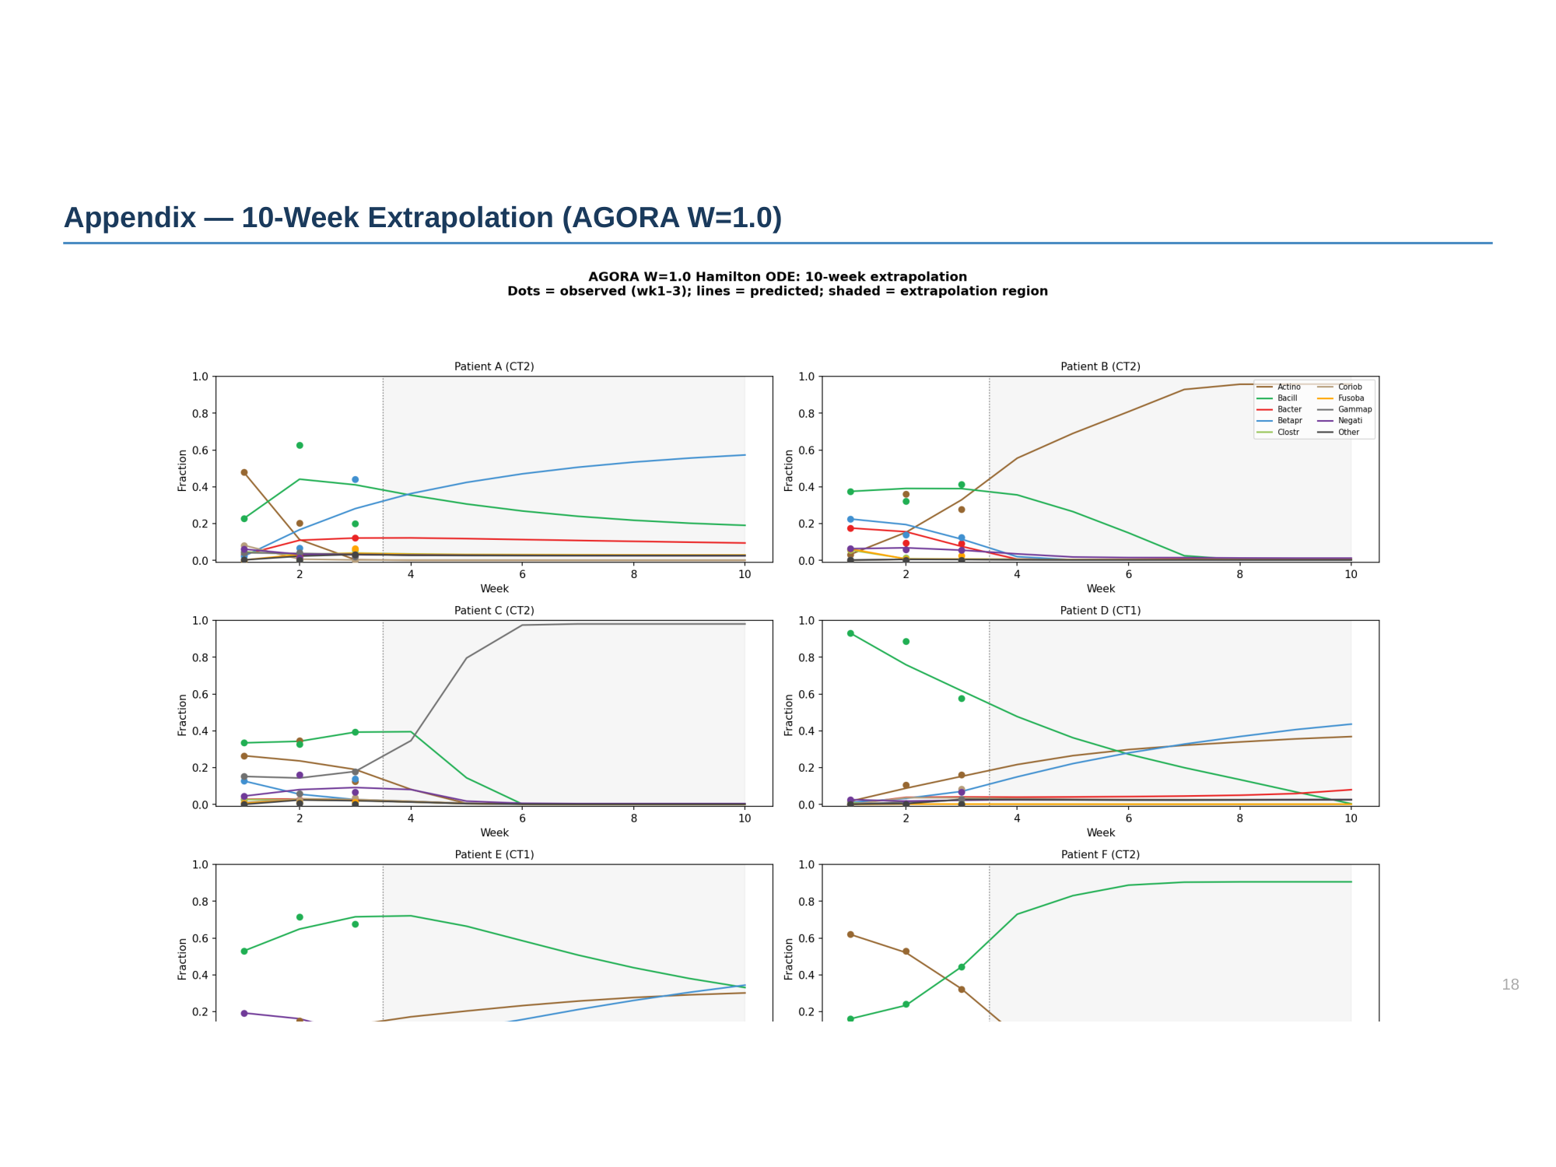

Slide 19
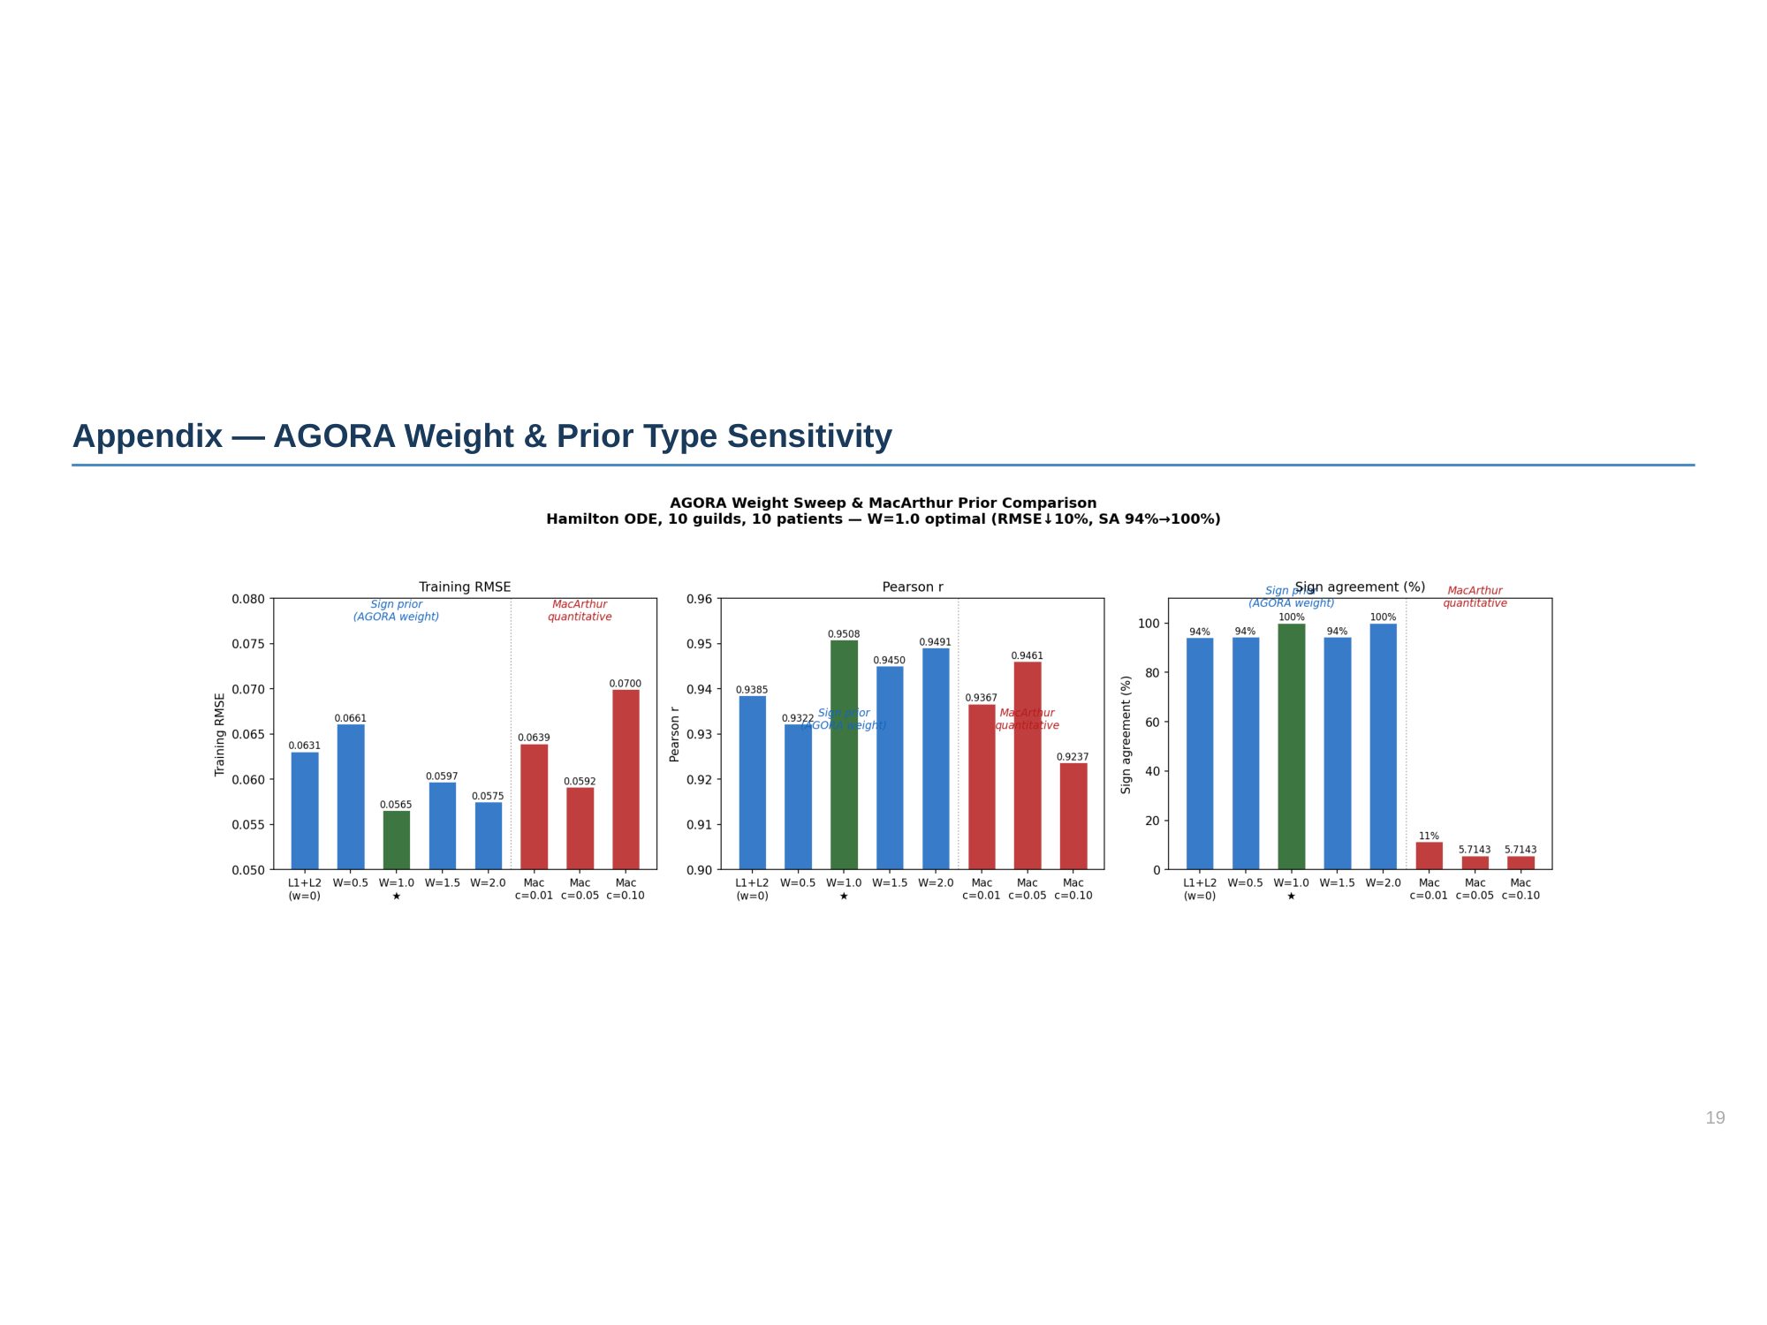

Slide 20
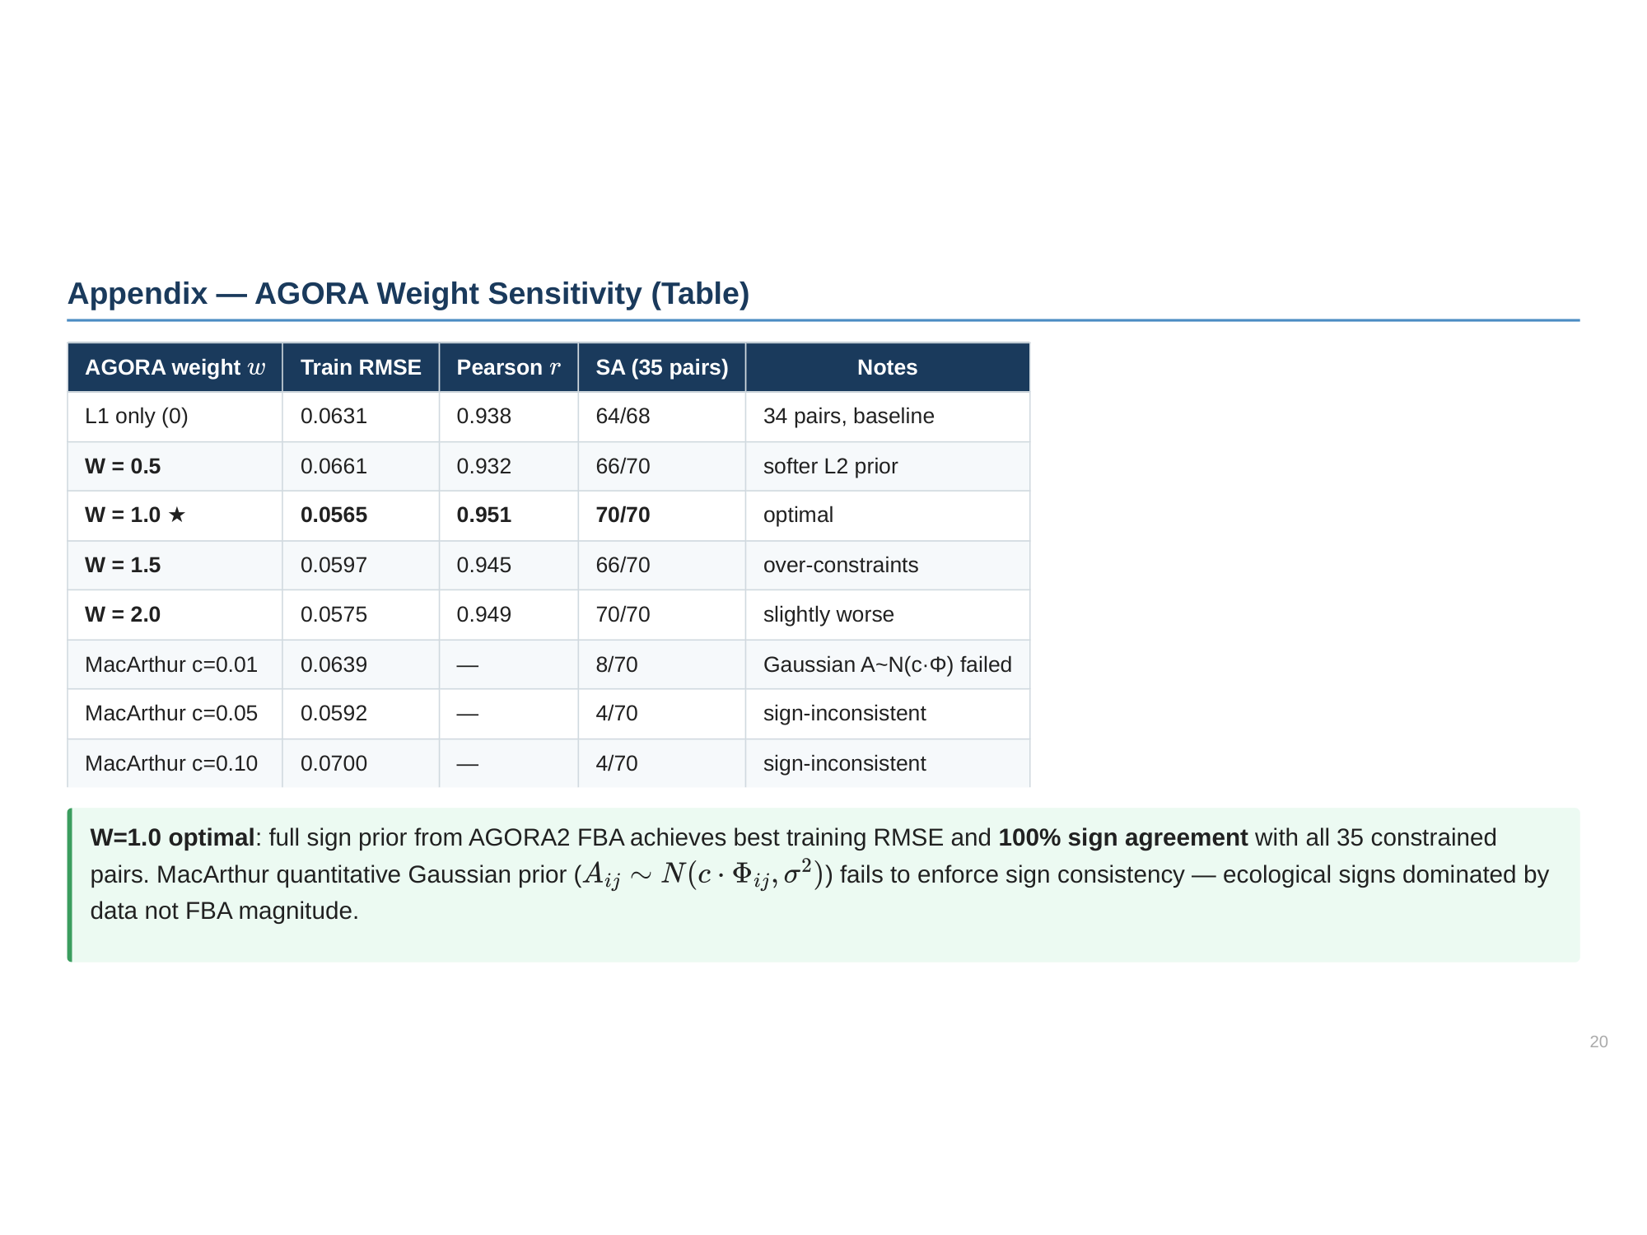

Slide 21
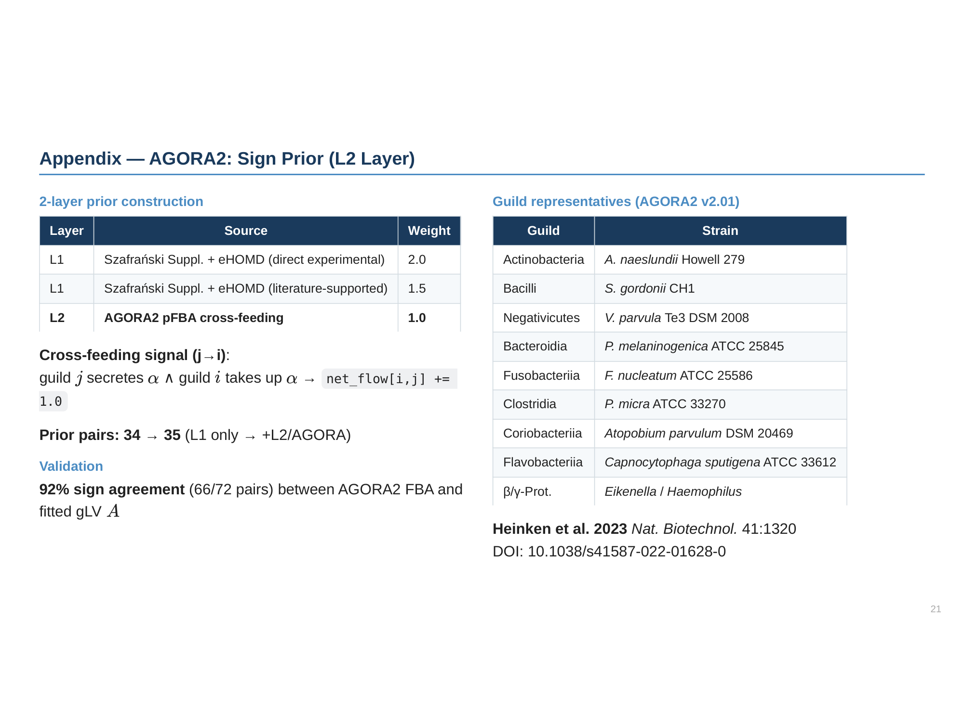

Slide 22
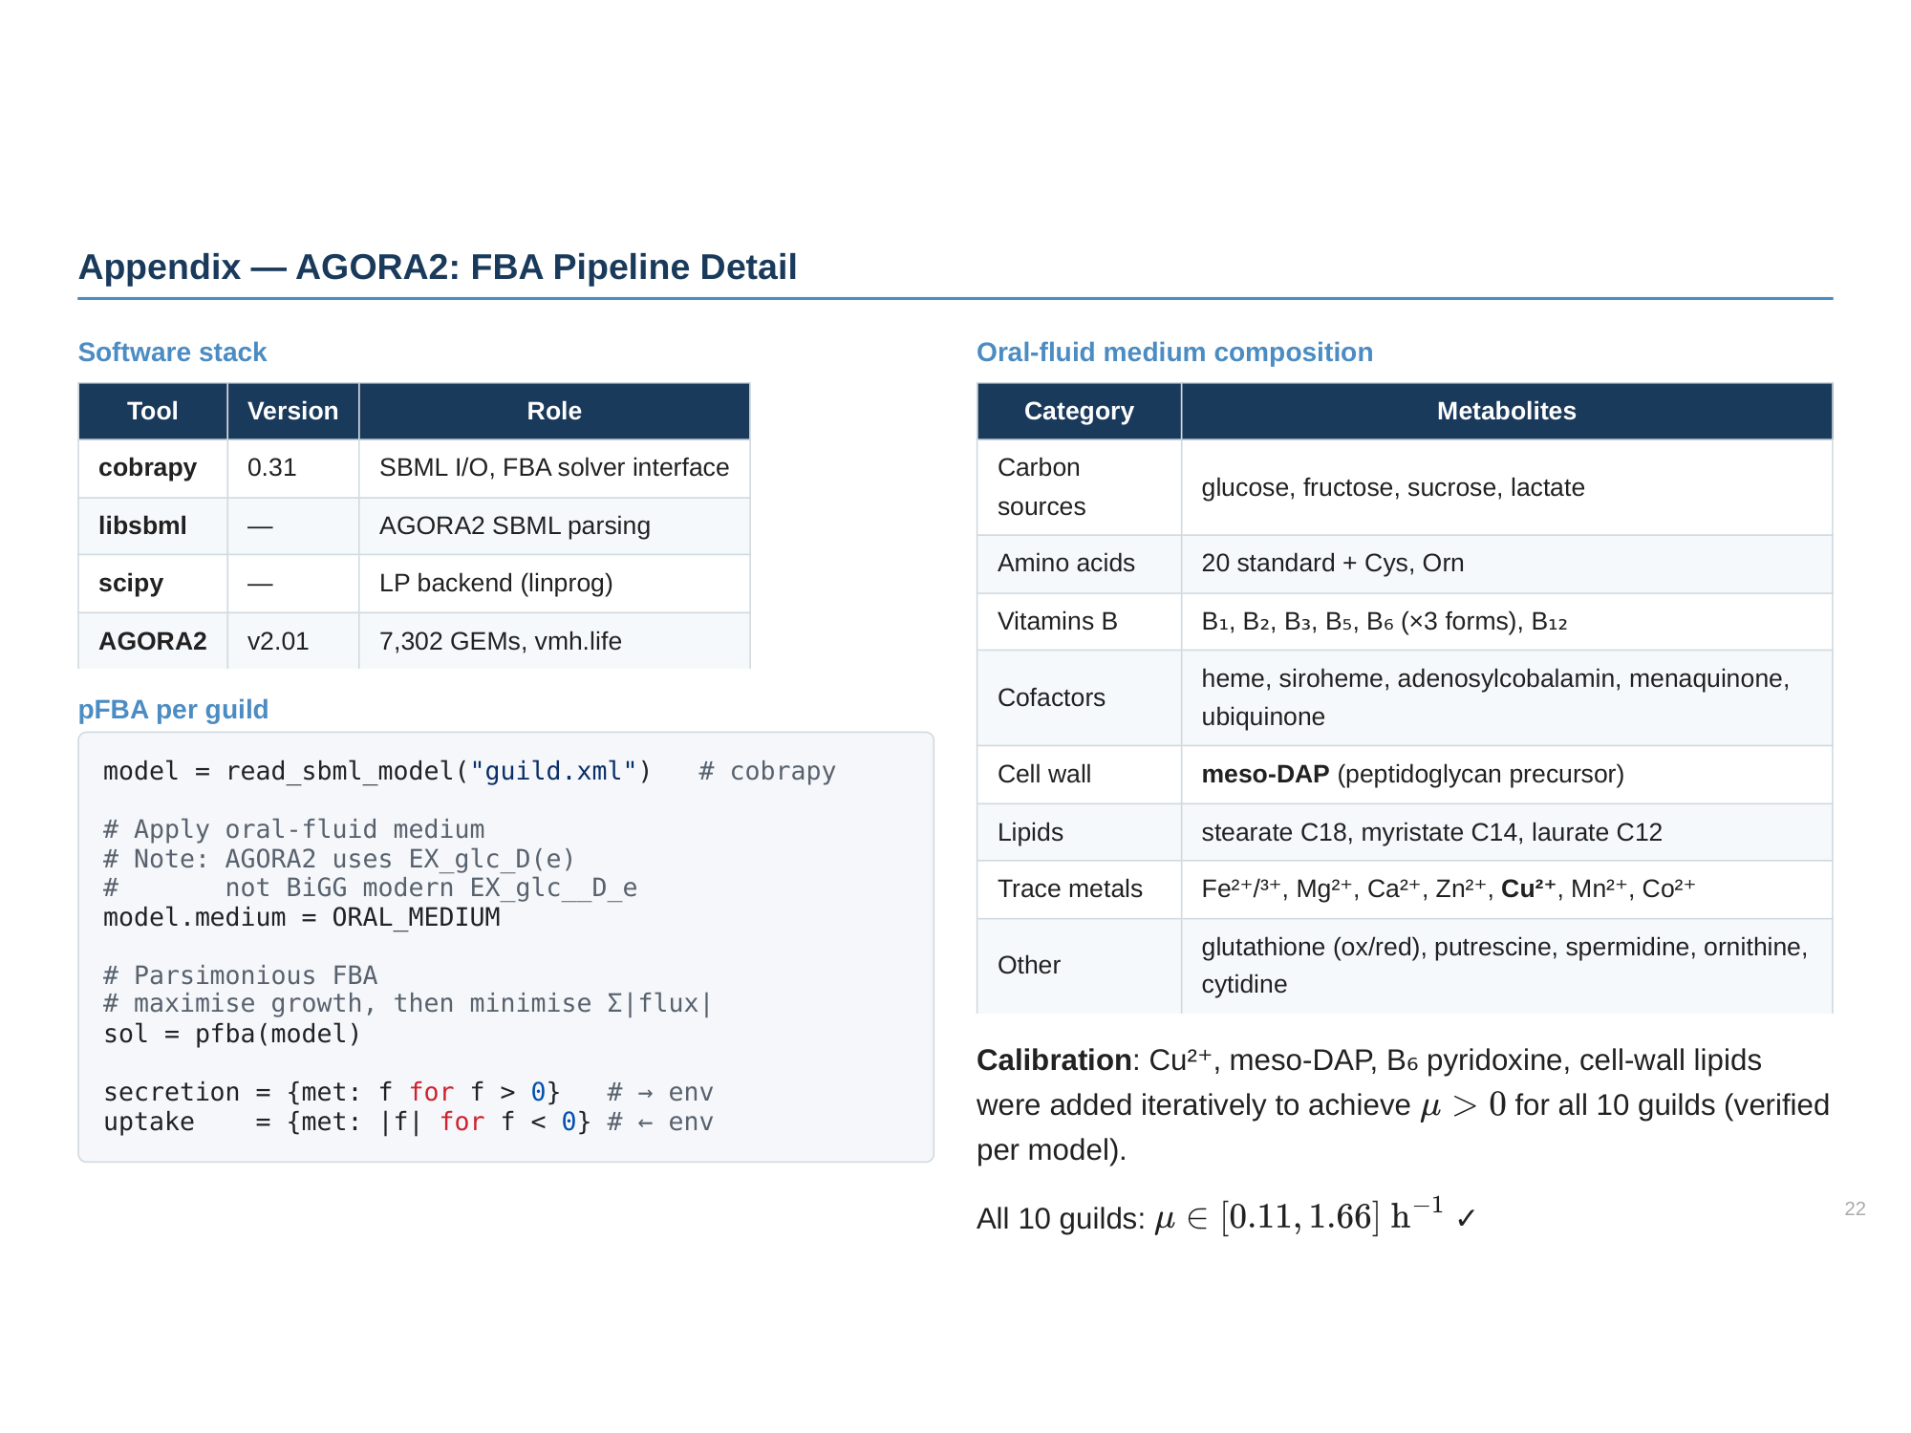

Slide 23
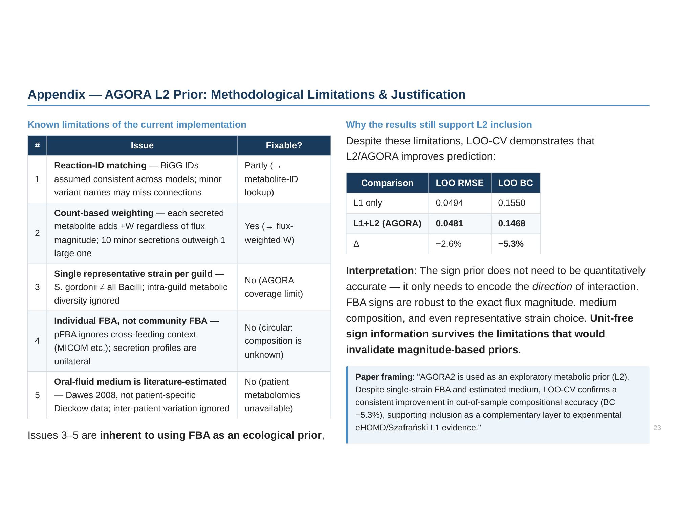

Slide 24
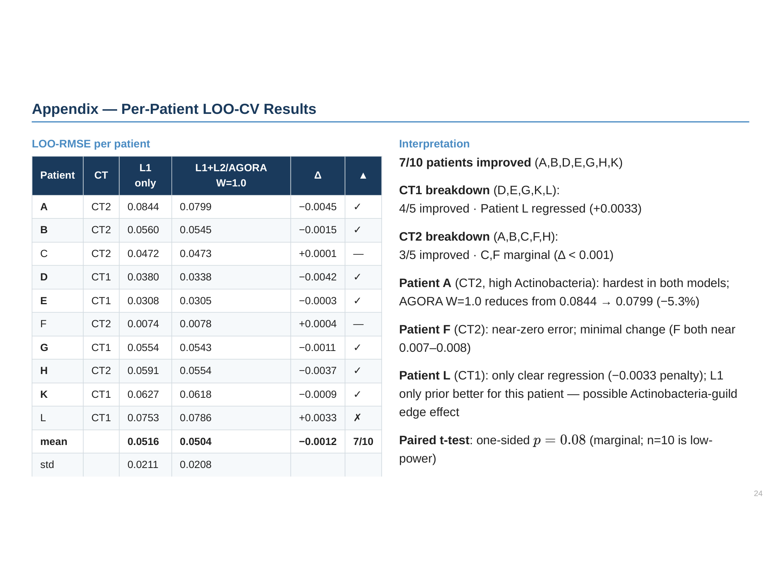

Slide 25
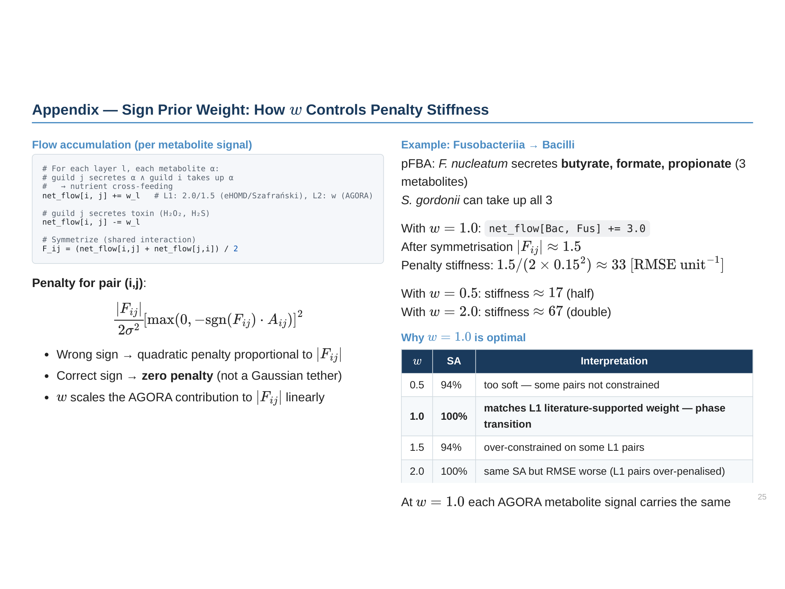

Slide 26
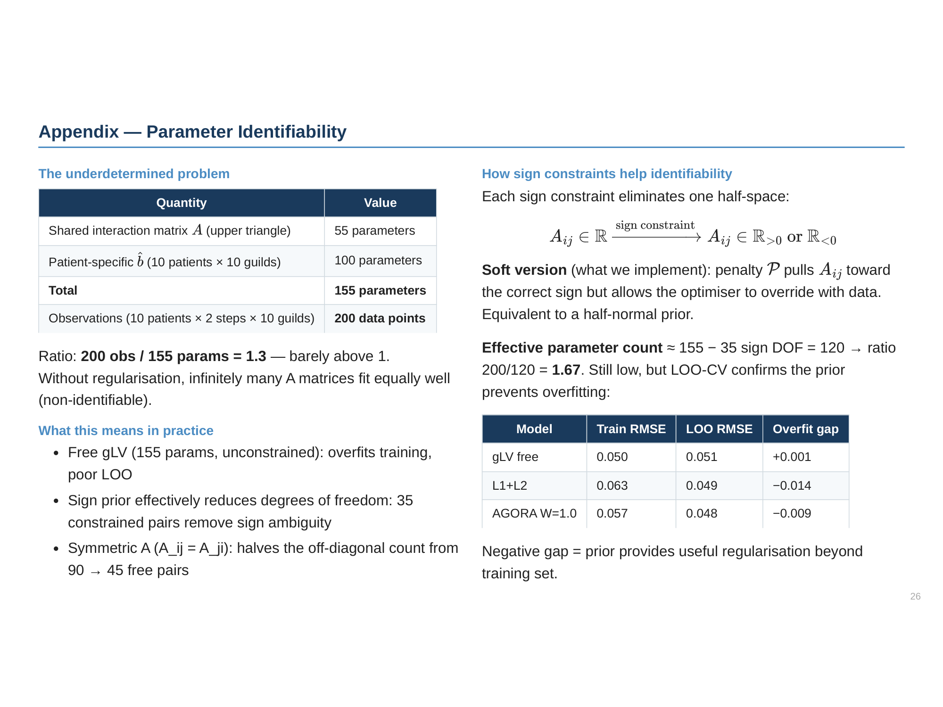

Slide 27
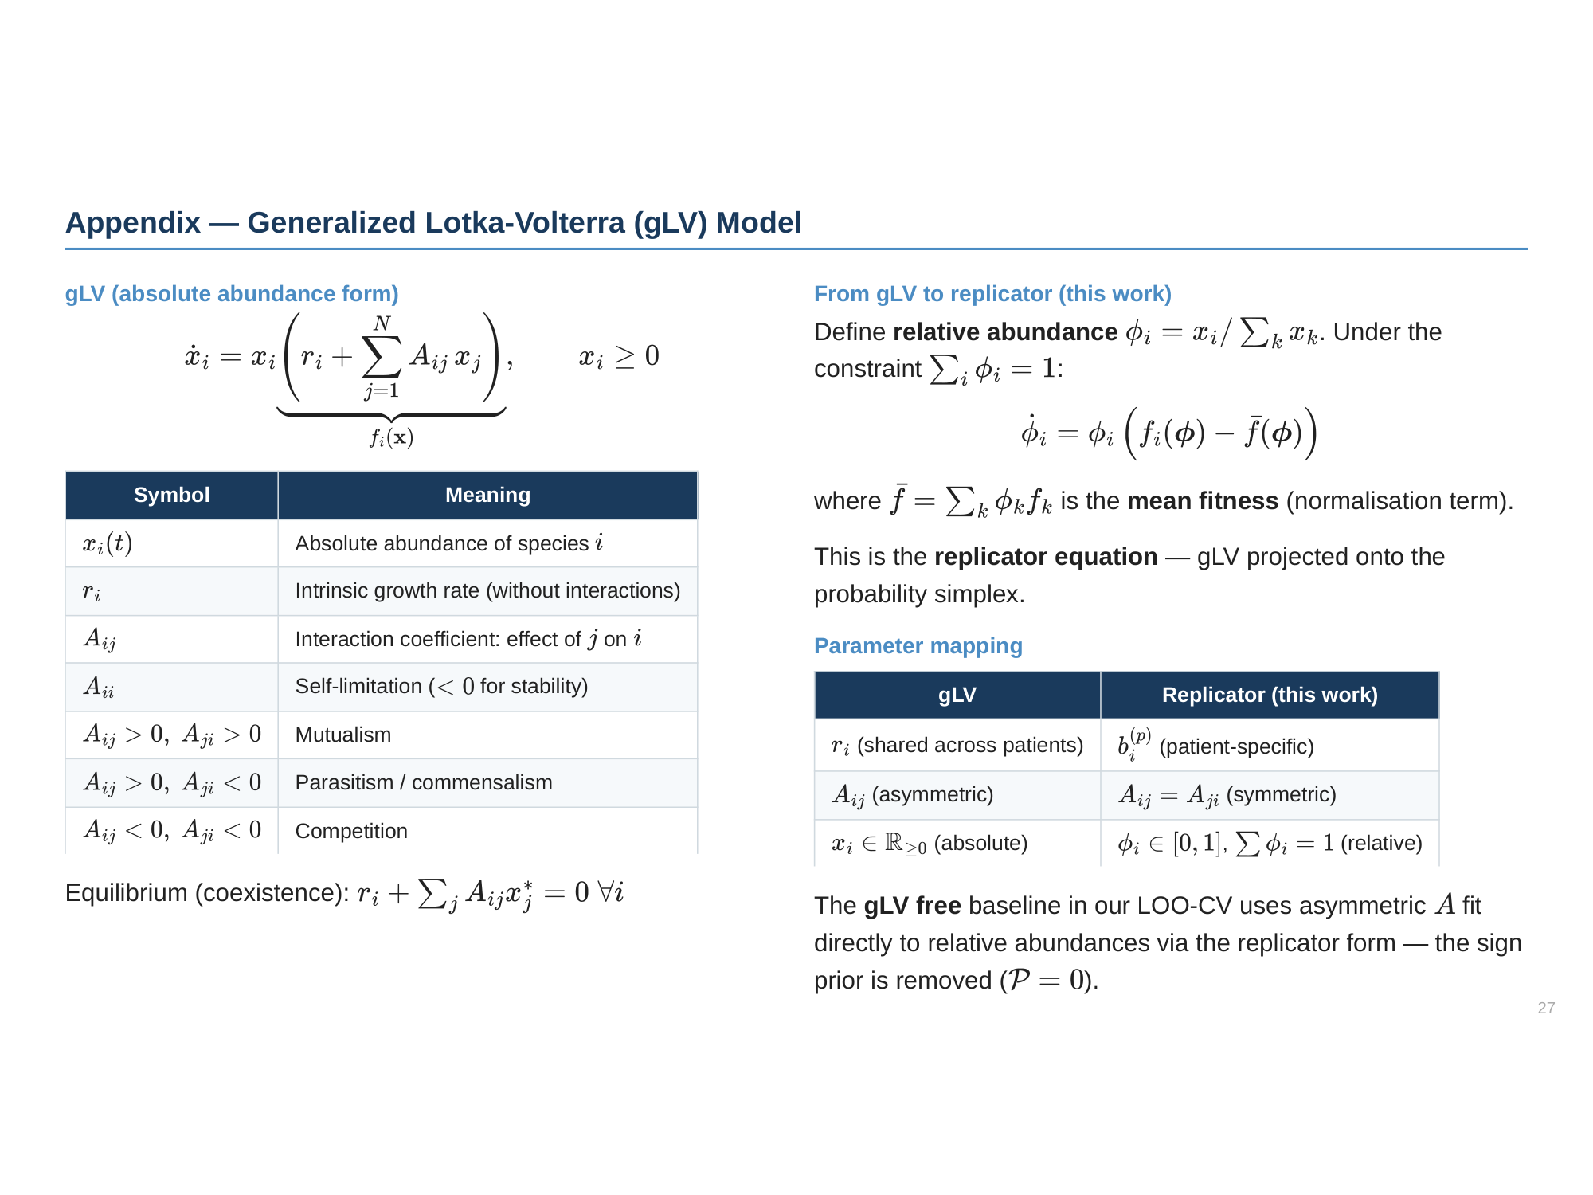

Slide 28
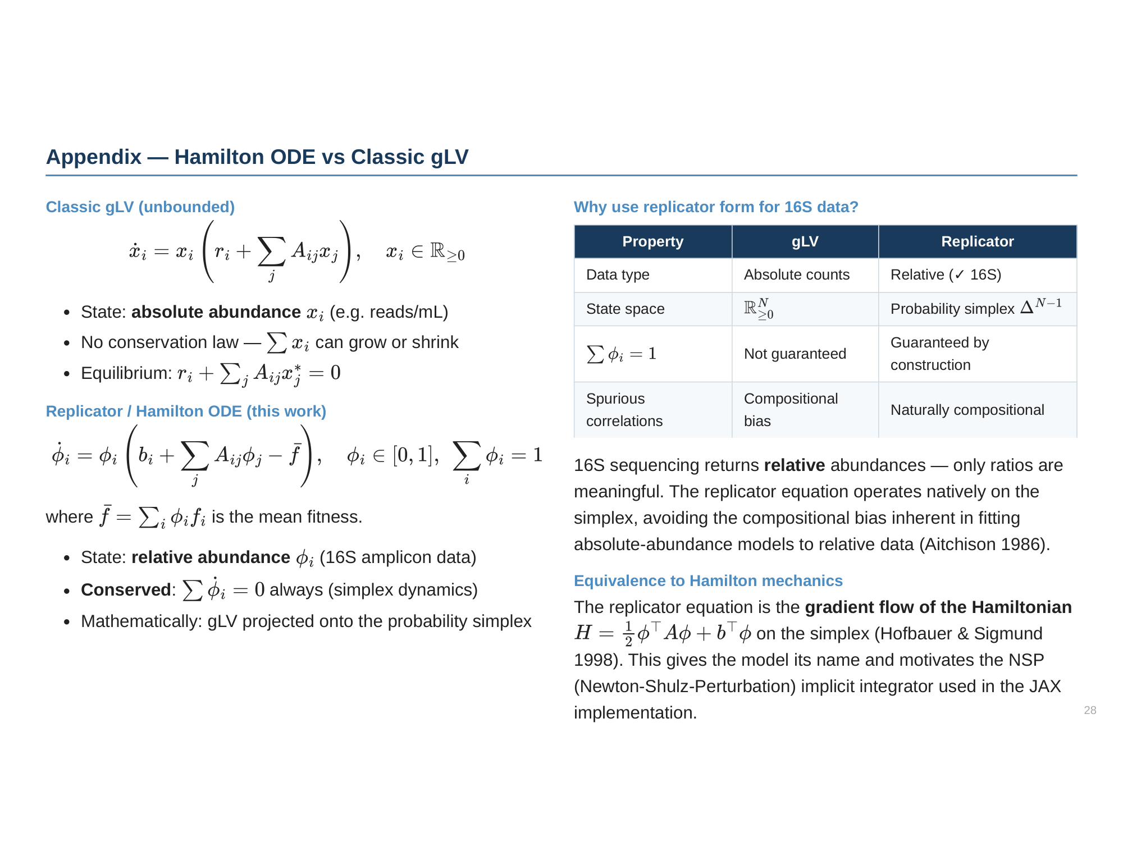

Slide 29
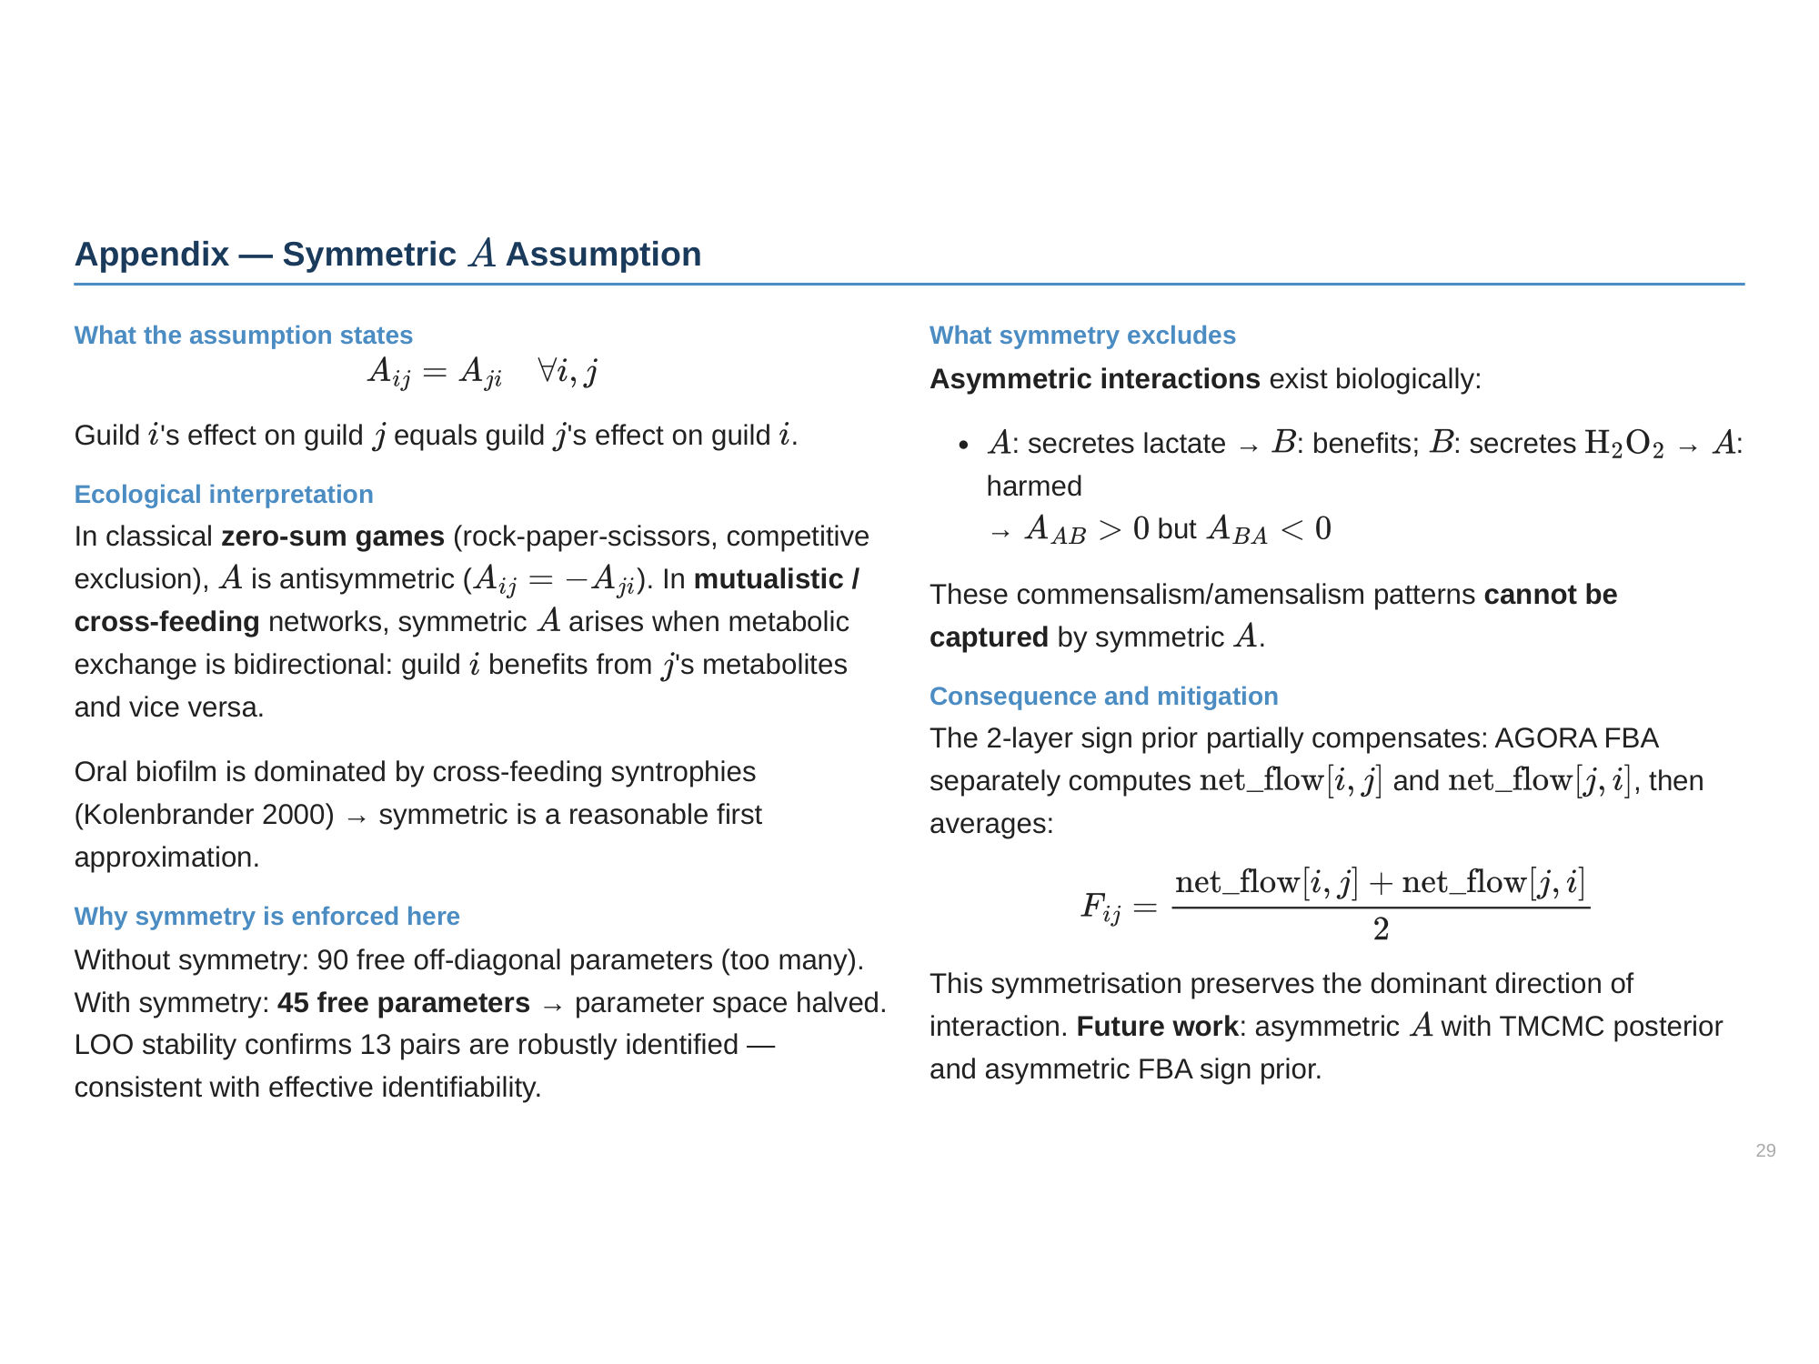

Slide 30
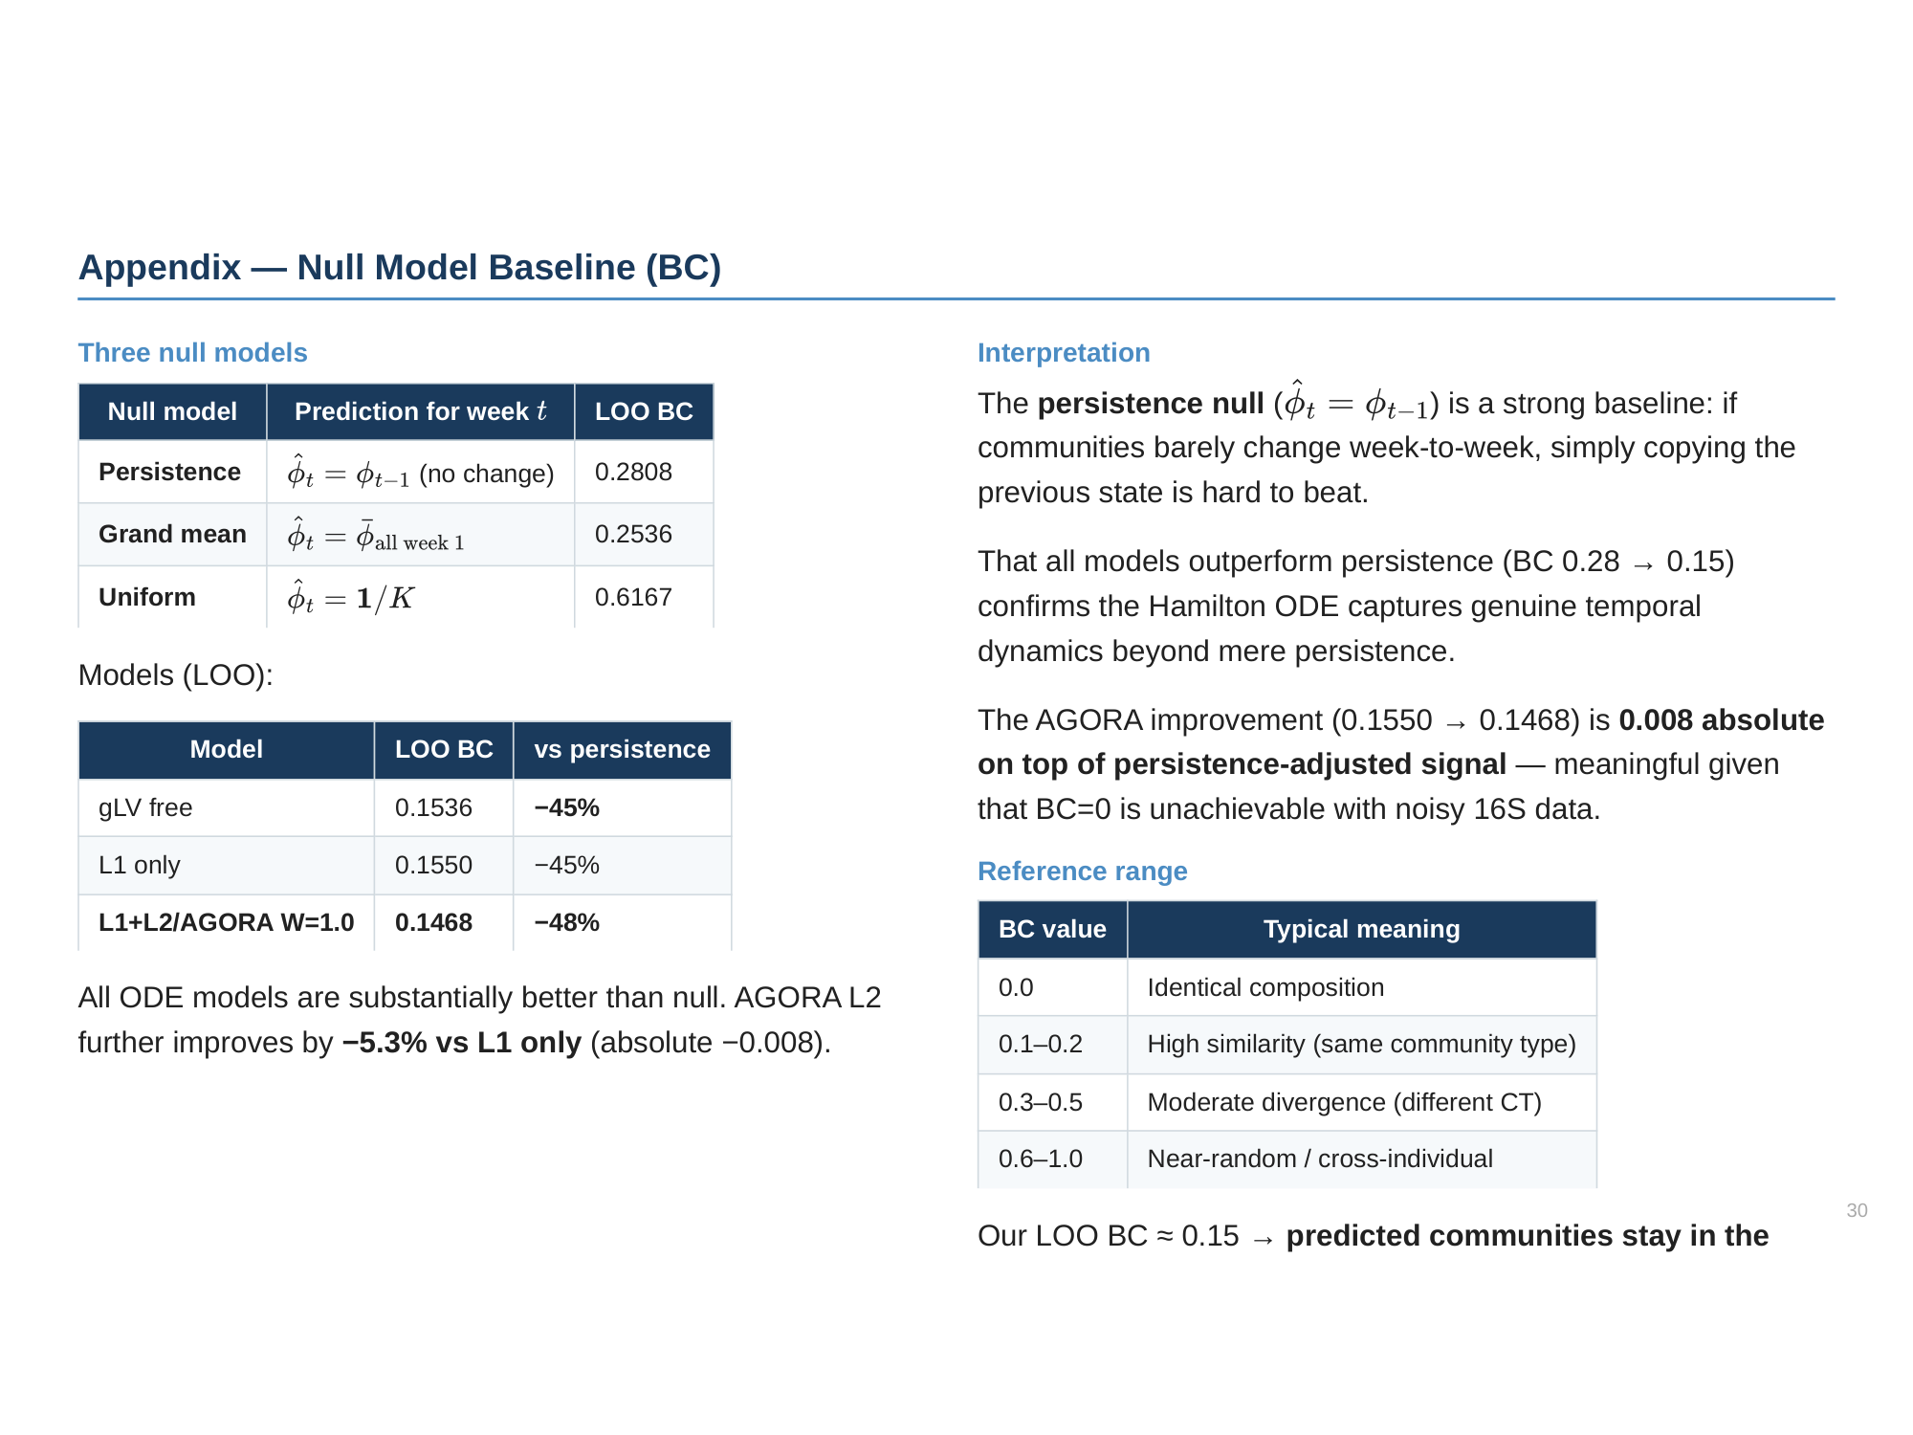

Slide 31
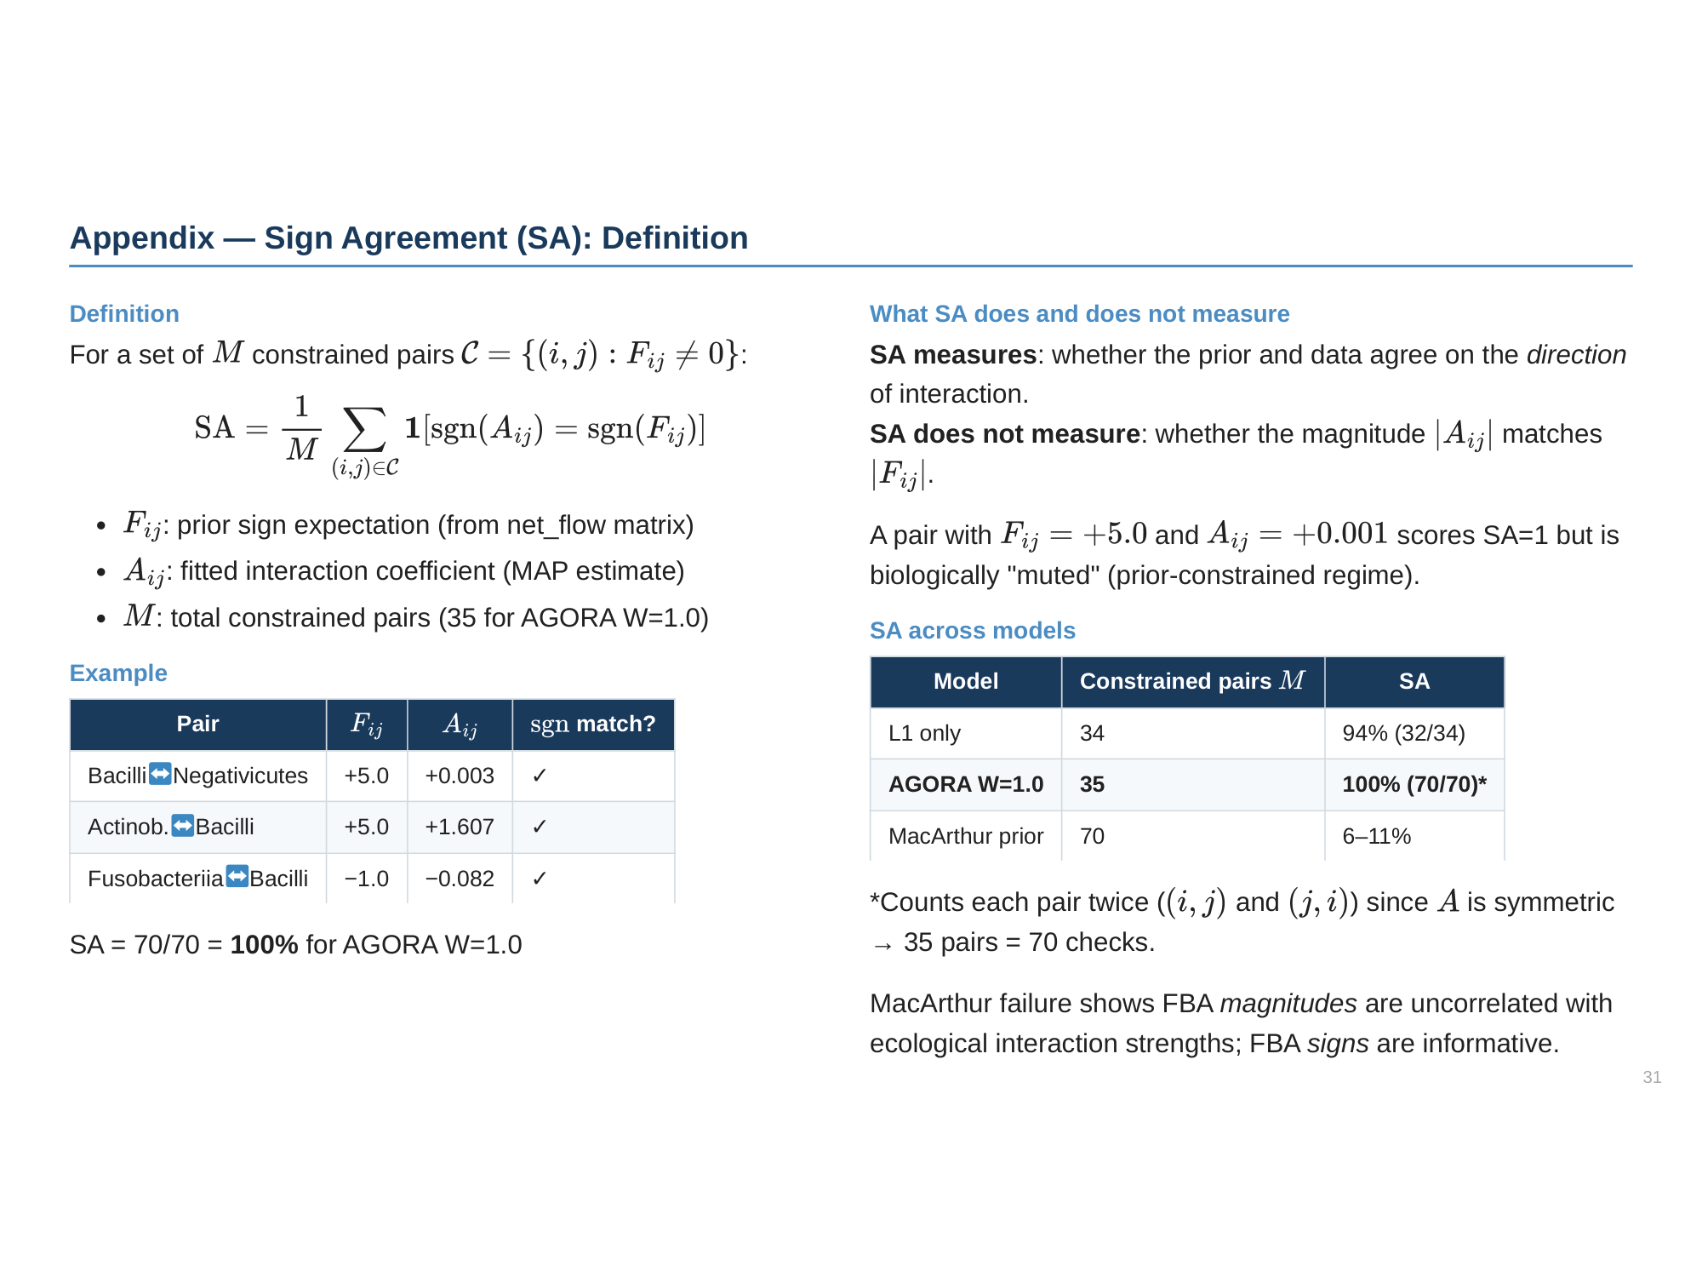

Slide 32
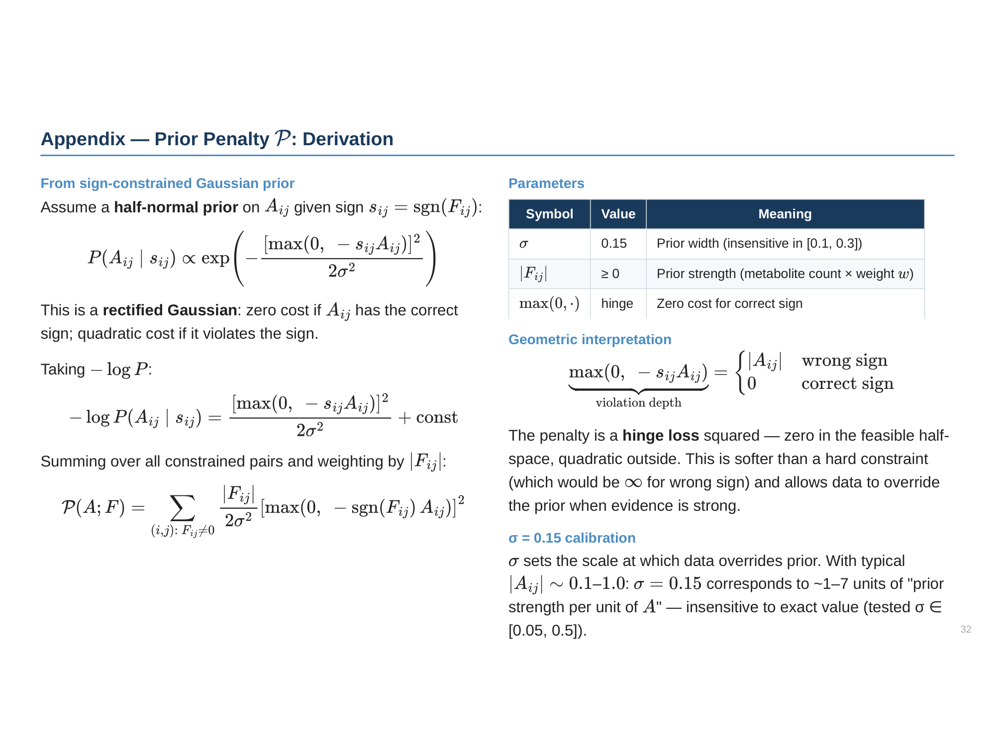

Slide 33
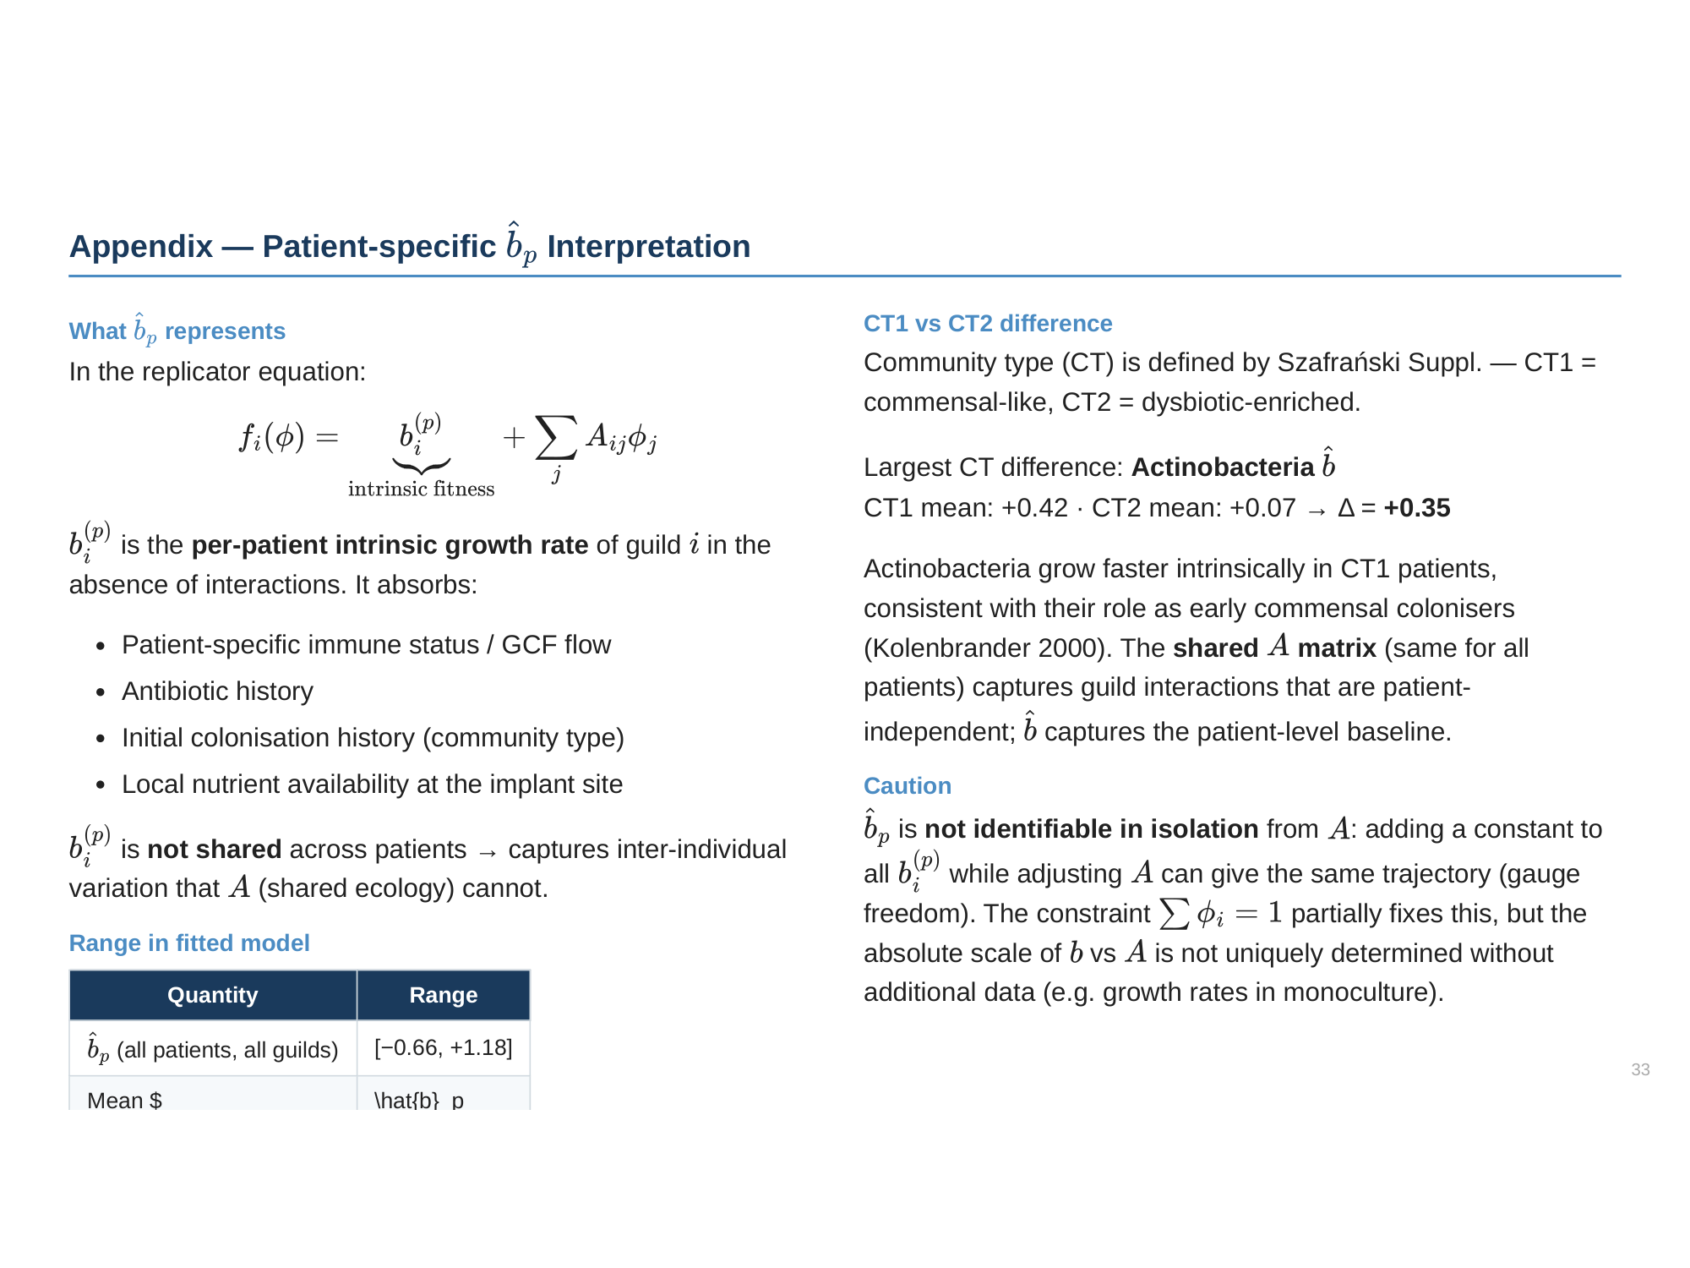

Slide 34
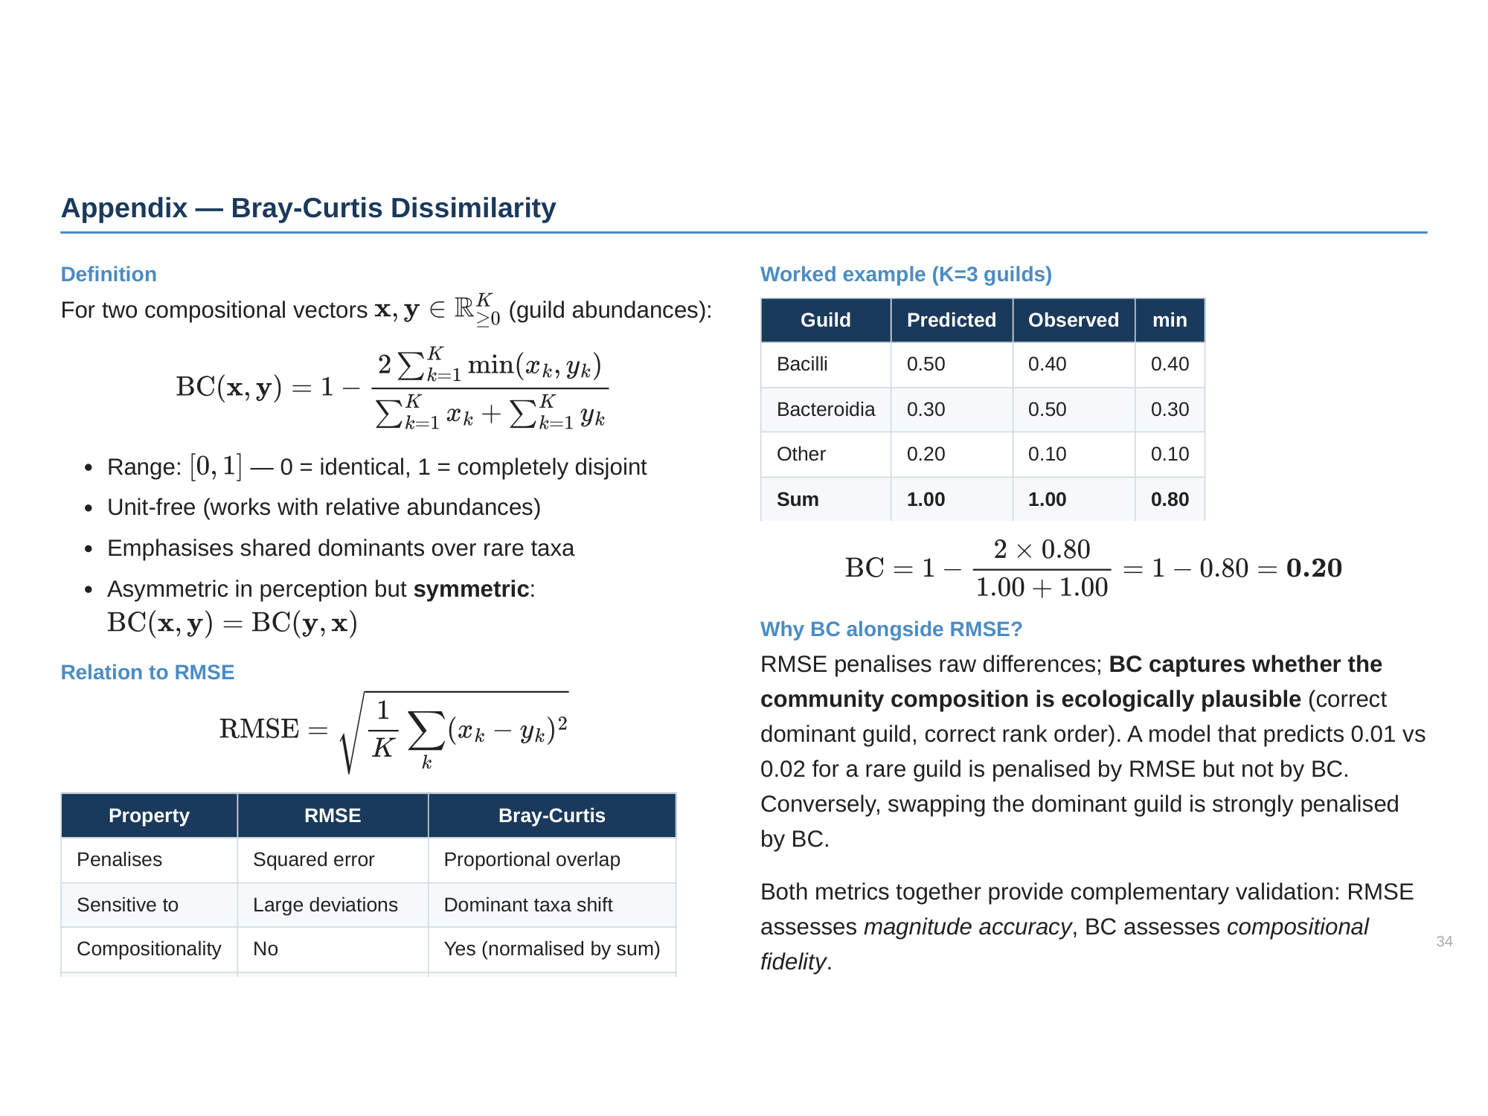

Slide 35
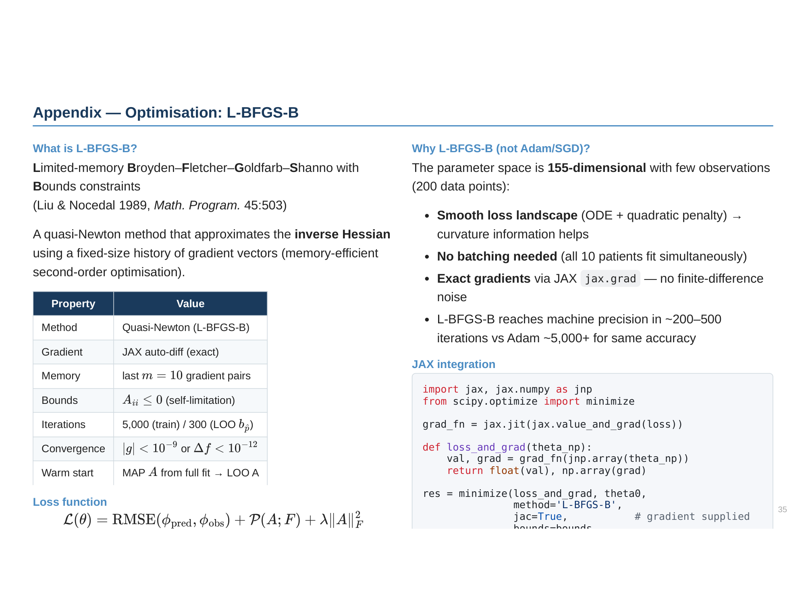

Slide 36
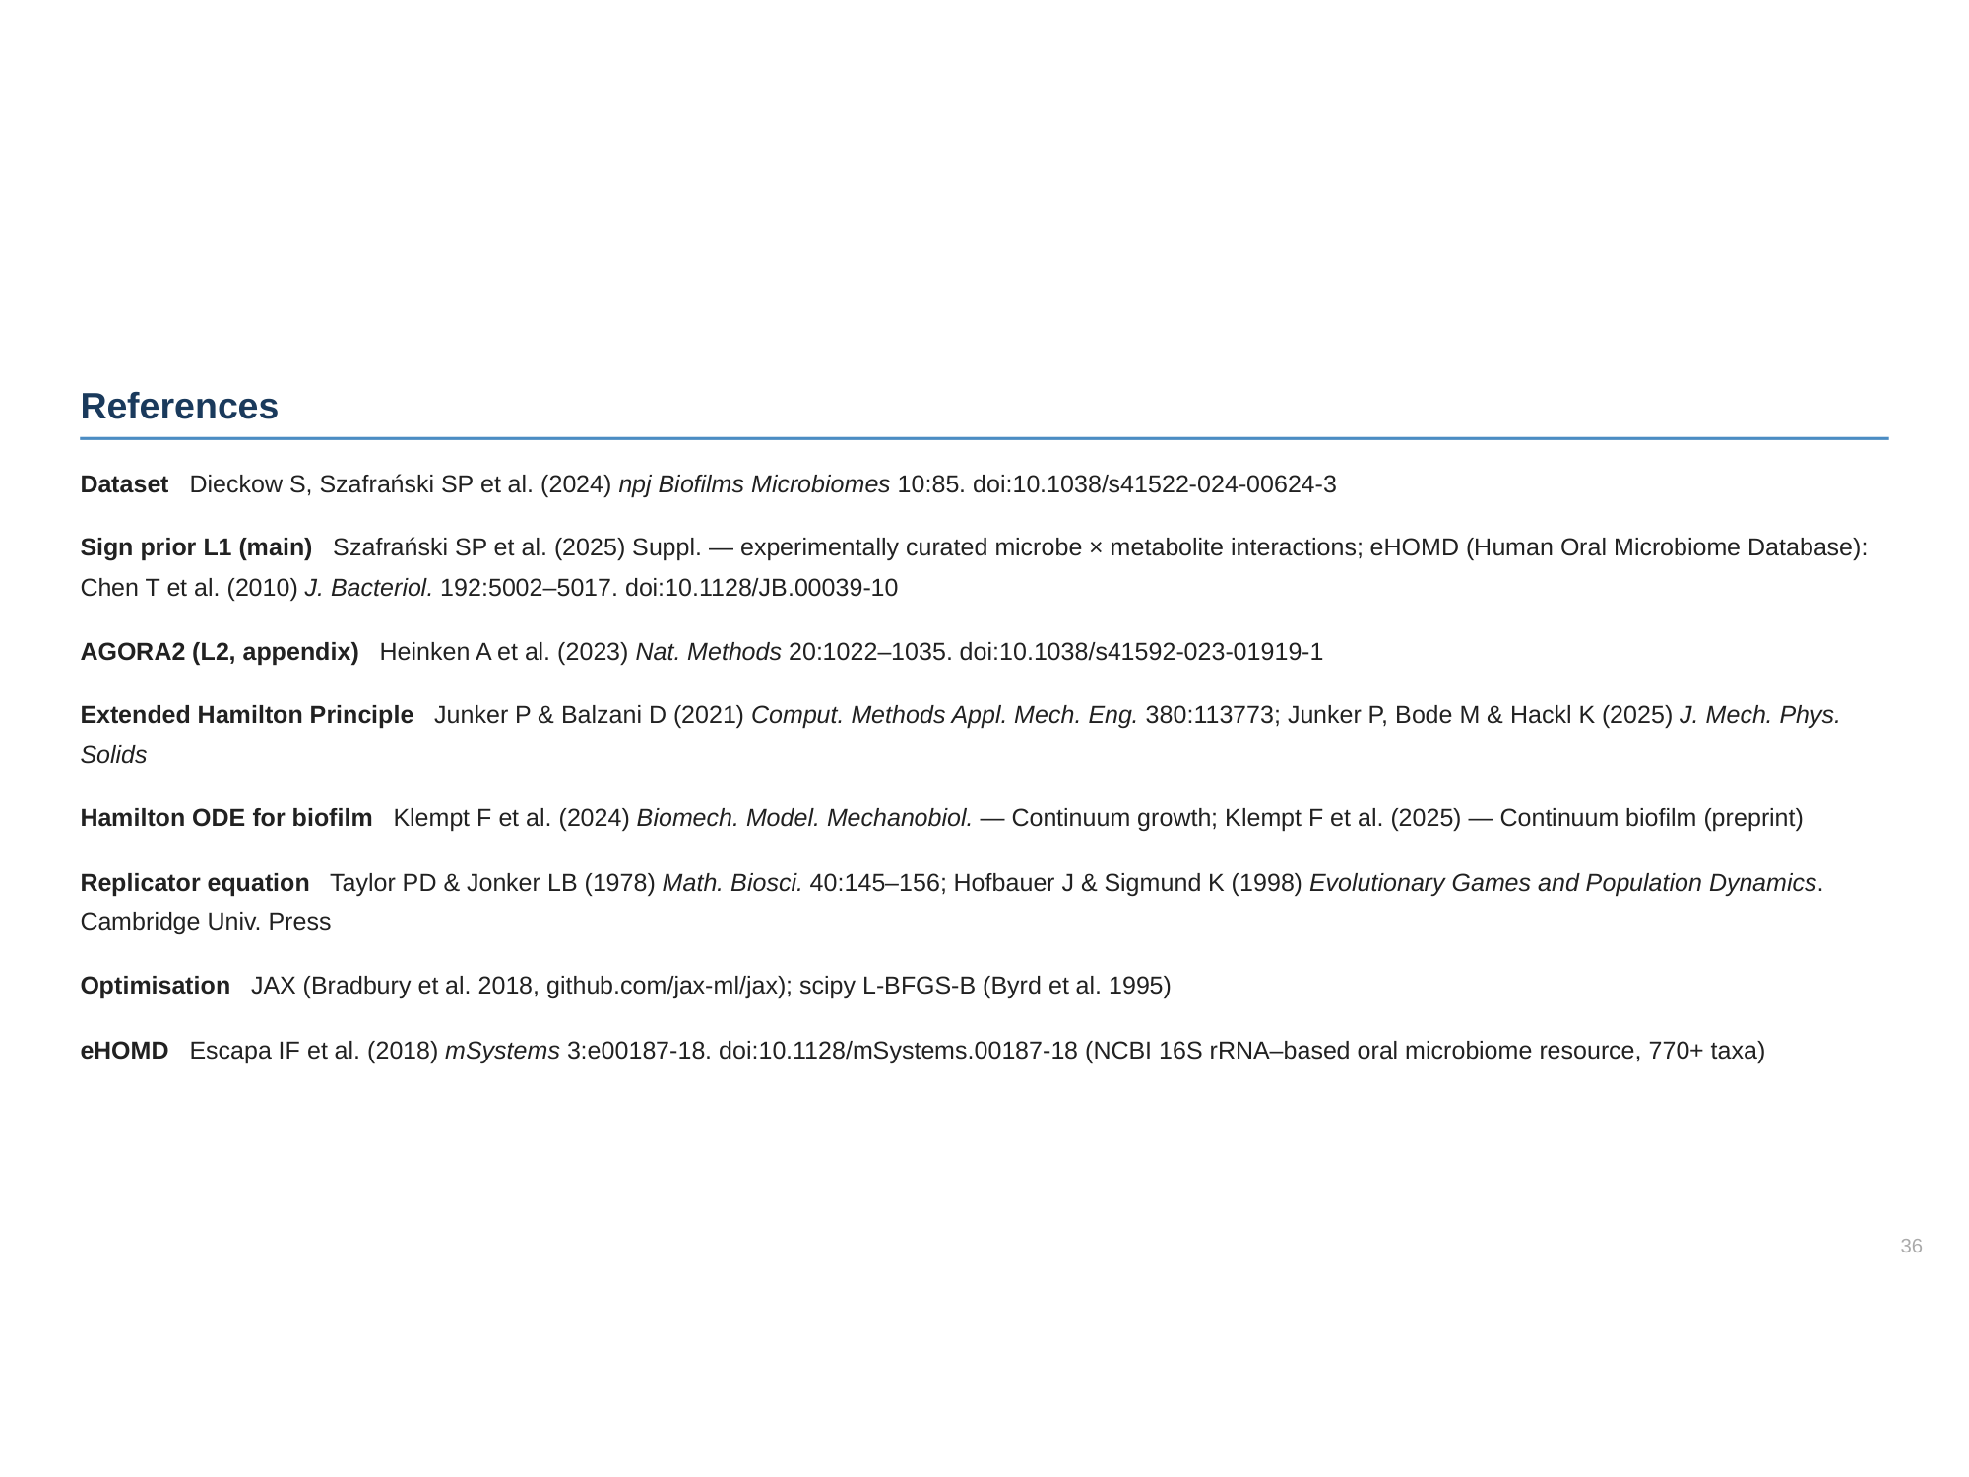

Slide 37
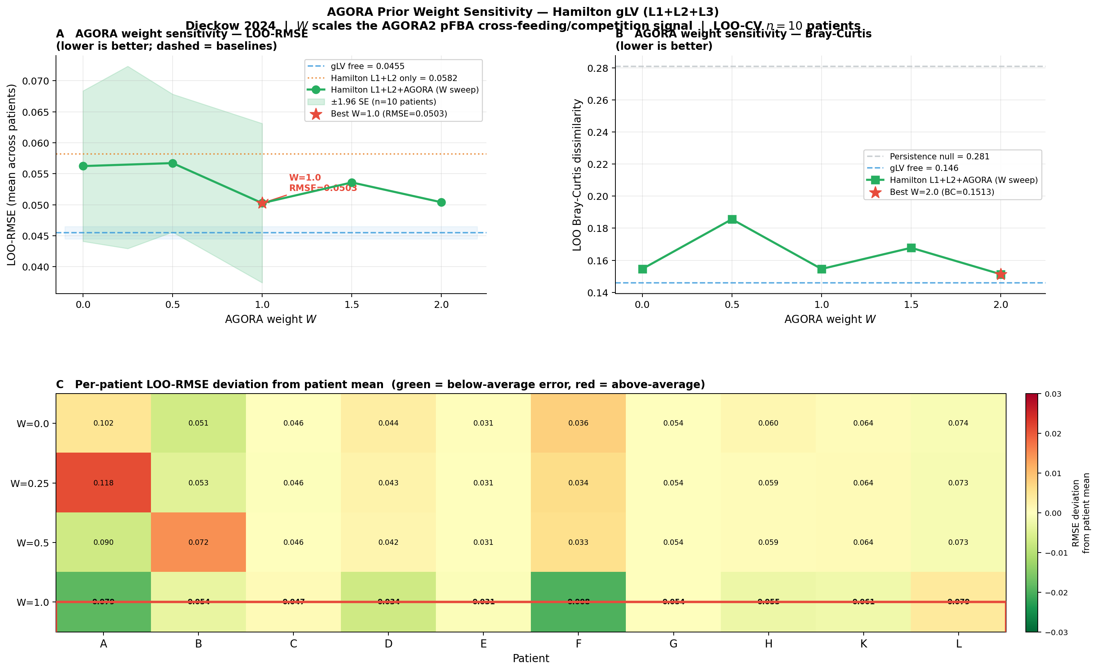
AGORA Weight Sensitivity (W = 0–2.0)
Phase transition to 100% sign agreement at W = 1.0
W=1.0 optimal: LOO-RMSE = 0.0504 (min), SA jumps 94%→100%. Panel A: U-shaped RMSE vs W. Panel B: Bray-Curtis (min 0.147 at W=2.0, W=1.0 near-optimal 0.1468). Panel C: per-patient heatmap — Patients A and F most sensitive.

Slide 38
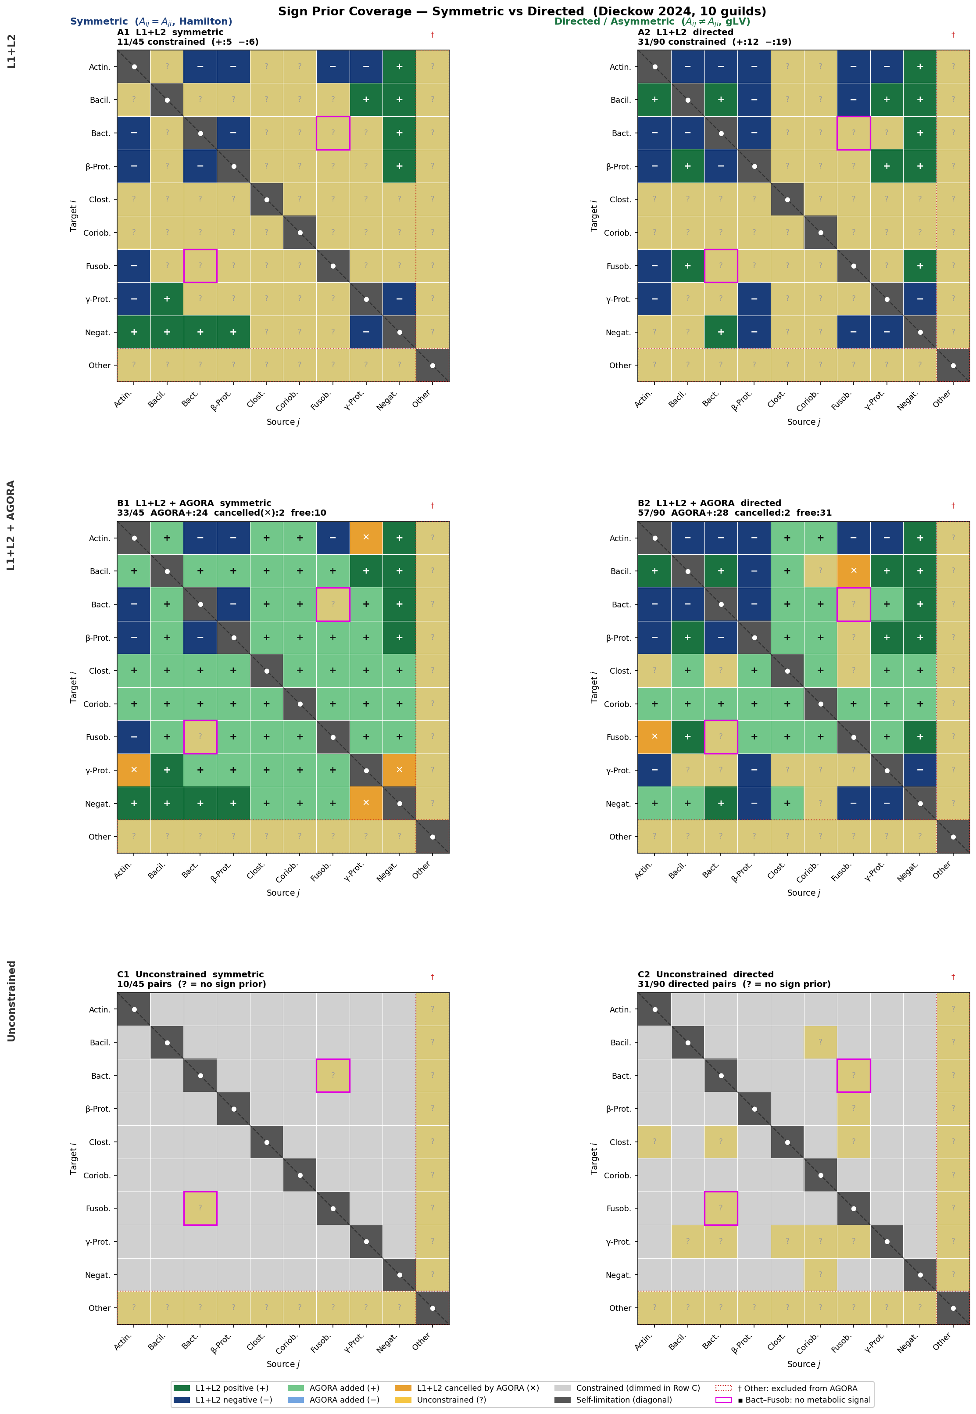
Sign Prior Coverage — Layer-by-Layer (AGORA v1)
3×2: rows = L1+L2 / L1+L2+AGORA v1 / Unconstrained · cols = Symmetric (Hamilton) / Directed (gLV)
v1 ORAL_MEDIUM (blood-plasma scale): all 24 AGORA-added pairs positive — no competition signal. L1+L2: 11/45 sym constrained. L1+L2+AGORA v1: 33/45 sym. Amber ✕ = 2 pairs where AGORA cancelled L1+L2 signal (Actin–γ-Prot, γ-Prot–Negat).

Slide 39
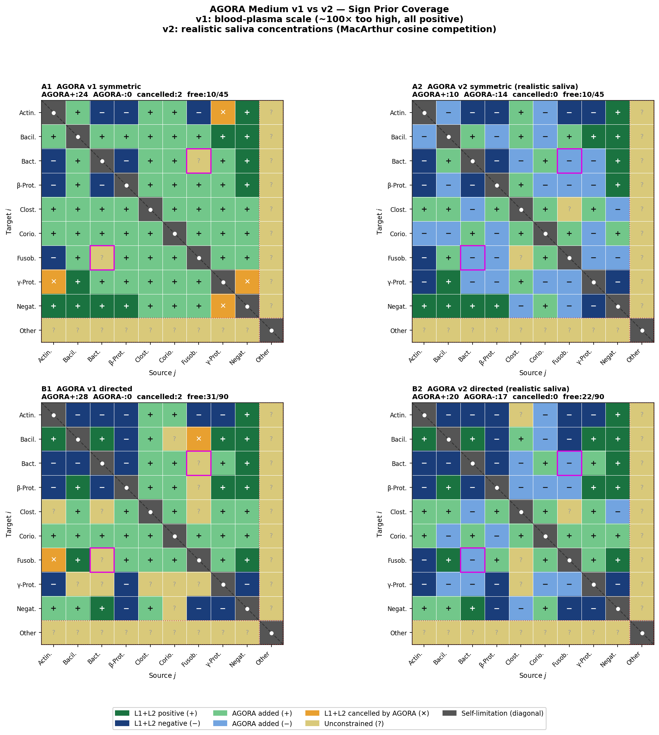
AGORA v1 vs v2 — Realistic Saliva Medium
v1: blood-plasma scale (~100× too high) · v2: Dawes 2008 saliva + MacArthur cosine competition
Root cause of v1 all-positive:
Glucose v1: 10.0 mmol/gDW/h (saliva: ~0.10)
Amino acids v1: 0.5–2.0 → v2: 0.02–0.10
Surplus nutrients → cross-feeding dominates
→ 24 AGORA-added pairs, all positive
v2 fix:
Realistic saliva concentrations (Dawes 2008)
MacArthur cosine niche overlap for competition
α_ij = (c_i·c_j)/(|c_i||c_j|)
v1 v2
μ (Bacilli) 1659/h 35/h ✓
AGORA+ 24 10
AGORA− 0 14 ← emerges
Constrained 33/45 35/45
Directed 57/90 68/90
Bact–Fusob free negative

Slide 40
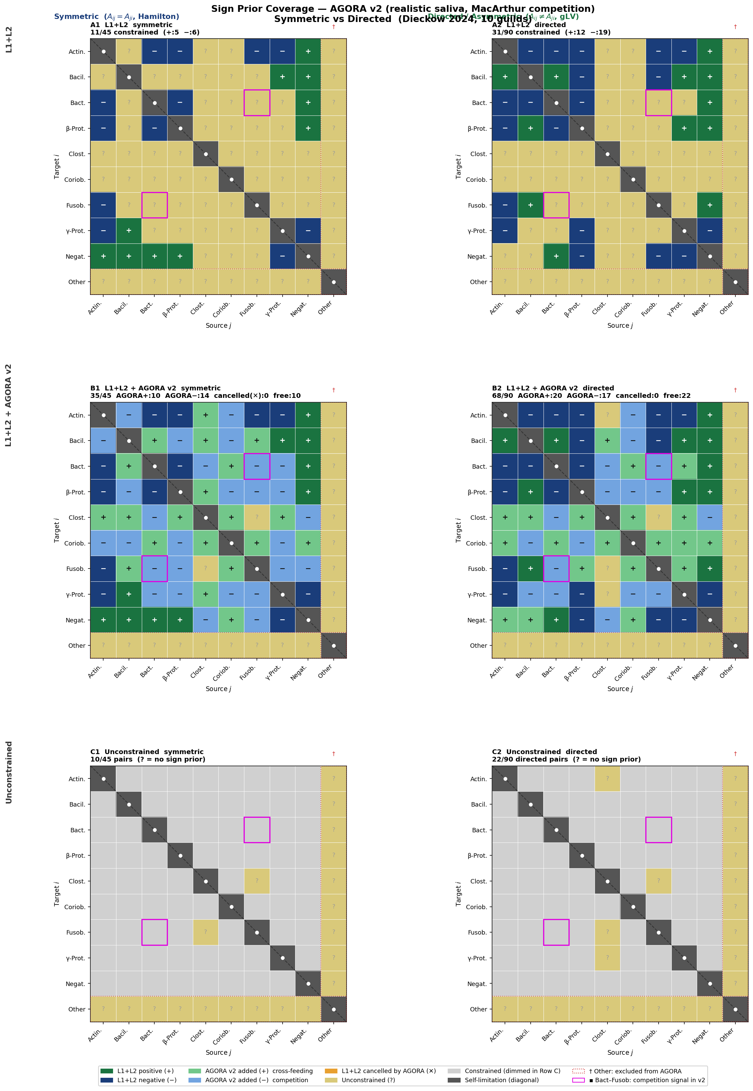
Sign Prior Coverage — AGORA v2 (Realistic Saliva)
Competition signals emerge from MacArthur niche overlap · 35/45 sym, 68/90 directed constrained
v2 improvements: AGORA−=14 sym (was 0). Bact–Fusob acquires negative prior (competition). 2 previously cancelled pairs resolved (amber ✕ gone). LOO-CV with v2 prior: planned next step to quantify prediction improvement.

