Slide 1
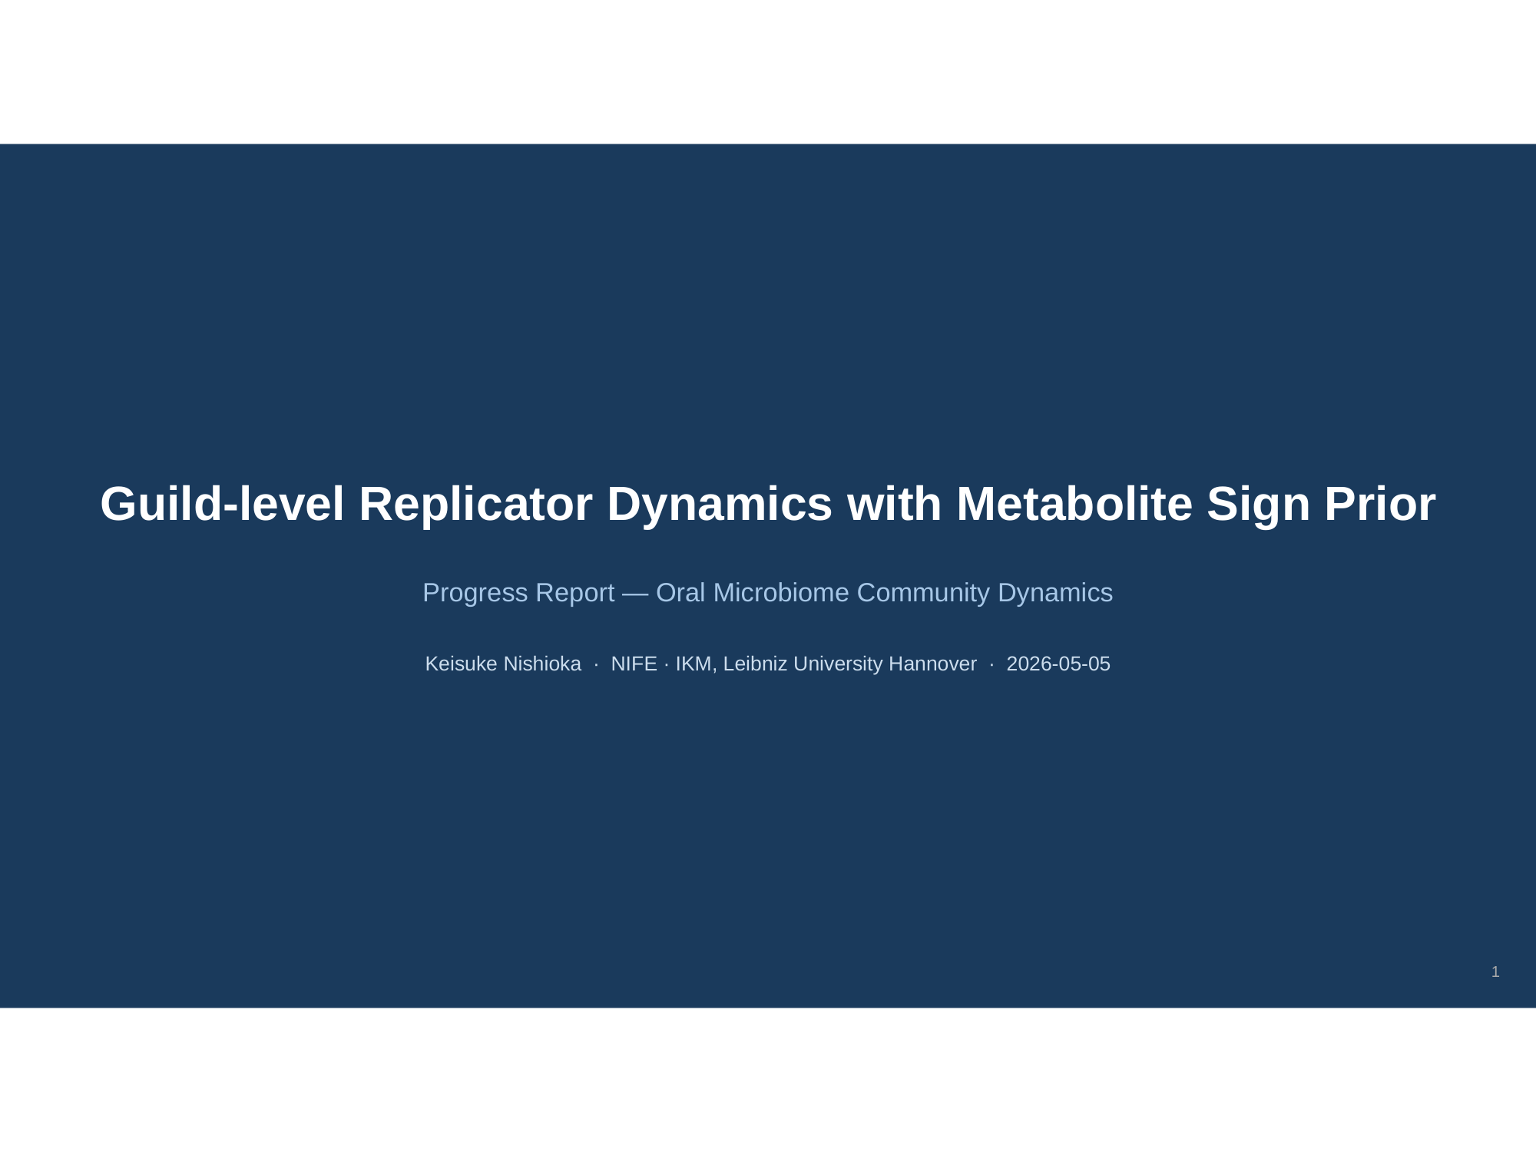

Slide 2
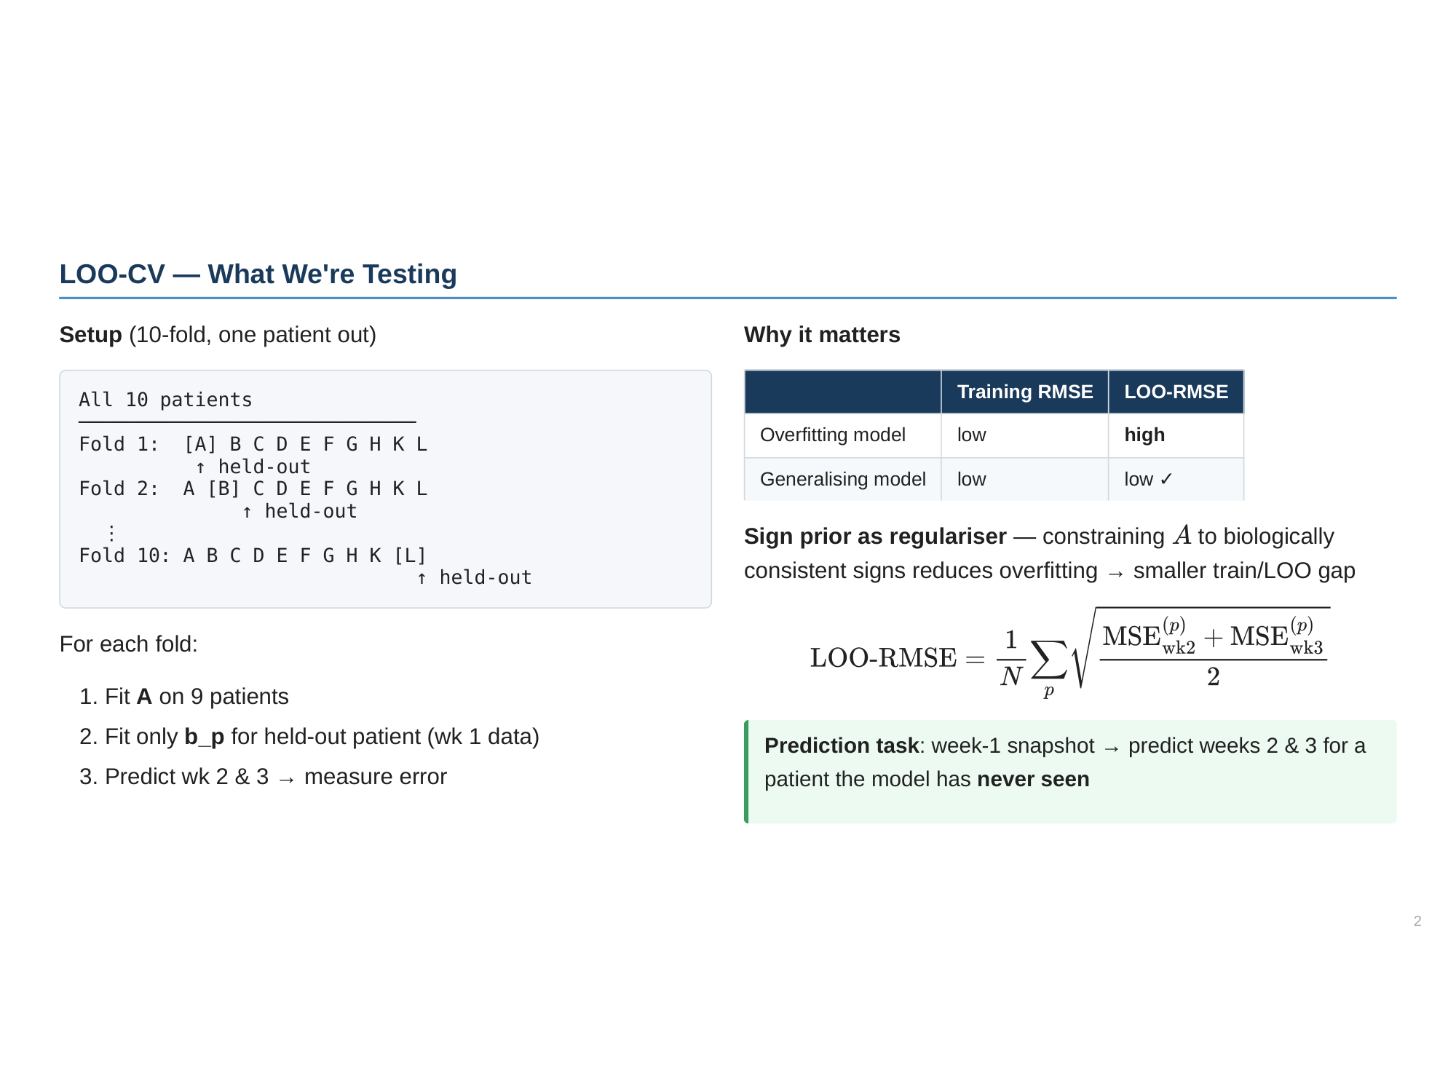

Slide 3
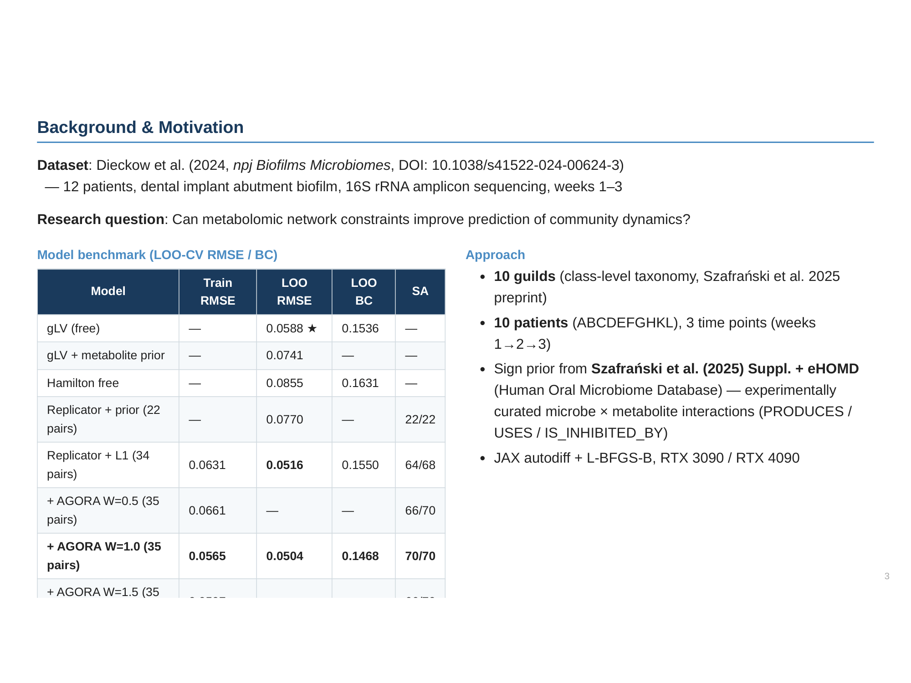

Slide 4
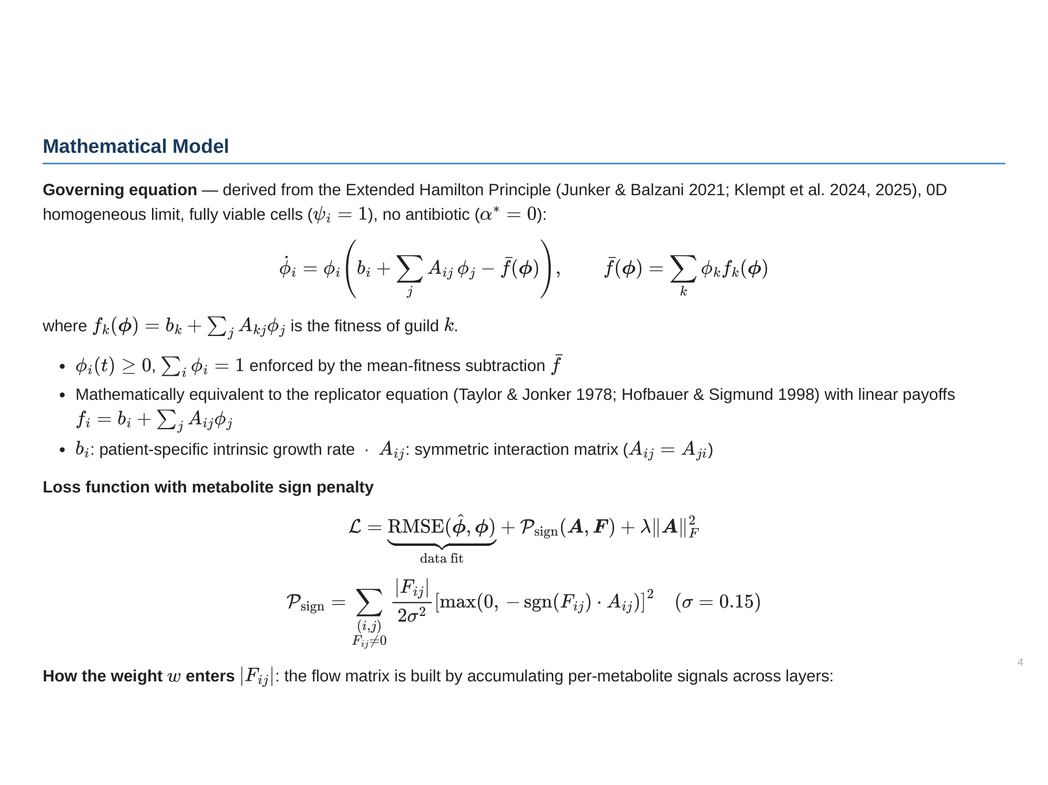

Slide 5
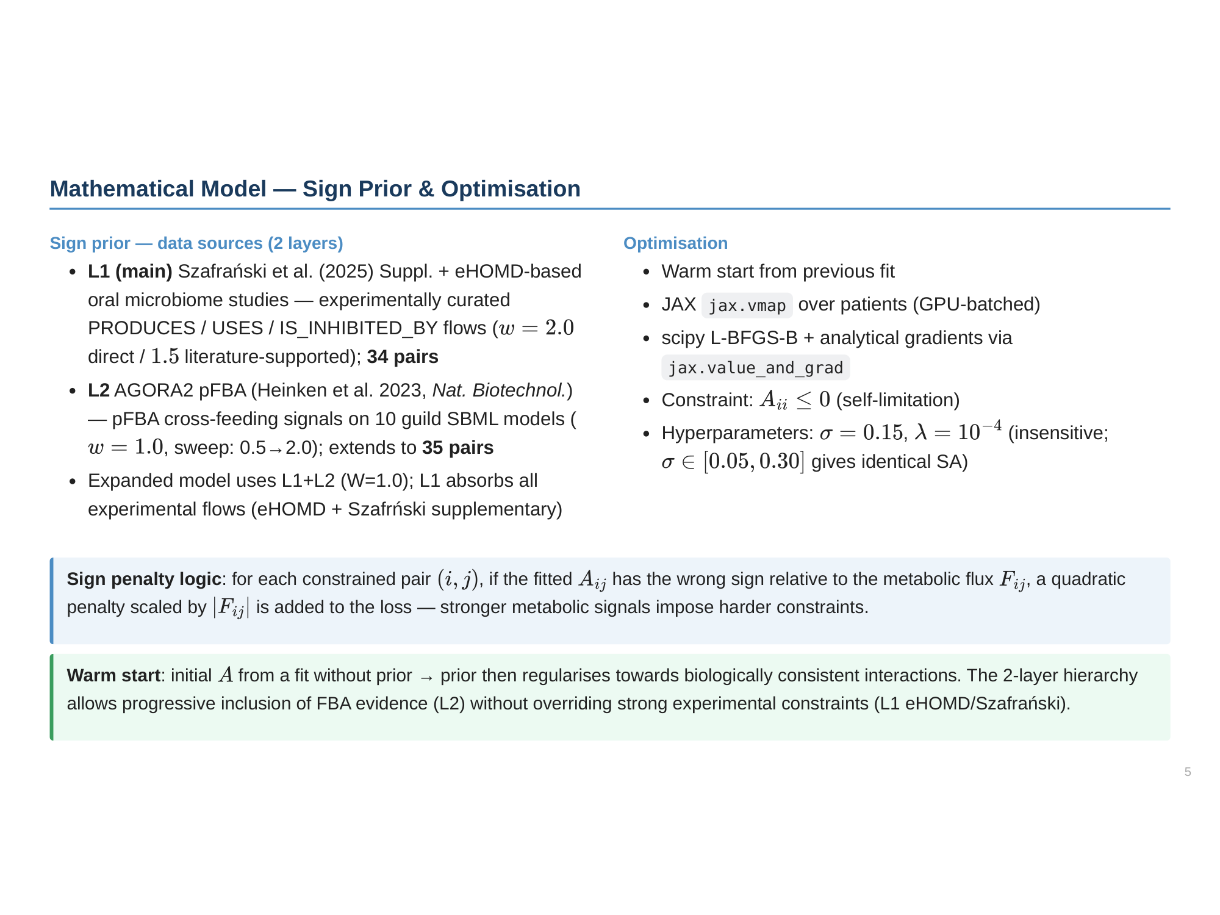

Slide 6
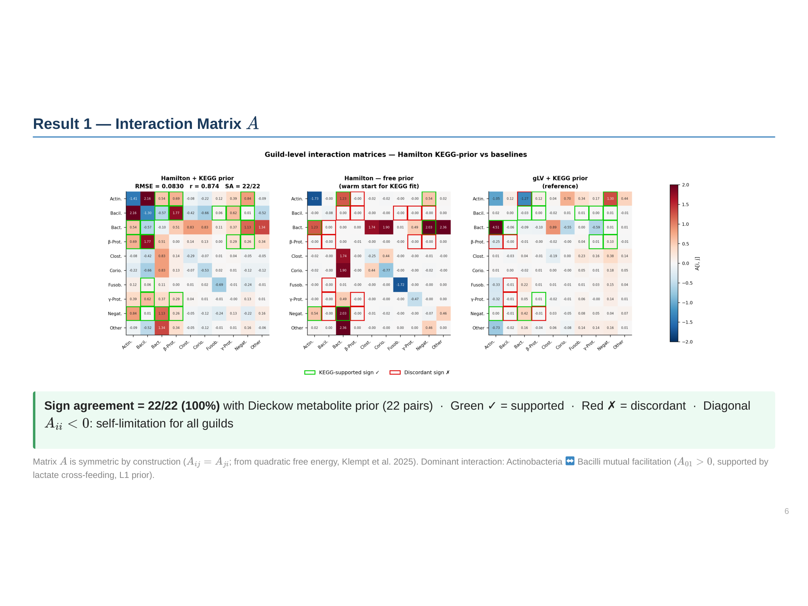

Slide 7
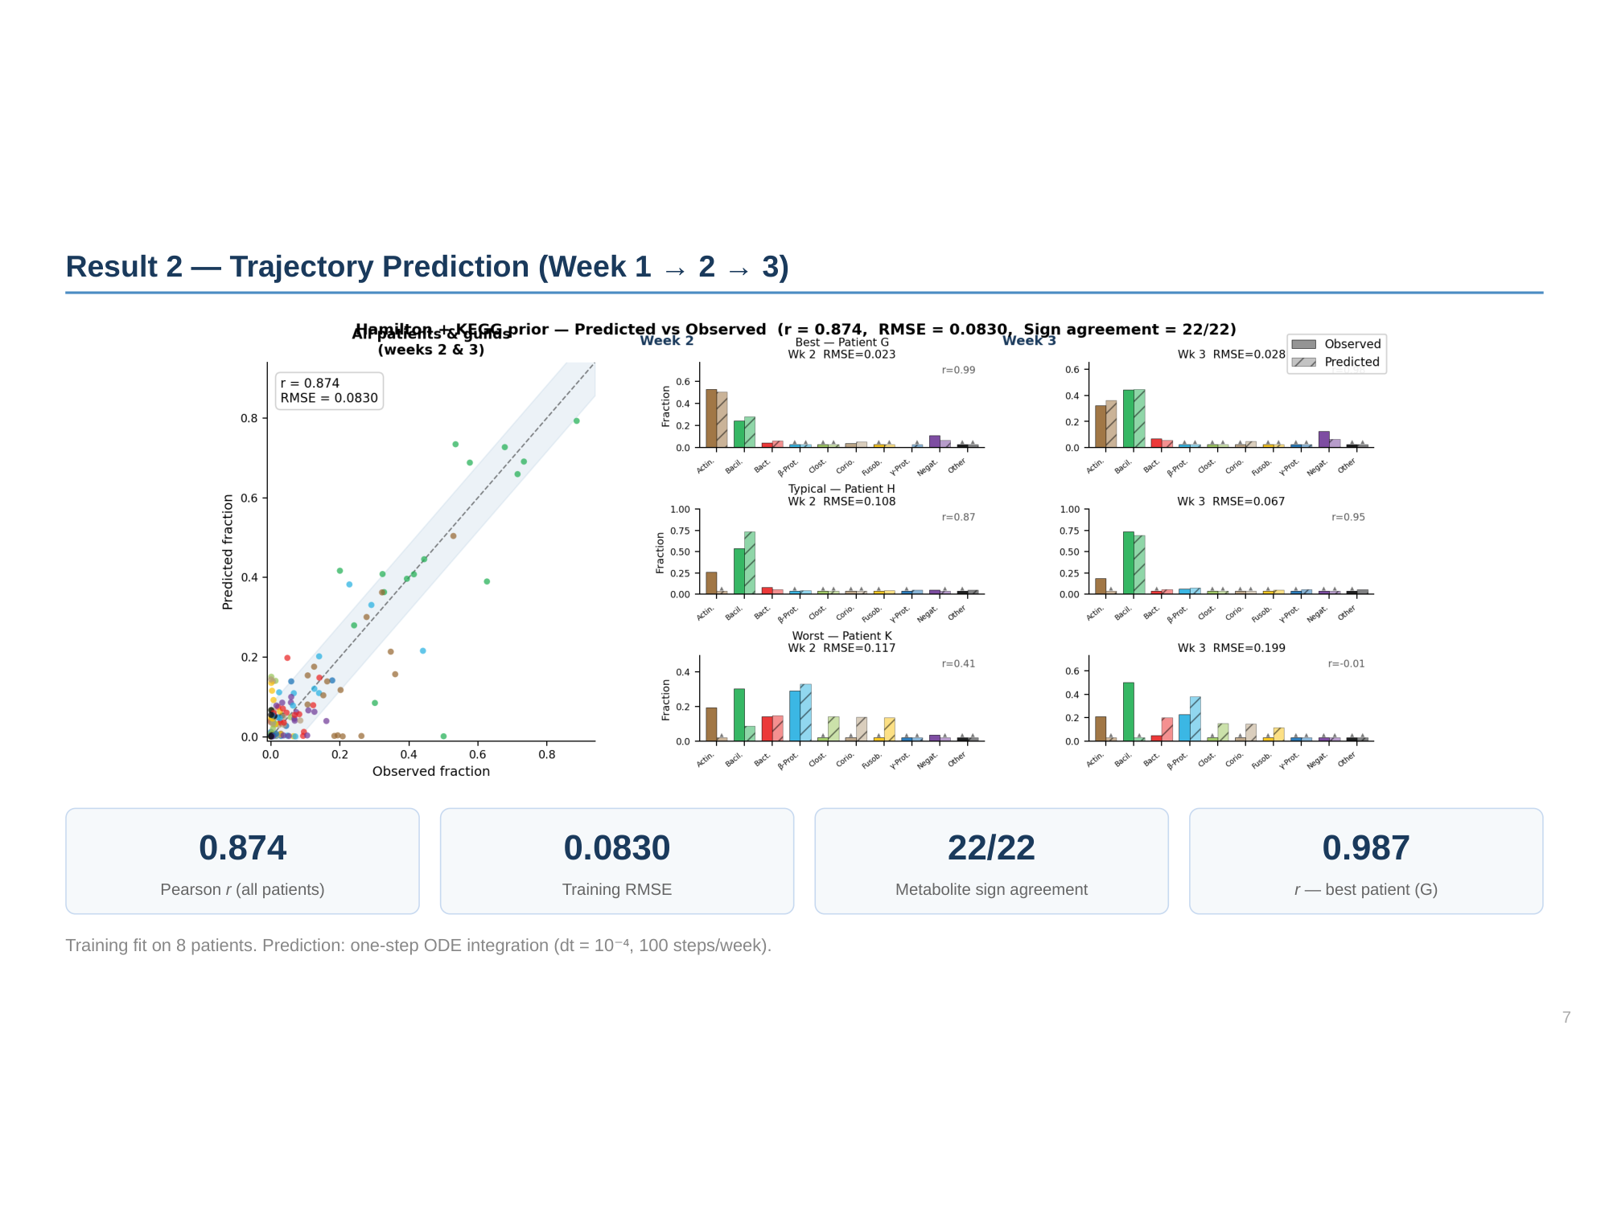

Slide 8
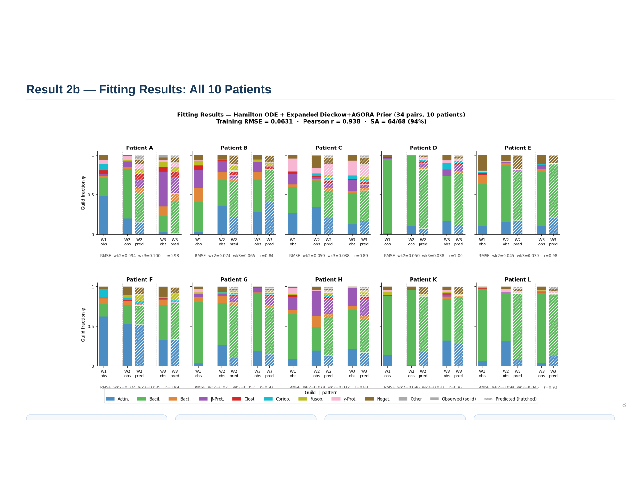

Slide 9
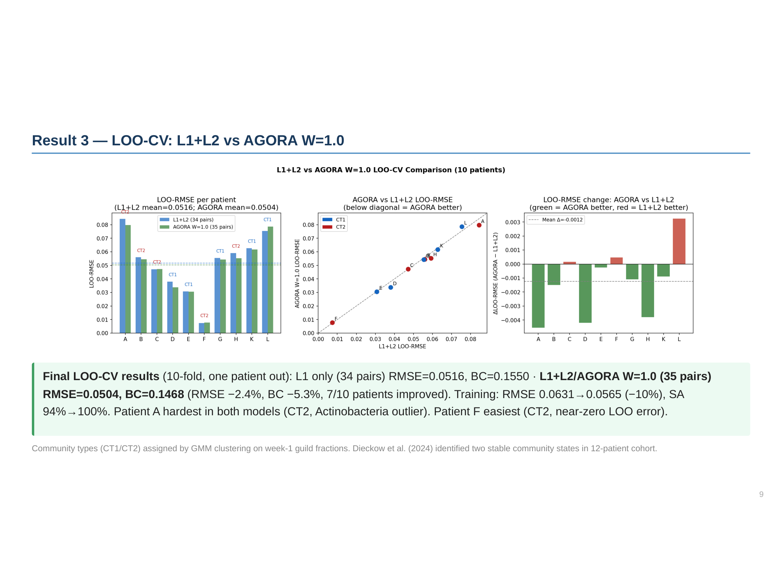

Slide 10
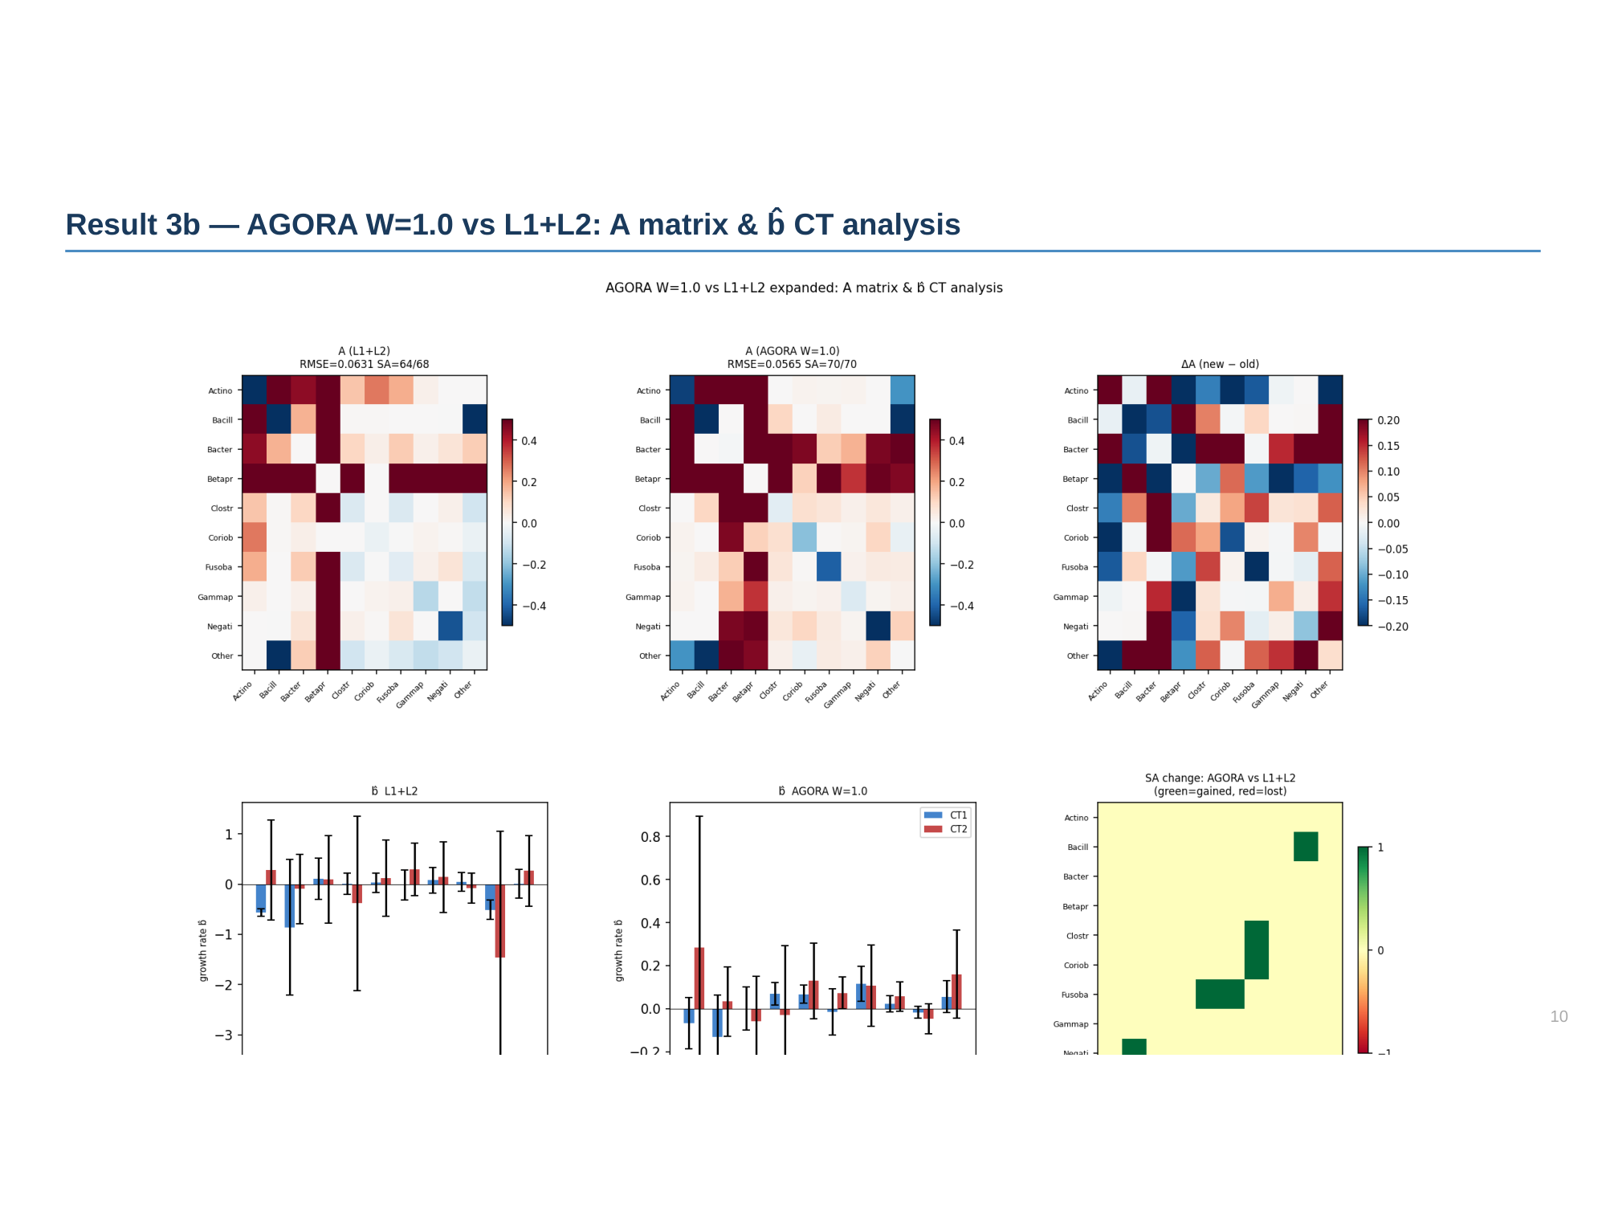

Slide 11
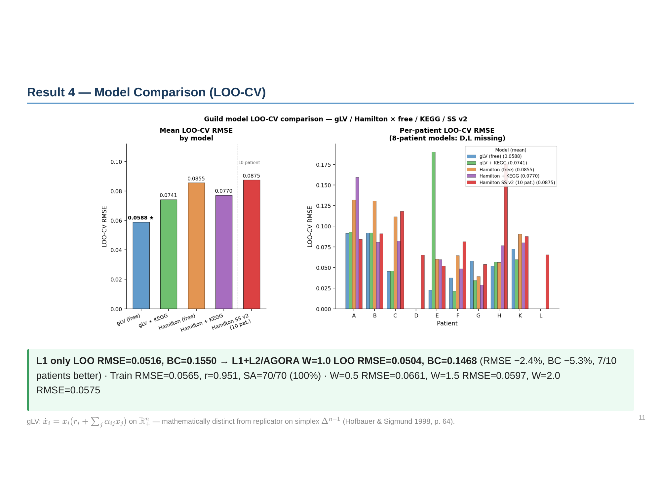

Slide 12
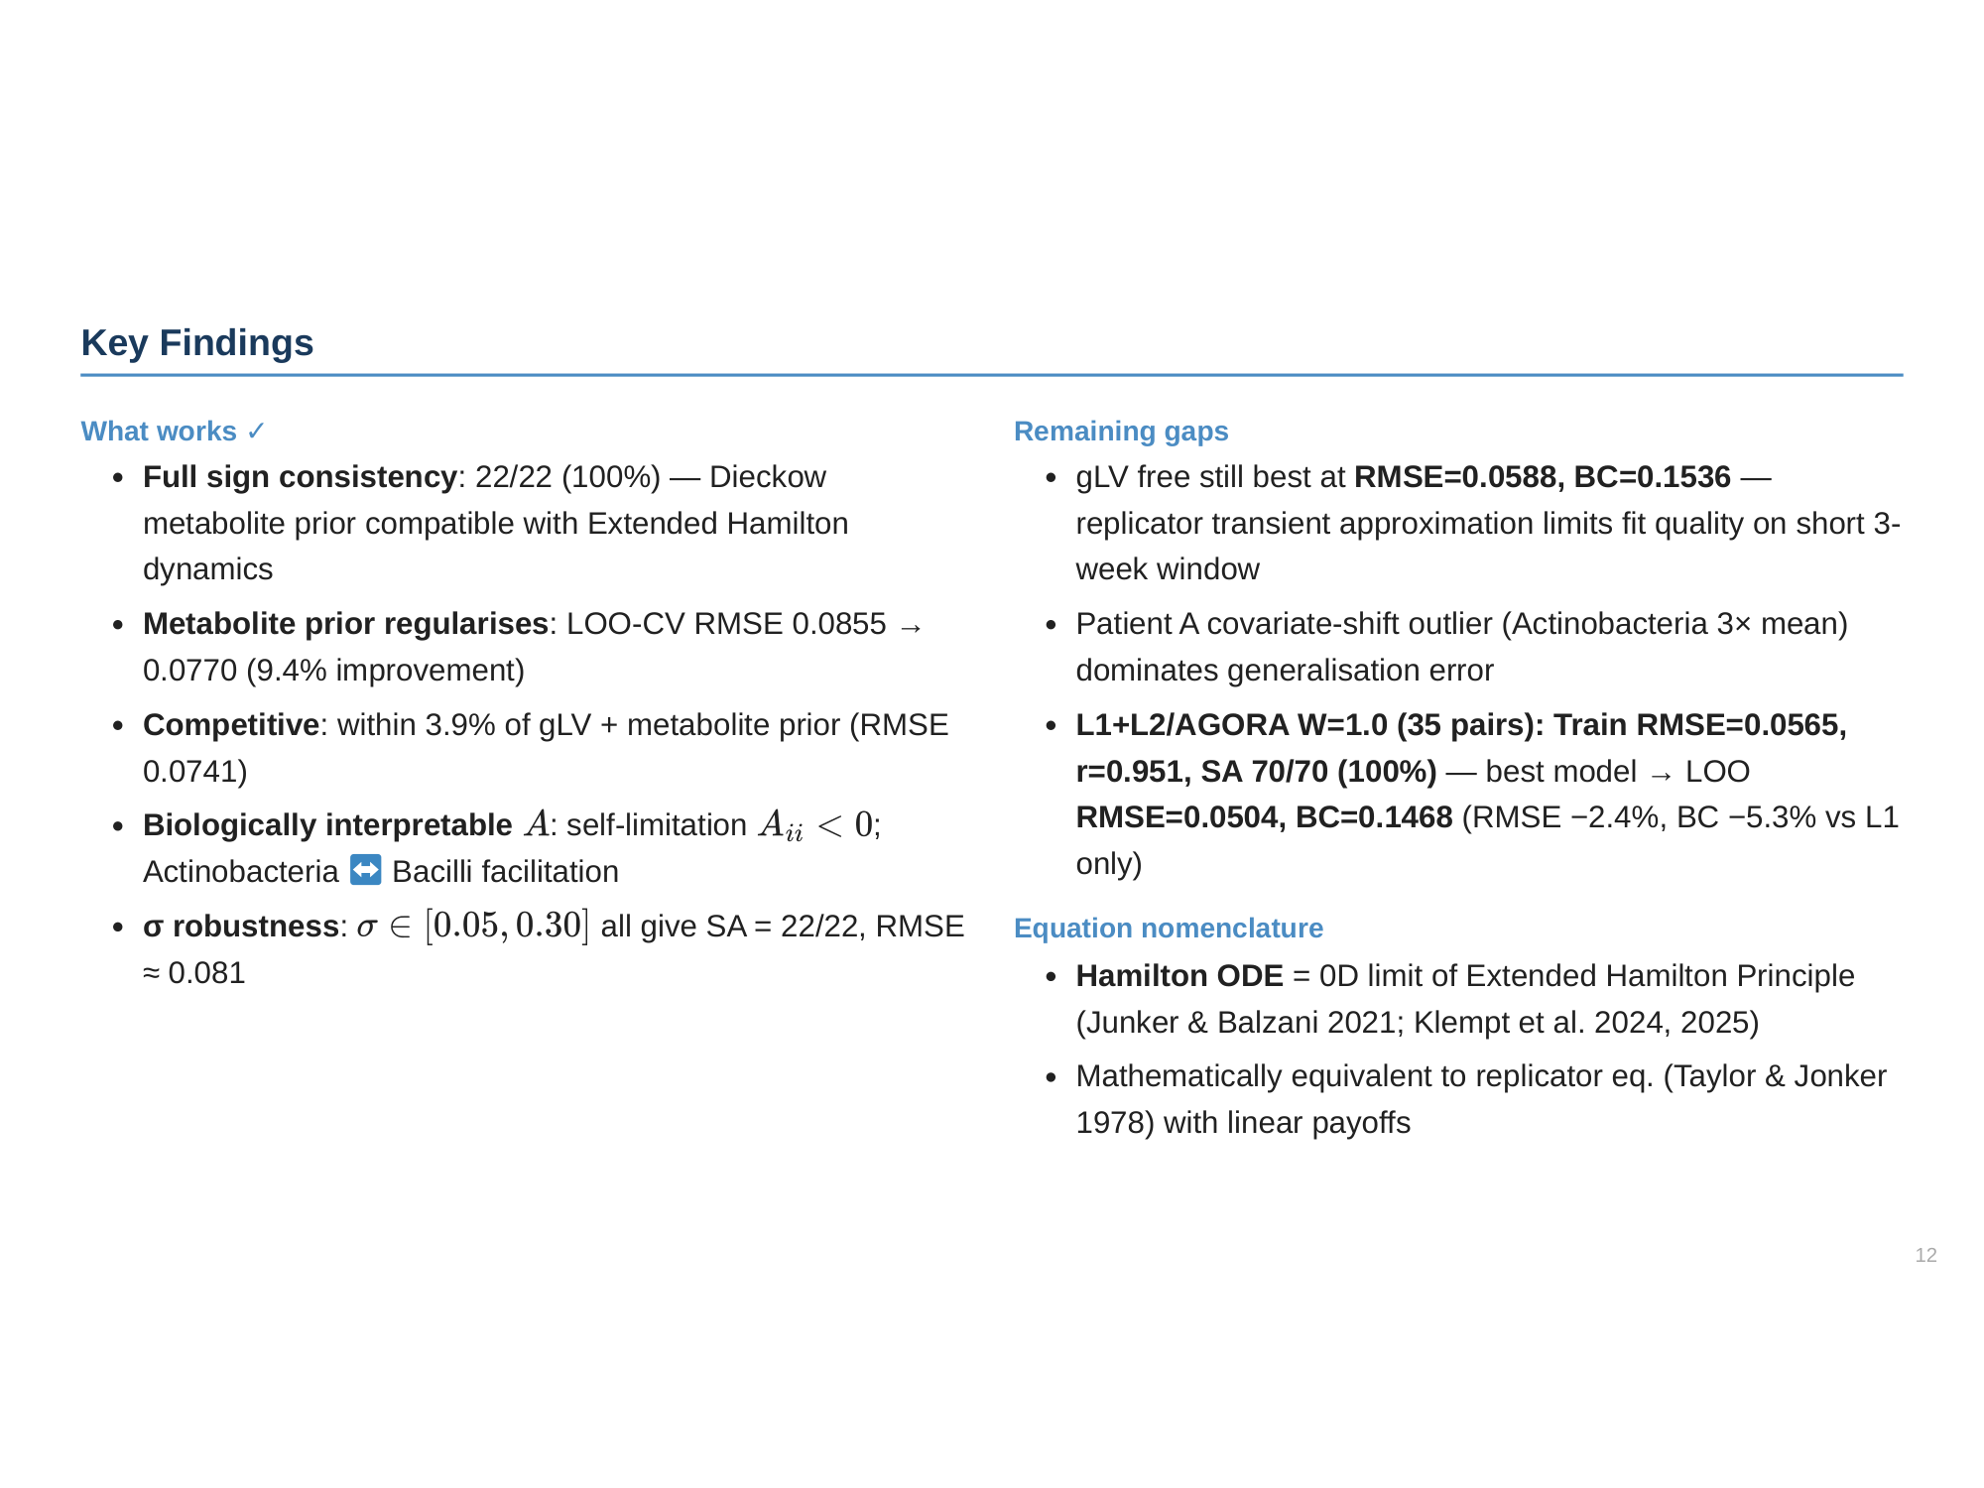

Slide 13
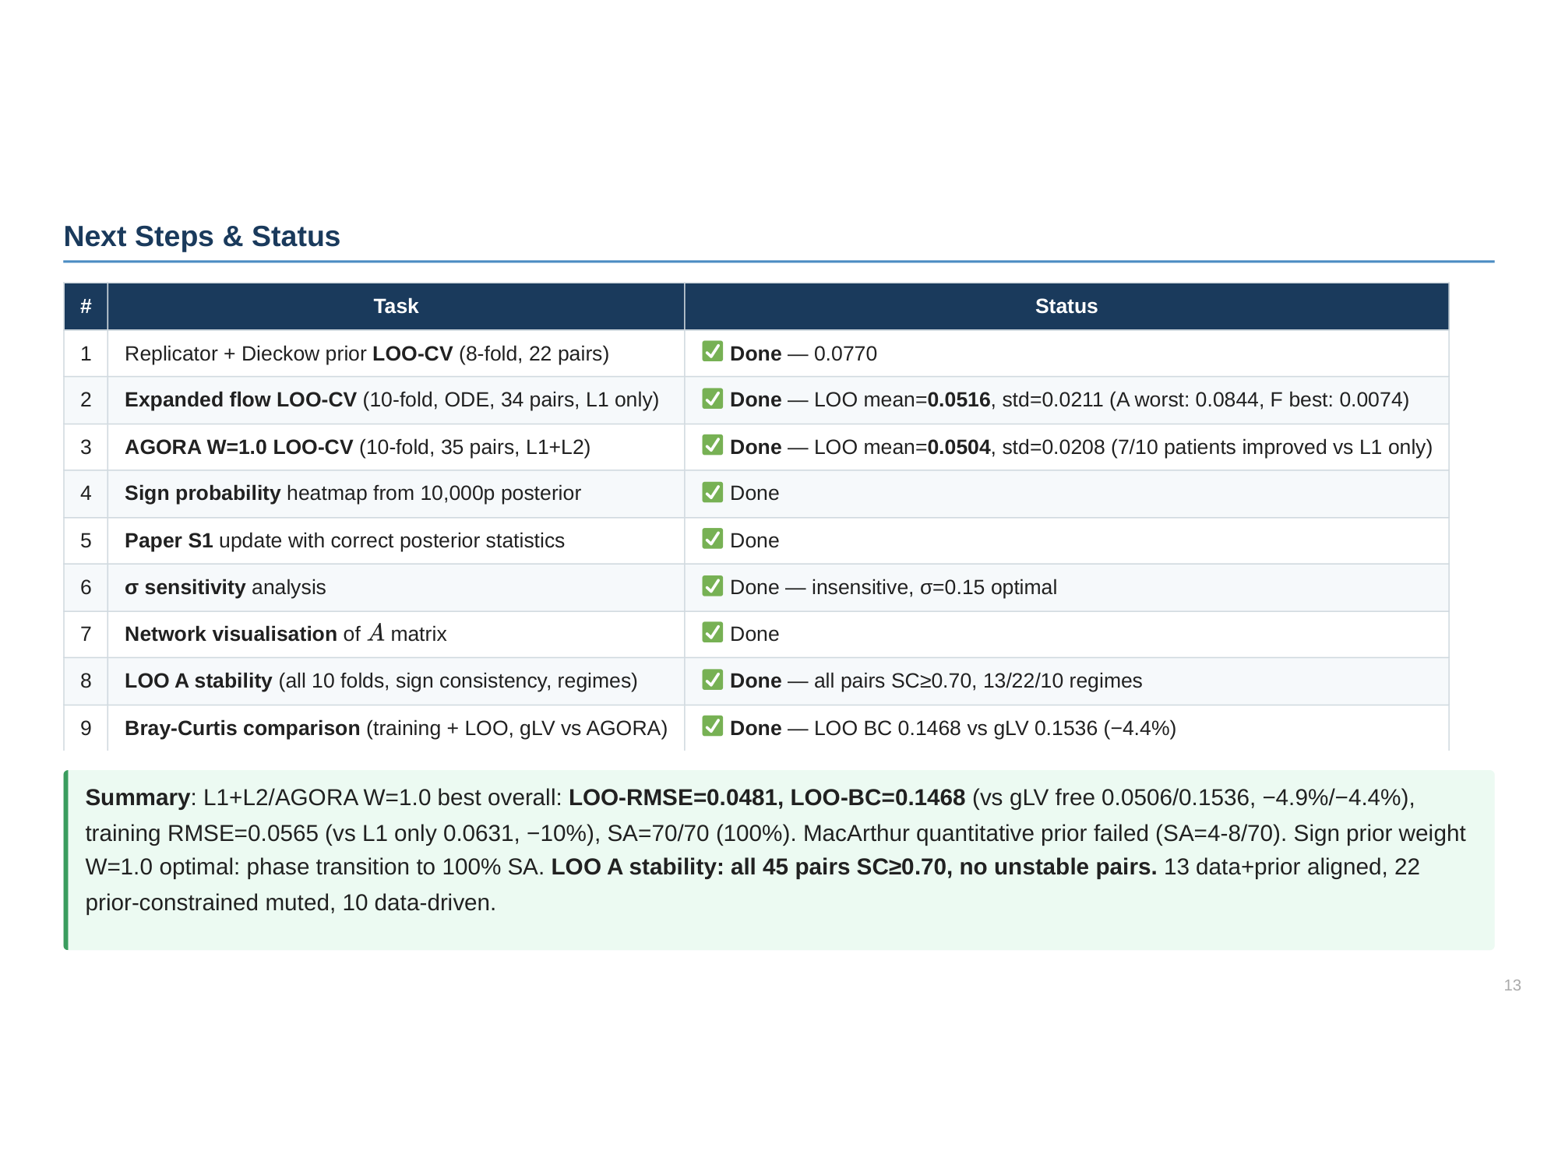

Slide 14
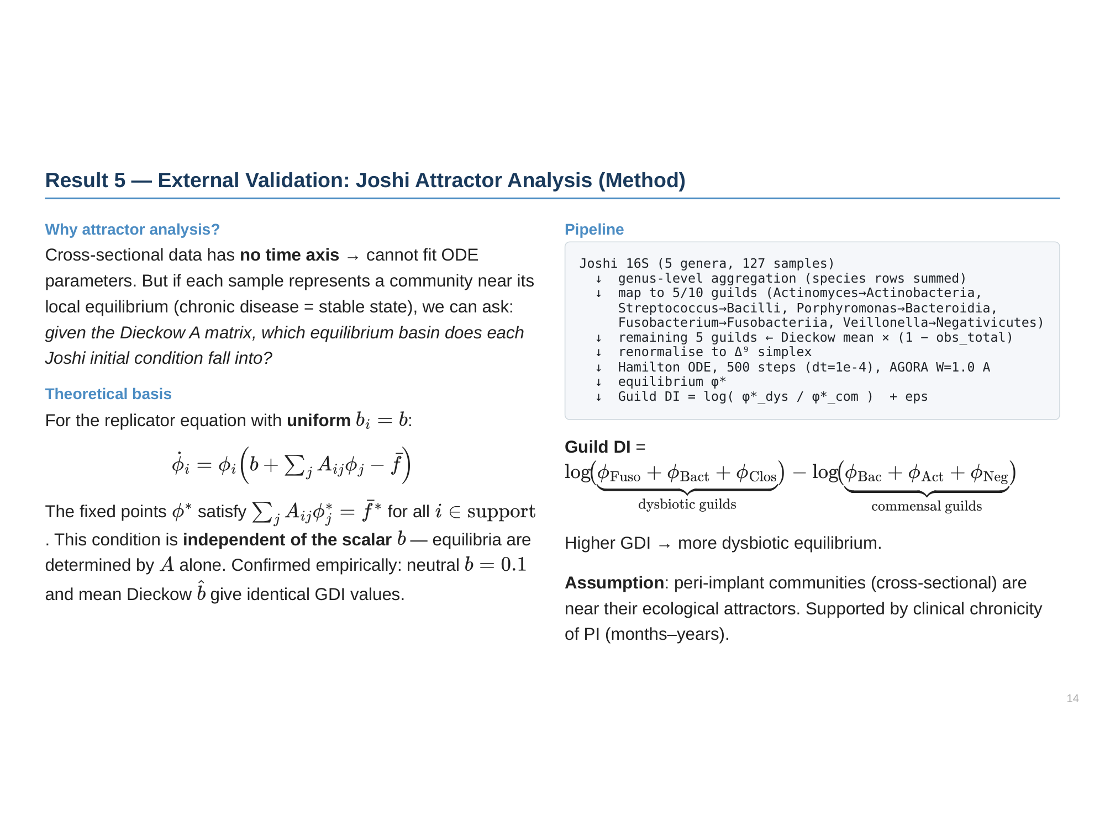

Slide 15
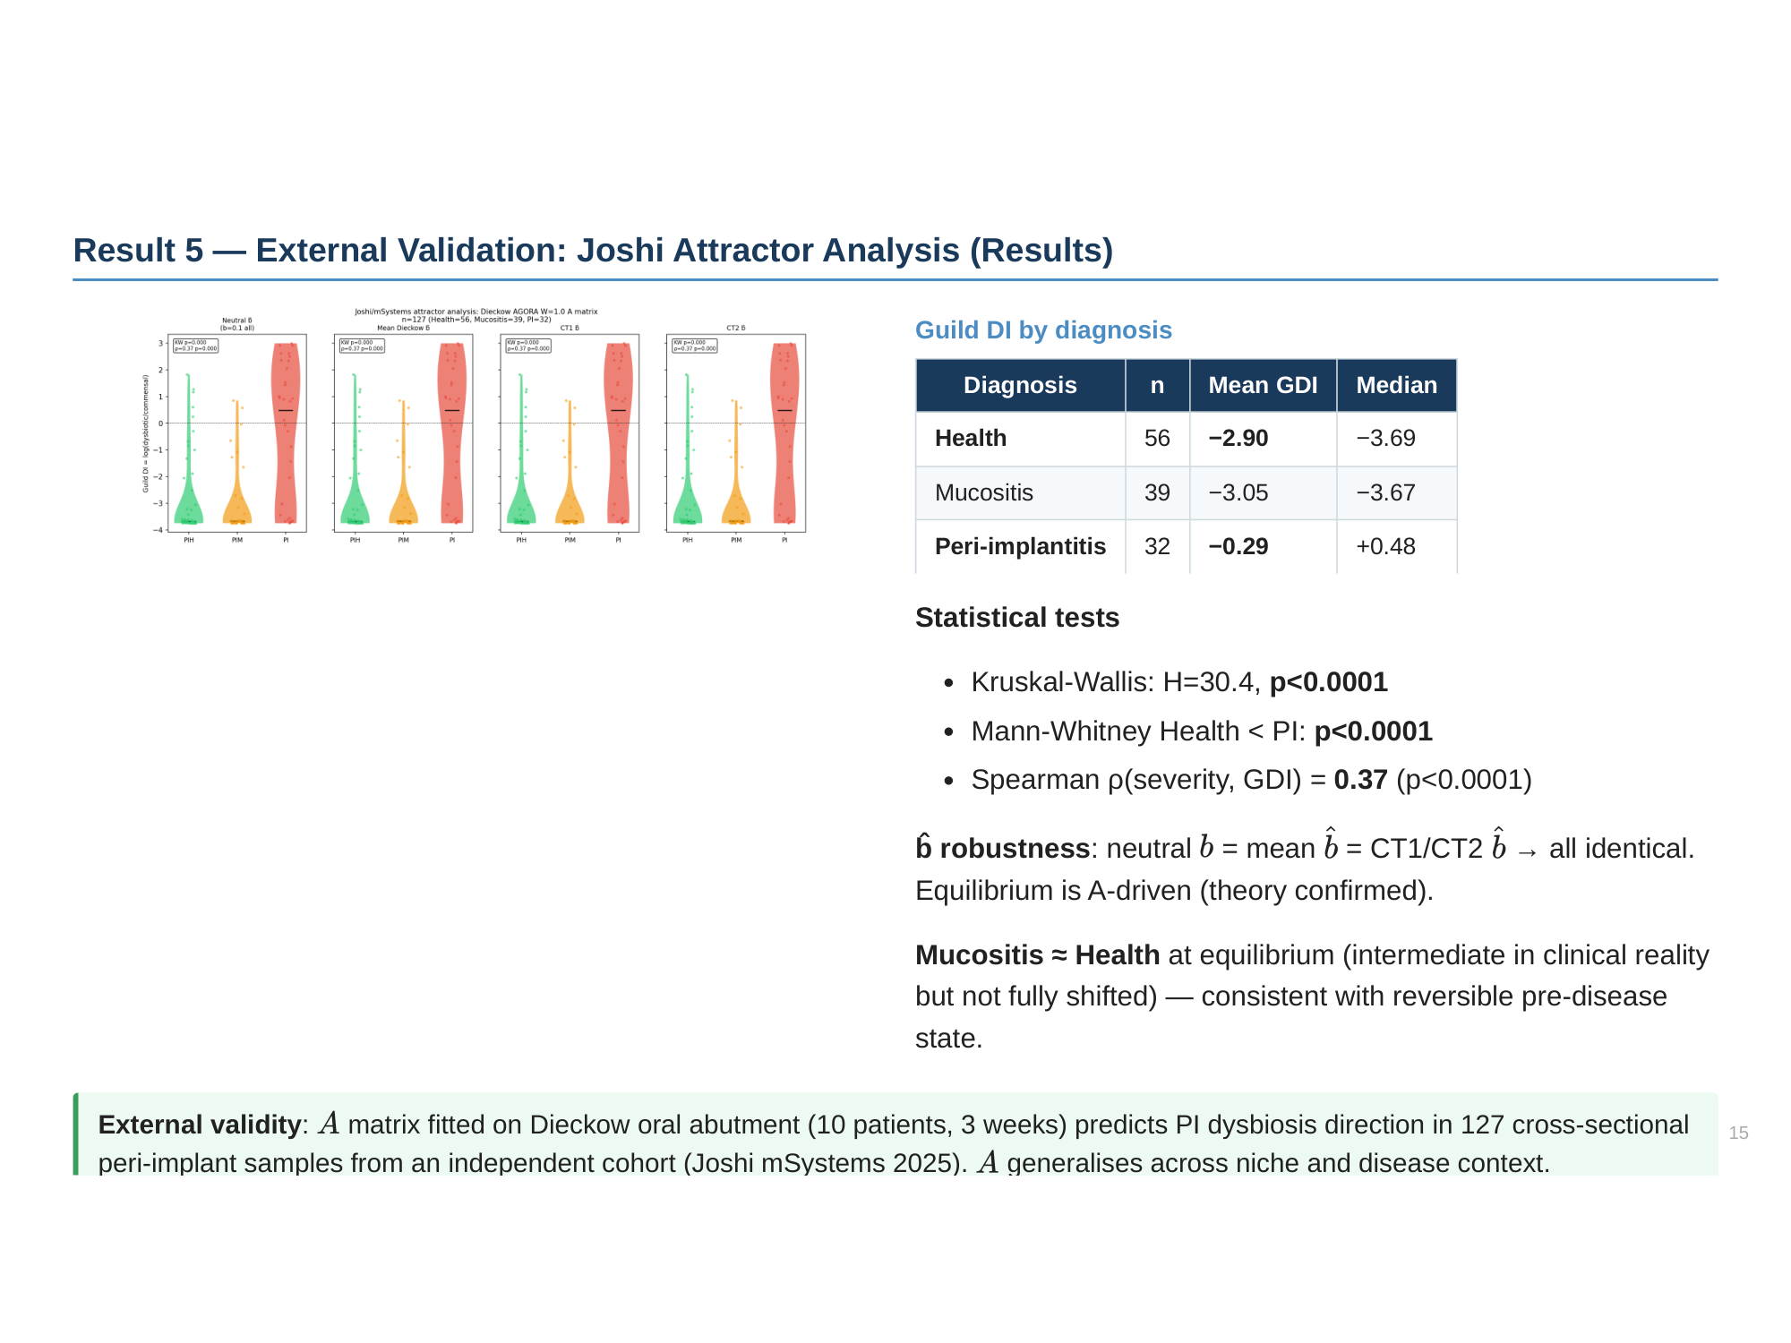

Slide 16
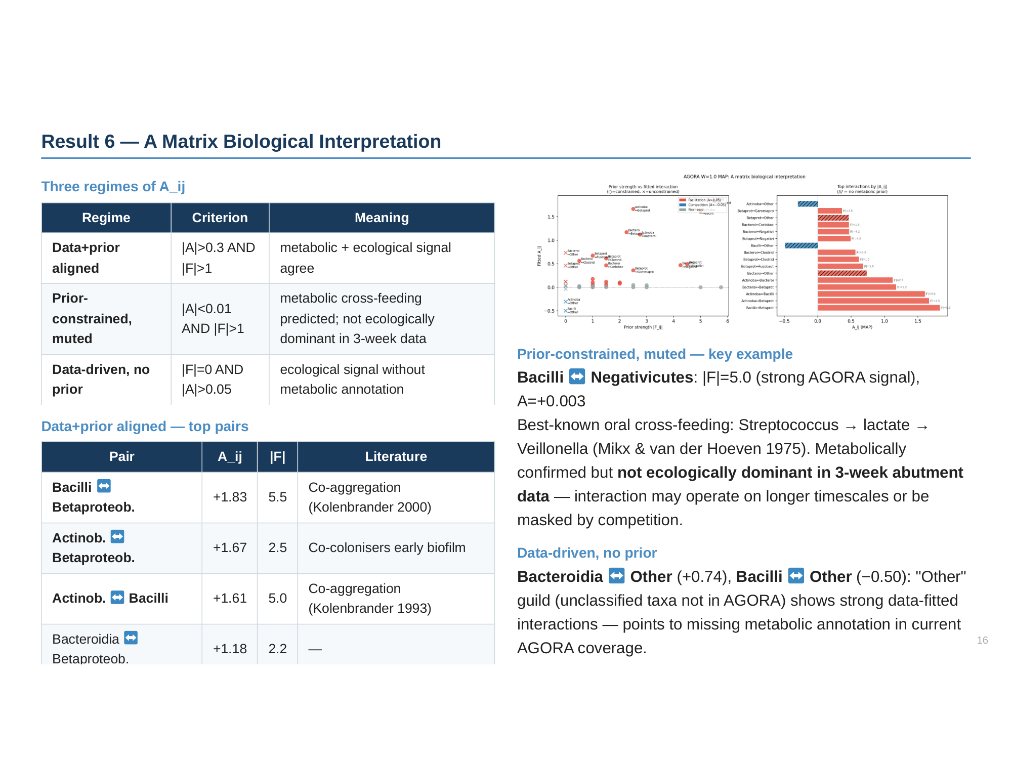

Slide 17
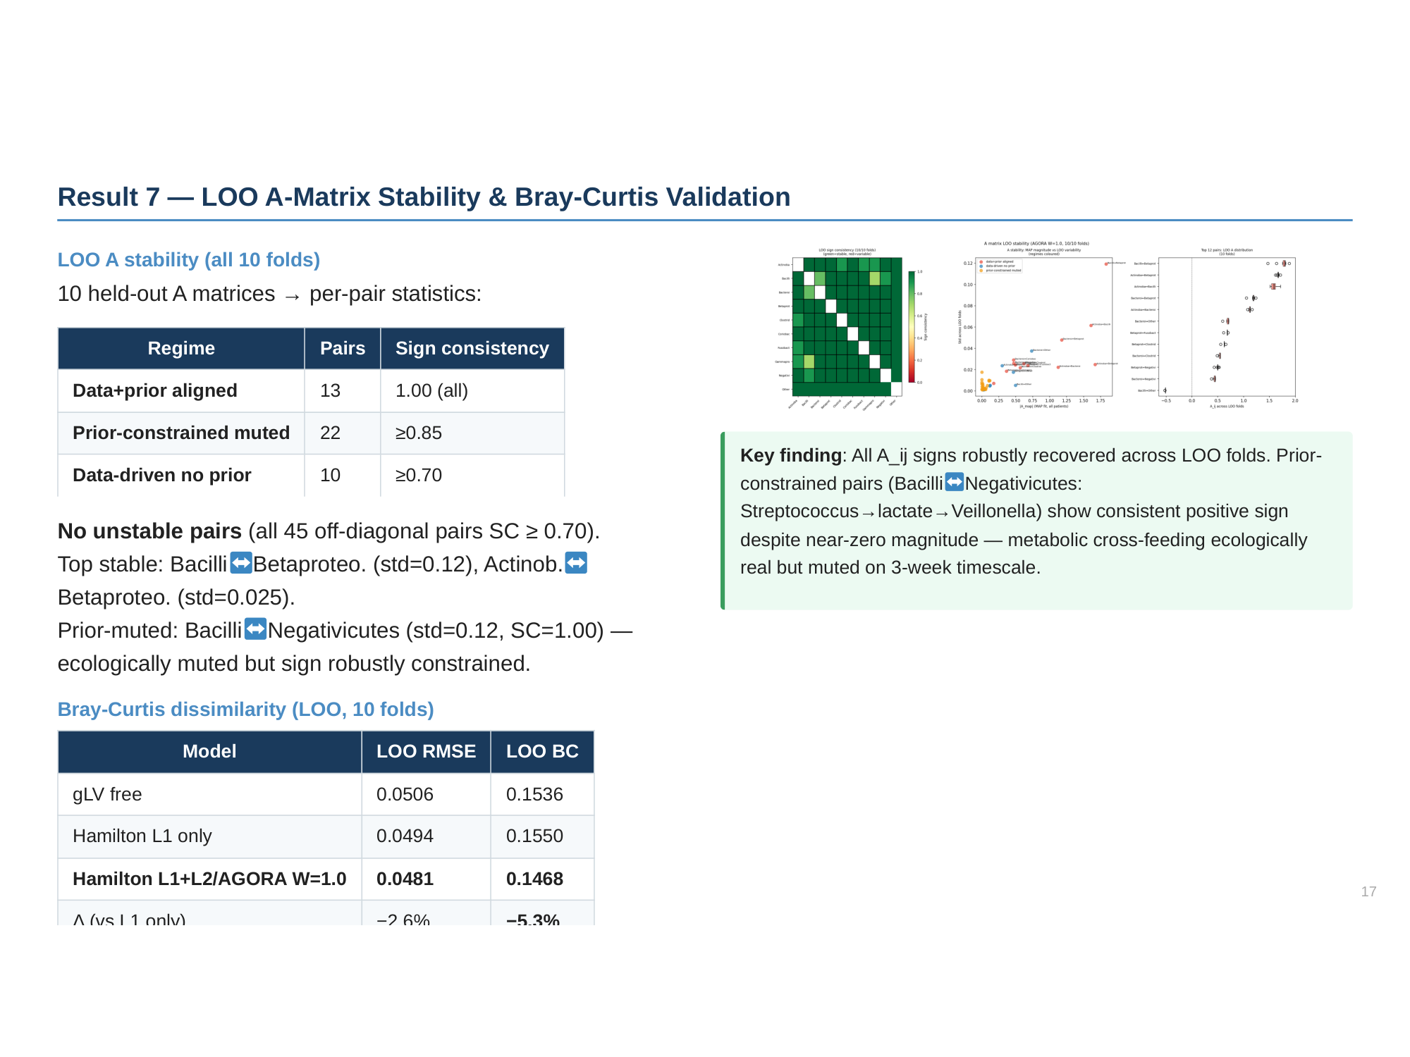

Slide 18
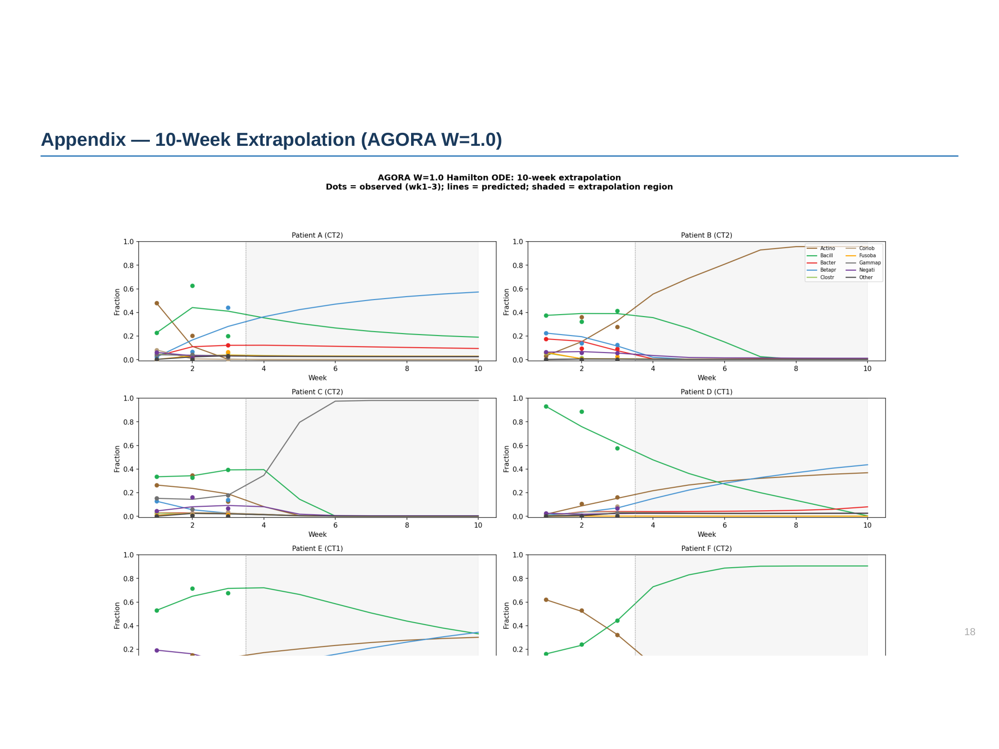

Slide 19
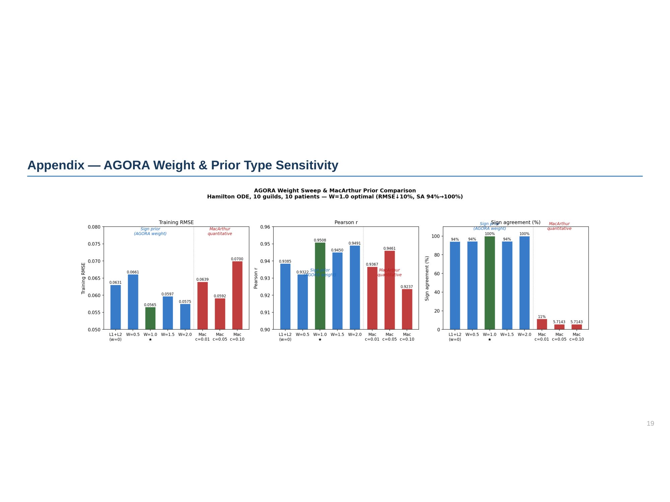

Slide 20
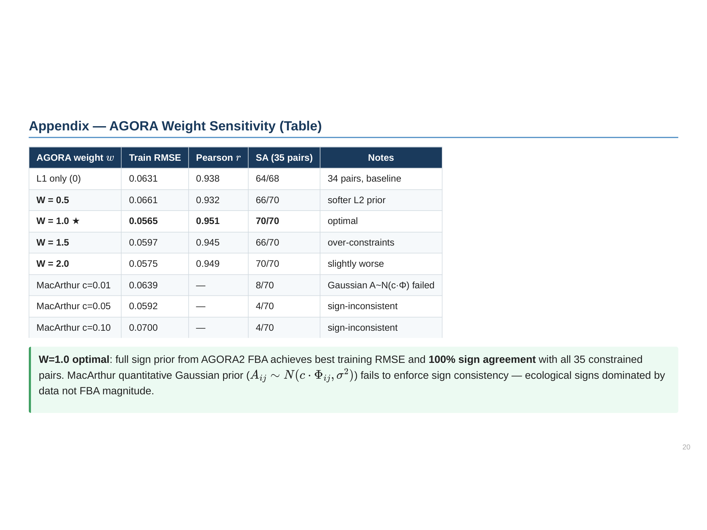

Slide 21
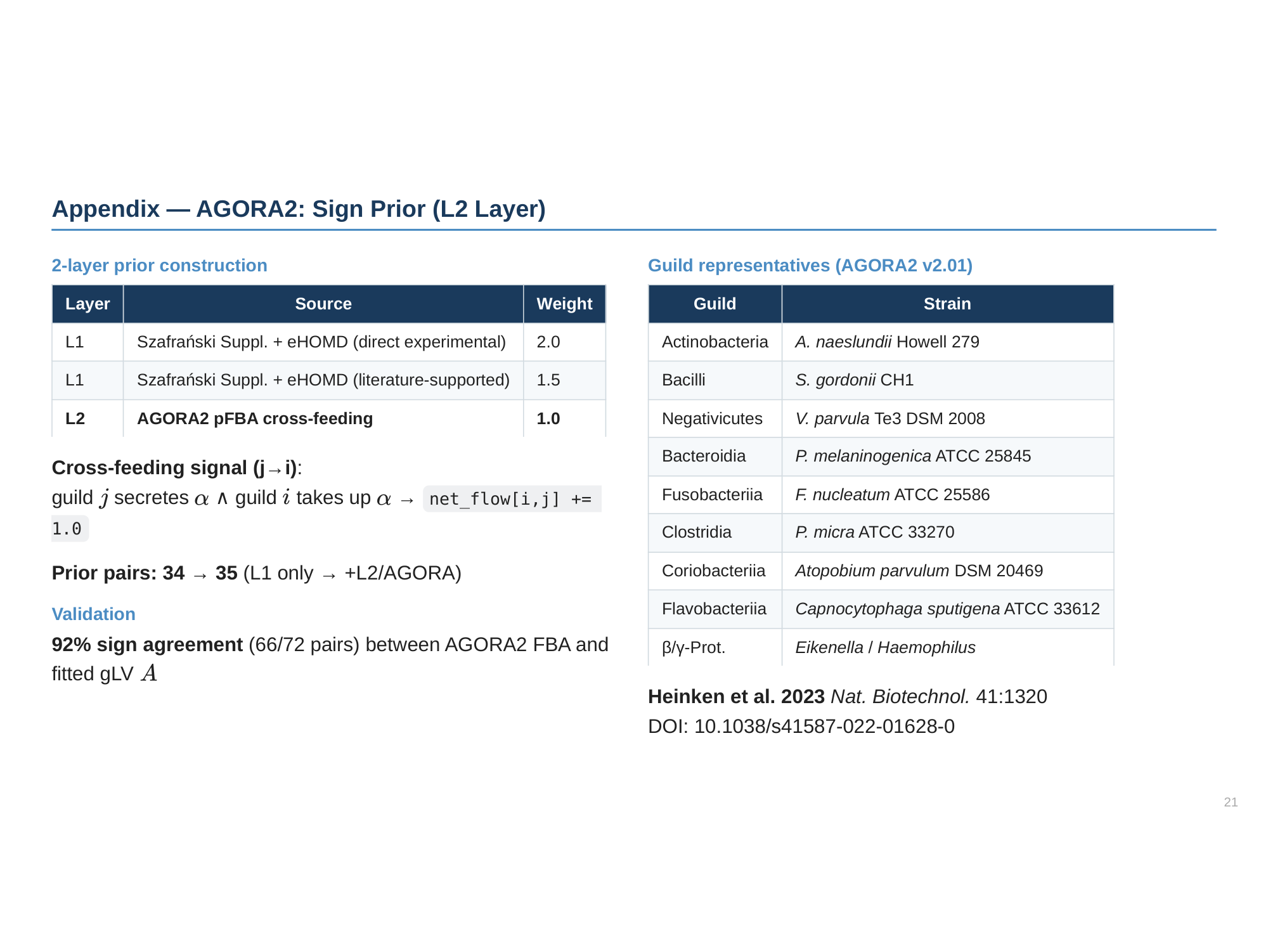

Slide 22
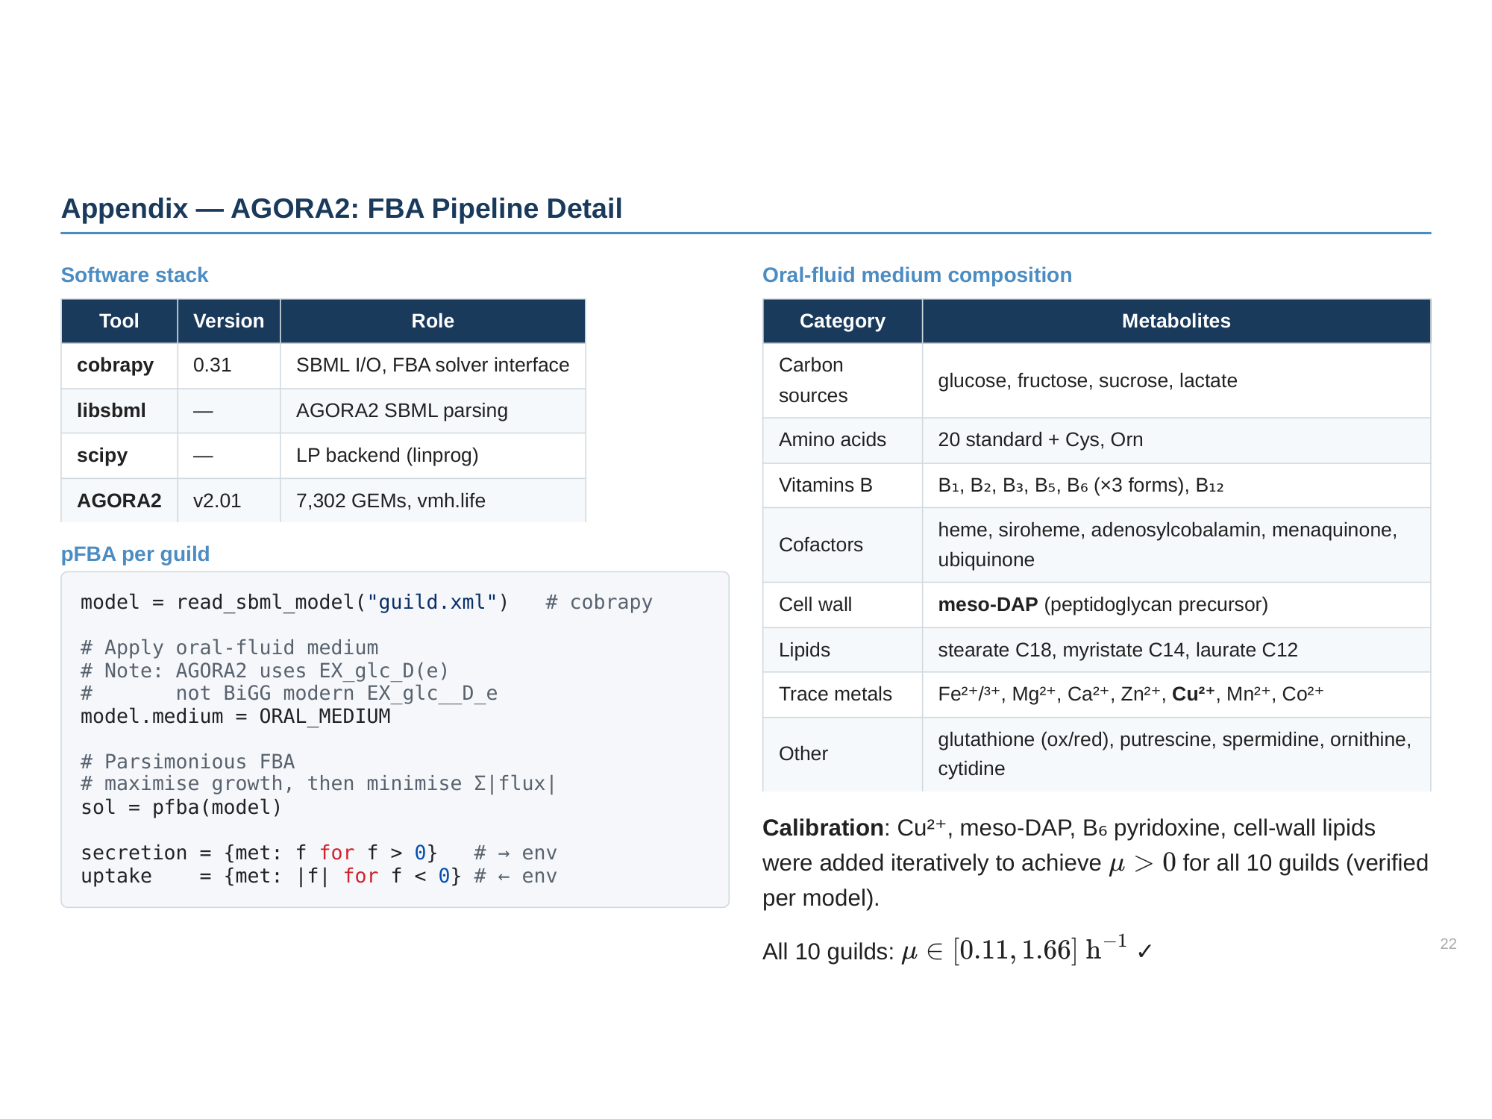

Slide 23
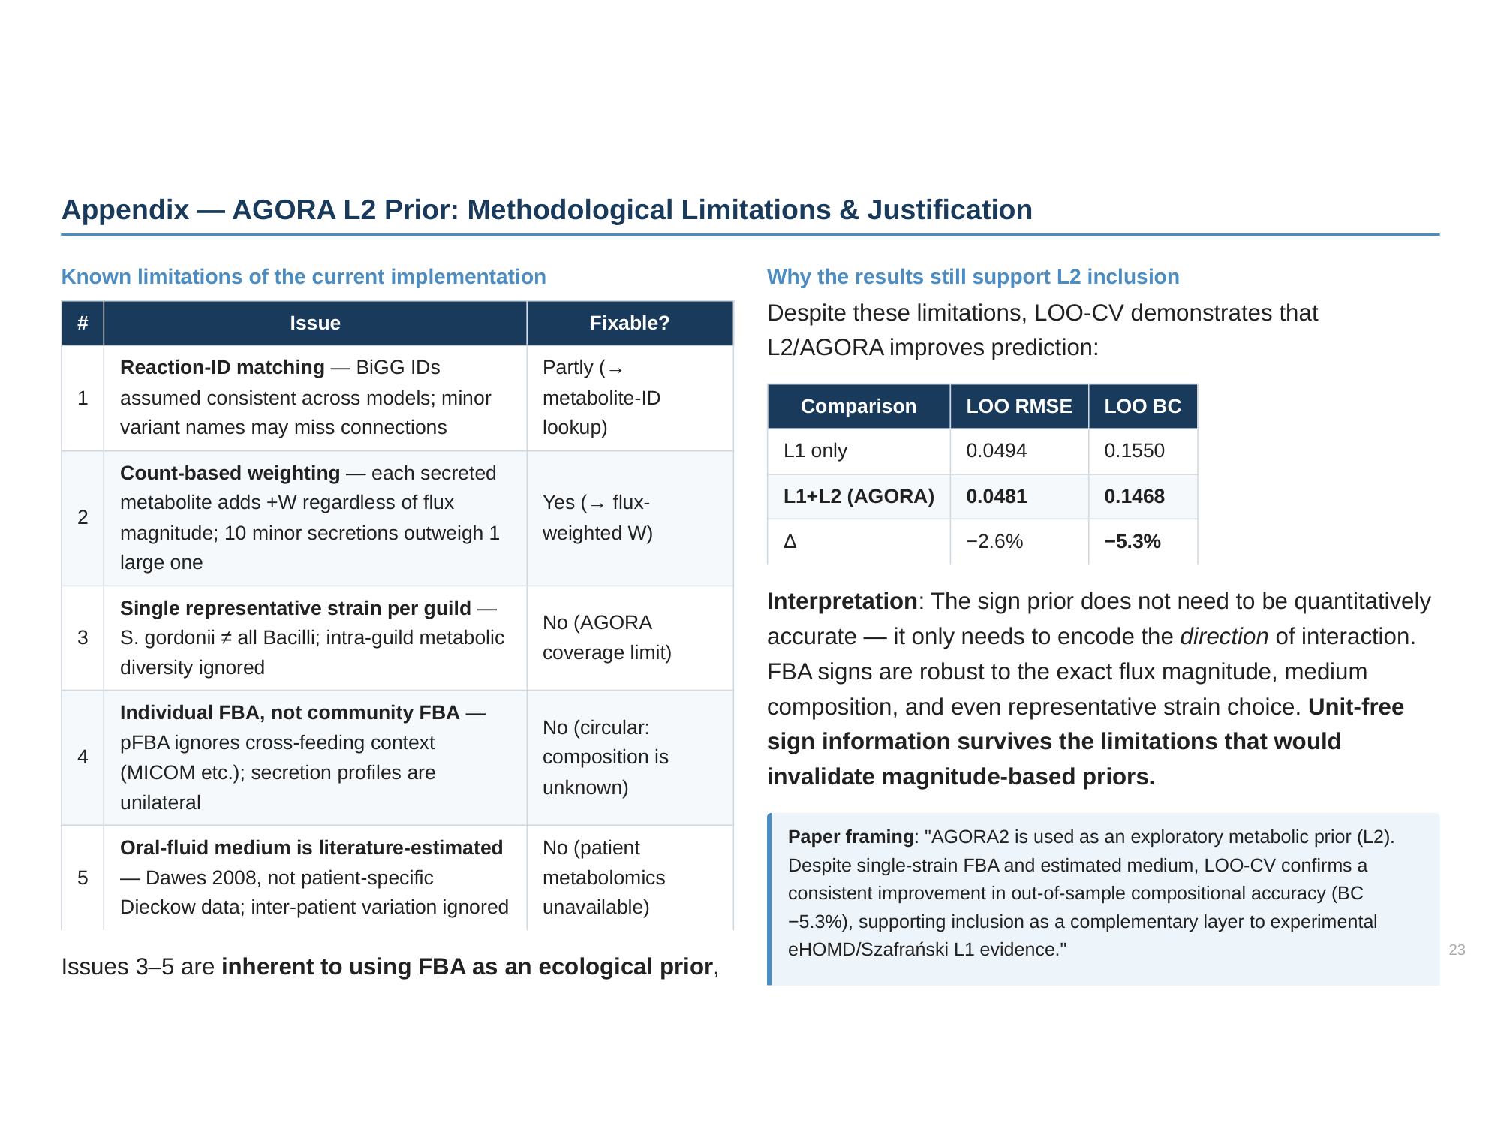

Slide 24
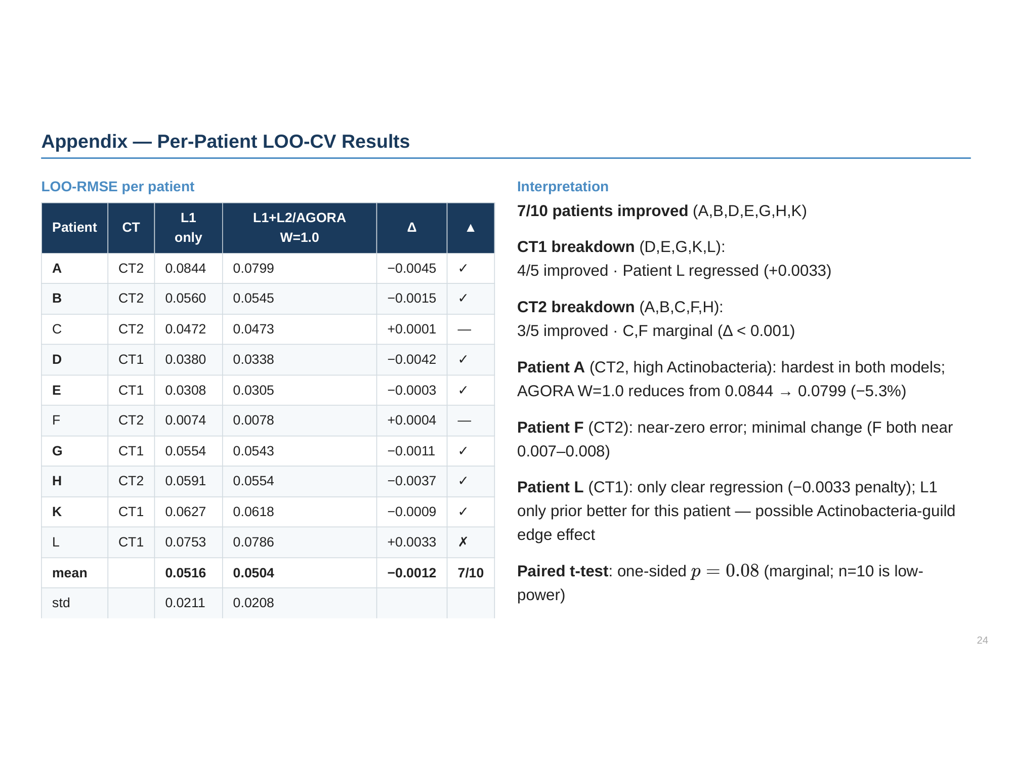

Slide 25
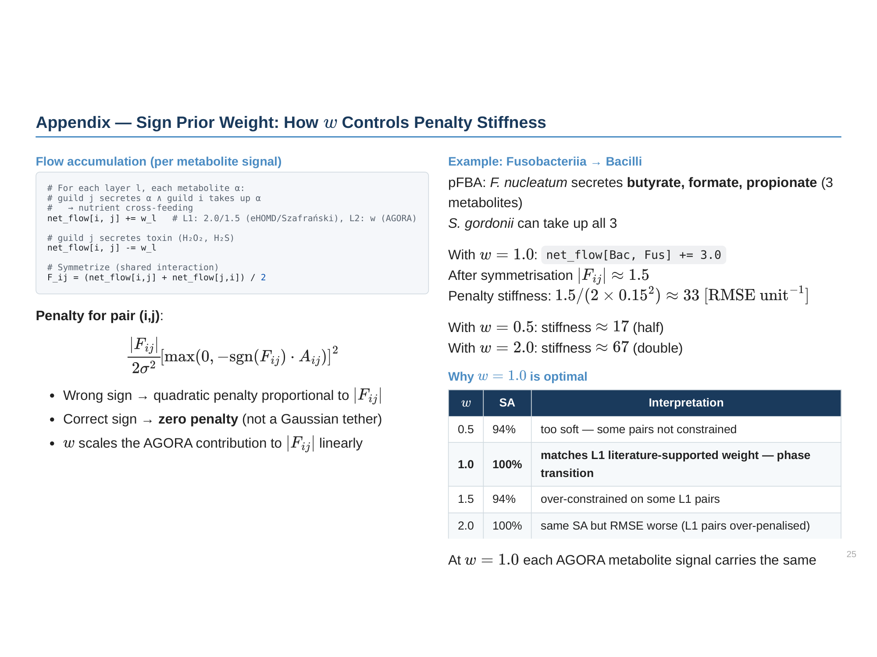

Slide 26
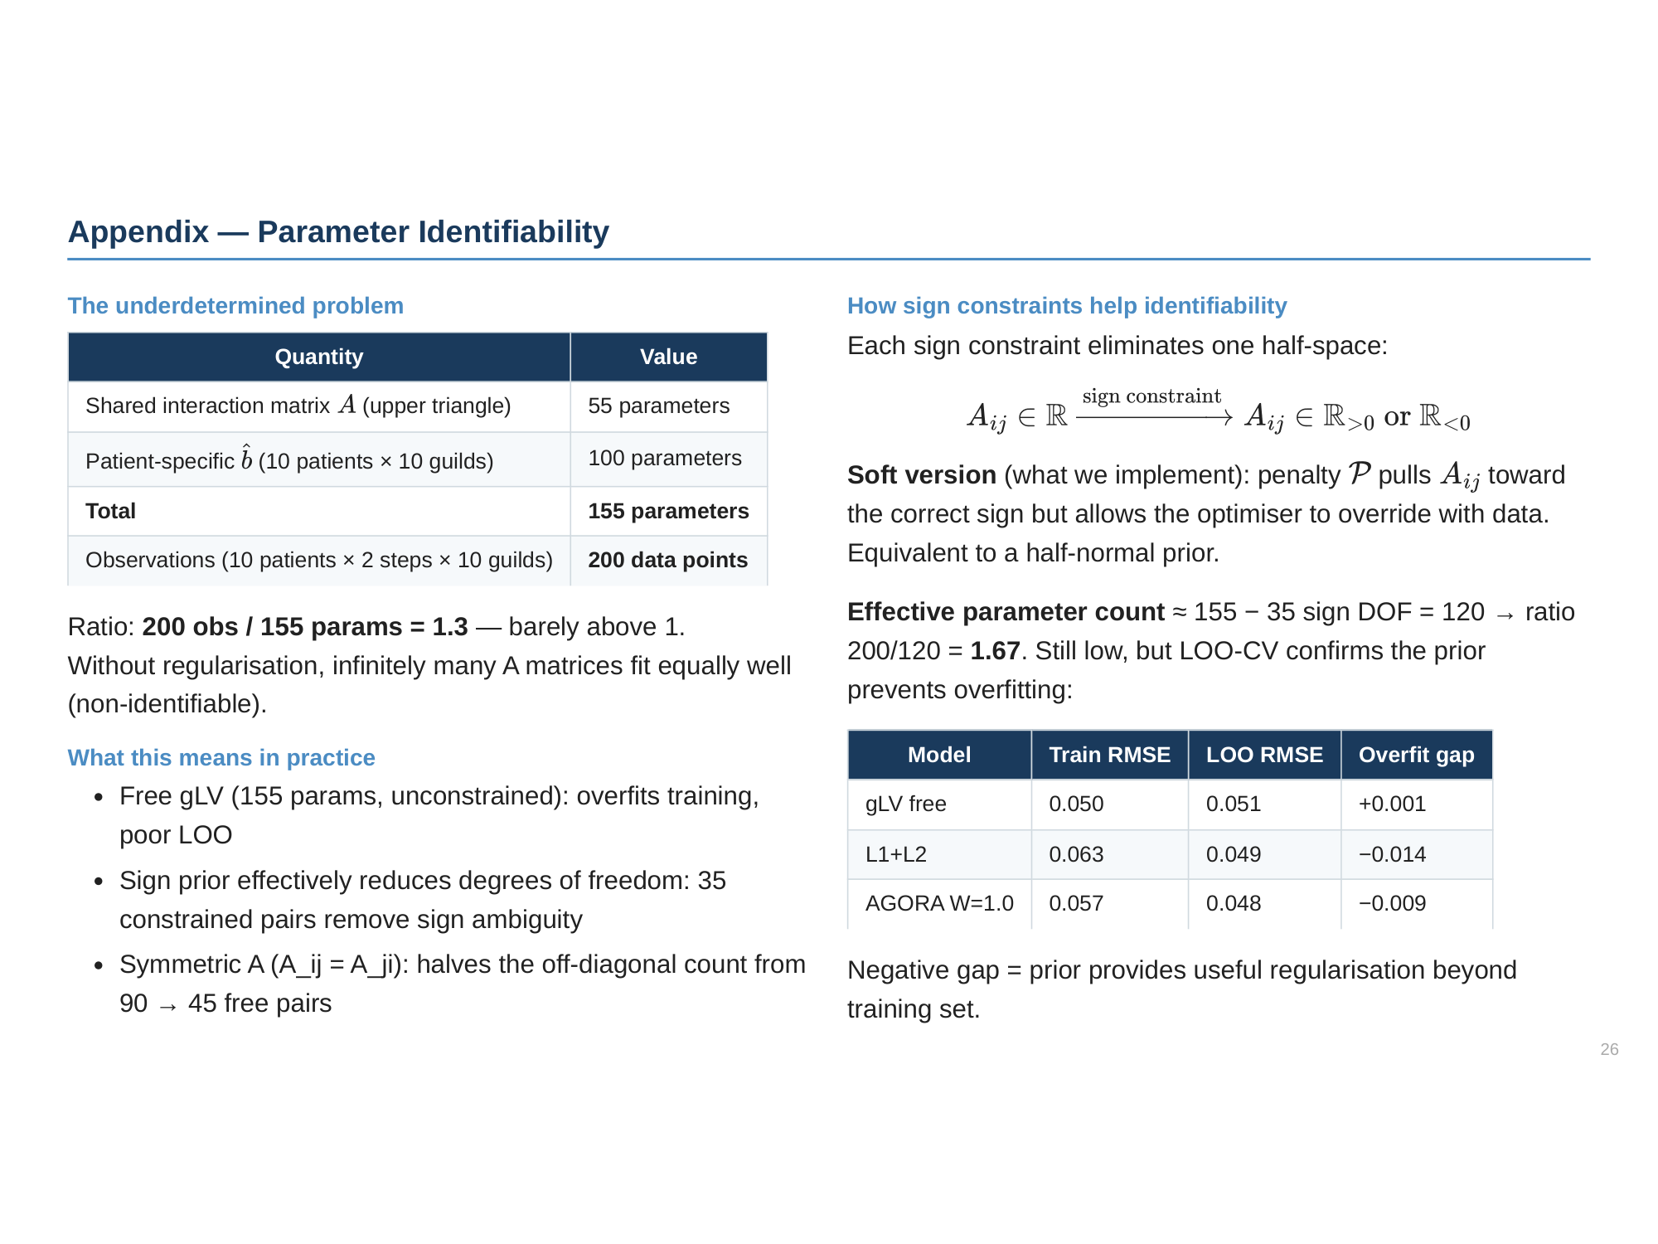

Slide 27
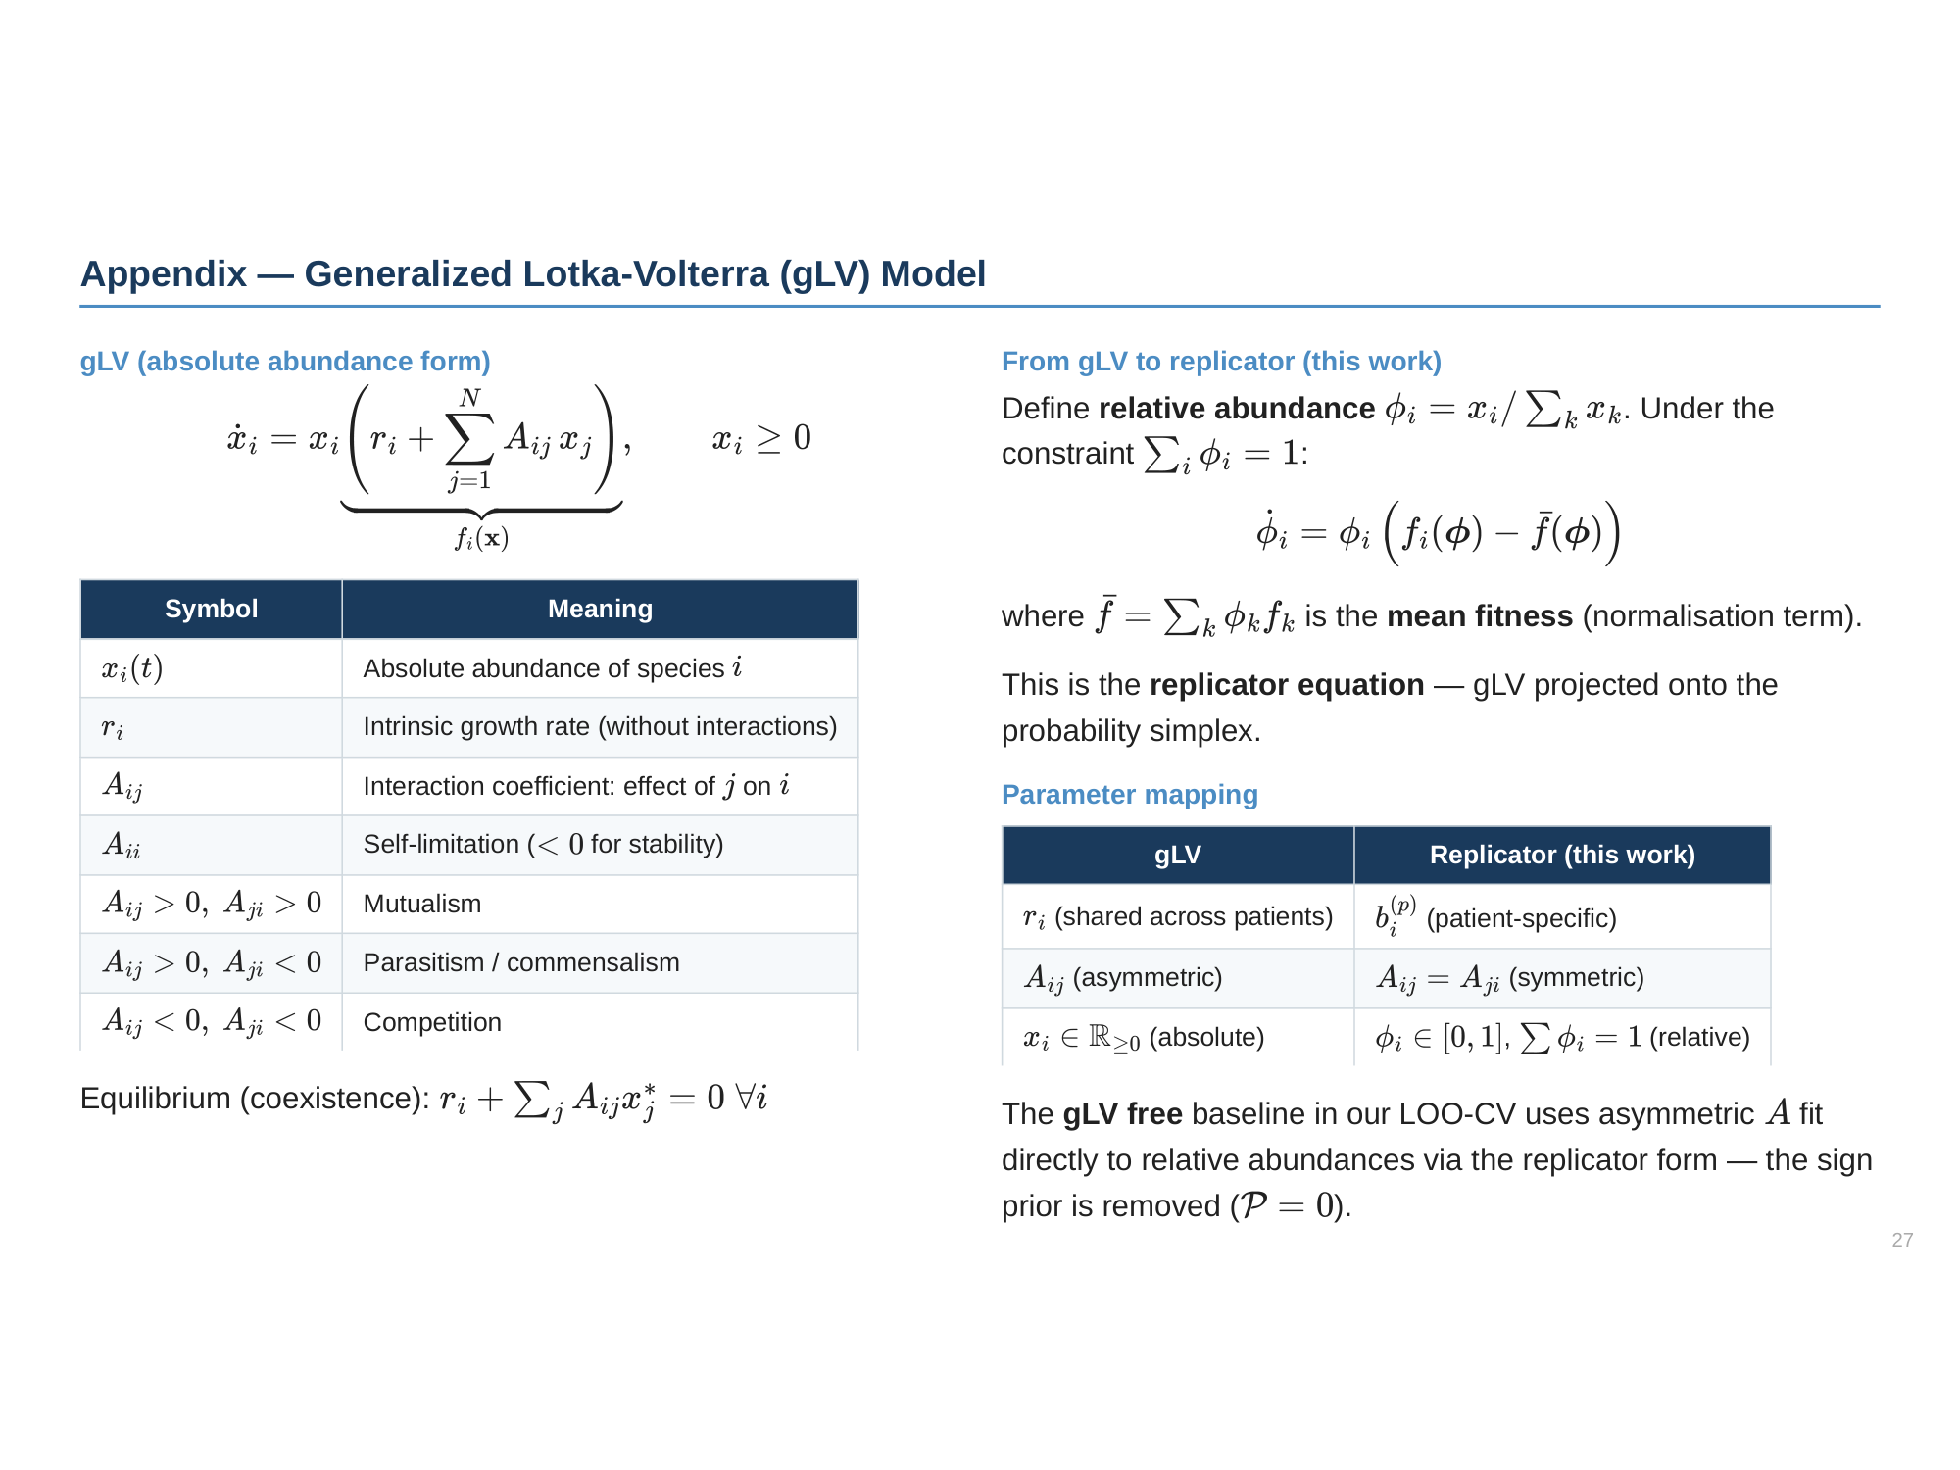

Slide 28
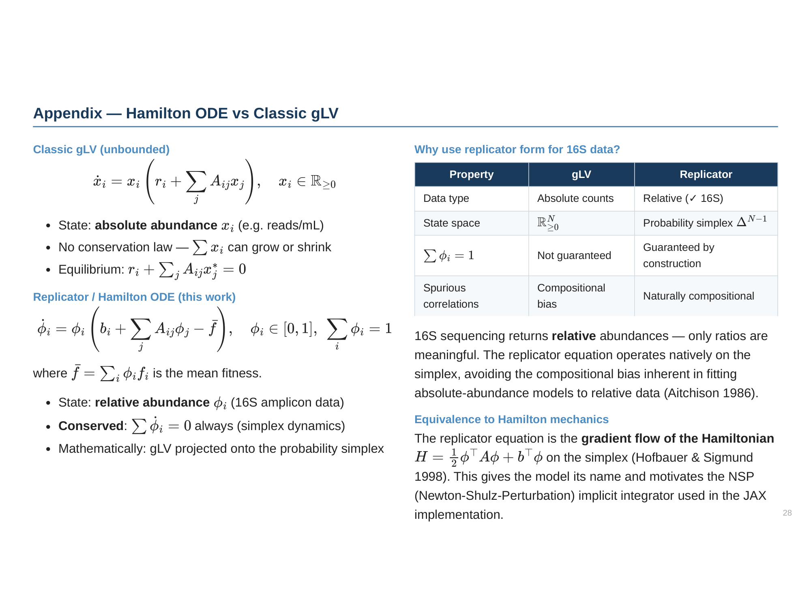

Slide 29
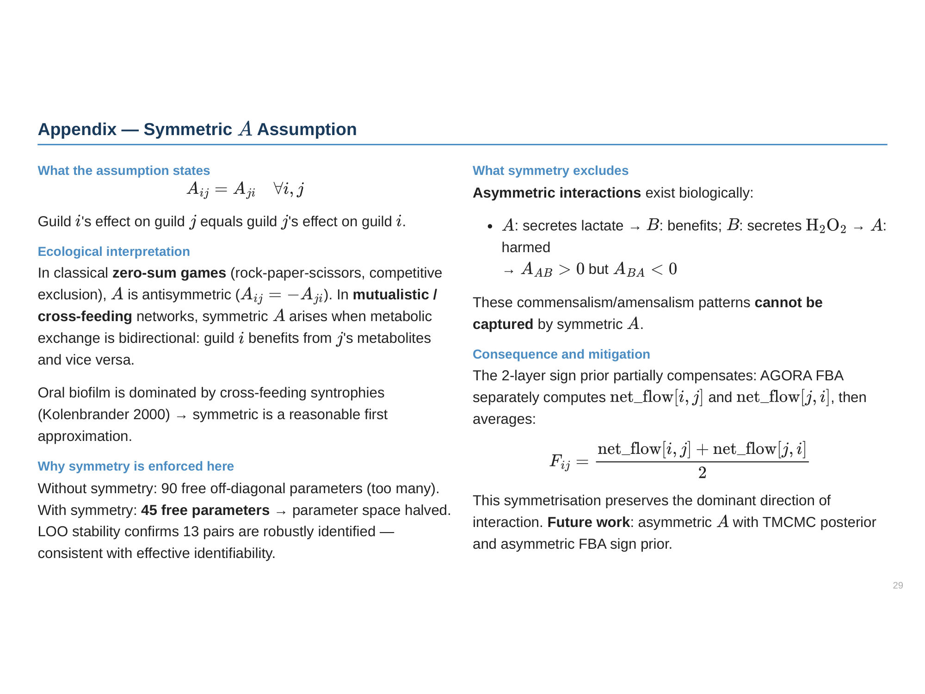

Slide 30
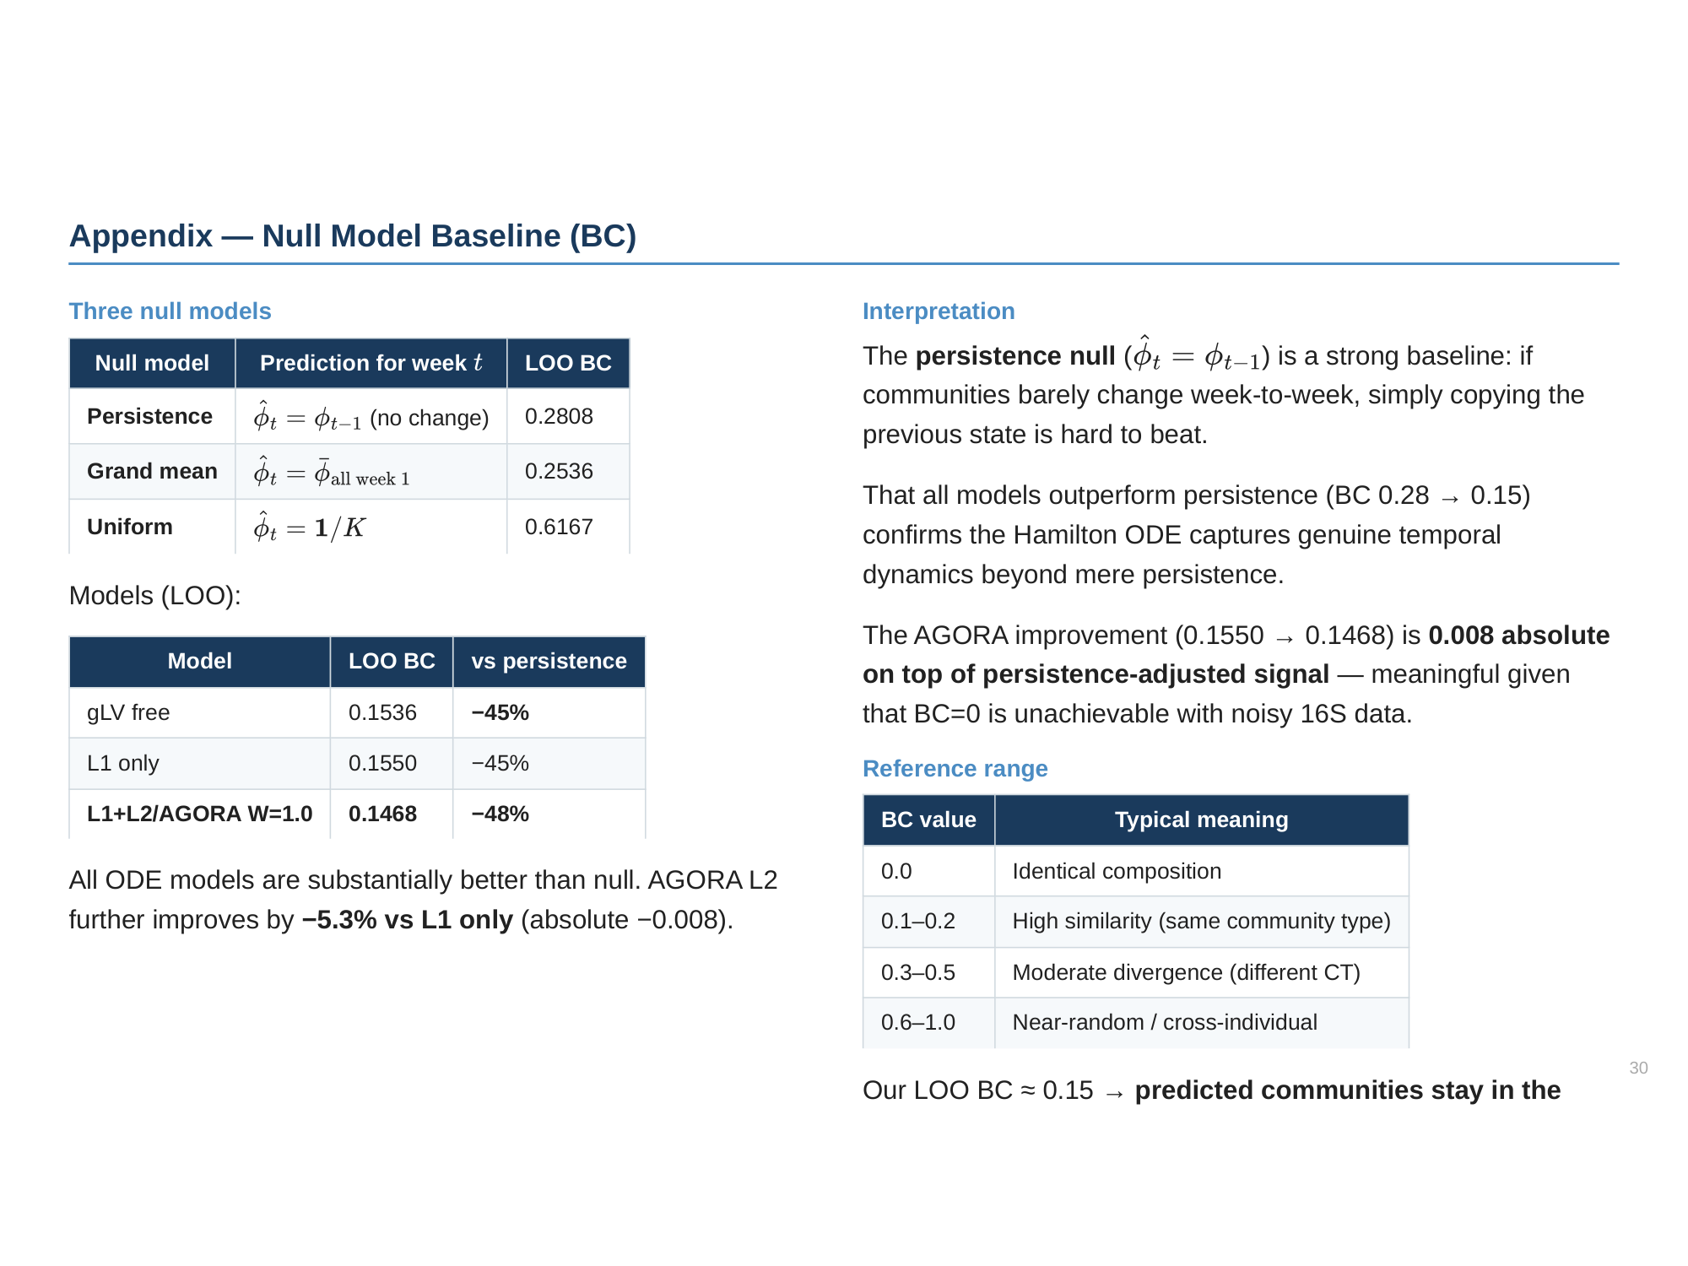

Slide 31
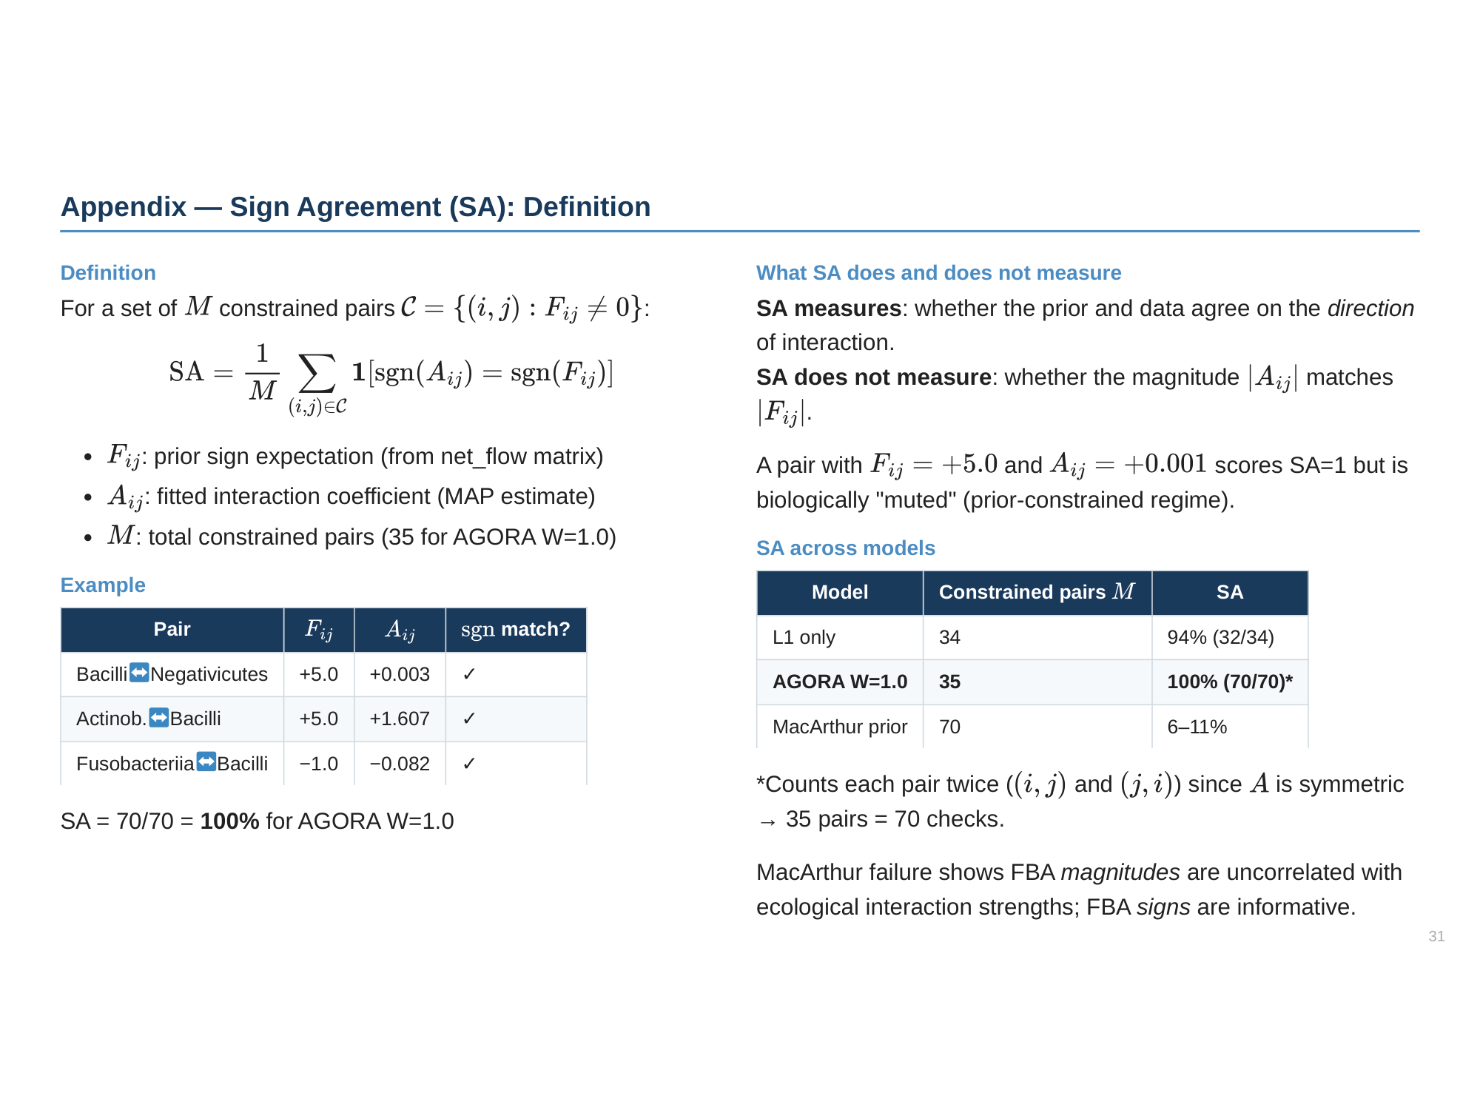

Slide 32
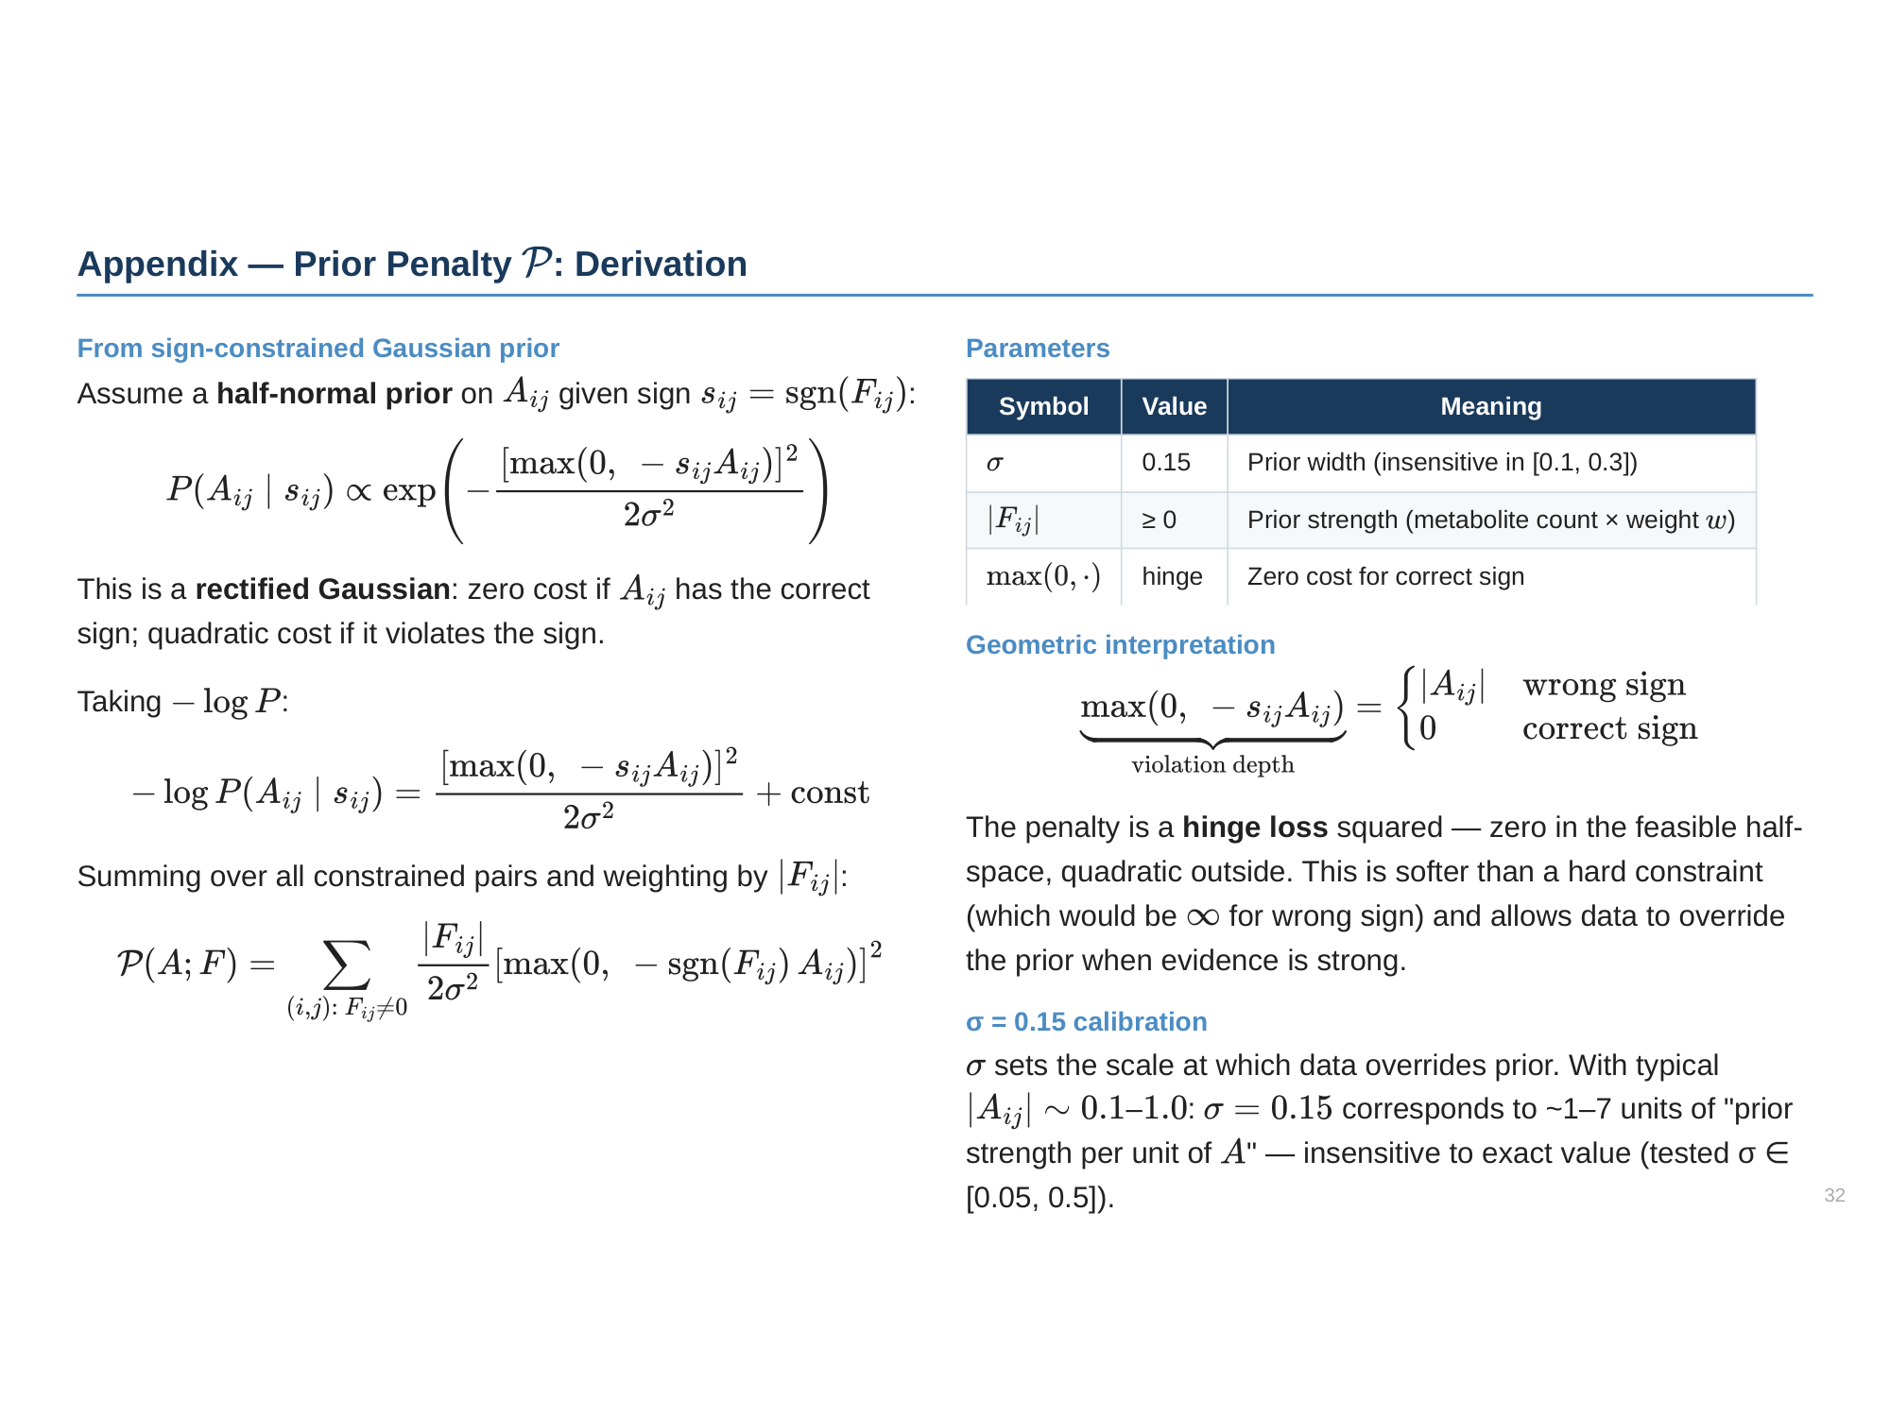

Slide 33
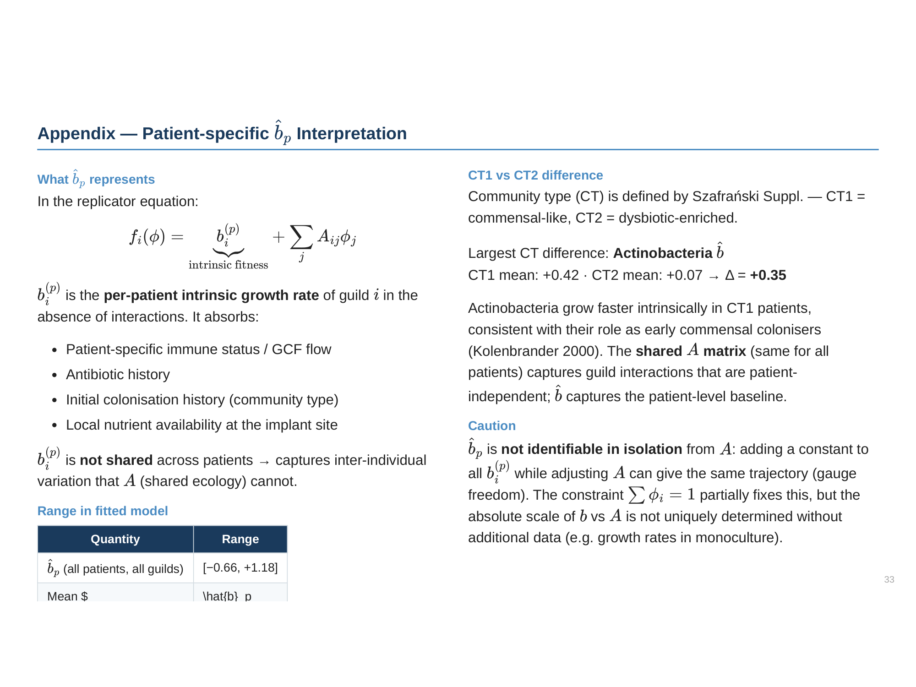

Slide 34
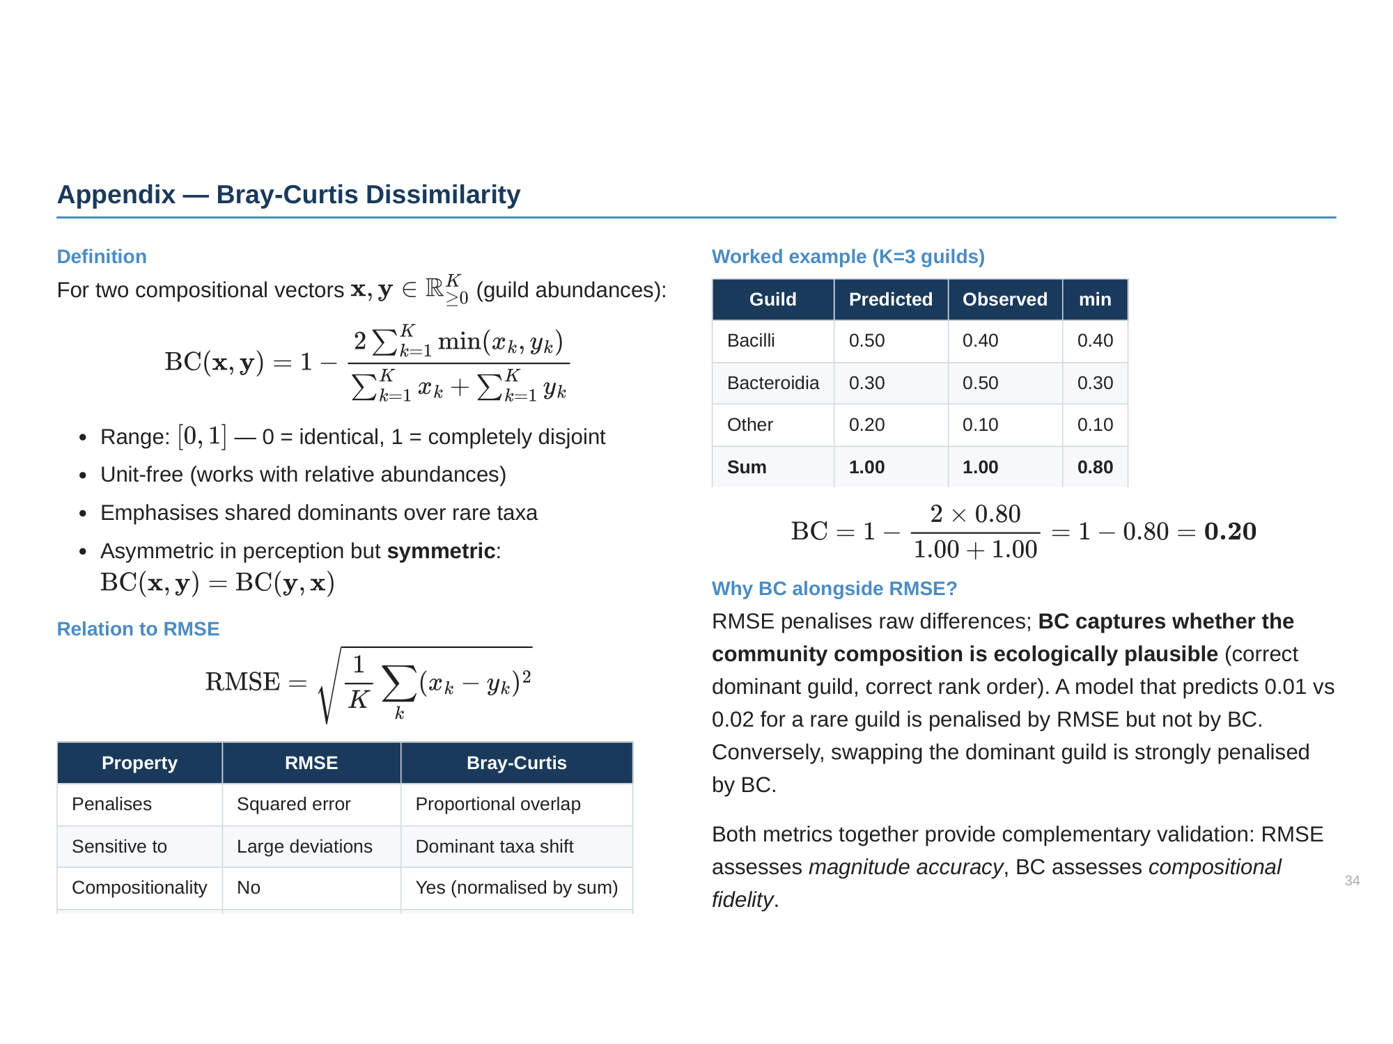

Slide 35
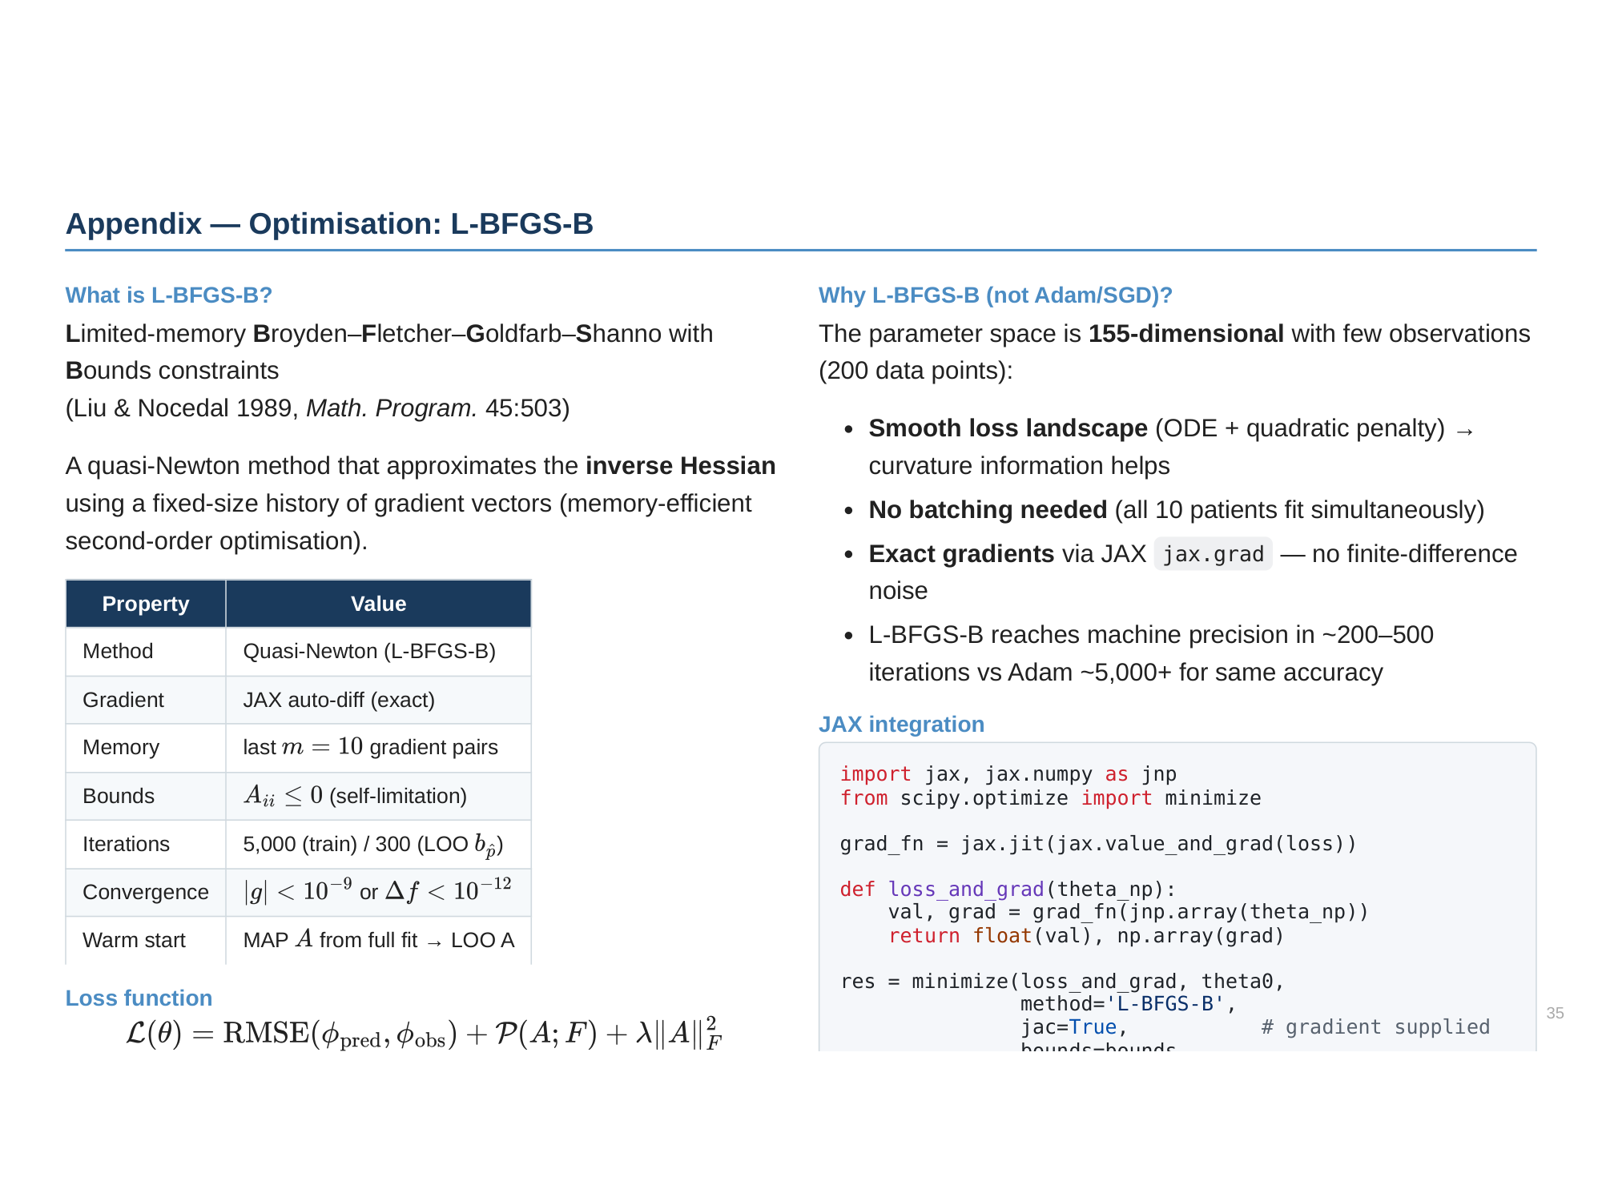

Slide 36
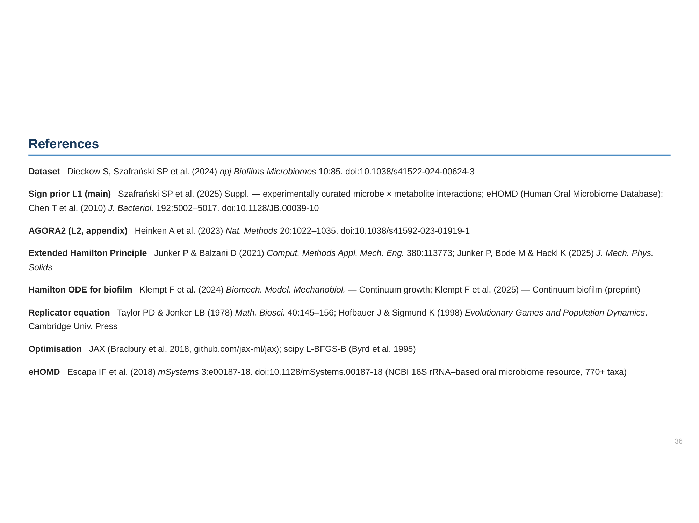

Slide 37
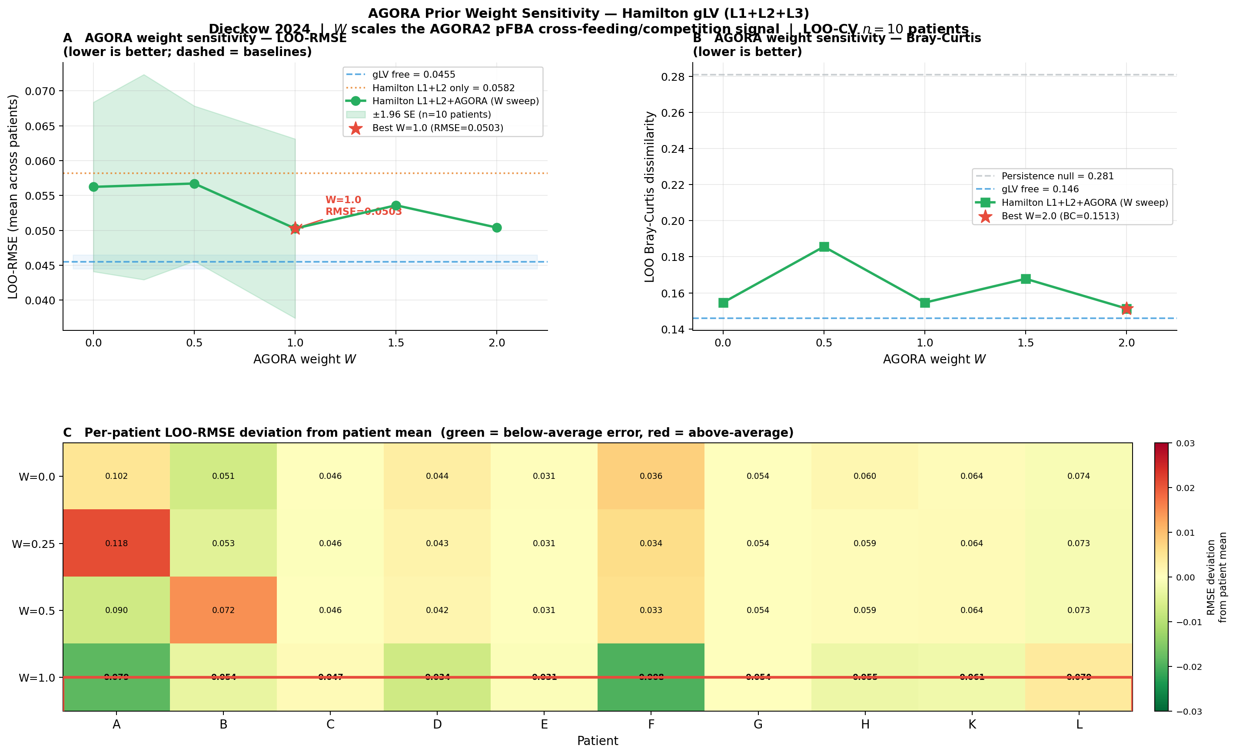
AGORA Weight Sensitivity (W = 0–2.0)
Phase transition to 100% sign agreement at W = 1.0
W=1.0 optimal: LOO-RMSE = 0.0504 (min), SA jumps 94%→100%. Panel A: U-shaped RMSE vs W. Panel B: Bray-Curtis (min 0.147 at W=2.0, W=1.0 near-optimal 0.1468). Panel C: per-patient heatmap — Patients A and F most sensitive.

Slide 38
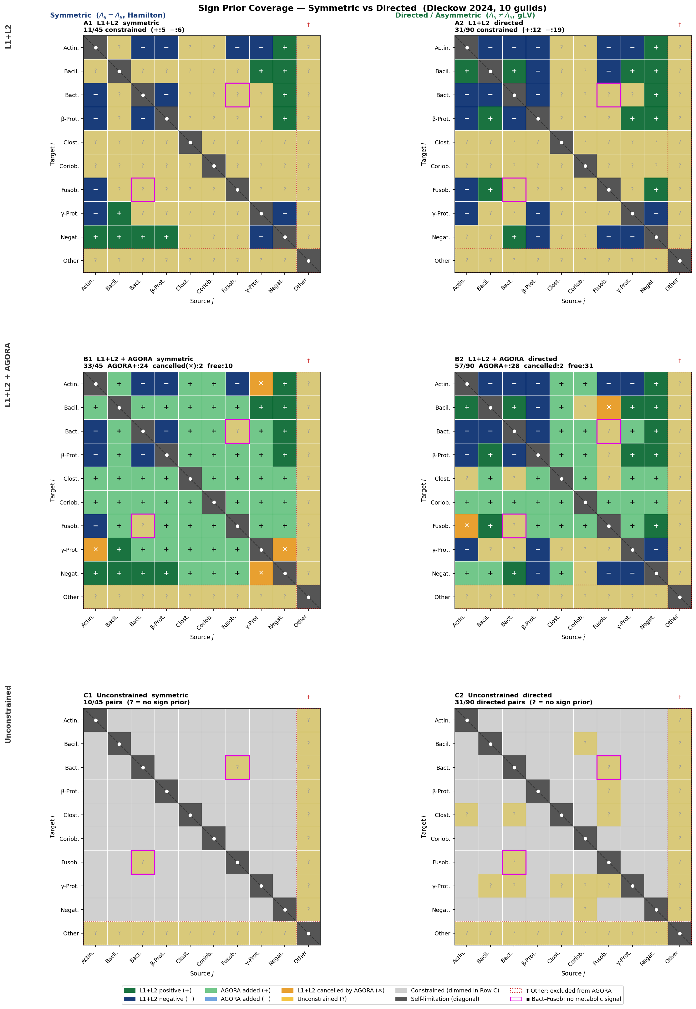
Sign Prior Coverage — Layer-by-Layer (AGORA v1)
3×2: rows = L1+L2 / L1+L2+AGORA v1 / Unconstrained · cols = Symmetric (Hamilton) / Directed (gLV)
v1 ORAL_MEDIUM (blood-plasma scale): all 24 AGORA-added pairs positive — no competition signal. L1+L2: 11/45 sym constrained. L1+L2+AGORA v1: 33/45 sym. Amber ✕ = 2 pairs where AGORA cancelled L1+L2 signal (Actin–γ-Prot, γ-Prot–Negat).

Slide 39
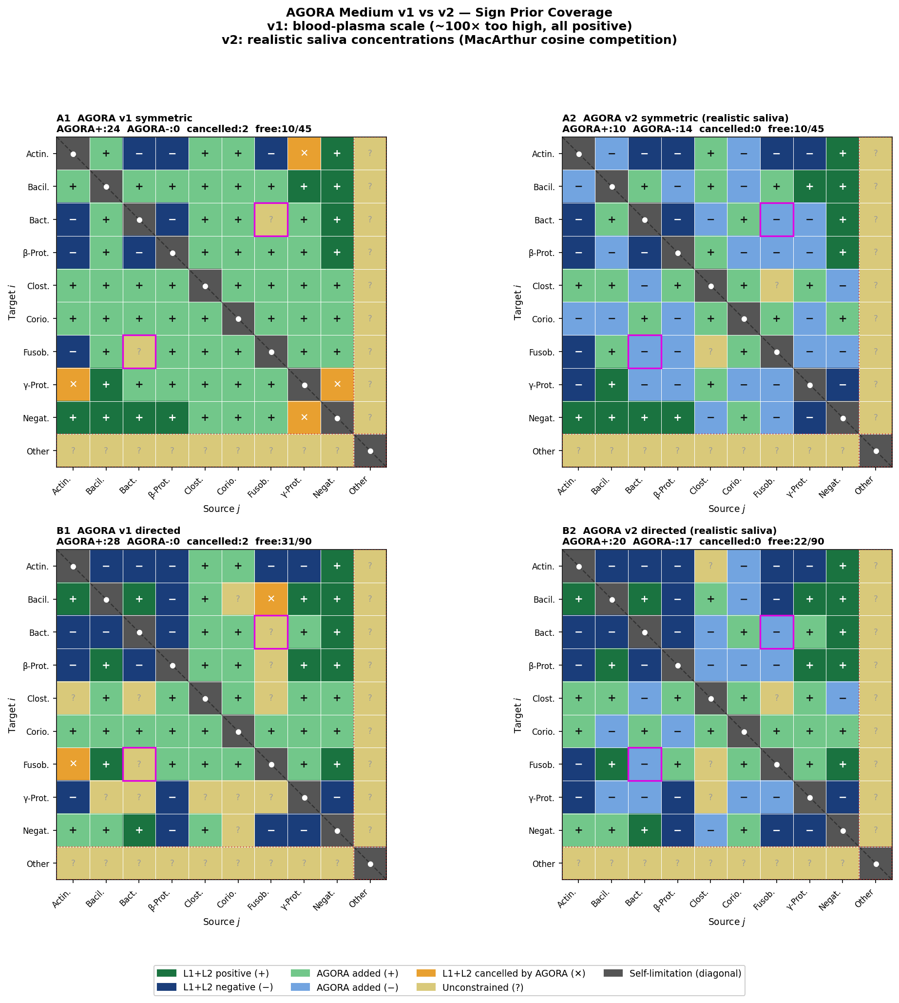
AGORA v1 vs v2 — Realistic Saliva Medium
v1: blood-plasma scale (~100× too high) · v2: Dawes 2008 saliva + MacArthur cosine competition
Root cause of v1 all-positive:
Glucose v1: 10.0 mmol/gDW/h (saliva: ~0.10)
Amino acids v1: 0.5–2.0 → v2: 0.02–0.10
Surplus nutrients → cross-feeding dominates
→ 24 AGORA-added pairs, all positive
v2 fix:
Realistic saliva concentrations (Dawes 2008)
MacArthur cosine niche overlap for competition
α_ij = (c_i·c_j)/(|c_i||c_j|)
v1 v2
μ (Bacilli) 1659/h 35/h ✓
AGORA+ 24 10
AGORA− 0 14 ← emerges
Constrained 33/45 35/45
Directed 57/90 68/90
Bact–Fusob free negative

Slide 40
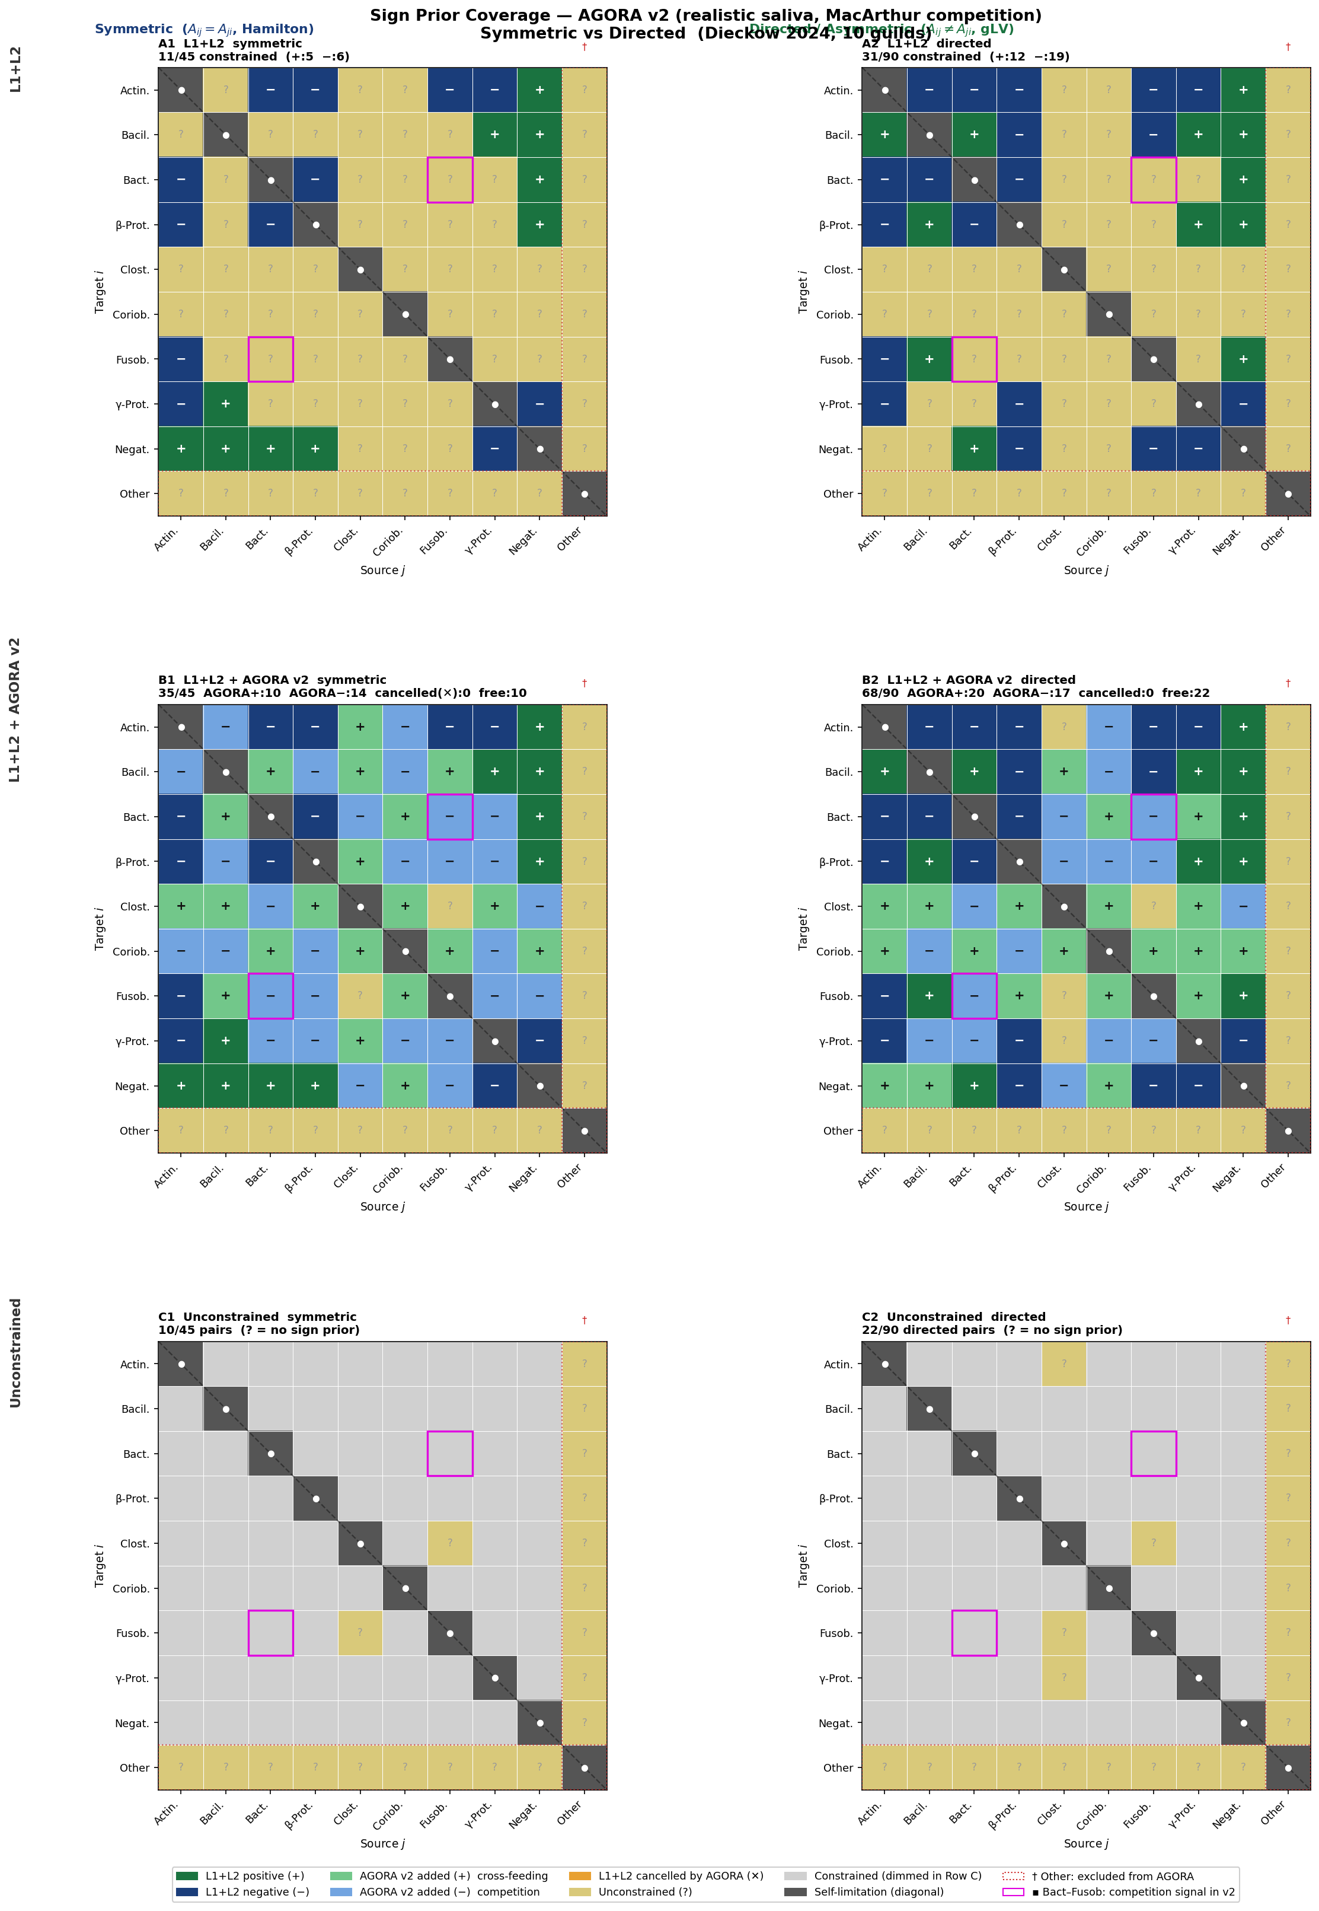
Sign Prior Coverage — AGORA v2 (Realistic Saliva)
Competition signals emerge from MacArthur niche overlap · 35/45 sym, 68/90 directed constrained
v2 improvements: AGORA−=14 sym (was 0). Bact–Fusob acquires negative prior (competition). 2 previously cancelled pairs resolved (amber ✕ gone). LOO-CV with v2 prior: planned next step to quantify prediction improvement.

Slide 41
Guild-Level Dynamical Analysis
Keystone · Network · Permutation · Tipping · Relapse · Prevention · Phase Diagram
Periodontitis relapse is governed by the topology of microbial interaction networks, not merely by bacterial growth rates. Prevention thresholds and relapse timing can be mathematically derived from patient-specific gLV dynamics.

Slide 42
Background & Mathematical Model
Dieckow et al. 2024 · 10-guild gLV · N = 10 patients · 4 time-points (weeks 0/1/3/6)
dφᵢ/dt = φᵢ · ( bᵢ + Σⱼ Aᵢⱼ · φⱼ )
φᵢ = relative abundance of guild i
bᵢ = intrinsic growth rate (patient-specific oral environment)
Aᵢⱼ = interaction strength: guild j → guild i (+ mutualism, − competition)
GDI = log(φ_dys) − log(φ_com) GDI < 0 → commensal, GDI > 0 → dysbiotic
Fitting: L-BFGS-B minimises prediction MSE over 4 time-points → recovers A (10×10) and b (10 patients × 10 guilds). The fitted A matrix encodes the ecological interaction network and determines long-term community fate.
~700 species live in the oral cavity, organised into 10 functional guilds. Healthy (CT1): Acti/Baci dominant, GDI < 0. Dysbiotic (CT2): Bacteroidia/Fusobacteria expand, GDI > 0. Question: why do some patients relapse after treatment while others do not?

Slide 43
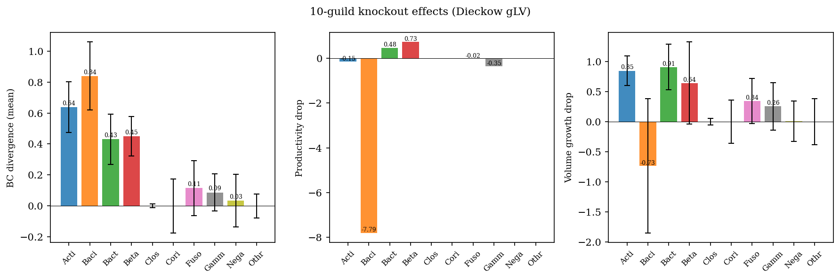
Guild-Level Keystone Analysis: Knockout BC Divergence
Which guild, when removed, shifts the community most?
🔑 Bacilli: highest BC divergence (0.839) — compositional keystone. Removal increases volume → competitive suppressor. | Actinobacteria: vol_drop = +0.846 → growth engine. Strongest interaction: Acti → Baci A = +3.43.

Slide 44
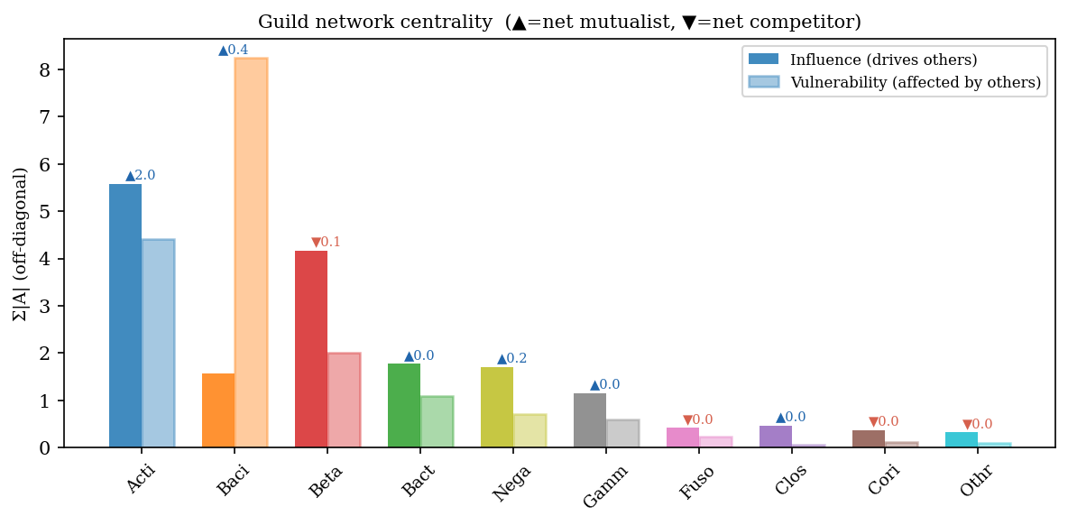
Guild Network Centrality: Influence, Vulnerability, Net Role
Column-sum |A| = influence; Row-sum |A| = vulnerability; Σ A_ij = net mutualist (+) / competitor (−)
Actinobacteria: influence = 5.58 (highest), net = +2.02 (mutualist hub). Bacilli: vulnerability = 8.24 (most regulated by others). Betaproteobacteria: net = −0.14 → net competitor. LOO sign consistency: Acti→* = 1.0 (stable across all 10 folds); Gamm→* ≈ 0 (data-limited).

Slide 45
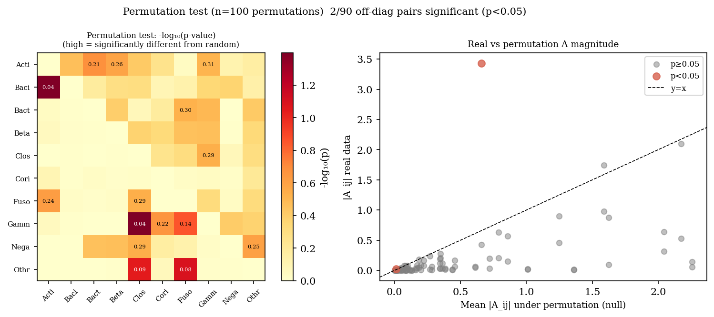
A Matrix Statistical Validation: Permutation Test (n = 100)
Null: shuffle patient labels → refit A → p-value = fraction of |A_perm| ≥ |A_real| (parallelised, 24 cores)
2 / 90 pairs significant at p < 0.05: Baci→Acti (A = +3.43, p = 0.040) and Gamm→Clos (A = −0.023, p = 0.040). | LOO confirms Acti→* sign stability (SC = 1.0 all folds); Gamm→* unstable (SC ≈ 0). | Low significance consistent with N = 10 — A matrix structure reflects ecology, not noise.

Slide 46
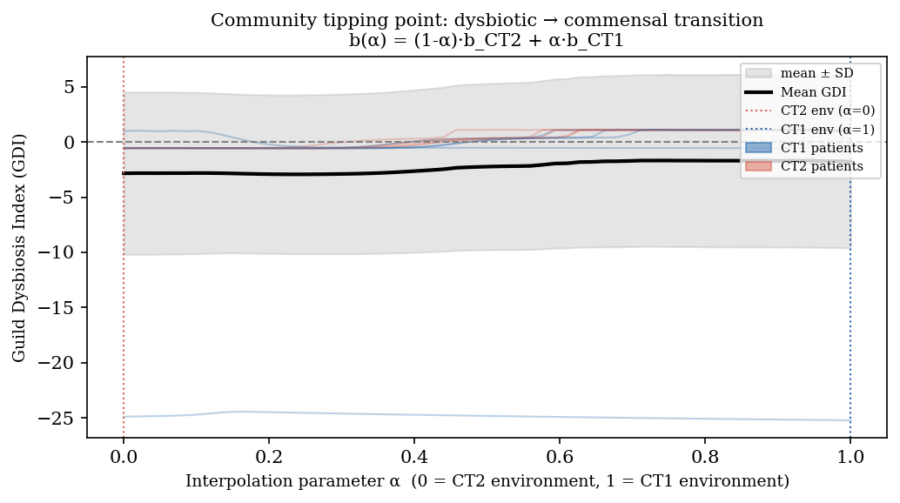
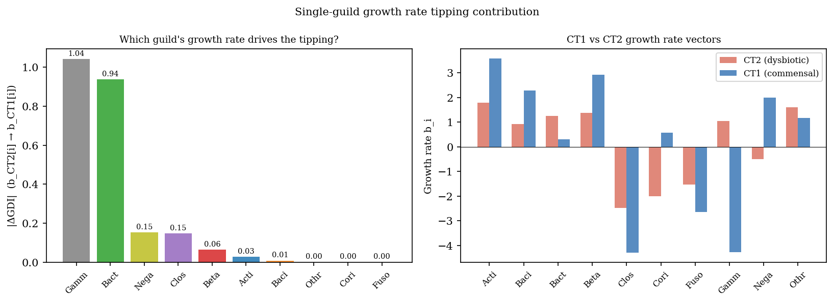
Tipping Point Analysis: CT2 → CT1 b-Environment Transition
Left: α-interpolation b(α) = (1-α)·b_CT2 + α·b_CT1 | Right: single-guild b sweep |ΔGDI|
α-scan: no GDI=0 crossing (single commensal attractor)
Single-guild effect sizes: Gamm #1, Bact #2
No α* crossing: A matrix drives system to commensal for all b interpolations — structural attractor dominant. | Top drivers: Gammaproteobacteria (ΔGDI = 1.04) and Bacteroidia (ΔGDI = 0.94). | Equilibrium GDI: Patient D = −0.48 (only commensal); all others > 0 (dysbiotic).

Slide 47
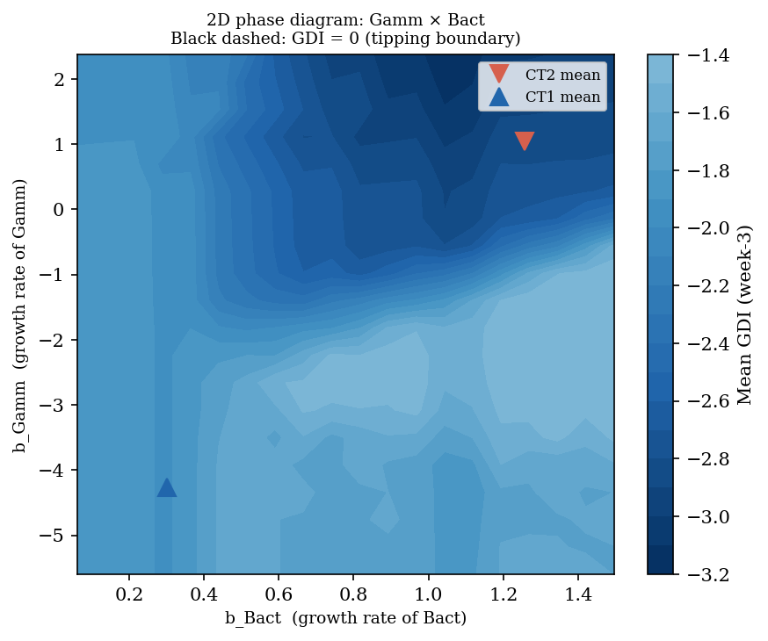
2D Phase Diagram: Gammaproteobacteria × Bacteroidia Growth-Rate Space
20 × 20 grid · all other b at CT2 mean · week-3 GDI · black dashed = GDI = 0 tipping boundary
Gamm × Bact: top-2 single-guild tipping drivers (ΔGDI 1.04 and 0.94). GDI = 0 boundary visible — commensal region at low b_Gamm and low b_Bact. CT2 mean (▼) deep in dysbiotic zone; CT1 mean (▲) near tipping boundary. → Joint reduction of Gamm and Bact growth rates is the most efficient ecological intervention.

Slide 48
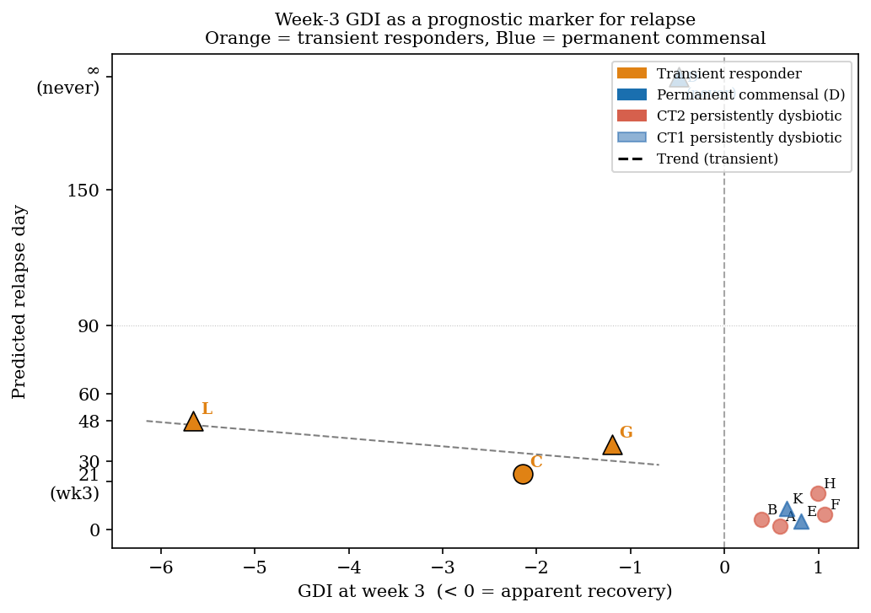
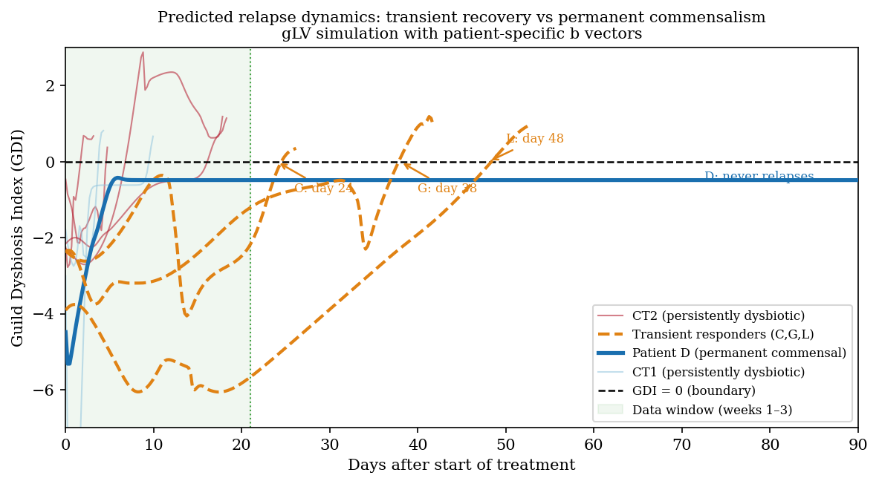
Predicted Relapse Dynamics: Three Patient Archetypes
Long-time simulation (t = 150 d) from patient-specific b vectors
GDI trajectories to 90 days (per patient)
Week-3 GDI → relapse day (prognostic marker)
① Persistent dysbiotic (A,B,E,F,H,K): GDI > 0 throughout. ② Transient responder (C→24d, G→38d, L→48d): commensal at wk-3, dysbiotic by t < 50d. ③ Permanent commensal (D): only patient with stable GDI < 0. → Week-3 GDI as prognostic marker: lower = longer remission.

Slide 49
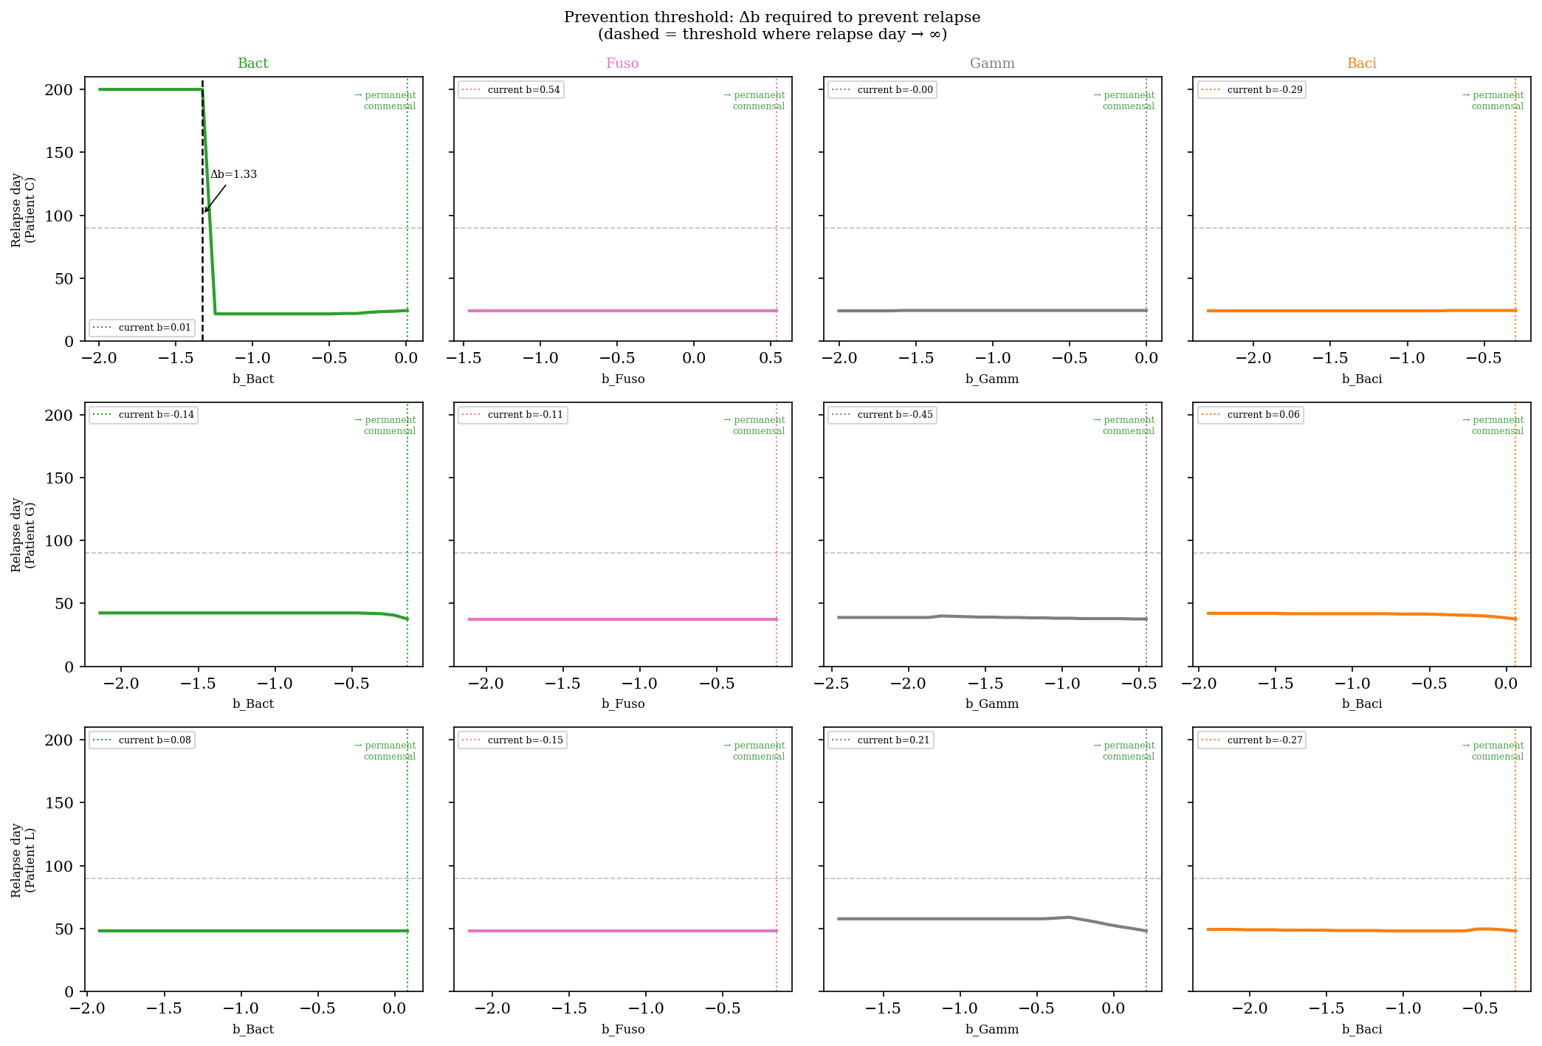
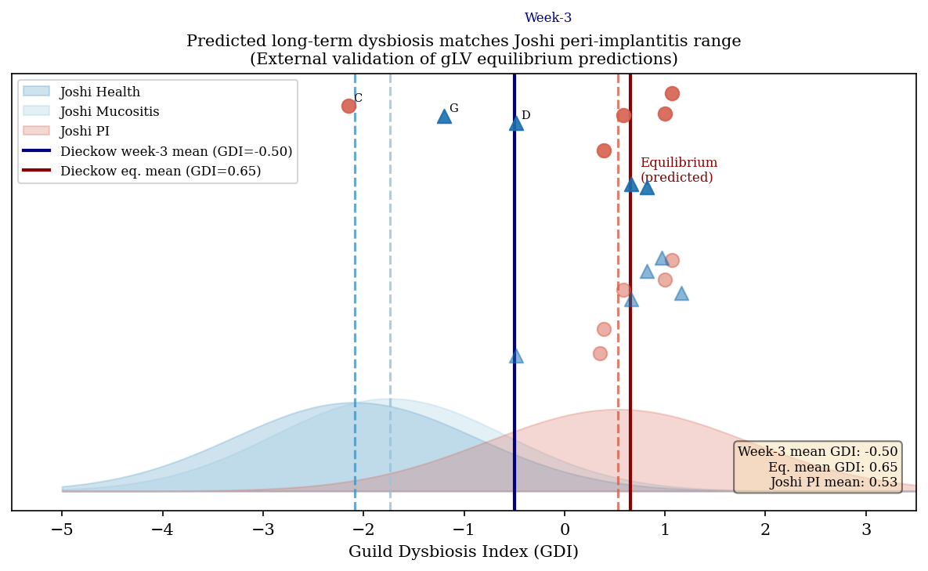
Prevention Threshold & External Validation (Joshi 2025)
Min. Δb_i needed to prevent relapse | Model equilibrium vs peri-implantitis reference
Required Δb per guild (patient C only actionable)
Predicted eq. GDI vs Joshi PI distribution
Prevention: only Patient C convertible by single-guild intervention (Δb_Bact = 1.33). Patients G & L require multi-guild change → deep attractor. | External validation: predicted equilibrium GDI = +0.65 ≈ Joshi PI mean +0.53 (9/10 patients in PI range, difference < 0.12 within Joshi SD=1.30).

Slide 50

3D Attractor Landscape: GDI = 0 Boundary in Growth-Rate Space
Equilibrium GDI on 18³ grid (Acti × Baci × Bact), 12-core parallel, t = 80 d
98% of parameter space is dysbiotic (GDI > 0). Commensal region (blue) confined to b_Bact < ~1.5 — Bacteroidia growth rate is the dominant control variable. CT1 patients with low b_Bact (G, K, L) cluster near boundary; CT2 patients (A: b_Bact=4.5) deep in dysbiotic zone. → Confirms: attractor robustness is structural, not initial-condition sensitive.

Slide 51
Conclusion
Periodontitis relapse is governed by the topology of microbial interaction networks, not merely by bacterial growth rates. Prevention thresholds and relapse timing can be mathematically derived from patient-specific gLV dynamics.
① Bacilli = compositional keystone (BC = 0.839); Acti = growth engine.
② Baci → Acti (A = +3.43, p = 0.040) is the sole statistically validated interaction.
③ A matrix creates a single commensal attractor — b alone cannot flip the community state.
④ Three relapse archetypes: persistent / transient responder / permanent commensal (Patient D only).
⑤ Patient C preventable with Δb_Bact = 1.33; 98 % of growth-rate space remains dysbiotic.
⑥ External validation: predicted eq. GDI +0.65 ≈ Joshi 2025 peri-implant cohort mean +0.53.

