Slide 1
Coupling the multi-species point model to the growth field
Progress report for Oliver and Dr. Soleimani
Keisuke Nishioka, IKM, Leibniz Universität Hannover, October 2026

Slide 2
Where the coupling stands
Implemented as agreed in your element: the point model (Klempt et al. 2026) runs at every Gauss point as published, consumption by the living biomass Σᵢ φ̄ᵢ, antibiotic in the second nutrient field. A Python version solves the same equations.
Composition is robust: Σᵢ φ̄ᵢ, the shares and c agree between the two codes and change by less than 1 % from 16³ to 128³.
The front term −r c/(k+c) n_c·∇φ of Eq. 34 needs care: at the paper's r the cell Péclet number is about 31 on 16³, so a central gradient oscillates.
Stress converges with a second-order scheme: seed von Mises stress 6.2 × 10⁻⁴ Pa (separate example, from 32³ on).
Notes:
Four messages: the coupling is in the element as agreed; the composition results are robust; the front term is the numerical difficulty; with a proper scheme the stress converges.

Slide 3
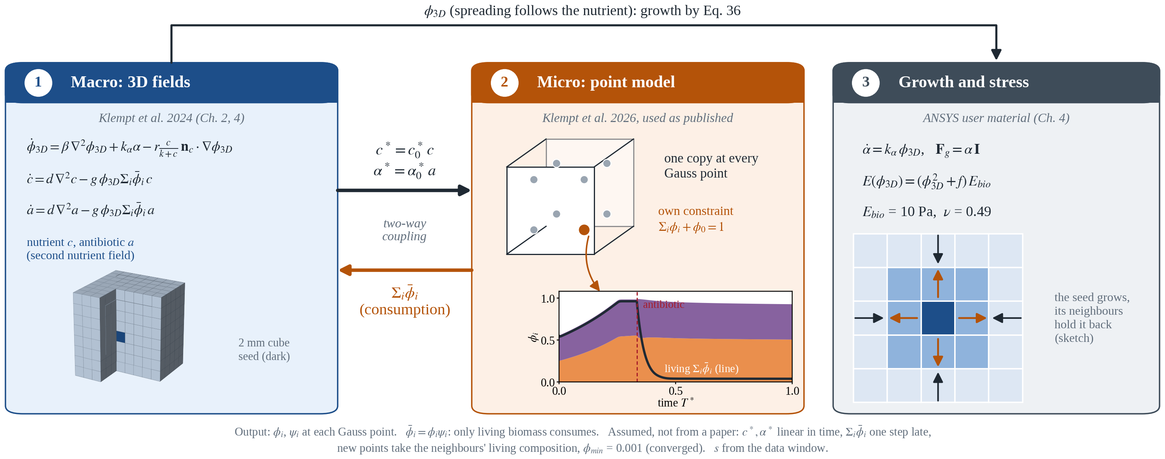
The coupling agreed on 20 October
Figure 1: Agreed coupling: the 3D fields of Klempt et al. (2024) pass c* and α* to the point model of Klempt et al. (2026) at each Gauss point, which returns Σᵢ φ̄ᵢ for the consumption in Eq. 35.
Notes:
Fields to point model: c* = c*_0 c and alpha* = alpha*_0 a, linear in time over the inner steps. Point model to fields: the living volume fraction sum_i phibar_i scales the consumption of c and a. Eq. 36 is unchanged, so the composition reaches the stress through the nutrient field and the front term.

Slide 4
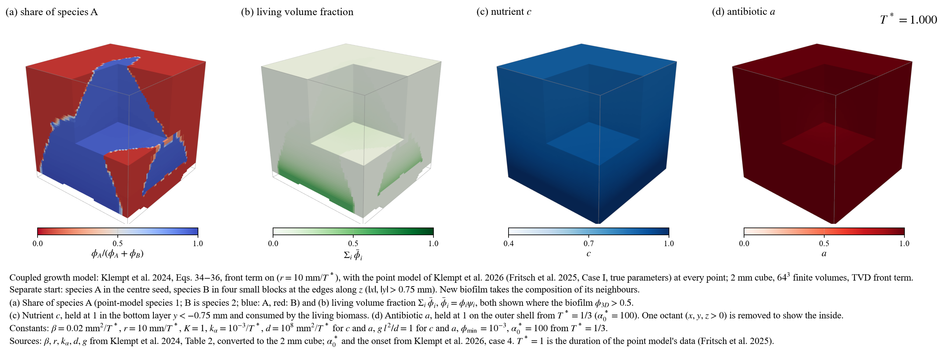
Separate example with antibiotic
Figure 2: Separate start, T* = 0 to 1 (video): (a) φ₁/(φ₁ + φ₂), (b) Σᵢ φ̄ᵢ, (c) c, (d) a. Python, 64³.
A (point-model species 1) in the seed, B (species 2) in four blocks at the z edges; nutrient from the bottom, antibiotic from all outer faces from T* = 1/3 (α*₀ = 100)
Newly reached cells take the composition of the biofilm they grow from; the antibiotic kills B and, where the nutrient is low, A
Notes:
Python, 64-cube grid, one eighth cut away. Panels as in the caption band of the video.

Slide 5
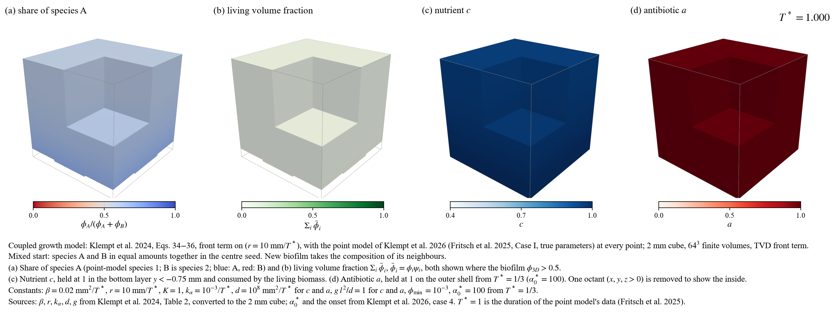
Mixed example with antibiotic
Figure 3: Mixed start, T* = 0 to 1 (video): panels as in Figure 2. Python, 64³.
A and B start together in the seed with equal amounts; same nutrient and antibiotic as before
The antibiotic acts where c* = c*₀ c falls below α* bᵢ: the nutrient field decides where it kills
Notes:
Same set-up, mixed start with equal amounts (Oliver's suggestion).

Slide 6
Five examples on the finest grid
Table 1: Seed means at T* = 1 (Python, 128³, TVD front term).
Example | Σᵢ φ̄ᵢ | share of A | nutrient c | α − 1 | von Mises [Pa]
Separate | 0.965 | 0.978 | 0.539 | 9.32e−4 | 6.18e−4
Separate, antibiotic | 0.147 | 0.951 | 0.910 | 9.33e−4 | 6.05e−4
Mixed, equal amounts | 0.960 | 0.848 | 0.578 | 9.07e−4 | 4.87e−4
Mixed, equal amounts, antibiotic | 0.038 | 0.613 | 0.970 | 9.05e−4 | 4.26e−4
Mixed (0.25, 0.30), antibiotic | 0.037 | 0.511 | 0.971 | 9.04e−4 | 4.29e−4
Constants: Klempt et al. (2024), Table 2, converted; Fritsch et al. (2025), case I; α*₀ = 100 from T* = 1/3 (Klempt et al. 2026, case 4).
The antibiotic lowers the living fraction of the seed from 0.965 to 0.147 (separate) and from 0.960 to 0.038 (mixed)
α − 1 hardly changes between examples (Eq. 36 is unchanged): the composition reaches the stress through c and the front term −r c/(k+c) n_c·∇φ

Slide 7
The front term −r c/(k+c) n_c·∇φ is an advection
Pe = r h / (2β) ≈ 31
on 16³ (r = 10 mm/T*, β = 0.02 mm²/T*). With a central gradient φ oscillates and the element stops after two increments; a smaller time step does not help.
Constant added diffusion r h/4
First order. Stable in the element, but the stress at 16³ is about a quarter of the converged value.
Lax–Wendroff with an extremum sensor
Used in the element: second order away from extrema, φ stays in [0, 1]; on 16³ it matches Python with the same form.
TVD upwinding (MUSCL, minmod)
Used in Python for the main results; converged from 64³ on.
Notes:
None of the three changes Eqs. 34 to 36. Klempt 2024 does not state a stabilisation; on its own mesh the cell Peclet number is about 25.

Slide 8
Grid convergence: stress needs a second-order scheme
Figure 4: Seed means of the separate example with antibiotic at T* = 1 against the grid (h = 2 mm / n). Element: your element with the agreed coupling (ANSYS), 16³ so far.

Slide 9
What the comparison found in the element and in Python
Surface points of the element
Column sums of the NEM Laplacian
φ at the surface points was an inverse-distance mean that also took inner points; at a wall with φ = 1 it came out low and φ leaked through the wall. Taking the nearest Gauss point reduced the leak to a quarter.
The rows sum to zero, the columns do not, so the operator does not conserve φ with equal weights. A conservative form removes the rest of the leak.
Neighbour selection
Python wall gradient
The search keeps the first 30 points in element order; on 16³ and 24³ the stencils became asymmetric inside the domain. Selecting by distance makes them symmetric to 1e−15.
My Python version took a one-sided gradient in the wall cells for the front term −r c/(k+c) n_c·∇φ; corrected to the zero-flux mirror. After both corrections the codes agree on 8³ within 1 to 5 %.
Notes:
Checks that passed: every traced point-model step in the element equals the point model alone to 1.8e-12; the transient nutrient equation with the Table 2 diffusivity equals the quasi-static one to 1e-4; the time step 0.00125 is converged to about 1 %.

Slide 10
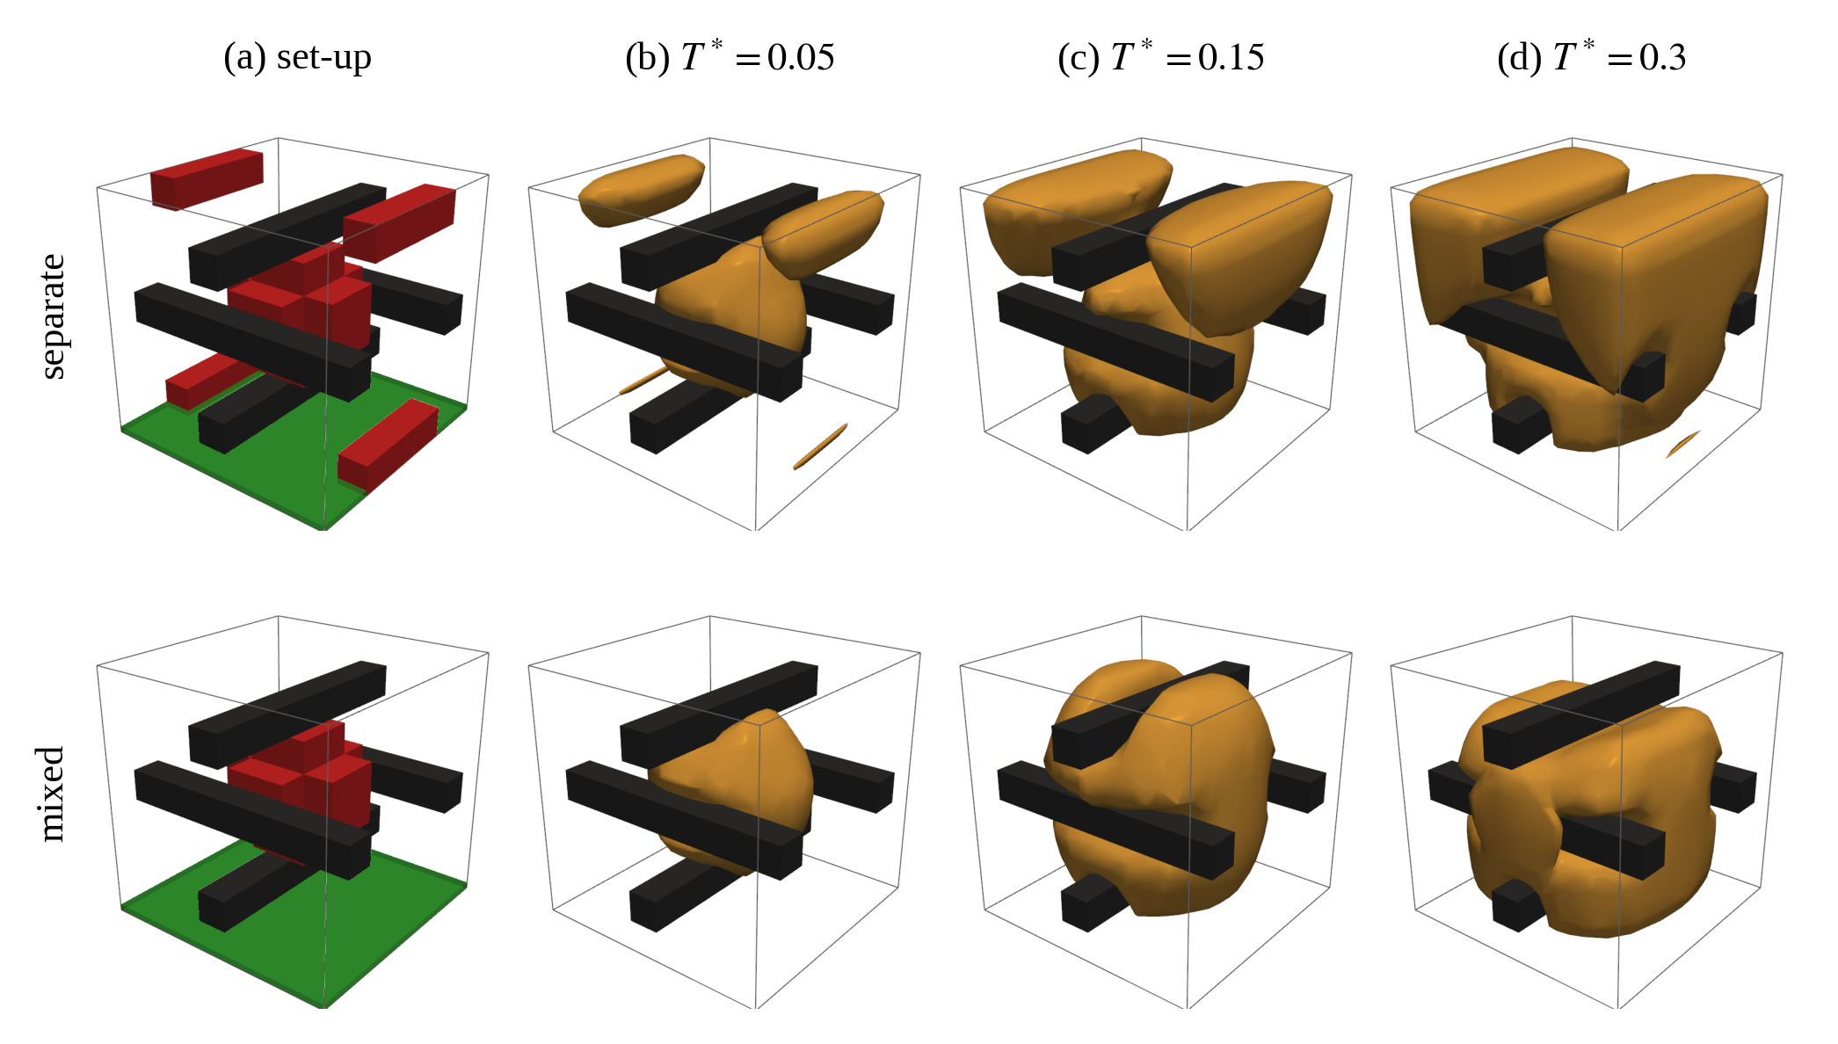
Growth around rigid bars (Klempt 2024, Sect. 4.3)
Four bars after Fig. 9 of the paper (positions read off the sketch), no biofilm or nutrient inside, frictionless contact
The biofilm grows around the bars and closes behind them, as in Fig. 10
The bars restrain the swelling: seed stress about ten times higher than without bars
Figure 5: φ_{3D} ≥ 0.5 around four rigid bars, separate (top) and mixed (bottom) start; set-up after Klempt et al. (2024), Fig. 9.

Slide 11
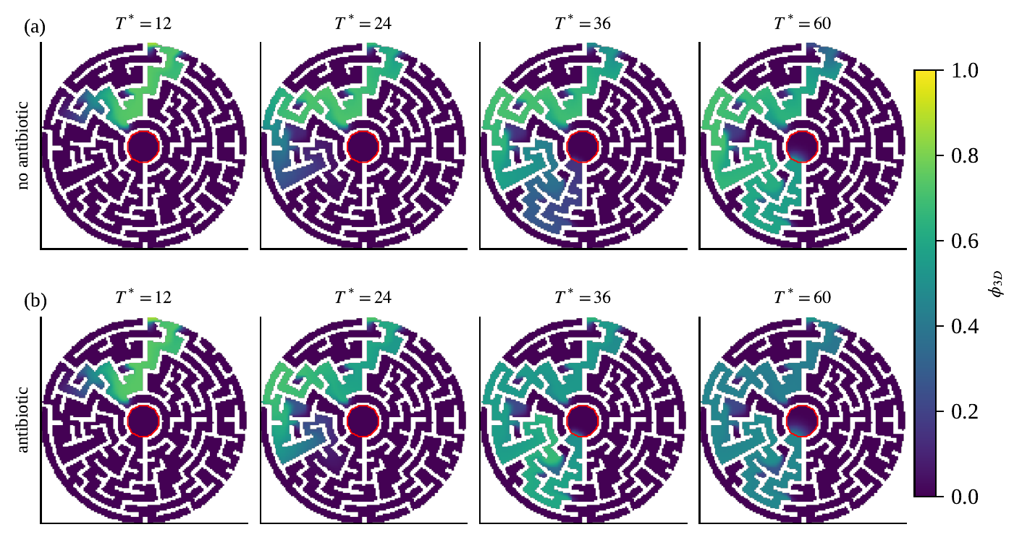
The maze of Fig. 11 with the coupling
Figure 6: φ_{3D} in the maze of Klempt et al. (2024), Fig. 11 (560 µm across, 2D, h = 4 µm, Table 6 constants), without (a) and with (b) antibiotic held at the entrance from T* = 20. Nutrient held in the centre (red), colony at the entrance (top).
The biofilm follows the corridors, also into dead ends, and comes within about 40 µm of the source by T* = 60; with the antibiotic it stays about 130 µm away.

Slide 12
Questions and next steps
Questions for you
Next steps
1. How was the front term −r c/(k+c) n_c·∇φ stabilised in the runs of Klempt 2024? The cell Péclet number is about 25 on the paper's mesh.
2. Can I keep the three element fixes (nearest Gauss point at the surface, conservative Laplacian, neighbours by distance)?
3. Is a stabilised front term acceptable in the thesis, stated as a numerical treatment of Eq. 34?
• Element runs on 24³ with the Lax–Wendroff form for the convergence table
• Thesis finished by 4 November with the results up to then
• Thesis PDF by 14 December, colloquium on 16 December
• A joint paper on the coupling and its verification, aimed at June 2027

Slide 13
References
[1] F. Klempt, M. Soleimani, P. Wriggers, P. Junker. A Hamilton principle-based model for diffusion-driven biofilm growth. Biomech. Model. Mechanobiol. 23 (2024) 2091–2113.
[2] F. Klempt, H. Geisler, M. Soleimani, P. Junker. A continuum multi-species bacterial growth model with a novel interaction scheme. Arch. Appl. Mech. 96 (2026) 164.
[3] L. Fritsch, H. Geisler, J. Grashorn, F. Klempt, M. Soleimani, M. Broggi, P. Junker, M. Beer. Bayesian updating of constitutive parameters under hybrid uncertainties with a novel surrogate model applied to biofilms. arXiv:2512.15145 (2025).

Slide 14
Appendix A: notation
φ_{3D}, α | biofilm phase field and growth (F_{g} = α I, α(0) = 1), Klempt et al. 2024
c, a | nutrient and antibiotic fields (the element's first and second nutrient field)
β, k_{α}, r, k | diffusion of φ, growth rate, front speed, Monod constant (Eqs. 34, 36)
d, g | diffusion and uptake of c and a (Eq. 35)
φᵢ, ψᵢ, φ₀ | volume fraction and living fraction of species i, void (Klempt et al. 2026)
φ̄ᵢ = φᵢψᵢ | living volume fraction of species i; Σᵢ φ̄ᵢ enters the consumption
c* = c*₀ c, α* = α*₀ a | nutrient and antibiotic seen by the point model (not the growth α)
T*, s | normalised time; point-model time per unit T* (s = 0.1)

Slide 15
Appendix B: equations and constants
φ̇_{3D} = β∇²φ_{3D} + k_{α}α − r c/(k + c) n_{c}·∇φ_{3D} (Eq. 34)
ċ = d∇²c − g φ_{3D} (Σᵢ φ̄ᵢ) c, ȧ = d∇²a − g φ_{3D} (Σᵢ φ̄ᵢ) a (Eq. 35; gφ printed is a misprint)
α̇ = k_{α} φ_{3D} (Eq. 36, unchanged)
Point model of Klempt et al. 2026 at every Gauss point as published, with Σᵢ φᵢ + φ₀ = 1
β | 0.02 mm²/T* | Klempt 2024 Table 2, converted to the 2 mm cube
d, g | 10⁸ mm²/T*, gℓ²/d = 1 | Table 2 (fields quasi-steady within 4e−8 T*)
r, k, k_{α} | 10 mm/T*, 1, 10⁻³ 1/T* | Table 2
E, ν | 10 Pa, 0.49 | Table 2; void floor f = 10⁻³ (converged)
A, b, η, c*₀, s | Fritsch case I, 100, 0.1 | Fritsch et al. 2025
α*₀, onset | 100 from T* = 1/3 | Klempt 2026 case 4
φ_{min} | 0.001 | not in a paper; converged (assumption)

