Slide 1
Biofilm Growth and Stress on a Real Molar
3D demonstrations of the growth model, with converged stresses and no experimental data
Keisuke Nishioka
Institute of Continuum Mechanics (IKM), Leibniz Universität Hannover
20 October 2026
Notes:
I will show the growth model of my thesis in three dimensions, first on the thesis test problem and then on a real molar, with stresses that I checked against mesh refinement.

Slide 2
What I show
• Growth model of Klempt et al. (2024): phase φ with dφ/dt = β∇²φ + k_α α (plus the bound on φ), growth F_g = α I, stiffness E(φ² + f), E = 10 Pa, ν = 0.49.
• Added in this work: a nutrient supplied by the saliva and used up by the biofilm (Klempt et al. 2024, Eq. 35), and a growth limit by pressure, ω = min(1, max(0, 1 − p/p_h)).
• Geometry: the thesis's 2 mm cube for verification, then a real lower first molar at its real size (surface from a public CC BY 4.0 data set).
• Every stress I quote is checked against mesh refinement; values that do not converge are not quoted.
• Only the verification problem is a thesis result. No experimental data are used.
2
Notes:
The growth model is the one of Klempt et al. 2024. I added a nutrient that the saliva supplies and the biofilm uses up, and a limit on growth by pressure. Only the first case is a thesis result, every stress I quote is mesh-converged, and no experimental data are used.

Slide 3
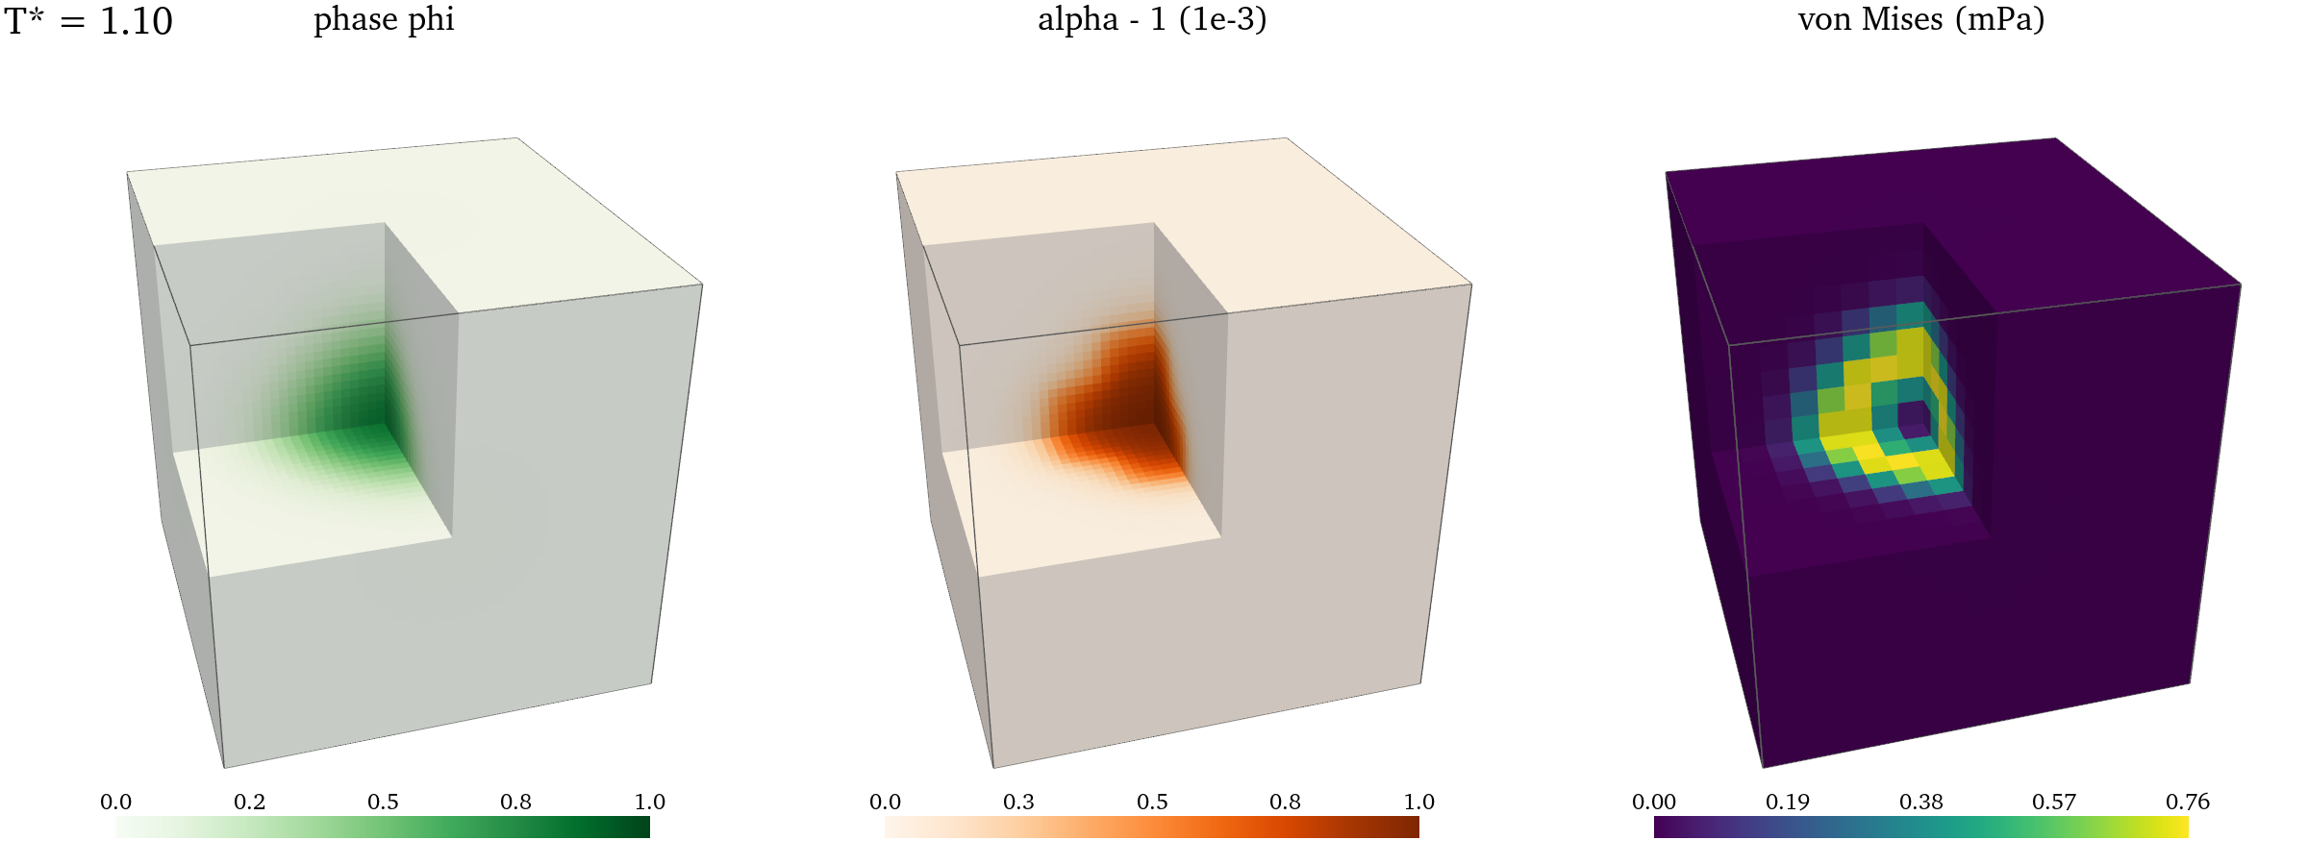
1. Verification: the thesis problem in 3D
β = 0.02 mm²/T*, k_α = 1e−3 /T*, E = 10 Pa, ν = 0.49, T* = 1.1; one octant cut away. Seed von Mises at T* = 1.1: 6.19e−4 Pa (thesis, 16³: 6.18e−4 Pa). The stress forms a ring at the edge of the seed.
3
Notes:
This is the verification problem of Chapter 4: a seed in the centre of the 2 mm cube. The seed stress at the end agrees with the thesis value to 0.2 percent, and the stress forms a ring at the edge of the seed.

Slide 4
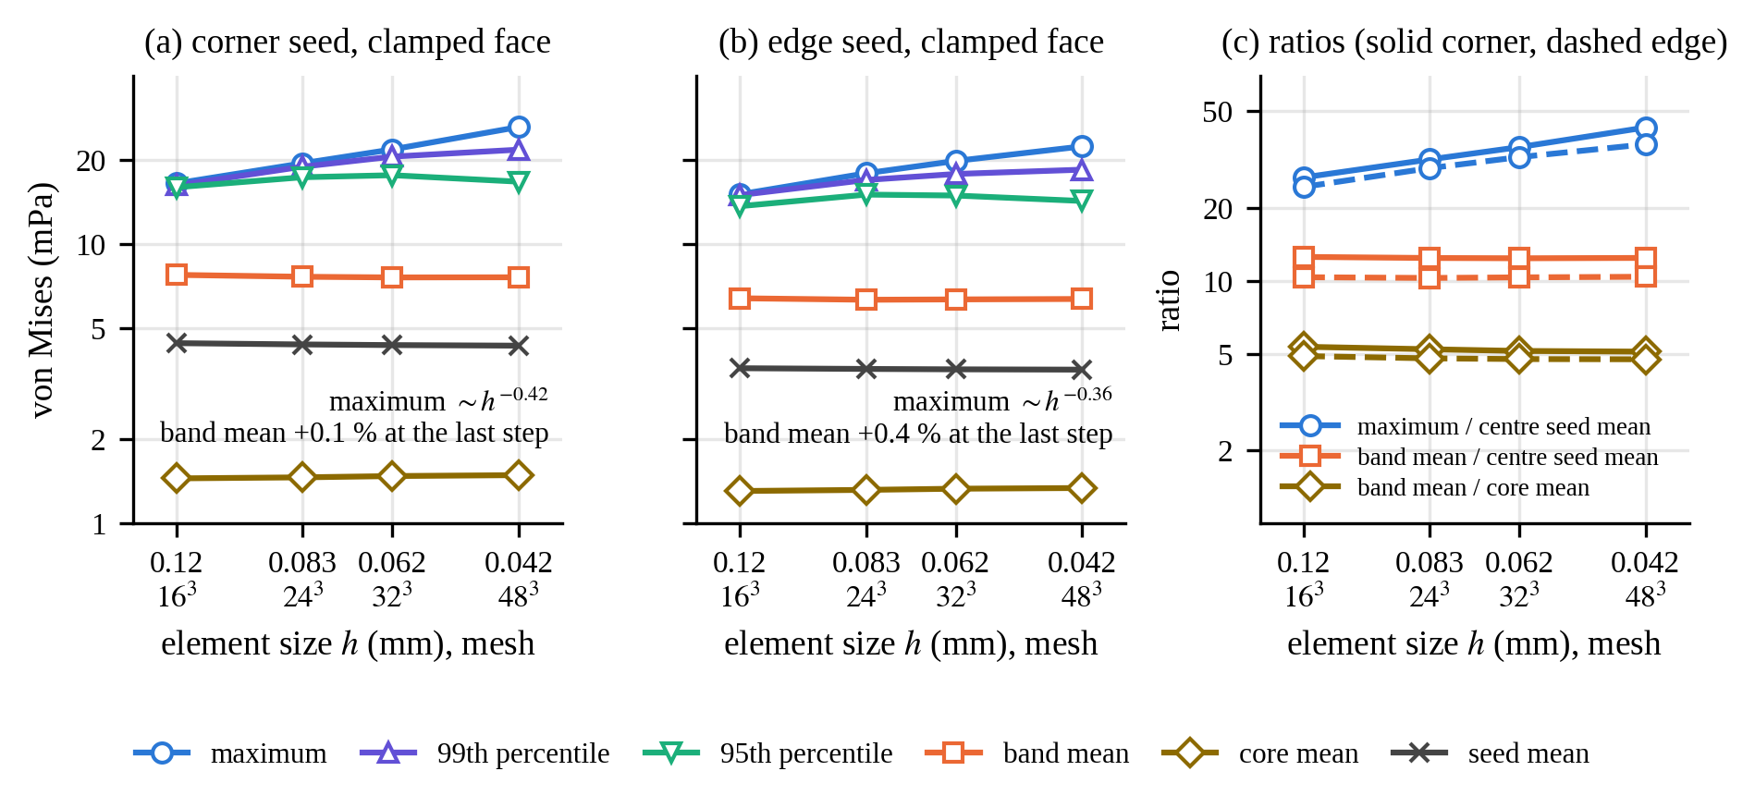
2. Stress next to a fixed surface: what converges
Seed on a clamped face of the cube, meshes 16³ to 48³. The mean stress in the biofilm next to the face converges (less than 1 % change from 24³ on) and is 10 to 12 times the seed stress of the verification problem. The pointwise maximum at the corner grows as about h^−0.4, so I quote means and percentiles only.
4
Notes:
When the seed touches a clamped face, the stress concentrates in the biofilm next to it. The mean over that layer converges, to within one percent, and is ten to twelve times the free-seed value. The pointwise maximum at the corner keeps growing with refinement, so I only quote means and percentiles.

Slide 5
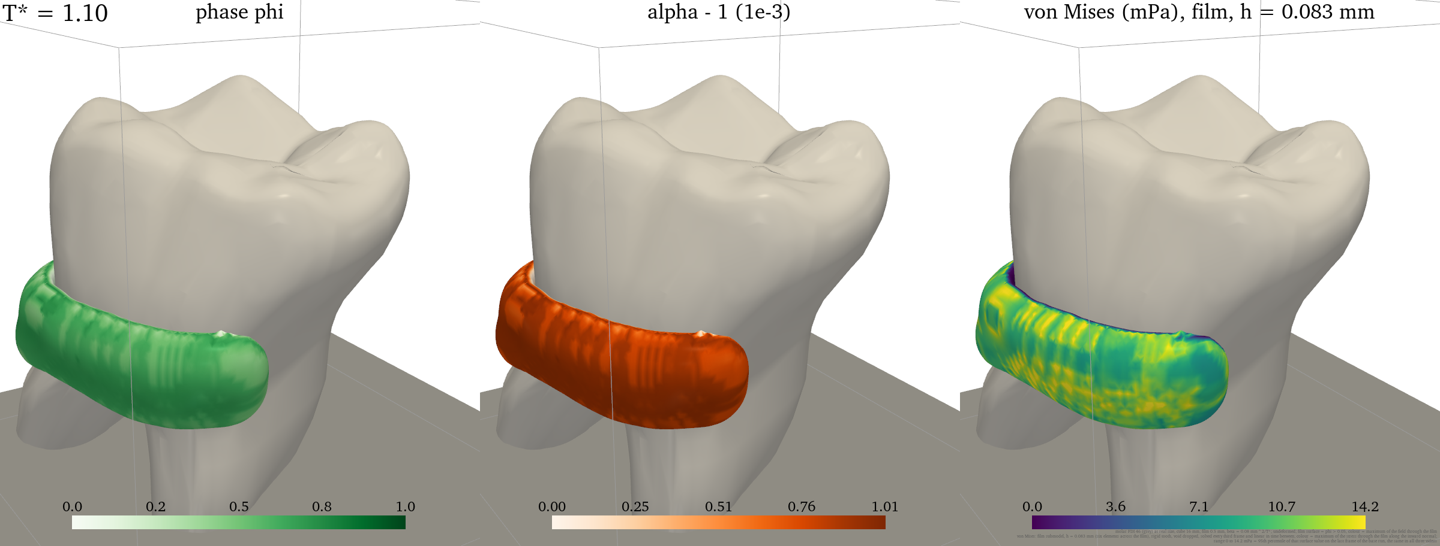
3. A biofilm on a real molar
Lower first molar at real size (crown about 10 × 12 mm) in a 16 mm box, root clamped; a 0.5 mm film on one flank at the cervical third. β scaled to 0.08 mm²/T* (an assumption). Growth converged to 2 %; stress from the film model.
5
Notes:
This is a lower first molar at its real size, from a public data set under CC BY 4.0. A half-millimetre film sits on one flank near the gum line. The growth field converges to two percent; the stress colours come from the film model of the next slide.

Slide 6
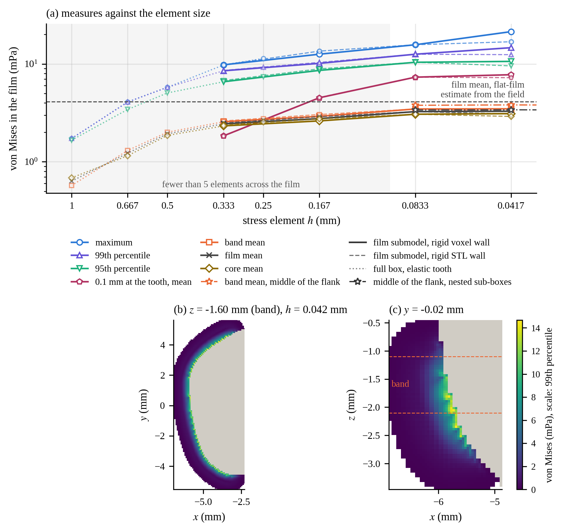
4. Resolving the stress in a 0.5 mm film
On meshes of the whole box the film is one or two elements thick and the stress does not converge. I solve the film alone with the tooth rigid (0.1 % effect), down to h = 0.028 mm. With six elements across the film the means converge: film 3.3 mPa (±1 %), cervical band 3.5, the 0.1 mm next to the tooth 7.8, 95th percentile 10.5 mPa.
6
Notes:
On meshes of the whole box the film is only one or two elements thick and the stress does not converge. I solve the film alone with the tooth as rigid, down to 28 micrometres. With six elements across the film the mean converges to 3.3 millipascal, and the highest values sit in the tenth of a millimetre next to the tooth.

Slide 7
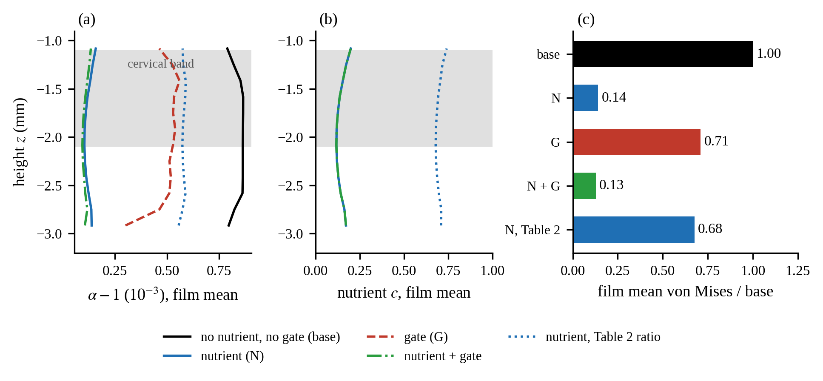
5. Nutrient and the growth limit on the molar
Nutrient from the saliva, consumption gφc with g/d = 10 /mm² (chosen; 10 times the Table 2 ratio): c falls to 0.07 at the tooth, growth and stress drop to about one seventh. At the Table 2 ratio they drop to 0.68. The growth limit alone (p_h half the film pressure without it, a choice) gives 0.71. Stress: end states re-solved with the film model.
7
Notes:
With the nutrient used up in the film, growth and stress drop to about one seventh; at the paper's ratio to two thirds. The pressure limit alone gives about 0.7. The consumption rate and the threshold are my choices.

Slide 8
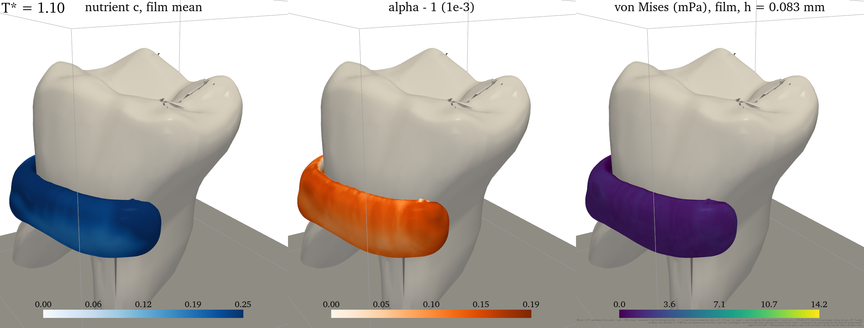
5. Nutrient and growth limit: videos
Nutrient and growth limit together; same colour scale for the stress as the base video (0 to 14.2 mPa).
8
Notes:
With the nutrient used up in the film, growth and stress drop to about one seventh; at the paper's ratio to two thirds. The pressure limit alone gives about 0.7. The consumption rate and the threshold are my choices.

Slide 9
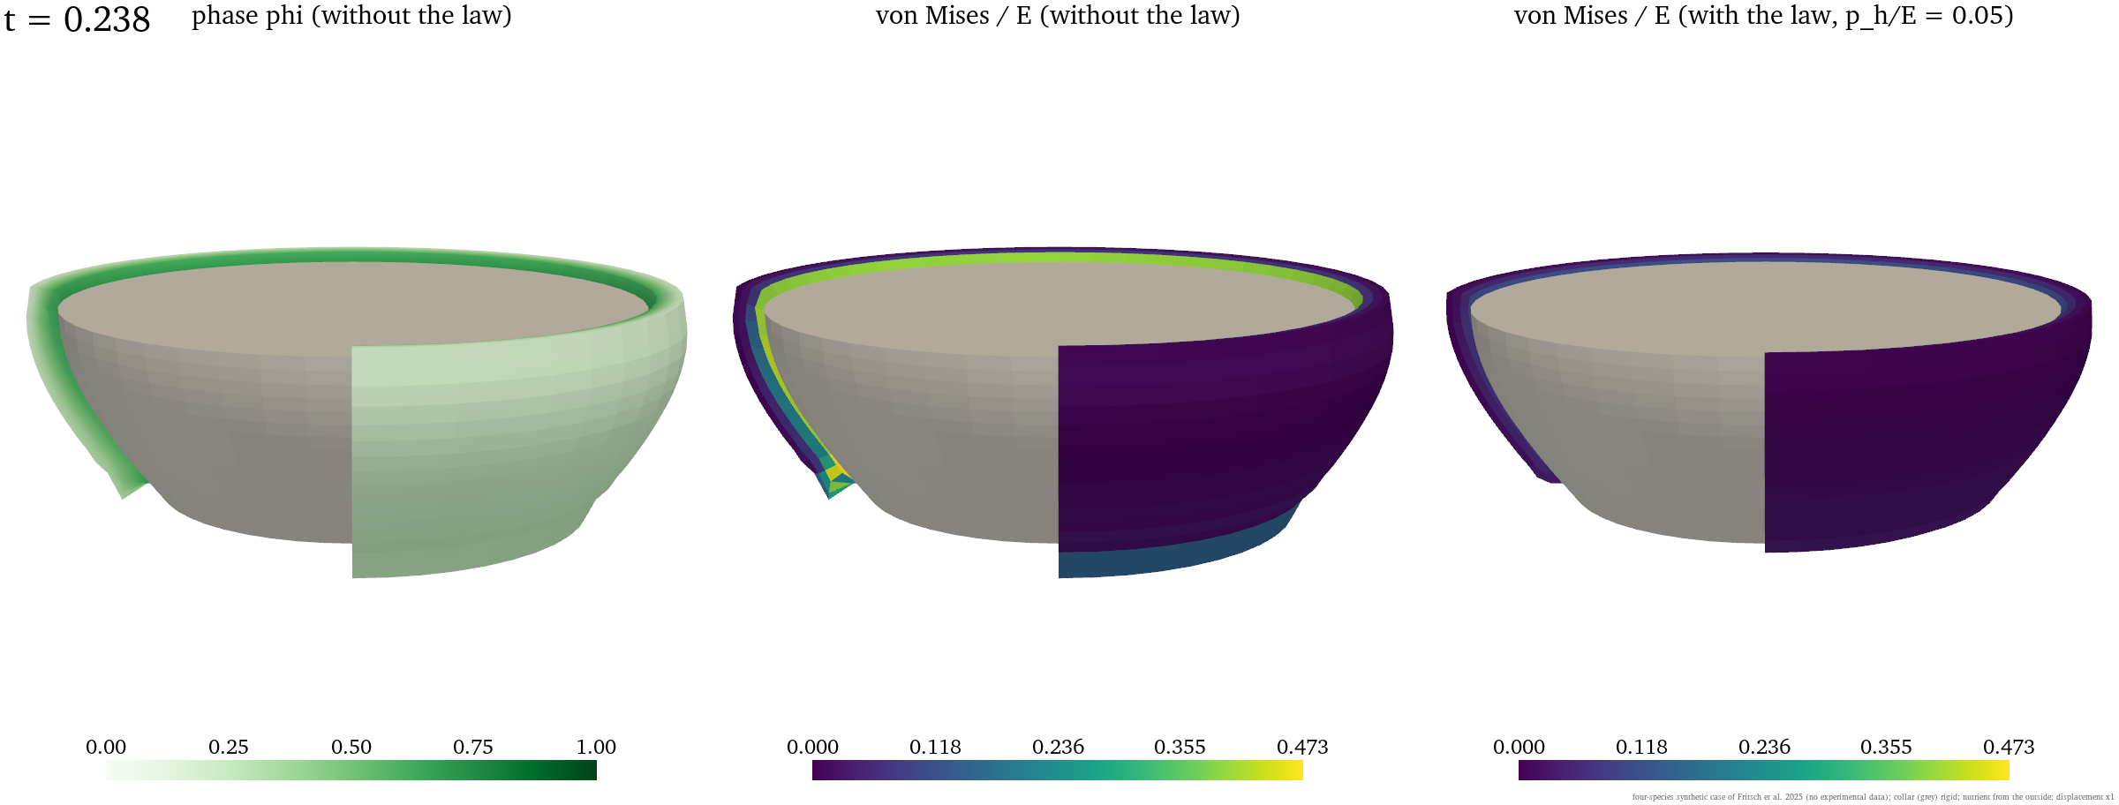
6. Four species on a tooth-like collar (synthetic data)
A 0.25 mm layer on a crown-shaped collar, inner face bonded, nutrient from the outside. Point model: the four-species case of Fritsch et al. (2025) with their true parameters. One quarter cut away; finite strain.
9
Notes:
On a crown-shaped collar I use the four-species synthetic case of Fritsch et al. 2025 with their true parameters, so no experimental data enter. Growth is large here, so this run is finite strain.

Slide 10
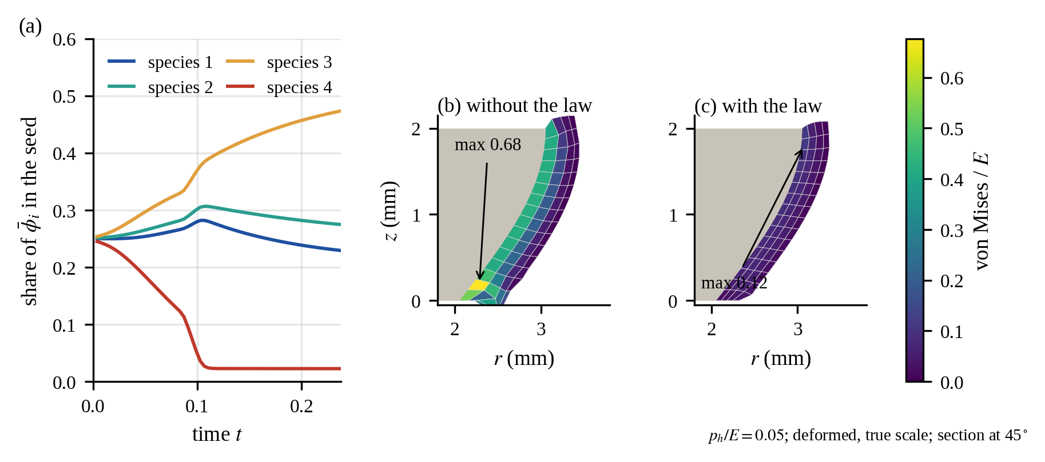
6. Section and composition
(a) Species 3 takes over the seed (share 0.47), species 4 almost disappears (0.02). (b), (c) Section at 45°: without the limit the von Mises stress reaches 0.68 E at the bonded base; with p_h/E = 0.05 the largest value is 0.12 E.
10
Notes:
Species three takes over and species four almost disappears. Without the limit the stress reaches 0.68 times E at the bonded base; with it, 0.12 times E.

Slide 11
Summary
• The 3D view reproduces the thesis value of the seed stress (0.2 % difference).
• Next to a fixed surface the biofilm stress is 10 to 12 times the free-seed value (converged band mean).
• On a real molar a 0.5 mm film needs about six elements across it; then the film mean is 3.3 mPa (E = 10 Pa), highest in the 0.1 mm next to the tooth.
• A nutrient limited by consumption lowers growth and stress more than the pressure limit.
• Tooth surface: Diaz, Ferro Sánchez, Campo, Mendeley Data (2024), doi:10.17632/xjsx7nfhj8.1, CC BY 4.0.
• Next at Keio: the calibrated parameters of Chapter 3 on this molar, and an implant.
11
Notes:
The 3D view reproduces the thesis value. Next to fixed surfaces the stress is ten to twelve times the free value. On the real molar the film needs six elements across it, and then the film mean is 3.3 millipascal. Next at Keio: the calibrated parameters on this tooth, and an implant.

