Slide 1
WCCM–ECCOMAS 2026 · CONCEPT STUDY
Weak-form FEM Operator Learning
+ Online Adaptation
for semiconductor device simulation (GAA / CFET / TSV)
FEM as the authority on accuracy · networks & continuation as accelerators
12 self-contained, seed-fixed concept demos
〈氏名・所属〉 · github: keisuke58/wccm2026-cfrp-gnn

Slide 2
MOTIVATION
The Poisson solve is the TCAD bottleneck
Device TCAD self-consistently couples Poisson ↔ drift-diffusion (Gummel / Newton).
The innermost, most-repeated step is the Poisson (nonlinear Poisson) solve.
On GAA/CFET meshes this is re-solved thousands of times per bias & per design.
Goal: accelerate it with machine learning — without giving up FE accuracy.
Poisson −∇·(ε∇φ) = ρ(φ)
bottleneck
Drift-diffusion (n, p currents)
self-consistent loop (repeat to convergence)
2

Slide 3
WHERE THE FIELD IS
ML for device simulation — and the open lane
1
Compact / SPICE models
mature
2
CNN grid-Poisson surrogates
strong-form
3
PINN coupled systems
strong-form
4
GNN / diffusion on meshes
strong-form
5
DeepONet / FNO operators
operator
6
Solver convergence acceleration
warm-start
7
MC transport (Otsuki & Mori)
MC + FD
8
Inverse design / online learning
frontier
Surrogates ②–④ are overwhelmingly strong-form / grid-based → the weak-form (FEM) operator lane is open.
3

Slide 4
THE IDEA
Put the weak form (FEM) at the core
Strong form (finite differences / PINN) enforces the PDE pointwise — and breaks flux continuity [ε ∂φ/∂n] = 0 at material interfaces (variable ε).
Weak / Galerkin form builds interface flux-continuity into the assembled residual — naturally robust to variable ε and unstructured meshes.
strong form (pointwise)
weak form (Galerkin FE)
residual = Δφ + ρ/ε at nodes
residual = K(ε)φ + κ·M·sinh(φ) − Mρ
interface flux continuity: not guaranteed
interface flux continuity: built in
4

Slide 5
PROPOSAL
Four components: A · D · B · C
A
Weak-form loss / data
D
FE a-posteriori error
Physics loss = assembled FE residual K(ε)φ−Mρ (Galerkin), not a pointwise Laplacian.
One residual estimator unifies mesh refinement and the online-learning trigger.
B
Operator learning branch
C
Net = accelerator
GNN / DeepONet branch ingests mesh & conditions (mesh-agnostic, repo-native).
FEM stays the accuracy authority; the net only warm-starts Newton / continuation.
5

Slide 6
DIFFERENTIATION
Method-level, not application-level
Otsuki & Mori (baseline)
This work
3D Monte-Carlo transport for GAA
Poisson inside the MC loop replaced by a PI-DeepONet
Discretization core: strong-form finite differences
Online learning accelerates the MC run
Weak-form (Galerkin FE) at the operator core
Interface-robust residual K(ε)φ−Mρ as the physics loss
FE a-posteriori estimator drives refinement + online trigger
FEM keeps accuracy; net / continuation only accelerate
Same receptive frame ("ML accelerates TCAD"); the discretization core differs — demo ② quantifies it.
6

Slide 7
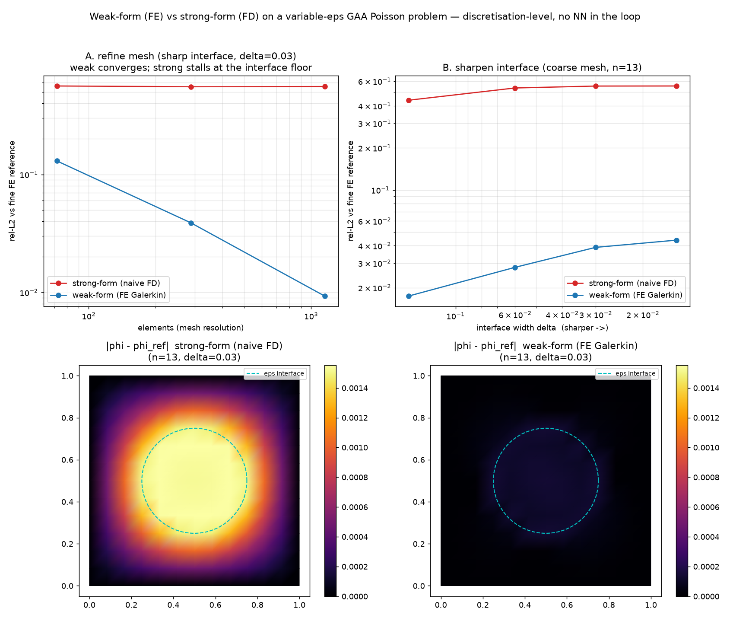
DEMO ② — THE ONE-PANEL NOVELTY
Weak form vs strong form (no NN involved)
2
Pure discretization test at a material interface (variable ε).
Weak form converges at O(h²); strong form stalls at an interface-error floor.
This is the quantitative backbone for "why weak form".
O(h²)
~0.55
weak: 0.13 → 0.0093
strong: floor
bench_weak_vs_strong.py — FE vs FD, refinement + interface study
7

Slide 8
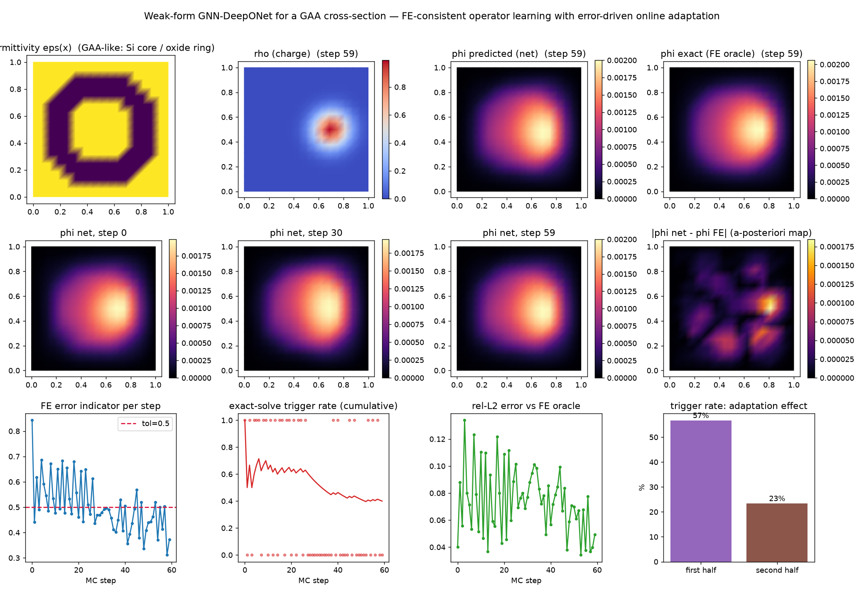
DEMO ① — OPERATOR LEARNING + ONLINE ADAPTATION
Weak-form PI-DeepONet with an FE error trigger
1
GNN-branch DeepONet trained on the Galerkin residual (idea A+B).
FE a-posteriori estimator triggers an exact solve only when needed (idea D).
Replay adaptation lowers the trigger rate as deployment proceeds.
24 / 60
57%→23%
triggered exact solves
trigger rate
pi_deeponet_fem_gaa.py — rel-L2 0.074 at unchanged FE accuracy
8

Slide 9
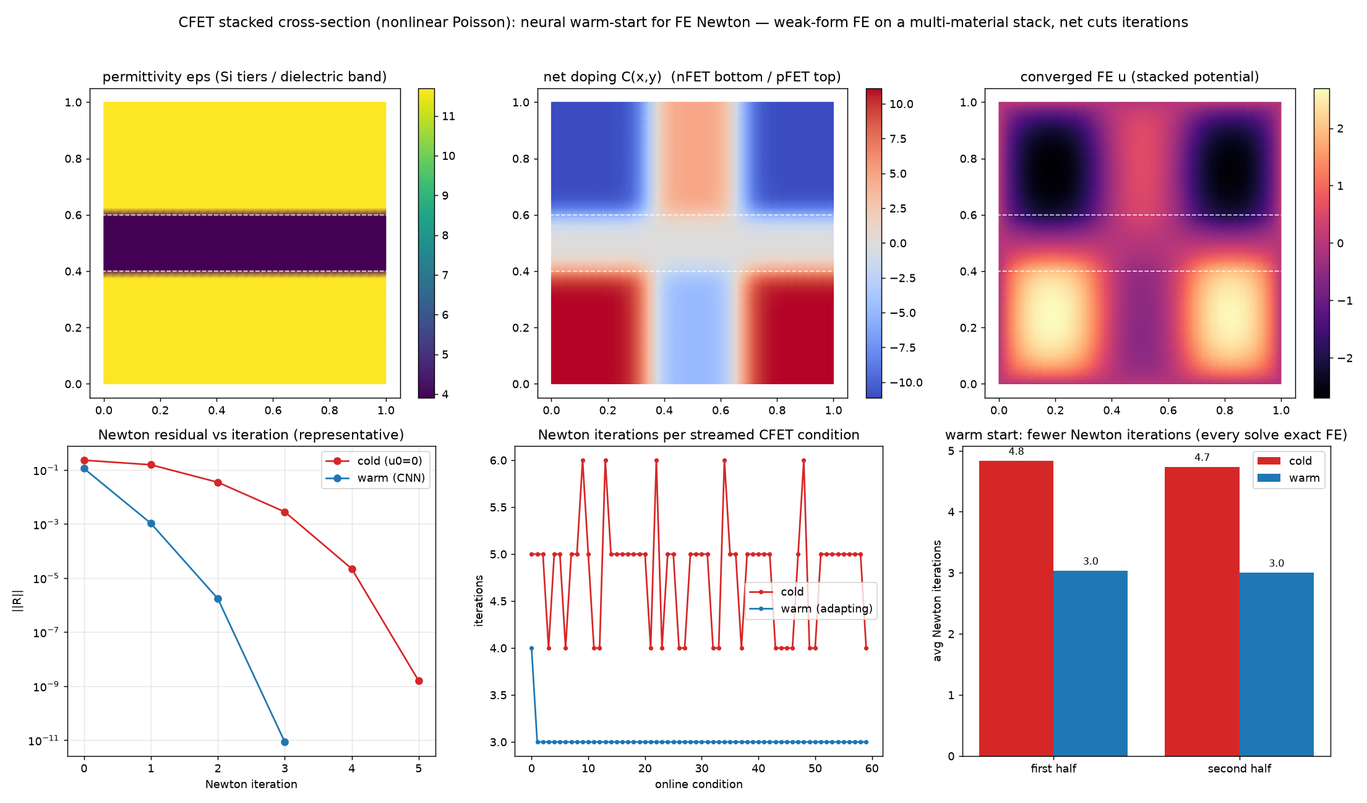
DEMOS ③ ④ ⑤ — IDEA C, NEWTON WARM-START
Learned warm-start: 1D → 2D GAA → CFET stack
3
4
5
A learned initial guess seeds damped Newton; every solve stays exact FE.
1D nonlinear Poisson → 2D GAA slice → multi-material CFET cross-section.
FEM guarantees accuracy; the net only cuts iterations.
~40%
4.8→3.0
fewer Newton iters
CFET cold→warm
cfet_stack_warmstart.py (n/p stack) — cf. fe_/dd2d_ warm-start demos
9

Slide 10
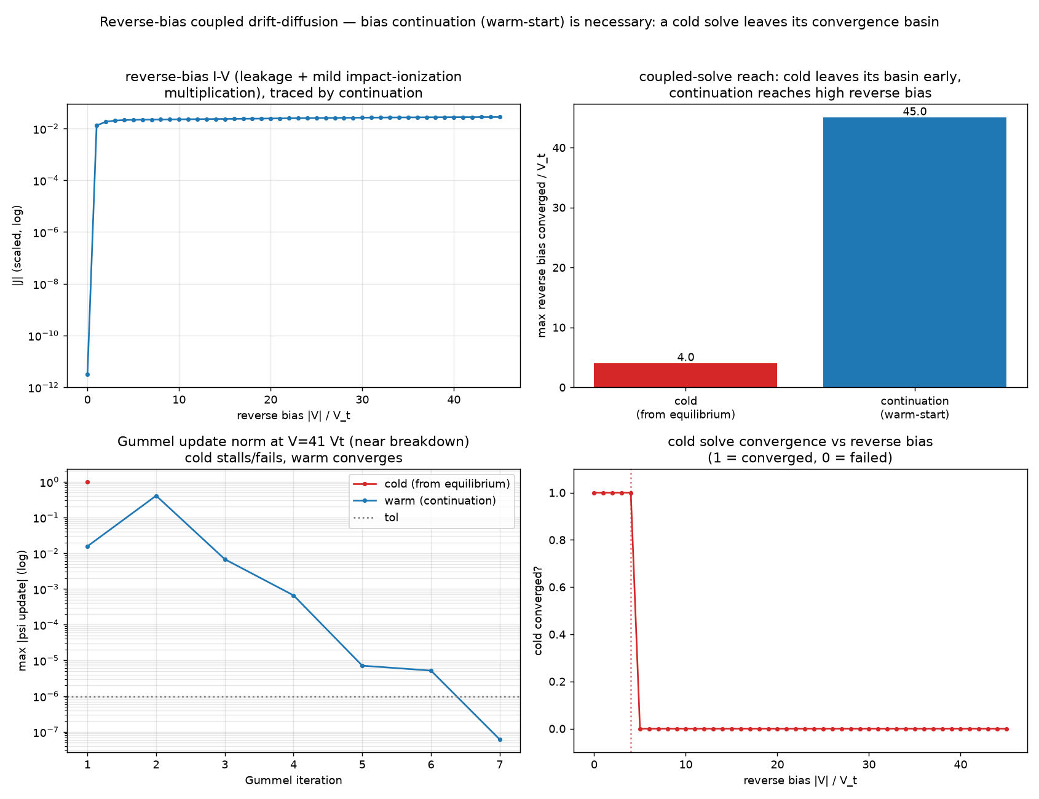
DEMOS ⑧ ⑨ — FULL DRIFT-DIFFUSION
Coupled DD: ideal diode & continuation at high bias
8
9
1D pn junction, Scharfetter–Gummel + Gummel (⑧): ideal-diode I–V validated.
High reverse bias (⑨): cold start diverges at 4 V_t; continuation reaches 45 V_t.
Here idea C is not "faster" — it decides convergence vs divergence.
4 V_t → 45 V_t
J∝e^{V/Vt}−1
cold diverges → continues
diode validated
dd_breakdown_continuation.py — impact ionization kept mild (~×2.1)
10

Slide 11
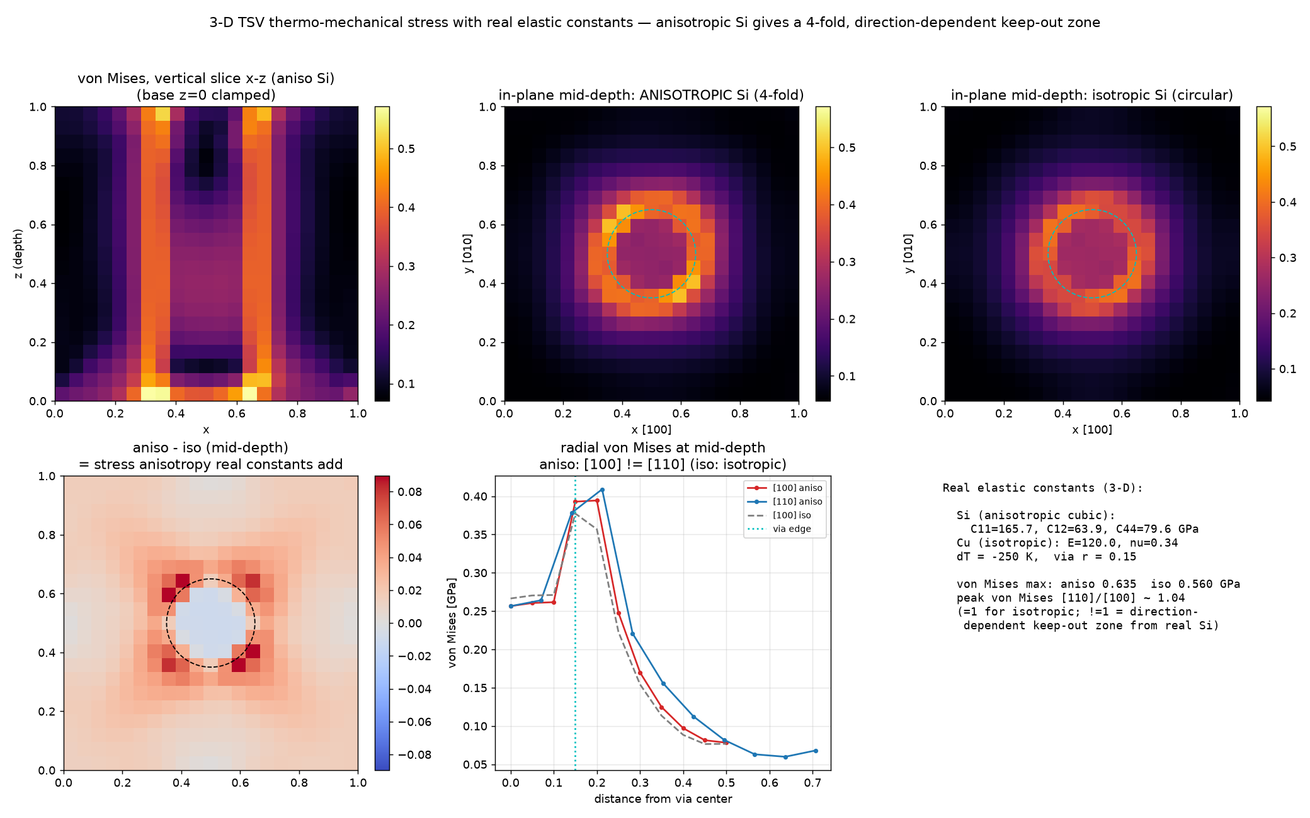
DEMOS ⑥ ⑦ — TSV THERMO-MECHANICAL STRESS
3D-stack packaging: FE thermoelasticity + KOZ
6
7
2D (⑥): CNN stress-field surrogate + keep-out-zone from FE thermoelasticity.
3D (⑦): real elastic constants — anisotropic Si (C11/C12/C44) vs isotropic Cu.
Anisotropy gives 4-fold (cloverleaf) stress → direction-dependent KOZ.
IoU 0.819
2 analytic PASS
⑥ keep-out zone
⑦ machine precision
tsv_3d_stress.py — bridges to the repo's CFRP stress × GNN core
11

Slide 12
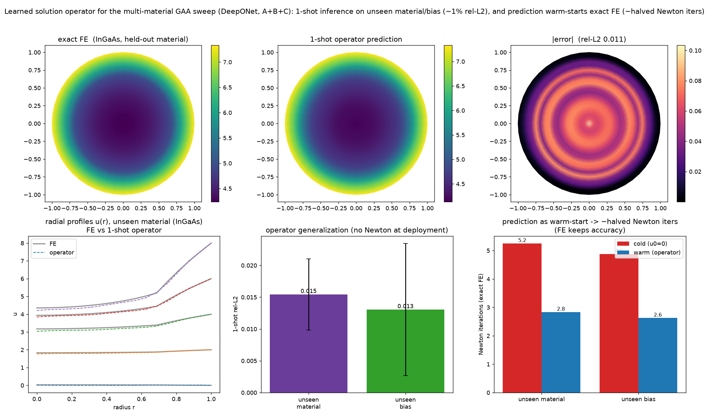
DEMOS ⑩ ⑪ — REAL MULTI-MATERIAL TCAD WORKLOAD
Material sweep amortized, then made a learned operator
10
11
Mirrors Balaji+2026 (Sentaurus): Si/Ge/GeSn/InGaAs/MoS₂ × bias, cylindrical GAA.
⑩ continuation amortizes 45 self-consistent FE solves (217→161 Newton iters).
⑪ DeepONet: 1-shot on an unseen material, then warm-starts FE (A+B+C unified).
rel-L2 0.015
5.2→2.8
⑪ unseen material
⑪ warm-start iters
gaa_operator_deeponet.py — normalization uses train materials only (no leak)
12

Slide 13
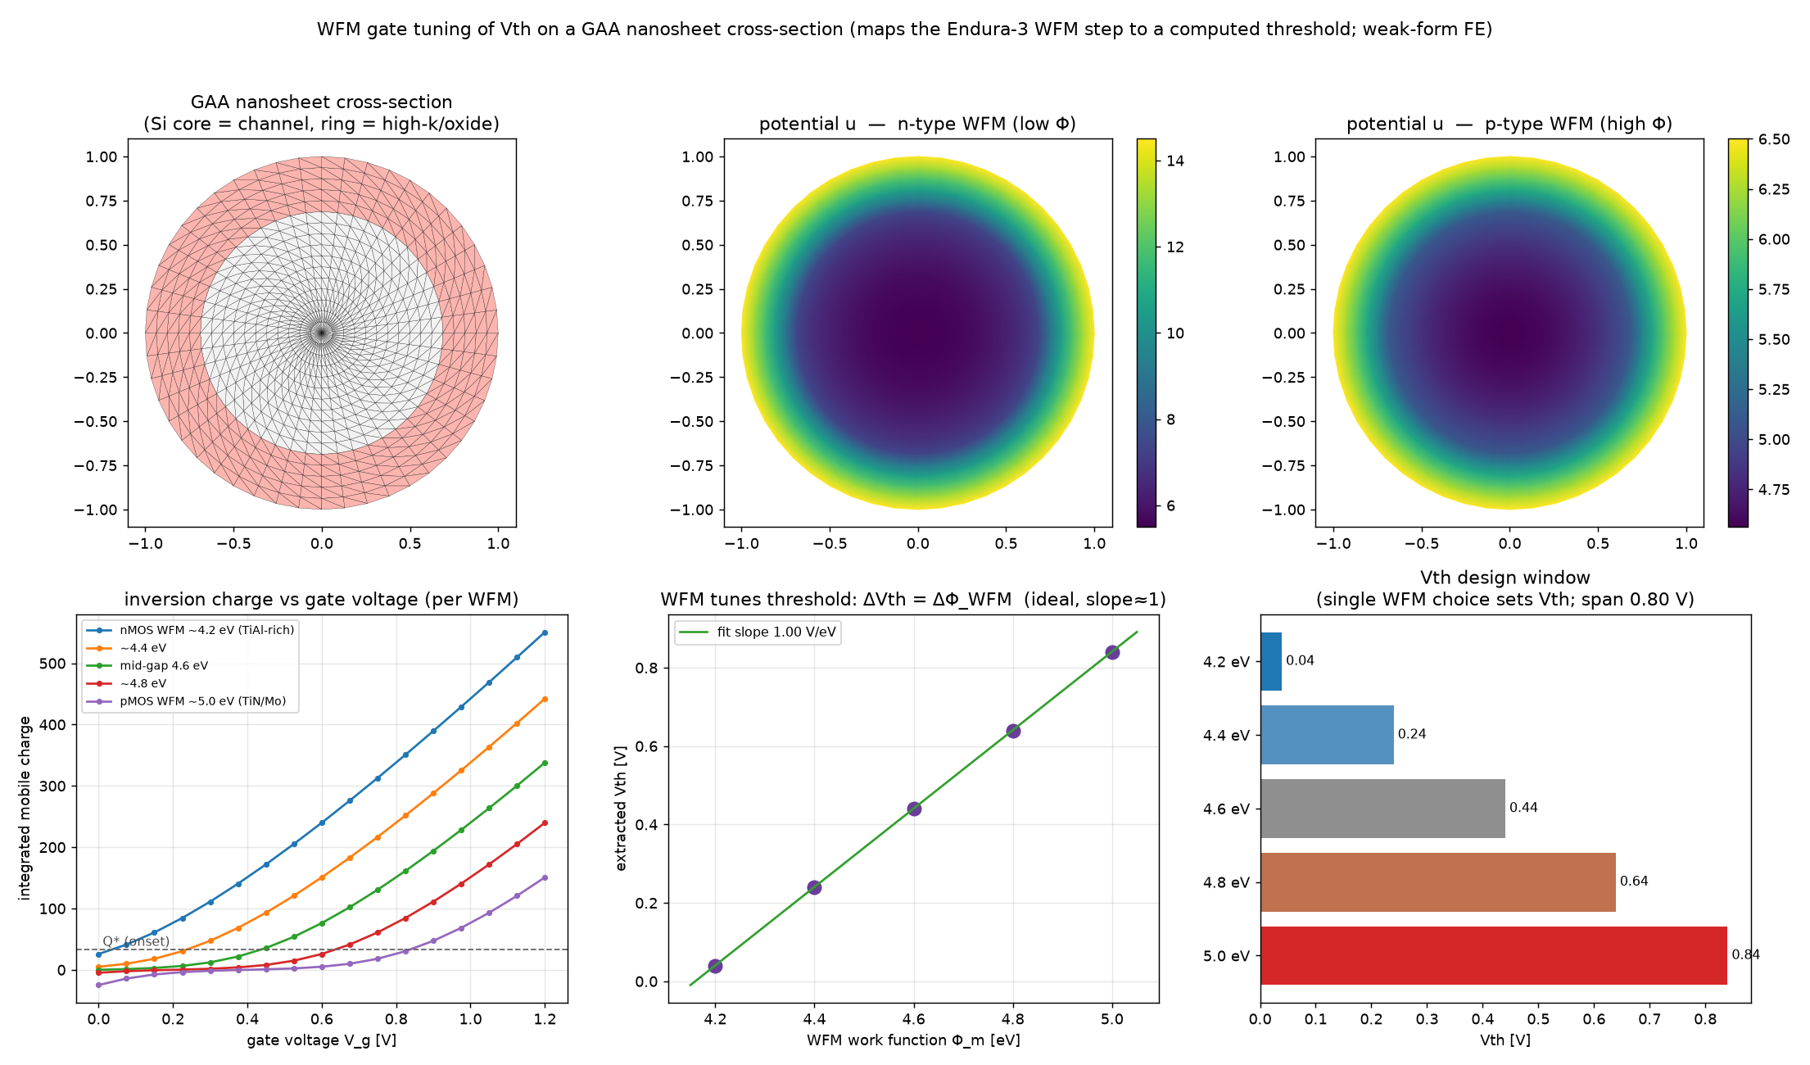
DEMO ⑫ — WFM TUNES THE THRESHOLD VOLTAGE
Work-function metal → Vth on the GAA cross-section
12
Maps the pilot-line WFM step (Applied Endura-3 class) to a computed threshold.
5 WFM (Φ_m 4.2–5.0 eV): FE Q–V_g solves on the disk → extract Vth per metal.
Recovers the ideal flat-band law ΔVth = ΔΦ_WFM on the real cross-section.
1.00 V/eV
0.04→0.84 V
ΔVth / ΔΦ_WFM (slope)
Vth design window
gaa_wfm_vth.py — ideal flat-band model (no traps/poly-depletion), illustrative scale
13

Slide 14
FROM FAB TO SIMULATION
Pilot-line process ↔ what we simulate
AIST advanced-semiconductor pilot line (GAA nanosheet) → this work's demos
Si nanosheet channel — SiGe release (Certas)
GAA nonlinear Poisson ①③④⑩⑪⑫
High-k + WFM gate (Eagle-XP4 / Endura-3)
variable-ε interface · WFM→Vth ②⑫
SiGe → Ge / GeSn channels (EpiPrime)
multi-material sweep ⑩⑪ (Balaji+2026)
CFET / 3D stack / TSV (next node)
CFET slice ⑤ · TSV thermo-mech ⑥⑦
material × bias TCAD sweep (Sentaurus)
continuation ⑩ · learned operator ⑪
14

Slide 15
NATIONAL CONTEXT
Post-5G “B” national project ↔ our demos
METI / NEDO Post-5G · 先端半導体製造技術 (B) — ¥76.9 B budget · target 2030: ¥15 T domestic semiconductor sales
B-a1 前工程 · GAA nanosheet
TEL / SCREEN / Canon + AIST pilot line
GAA electrostatics ①③④⑤⑩⑪⑫
B-b1/b2 後工程 · 3D packaging · WoW/CoW
TSMC 3DIC / RaaS / Sony
TSV thermo-mechanics ⑥⑦ (+ CFRP×GNN)
new channel / interconnect · SiGe·Ge·2D, Cu→Ru
multi-material sweep ⑩⑪ (Balaji+2026)
B-d1 国際連携 · 2 nm logic (Rapidus)
the target device (context)
15

Slide 16
HONEST LIMITATIONS
What is — and is not — demonstrated
All 12 are concept demos (CPU, minutes, seed-fixed).
①'s error indicator is the raw relative Galerkin residual; the tolerance is calibrated, not a solution-error bound.
Warm-start on robust monotone solves gives modest gains (~10–40%); the decisive case is ⑨ (converge vs diverge).
1D full DD (⑧⑨) is implemented; coupled 2D/3D semiconductor DD (Full Newton, needs variable scaling) is future work.
"3D unimplemented" refers to semiconductor DD only — 3D thermoelasticity (⑦) is implemented.
⑩⑪ screening κ is an illustrative non-dimensional scale (ordering & trends are physical); ⑪'s disk is near radially symmetric.
16

Slide 17
ROADMAP
Next axes
True vertical-gate geometry + unstructured mesh
2D-CFET (2D-material channels)
True avalanche (implicit G) & 2D Full-Newton coupled DD (variable scaling)
Learned operator on asymmetric doping (trunk expressiveness) + GNN branch
η-driven h-refinement (AMR) with mesh-agnostic branch
3D stress-field surrogate; KOZ classification in the CFRP-defect GNN pipeline
17

Slide 18
TAKEAWAY
Weak form at the core makes the surrogate
interface-robust — FEM stays the authority,
learning & continuation only accelerate.
②
weak form: O(h²) vs strong-form floor
①
operator learning + FE-triggered online adaptation
③–⑤,⑩
warm-start / continuation: ~40% fewer iters
⑨
continuation decides converge vs diverge
⑪
learned operator: 1-shot on unseen material
⑥⑦
TSV thermo-mechanics → bridges to CFRP × GNN
18

Slide 19
APPENDIX — INDUSTRY CONTEXT
Operating models: imec vs 産総研/TIA vs LSTC/Rapidus
項目 | imec (BE) | 産総研 / TIA (JP) | LSTC / Rapidus (JP)
モデル | IIAP：産業界の会費で回る中立ハブ | 共用ライン＋コンソーシアム＋国プロ | 束ね役 → 2nm 量産（imec/IBM 連携）
資金 | 会費主体・政府 ~15%（~€8–9 億/年） | 国費（運営費交付金）主体・~1,000 億/年 | 国費（経産/NEDO）中心
参加・IP | 出資に応じた階層アクセス | 会員制／助成は事業者帰属 | 組合員・企業帰属
強み | 中立・グローバル・意思決定が速い | 計量標準・材料・中立インフラ | 量産直結・海外連携
弱み | 自国の産業化は間接的 | 分散・スピード・処遇で見劣り | 新興・巨額の国費依存
出典整理: research/SEMICON_NATIONAL_RD_ECOSYSTEM.md（数値は概算・要確認）。日本の座組は 基礎/材料(NIMS)→共用試作(AIST/TIA)→束ね(LSTC)→量産(Rapidus) のバケツリレー。
19

