Slide 1
ICT03A: Advanced Robotics #2 Frame Transformation
Keitaro Naruse
Email: naruse@u-aizu.ac.jp

Slide 2
2D frame transformation

Slide 3
Motivation: Mapping 動機: 地図生成
Frame := Coordinate system フレーム= 座標系
Suppose we detect and measure an object in a robot frame
How do we convert it to world frame in a single step?
This is two-step: rotation（回転） and translation（並進）
Y_{W}
X_{V}
Y_{V}
O_{V}
O_{W}
X_{W}

Slide 4
2D Homogeneous Transformation Matrix 二次元同次変換行列
Y_{W}
1-step transformation by homogeneous transformation matrix
X_{V}
Y_{V}
It is a special version of Affine transformation
Only translation and rotation
No scale and shear
because we consider only a rigid body
O_{V}
O_{W}
X_{W}

Slide 5
Matlab Sample Code of 2D Homogeneous Trans. Matrix
function [T] = T2D(x, y, q)
%T2D returns 2D homogeneous trannsformation matrix
% from a target frame to a world frame
% Input
% - x: x coordinate of target x-origin in a world frame
% - y: y coordinate of target y-origin in a world frame
% - q: angle from a world to target frame
% Output
% - T: 3*3 matrix
T = [
cos(q), -sin(q), x;
sin(q), cos(q), y;
0, 0, 1
];
end

Slide 6
Matlab Sample Code of 2D Homogeneous Trans. Matrix
% Vehicle frame to world frame
X = 6.0; Y = 3.0; Q = deg2rad(60.0);
T = T2D(X, Y, Q);
% Homegeneous points in vehicle frame
pV = [
1, 1, -1, -1; % x
-2, 4, 4, -2; % y
1, 1, 1, 1 % constant
];
% Homegeneous Points in world frame
pW = [ T*pV(:,1), T*pV(:,2), T*pV(:,3), T*pV(:,4)];
% Homegeneous points in vehicle frame
figure(1);
plot(pV(1,:), pV(2,:), 'b+-', pW(1,:), pW(2,:), 'r*-');
xlim([-10 10]); ylim([-10 10]); grid on; pbaspect([1 1 1]);

Slide 7
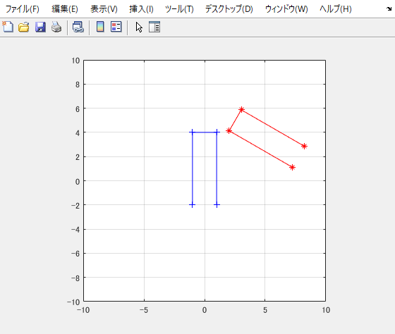
Results

Slide 8
Quiz #1: Frame Transformation in 2D
Suppose a vehicle moves as in the left figure
At each of the positions, it measures the four points from its local frame
Make an integrated map of sensed points with homogeneous transformation matrix

Slide 9
Example of Result

Slide 10
3D frame transformation

Slide 11
Motivation: Sensor in 3D Space 動機: 3次元空間でのセンシング
Translation in 3D is easy and no problem
However, the orientation in 3D is not so easy
Roll, Pitch, Yaw angle or Euler angle
Rotation matrix
Quaternion
SO(3): Special Orthogonal Group of 3
3D Homogeneous transformation matrix 3次元同次変換行列
Z_{W}
Z_{S}
Y_{S}
Camera
LIDAR
X_{S}
Y_{W}
O_{W}
X_{W}

Slide 12
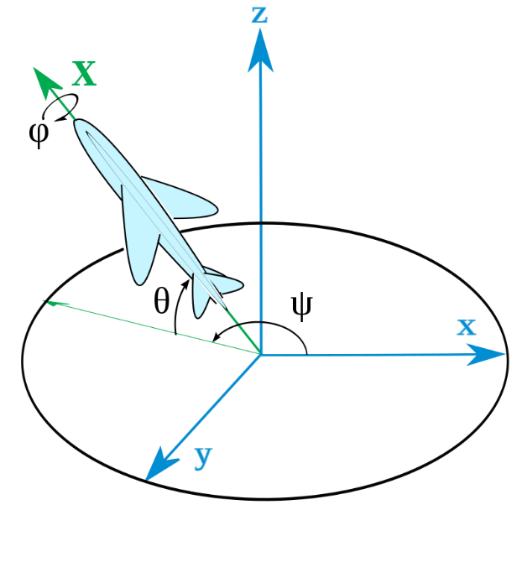
Roll, Pitch, and Yaw Angle (Variation of Euler Angle) ロール角，ピッチ角，ヨー角（オイラー角）
Represent orientation of two frames by three angles
Roll: φ represents a rotation around the x axis,
Pitch: θ represents a rotation around the y axis,
Yaw: ψ represents a rotation around the z axis
Gimbal lock problem

Slide 13
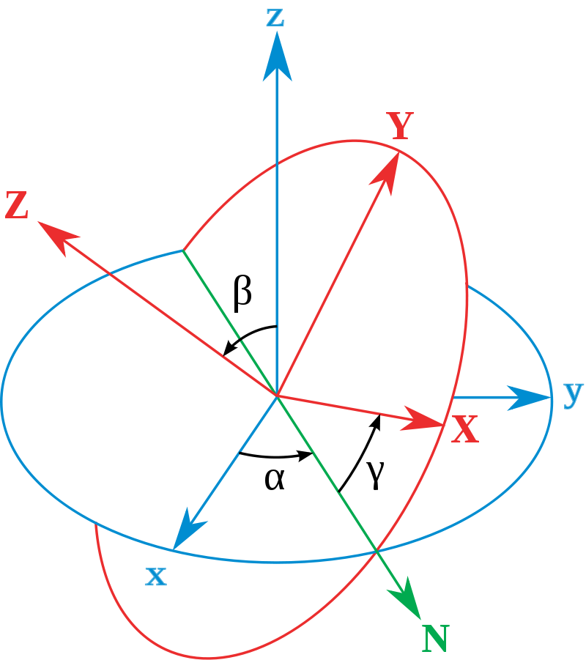
Euler Angle (Narrow Sense) 狭義のオイラー角
Represent orientation of two frames by three angles
α (or φ) represents a rotation around the z axis,
β (or θ) represents a rotation around the x′ axis,
γ (or ψ) represents a rotation around the z″ axis
Gimbal lock problem

Slide 14
Problem of Euler Angle Representation: Gimbal Lock オイラー角の問題：ジンバルロック
If two axis rotates around the same axis, it loses one degree of freedom
We cannot represent the orientation between the two frames
(Numerical singular point) 数値的な特異点

Slide 15
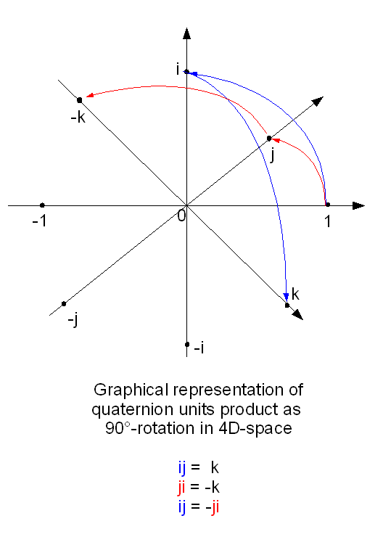
Quaternion クオータニオン・四元数
Represent three angles with one real and three imaginary numbers
It is getting popular method and often used in CG
Mathematically stable and no gimbal lock problem
A bit redundant
Not so intuitive

Slide 16
3D Rotation Matrix 3次元回転行列
Rotation around each axis
Represent three angles with 3*3 matrix
It is often used in robotics
Mathematically stable and no gimbal lock problem
Redundant representation

Slide 17
3D Homogeneous Transformation Matrix 3次元同次変換行列
Z_{W}
X_{S}
Y_{S}
X_{S}
RGB-D Cam
LIDAR
Y_{W}
O_{W}
X_{W}

Slide 18
Camera Frame
World Frame
z^{W}
z^{c}
x^{c}
y^{W}
x^{W}
y^{c}
pV = [
0.32, 0.32, -0.32, -0.32; % u = x
-0.24, 0.24, 0.24, -0.24; % v = -y
1.00, 1.00, 1.00, 1.0; % z = depth
1, 1, 1, 1 % constant
];
Camera frame to world one
Rotate around x with 90 deg

Slide 19
Matlab Sample Code: Main
% Vehicle frame to world frame
Dx = 0.0; Dy = 0.0; Dz = 0.0;
R = deg2rad(-90.0);
P = deg2rad( 0.0);
Y = deg2rad( 0.0);
% Transformatio matrix from camera to world frame
T = HTTrans([Dx; Dy; Dz]) * HTRotZ(Y) * HTRotY(P) * HTRotX(R);
% Homegeneous points in camera frame
pC = [
0.32, 0.32, -0.32, -0.32; % u = x
-0.24, 0.24, 0.24, -0.24; % v = -y
1.00, 1.00, 1.00, 1.0; % z = depth
1, 1, 1, 1 % constant
];
% Homegeneous Points in world frame
pW = [ T*pC(:,1), T*pC(:,2), T*pC(:,3), T*pC(:,4)];
% Display points in vehicle and world frame at the same window
figure(1);
plot3(pC(1,:), pC(2,:), pC(3,:),'b+-', pW(1,:), pW(2,:), pW(3,:),'r*-')
xlim([-3 3]); ylim([-3 3]); zlim([-3 3]);
grid on; pbaspect([1 1 1]);

Slide 20
Matlab Sample Code: Functions
function [m] = HTRotX(q)
% HTRotX(q): returns a homegeneous transformation matirx of rotating an angle of q around Y-axis
m = [1, 0, 0, 0;...
0, cos(q),-sin(q), 0;...
0, sin(q), cos(q), 0;...
0, 0, 0, 1];
end
function [m] = HTRotY(q)
% HTRotY(q): returns a homegeneous transformation matirx of rotating an angle of q around Y-axis
m = [ cos(q), 0, sin(q), 0;...
0, 1, 0, 0;...
-sin(q), 0, cos(q), 0;...
0, 0, 0, 1];
end
function [m] = HTRotZ(q)
% HTRotZ(q): returns a homegeneous transformation matirx of rotating an angle of q around Z-axis
m = [cos(q), -sin(q), 0, 0;...
sin(q), cos(q), 0, 0;...
0, 0, 1, 0;...
0, 0, 0, 1];
end

Slide 21
function [m] = HTTrans(t)
% HTTrans(t): returns a homegeneous transformation matirx of translation
% movetion with a column vector of t
m = [1, 0, 0, t(1);...
0, 1, 0, t(2);...
0, 0, 1, t(3);...
0, 0, 0, 1];
end

Slide 22
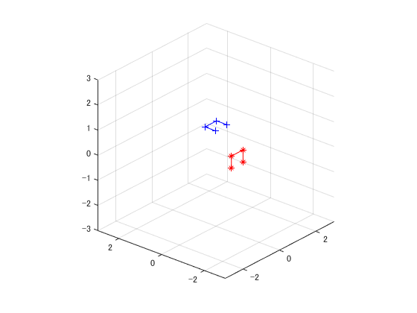
Result

Slide 23
Quiz #2: Frame Transformation in 3D: Frame Conversion from Camera to Vehicle
Camera has its frame (defined in camera SDK)
Vehicle has another frame (by convention, e.g., moving direction is x)
Camera has attached to vehicle at a height of 1.0 m in the center of vehicle
How do we represent T from camera to vehicle frame
z_{c}
Camera frame
(RGB-D Cam)
x_{c}
y_{c}
z_{v}
Vehicle frame
(Turtlebot)
y_{v}
x_{v}

Slide 24
Quiz #2: Frame Transformation in 3D: Frame Conversion from Vehicle to World
x_{v}
y_{v}
Vehicle moves in world frame
Make a homogeneous transformation matrix from vehicle to world in each vehicle position
y_{v}
x_{v}
y_{w}
x_{w}

