Slide 1
Fragments
Features, tips and tricks

Slide 2
Fragments example

Slide 3
Create Fragment class
Create public class FooFragment extends Fragment
API11+: android.app.Fragment
API4+: android.support.v4.app.Fragment
Implement
public View onCreateView(LayoutInflater inflater, ViewGroup root, Bundle savedInstanceState) {
View fragment = inflater.inflate(R.layout.fragment_layout, root, false);
return fragment;
}
Notes:
Old-school solution drawbacks:
Complex View code
View itself has no good life-cycle

Slide 4
Create Fragment layout
The simplest layout is a TextView
<?xml version="1.0" encoding="utf-8"?>
<TextView xmlns:android="http://schemas.android.com/apk/res/android"
android:layout_width="wrap_content"
android:layout_height="wrap_content"
android:text="@string/hello_world" />

Slide 5
Include Fragment to another layout
activity_main.xml
<RelativeLayout xmlns:android="http://schemas.android.com/apk/res/android"
android:layout_width="match_parent"
android:layout_height="match_parent">
<fragment
android:id="@+id/test_fragment"
android:layout_width="match_parent"
android:layout_height="wrap_content"
class="com.foo.FooFragment" />
</RelativeLayout>

Slide 6
Change Activity class
Parent class
API11+ public class MainActivity extends android.app.Activity
API4+ public class MainActivity extends android.support.v4.app.FragmentActivity

Slide 7
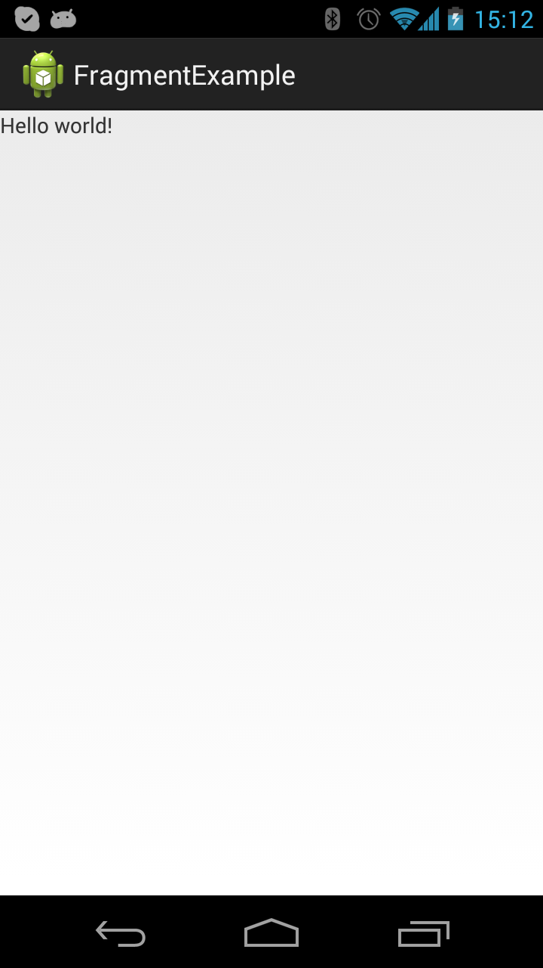
Profit

Slide 8
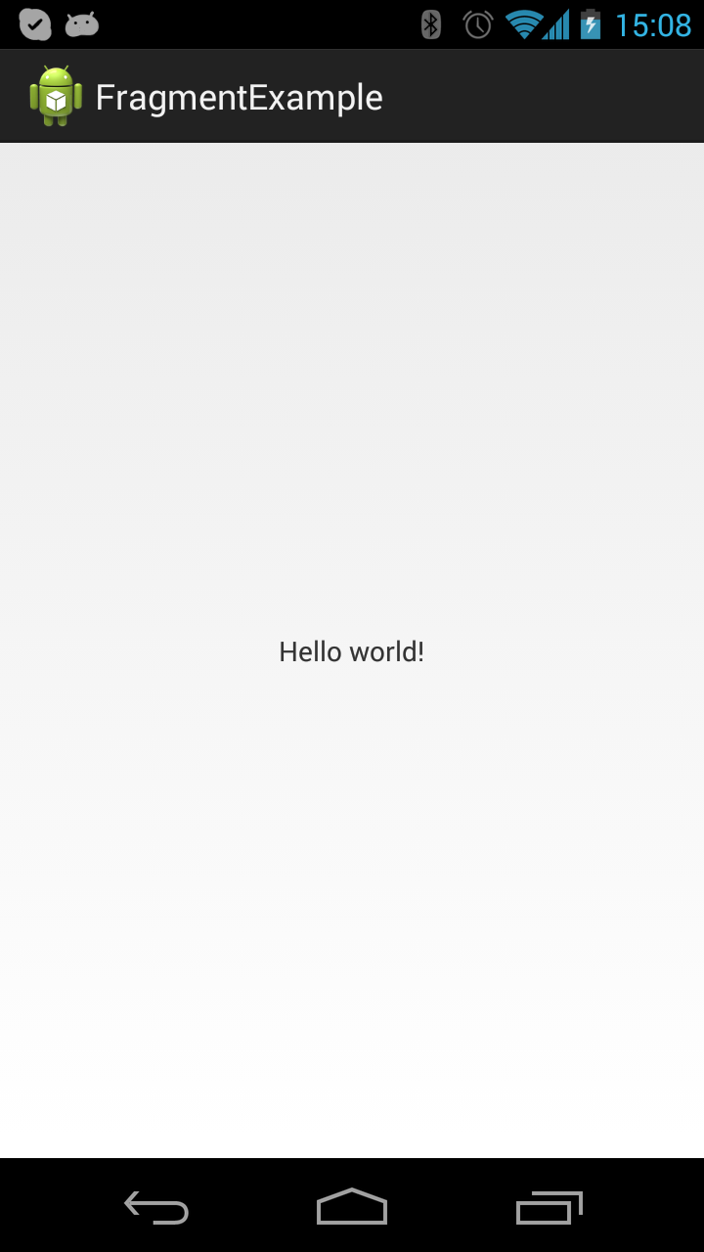
Exercise 1
Notes:
Please center fragment’s content (‘Hello world!’)
activity_main.xml RelativeLayout add attribute android:gravity=“center”
activity_main.xml fragment change attribute android:layout_width=“match_parent” to android:layout_width=“wrap_content”

Slide 9
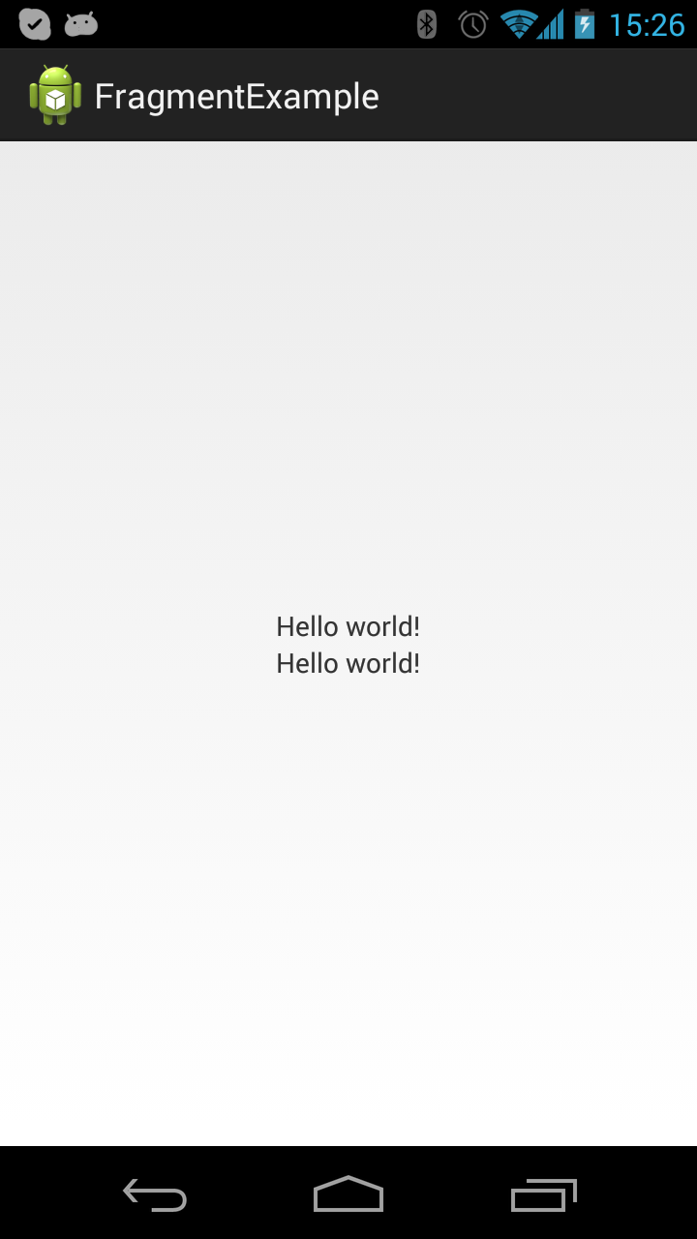
Exercise 2
Notes:
Add two fragments
Add one more fragment, having it’s own id and proper positioning.
<fragment
android:id="@+id/test_fragment2"
android:layout_width="wrap_content"
android:layout_height="wrap_content"
class="com.foo.FooFragment"
android:layout_below="@id/test_fragment"/>

Slide 10
Inserted Fragments example

Slide 11
Create Inserted Fragment class
Is a regular fragment class
public class InsertedFooFragment extends Fragment {
@Override
public View onCreateView(LayoutInflater inflater, ViewGroup root, Bundle savedInstanceState) {
View fragment = inflater.inflate(R.layout.inserted_fragment, root, false);
return fragment;
}
}

Slide 12
Create Inserted Fragment layout
Contains Android Views and <fragment> tags
<?xml version="1.0" encoding="utf-8"?>
<fragment xmlns:android="http://schemas.android.com/apk/res/android"
android:id="@+id/test_fragment"
android:layout_width="wrap_content"
android:layout_height="wrap_content"
class="com.foo.FooFragment" />

Slide 13
Include Inserted Fragment to a layout
activity_main.xml
<RelativeLayout xmlns:android="http://schemas.android.com/apk/res/android"
android:layout_width="match_parent"
android:layout_height="match_parent"
android:gravity="center" >
<FrameLayout
android:id="@+id/test_inserted_fragment"
android:layout_width="wrap_content"
android:layout_height="wrap_content" />
</RelativeLayout>

Slide 14
Change Activity class to use Inserted Fragment
public class MainActivity extends FragmentActivity {
@Override
protected void onCreate(Bundle savedInstanceState) {
super.onCreate(savedInstanceState);
setContentView(R.layout.activity_main);
FragmentManager fm = getSupportFragmentManager();
FragmentTransaction transaction = fm.beginTransaction();
transaction.replace(R.id.test_inserted_fragment, new InsertedFooFragment());
transaction.addToBackStack(null);
transaction.commit();
}
}

Slide 15
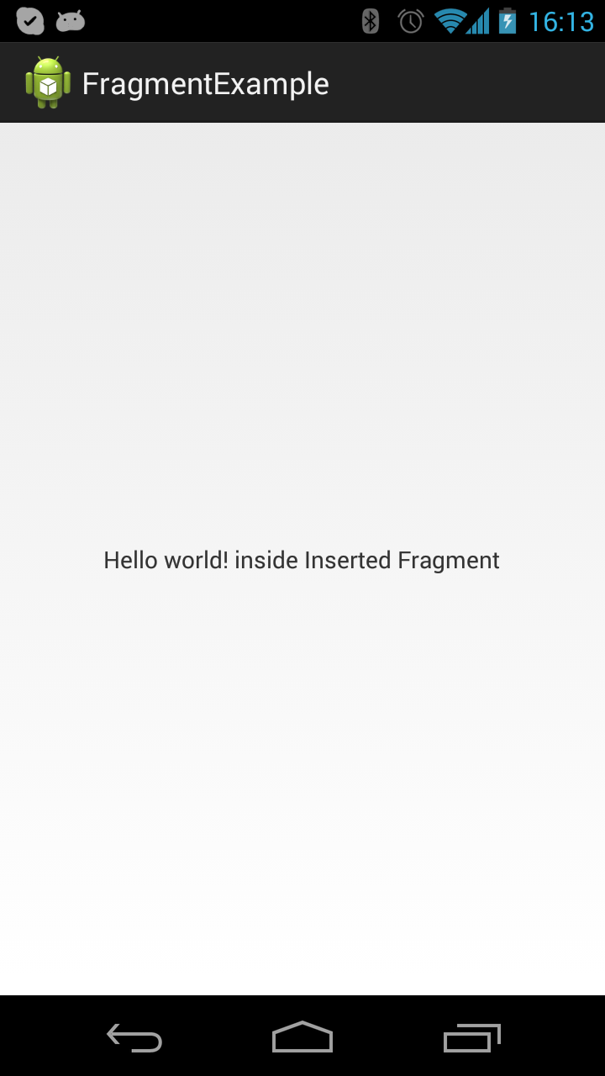
Profit

Slide 16
Exercise 1
Run app, change device orientation, get crash.
Fix crash
Notes:
The problem is in inserted_fragment.xml file.
<fragment> tag will be added to the parent fragment two times with the same id. Possible fix is to change it for <FrameLayout> and change onCreateView() in InsertedFooFragment.java
@Override
public View onCreateView(LayoutInflater inflater, ViewGroup root, Bundle savedInstanceState) {
View fragment = inflater.inflate(R.layout.inserted_fragment, root, false);
FragmentManager fm = getFragmentManager();
FragmentTransaction transaction = fm.beginTransaction();
transaction.replace(R.id.test_fragment, new FooFragment());
transaction.addToBackStack(null);
transaction.commit();
return fragment;
}

Slide 17
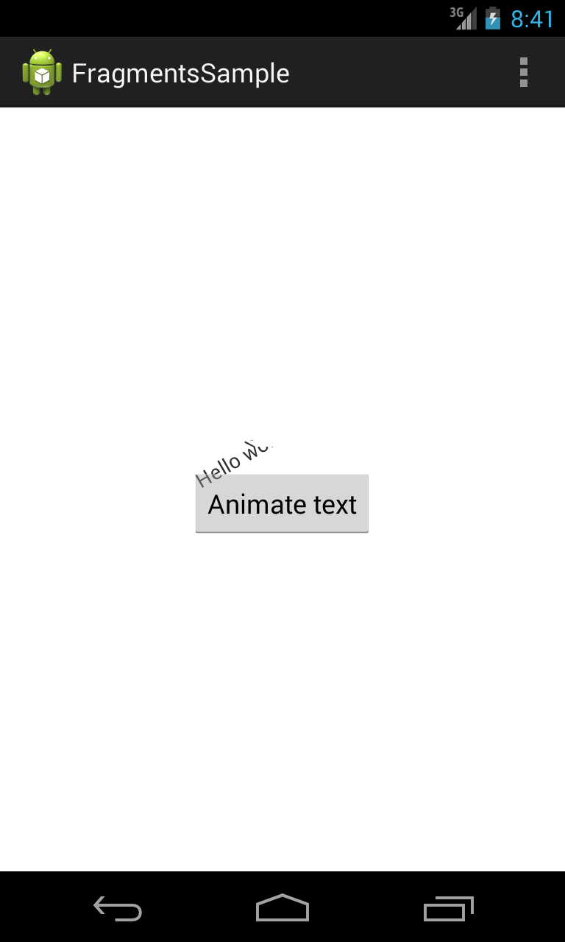
Exercise 2
Add LinearLayout to fragment layout
Add Button after TextView in LinearLayout
In Fragment code process onClick event on Button to make rotation of TextView
Keys:
- Use OnClickListener to handle click event on Button
- Use ObjectAnimator.ofFloat to implement object animation

Slide 18
adb

Slide 19
adb command line params
adb shell. Provides a device console.
adb shell ls /sdcard/
adb devices. Shows a list of attached devices including emulators.
List of devices attached
0149B2840C01600B device
adb kill-server, adb start-server. A way to restart adb service on your PC.
adb logcat. Getting logs from a device.
D/MessageMe(23823): PreferencesDataStore: Load application preferences
adb logcat –b radio. Getting radio logs from a device.
D/RILJ ( 608): [135180]> REQUEST_GET_NEIGHBORING_CELL_IDS
adb push/adb pull. Copy a file to a device/Copy a file from to your PC
adb push test_file.txt /sdcard/
adb pull /sdcard/test_file.txt .

Slide 20
adb logcat usage
adb -s emulator-5554 logcat. Picks up the device in case of several devices connected. Device name can be taken from adb devices command output.
adb logcat –f log.txt. Outputs log to a file.
adb logcat -r 100 -n 5 -f log.txt. Rotates the log every 100 kbytes, creates max 5 rotated files.
adb logcat -c. Flushes the entire log and exits.
adb logcat -f out.txt -d. Dumps the log and exits immediately - doesn't block.
-v <format> - log formatting
adb logcat -v time
09-07 22:01:19.520 I/wpa_supplicant( 464): rfkill: WLAN unblocked
adb logcat –v brief
I/wpa_supplicant( 464): rfkill: WLAN unblocked
adb logcat –v process
adb logcat -v time LocationActivity:D LocationService:I *:E . Outputs logs with LocationActivity tag with Debug priority or higher, with LocationService tag with Info priority or higher, all logs with Error priority or higher.

Slide 21
sqlite3

Slide 22
Sqlite3 command line tool
Tool is located at <ANDROID_BUNDLE>\sdk\tools\sqlite3.exe
Open DB file sqlite3 db_test.db

Slide 23
Sqlite 3 commands
.shema
CREATE TABLE TEST_TABLE (REC_ID INTEGER PRIMARY KEY,REC_NAME TEXT NOT NULL);
CREATE TABLE android_metadata (locale TEXT);
.tables
TEST_TABLE android_metadata
SQL queries
SELECT * FROM TEST_TABLE;
DROP TABLE TEST_TABLE;
.help show all helpful commands
.quit

