Slide 1
Yomad
Keith Kurak, David Heineman, James Mather, Jennifer Evans

Slide 2
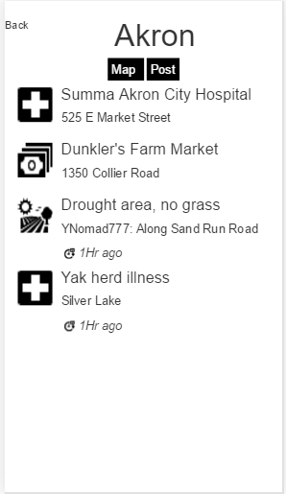

Slide 3
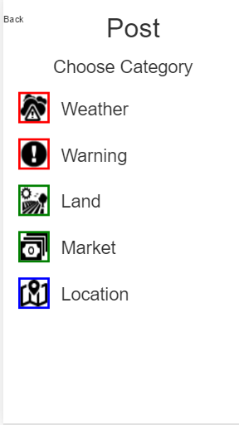

Slide 4
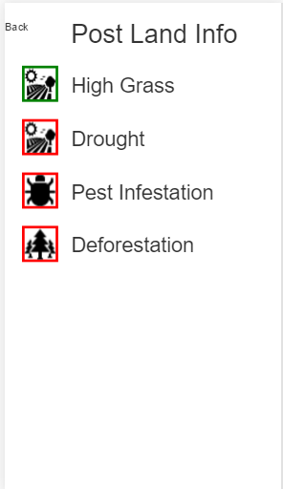

Slide 5
