Slide 1
Restaurant in Kyoto and Sapporo
Final Capstone Presentation

Slide 2
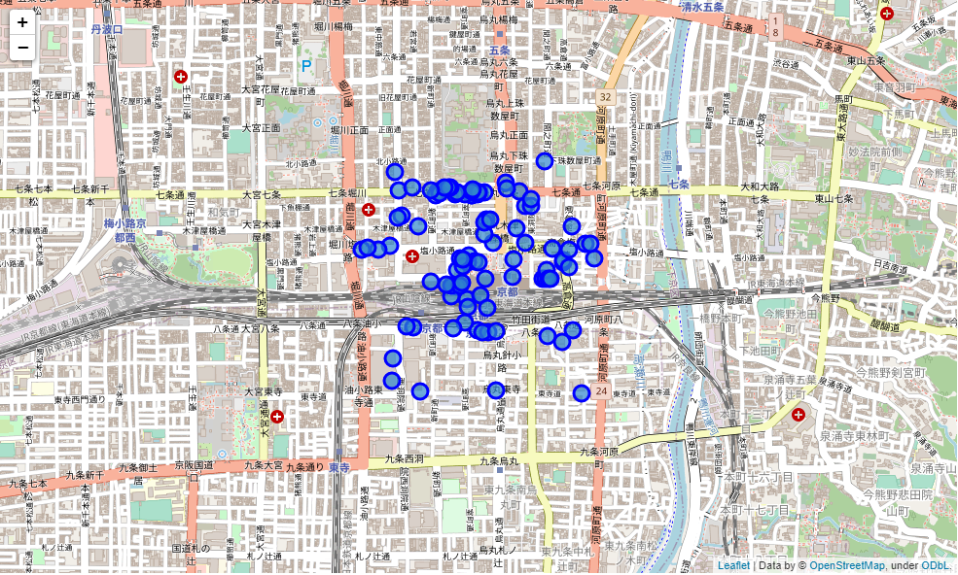
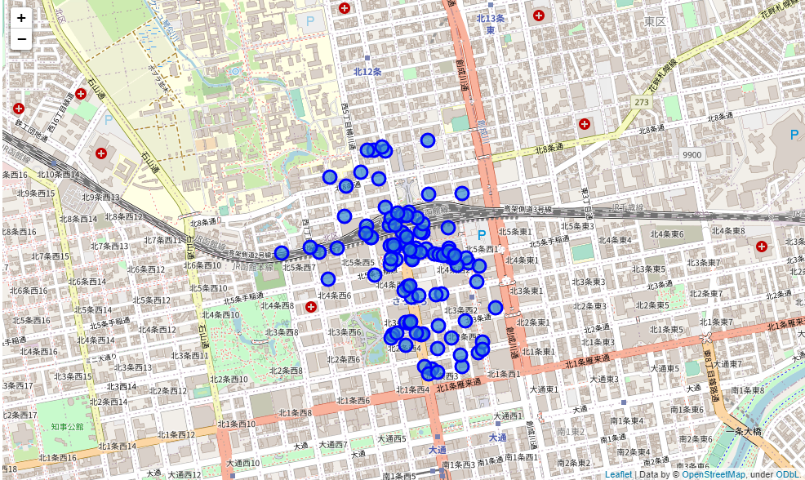
Restaurant Overview in both Cities
Kyoto
Sapporo

Slide 3
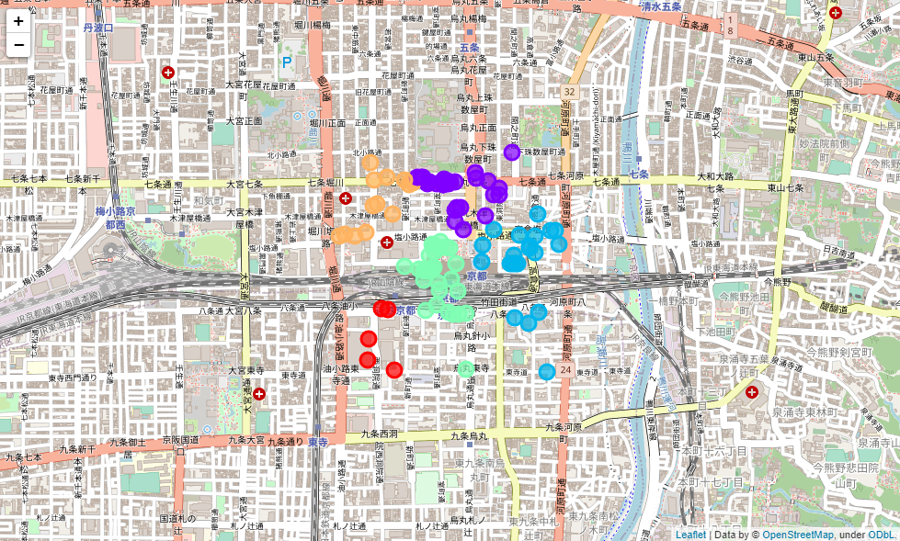
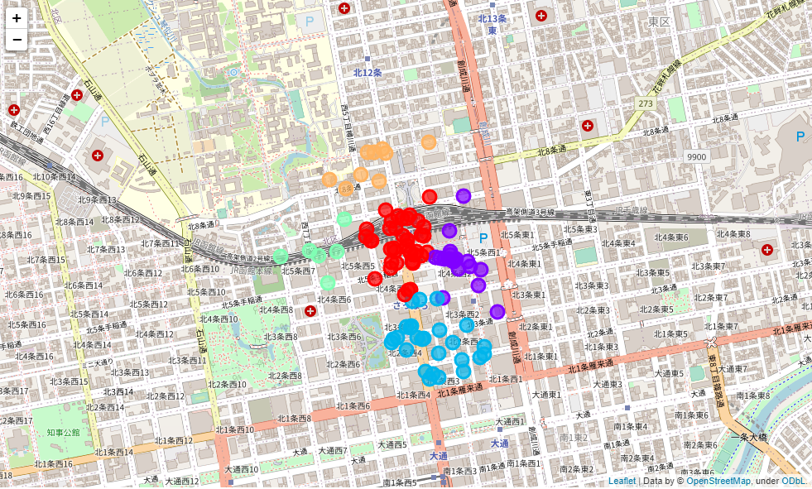
Restaurant Clustering in both Cities
Kyoto
Sapporo
High Competition
High Competition

Slide 4
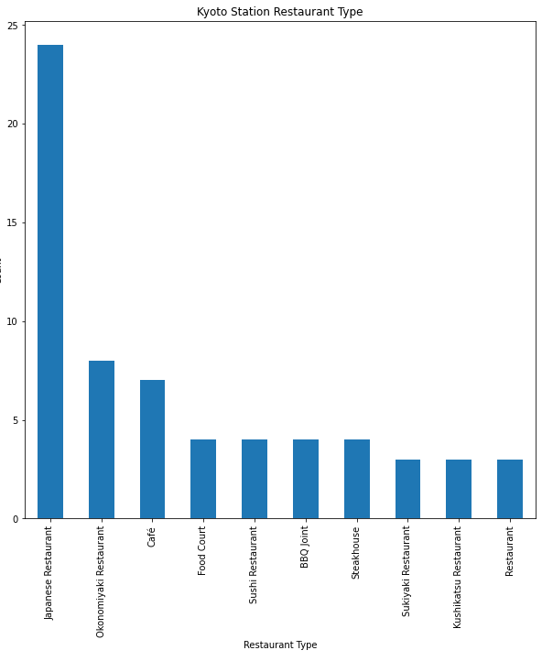
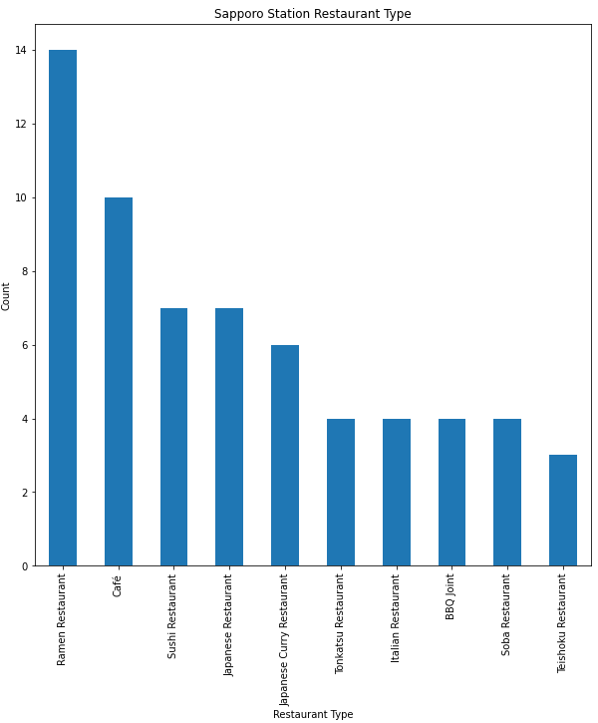
Type of Restaurant
High Competition
High Competition
Kyoto
Sapporo

Slide 5
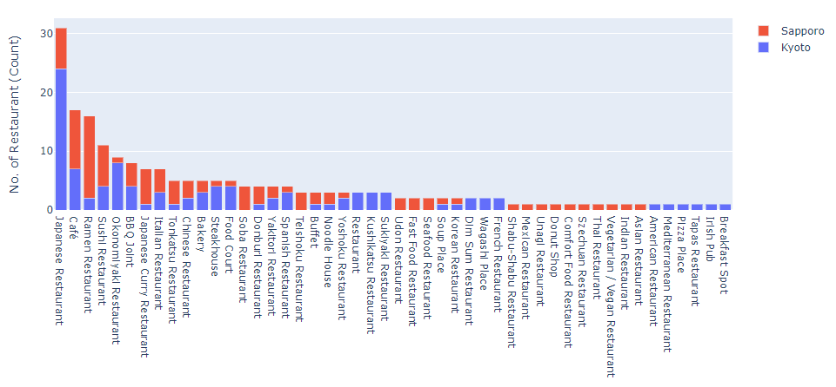
Summary on Restaurant Type for Both Cities
High Competition (National)
Popular in Particular City
Low Competition, Accepted for Both Cities

