Slide 1
Author: Keith Maina
Phase 3 project

Slide 2
Summary
In this project we are going to be creating a machine learning model that determines whether a user of the SyriaTelcom service churns out of the service or not.

Slide 3
Business Problem
Clilents who stop using a service are not good for any business, because that leads to losses. We need to find out the clients that are likely to churn prior to when they do actually churn, so that we could target client retention efforts toward them.

Slide 4
Data
This project uses data from SyriaTelcom which contains information on the kinds of subscriptions they have, their phone numbers, the state they're in along with whether past users have churned or not.

Slide 5
Methods
- The data provided had no null values, so no cleaning was necessary.
- The data was split into training and testing subsets.
- All categorical columns were one hot encoded and so was the state column.
- The data was also normalized for KNN- models.

Slide 6
Results
I was able to produce a deployable model after 8 iterations and I chose it for having both the highest f1_scores (which is a score of how well the model predicts).
The train score was 50.09% and the test score was 44.9%.
Another evaluation metric used was the AUC(Area Under the Curve) and the model in question had a score of 79.16%, which basically means that the model is correct 79.16% of the time.

Slide 7
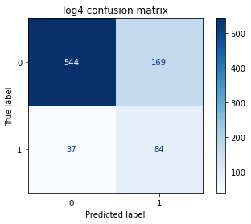
Visualisation
1 represents a churn while a 0 represents no churn.

