Slide 1
King County House Analysis
Author: Keith Maina

Slide 2
Summary
In this project we examined real estate data to perform predective modelling for the sake of being able to gauge the prices of homes that haven't been priced yet and we also performed a statistical test to know whether the presence of a waterfront affects the price of a home.

Slide 3
Business Problem
We wish to create a predictive model for prices of homes to be able to easily discern values of houses.
Business question:
Is waterfront property more valuable than non- waterfront property?

Slide 4
Data
This project uses the King County House Sales dataset. We use it because it has information on house pricing and the factors to consider when buying a house.

Slide 5
Methods
The data provided was fairly clean, to start with. All i had to do was remove the null values, and I chose to do so instead of filling the empty data points with values, because for modelling, I believe that for predictive modeling you should only use original data in order to maximize accuracy.
I also had to remove question marks from the 'sqft_basement' column and replace them with zeros. I assumed the question marks meant that the basement square footage was unknown.
For the statistical test, I split the data into 2 datasets, one containing pricing on houses with a waterfront and one containing pricing on houses without a waterfront.

Slide 6
Results
After performing a t-test on the prices of houses with a waterfront versus prices of houses without houses, I saw a p-value of 3.27e-20.
I also checked the correlation of other properties to house price and found the property with the highest correlation to price to be the square footage of the home.
Here is a scatter plot of the price and the square footage:

Slide 7
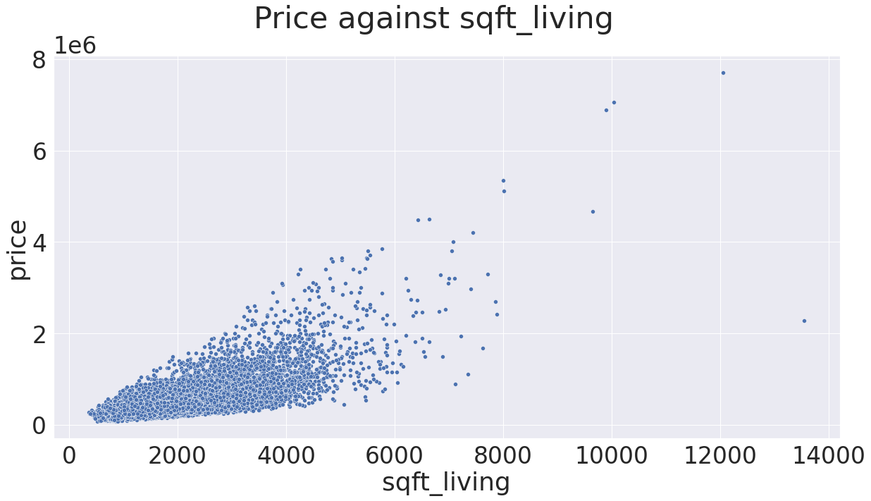
Results

Slide 8
Results
Below are visualisations of the 3 most significant iterations of the models:

Slide 9
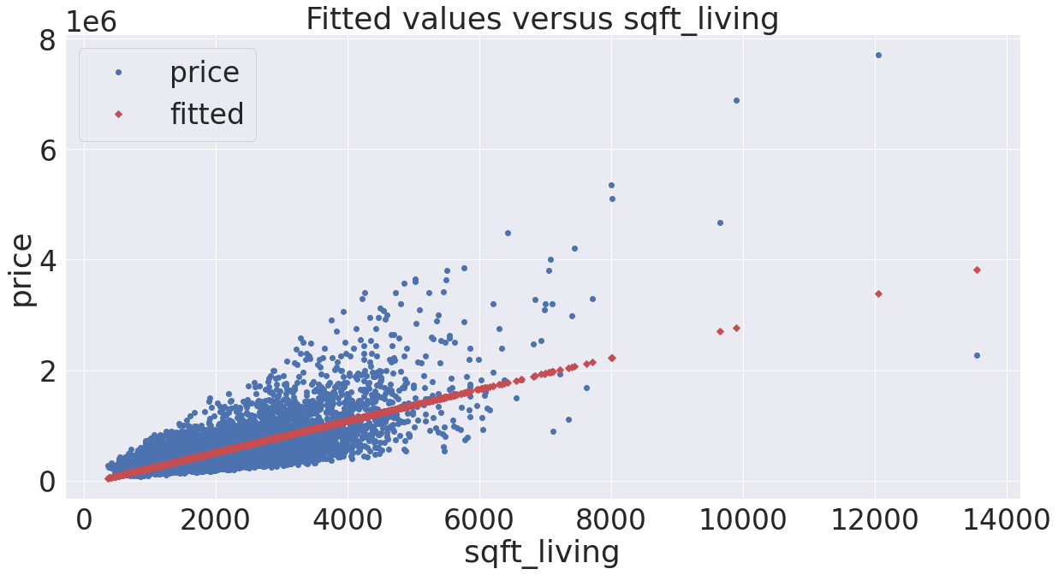
Results
Model using square footage only

Slide 10
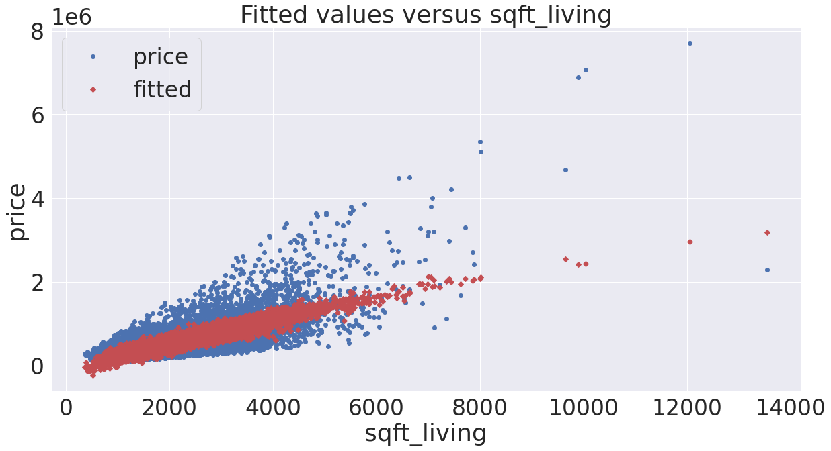
Results
Model using properties with significant correlation

Slide 11
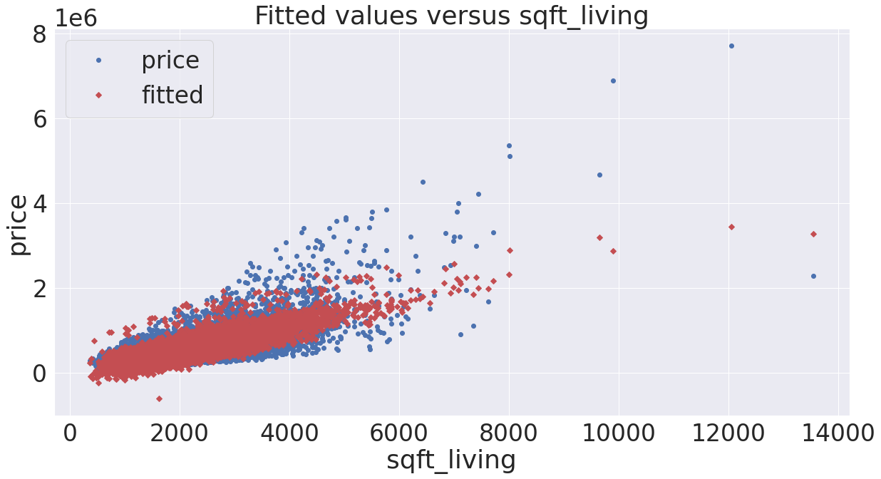
Results
Final model

Slide 12
Conclusions
I was able to produce a model after 5 iterations and I chose that model for having the least Mean Absolute Error when comparing the predicted values of said model with actual test values. This model can successfully predict the price of a home with 69.8% accuracy.
After conducting the test, I was able to come to the conclusion that the presence of a waterfront greatly increases the value of a home.

Slide 13
Thank you for your time.

