Slide 1

Bdale Garbee bdale@gag.com NAR 87103

Slide 2
Who is Bdale?
First contribution to Free Software circa 1979
HP Open Source & Linux Chief Technologist
Contributor to Debian GNU/Linux since October1994, including service as Debian Project Leader, early design of infrastructure, porting to several new architectures, maintaining many packages. Currently serve as chairman of the Debian Technical Committee.
President, Software in the Public Interest
Board member of Consumer Electronics Linux Forum
Board member of Open Media Now
Amateur satellite and high-power model rocket builder ...

Slide 3
Agenda
A gentle intro to the model rocketry hobby
The role of avionics, some existing products
AltusMetrum
Tools used
Future plans

Slide 4
The Basic Idea
We like to build, launch, and successfully recover hobby-sized models of rockets
Several elements to the hobby
  An ongoing learning process ... loud science!
  Progressive levels of technical achievement
  Craftsmanship involved in designing and building stable and effective rockets
  Camaraderie from collaborating with other enthusiasts in local clubs and at regional launches
Advanced objectives lead to incorporation of electronics and software...

Slide 5
Hobby Rocketry Categories
Largely delineated by total impulse, each letter prefix is a rough doubling, A is 2.5 newton-secs, H and up require certification and govt permits
  Model Rockets – up through D motors, 10-24mm
  Mid-Power Rockets – E, F, G motors, 24-29mm
  High-Power Rockets, 29-150mm, >= 160 Ns
    Level 1 – H and I motors
    Level 2 – J, K, and L motors
    Level 3 – M, N, and O motors (unlimited, really)
  Research (EX) Rockets – home-made motors

Slide 6
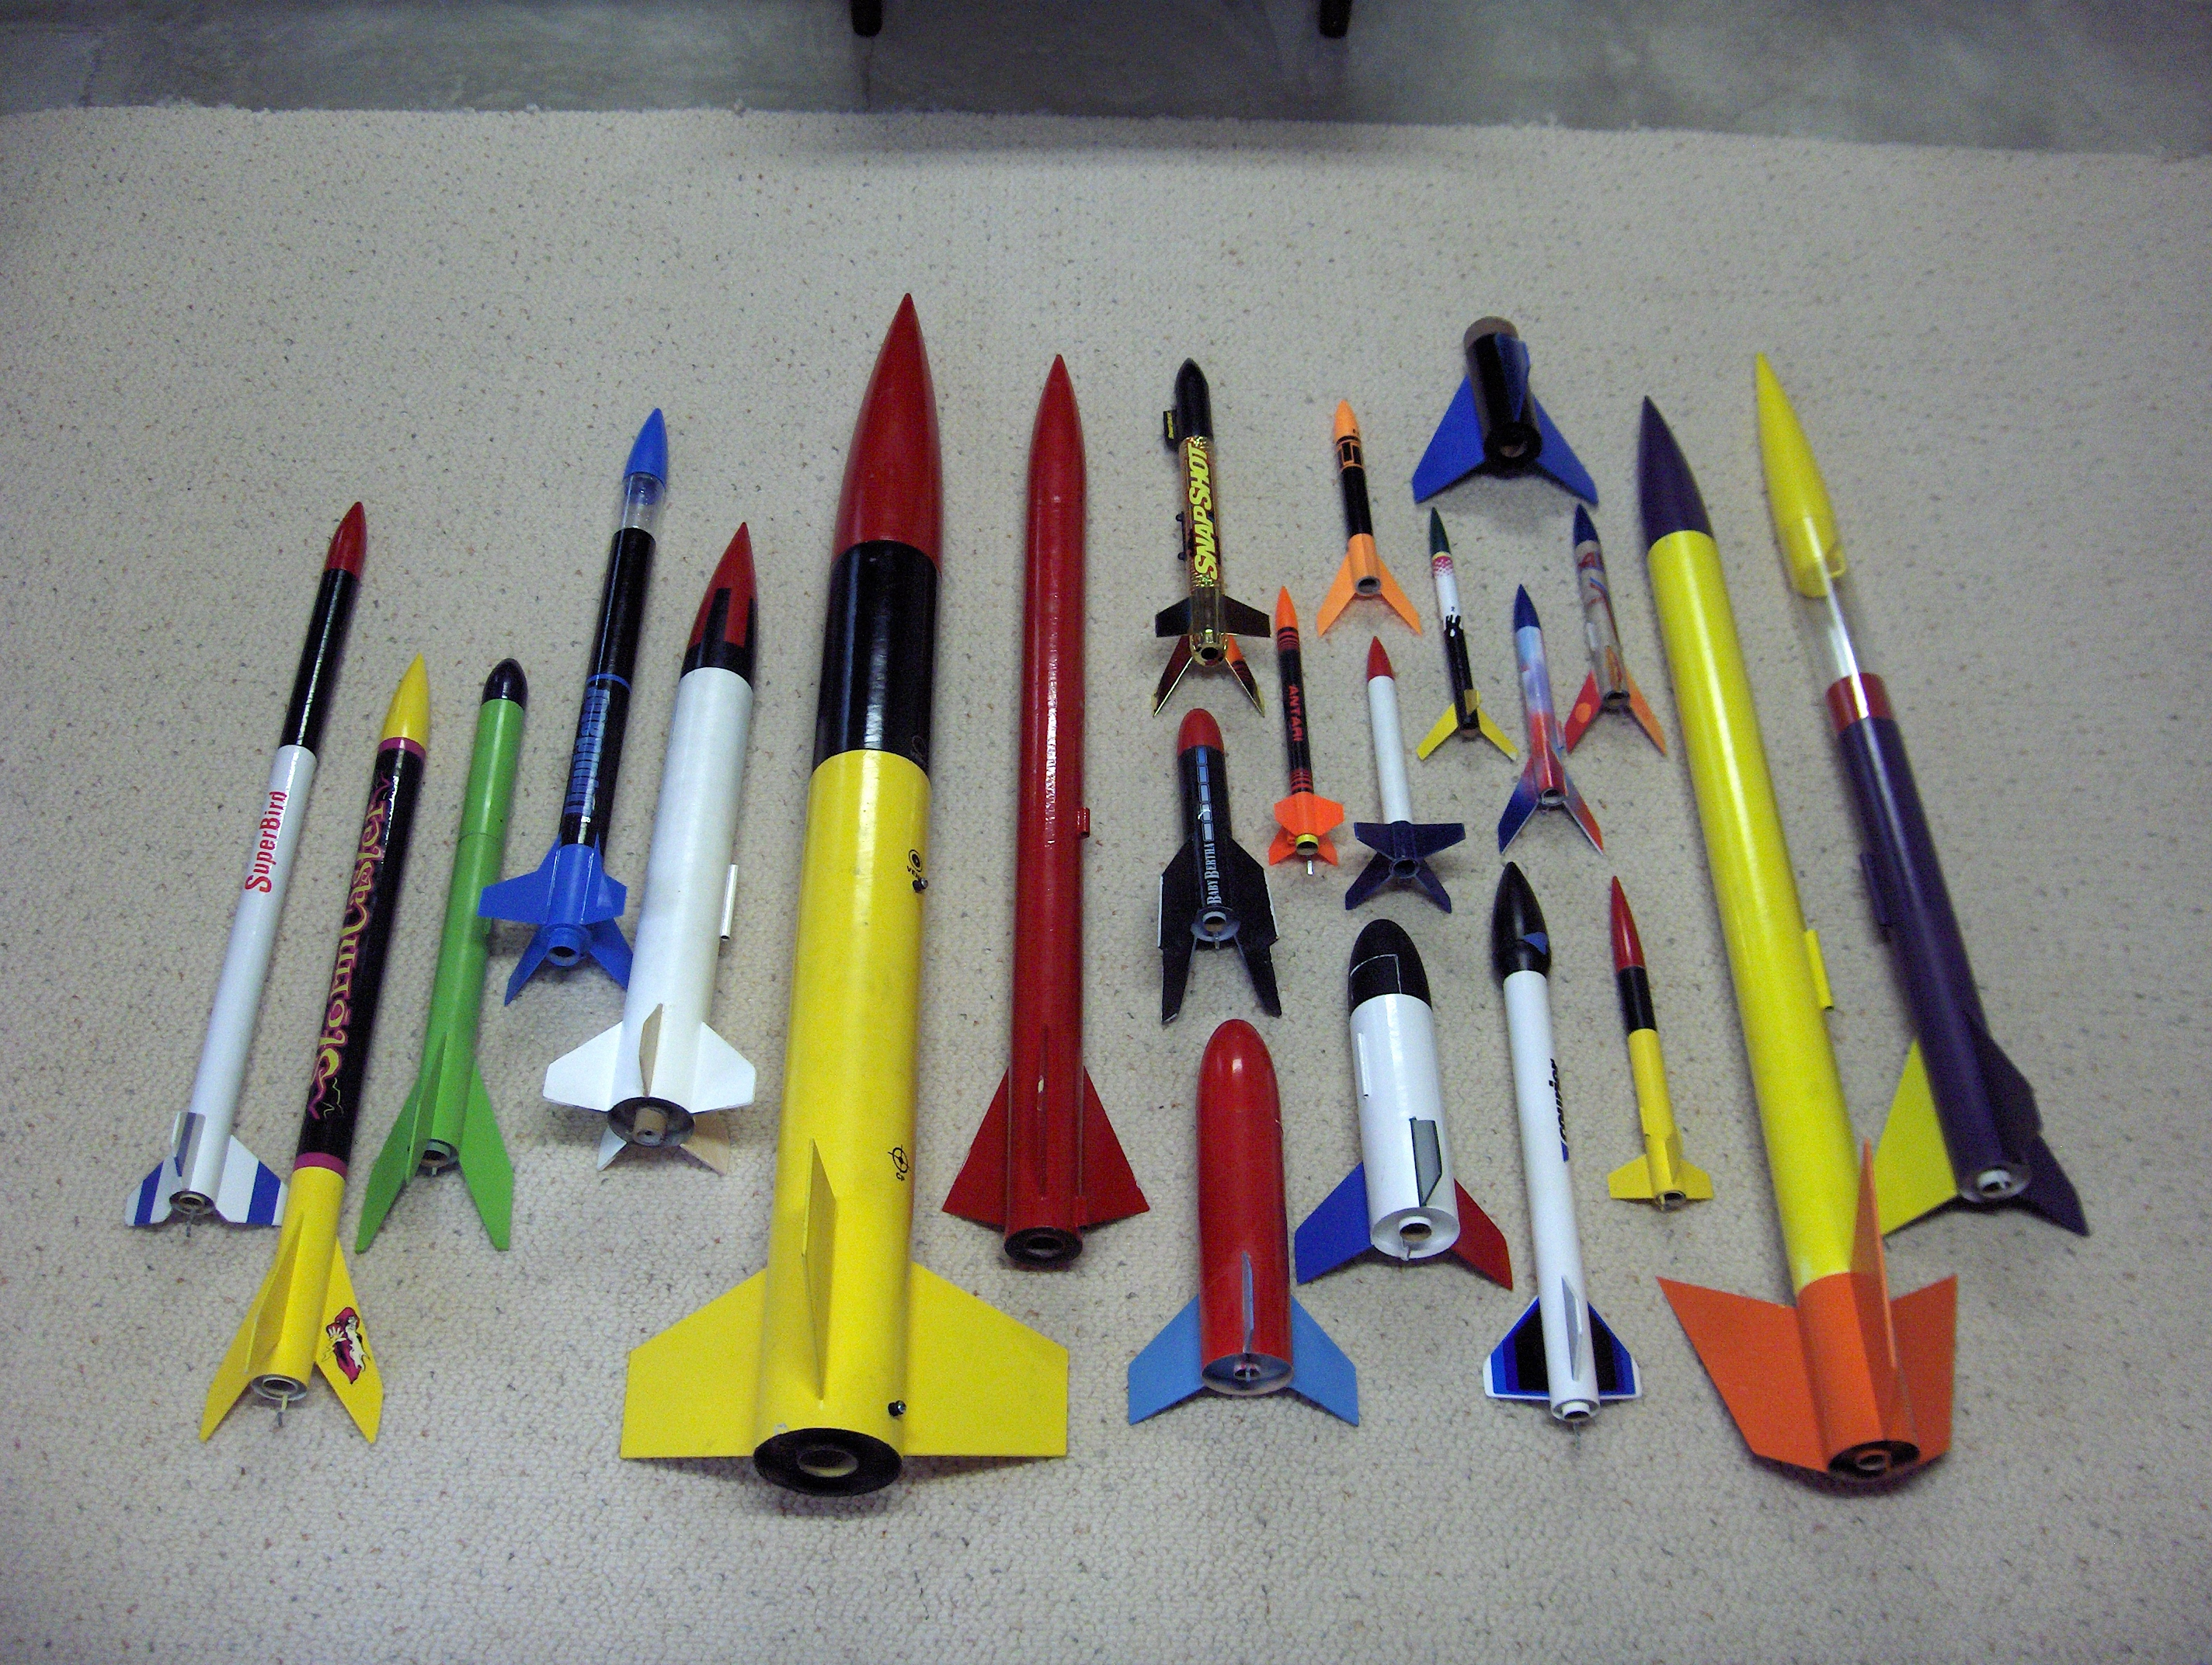

Slide 7
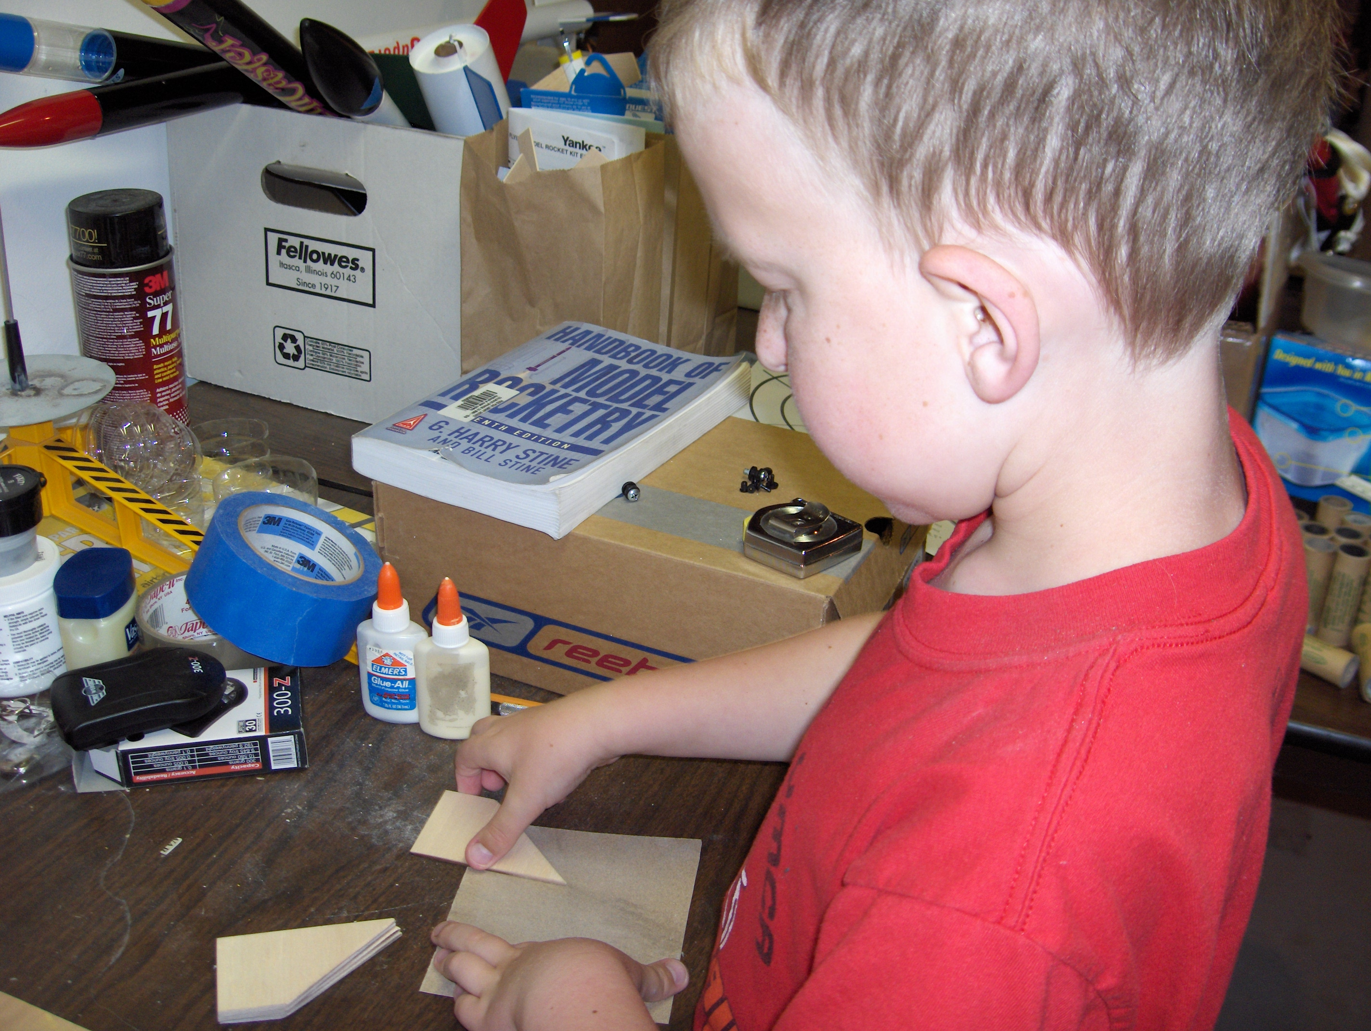
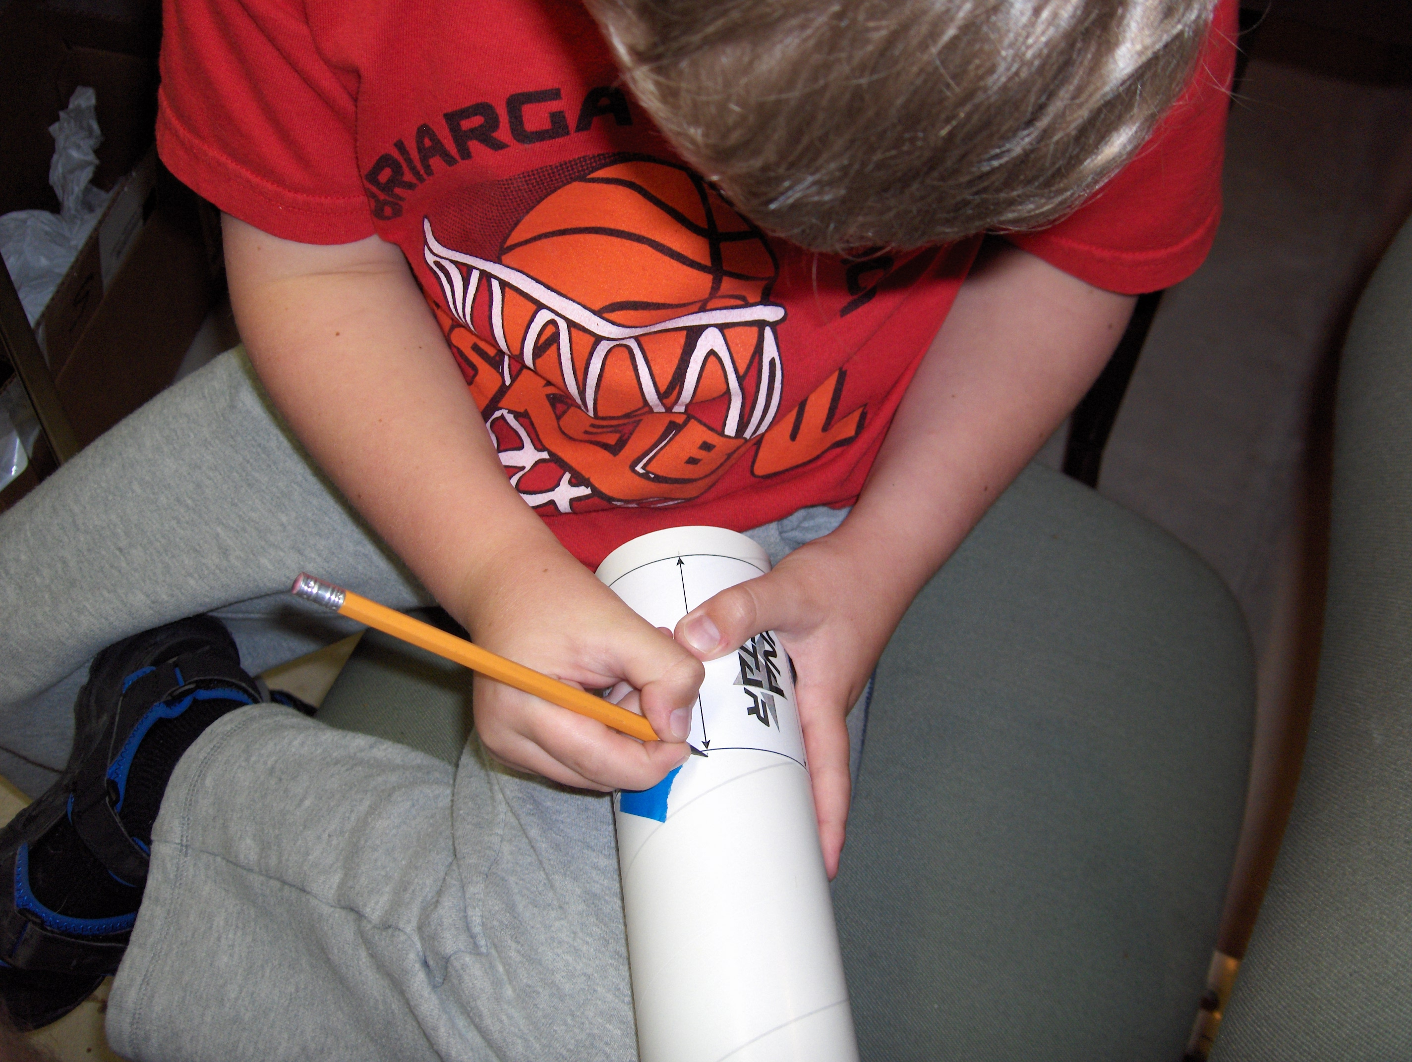
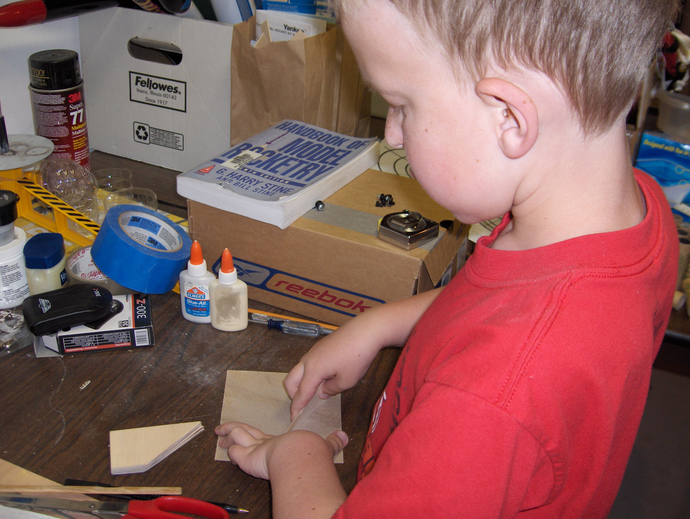
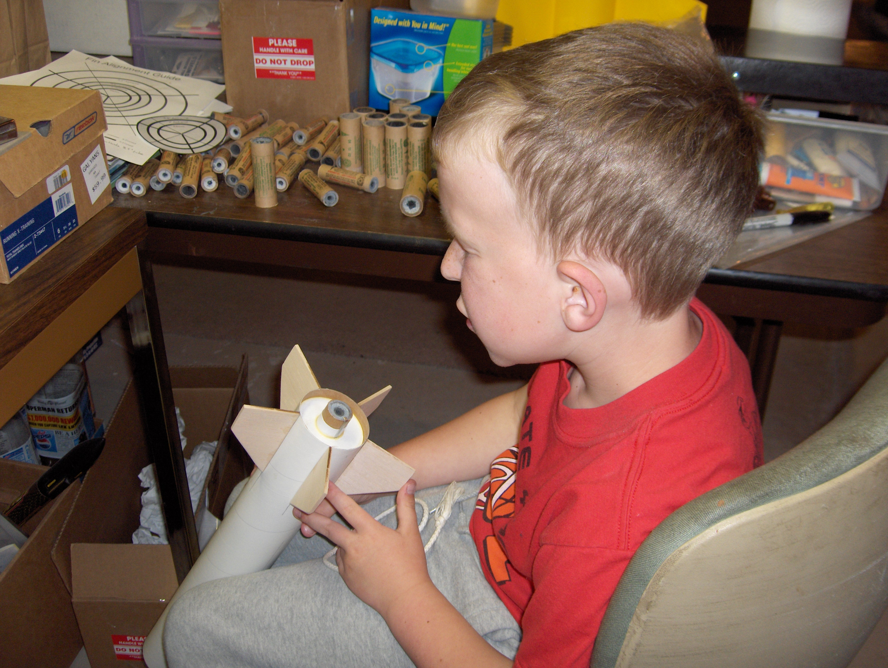

Slide 8
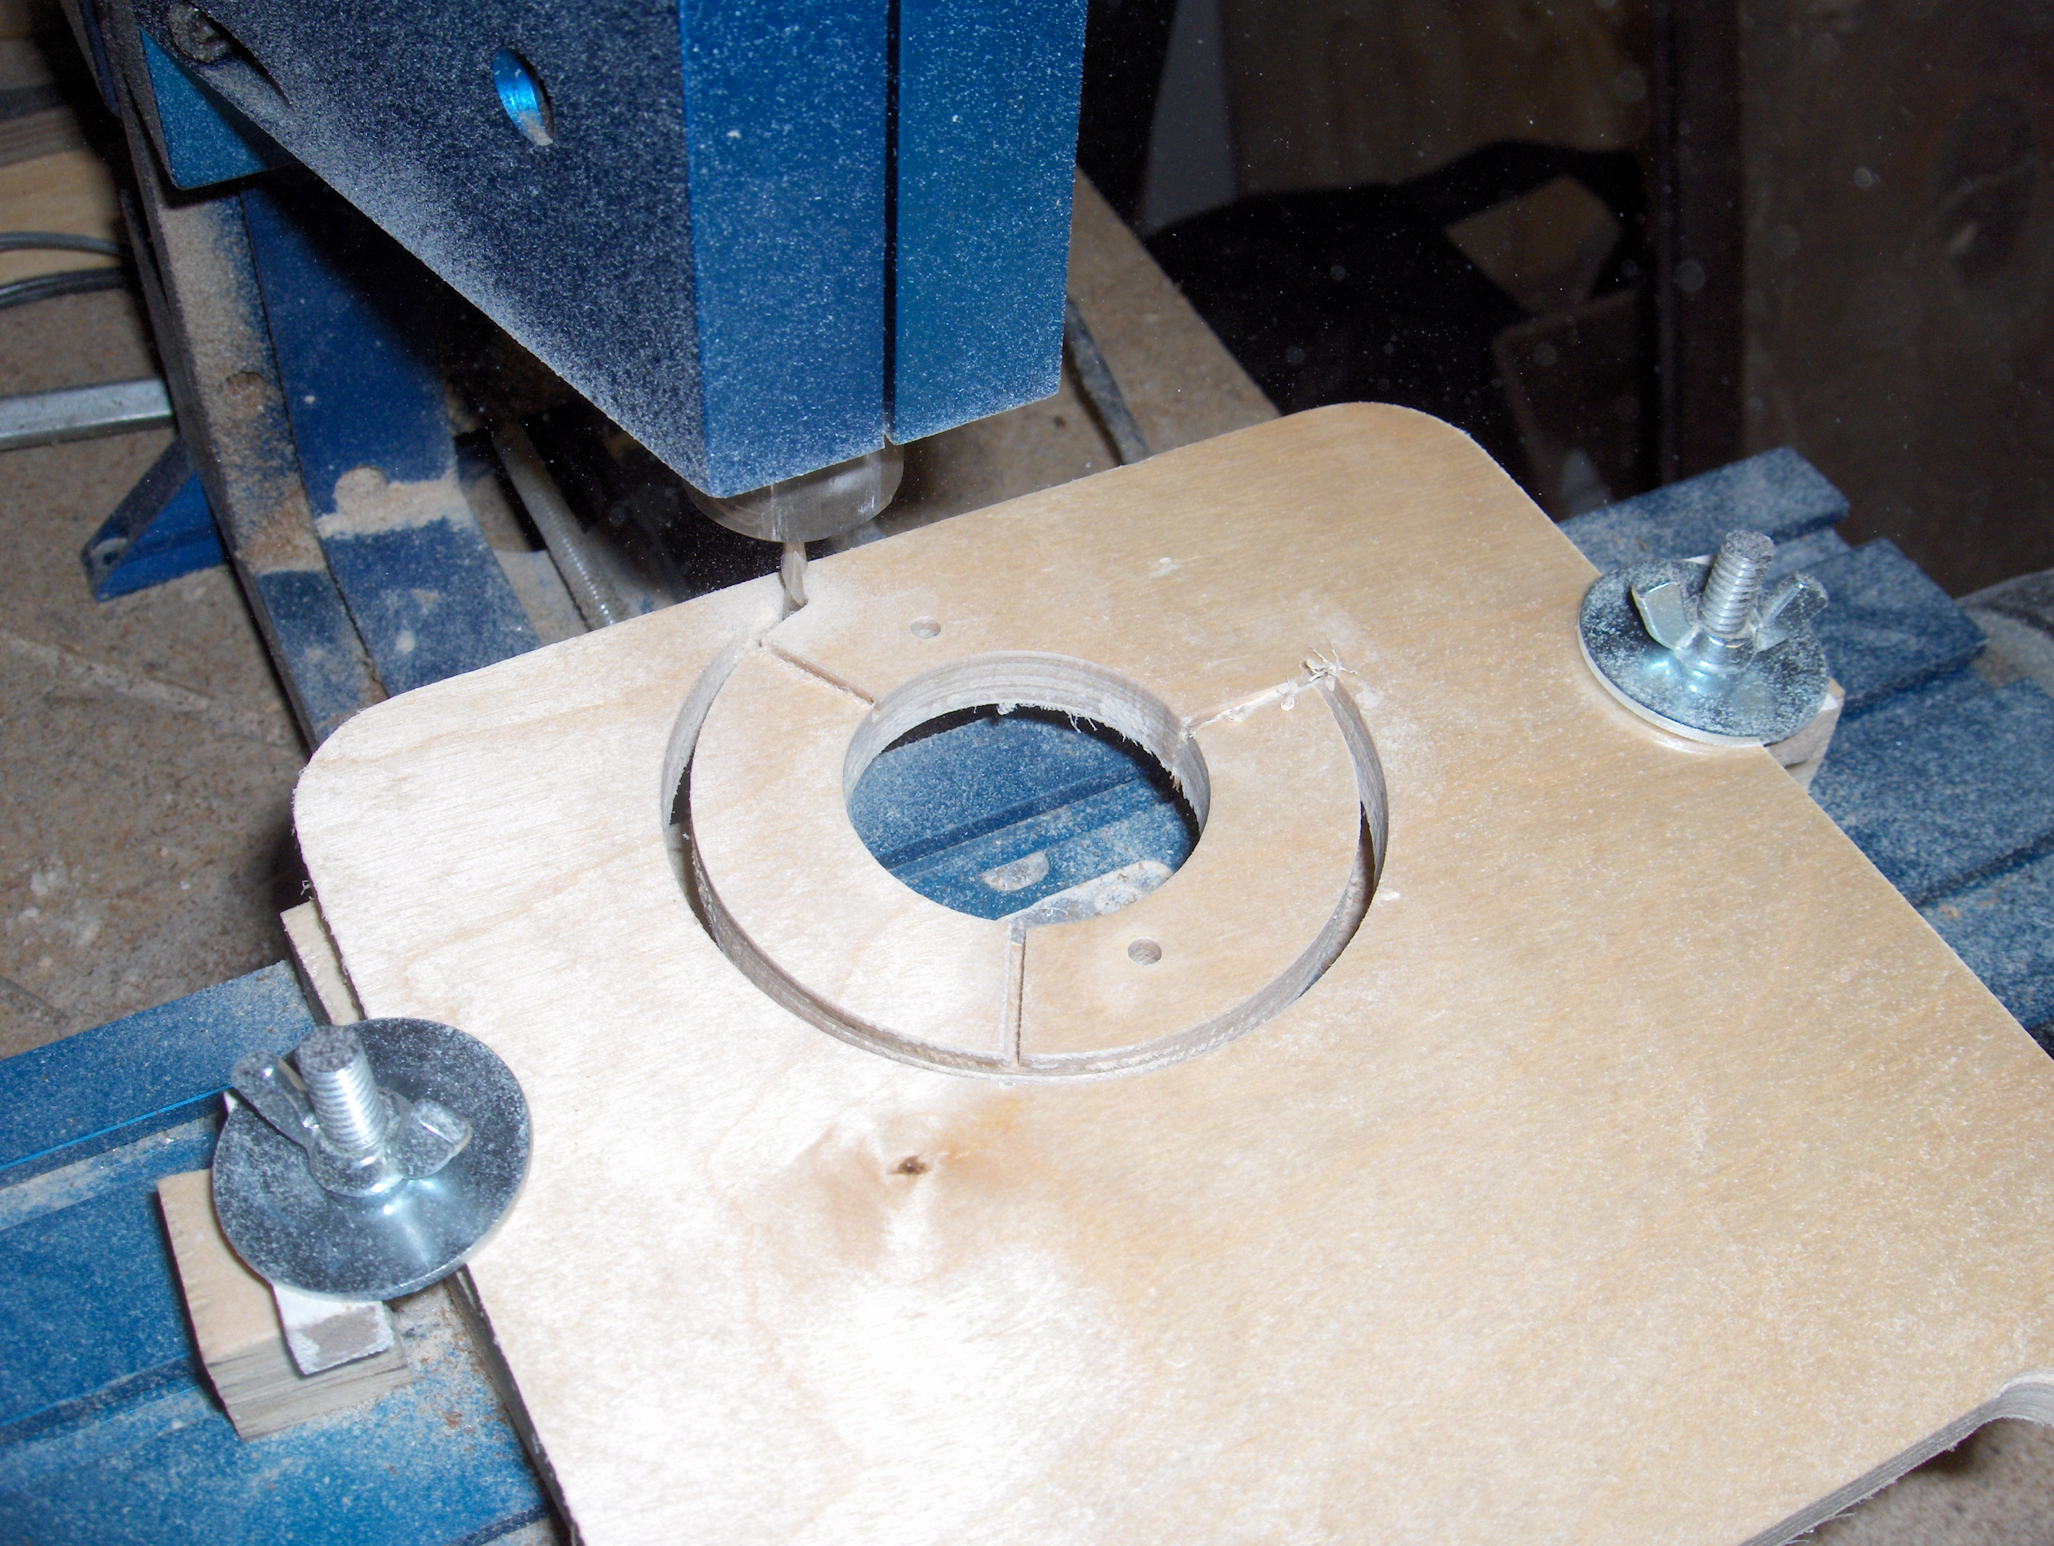

Slide 9
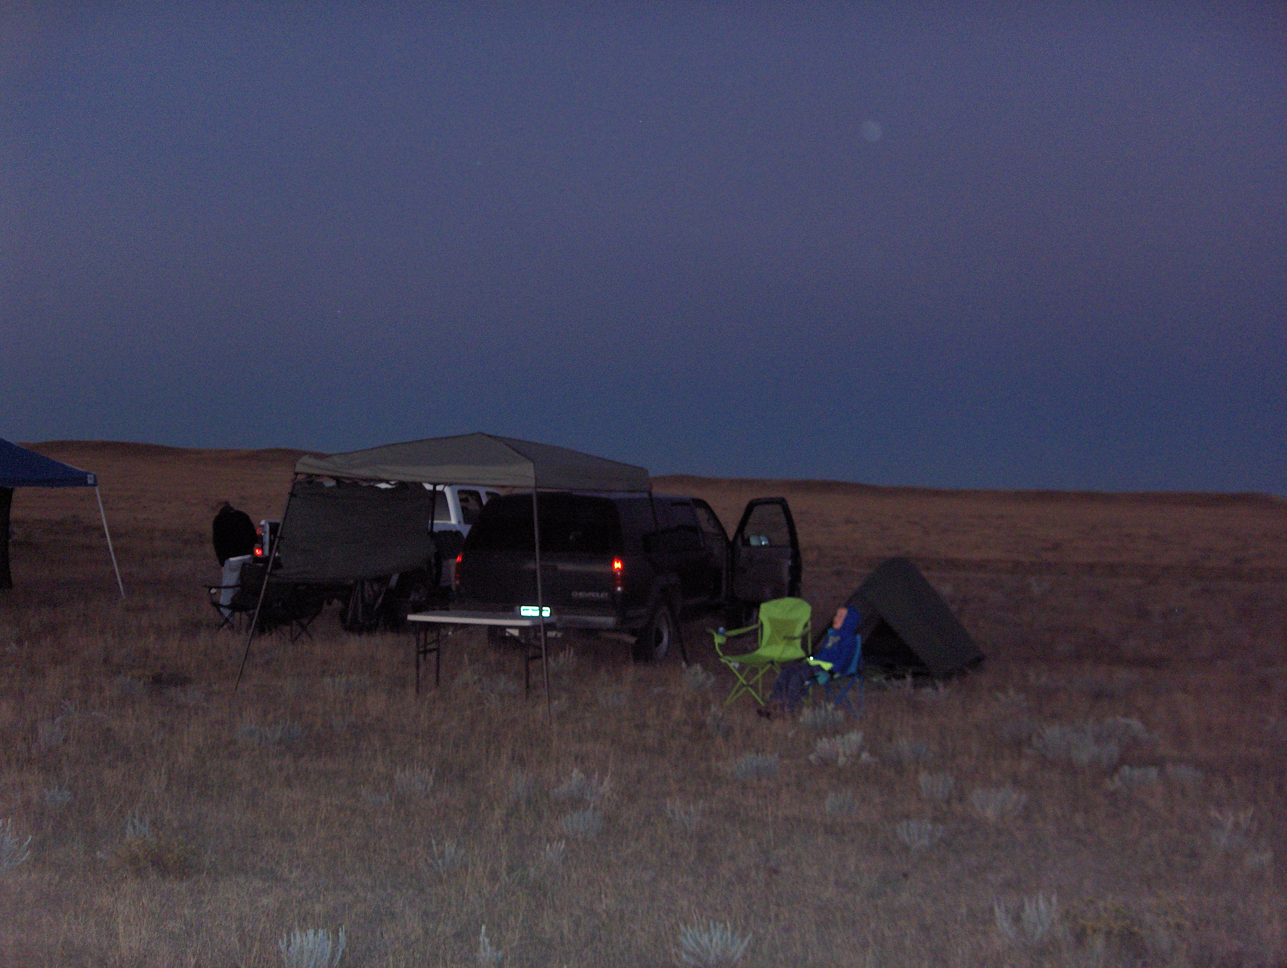

Slide 10
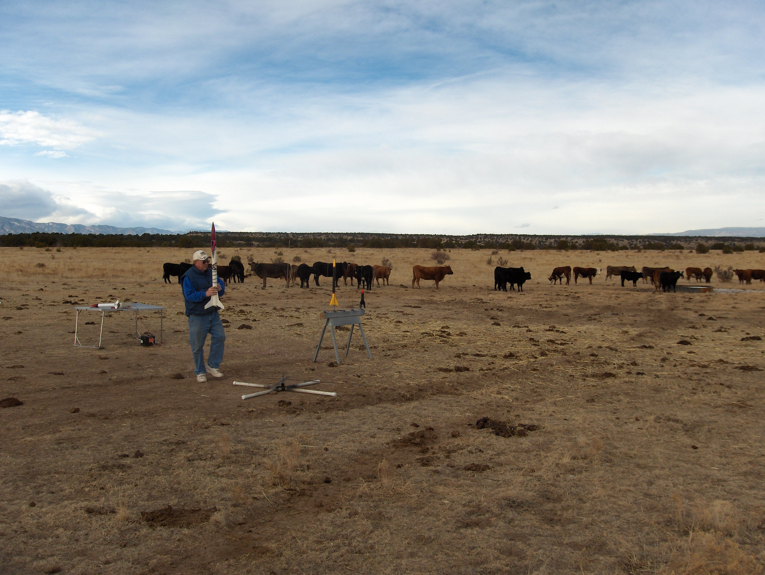

Slide 11
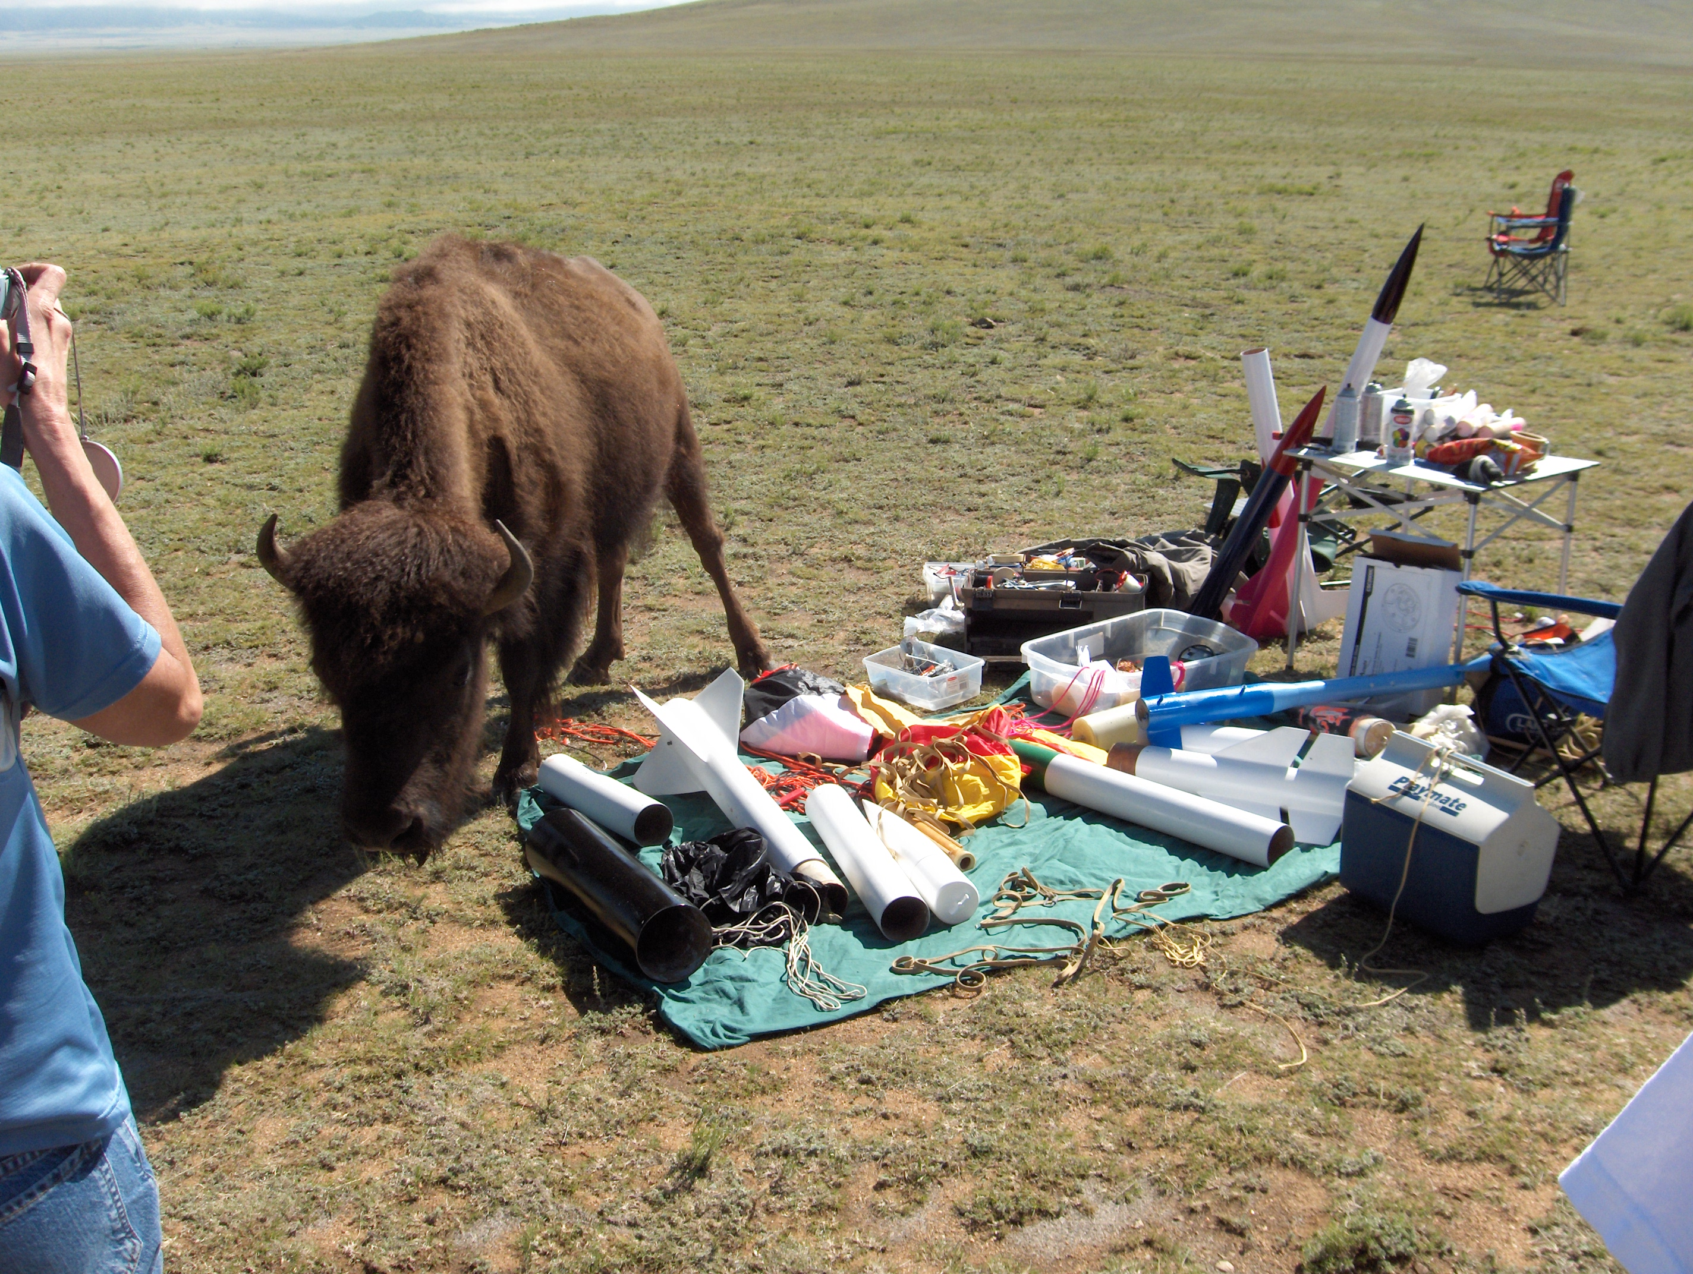

Slide 12
Role of Avionics
Control of recovery system
  Ability to deploy at apogee
  Ability to deploy at a defined altitude
Collection of flight data
  Max altitude – how high did it go?
  Max acceleration – did we break Mach?
  Acceleration and altitude profiles for more thorough analysis of vehicle and motor performance
Radio link to ground
  Position and health information, possibility of control

Slide 13
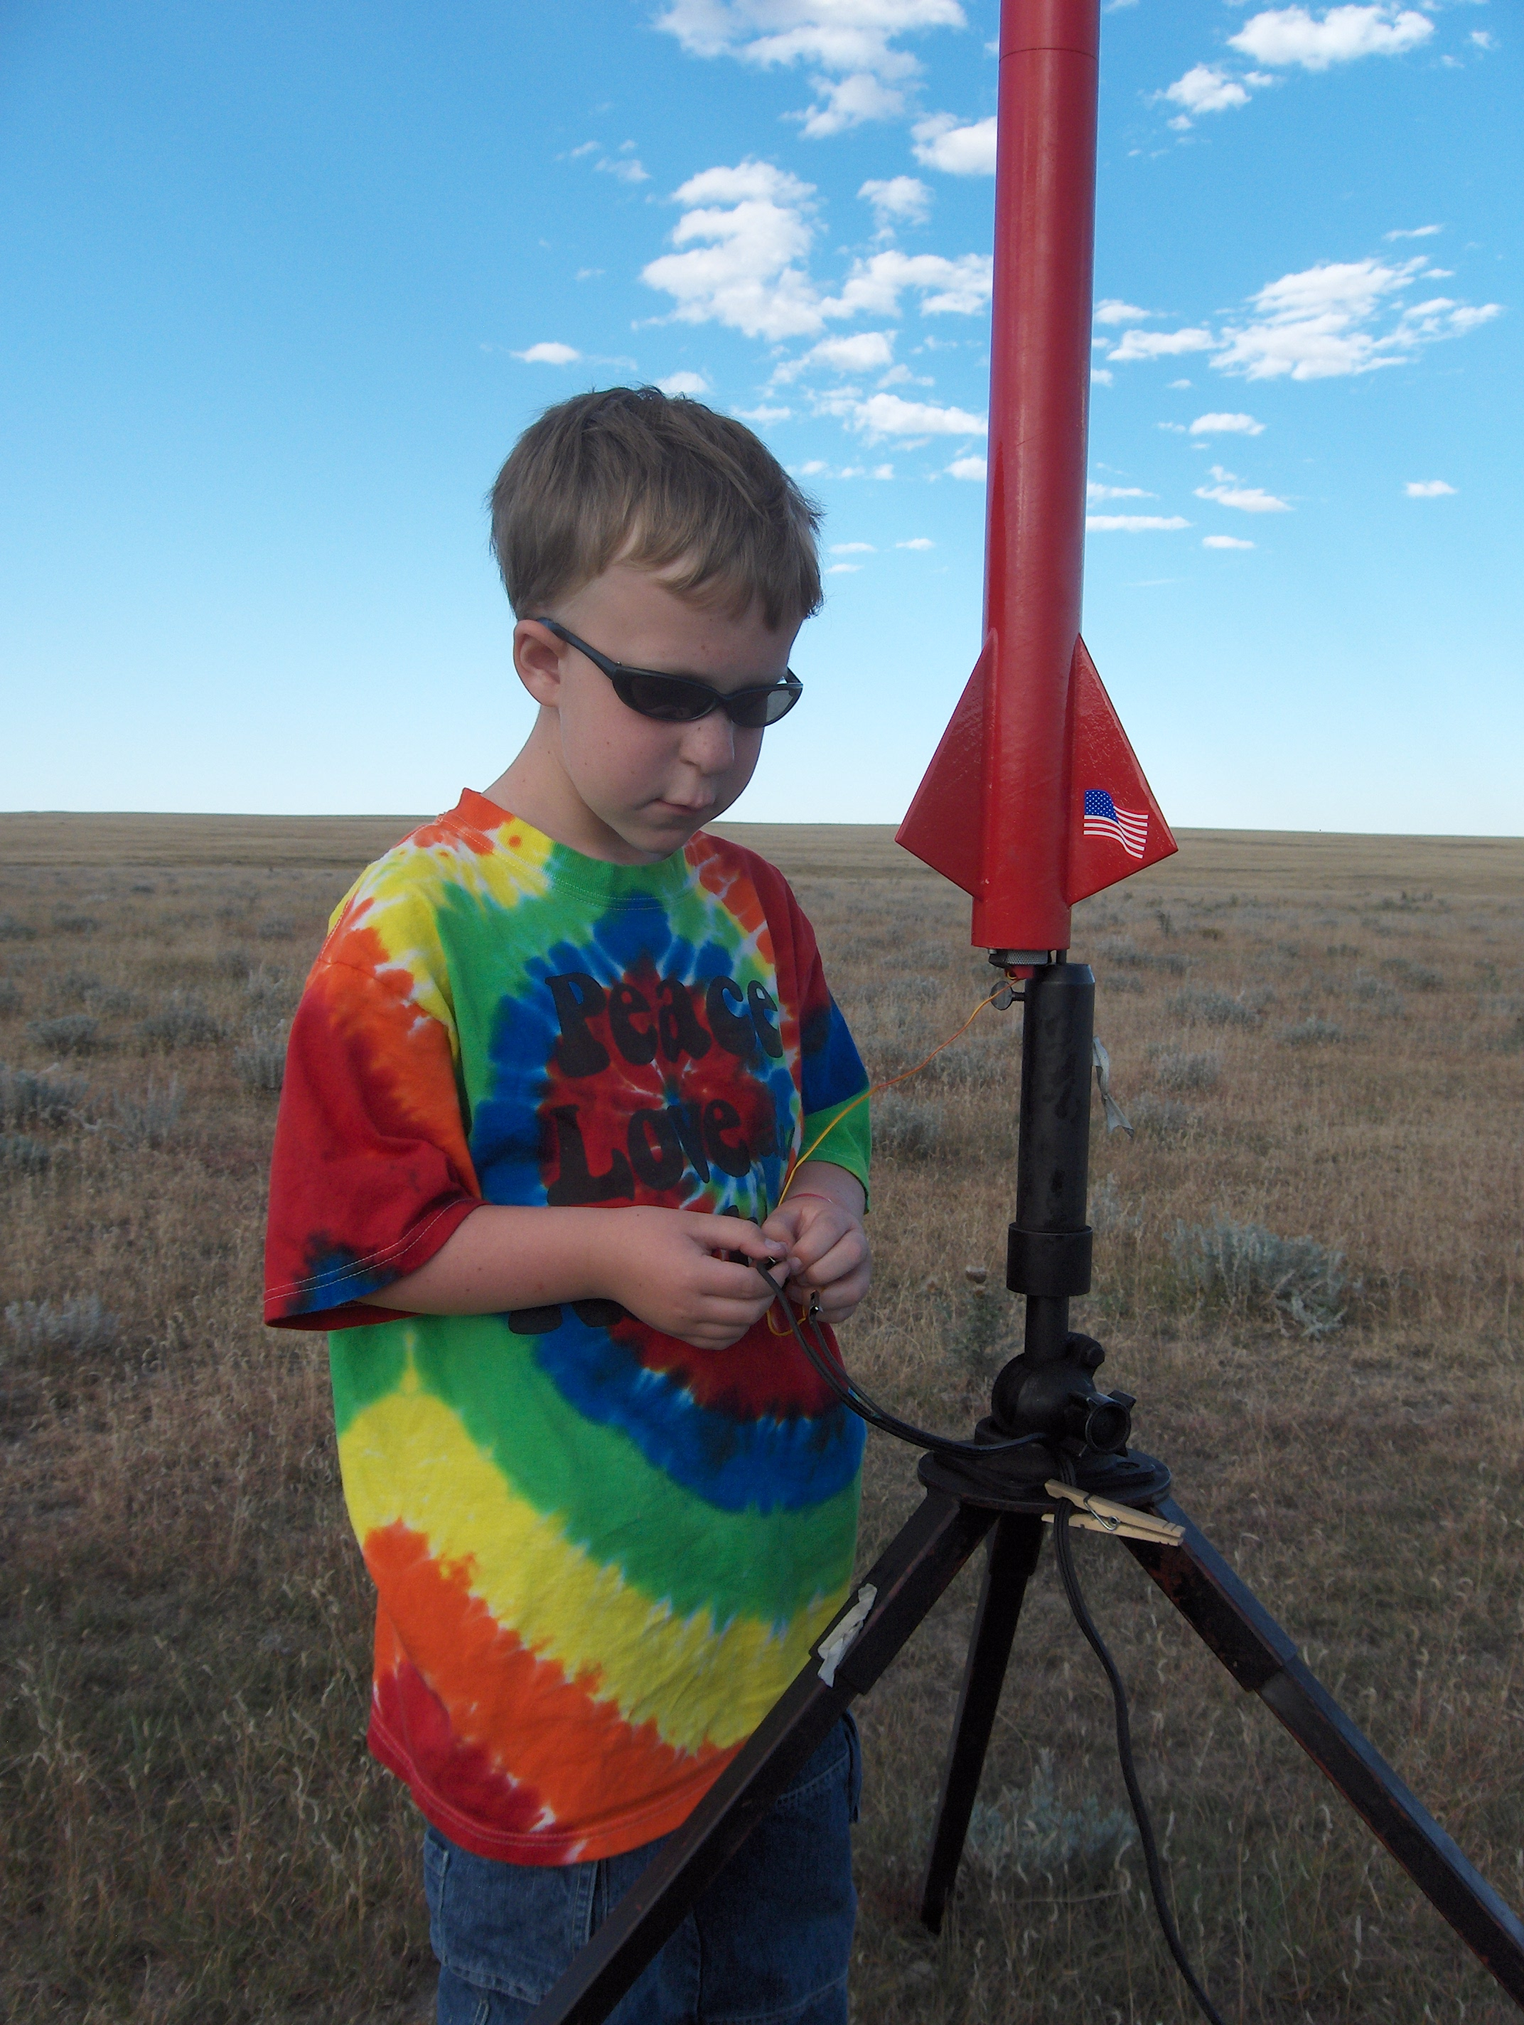
Even Simple Flight Data is Fun!
LOC/Precision “Lil Nuke” with added payload bay
Motor-based ejection
PicoAlt
Robert's first “big” rocket ... E-G motors!
Max recorded altitude 2001 feet on G77R-M

Slide 14
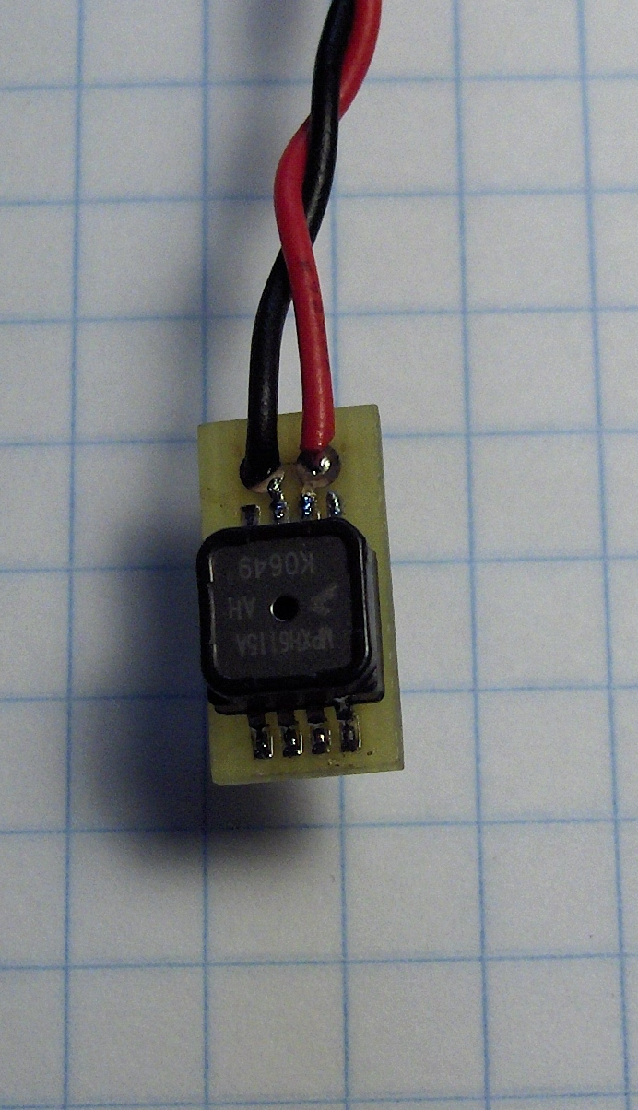
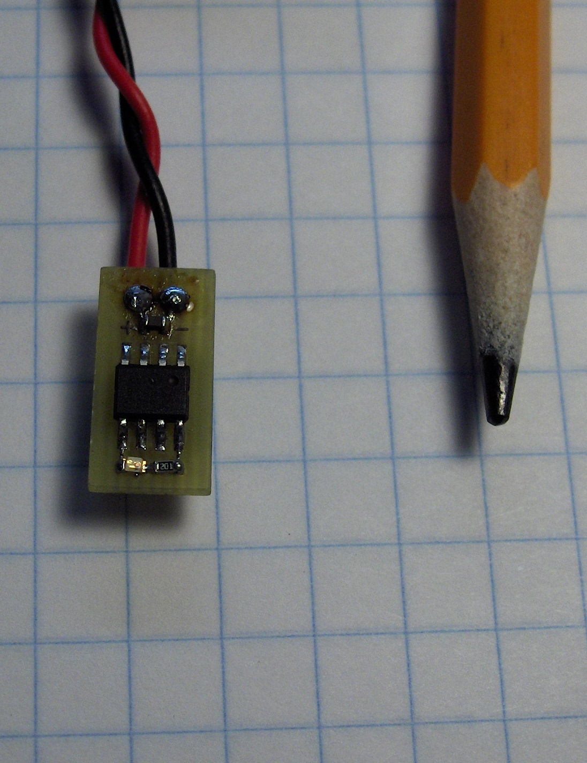
PicoAlt

Slide 15
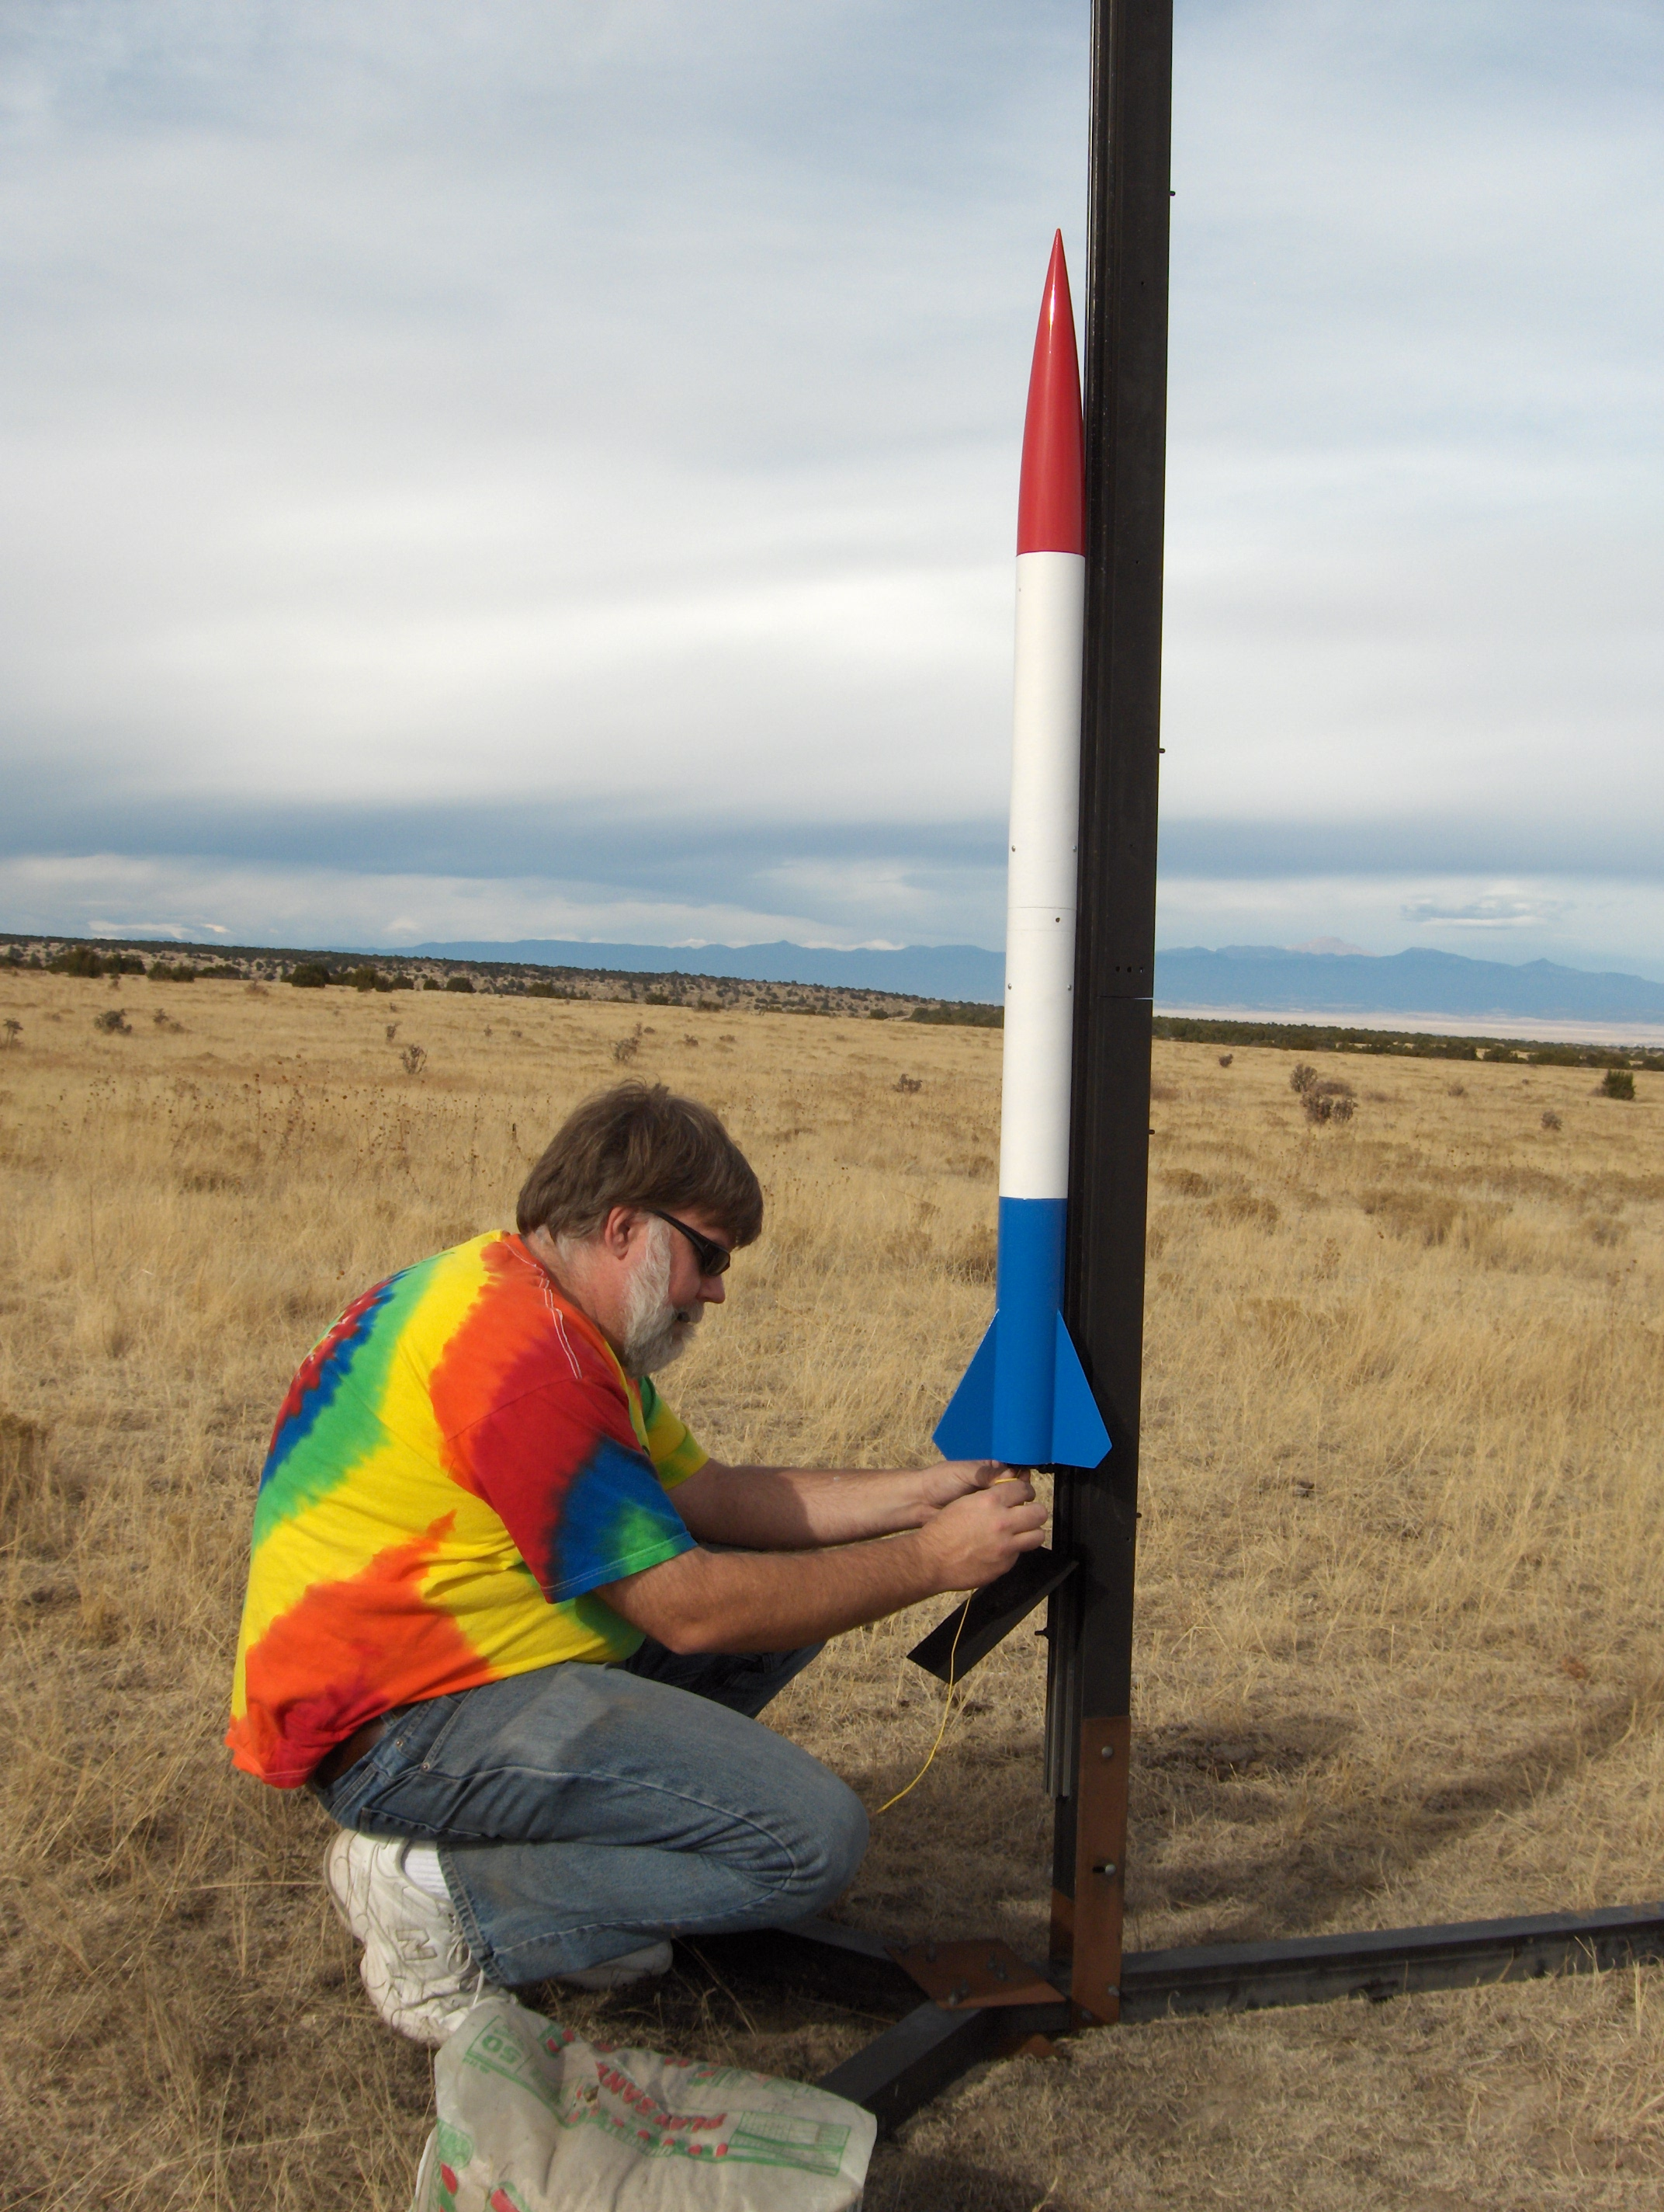
Dual Deploy
“Freedom Flies” was my first, custom, dual deploy rocket design
PerfectFlite MAWD
Holiday light charges w/ 0.5g black powder
H128 to 932 feet
J330 to 6597 feet
“bucket recovery” on third flight ...

Slide 16
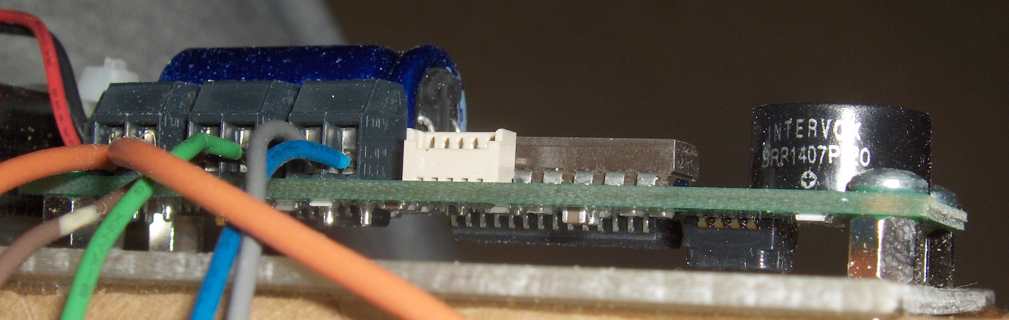
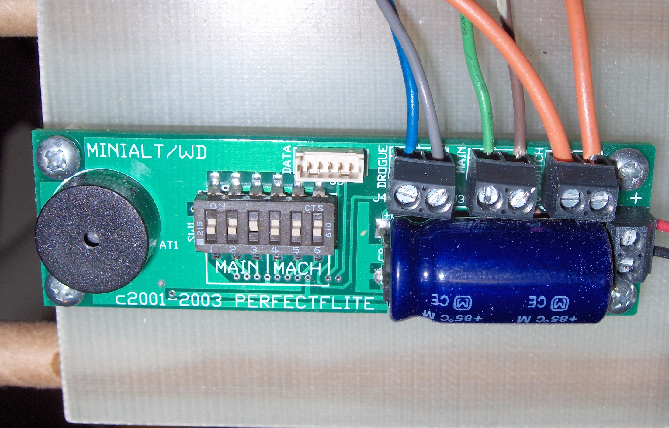
PerfectFlite MAWD

Slide 17
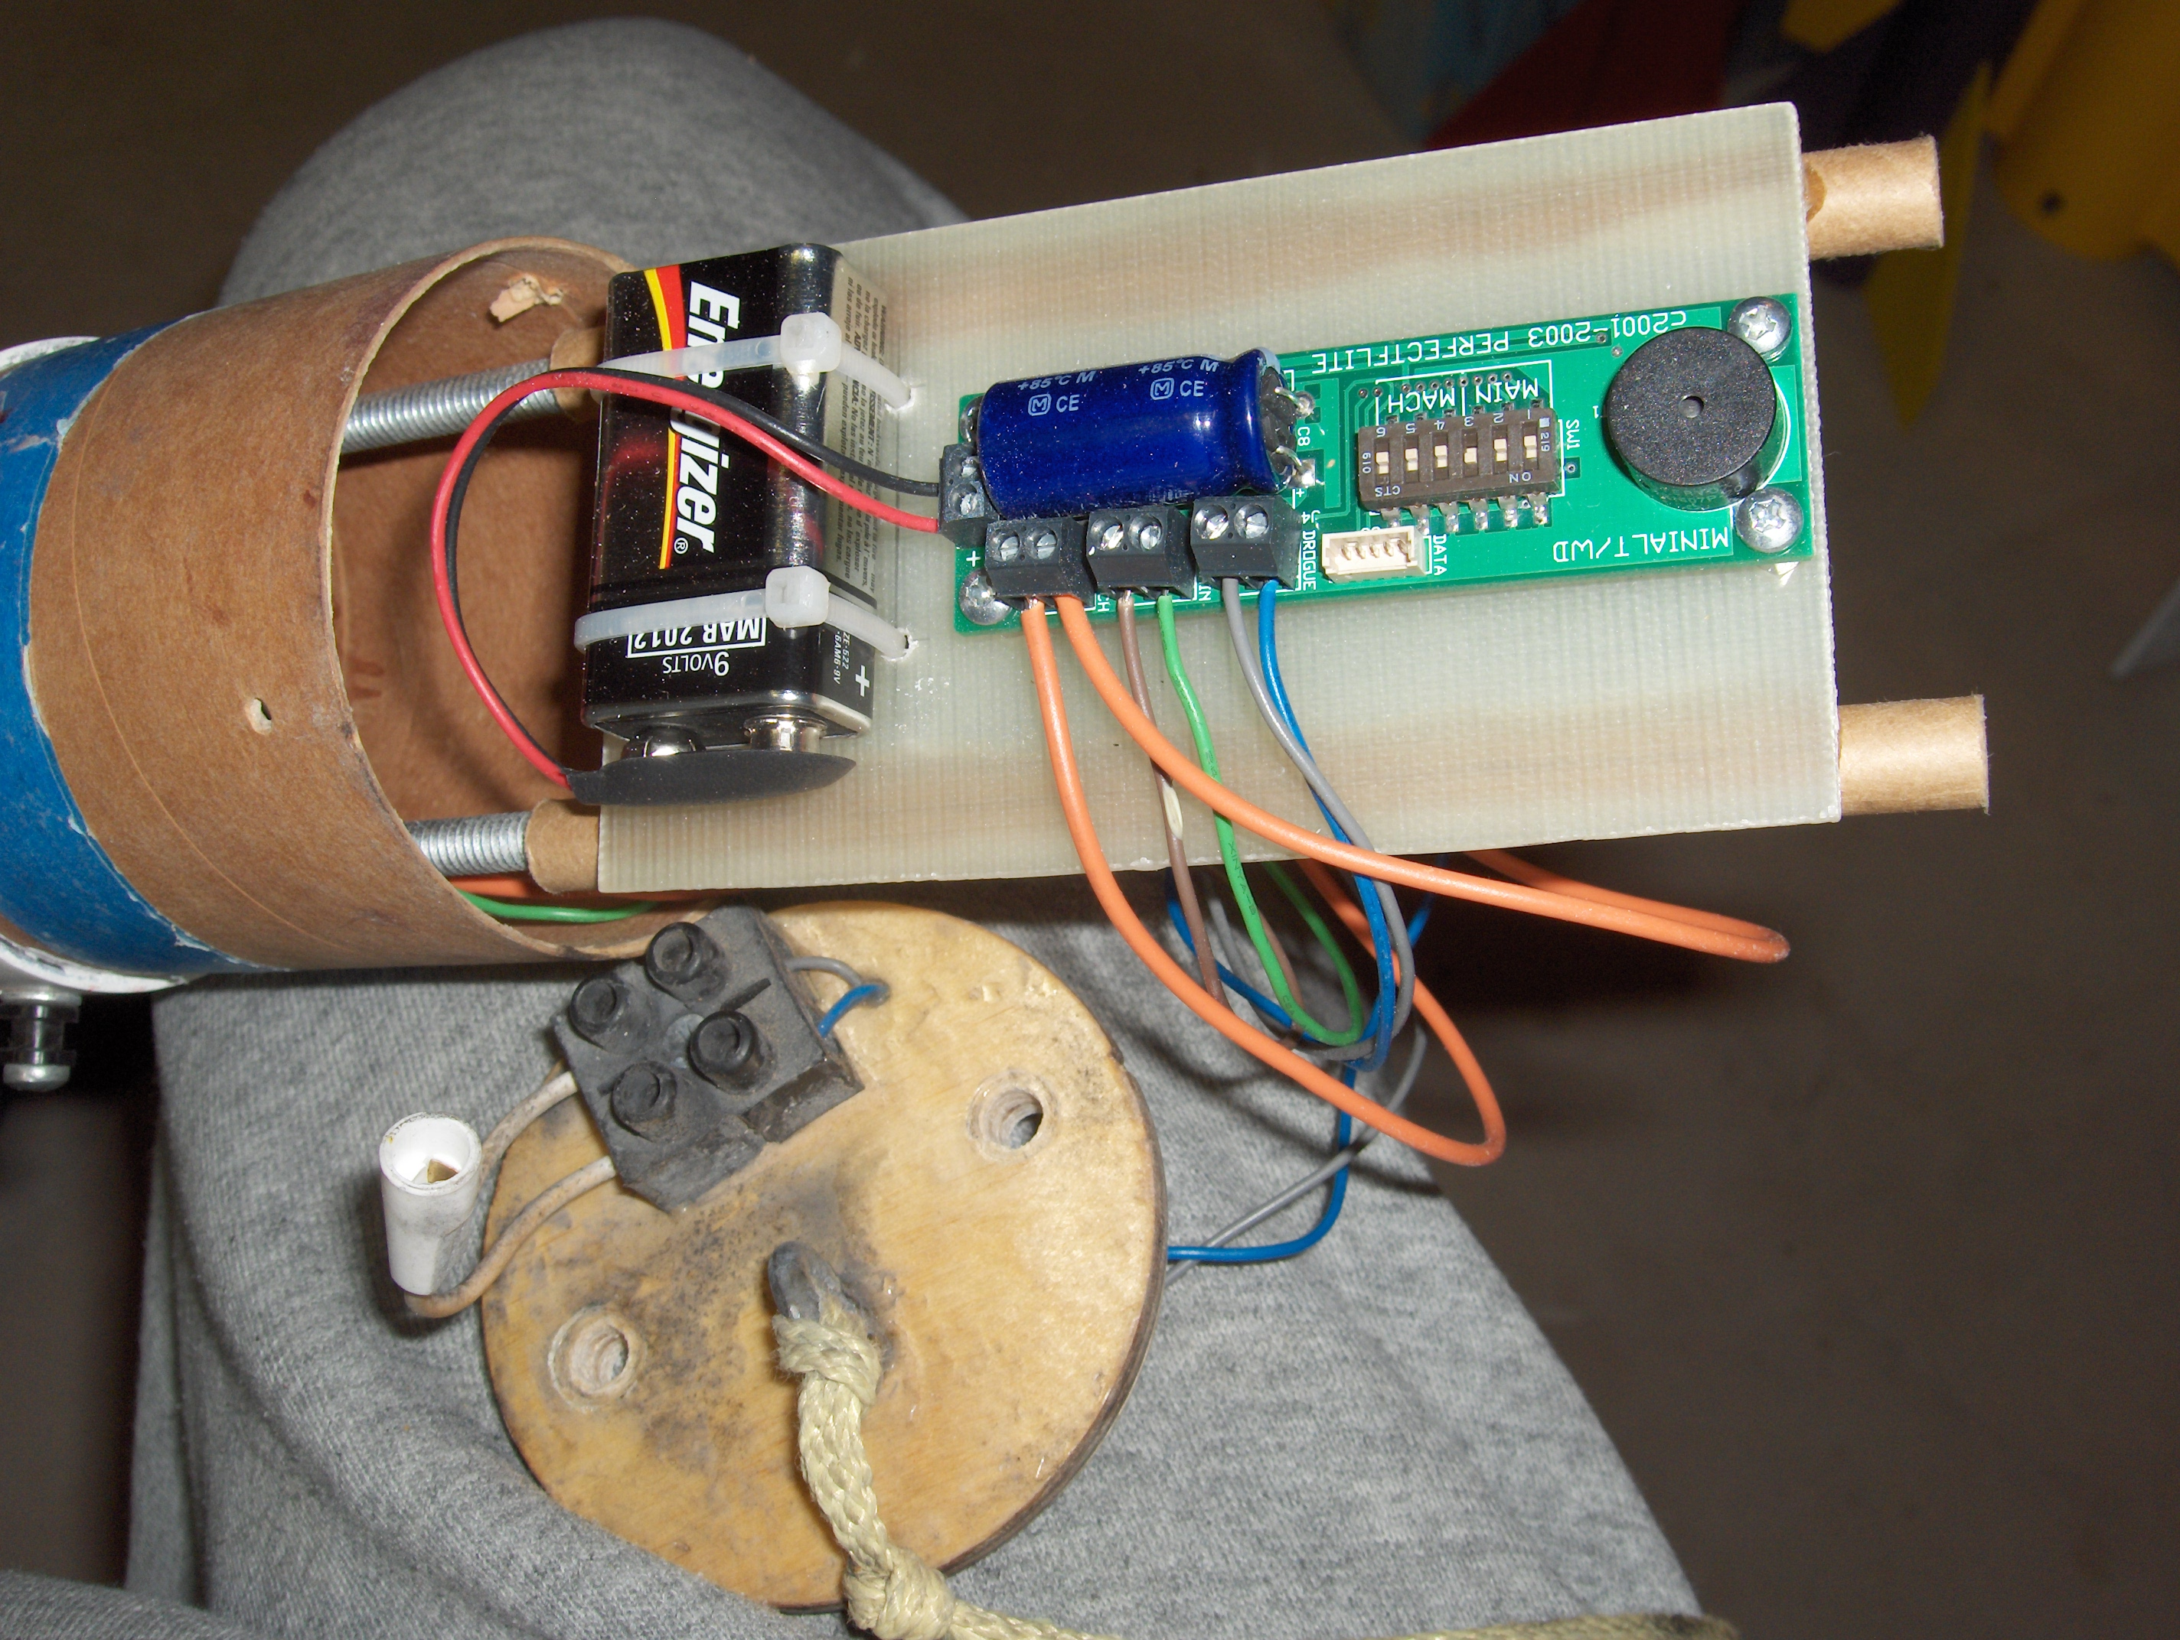

Slide 18


Slide 19
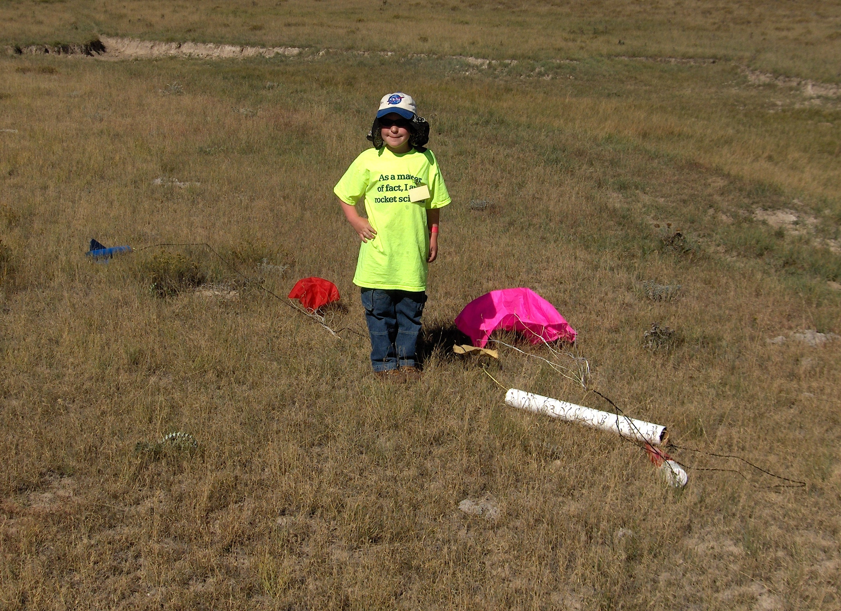

Slide 20
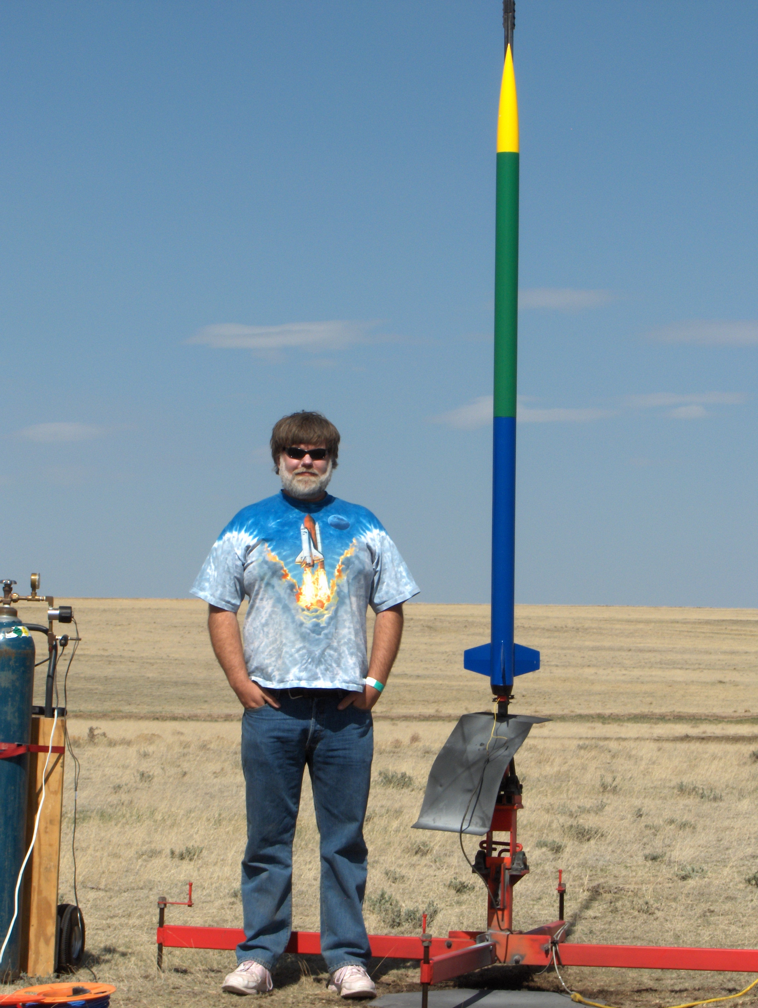
Flying High – 14,141 feet AGL
Largest-motor “good” flight to date, an L730 in a 75mm “Vertical Assault” kit airframe
Able to visually track through apogee event
RF beacon to find it...
Upper level winds carried the airframe 1.5 miles downrange even on a tiny drogue

Slide 21
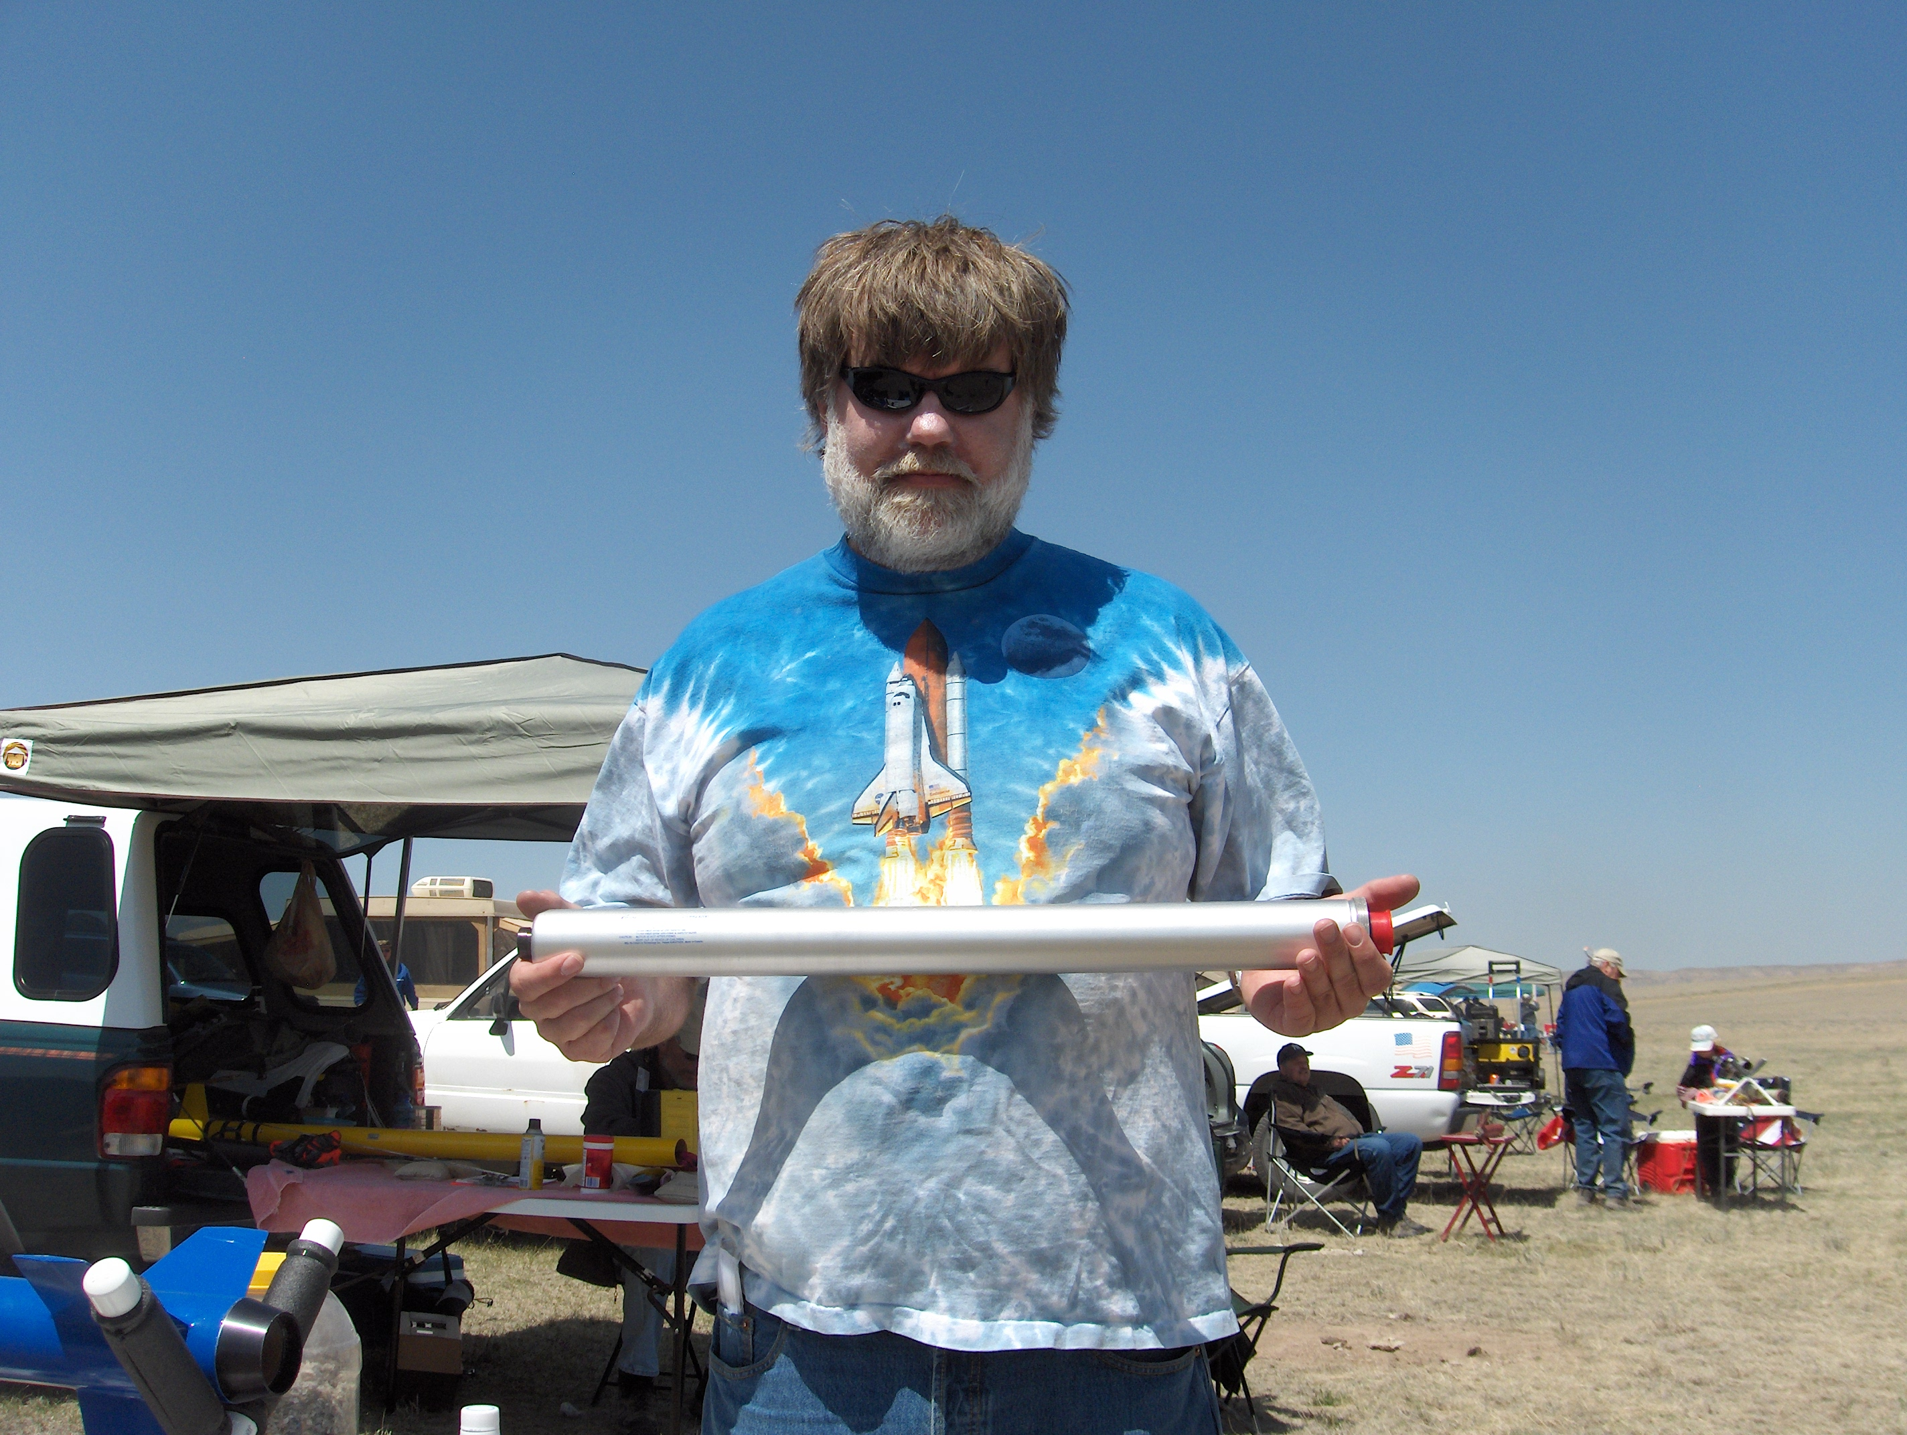

Slide 22
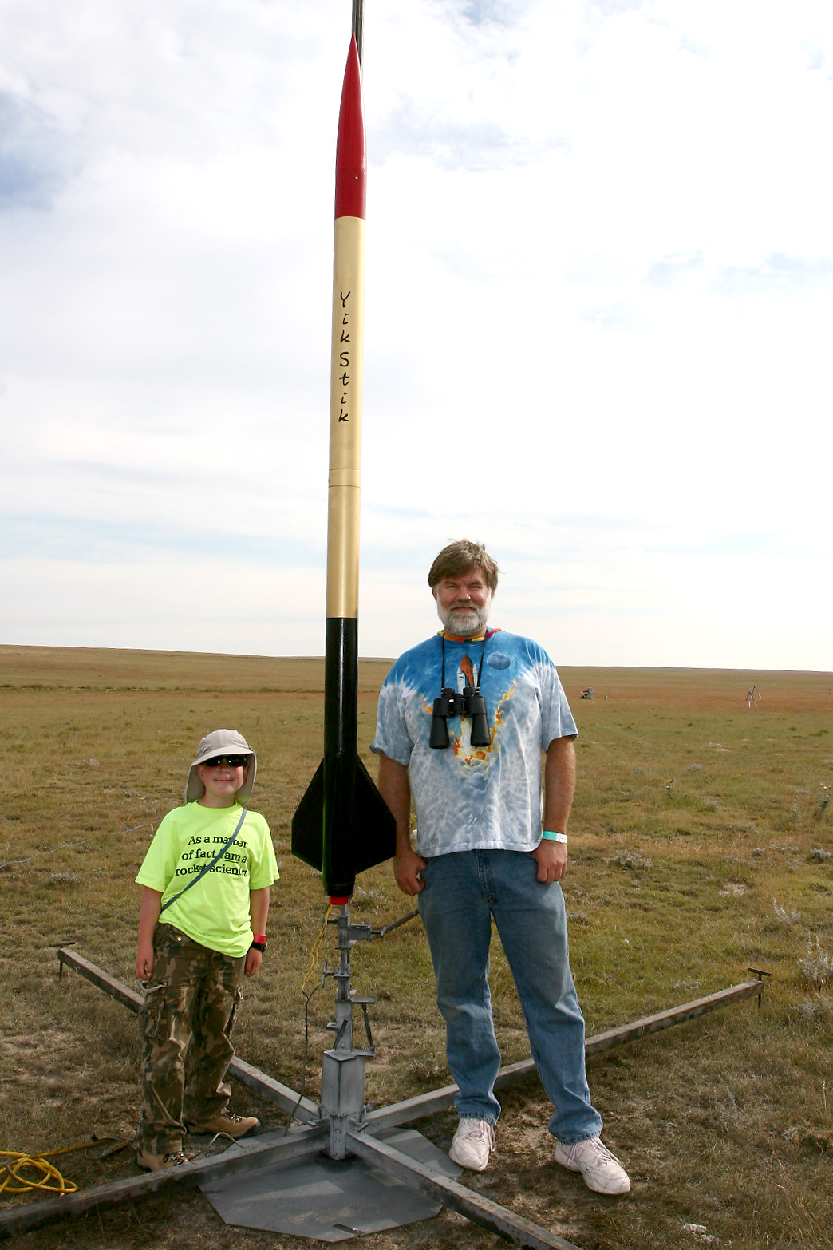
YikStik
Level 3 cert attempt on 4 October 2008
Full custom design, carbon fiber fins, body is 4” x 9' or so
M1297W motor
Stunningly beautiful launch and ascent
The black and gold bits are still missing...

Slide 23
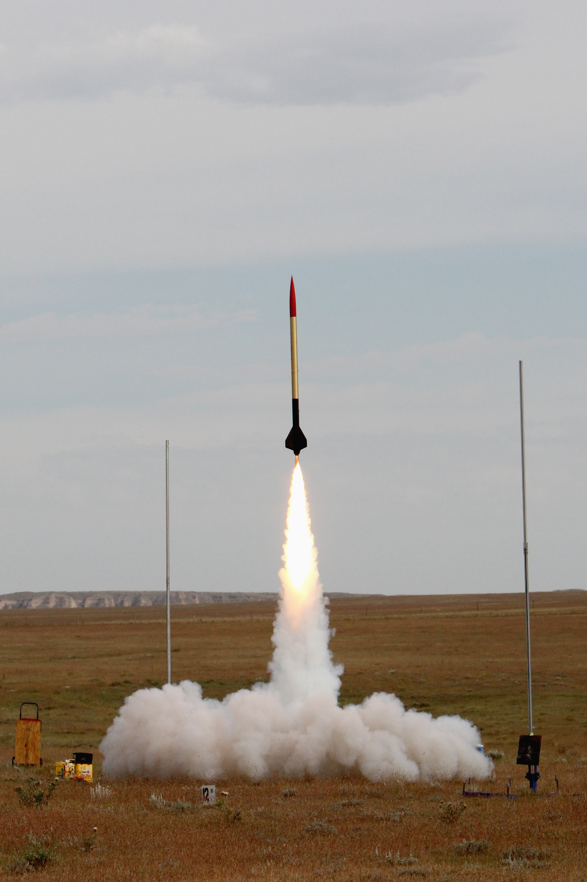
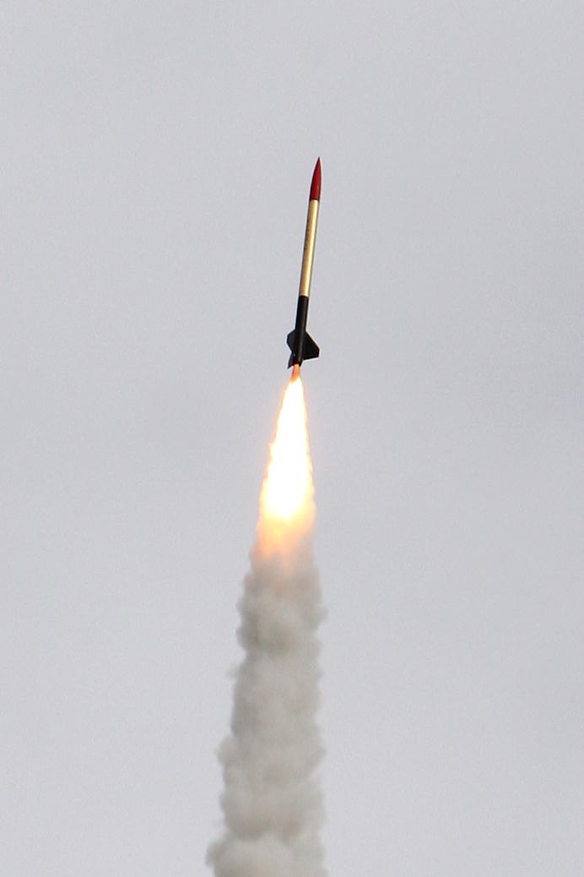

Slide 24
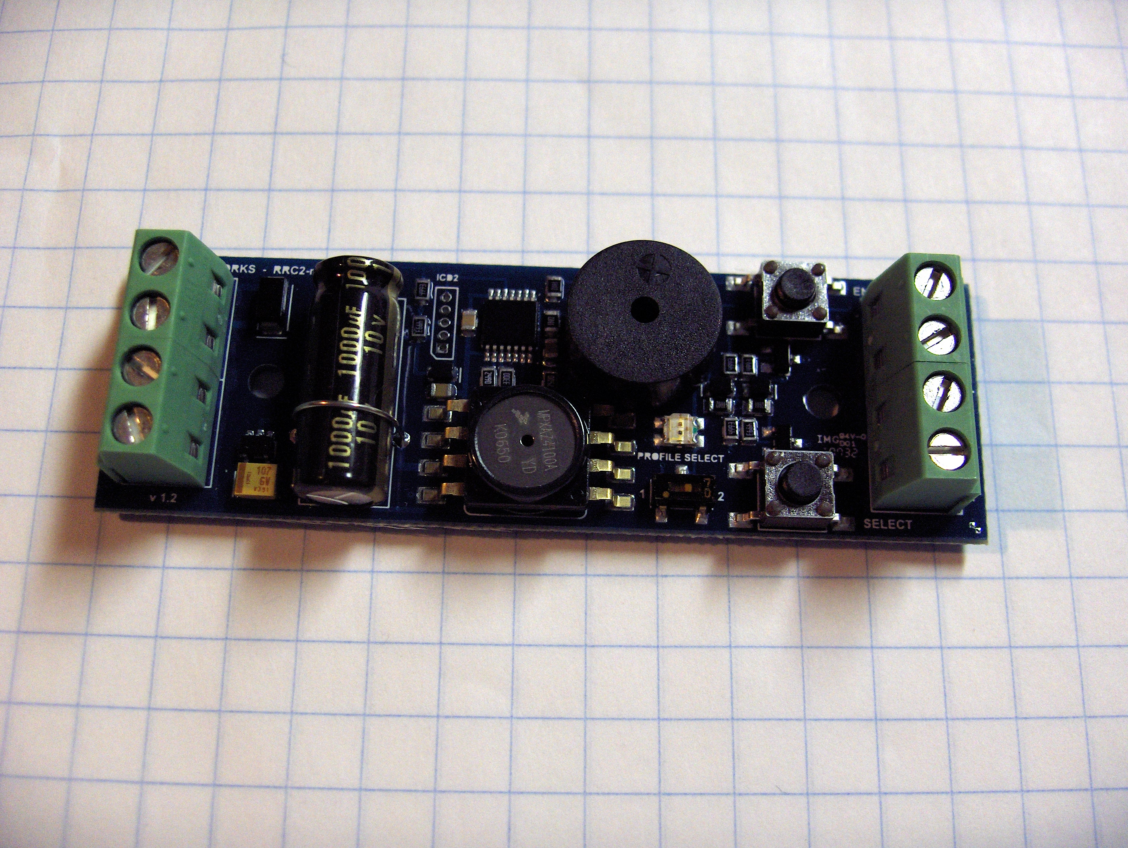
Missile Works Mini-RRC2

Slide 25
So What's the Problem?
All these altimeters are completely proprietary!
  Application-oriented documentation only!
  Some are complicated / “fiddly” to configure
  No schematics...
  No source code for firmware...
  Therefore... no real ability to modify behavior.
  Even the serial protocol for configuration and data extraction on some models is proprietary... and the feature set of the provided Windows/Mac software is very limited!

Slide 26
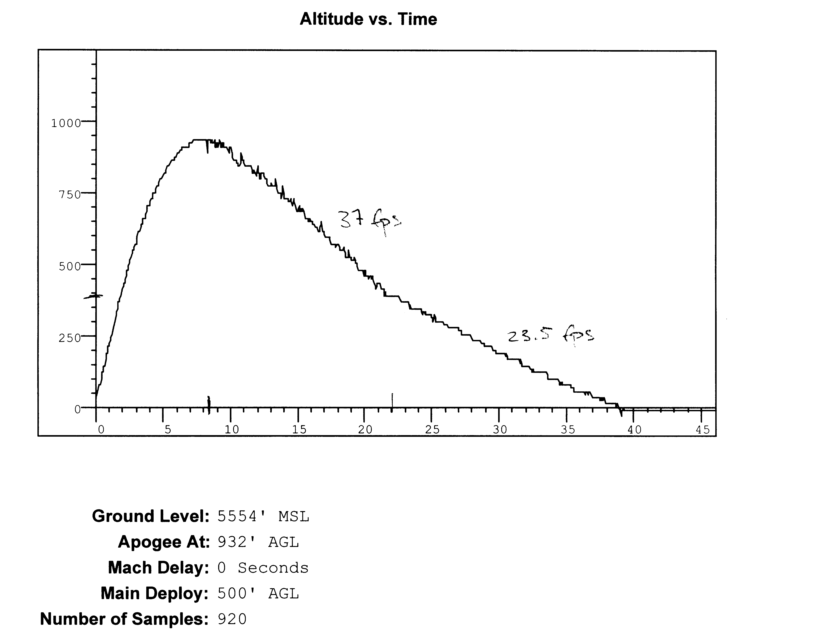

Slide 27
Altus Metrum
Design for a completely open (hardware and software) recording altimeter for model rockets
  Designed to fit 24mm tube, flexible battery choices
  Primary operations based on pressure sensor
  Flight profile, not just peak altitude
  Support for dual deploy (can fire 2 ejection charges)
  USB for data recovery and post-flight power source
Include enough “cool stuff” to make things fun...
  Accelerometer, temperature sensor
  Support for GPS receiver with serial interface
  Support for RF link to ground via serial interface

Slide 28
Primary Hardware Features
NXP LPC-2148 Processor (ARM7TDMI-S)
  512k Flash memory, 32k RAM
  USB plus lots of analog, digital, and serial I/O
Microchip 24FC1025 CMOS serial EEPROM
  128k x 8, I2C interface
Various Sensors
  Freescale MP3H6115A pressure sensor
  Freescale MMA7260QT 3-axis accelerometer
  Microchip MCP9700A temperature sensor
  (Honeywell 2-axis magnetic sensor left out of v0.1)

Slide 29
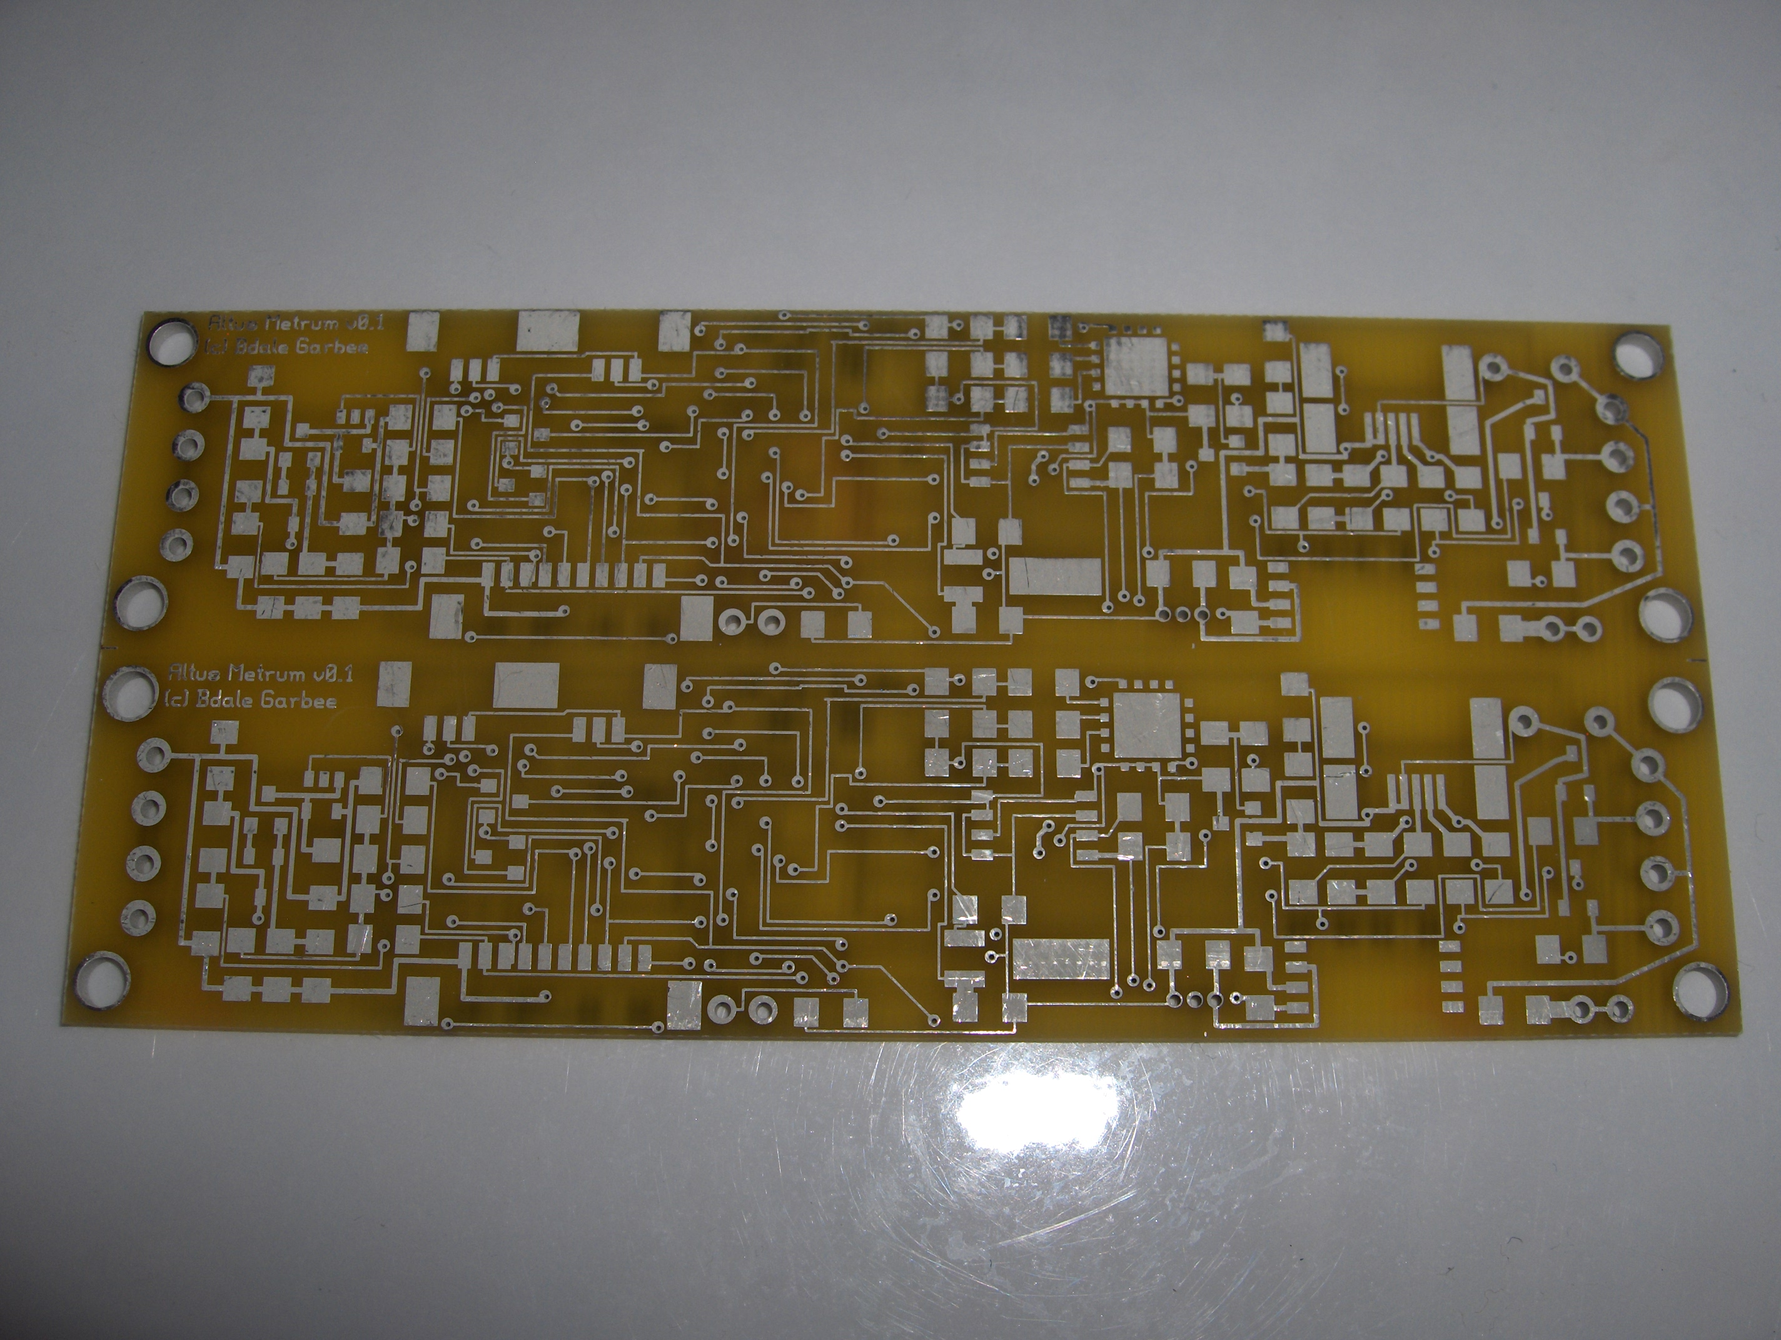

Slide 30
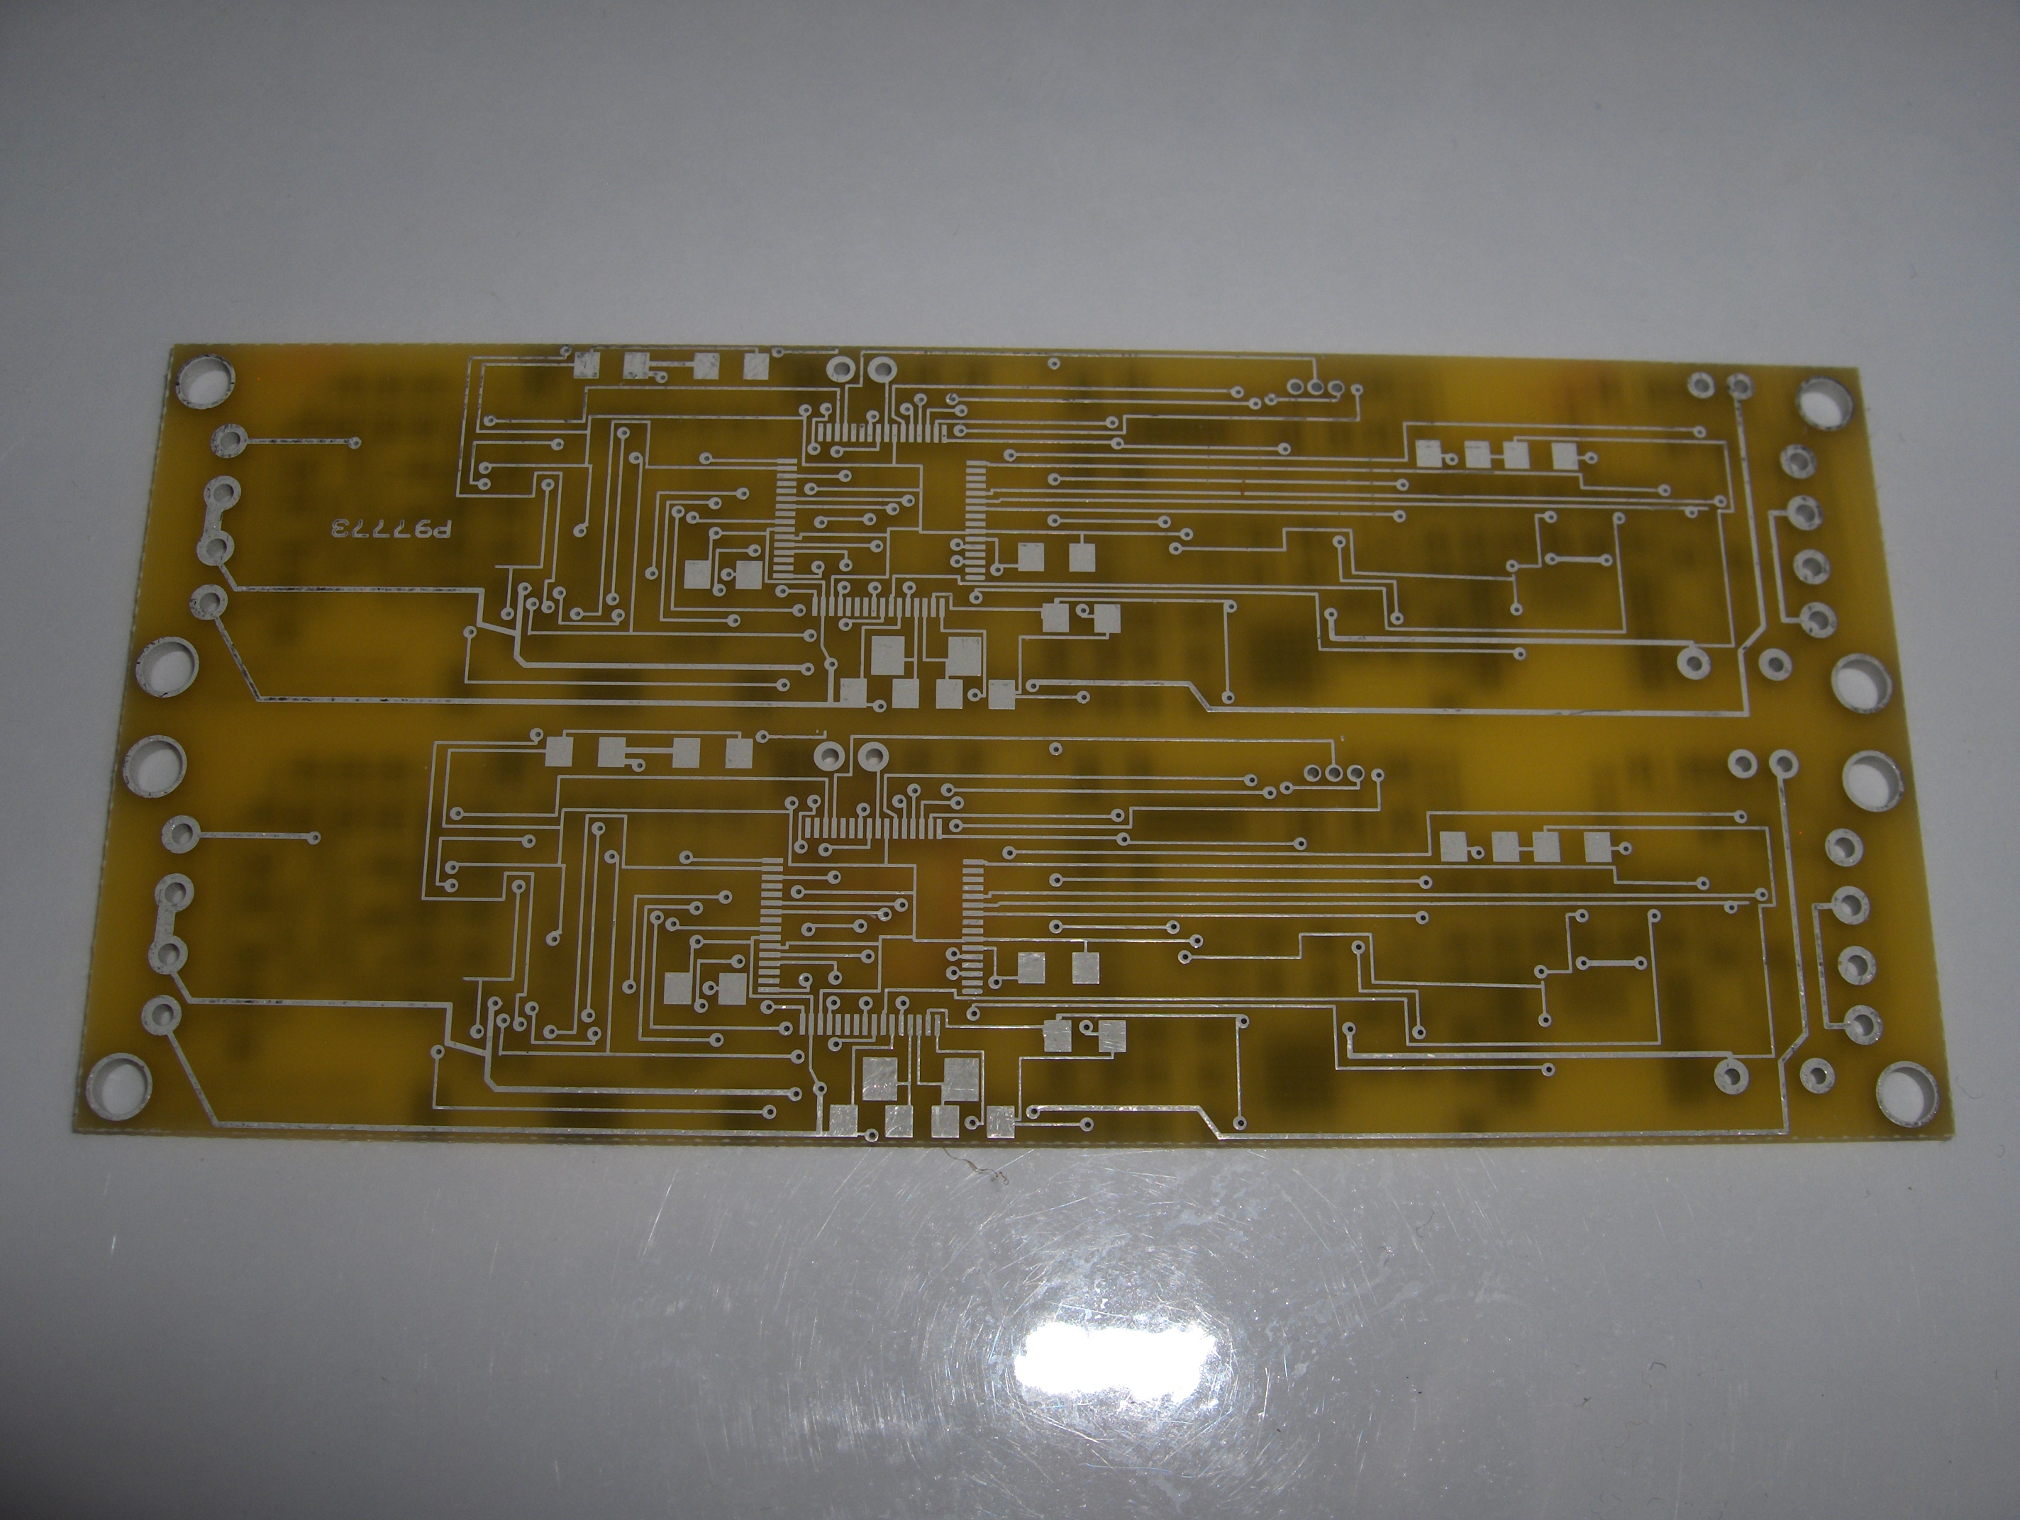

Slide 31
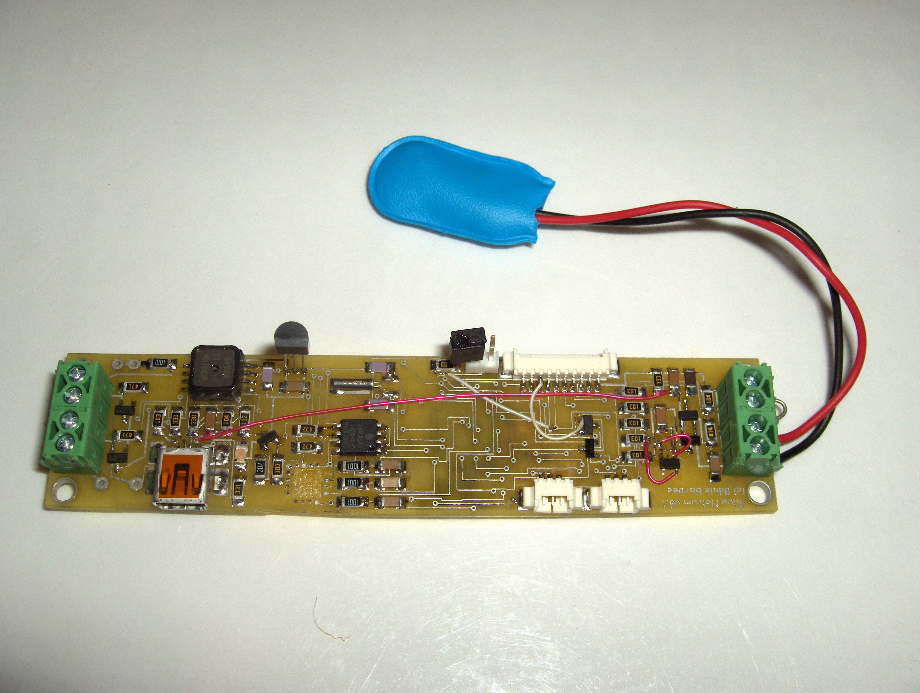

Slide 32
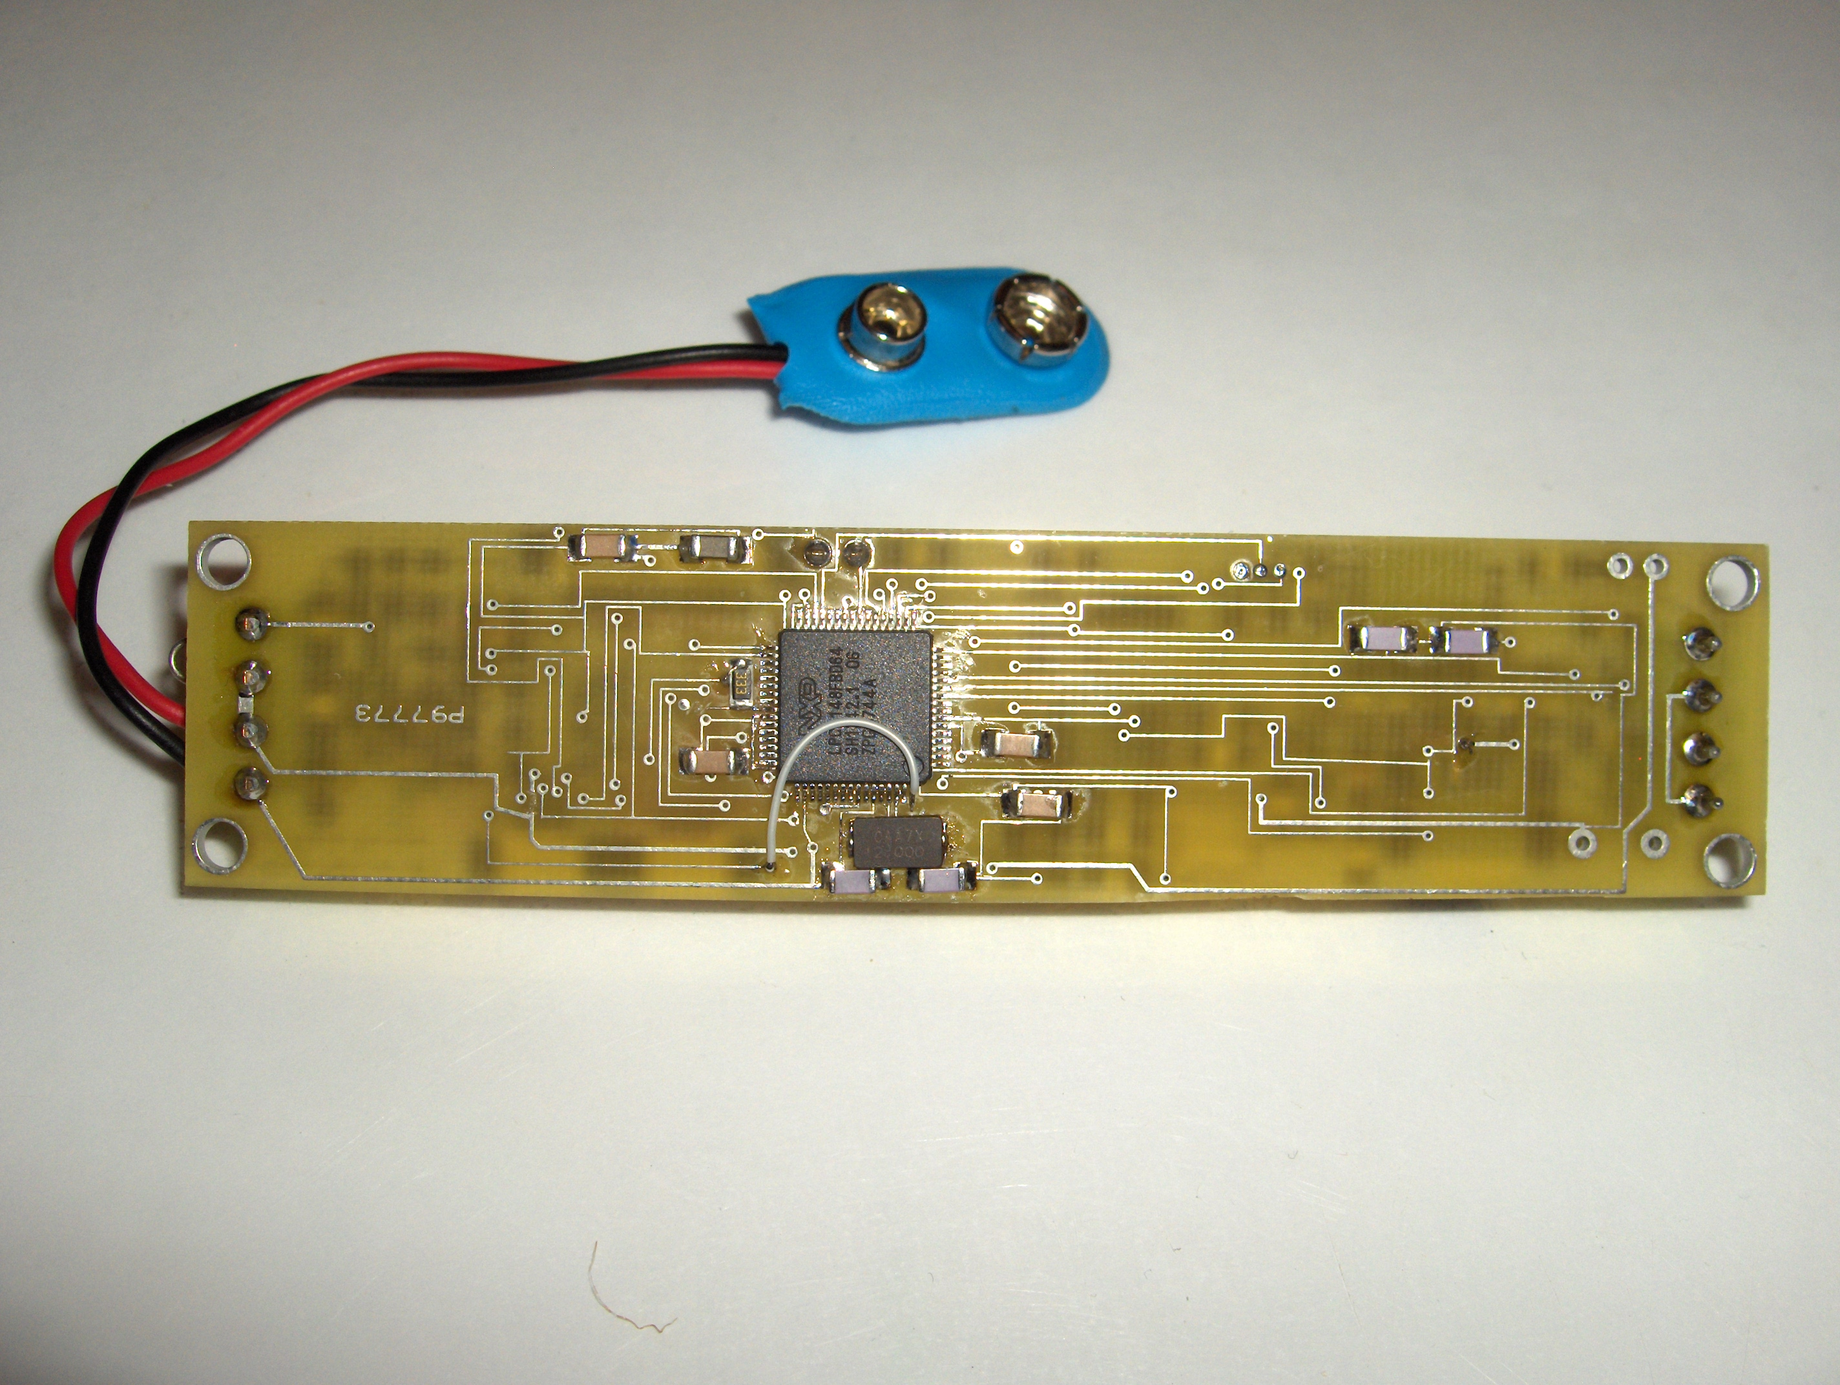

Slide 33
Software Features
Written mostly in C with some ARM assembler
Runs from on-chip flash, uses on-chip RAM, stores flight data to serial EEPROM chip
USB serial emulation for “console” interface
Uses GCC, newlib, FreeRTOS, LPCUSB
Based on a demo package written for the Olimex LPC-P2148 eval board by J C Wren

Slide 34
Licenses
The hardware design carries the TAPR Open Hardware License (OHL), which was created to be “GPL-like” for hardware designs.
The software is licensed GPL “v2 or later”.

Slide 35
Tools Used
Hardware design
  gEDA, including gschem and pcb
  DigiKey.com for parts selection and data sheets
  Gerbv and FreeDFM.com for verification
  BareBonesPCB.com for PCB fabrication
Software development
  gcc, binutils, newlib cross toolchain for arm-elf
  gdb via openocd to Olimex ARM-USB-OCD JTAG
  FreeRTOS
  LPC-P2148 demo package by J.C. Wren

Slide 36
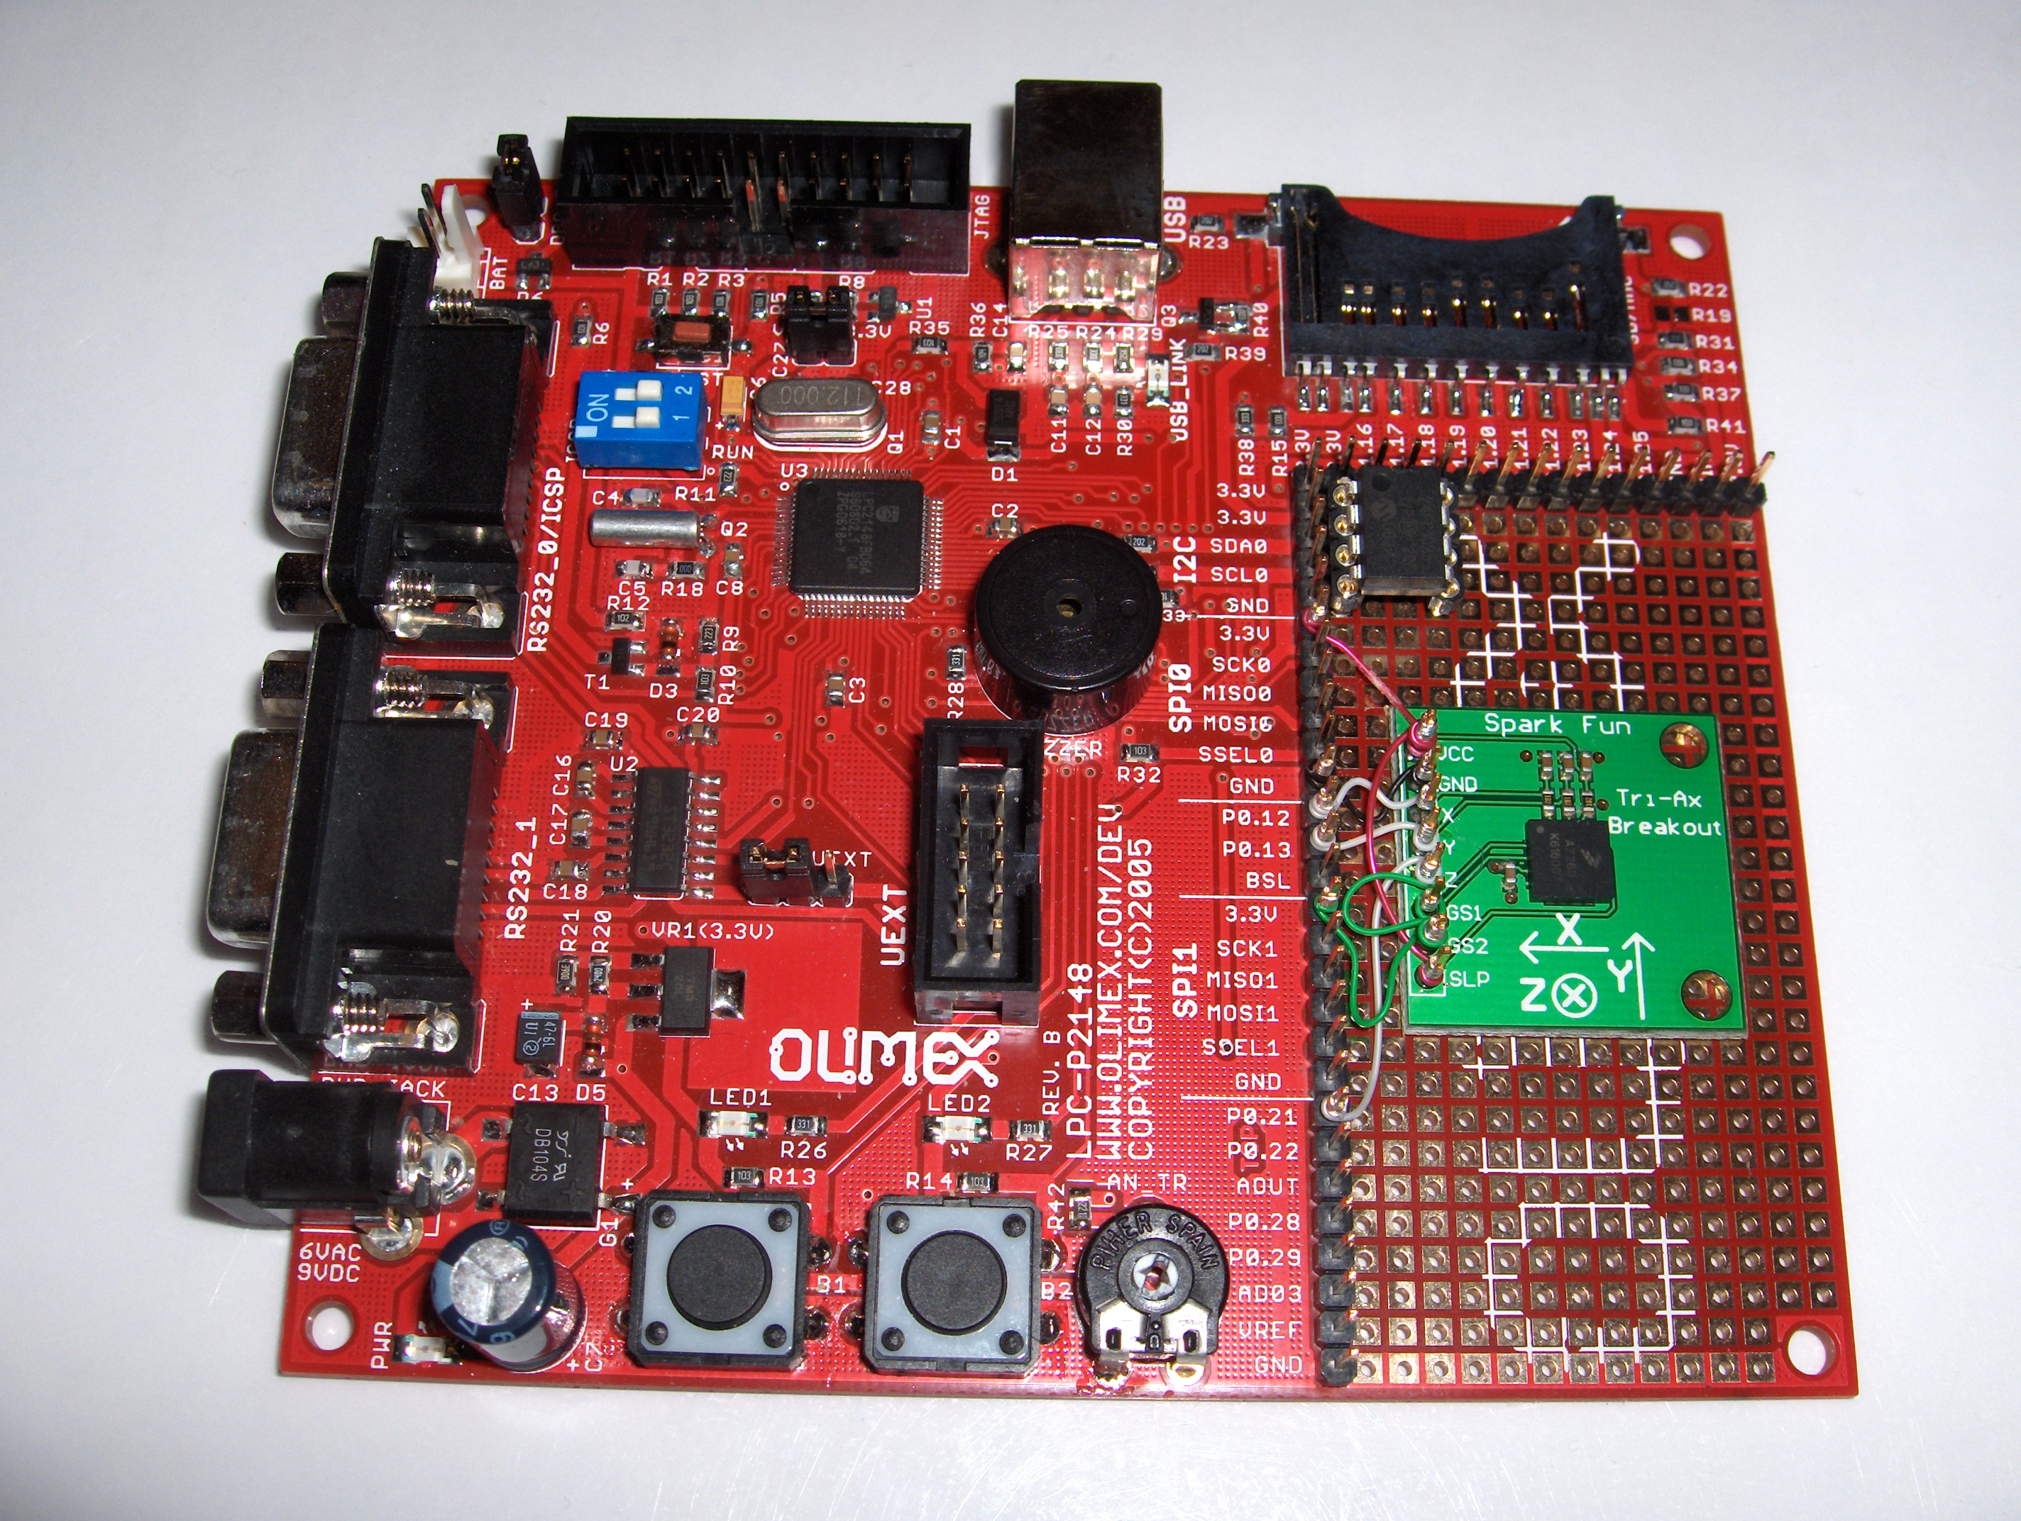

Slide 37
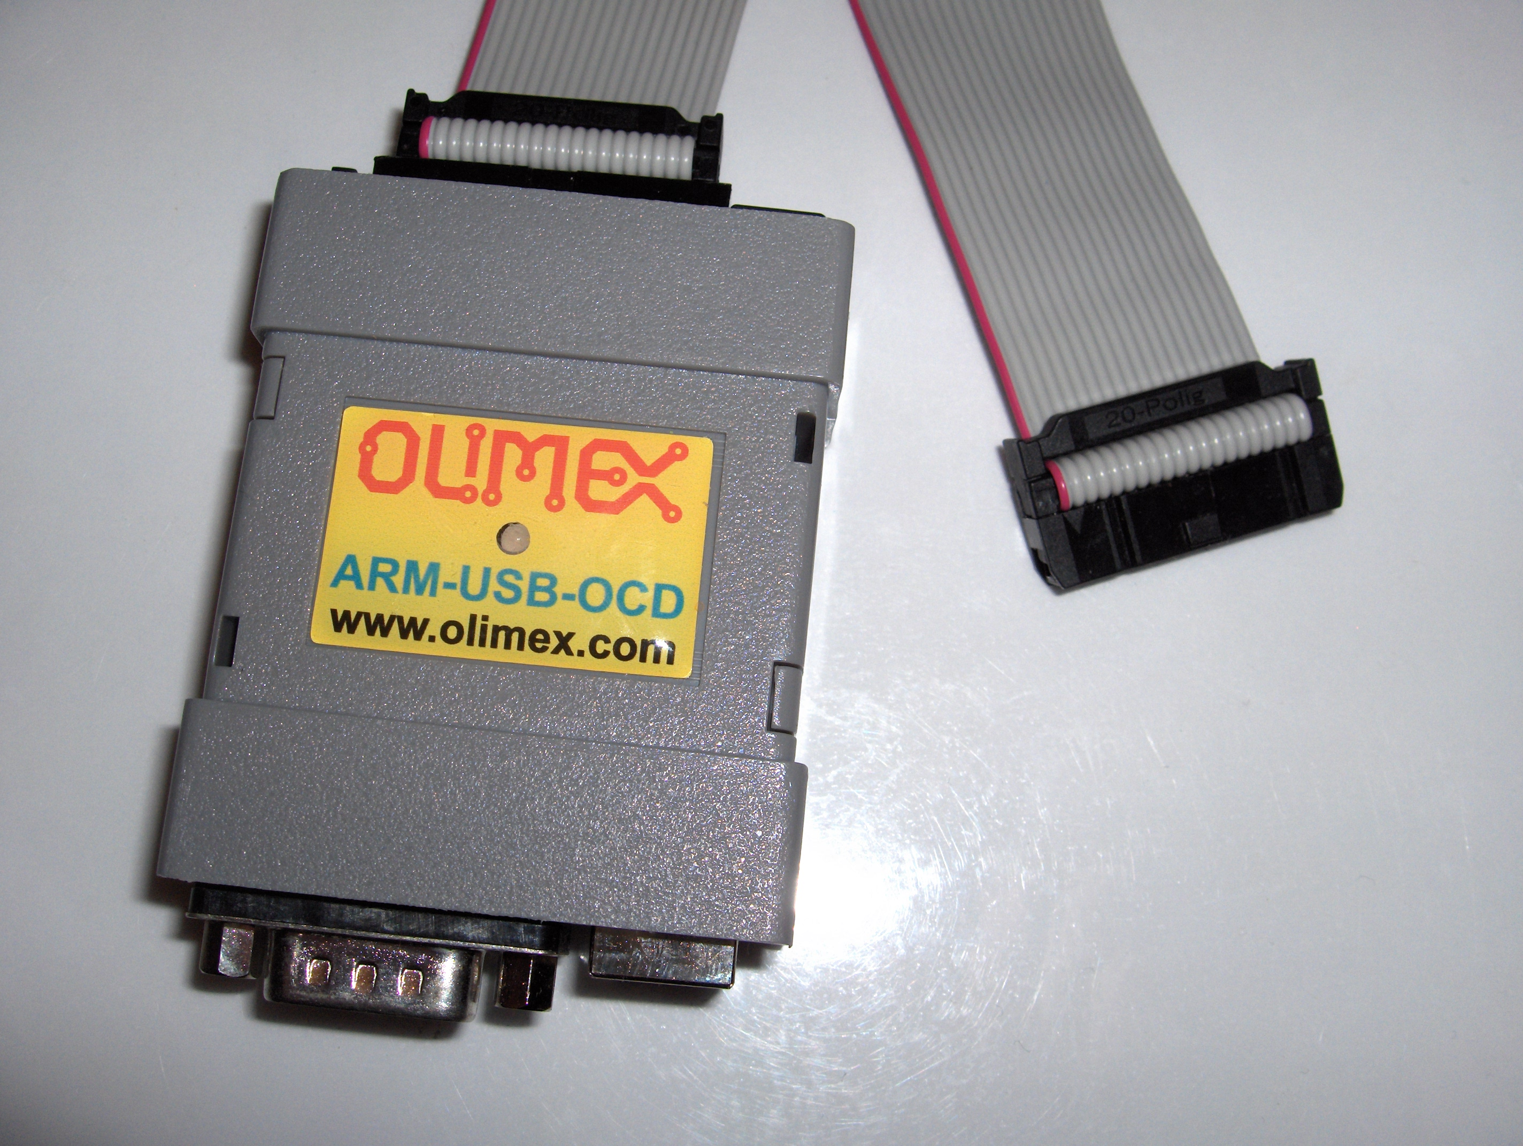

Slide 38
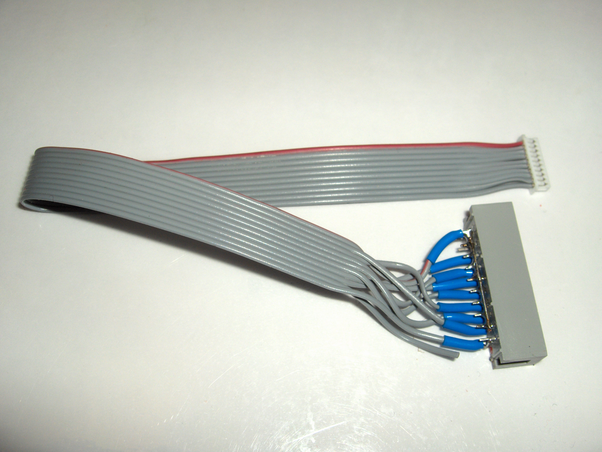

Slide 39
More Tools
PCB assembly
  Metcal soldering station for most parts
  Hot-air reflow setup
    Can't solder QFN parts in conventional way!
    Removal of random SMT parts is very easy
  Good tweezers are important
  Vision aids, including a 5-45x trinocular microscope
Turn-on and test
  HP (Agilent) mixed-signal oscilloscope

Slide 40
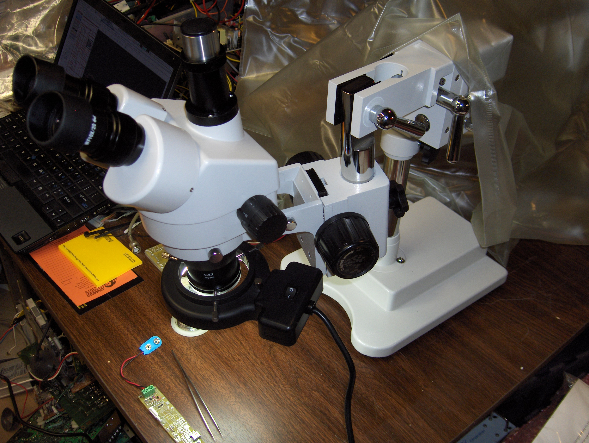

Slide 41
Current Status
First article PCB completely assembled (except for the accelerometer), and mostly tested.
Enough problems were found and fixed that loading more v0.1 boards didn't make sense
The first article PCB was damaged before being flown, so no test flights to report on yet!
Working now to complete a design revision, hope to load and fly a v0.2 board before the end of this season... my YikStik project was a major (but fun!) distraction this summer!

Slide 42
Changes for PCB v0.2
Fix all known design problems with v0.1
  Only lingering unresolved issue is USB indicator
Likely move to smaller SMT passive parts
Make the board slightly wider, 24mm tubing target turns out to be irrelevant and difficult!
Changes to serial & debug connector pinouts
Move to LiPo battery technology
  Include MAX155x USB LiPo charge controller
  Replace screw terminals with pads & JST connector
Include a beeper and/or LED status indicator

Slide 43
Future Plans
Complete design of PCB v0.2 and build some
Fly some test flights and gather data
Build a few to distribute to friends for feedback, respond to firmware feature requests (TARC)
Integrate GPS receiver and RF link
  Phil Karn, KA9Q, designing the downlink protocol
Might be fun to do some variants?
  Baro-record-only board to fit in 18mm tubing
  Dual deploy with LiPo and beacon in 24mm tubing

Slide 44
GPS and RF Links
Found some surplus sirf2 GPS modules for less than $20 US each with serial interface
Antennas on rockets are an issue, PSAS work on cylindrical patches looks worth duplicating, but my “driveway tests” were encouraging!
Plethora of RF options... Stephen Moraco is helping evalute promising 915mhz SS modules
Ground station design for flight monitoring, data collection, and recovery of high altitude flights... USRP and GNU Radio, perhaps?

Slide 45
Questions?
This project can be found at altusmetrum.org
  Still pretty sparse, as I really don't want anyone trying to duplicate the v0.1 hardware!
  I promise to put v0.2 data there even before I cut raw boards... more help would be great!
Other information at gag.com/rockets
  L3 “YikStik” rocket design is there for the curious
TAPR OHL info at tapr.org/ohl

