Slide 1

Hardware
Electronics in
Hobby Rockets
Bdale Garbee
NAR 87103 / TRA 12201 L3

Slide 2
Agenda
Electronics in rockets
Sensors
Dual deployment

Slide 3
Electronics in Rockets
Airframe recovery
  Deploying parachutes
  Finding the airframe
Collecting flight performance data
  Calibrating simulations
  Characterize research motors
Payloads
  Cameras, science experiments, etc
Control complex flights
  Multi-stage, air starts, clusters, etc

Slide 4
Airframe Recovery
Parachute deployment
  Deploy at apogee
  Deploy at a programmed height above ground
Finding the airframe
  Noise makers
  Beacons for radio direction finding (RDF, “fox hunting”)
  GPS

Slide 5
Performance Data
Even simple data can be fun to know
  How high did it go?
  How fast did it go?
Calibrating simulations
  Calibrate drag coefficient using actual flight data
Characterize research motors
  Compare acceleration to simulation results
  Measure chamber pressure and temperatures

Slide 6
Electronic Payloads
Video and still-frame cameras
Science experiments
  Temperature rise in nose and fins above Mach
  Exploring behavior of new sensors
Satellites and landers
  CANSAT
  ARLISS

Slide 7
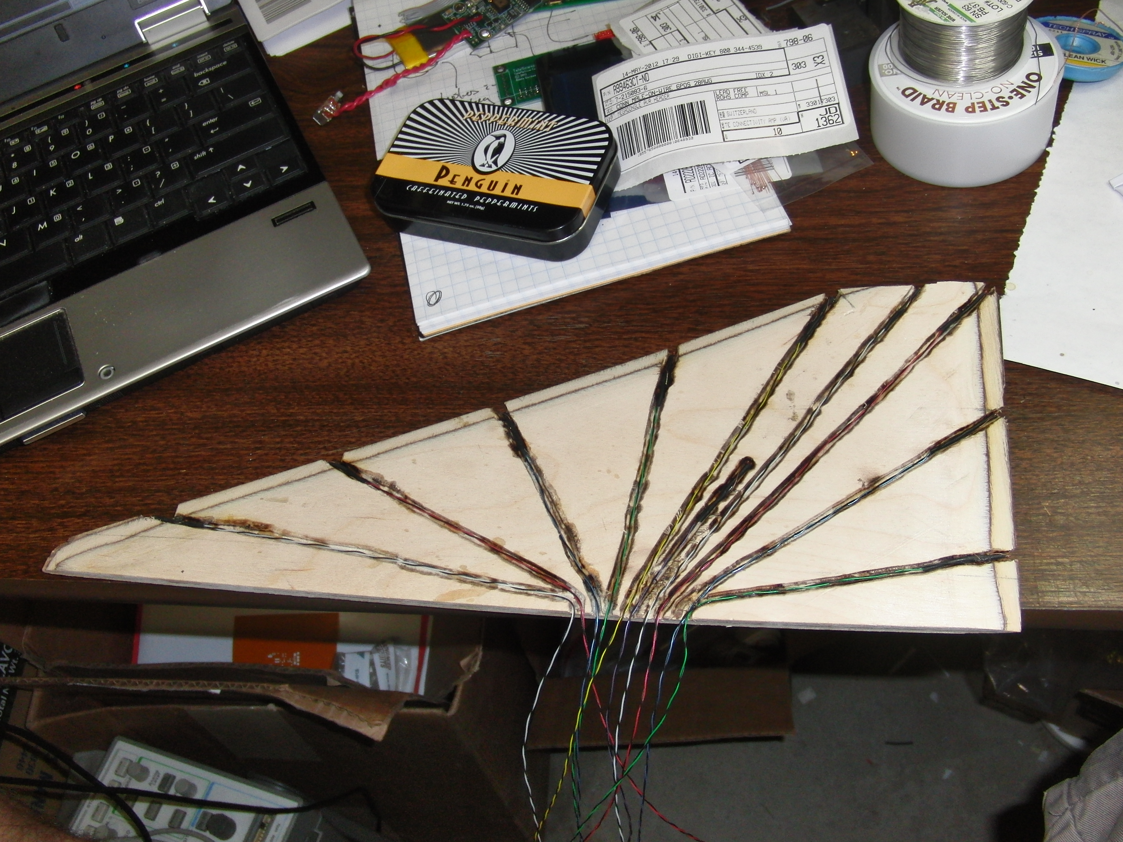

Slide 8
Complex Flights
Multi-stage
  Triggering separation
  Igniting upper stage motor(s)
Air Starts
  Igniting additional motors in flight
Clusters
  Can treat high power clusters like air starts
Complex flights pose additional safety risks
  Only ignite additional motors if flight is nominal

Slide 9
Hardware
Sensors

Slide 10
Sensor Types
Time
Temperature
Air pressure
Acceleration
Rotation
Magnetic
Light
GPS

Slide 11
Sensing Time
Electronic timers
  Usually based on quartz crystal reference
  Essentially just a fancy pulse counter
Need some mechanism for detecting launch
  Old-school approach was often a “break wire”
  G-switches
  Integration with other flight avionics
Events programmed to happen at specific times
  Far more reliable than motor delay grains...
  What happens if flight isn't nominal?

Slide 12
Temperature
Thermistors
  Basically a resistor that changes value with temperature
  Positive or negative temperature coefficients
  Good for most hobby rocketry uses
Thermocouples
  Two dis-similar metals in contact with each other
  Produce tiny voltage with temperature difference
  Can measure very high temperatures, thus can be useful for motor characterization
Digital temperature measuring integrated circuits
All analog temperature sensors must be calibrated

Slide 13
Air Pressure
MEMS barometric sensors
Have finite range and accuracy
  Lowest useful pressure measurable limits max altitude
  Resolution and noise of sensor limit accuracy
Converting pressure to altitude
  Standard model of the atmosphere, temp dependent
Only really useful for relative altitudes
  Calibrate “starting elevation” while waiting for launch
Can be “fooled” by Mach transitions, etc
MS5607 works to 30km, 20cm at sea level!

Slide 14
Acceleration
MEMS acceleration sensors
Have finite range and accuracy
  Plus and minus maximum G ratings
  Resolution and noise of sensor limit accuracy
Sampling rate
3-axis sensors with ranges up to about 18g
Single-axis sensors to 200g or more

Slide 15
Rotation
MEMS gyros
Have finite range and accuracy
  Plus and minus limits in degrees / second
  Resolution and noise of sensor limit accuracy
Sampling rate
3-axis sensors with ranges up to 2000 deg/sec

Slide 16
Magnetism
MEMS compass
Measures influence of Earth's magnetic field
Readings are noisy
Must be calibrated before flight
Nearby metal alters readings due to eddy currents
  Launch rods and rails

Slide 17
Light
Photo cells
Photovoltaic (solar) cells
Mostly a curiosity...
Possible to detect rotation rates
Possible to detect passing through cloud layers

Slide 18
GPS
Radio receiver listening to GPS satellites
  Satellites send precise timing and satellite orbit info
  Receiver works out where it must be for arrival times of the different signals to make sense
  X, Y, Z, and time .. at least 4 satellites needed
“Anti-SCUD” rules limit velocity & altitude
Consumer receivers not meant for high dynamics
  Virtually impossible to retain lock under high acceleration
Best solution we have for knowing where the rocket is during and after flight
u-blox 7 series currently best in class for rockets

Slide 19
Sensor Combinations
Individual sensors always have limits, combining sensors in software can give better results
  Baro better than GPS during boost, GPS better up high
Kalman filtering is an approach to “sensor fusion” that provides outstanding results, and is used in all Altus Metrum flight computers
Combinations of acceleration, rotation, and magnetic sensors are often refered to as an “IMU” or inertial measurement unit
  Accelerometers can tell you pre-launch orientation
  Gyros can tell you rotation about each axis in flight

Slide 20
Hardware
Dual Deploy

Slide 21
What is Dual Deploy?
A very useful approach to recovering airframes closer to the launch site
  First event at apogee where kinetic energy is minimal
  Second event at a programmed altitude above ground
Drogue or drogueless descent from apogee
  Rapid descent for minimal drift down-wind
  Controlled, not ballistic, descent!
Final descent under larger “main” parachute
  Minimize damage to airframe
  Safety

Slide 22
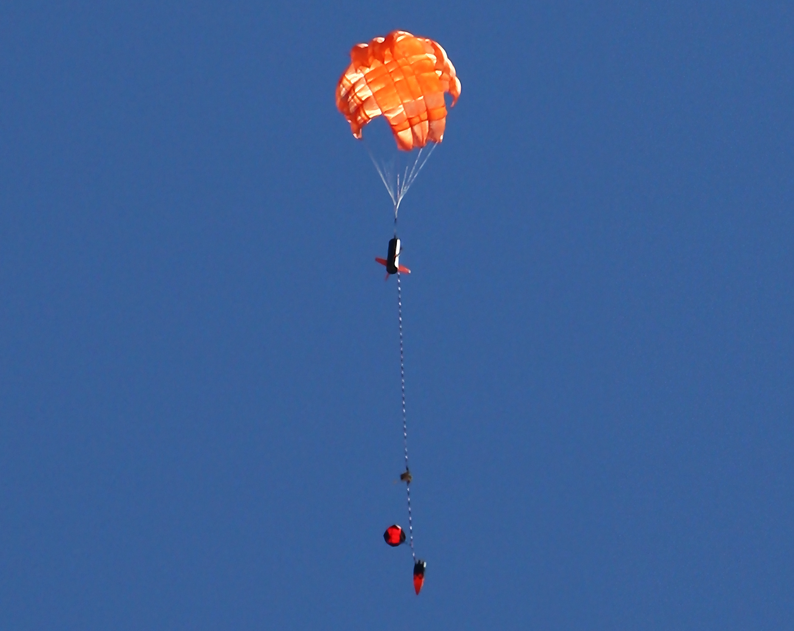

Slide 23
What's Needed?
Airframe designed for two deployments
  Most often done by having two bays and break points
  Can do dual deploy from one bay
Electronics bay
  Sealed from exhaust gases
  Static pressure port to outside air
  Accessible power switch
Flight Computer with at least 2 pyro channels
Low-current electric matches or Q2G2 igniters
Black powder
Charge holding materials

Slide 24
Important Details
Black powder charge sizing
  Depends on bay dimensions and desired force
  Too little and deployment fails to occur
  Too big and airframe will be damaged
Static port sizing
  Critical for baro-only flight computers
  Too small and pressure change “lags” at sensor
  Too large and turbulence may result
  Important for holes to be “clean” to avoid turbulence

Slide 25
Important Details
Use shear pins to prevent drag separation
  Suitable airframe material (cardboard tubes may tear)
  2-56 nylon screws and small polystyrene rod work well
  Include force to shear pins in black powder calculation
Redundant electronics (required for L3 certs)
  Use “apogee delay” on one altimeter to prevent simultaneous firing
  Set main deployment altitudes to different heights

Slide 26
Resources
Altus Metrum, http://altusmetrum.org
  Bdale and Keith's company .. open source avionics
Rocketry Online, http://www.info-central.org
  BP calculations, static port sizing, etc
Electronic payload competitions
  CANSAT, http://cansatcompetition.com
  ARLISS, http://www.arliss.org

