Slide 1


Slide 2
Just who are these guys?
Bdale
  HP Open Source & Linux Chief Technologist
  Chairman of the Debian Technical Committee, former DPL
  President of Software in the Public Interest
  Board member of Linux Foundation, CELF, etc
  2008 Lutece d'Or as “FLOSS Personality of the Year”
Keith
  Principal Engineer with Intel Open Source Technology Center
  X Window System developer since 1987
  Member of X Foundation and FreeDesktop.org boards
  1999 Usenix Lifetime Achievement Award

Slide 3
The Basic Idea
We like to build, launch, and successfully recover hobby-sized models of rockets
Confluence of many different avocations!
  Engineering in mission and vehicle design
  Physical craftsmanship
  Good excuse for camping in the middle of nowhere
  Visceral thrill associated with every launch!
Advanced objectives lead to incorporation of electronics and software...

Slide 4
Role of Avionics
Control of recovery system
  Ability to deploy at apogee
  Ability to deploy at a defined altitude
Collection of flight data
  Max altitude – how high did it go?
  Max acceleration – did we break Mach?
  Acceleration and altitude profiles for more thorough analysis of vehicle and motor performance
Radio link to ground
  Position and health information, possibility of control

Slide 5
Why AltusMetrum?
Most altimeters are completely proprietary!
  Application-oriented documentation only!
  No schematics...
  No source code for firmware...
  Therefore... no real ability to modify behavior.
Some non-commercial projects exist, but...
  Designs typically aren't well published
  Choices / compromises don't match our needs

Slide 6
Two Years Ago - Altus Metrum v0.1
Design for a completely open (hardware and software) recording altimeter for model rockets
  Designed to fit 24mm tube, flexible battery choices
  Primary operations based on pressure sensor
  Flight profile, not just peak altitude
  Support for dual deploy (can fire 2 ejection charges)
  USB for data recovery and post-flight power source
Include enough “cool stuff” to make things fun...
  Accelerometer, temperature sensor
  Support for GPS receiver with serial interface
  Support for RF link to ground via serial interface

Slide 7
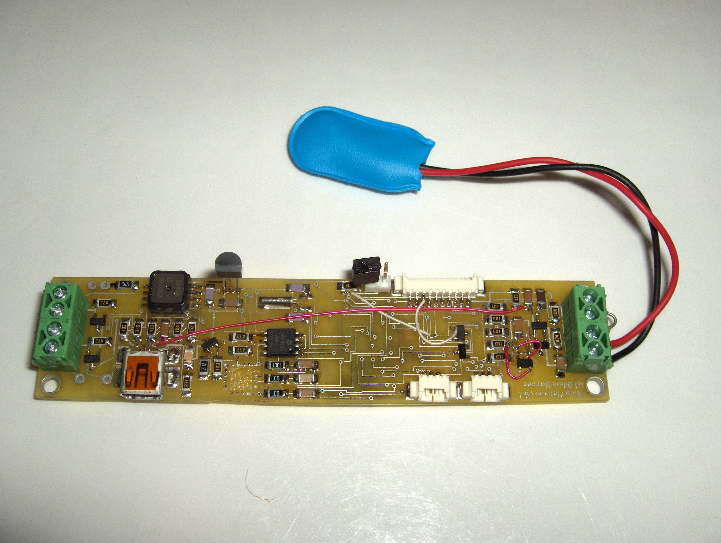

Slide 8
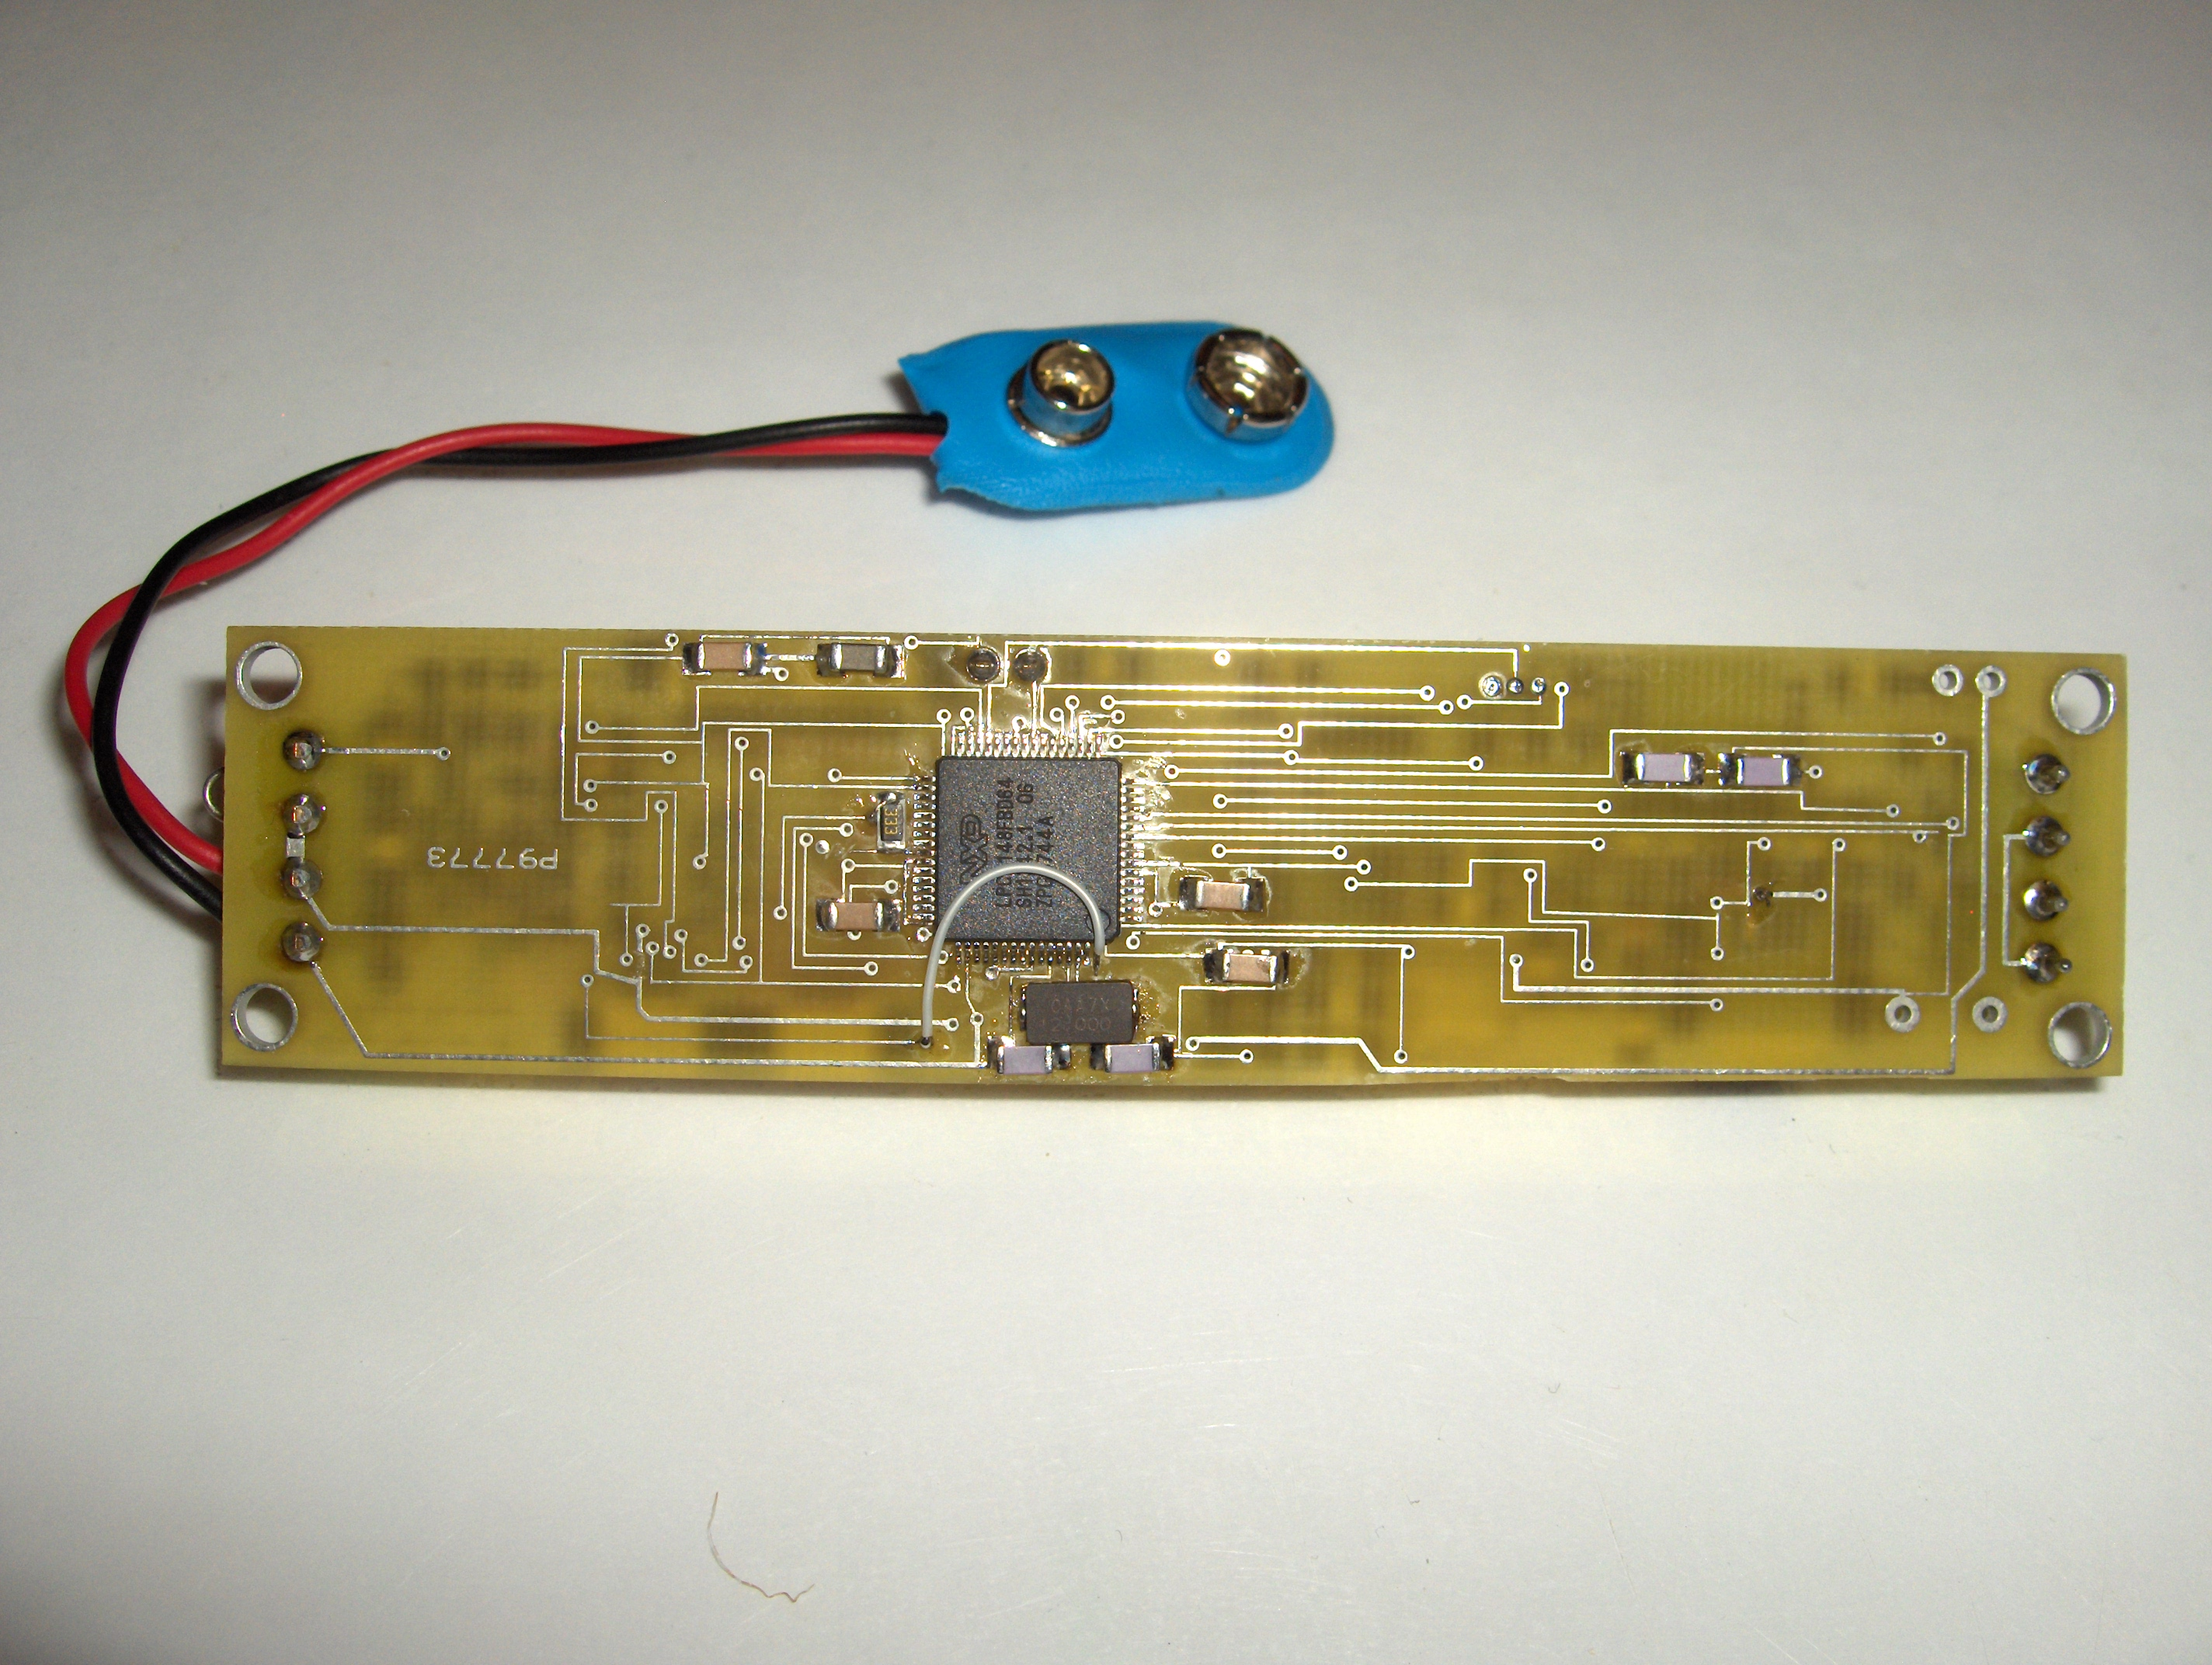

Slide 9
Plans for AltusMetrum v0.2
Fix all known design problems with v0.1
Likely move to smaller SMT passive parts
Make the board slightly wider, 24mm tubing target turns out to be irrelevant and difficult!
Move to LiPo battery technology
  Include MAX155x USB LiPo charge controller
  Replace screw terminals with pads & JST connector
Include a beeper and/or LED status indicator
Integrate GPS receiver and RF link

Slide 10
A Funny Thing Happened...
Keith and I both have BeeLine trackers...
We decided to work on a better RF beacon also using the TI CC1050 transmitter that could be used as a downlink for AltusMetrum
A mutual friend showed us the newer CC1111, which integrates a CPU and RF system... in one chip that's only $7 US in single quantities!
We realized we could build an integrated altimeter system with RF link for about the same price as a beacon...

Slide 11
TeleMetrum Low-level Access
CC1111 4-wire debug interface:
  debug data, debug clock, reset, ground
CP2103 -- 4 GPIOs controlled from USB
  One USB packet per half clock
Beagle USB hardware monitor
CC1111-based debug link
  emulates serial on USB
  provides high-level commands

Slide 12
TeleMetrum Software Development Environment
Small Device C Compiler, targeting 8051 CPU
Source Debugger for SDCC
Hex debugger using either CP2103 or CC1111 link
  Emulates mcs51 emulator
  Except talks to real hardware
  Hooks up to sdcdb

Slide 13
AltOS architecture
Multi-threaded
  Avoids the 'one big loop'
Non pre-emptive
  Limits where pre-emption can occur
sleep/wakeup rendezvous
  Good enough for Unix
Timers, mutexes
Basic OS services

Slide 14
AltOS Flight software architecture
Flight progress tracked through discrete states
Connect to host via USB serial emulation
  No kernel driver required
  Command line interface
  Also works over radio link
Configuration stored in EEPROM/Flash

Slide 15
AltOS Flight States
Pad - Sitting vertically
Boost - Acceleration > 2g and Speed > 5m/s or Height > +20m
Fast - Acceleration < -1/4 or Boost period > 15s
Coast - Speed < 200m/s or Height < Max_height - 500m
Apogee - Height < Max Height - 10m
Main - Height < Main Height
Land - Acceleration stable for 5 seconds and Height stable for 5 seconds and Height < Launch height + 1000m

Slide 16
AltOS Hardware Calibration
Radio calibrated by adjusting PLL against freq counter
  48MHz crystal good to 20ppm
  20ppm at 434MHz is 9Khz
Accelerometer calibrated by rotating board on bench
  Accelerometer output runs through 5V->3.3V divider
  Uses 1% resistors
  Also automatically adjusts for 100G/50G/40G devices

Slide 17
GPS adventures
Problem: GPS looses satellites during boost phase
GPS receivers track sats by synthesizing expected signal
  Frequency based on relative velociy
  Phase based on distance
Change in actual signal means changing synthetic signal
High acceleration means allowing faster changes
Change rate limited by 'loop filter' bandwidth.

Slide 18
TeleMetrum Hardware Features
TI CC1111F32 RF System on Chip
  Sub-1 Ghz transceiver
  8051 MCU, 32k Flash memory, 4k RAM
  USB plus lots of analog, digital, and serial I/O
Microchip 25LC1024 128kx8 SPI EEPROM
Various Sensors
  Freescale MP3H6115A pressure sensor
  Freescale MMA2202EG 50g accelerometer
  Microchip MCP9700A temperature sensor
Full LiPo battery support with USB charging

Slide 19
TeleMetrum v0.1

Slide 20
First TeleMetrum Flight
19 April 2009 in Bdale's Vertical Assault
a MAWD flew the rocket
Solid data collection until apogee, loose screw may have shorted power at ejection?
Hugely exciting, accel plot closely matched motor manufacturer data!

Slide 21
Our First Ballistic Return...
Keith's Little Dog Dual Deploy first flight
Ejection charges were not large enough
Flight data recovered!

Slide 22
First TeleMetrum Ejection Control
Keith's Nike

Slide 23
First TeleMetrum Dual Deploy
Bdale's redesigned BSD Horizon 4” kit
Aerotech K805G
The TM controlled drogue charge did not fire due to a broken wire!
MAWD as backup fired drogue 1 second later
TM deployed the main

Slide 25
Highest Measured Acceleration
Hawk Mountain Raptor kit, modified to reduce mass, CTI H399 motor
Renamed 'G-Spot' by my wife in honor of being “shorter, faster, and more exciting!”
Goal was to “need” the optional +/- 100g part
52.8 g acceleration

Slide 26
Highest Velocity and Altitude
Keith's 98mm rocket built for the drag race
Loki K350W motor
Keith's first drogueless, unintentionally ejected motor case at apogee!
337 meters/second
3672 meters AGL

Slide 27
TeleMetrum v0.2 Changes
SkyTraq Venus GPS integrated on-board with passive patch antenna, thus no serial port
Change to Atmel DataFlash for data logging
Ejection charge circuit now uses LiPo voltage directly with lower on resistance FET switches
Eliminated discrete temperature sensor
Added 8-pin “companion interface”
Tyco MicroMaTch connectors
All known bugs in v0.1 fixed

Slide 30
Tools Used
Hardware design
  gEDA, including gschem and pcb
  DigiKey.com for parts selection and data sheets
  Gerbv and FreeDFM.com for verification
  66each.com for 4-layer PCB fabrication
Software development
  SDCC toolchain for 8051
  Source debugger interface to bit-banged 3-wire debug interface

Slide 36
TeleMetrum Software
Keith volunteered to write the firmware
“Starting from sand”, he now has C source debugging working over the 3-wire debug port using SDCC
The only non-open source piece is the 8051 assembler in SDCC (a known problem), and upstream is working to resolve that
Expect to hear more from Keith ...

Slide 37
Licenses
The hardware designs carry the TAPR Open Hardware License (OHL), which was created to be “GPL-like” for hardware designs.
Our software is licensed GPL “v2 or later”.

Slide 38
Questions?
Hardware and software details are all online at altusmetrum.org
Other information at gag.com/rockets
TAPR OHL info at tapr.org/ohl

Slide 39
Backup

Slide 40
Hobby Rocketry Categories
Largely delineated by total impulse, each letter prefix is a rough doubling, A is 2.5 newton-secs, H and up require certification and govt permits
  Model Rockets – up through D motors, 10-24mm
  Mid-Power Rockets – E, F, G motors, 24-29mm
  High-Power Rockets, 29-150mm, >= 160 Ns
    Level 1 – H and I motors
    Level 2 – J, K, and L motors
    Level 3 – M, N, and O motors (unlimited, really)
  Research (EX) Rockets – home-made motors

Slide 87
TeleMetrum Hardware Features
TI CC1111F32 RF System on Chip
  Sub-1 Ghz transceiver
  8051 MCU, 32k Flash memory, 4k RAM
  USB plus lots of analog, digital, and serial I/O
Microchip 25LC1024 128kx8 SPI EEPROM
Various Sensors
  Freescale MP3H6115A pressure sensor
  Freescale MMA2202EG 50g accelerometer
  Microchip MCP9700A temperature sensor
Full LiPo battery support with USB charging

Slide 88
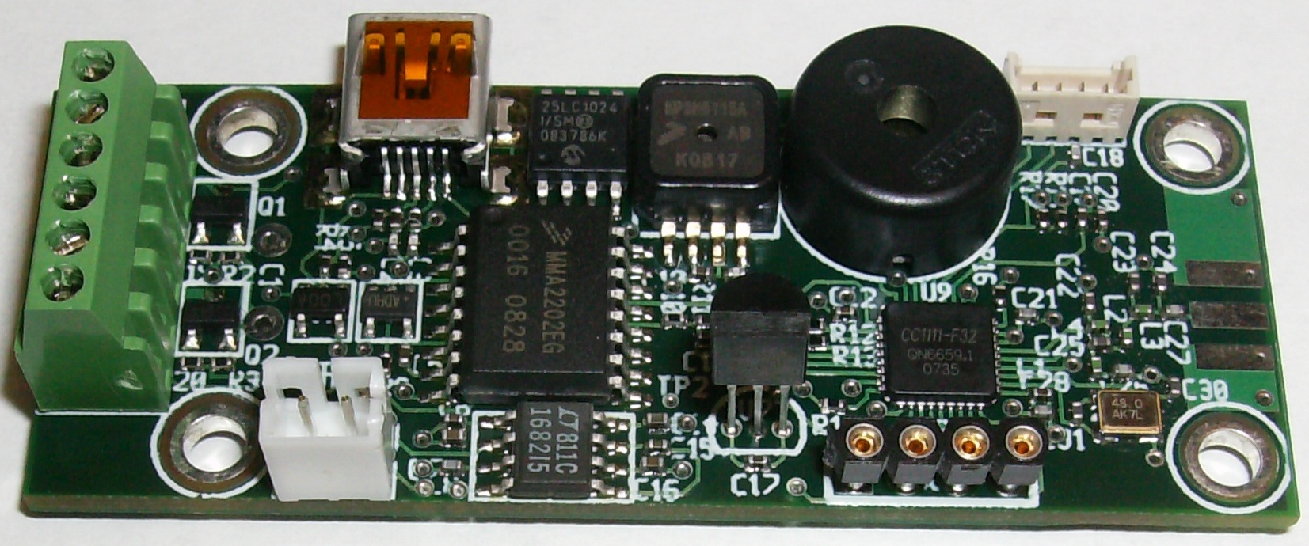
TeleMetrum v0.1

Slide 89
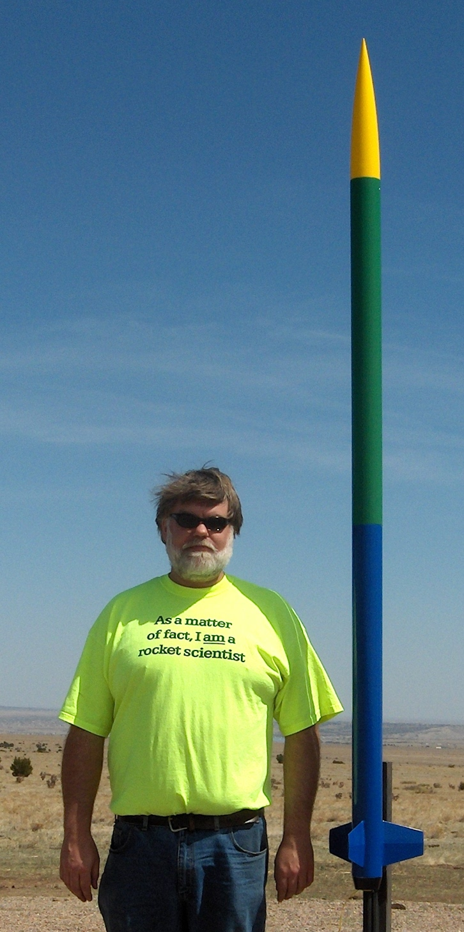
First TeleMetrum Flight
19 April 2009 in Bdale's Vertical Assault
a MAWD flew the rocket
Solid data collection until apogee, loose screw may have shorted power at ejection?
Hugely exciting, accel plot closely matched motor manufacturer data!

Slide 90
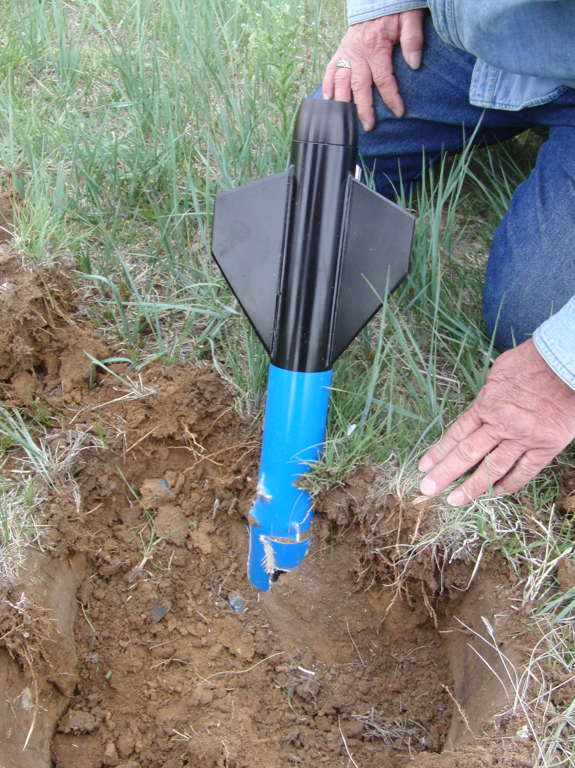
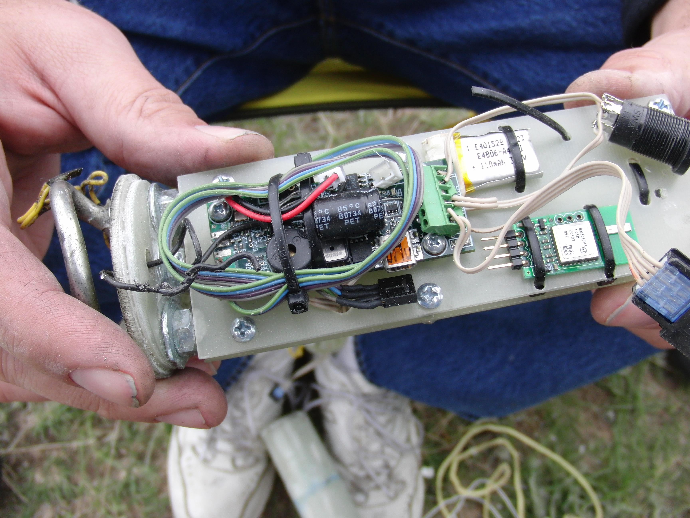
Our First Ballistic Return...
Keith's Little Dog Dual Deploy first flight
Ejection charges were not large enough
Flight data recovered!

Slide 91
First TeleMetrum Ejection Control
Keith's Nike

Slide 92
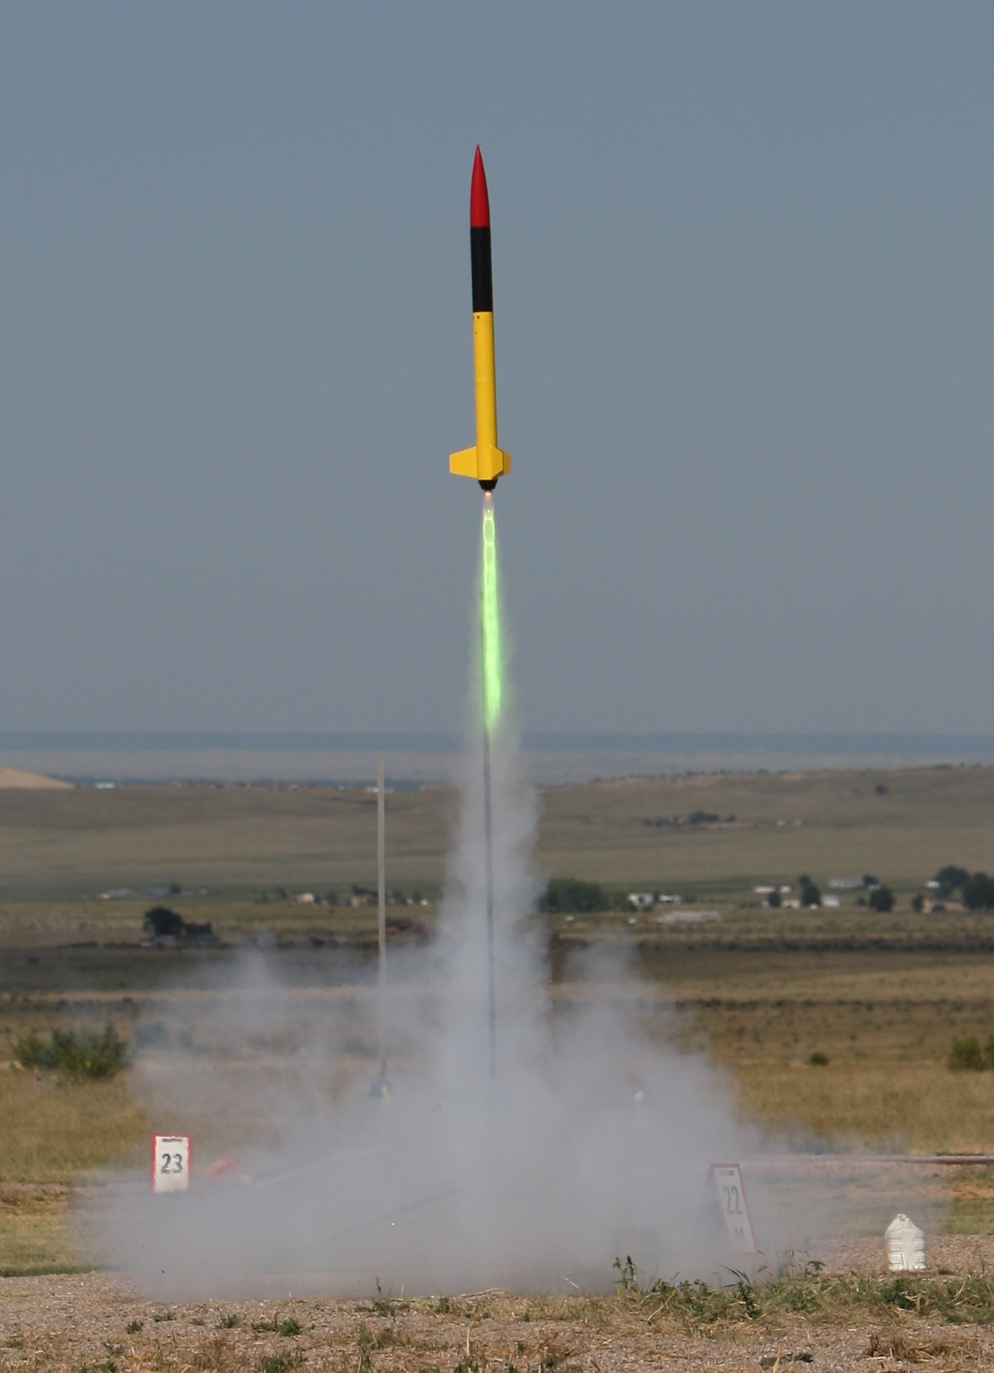
First TeleMetrum Dual Deploy
Bdale's redesigned BSD Horizon 4” kit
Aerotech K805G
The TM controlled drogue charge did not fire due to a broken wire!
MAWD as backup fired drogue 1 second later
TM deployed the main

Slide 93
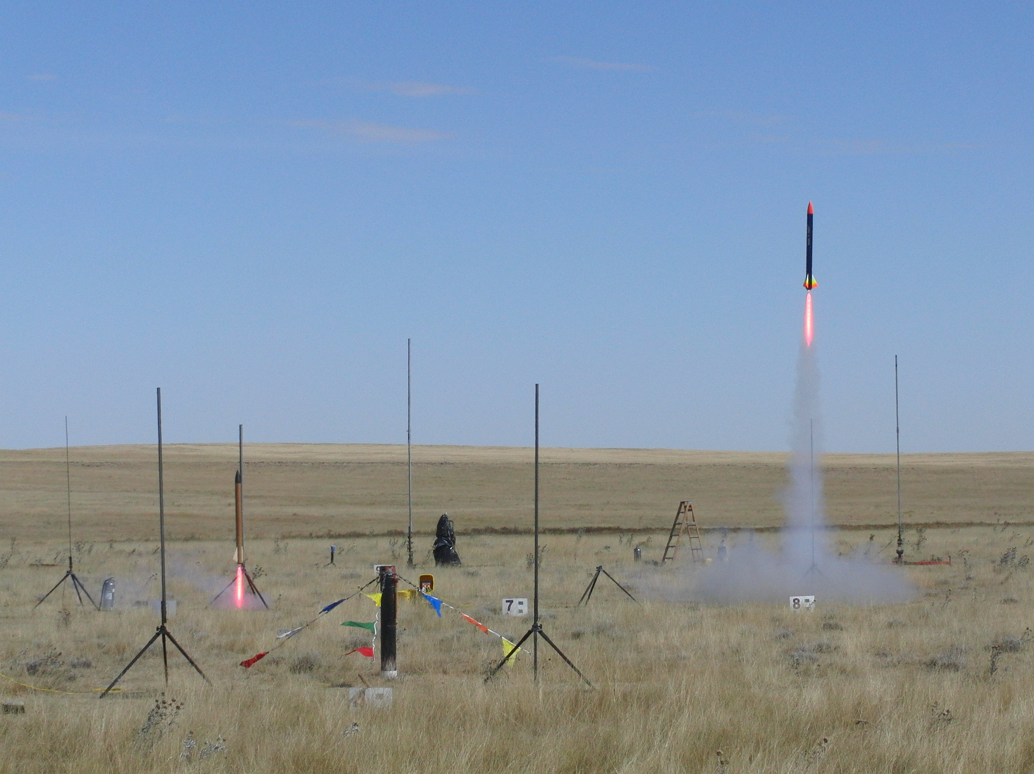

Slide 94
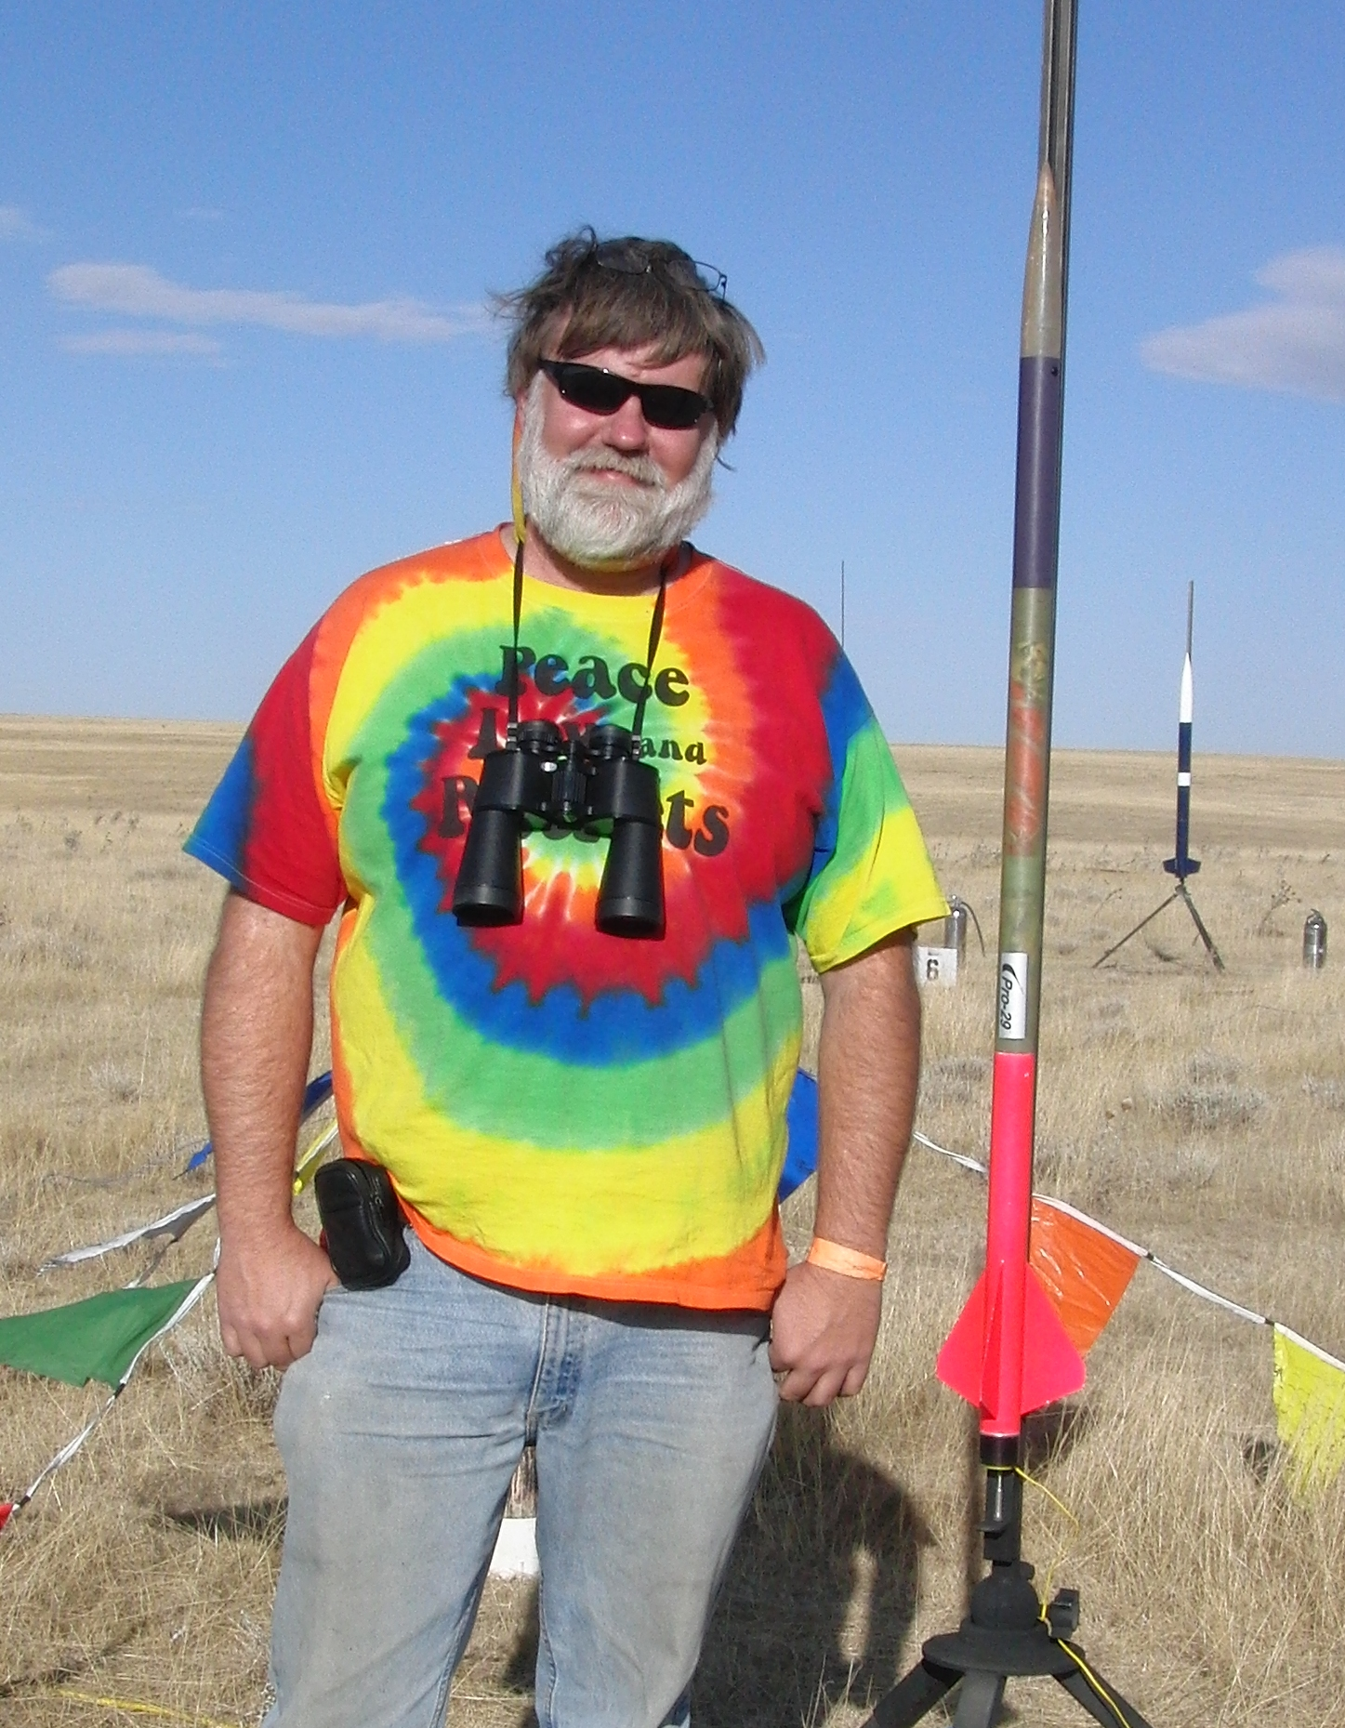
Highest Measured Acceleration
Hawk Mountain Raptor kit, modified to reduce mass, CTI H399 motor
Renamed 'G-Spot' by my wife in honor of being “shorter, faster, and more exciting!”
Goal was to “need” the optional +/- 100g part
52.8 g acceleration

Slide 95
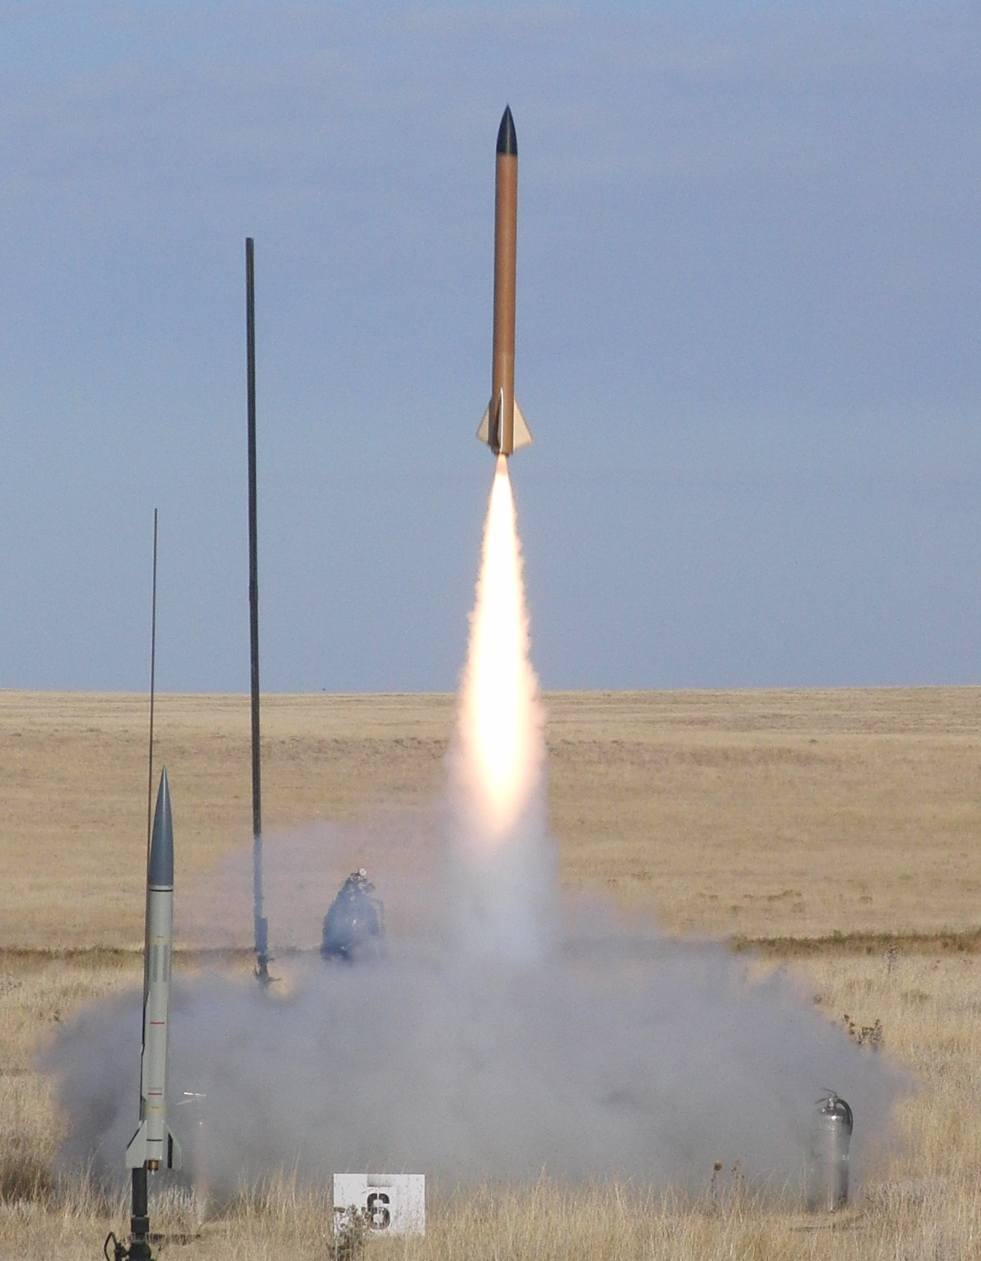
Highest Velocity and Altitude
Keith's 98mm rocket built for the drag race
Loki K350W motor
Keith's first drogueless, unintentionally ejected motor case at apogee!
337 meters/second
3672 meters AGL

Slide 96
TeleMetrum v0.2 Changes
SkyTraq Venus GPS integrated on-board with passive patch antenna, thus no serial port
Change to Atmel DataFlash for data logging
Ejection charge circuit now uses LiPo voltage directly with lower on resistance FET switches
Eliminated discrete temperature sensor
Added 8-pin “companion interface”
Tyco MicroMaTch connectors
All known bugs in v0.1 fixed

Slide 97
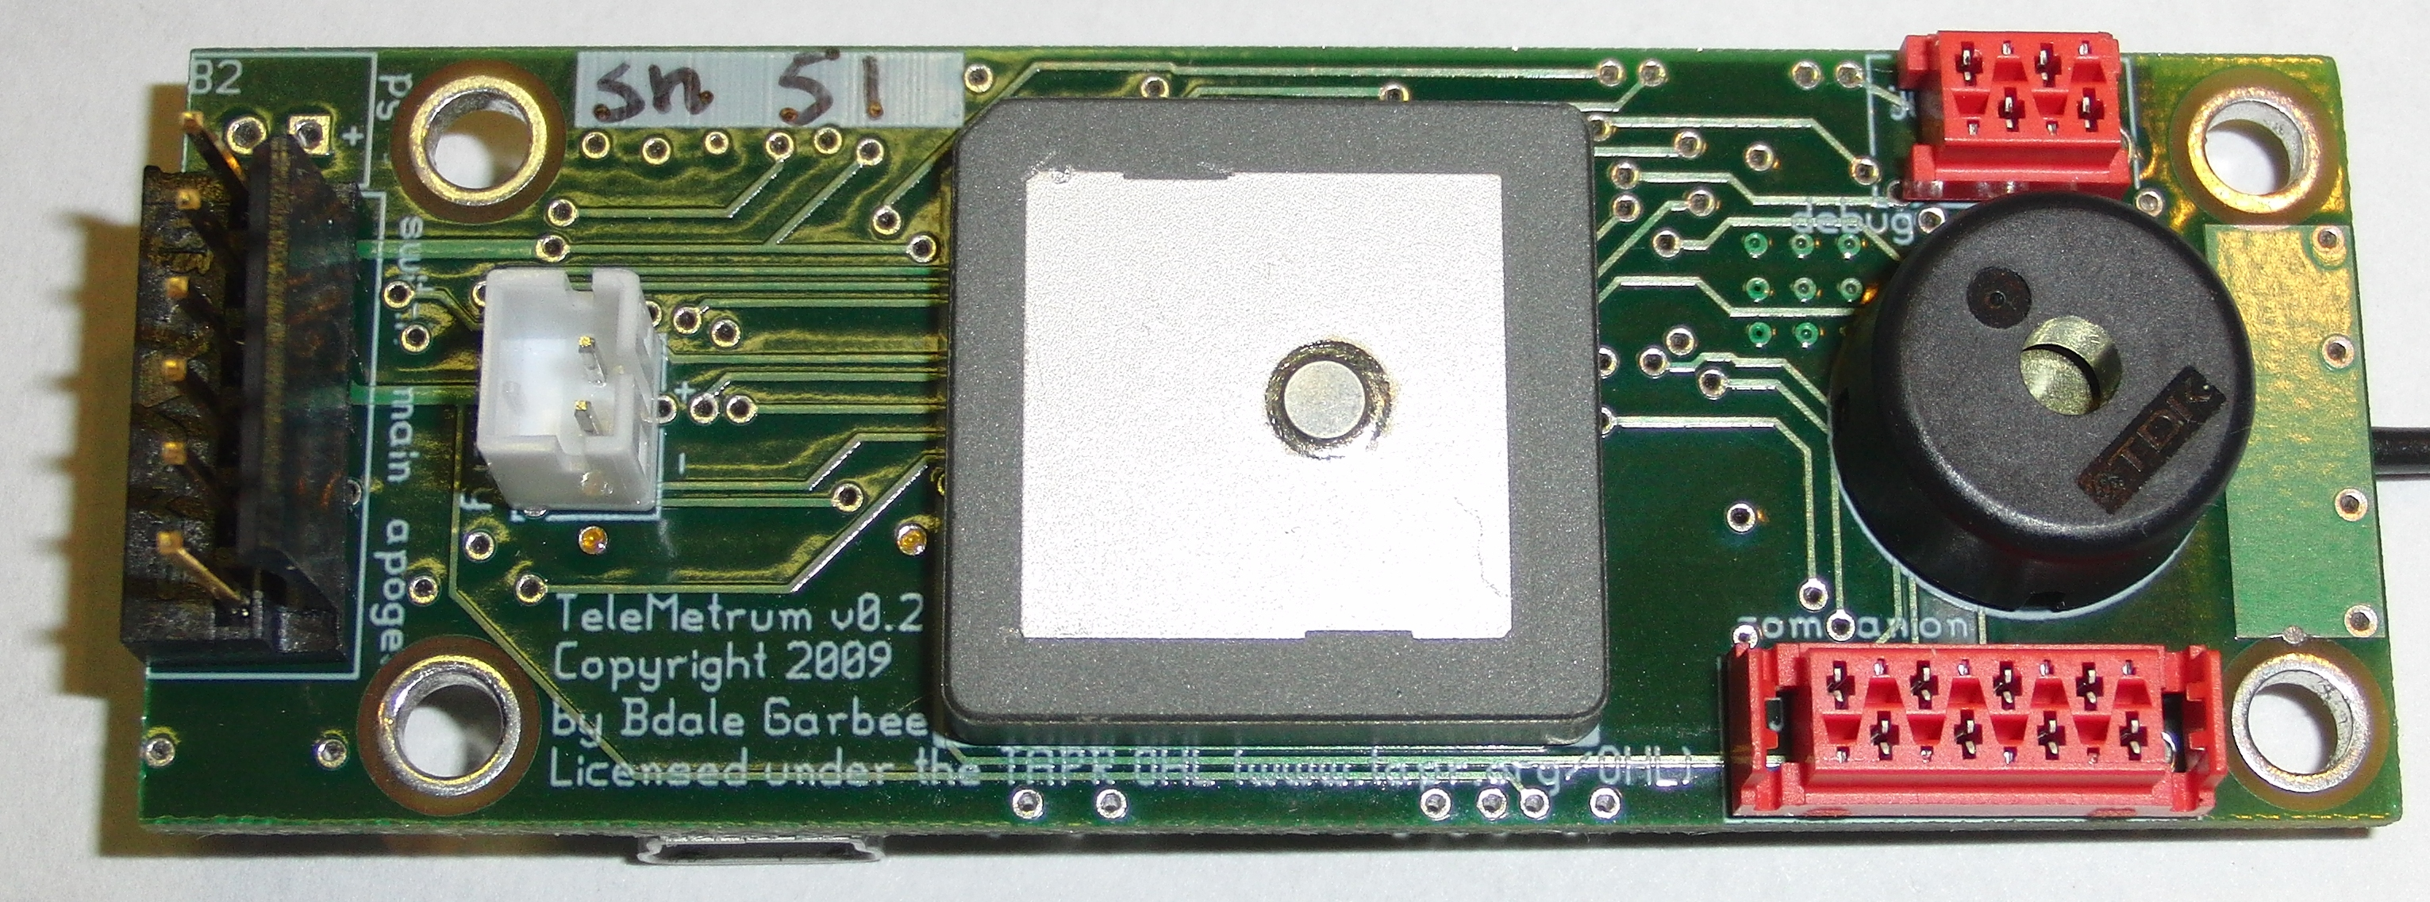
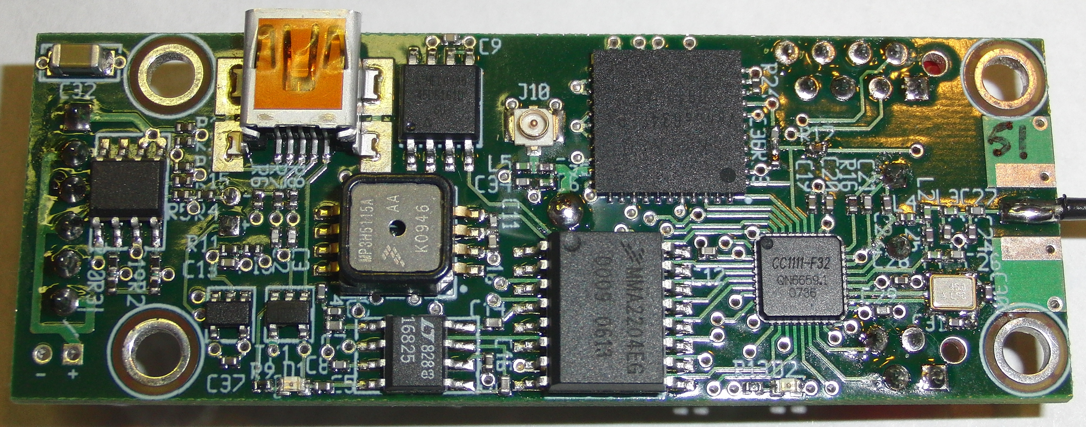

Slide 98
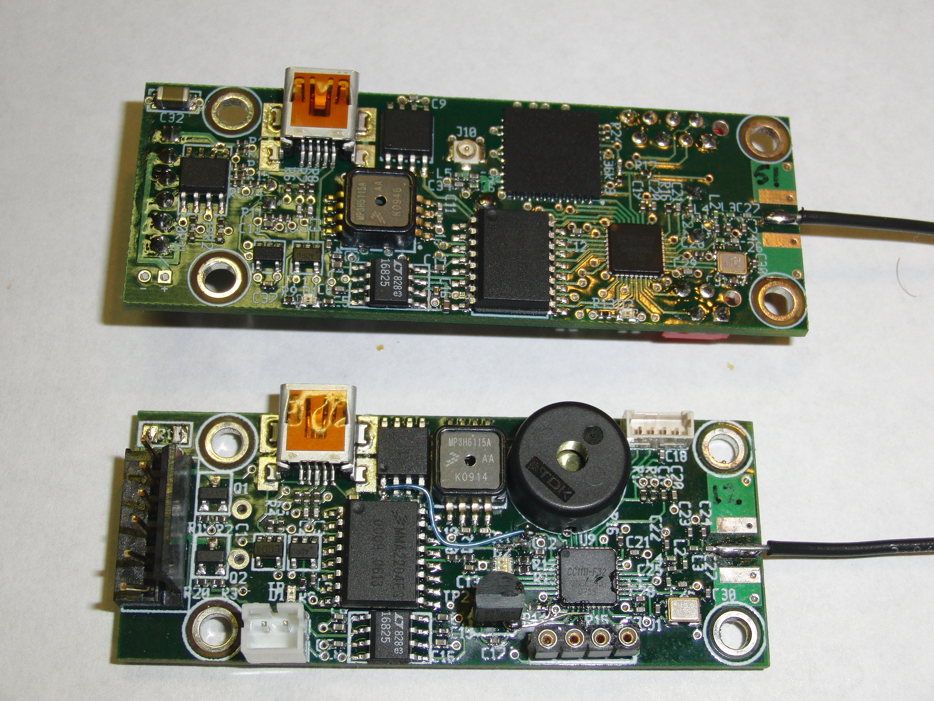

Slide 99
Tools Used
Hardware design
  gEDA, including gschem and pcb
  DigiKey.com for parts selection and data sheets
  Gerbv and FreeDFM.com for verification
  66each.com for 4-layer PCB fabrication
Software development
  SDCC toolchain for 8051
  Source debugger interface to bit-banged 3-wire debug interface

Slide 100
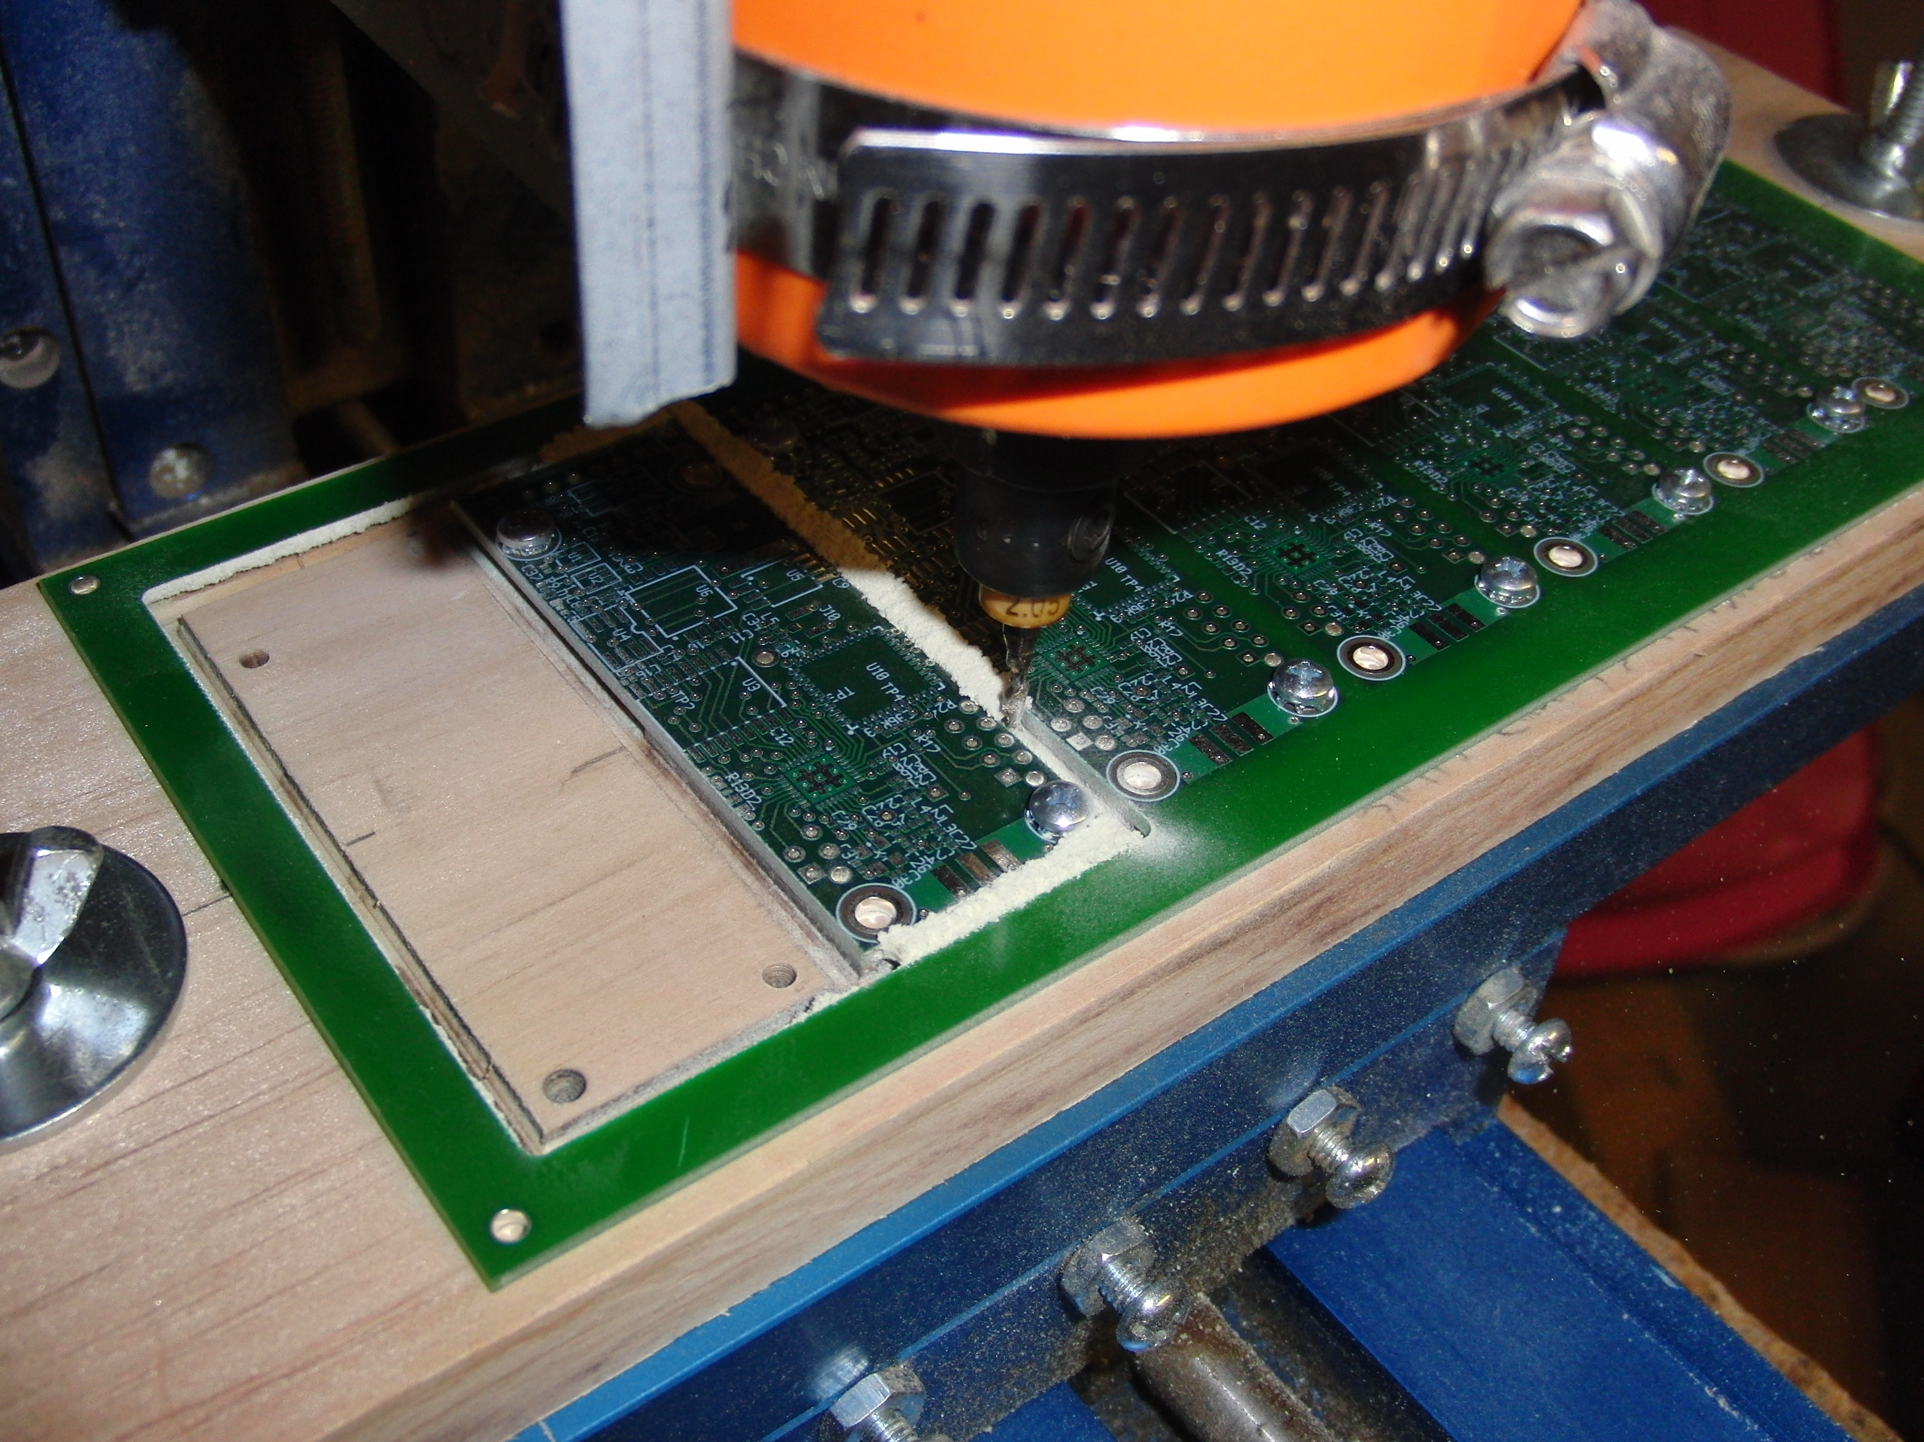

Slide 101
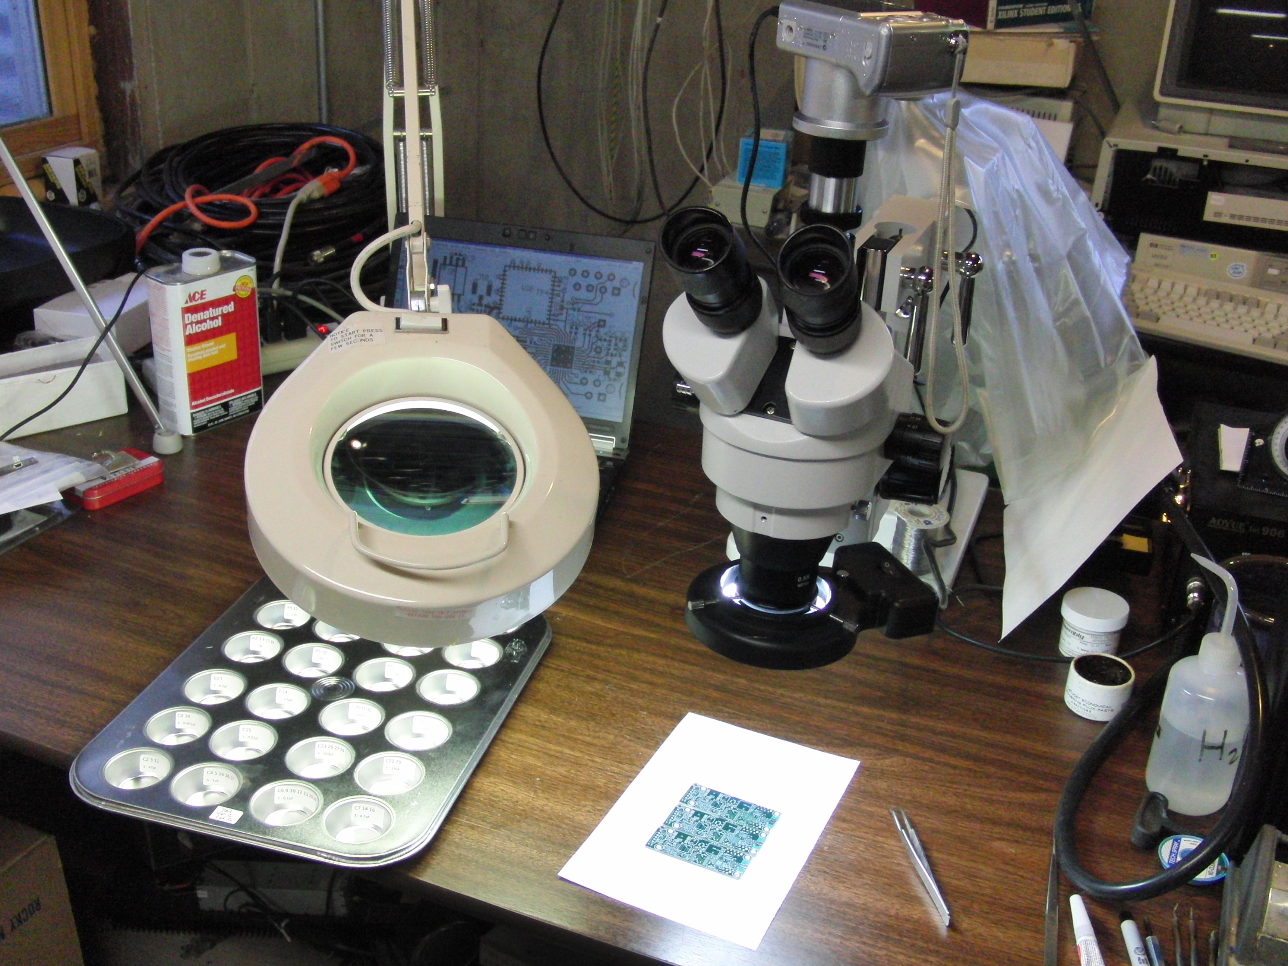

Slide 102
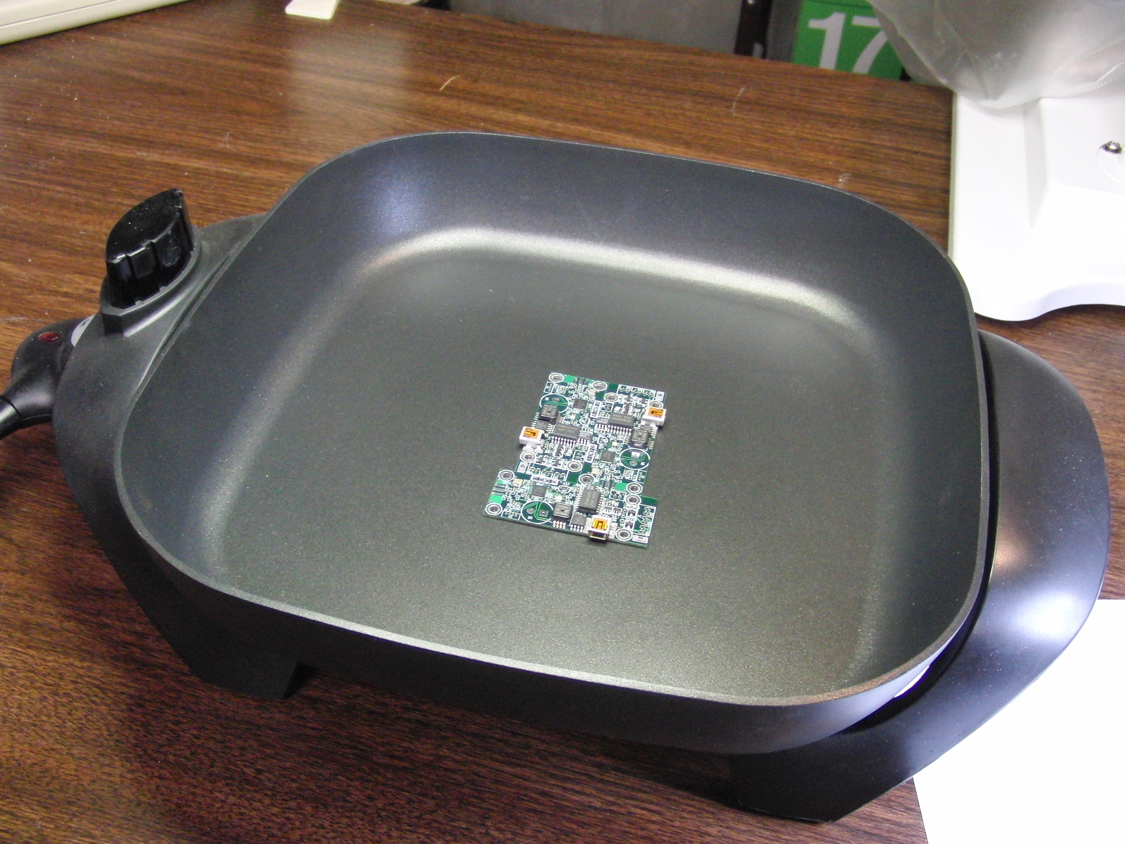

Slide 103
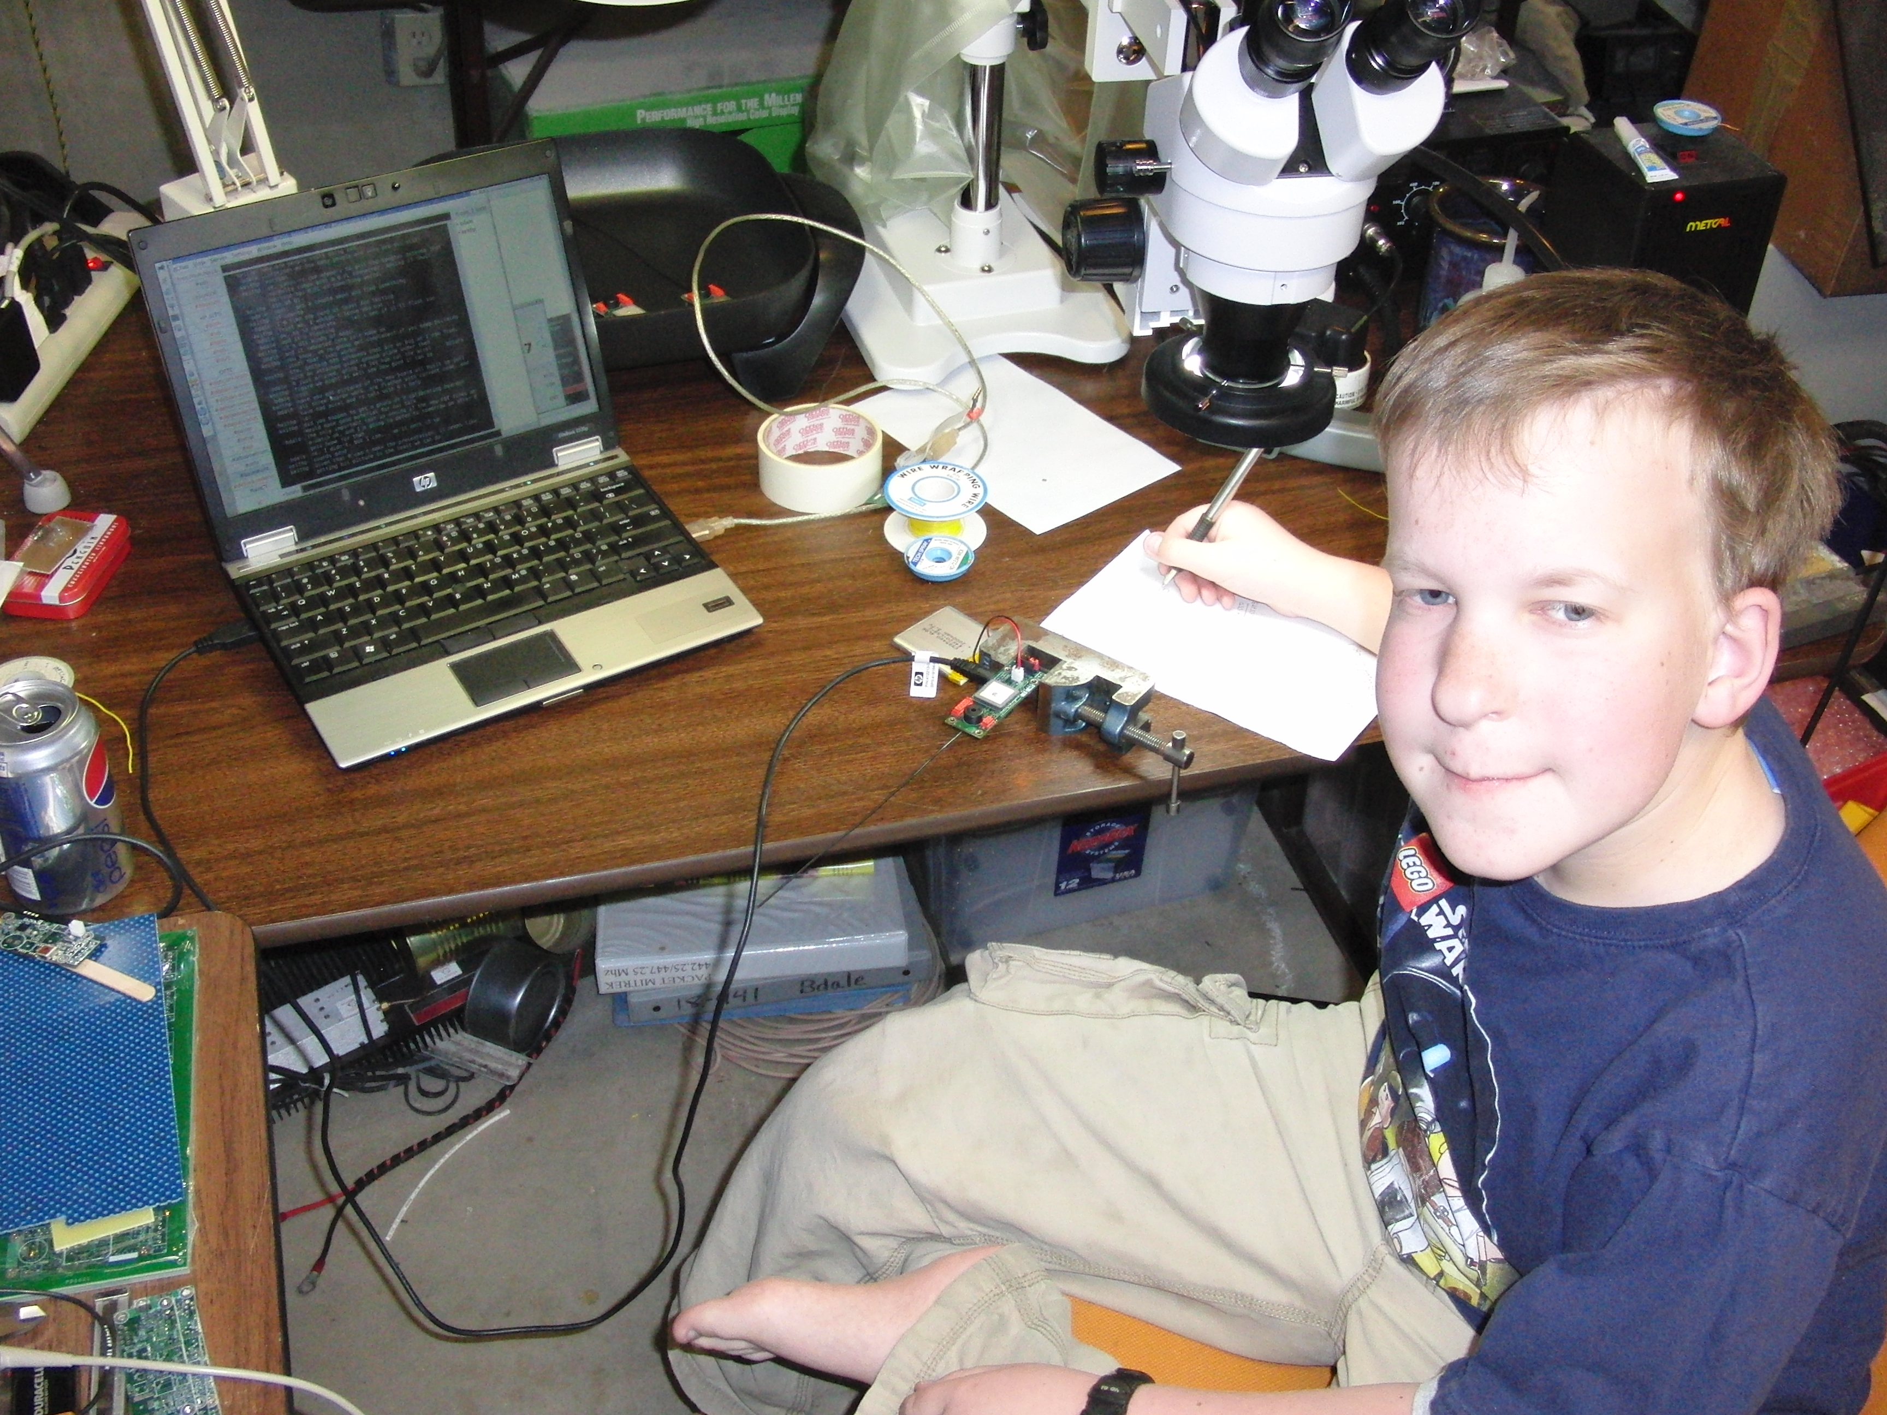

Slide 104
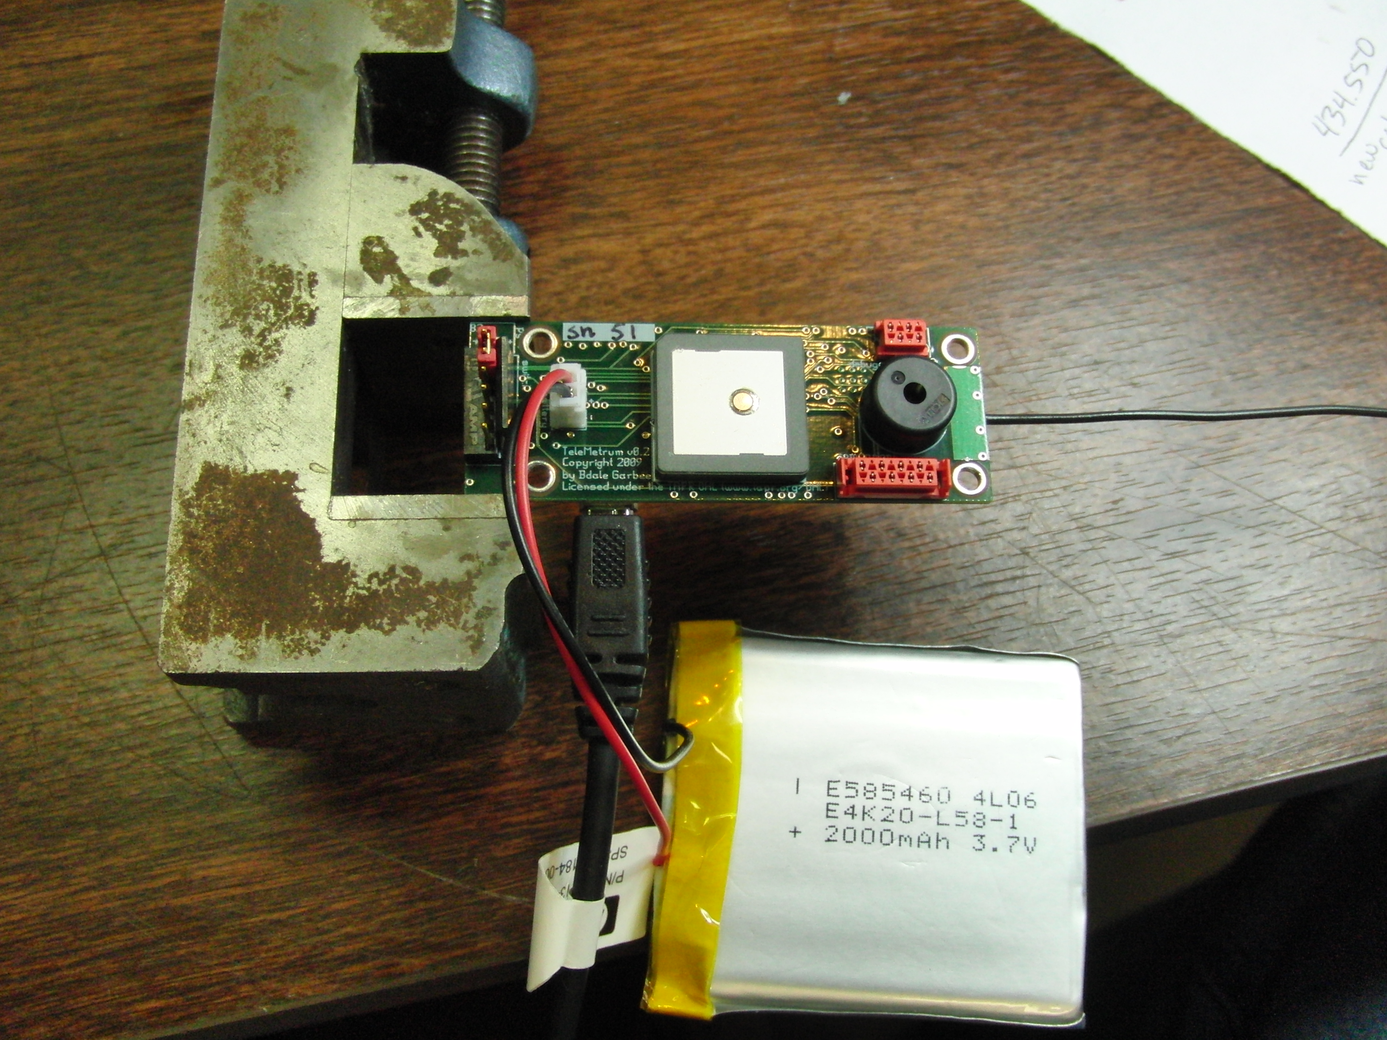

Slide 105
TeleMetrum Software
Keith volunteered to write the firmware
“Starting from sand”, he now has C source debugging working over the 3-wire debug port using SDCC
The only non-open source piece is the 8051 assembler in SDCC (a known problem), and upstream is working to resolve that
Expect to hear more from Keith ...

Slide 106
Licenses
The hardware designs carry the TAPR Open Hardware License (OHL), which was created to be “GPL-like” for hardware designs.
Our software is licensed GPL “v2 or later”.

Slide 107
Questions?
Hardware and software details are all online at altusmetrum.org
Other information at gag.com/rockets
TAPR OHL info at tapr.org/ohl

Slide 108
Backup

Slide 109
Hobby Rocketry Categories
Largely delineated by total impulse, each letter prefix is a rough doubling, A is 2.5 newton-secs, H and up require certification and govt permits
  Model Rockets – up through D motors, 10-24mm
  Mid-Power Rockets – E, F, G motors, 24-29mm
  High-Power Rockets, 29-150mm, >= 160 Ns
    Level 1 – H and I motors
    Level 2 – J, K, and L motors
    Level 3 – M, N, and O motors (unlimited, really)
  Research (EX) Rockets – home-made motors

Slide 110


