Slide 1

Bdale Garbee bdale@gag.com NAR 87103

Slide 2
Agenda
Brief intro to the Model Rocketry hobby
The role of avionics, some existing products
Altus Metrum
Tools used
Future plans

Slide 3


Getting Started
Estes and Quest are the biggest and most well-known kit and motor makers... both based in Colorado!
Building a kit is a great way to get started!
Finding a local club to join and fly with is highly recommended!

Slide 4
The Basic Idea
We like to build, launch, and successfully recover hobby-sized models of rockets
Several elements to the hobby
  Craftsmanship involved in building stable and effective rockets
  An ongoing learning process ... loud science!
  Progressive levels of technical achievement
  Camaraderie from collaborating with other enthusiasts in local clubs and at regional launches
Objectives of advanced modelers lead to incorporation of electronics and software...

Slide 5
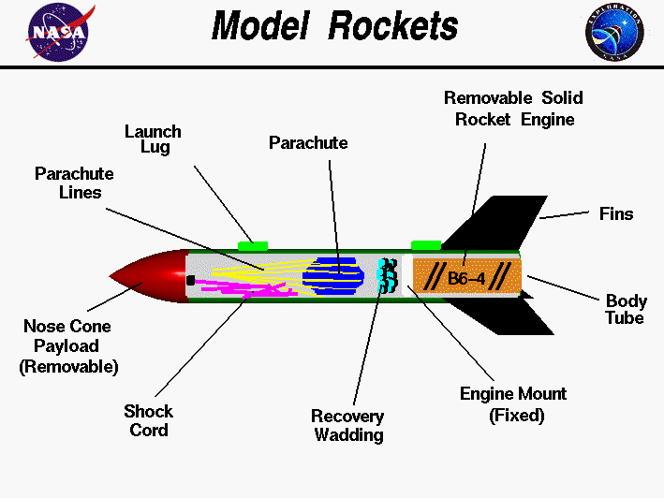

Slide 6
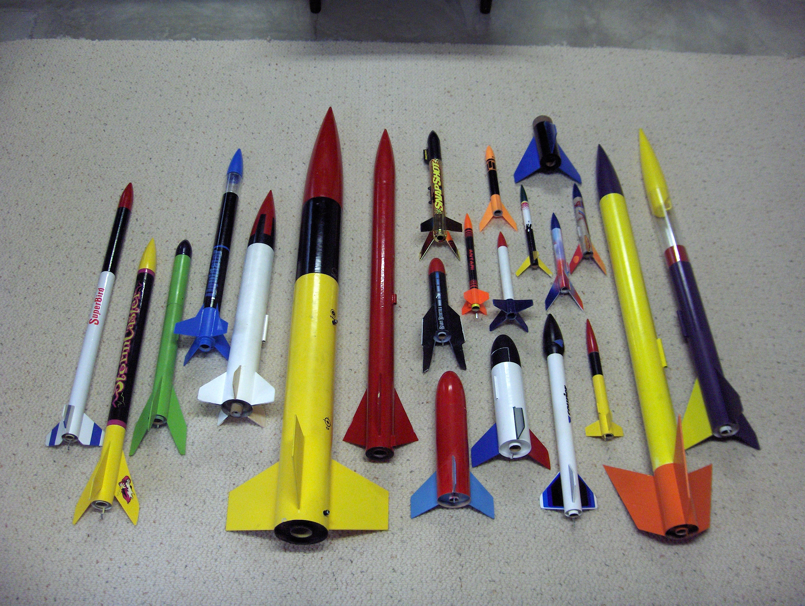

Slide 7
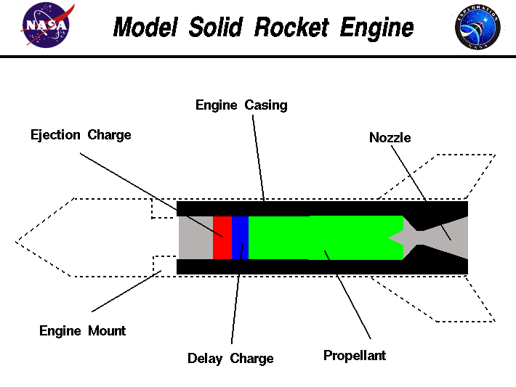

Slide 8
Hobby Rocketry Categories
Largely delineated by total impulse, each letter prefix is a rough doubling, A is 2.5 newton-secs, H and up require certification and govt permits
  Model Rockets – up through D motors, 10-24mm
  Mid-Power Rockets – E, F, G motors, 24-29mm
  High-Power Rockets, 29-150mm, >= 160 Ns
    Level 1 – H and I motors
    Level 2 – J, K, and L motors
    Level 3 – M, N, and O motors
  Research Rockets – bigger or home-made motors

Slide 9
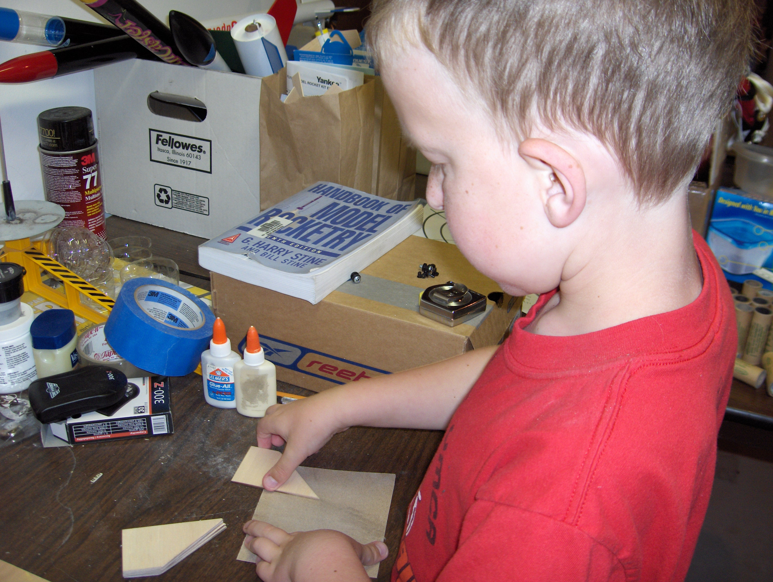
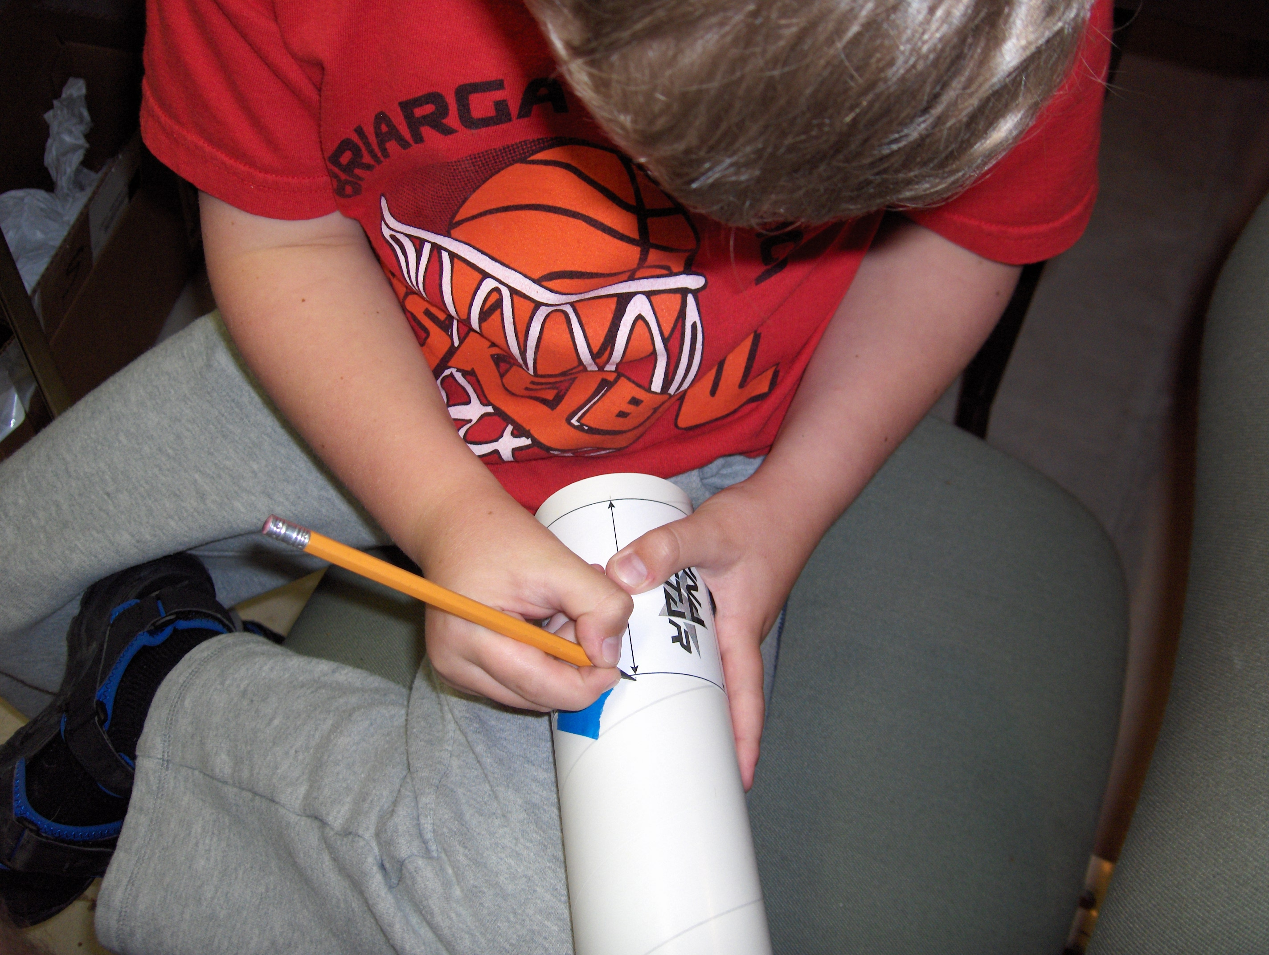
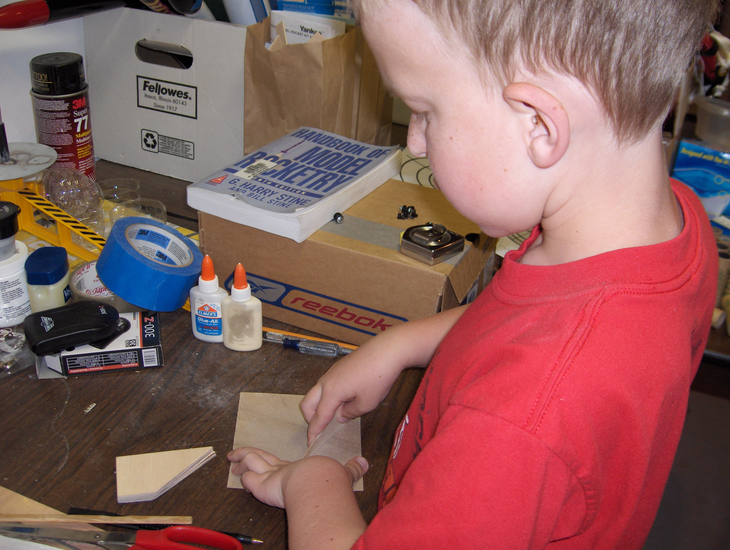
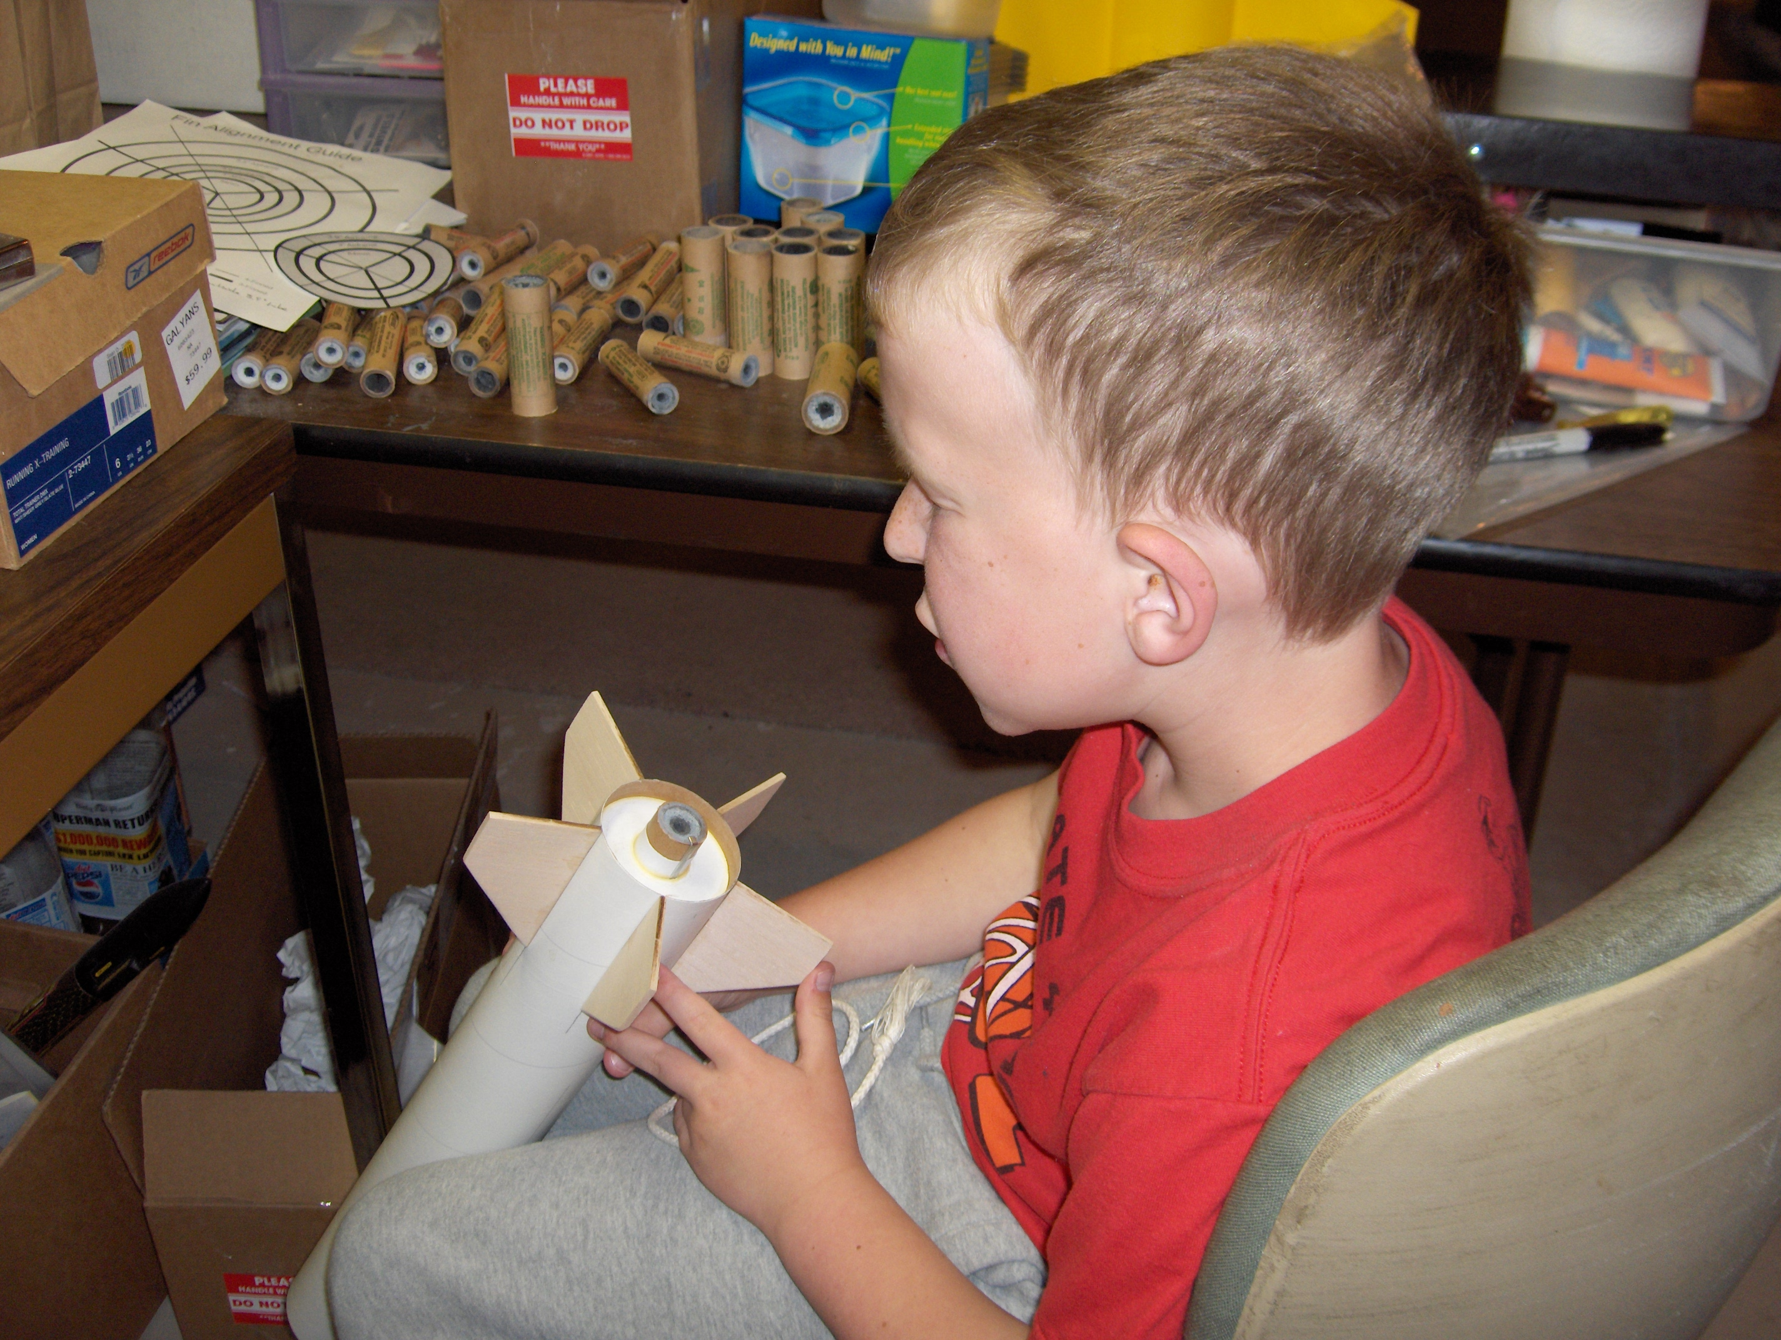

Slide 10
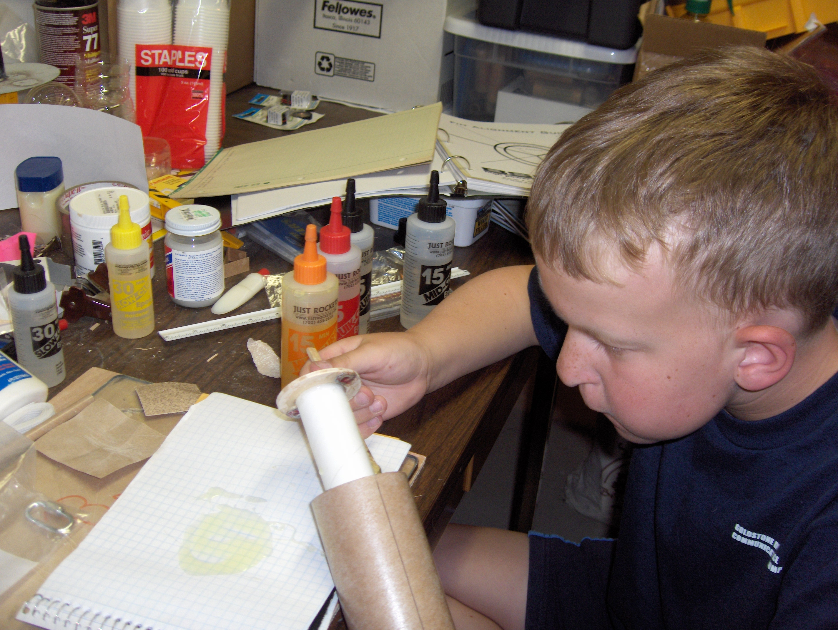

Slide 11
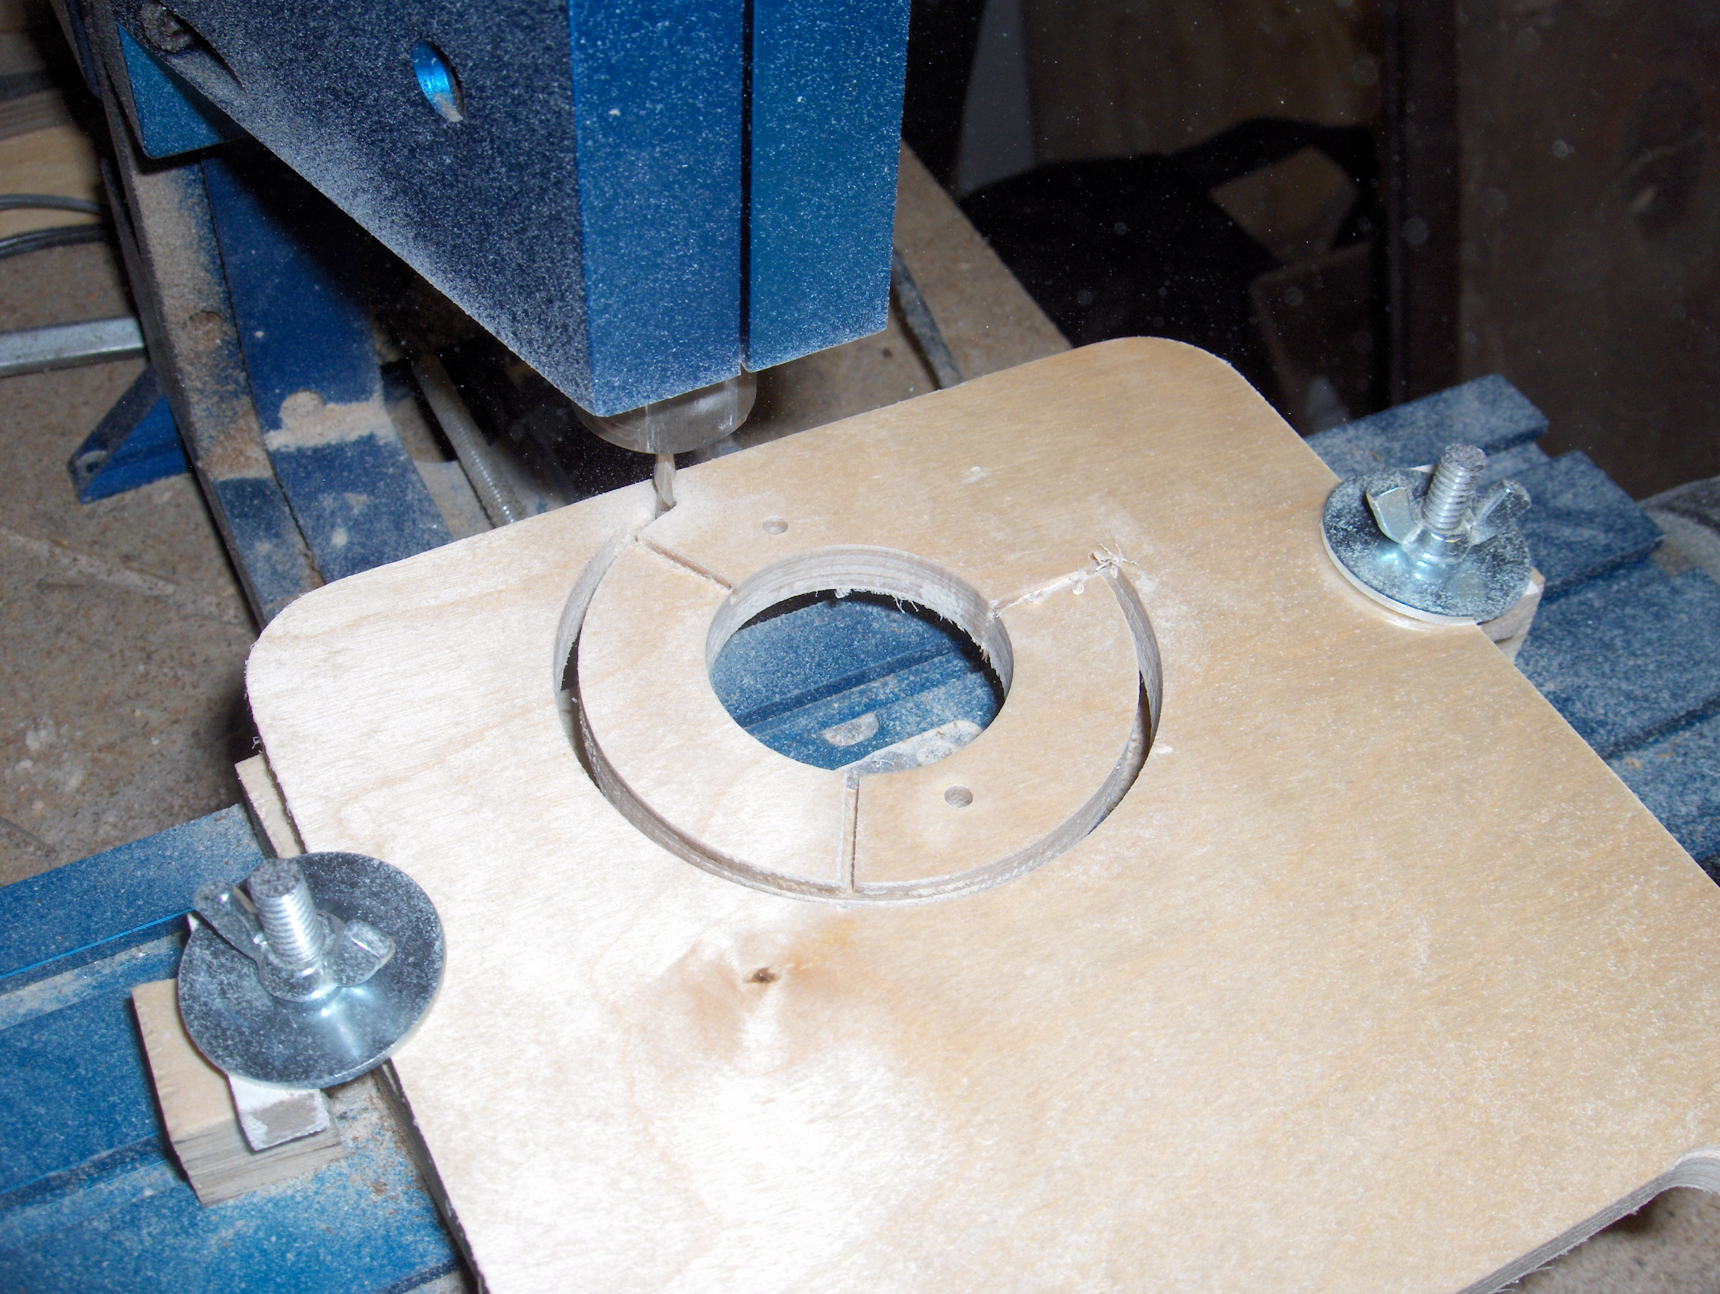

Slide 12
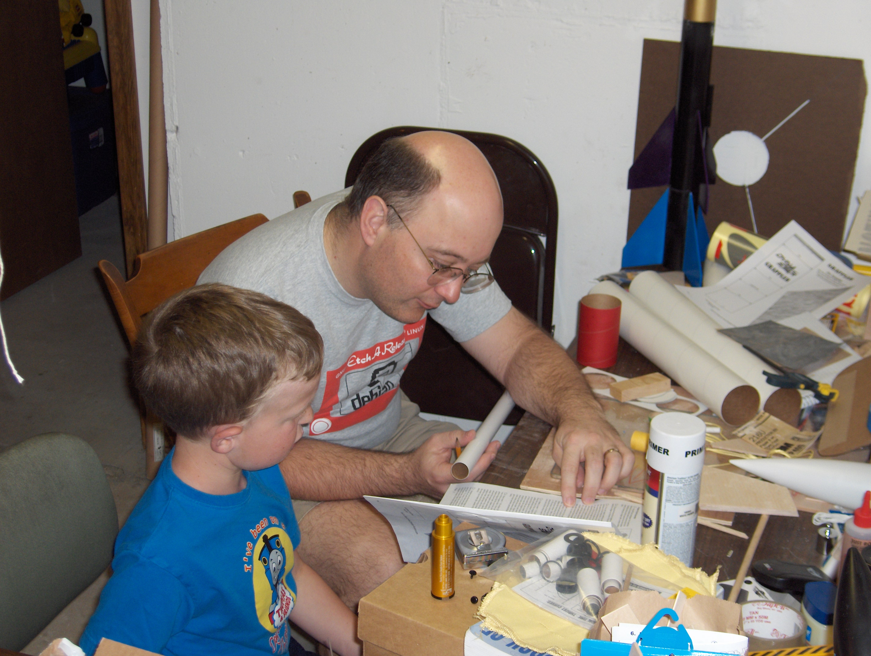
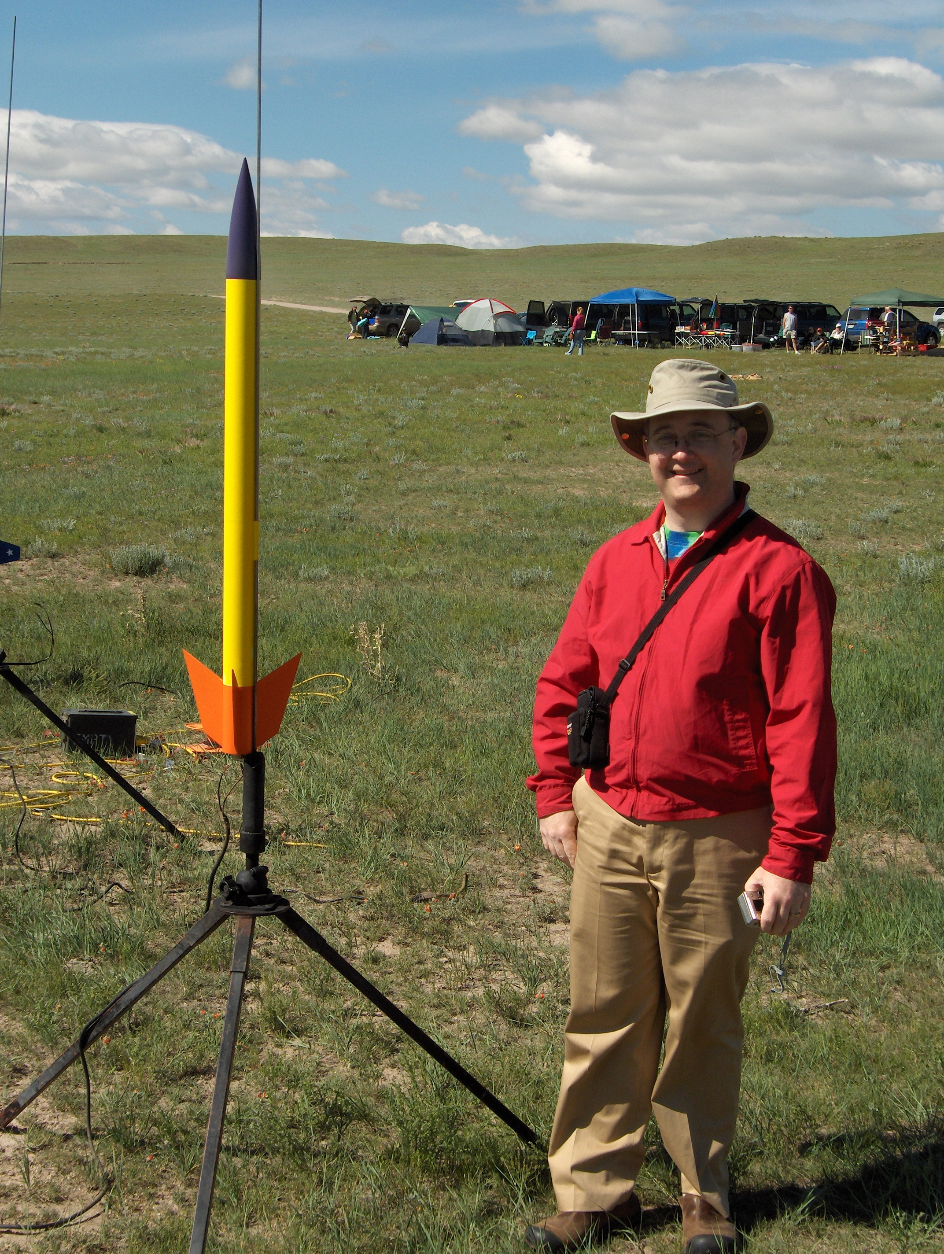
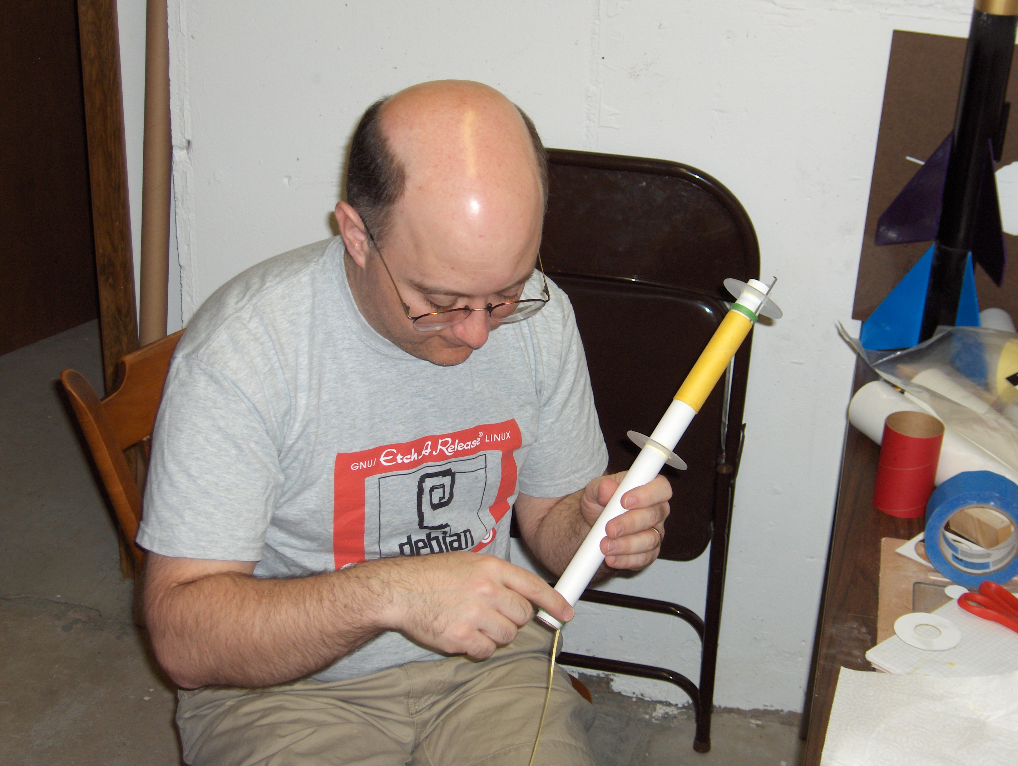

Slide 13
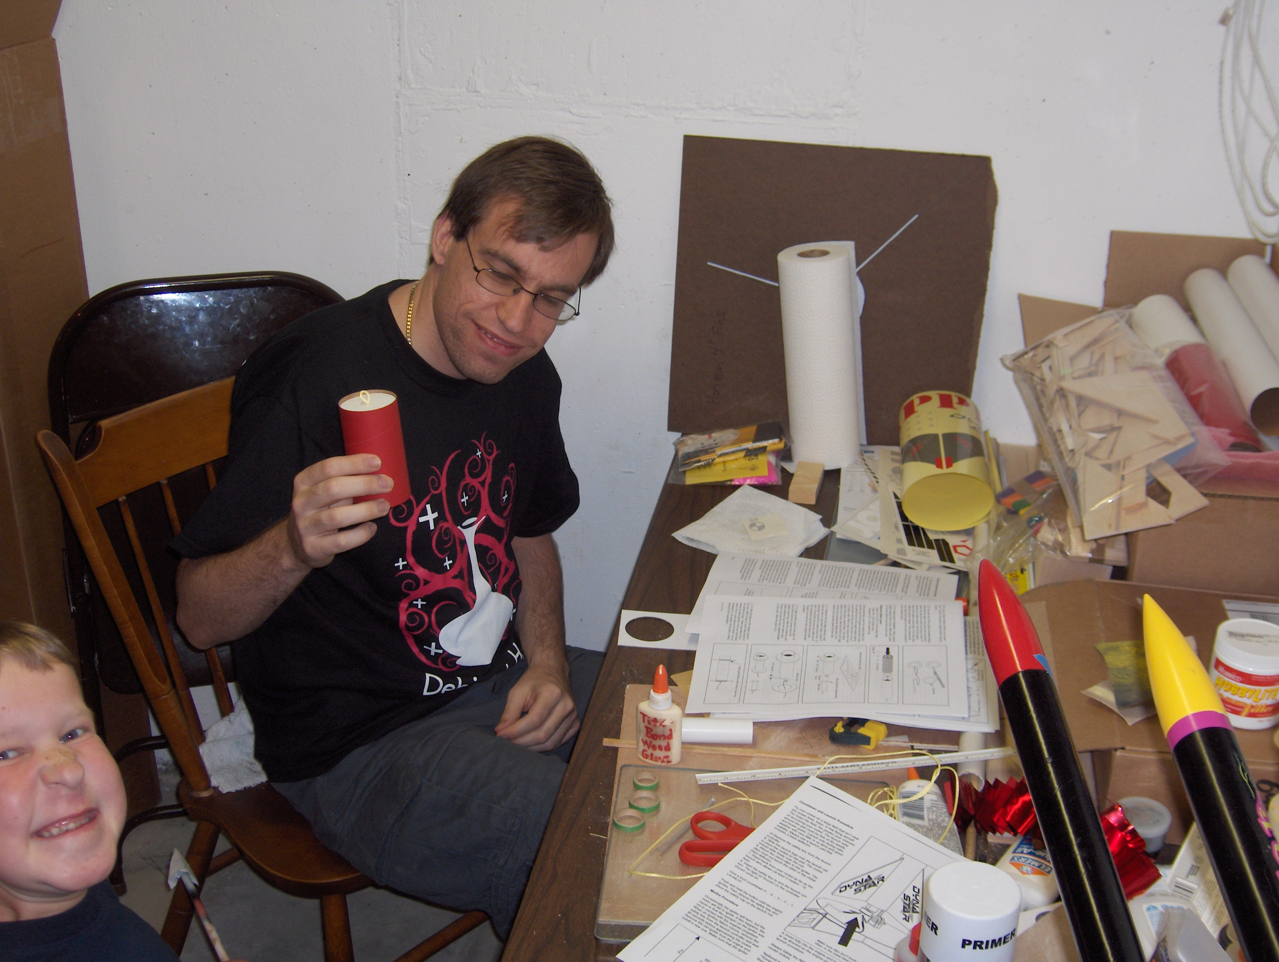
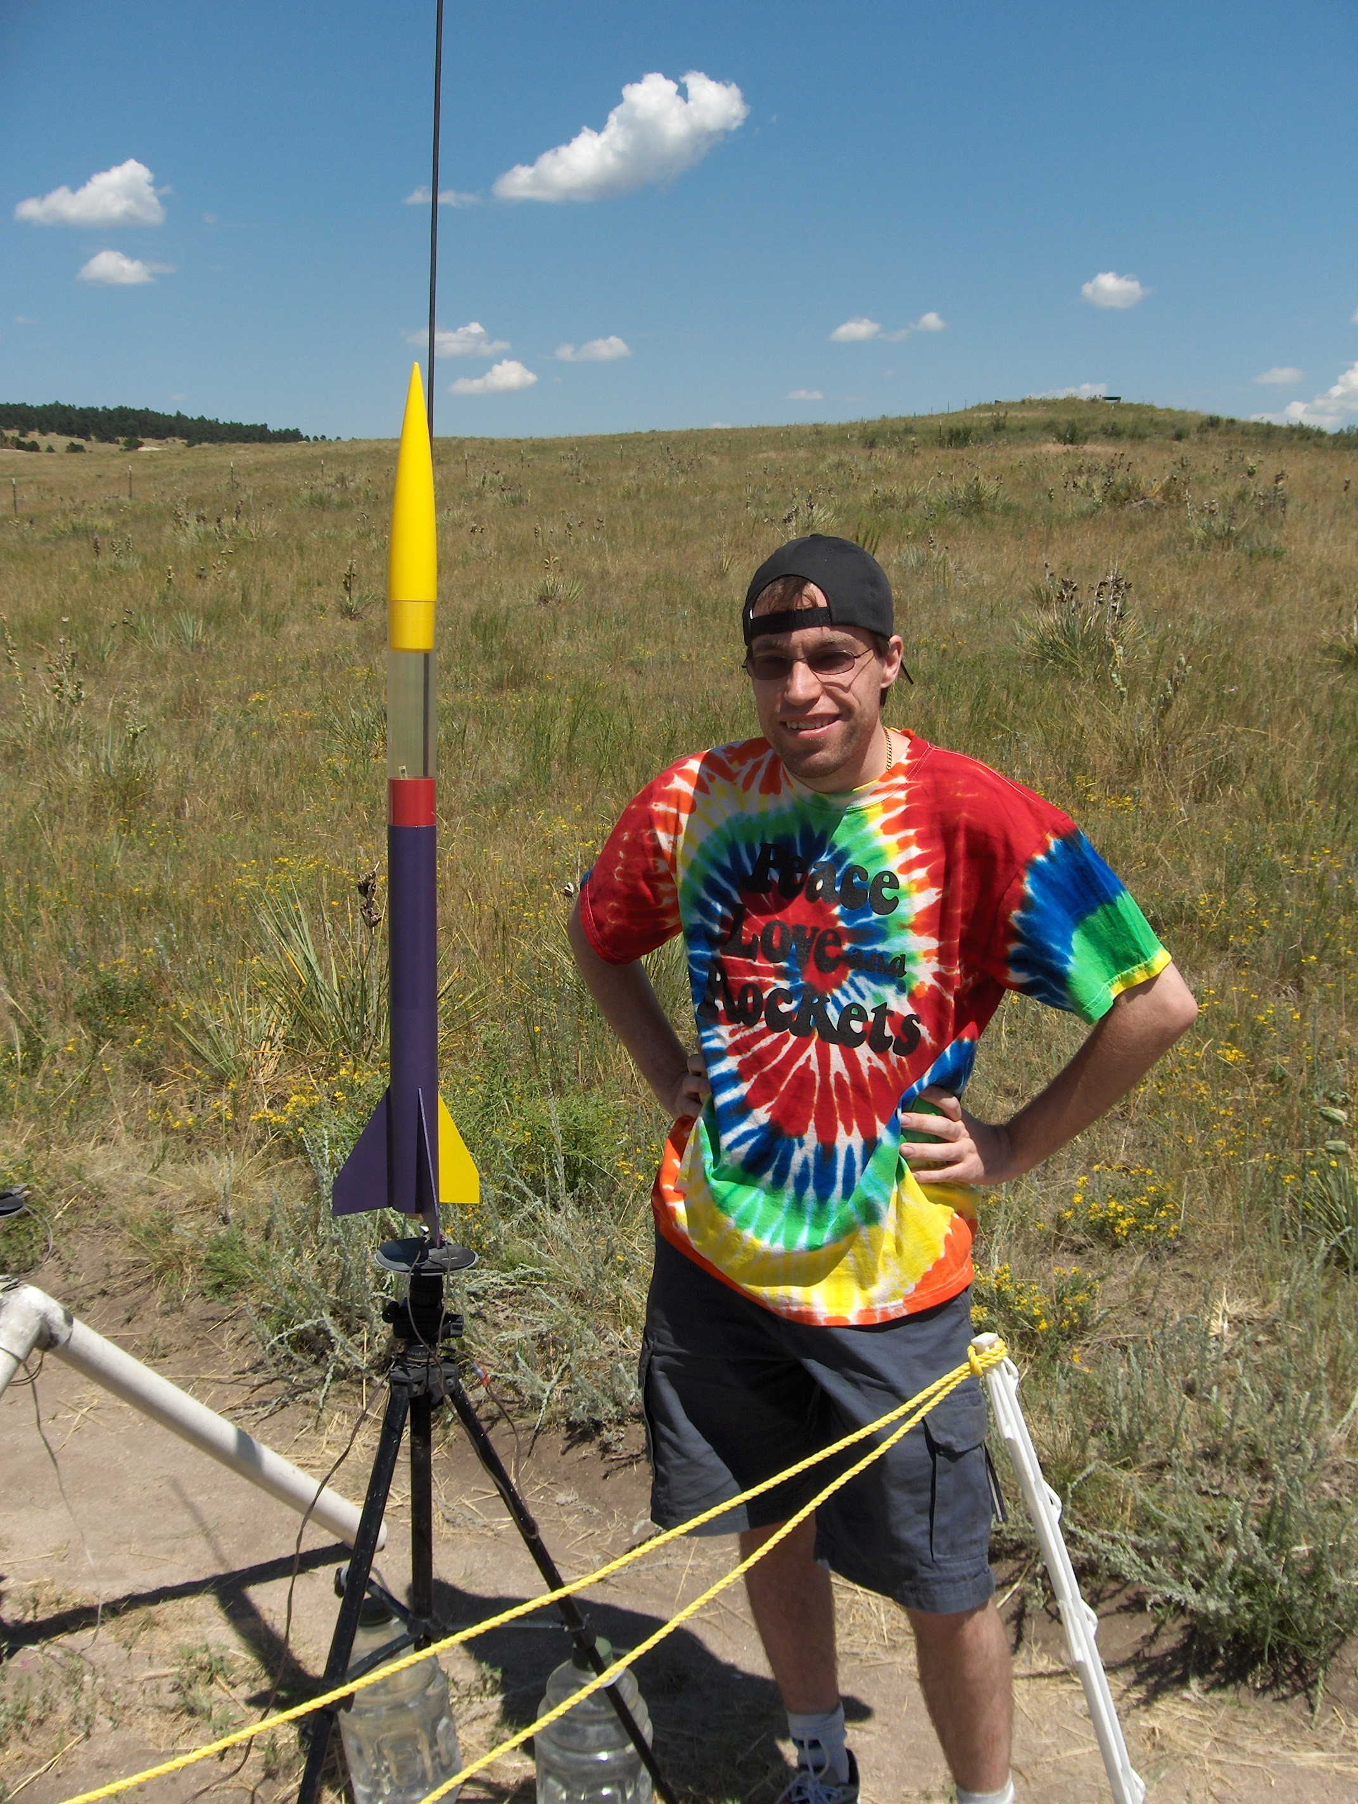
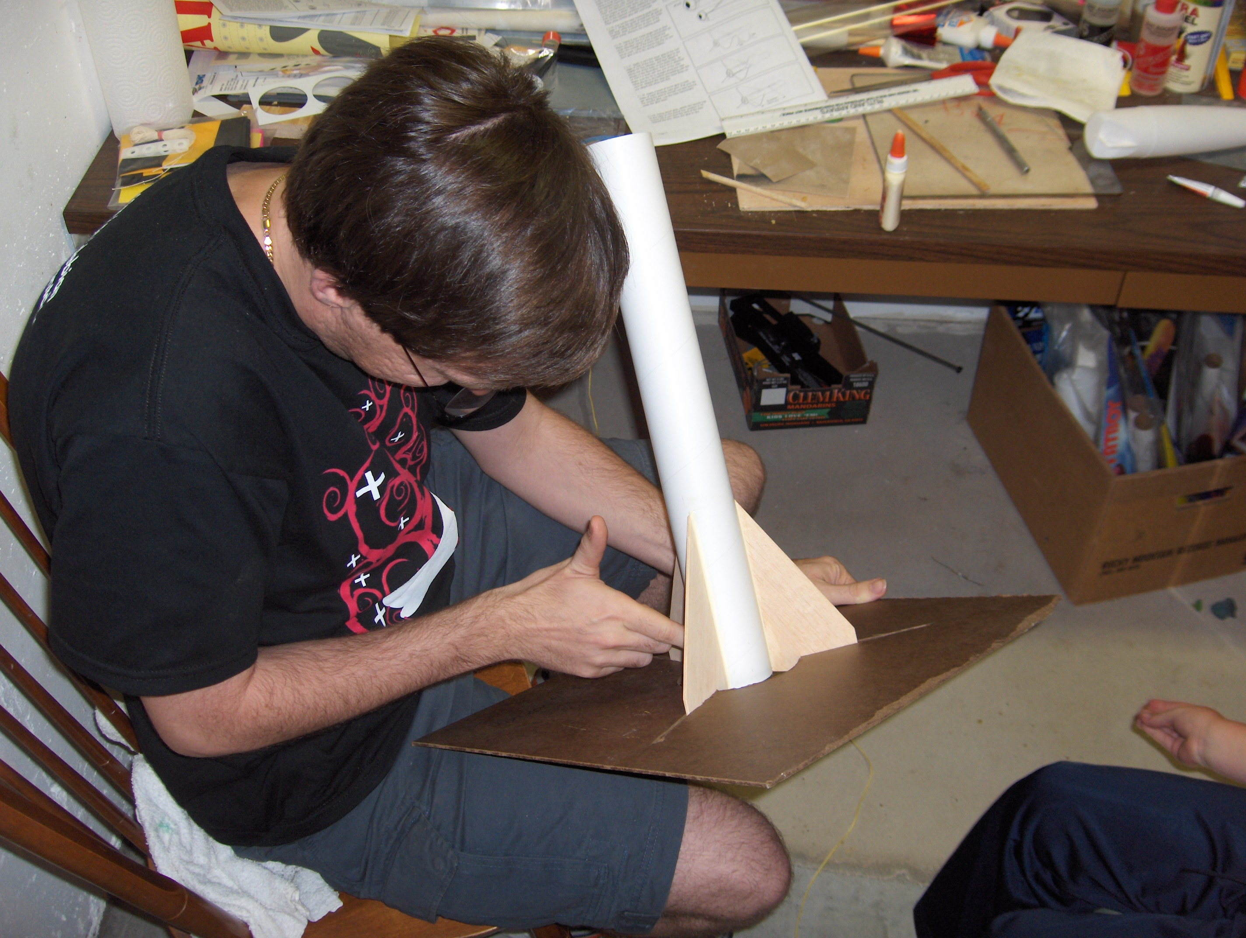

Slide 14
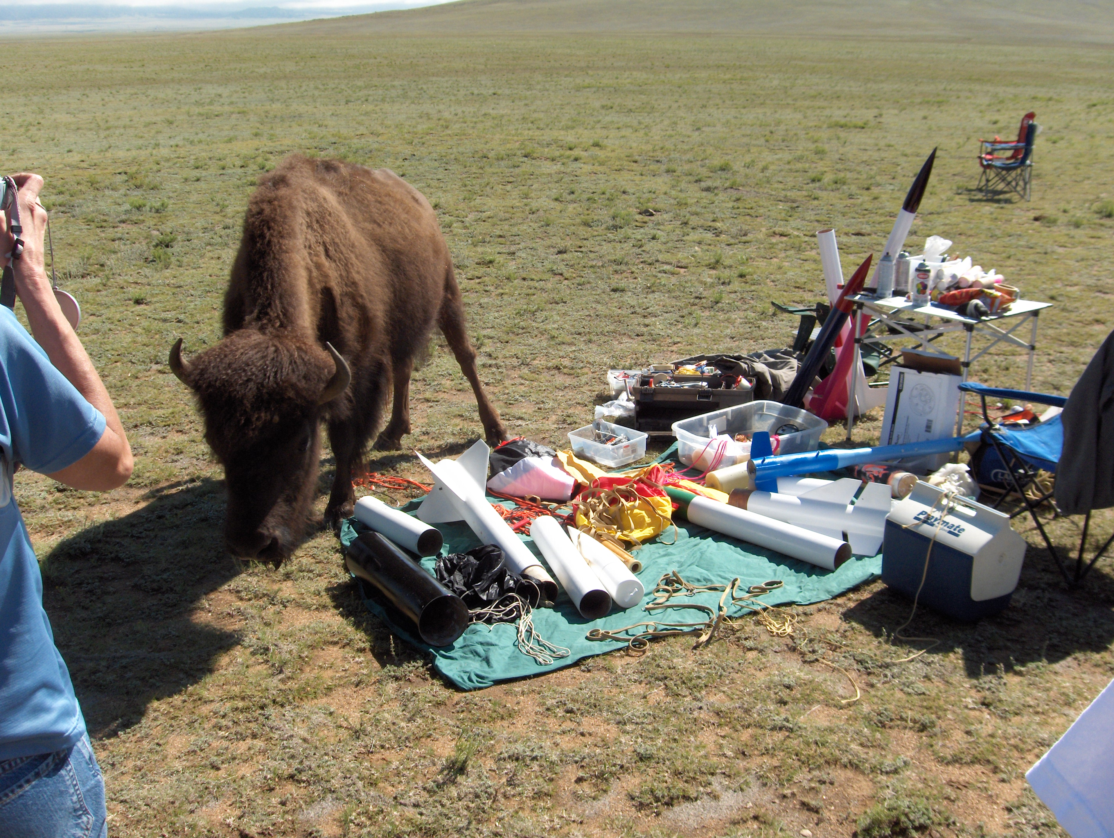

Slide 15
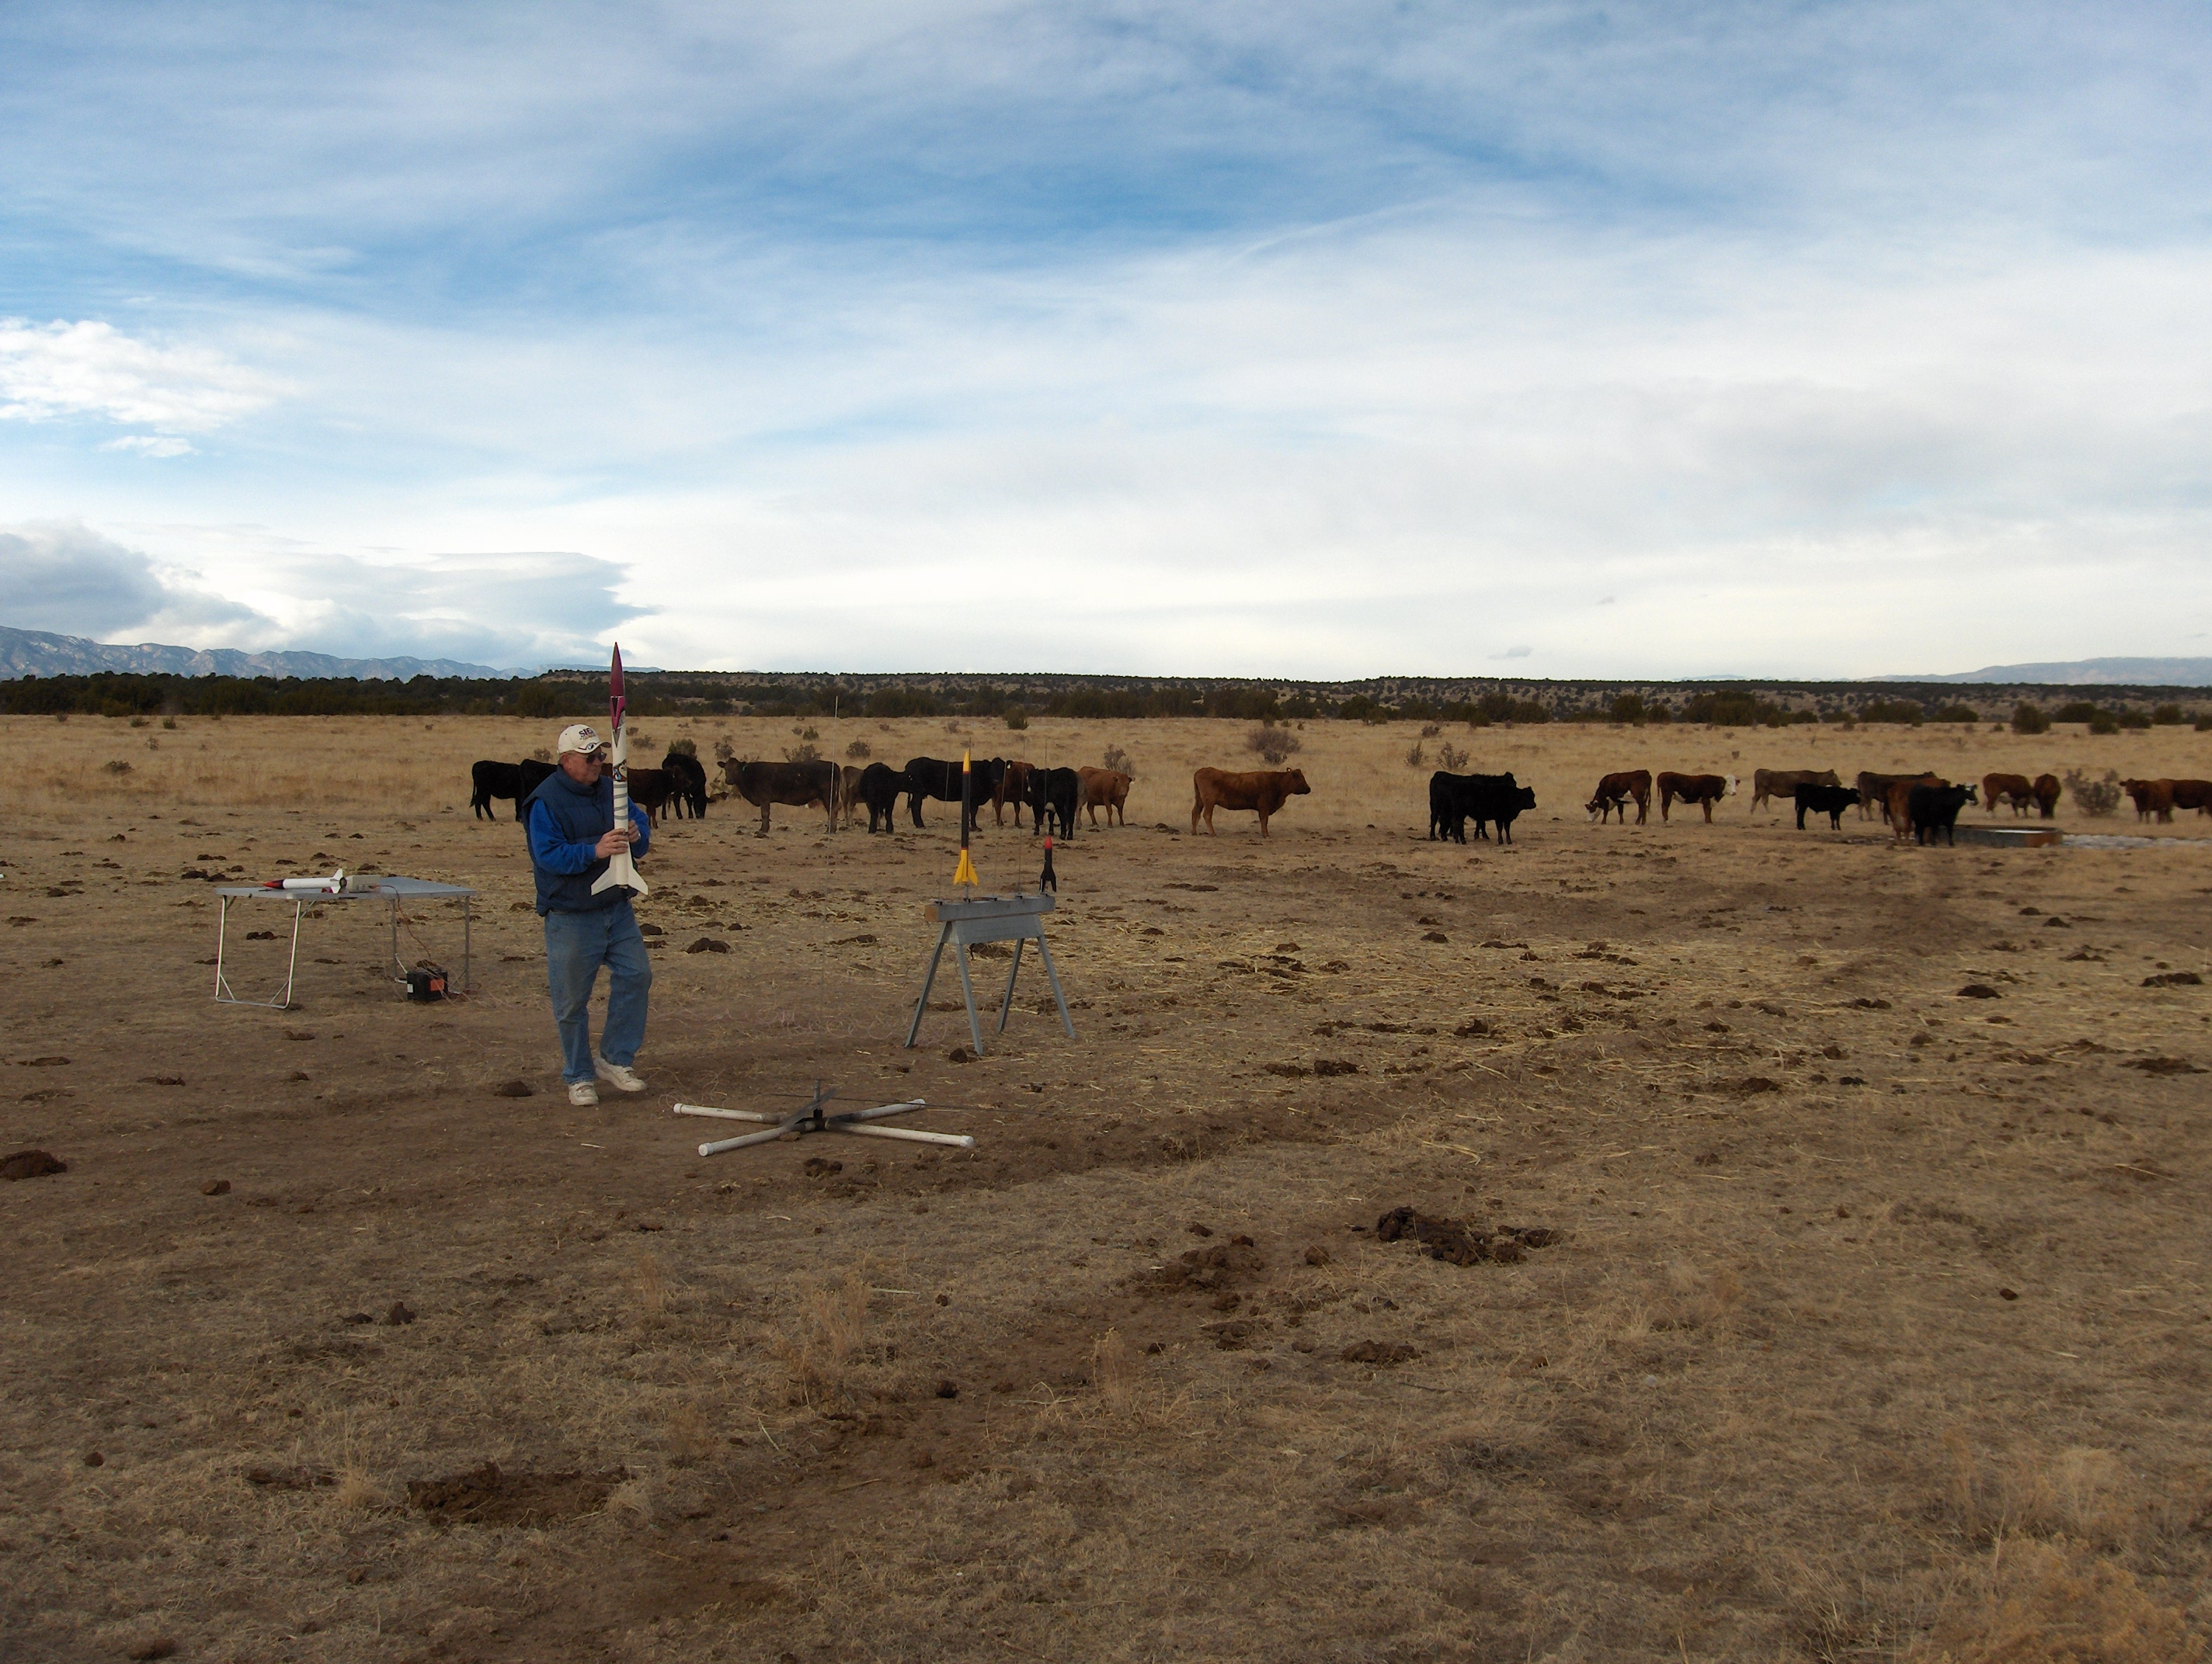

Slide 16
Role of Avionics
Control of recovery system
  Ability to deploy at apogee
  Ability to deploy at a defined altitude
Collection of flight data
  Max altitude – how high did it go?
  Max acceleration – did we break Mach?
  Acceleration and altitude profiles for more thorough analysis of vehicle and motor performance
Radio link to ground
  Position and health information, possibility of control

Slide 17
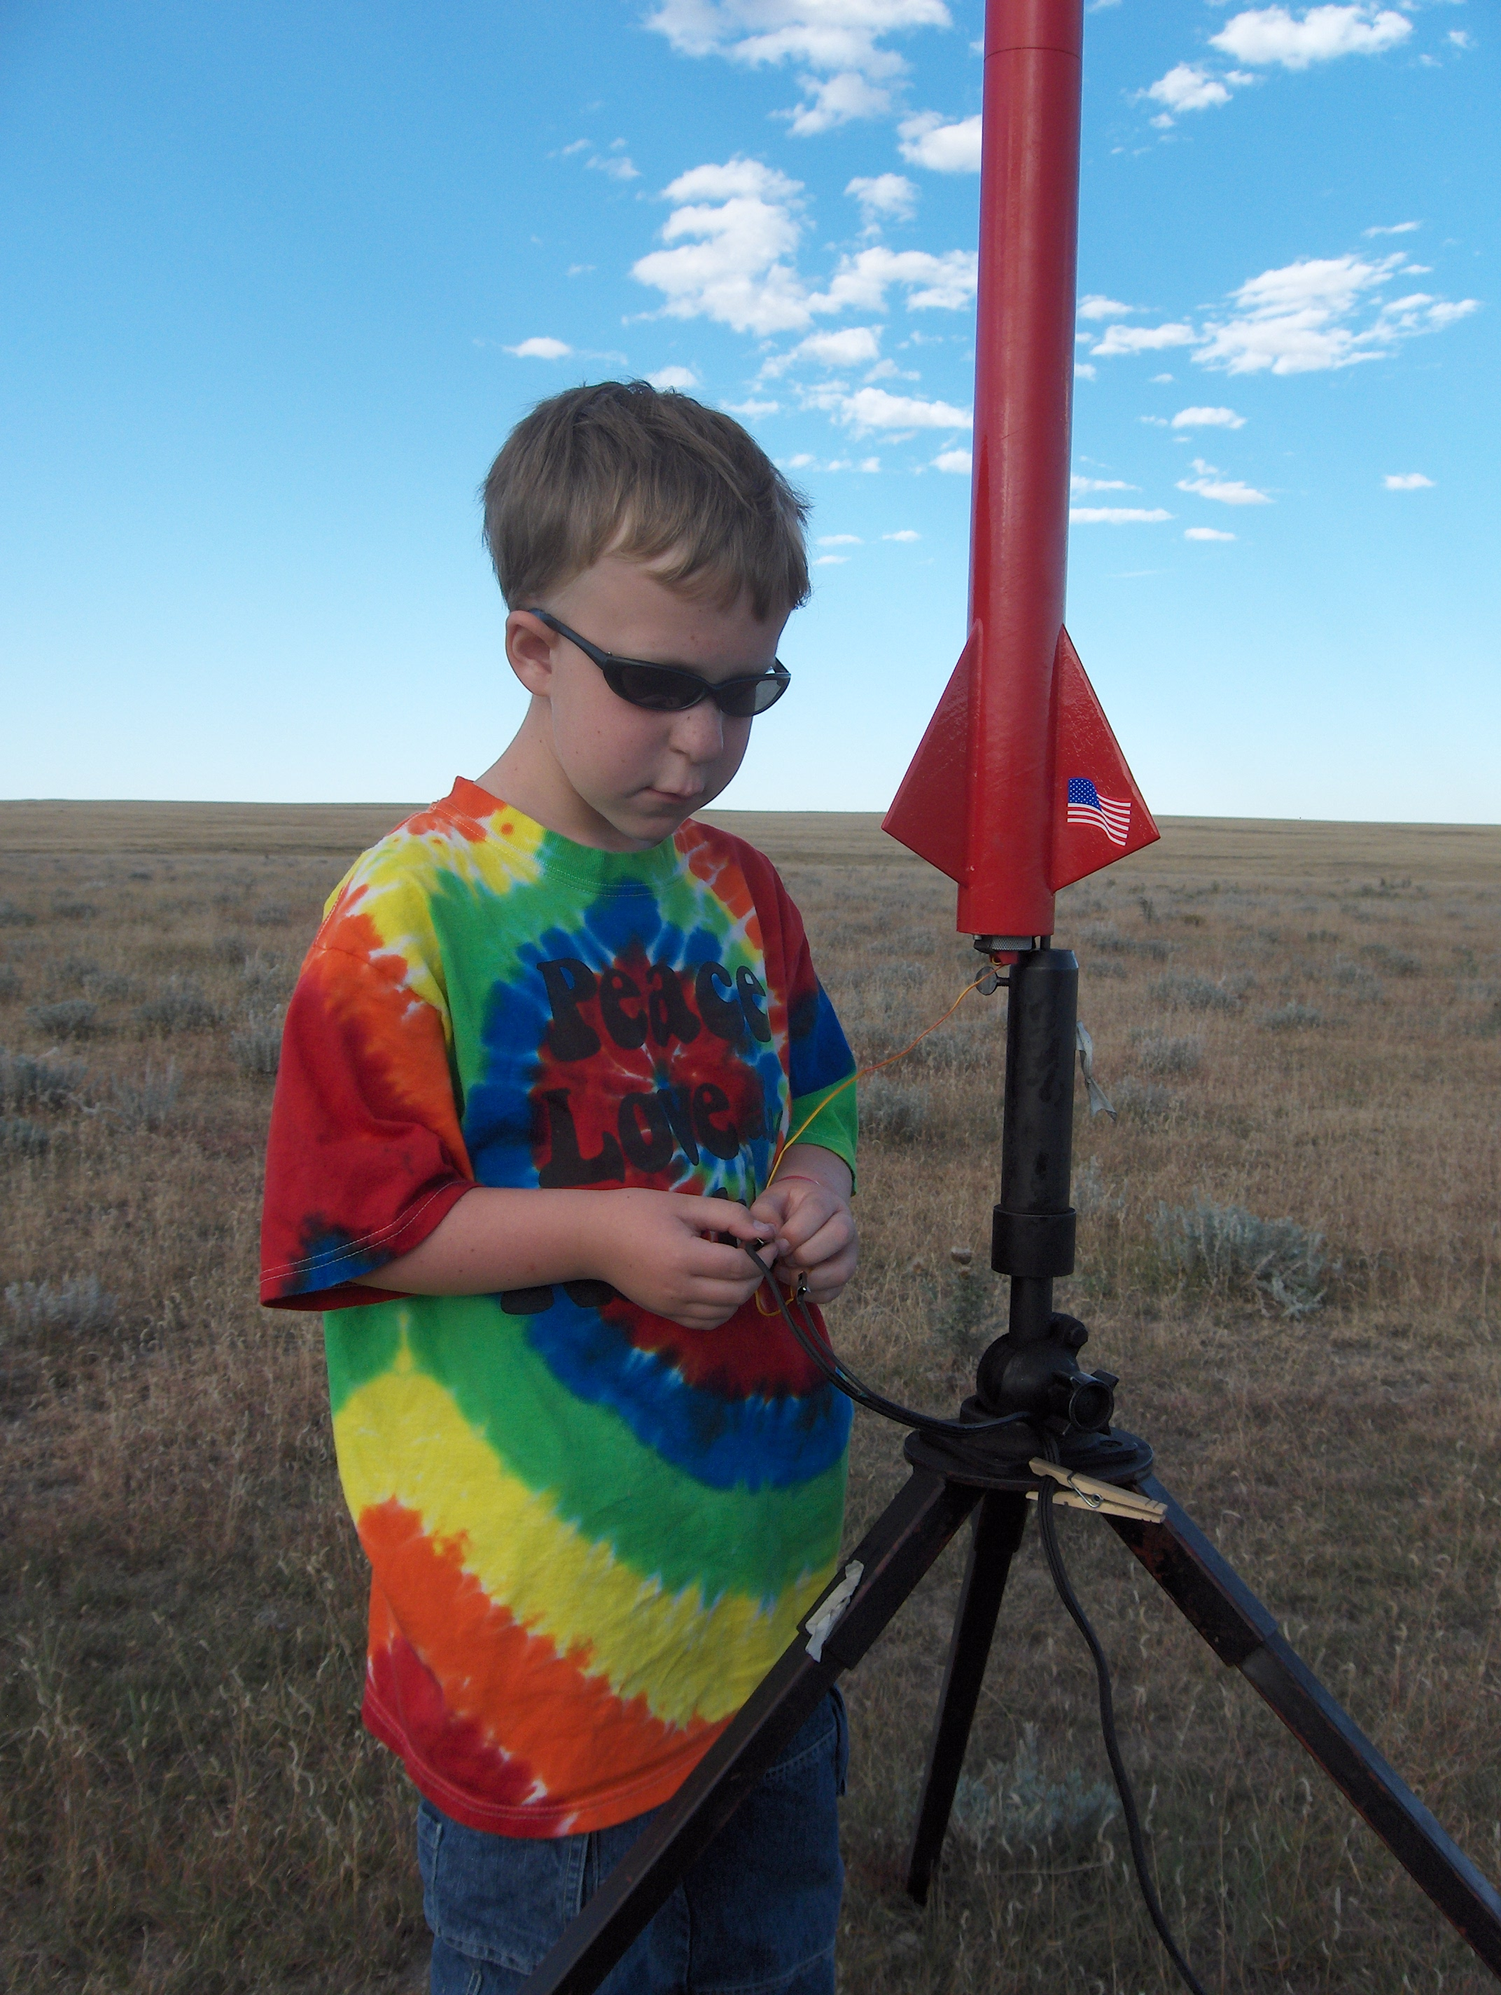
Even Simple Flight Data is Fun!
LOC/Precision “Lil Nuke” with added payload bay
Motor-based ejection
PicoAlt
Robert's first “big” rocket ... E-G motors!
Max recorded altitude 2001 feet on G77R-M

Slide 18
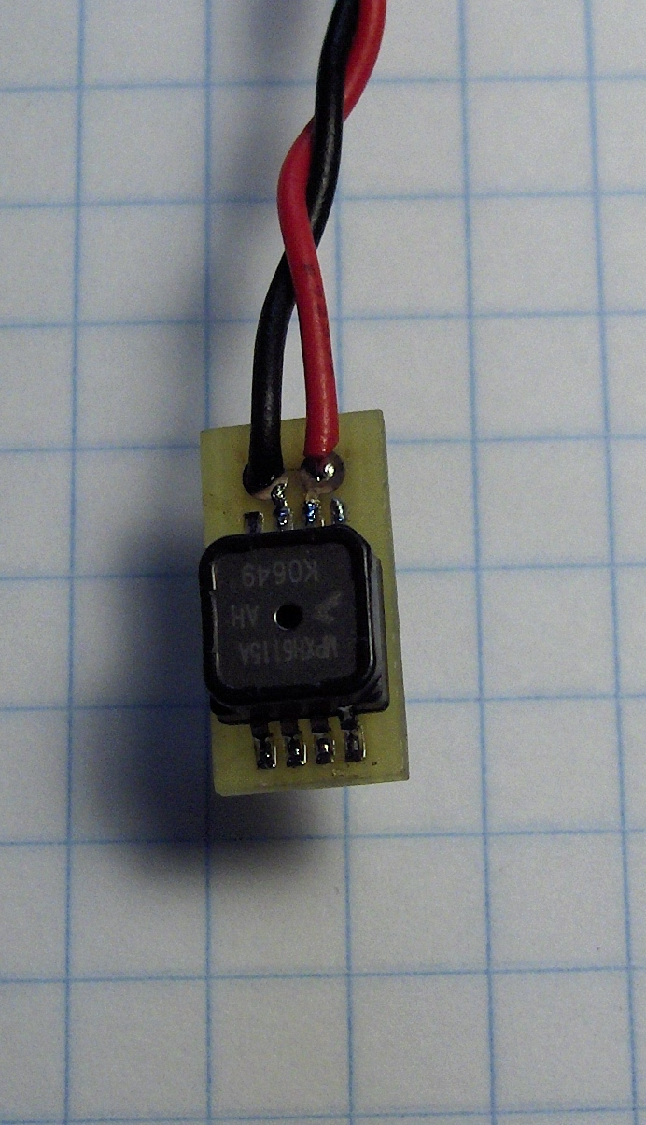
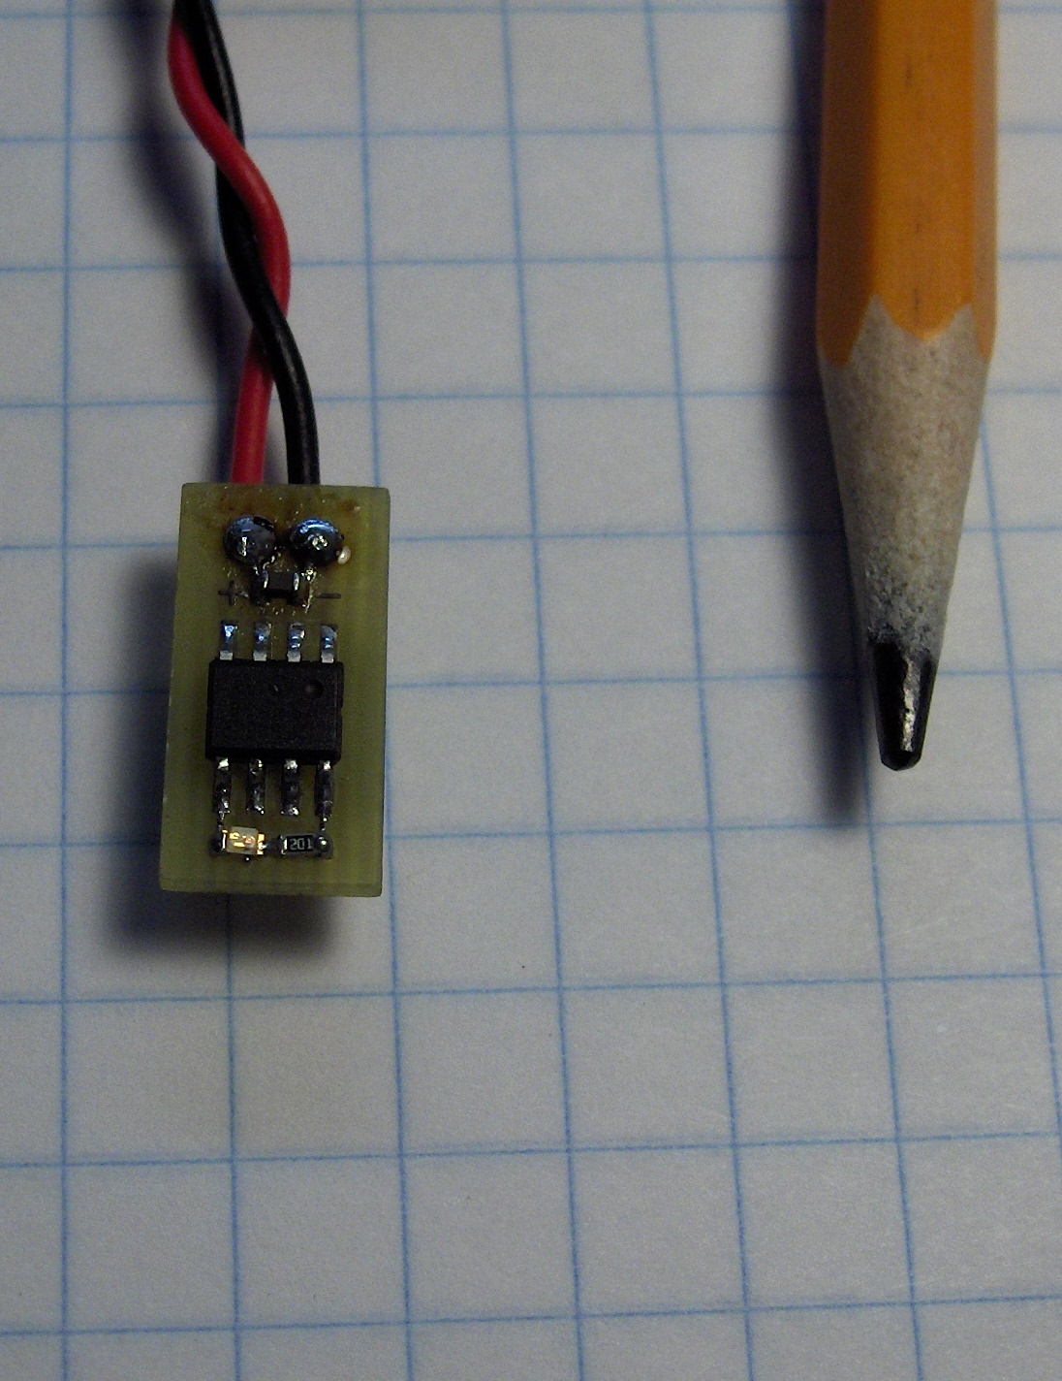
PicoAlt

Slide 19
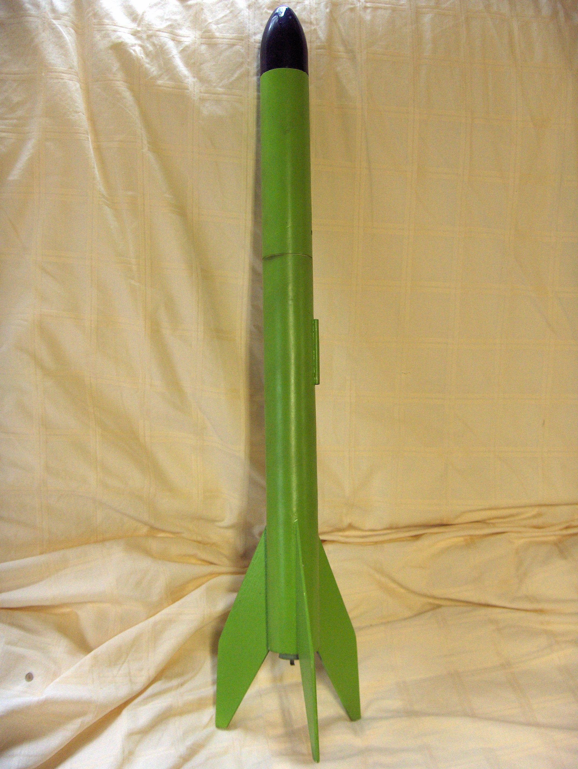
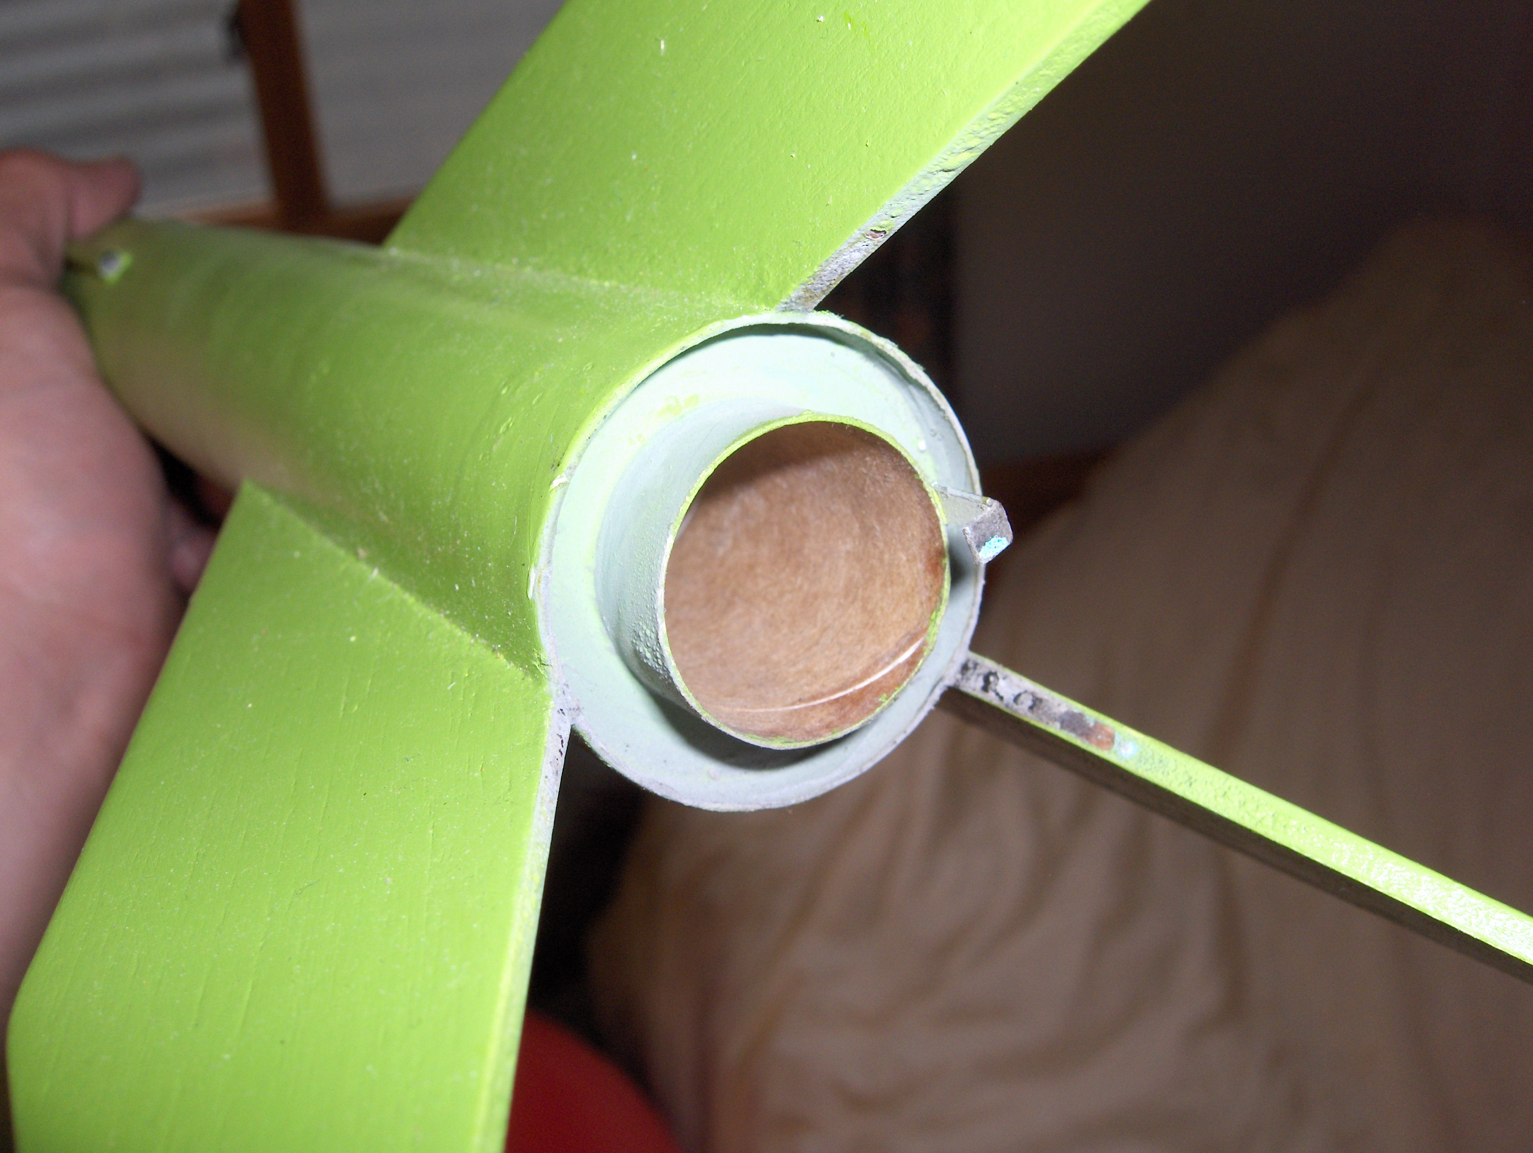
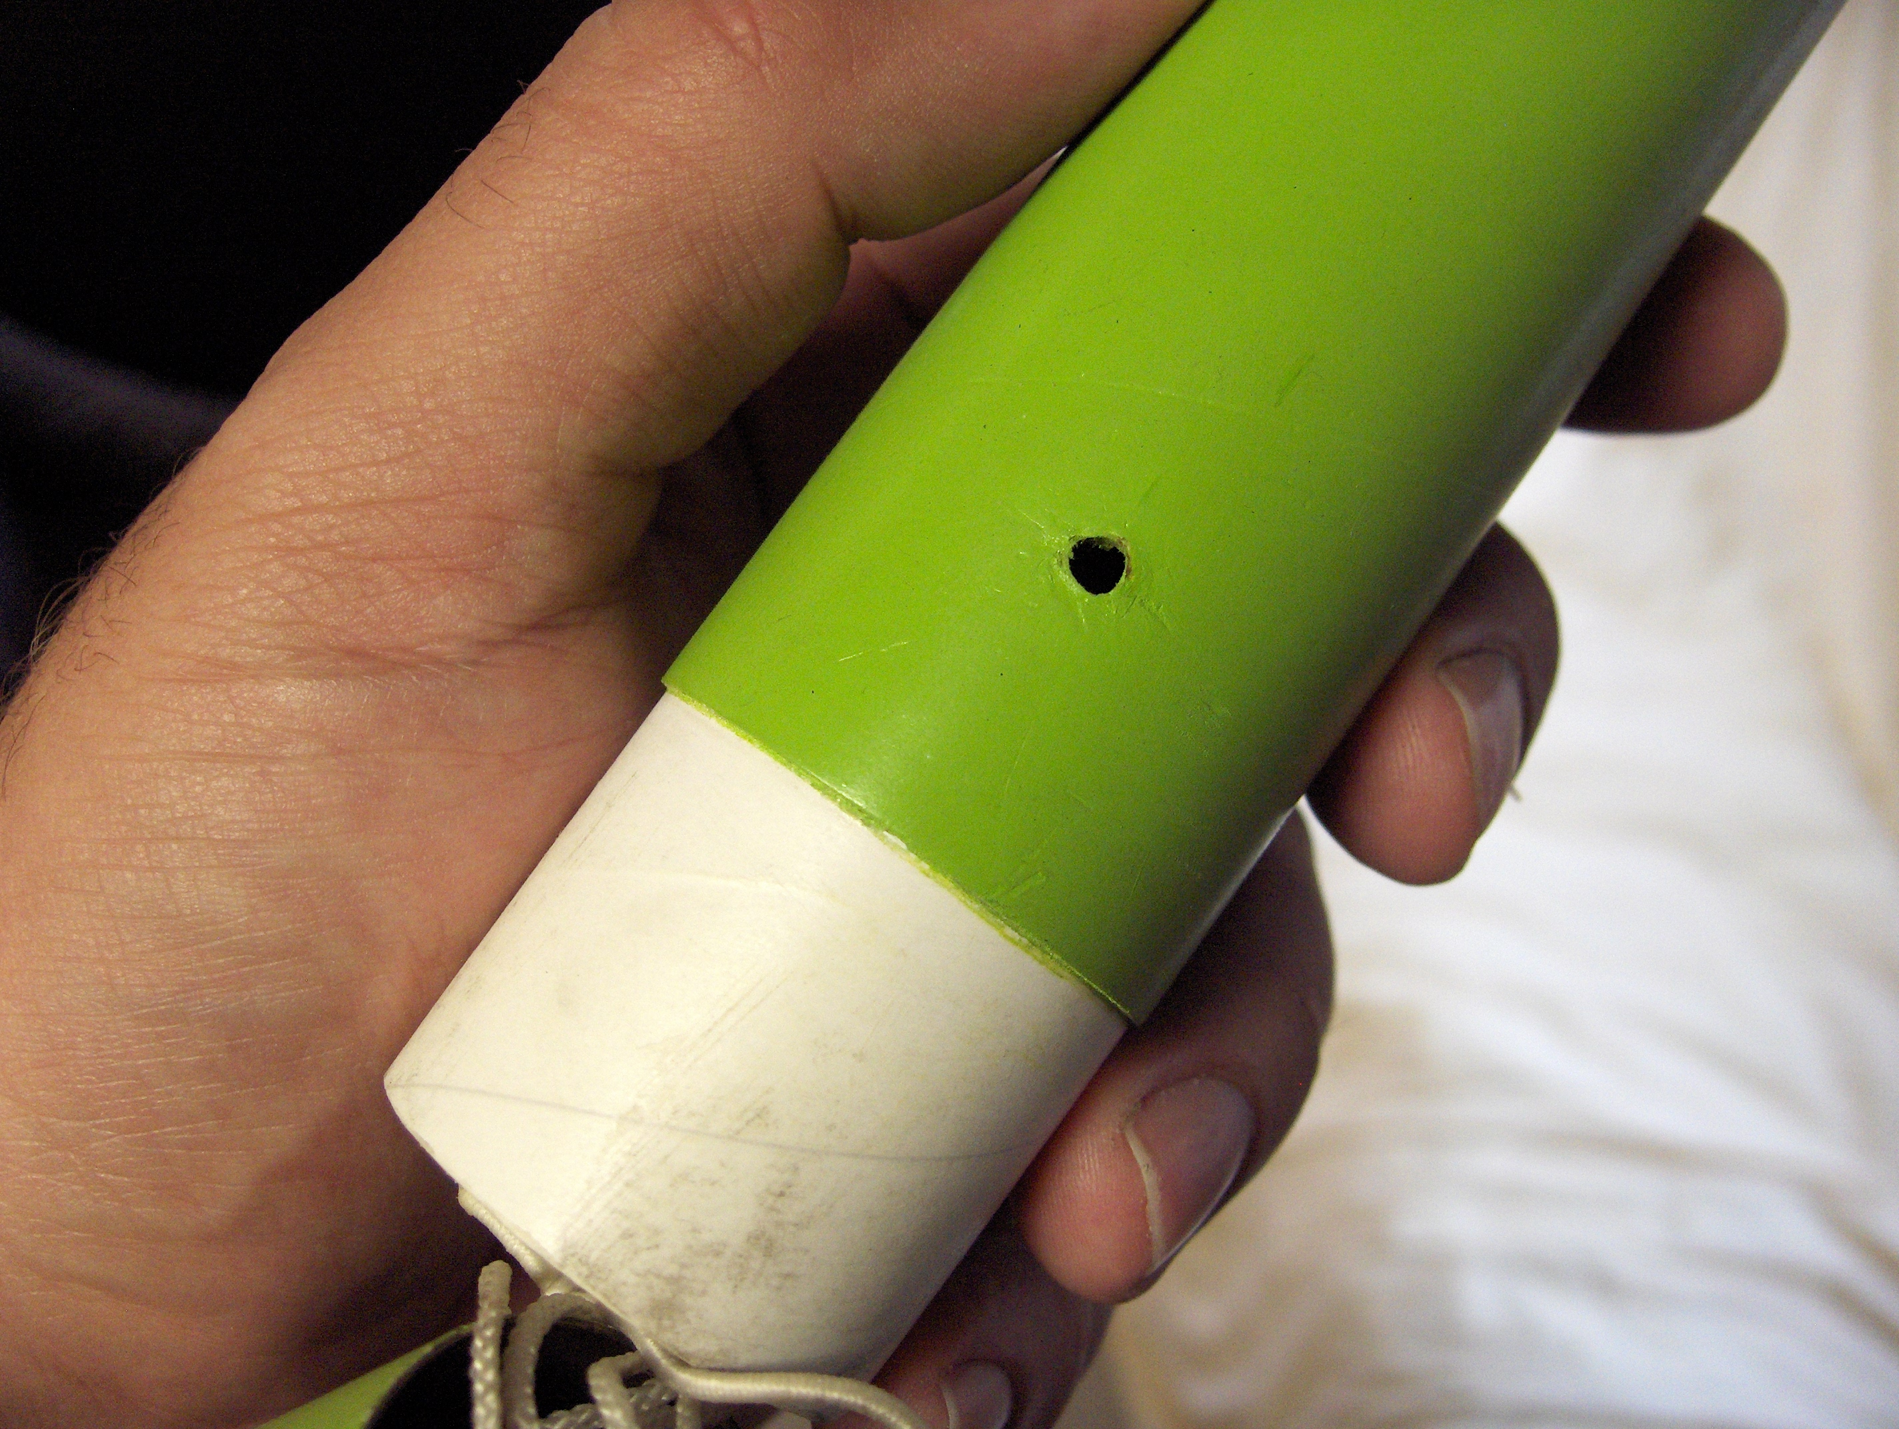

Slide 20
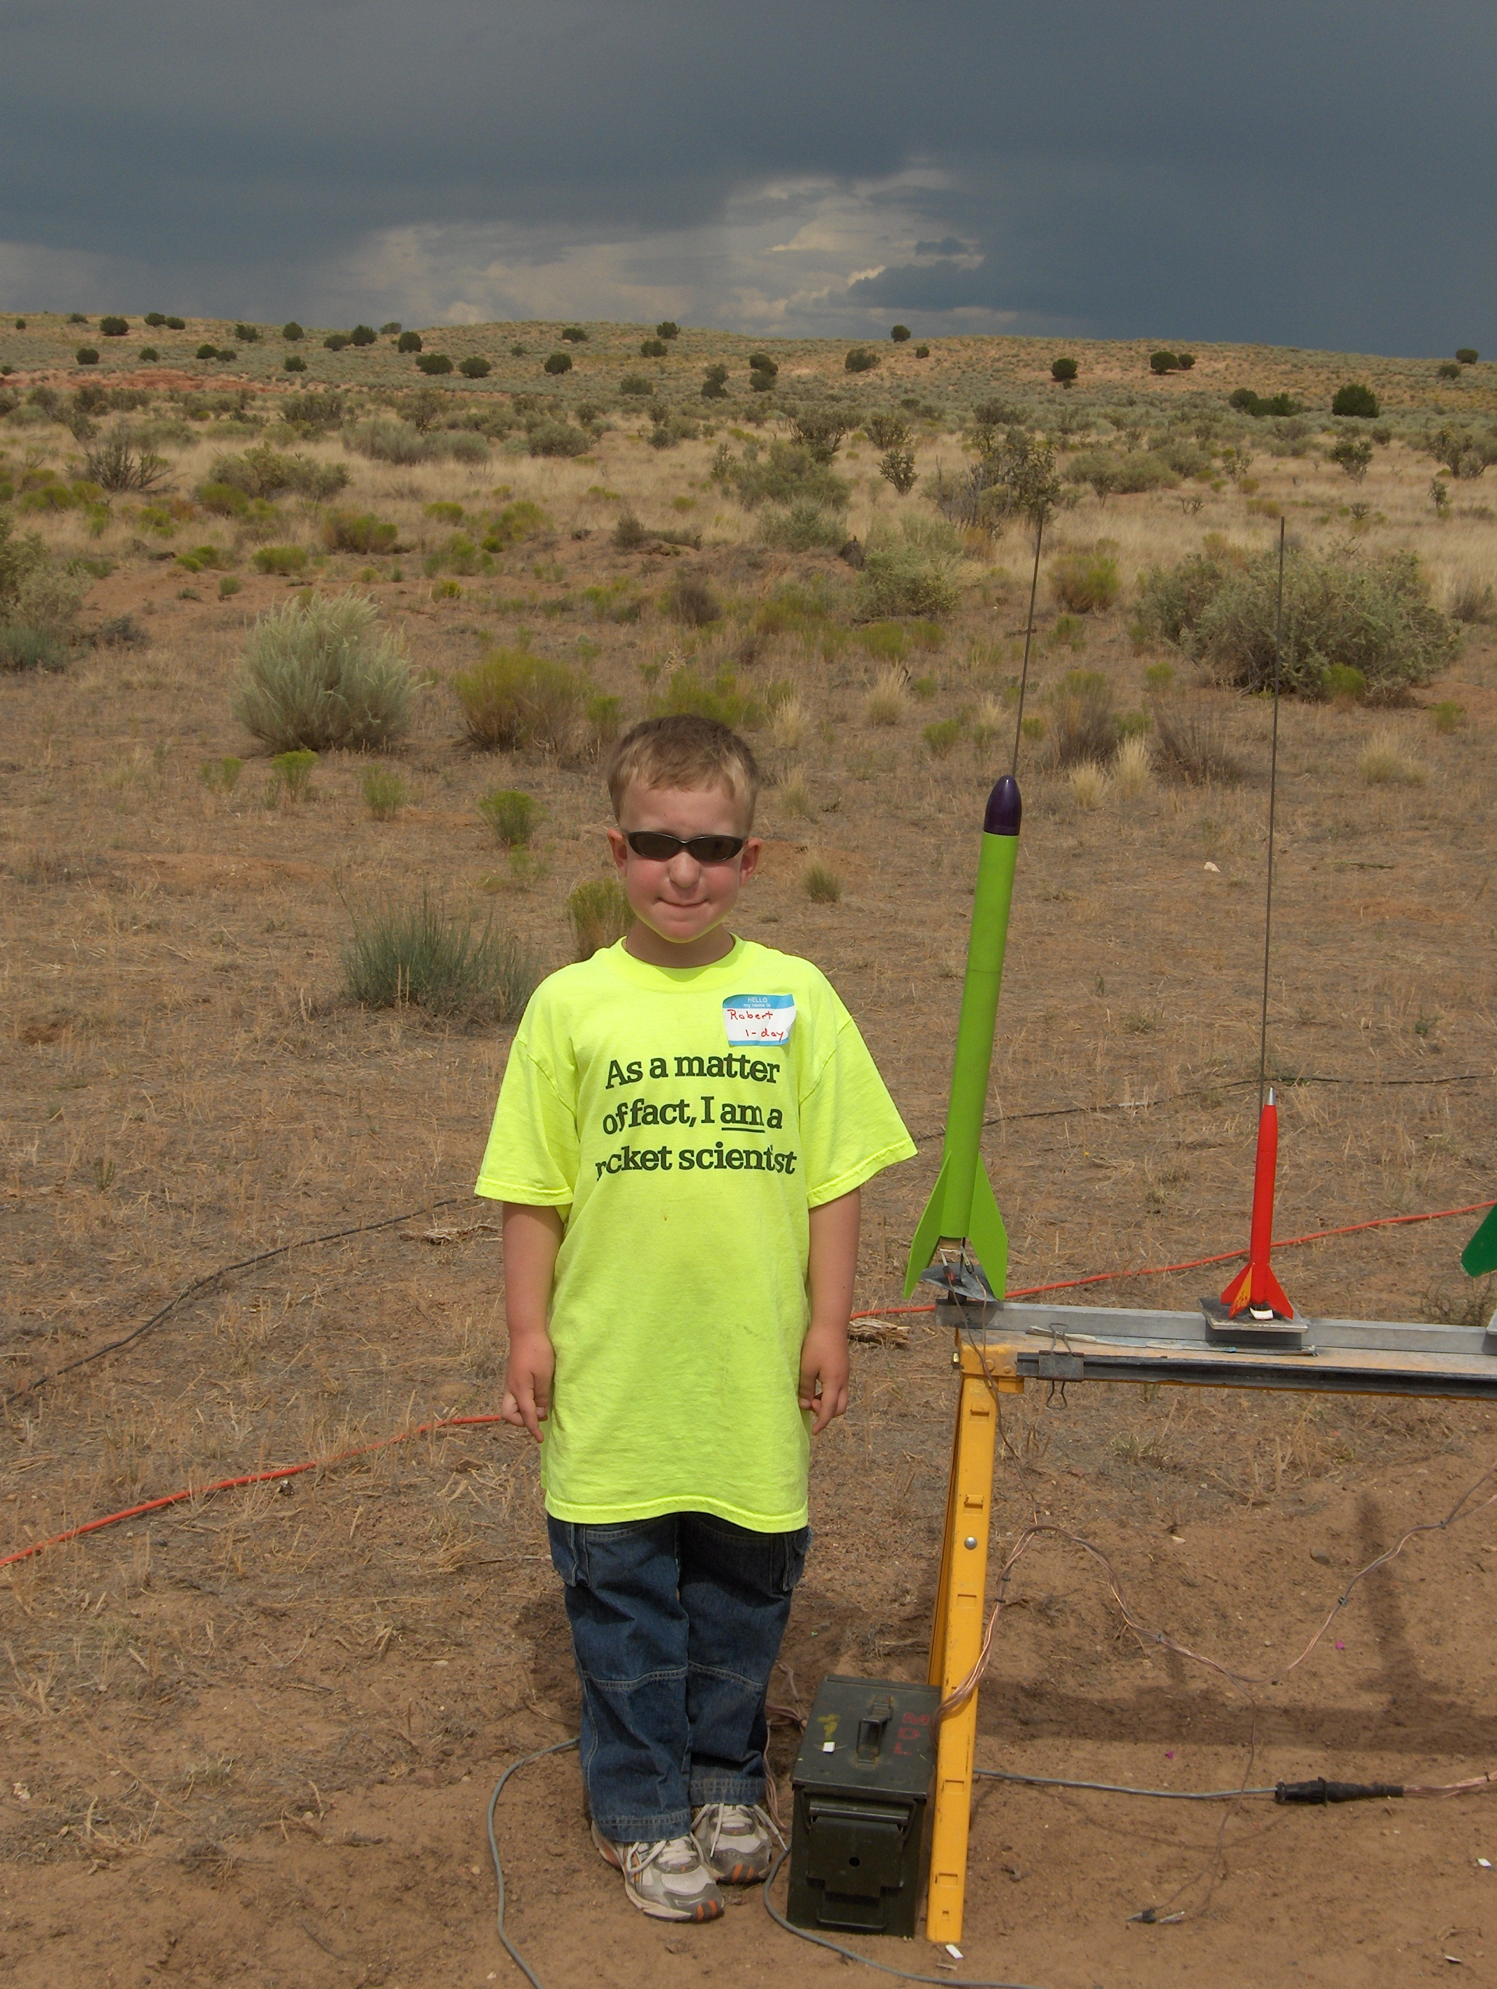
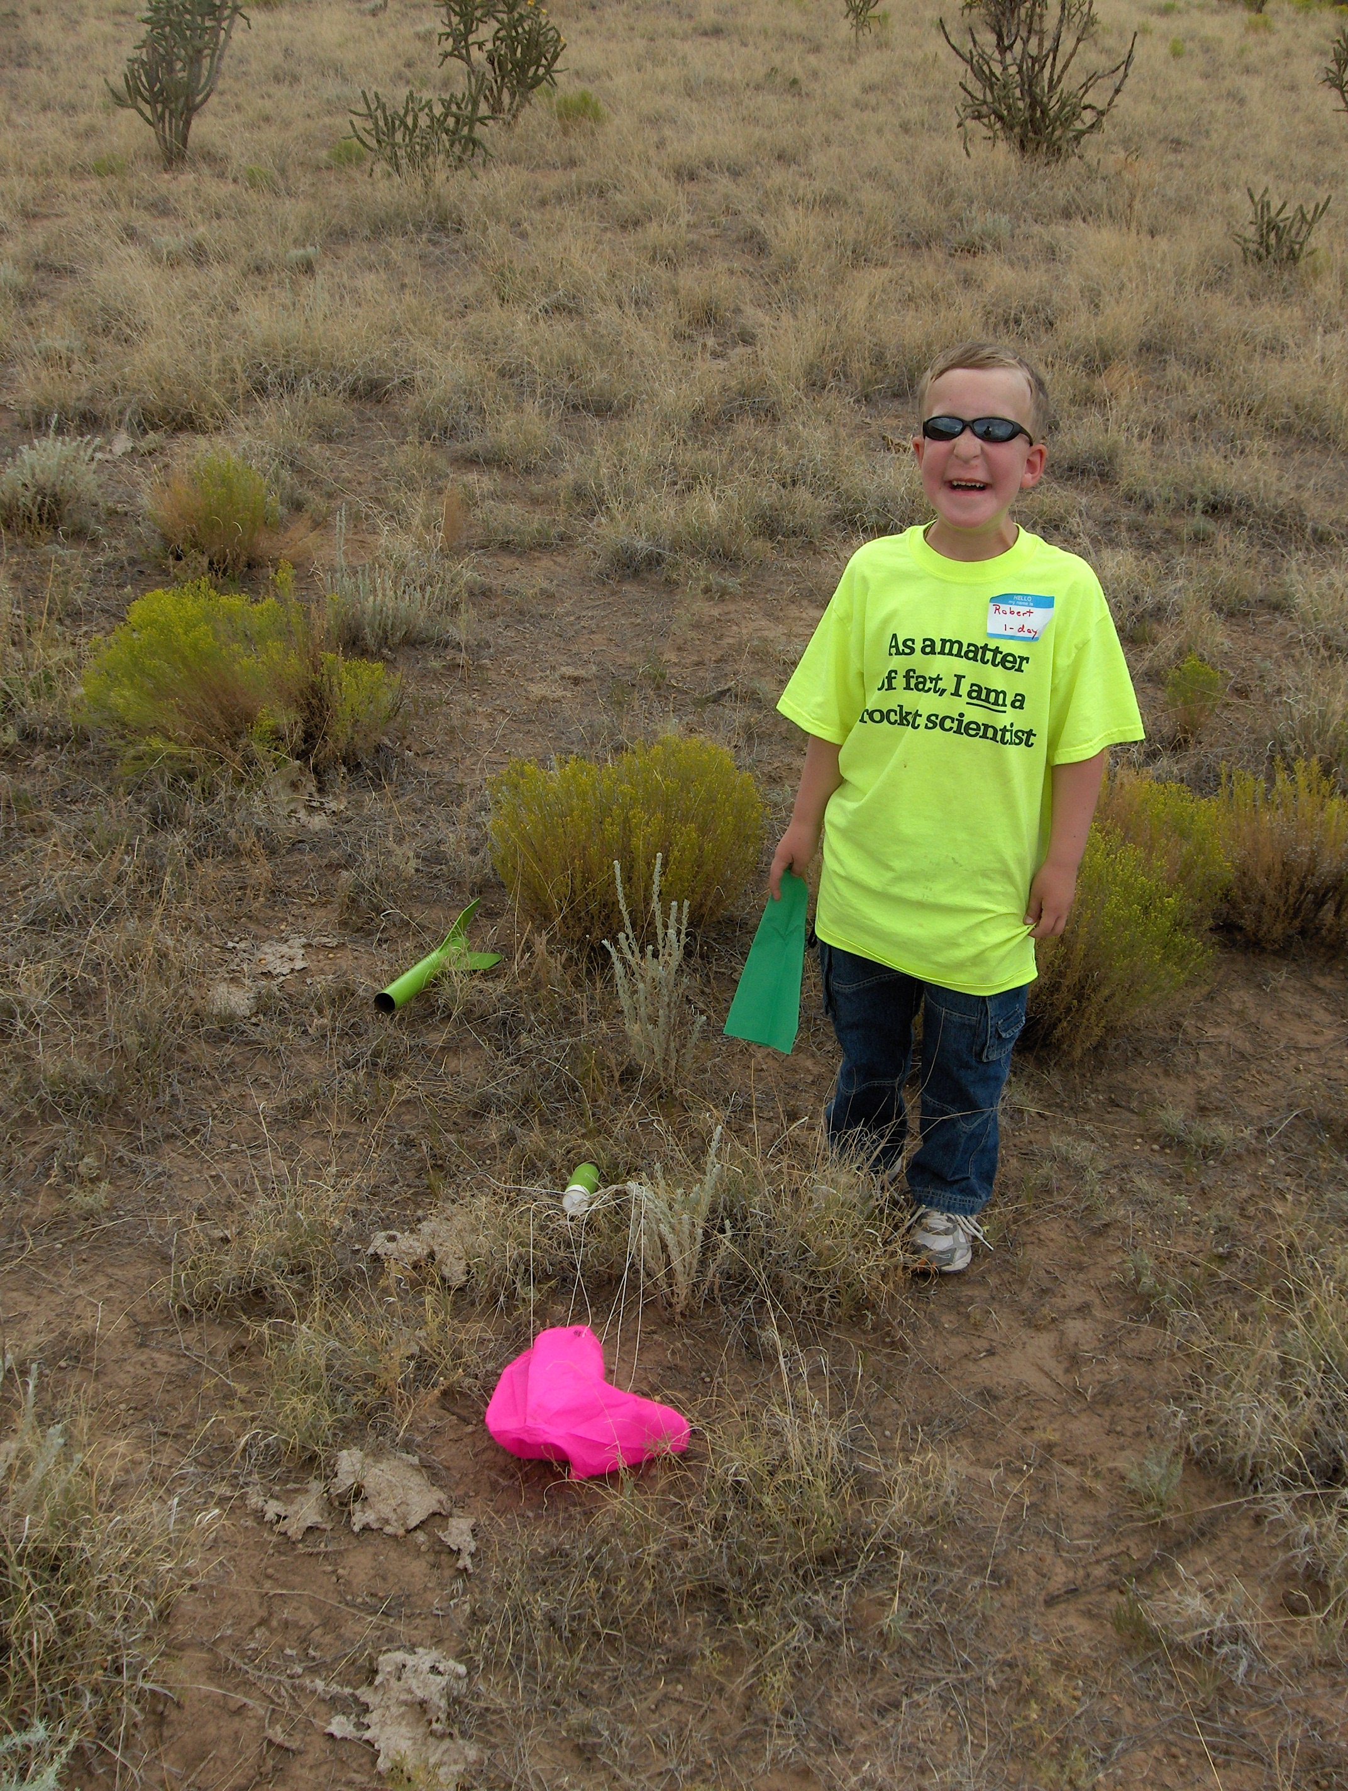
Sublime Grape, E9-8 to 1651 feet
Recovered 0.48 miles downrange!

Slide 21
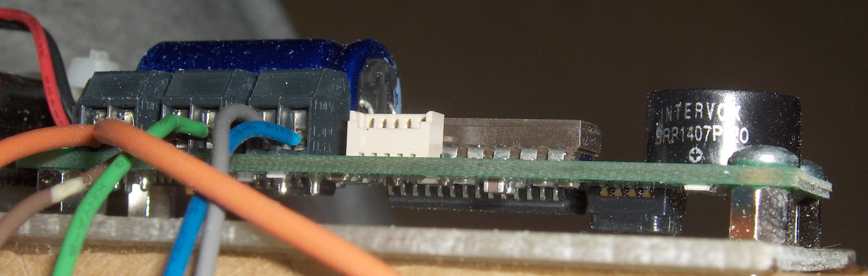
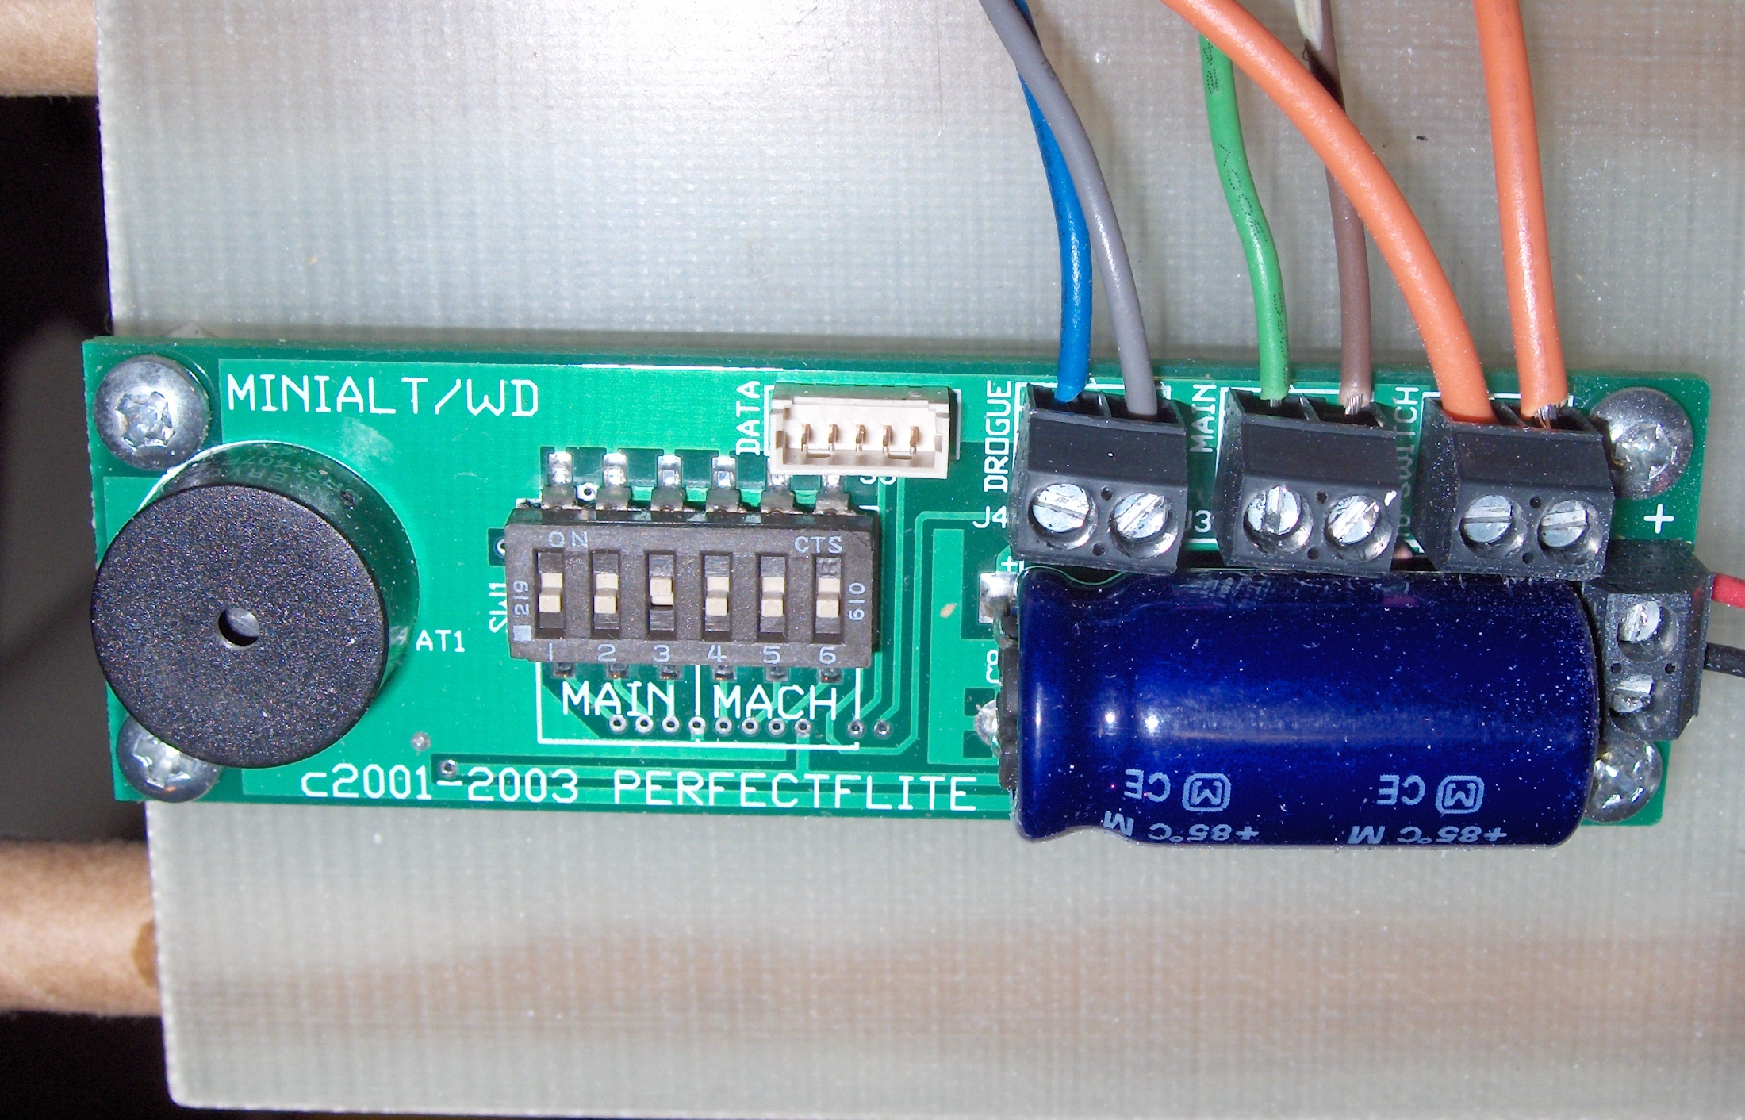
PerfectFlite MAWD

Slide 22
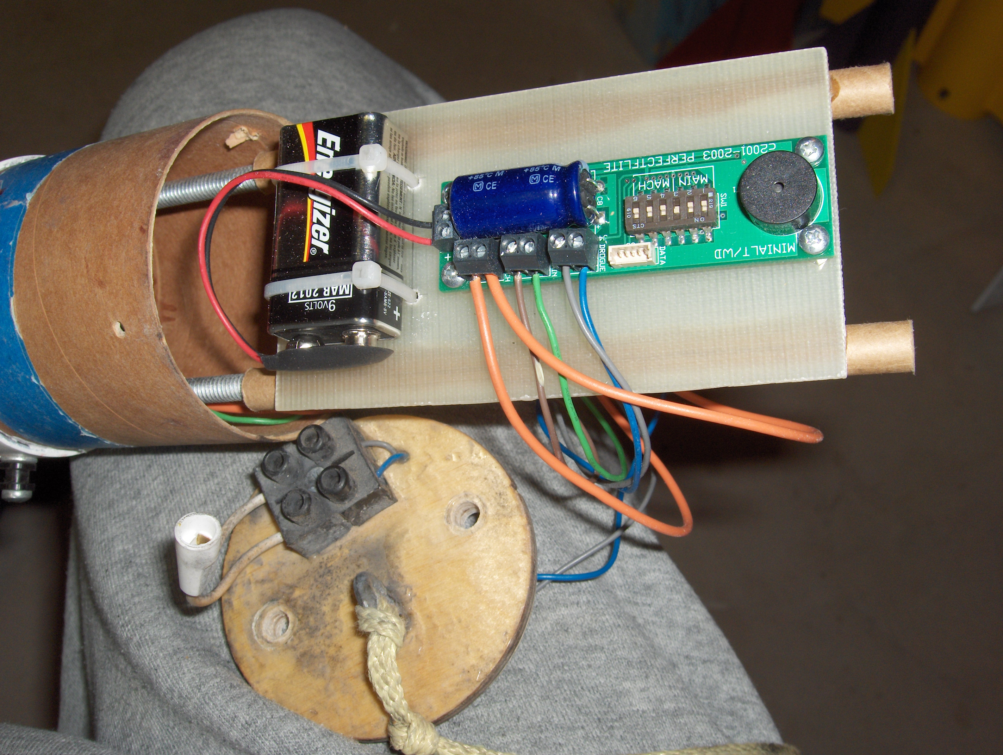

Slide 23
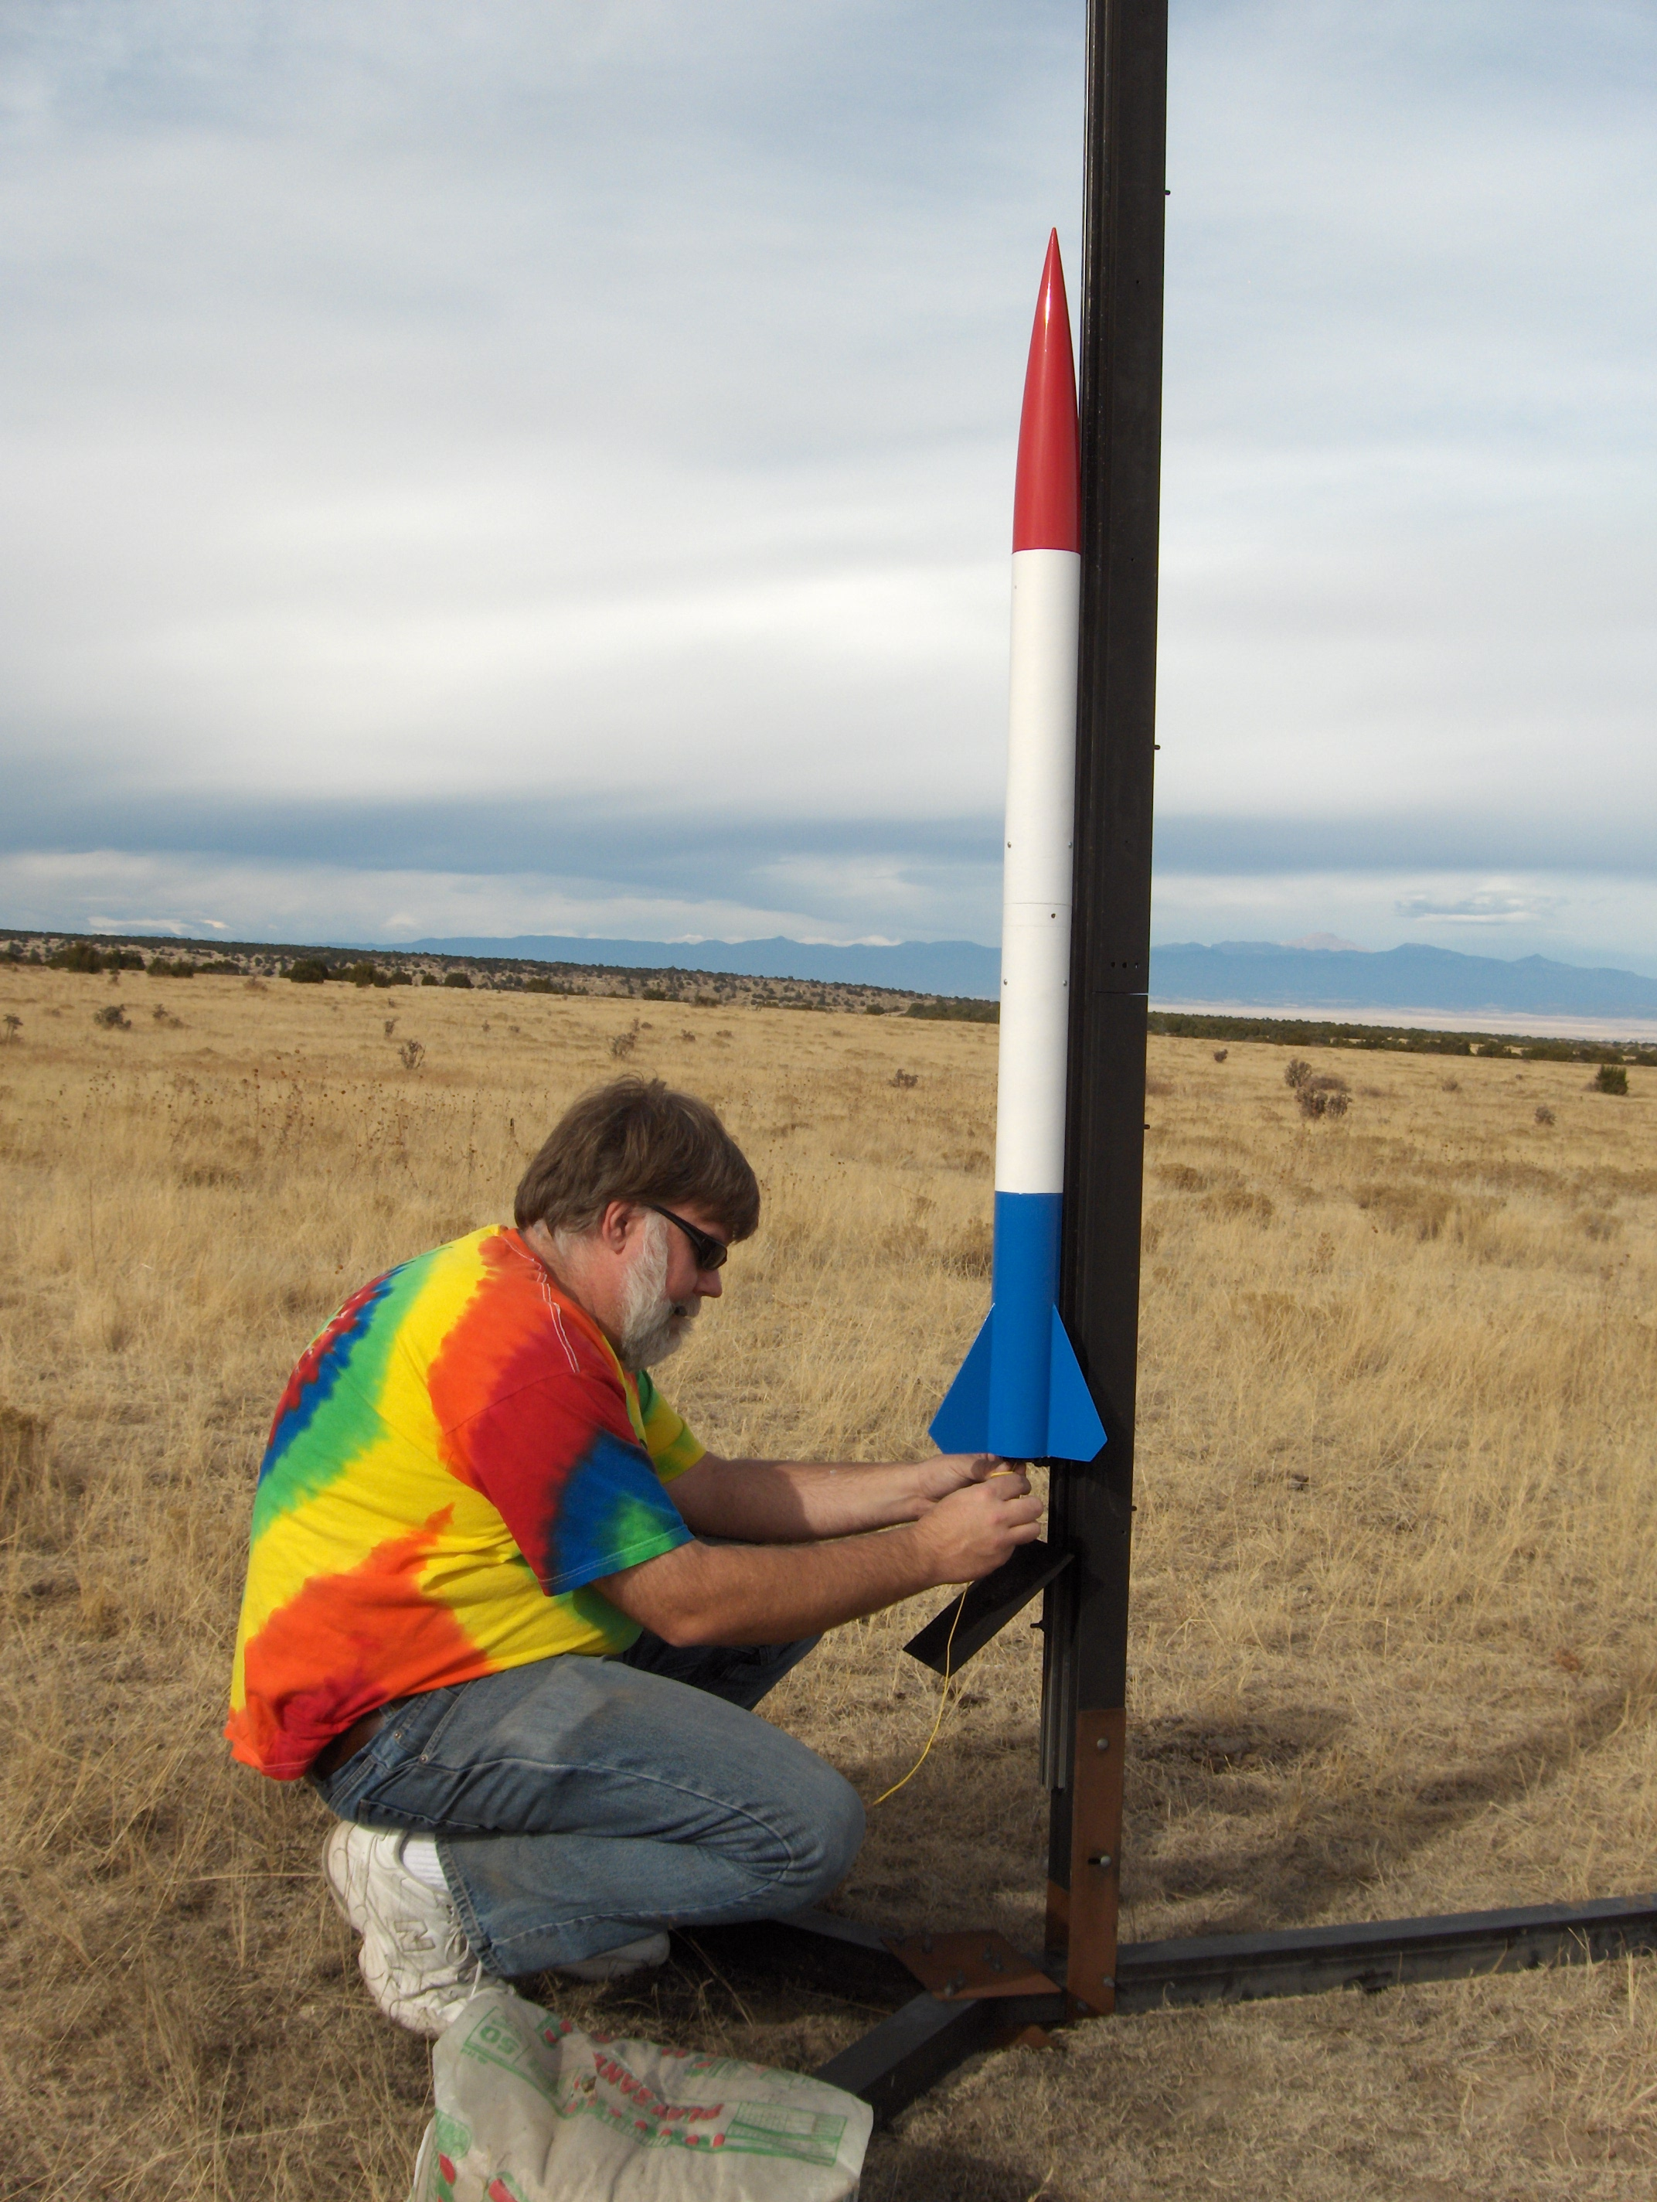
Dual Deploy
“Freedom Flies” was my first, custom, dual deploy rocket design
PerfectFlite MAWD
Holiday light charges w/ 0.5g black powder
H128 to 932 feet
J330 to 6597 feet

Slide 24


Slide 25
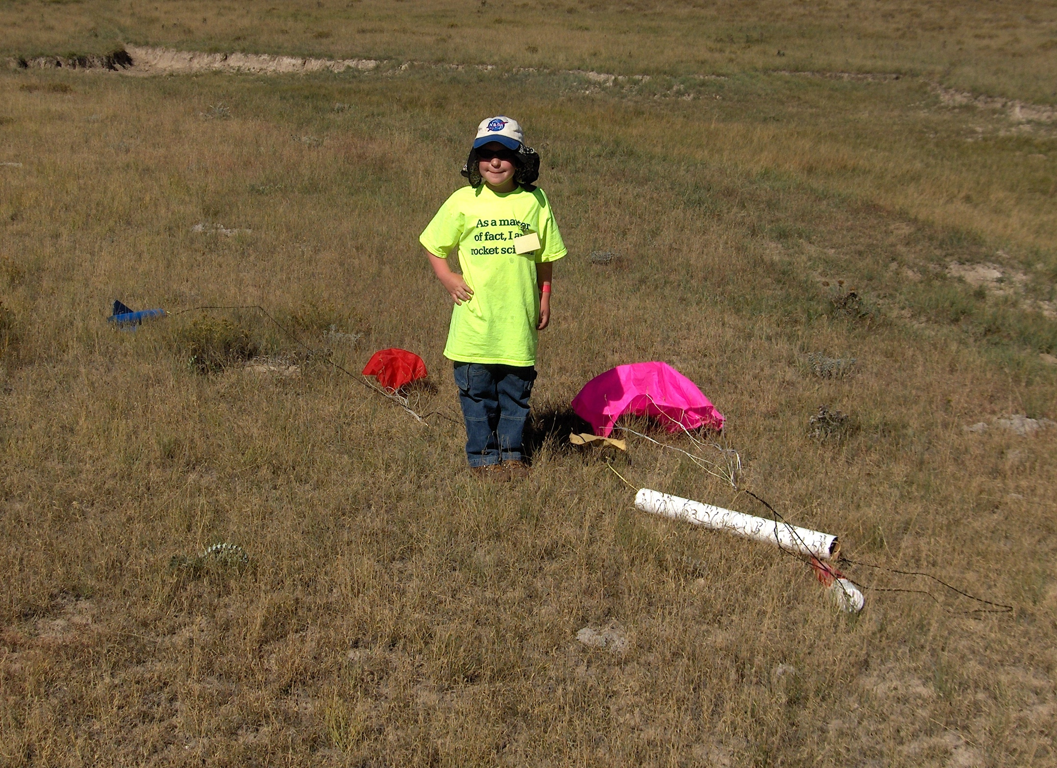

Slide 26
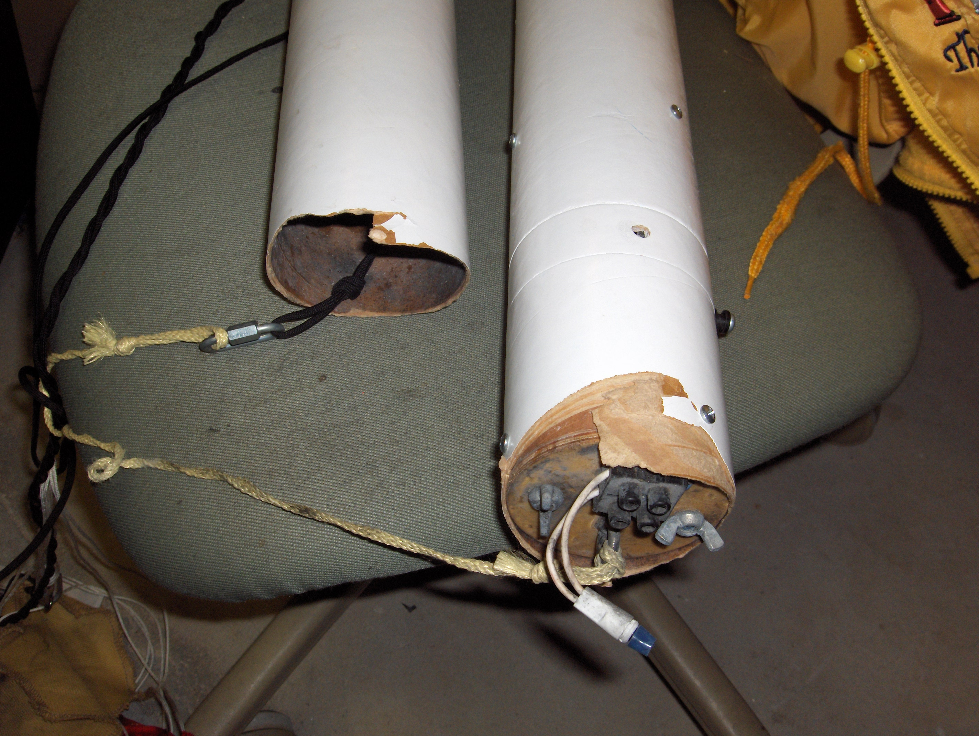

Slide 27
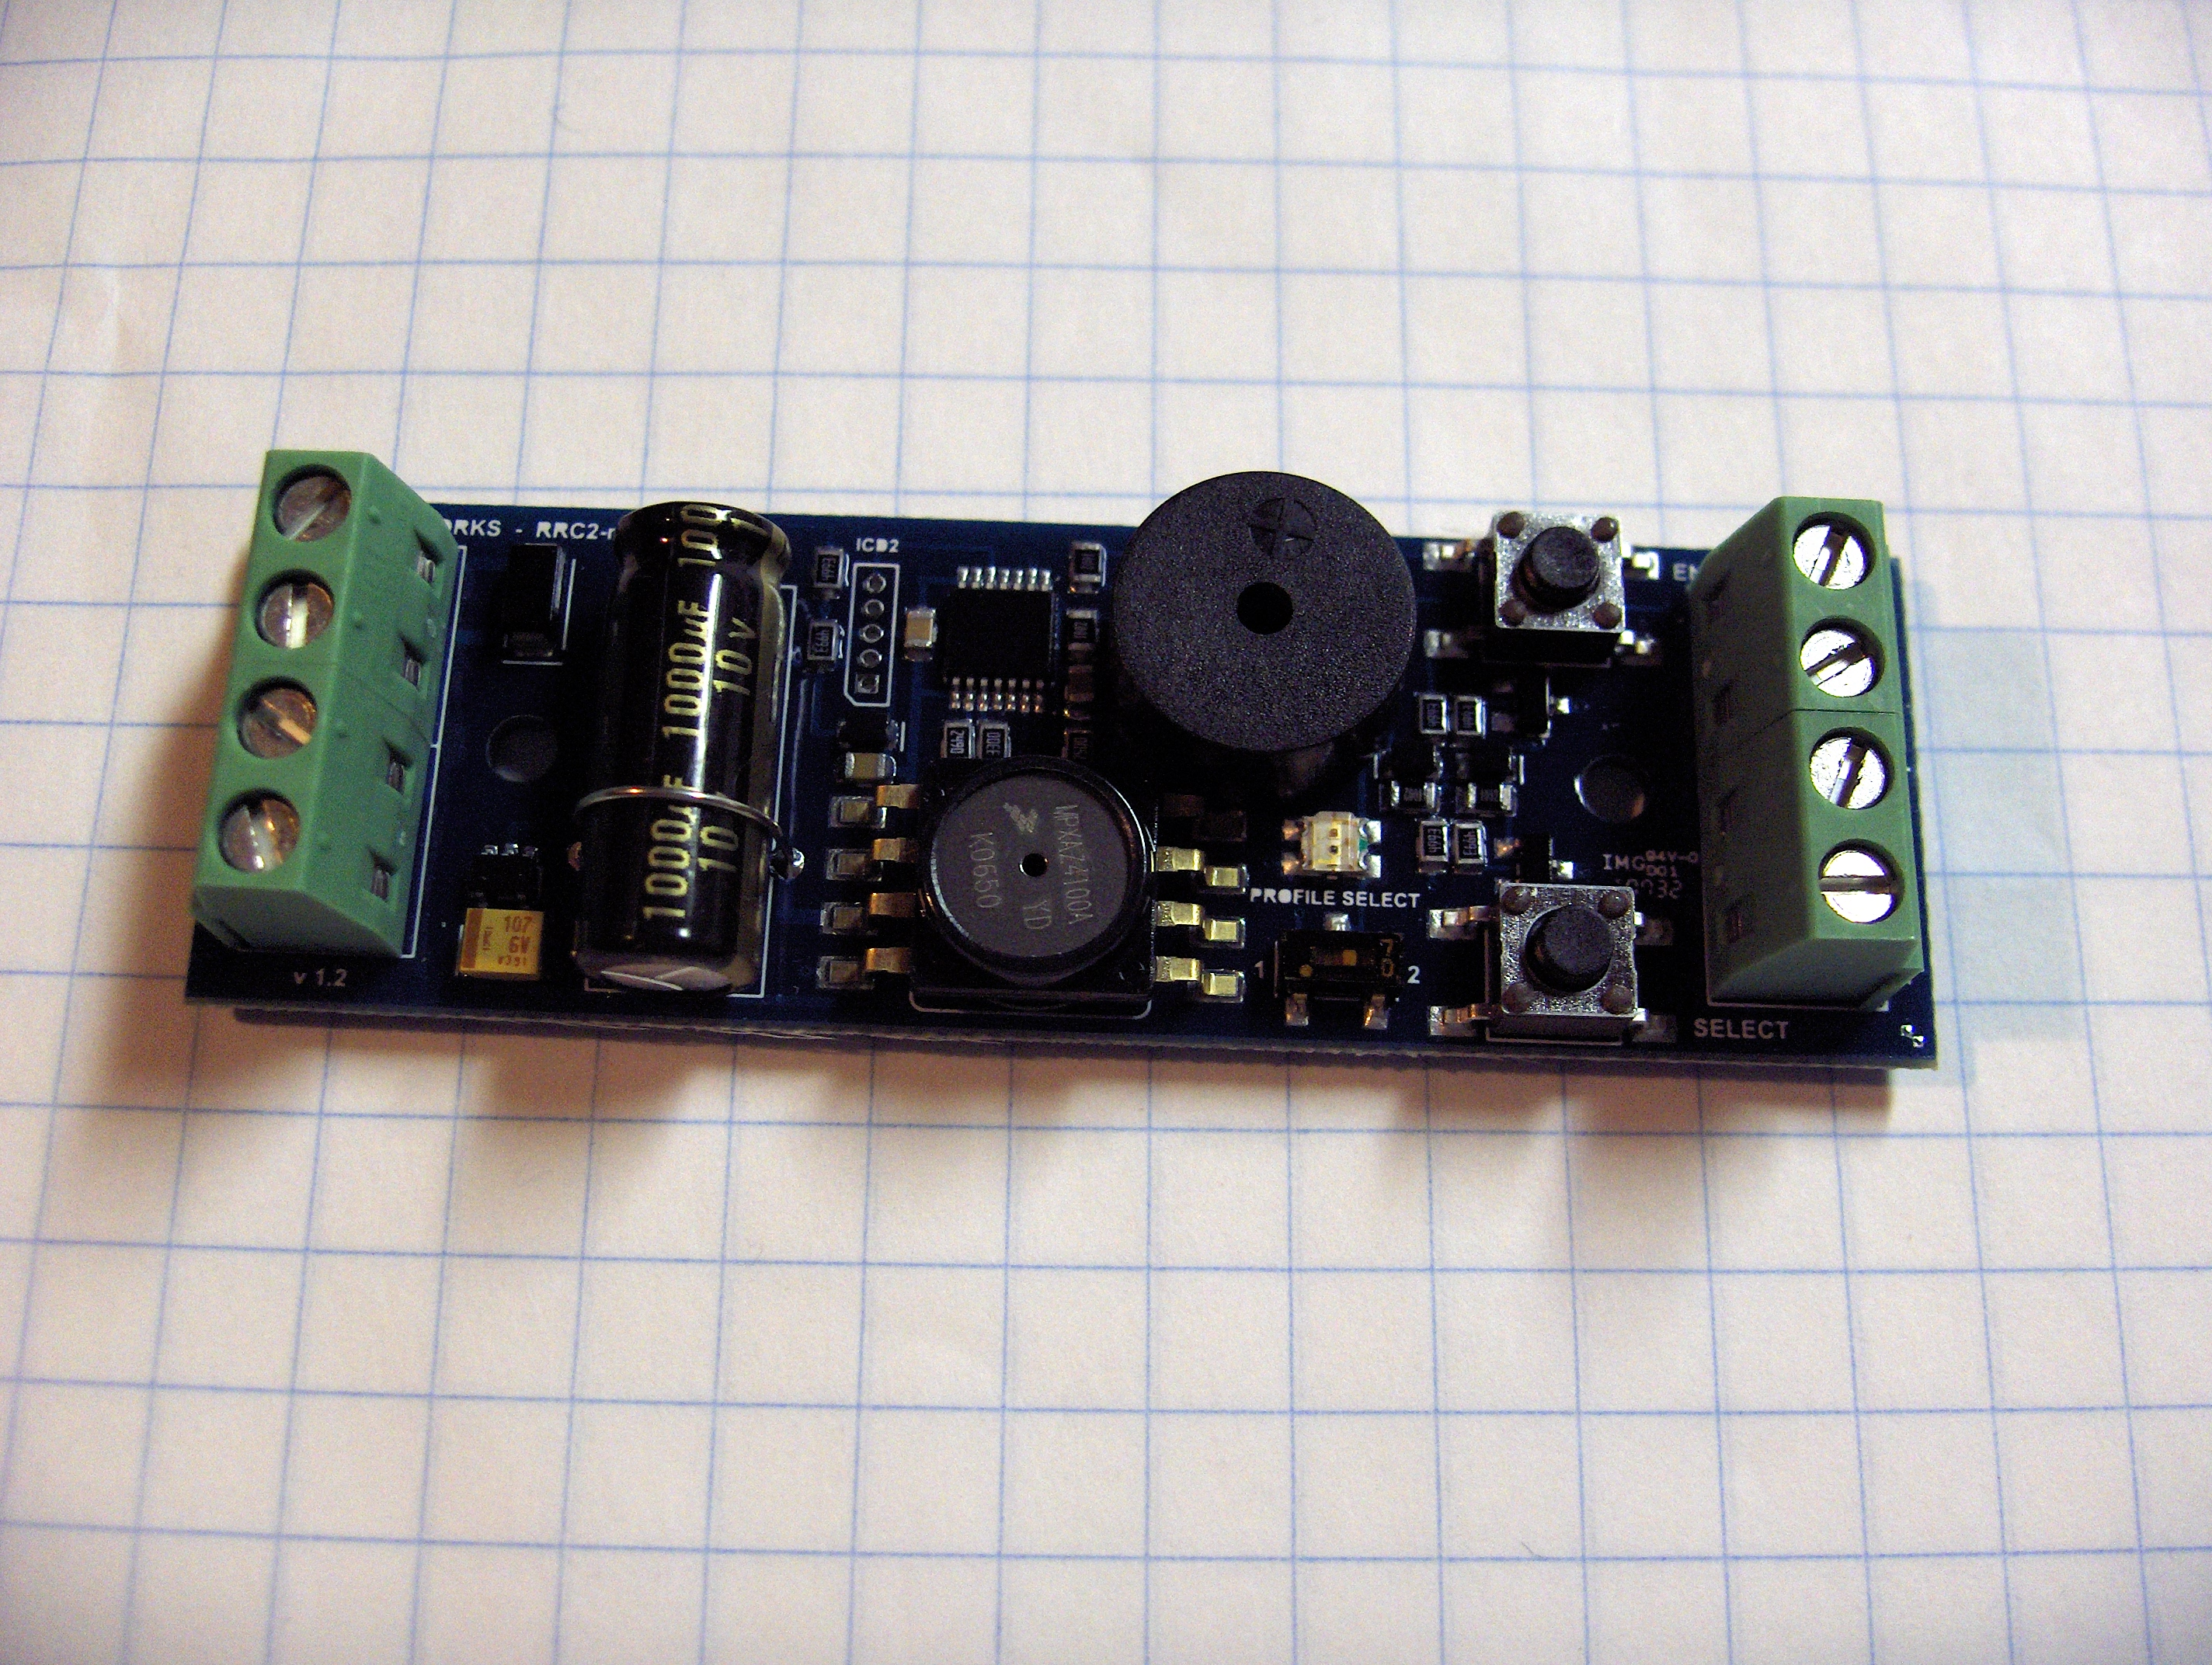
Missile Works Mini-RRC2

Slide 28
So What's the Problem?
These units are completely proprietary!
  Application-oriented documentation only!
  No schematics...
  No source code for firmware...
  Therefore... no real ability to modify behavior.
  Even the serial protocol for configuration and data extraction on some models is proprietary... and the feature set of the provided Windows/Mac software is very limited!

Slide 29
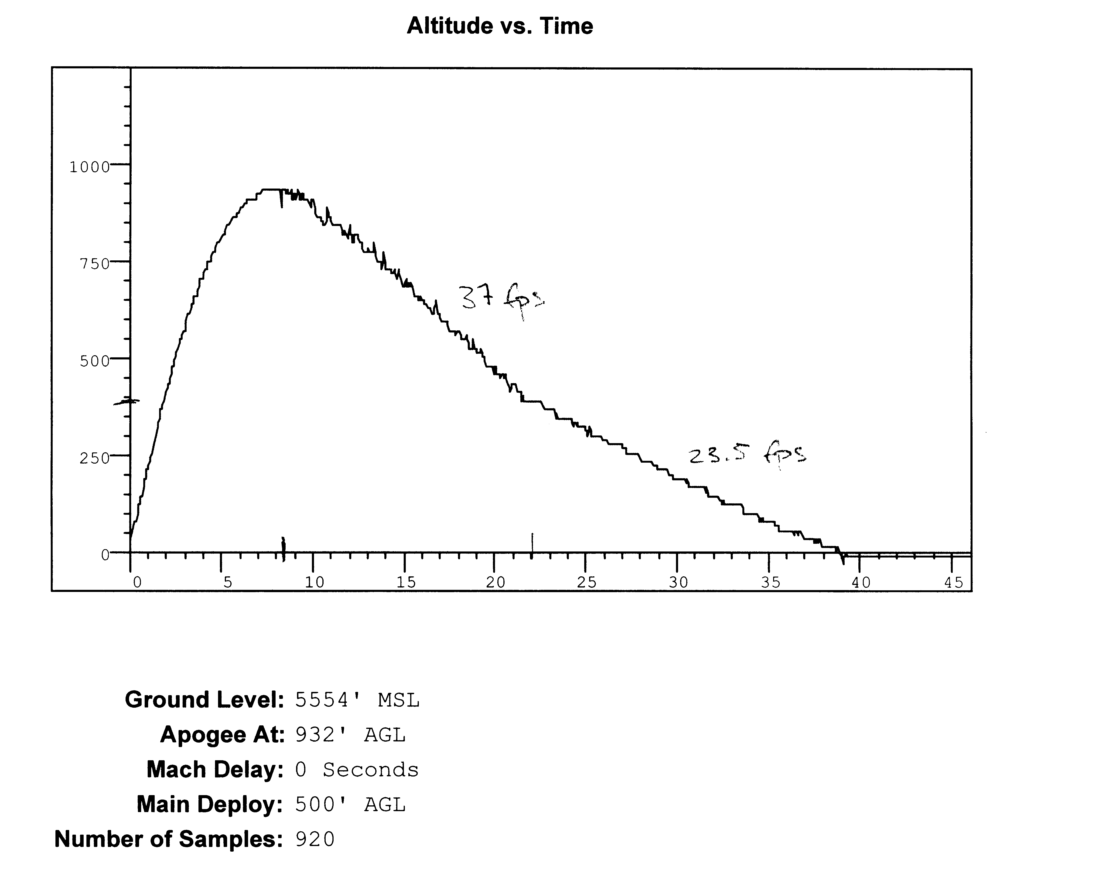

Slide 30
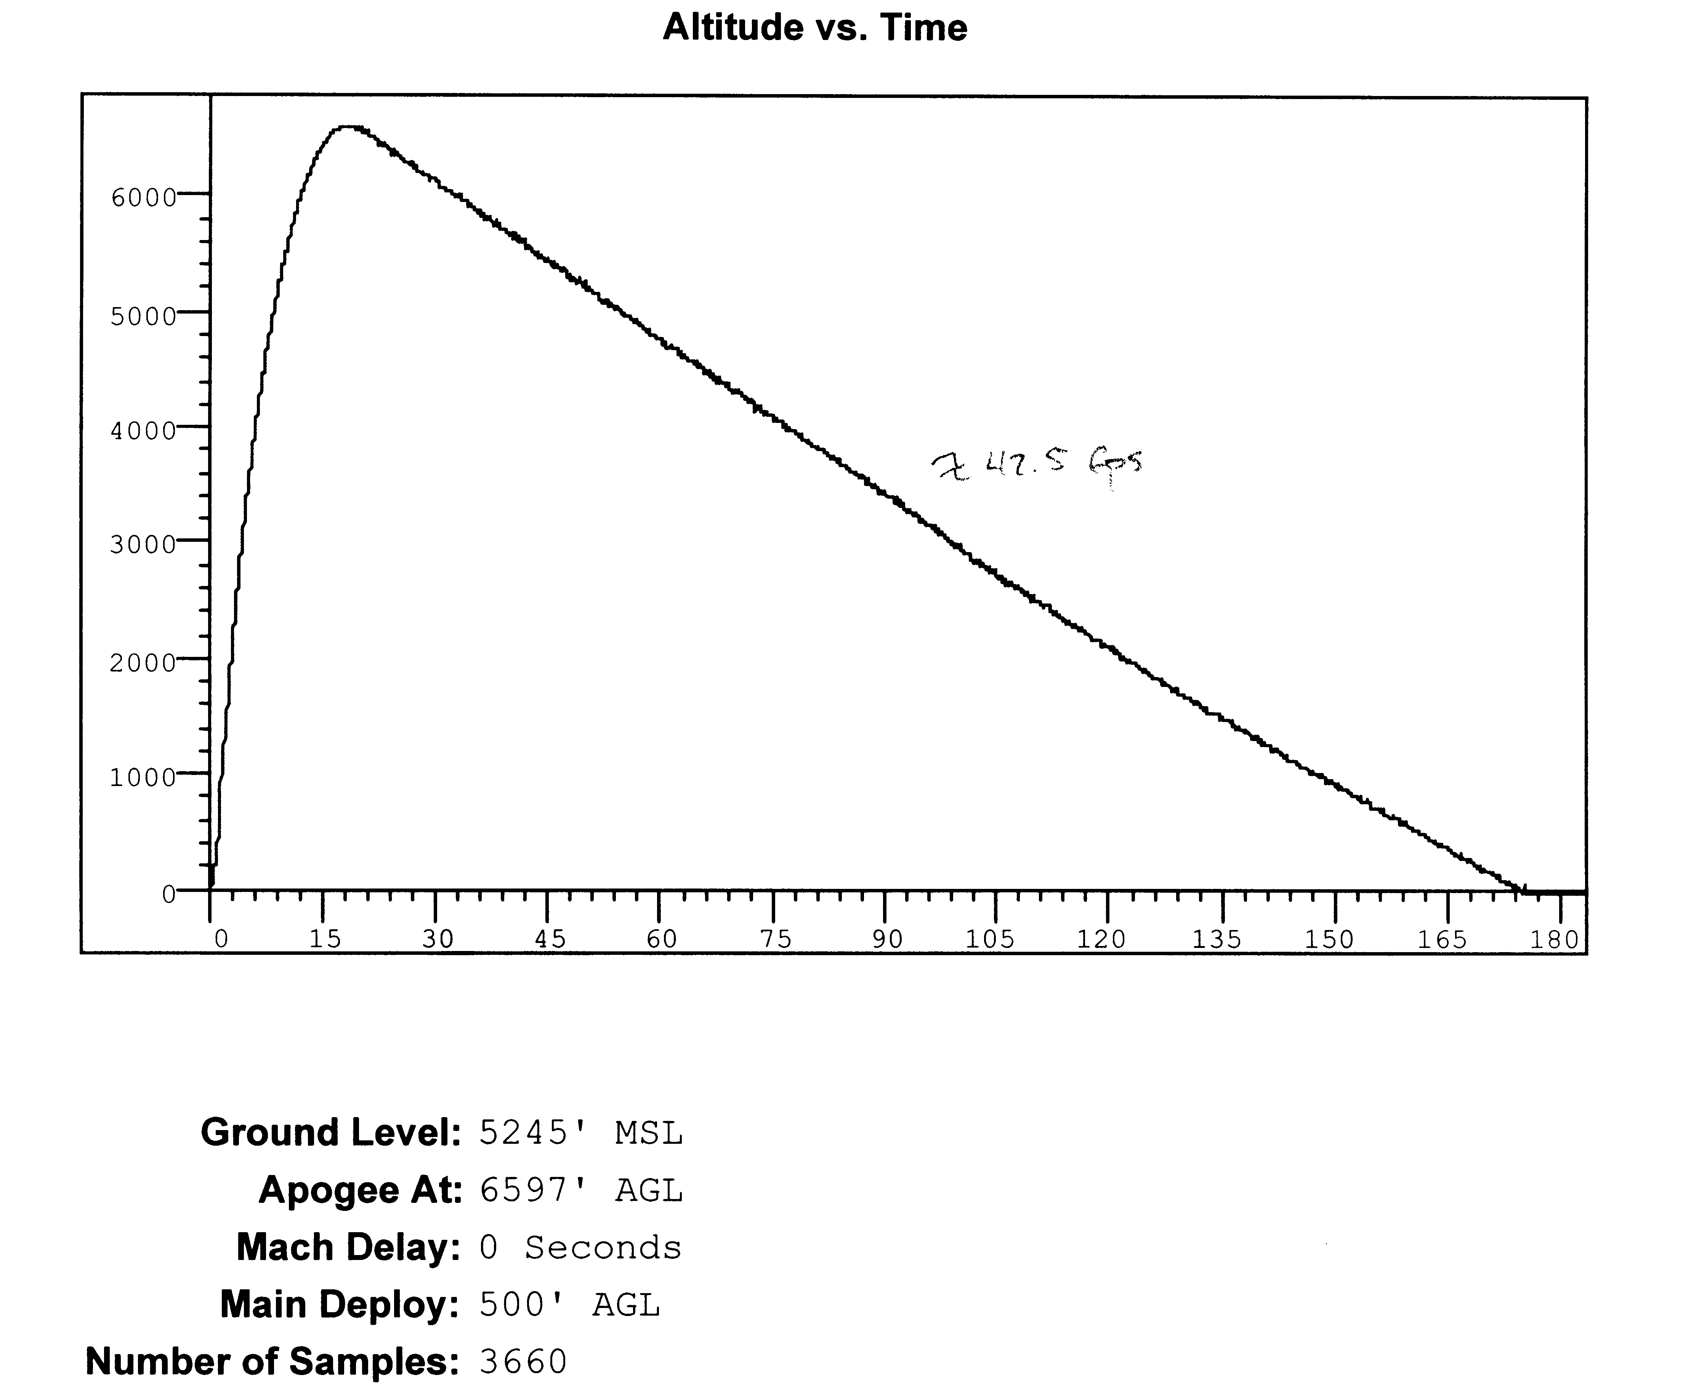

Slide 31
Altus Metrum
Design for a completely open (hardware and software) recording altimeter for model rockets
  Designed to fit 24mm tube, flexible battery choices
  Operation based on pressure sensor
  Flight profile, not just peak altitude
  Support for dual deploy (can fire 2 ejection charges)
  USB for data recovery and post-flight power source
Include enough “cool stuff” to make things fun...
  Accelerometer, temperature sensor
  Support for GPS receiver with serial interface
  Support for RF link to ground via serial interface

Slide 32
Primary Hardware Features
NXP LPC-2148 Processor (ARM7TDMI-S)
  512k Flash memory, 32k RAM
  USB plus lots of analog, digital, and serial I/O
Microchip 24FC1025 CMOS serial EEPROM
  128k x 8, I2C interface
Various Sensors
  Freescale MP3H6115A pressure sensor
  Freescale MMA7260QT 3-axis accelerometer
  Microchip MCP9700A temperature sensor
  (Honeywell 2-axis magnetic sensor left out of v0.1)

Slide 37
Software Features
Written mostly in C with some ARM assembler
Runs from on-chip flash, uses on-chip RAM, stores flight data to serial EEPROM chip
USB serial emulation for “console” interface
Uses GCC, newlib, FreeRTOS, LPCUSB
Based on a demo package written for the Olimex LPC-P2148 eval board by J C Wren

Slide 38
Licenses
The hardware design carries the TAPR Open Hardware License (OHL), which was created to be “GPL-like” for hardware designs.
The software is licensed GPL “v2 or later”.

Slide 39
Tools Used
Hardware design
  gEDA, including gschem and pcb
  DigiKey.com for parts selection and data sheets
  Gerbv and FreeDFM.com for verification
  BareBonesPCB.com for PCB fabrication
Software development
  gcc, binutils, newlib cross toolchain for arm-elf
  gdb via openocd to Olimex ARM-USB-OCD JTAG
  FreeRTOS
  LPC-P2148 demo package by J.C. Wren

Slide 43
More Tools
PCB assembly
  Metcal soldering station for most parts
  Hot-air reflow setup
    Can't solder QFN parts in conventional way!
    Removal of random SMT parts is very easy
  Good tweezers are important
  Vision aids, including a 5-45x trinocular microscope
Turn-on and test
  HP (Agilent) mixed-signal oscilloscope

Slide 44
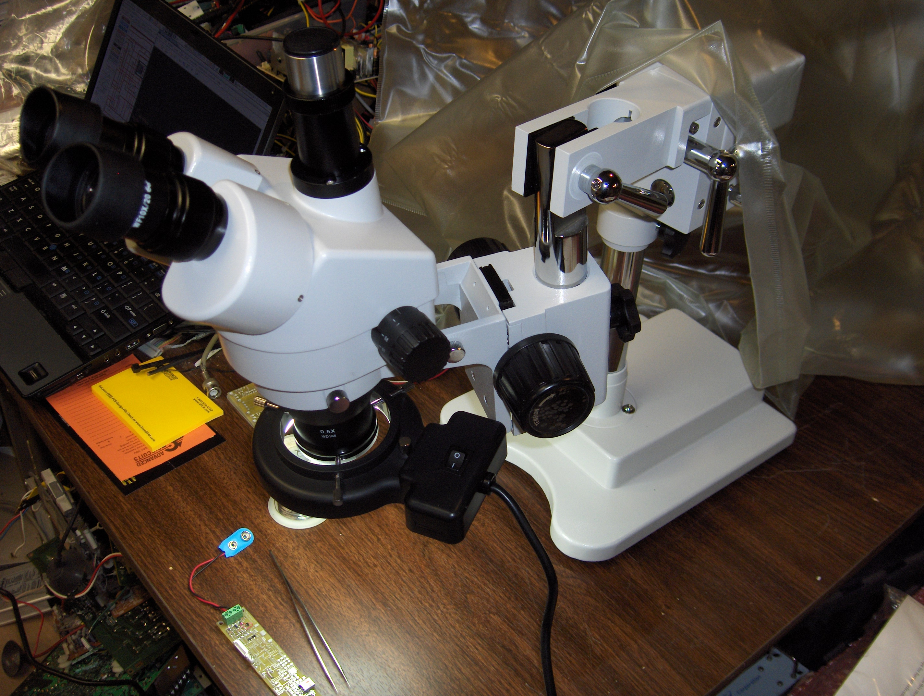

Slide 45
Current Status
First article is now completely assembled (except for the accelerometer), and mostly tested.
Enough problems have been found and fixed that more v0.1 boards are unlikely to be assembled...
The weather in Colorado has been unsuitable, and the flight software is not quite finished, so there have been no flight tests yet.

Slide 46
Future Plans
Complete testing and evaluation of v0.1
Fly first article
Update PCB to v0.2 and build a few to fly and share with friends
Integrate GPS receiver and RF link
Support others (TARC teams, etc) who want to customize the firmware for specific needs
Use as primary avionics for Level 3 certification flight in (northern hemisphere!) summer 2008
Might be fun to do a baro-only board for 18mm?

Slide 47
GPS and RF Links
Found some surplus sirf2 GPS modules for less than $20 US each with serial interface
Antennas on rockets are an issue, PSAS work on cylindrical patches looks worth duplicating
Plethora of RF options... from cheap 432 mhz downlink only, to high power spread spectrum 915mhz link modules ... not sure what will make the most sense yet!
Ground station design for flight monitoring, data collection, and recovery of high altitude flights... USRP and GNU Radio, perhaps?

Slide 48
Questions?
This project can be found at altusmetrum.org
Other information at gag.com/rockets
TAPR OHL info at tapr.org/ohl
We hope to show some demos at Open Day...
  but sorry, no actual rocket launches due to fire ban!

