Slide 1

Bdale Garbee bdale@gag.com NAR 87103

Slide 2
Who is Bdale?
First contribution to Free Software circa 1979
HP Open Source & Linux Chief Technologist
Contributor to Debian GNU/Linux since October1994, including service as Debian Project Leader, early design of infrastructure, porting to several new architectures, maintaining many packages. Currently serve as chairman of the Debian Technical Committee.
President, Software in the Public Interest
Board member of Consumer Electronics Linux Forum
Board member of Open Media Now
Amateur satellite and high-power model rocket builder ...
Bdale v2.0 ... Clean-shaven, and ready to launch!

Slide 3
Agenda
A brief (re-)intro to the model rocketry hobby
Making custom rocket parts
Motor design
Motor testing
Flight avionics
Story of my Level 3 certification attempts

Slide 4
The Basic Idea
We like to build, launch, and successfully recover hobby-sized models of rockets
Several elements to the hobby
  An ongoing learning process ... loud science!
  Progressive levels of technical achievement
  Craftsmanship involved in designing and building stable and effective rockets
  Camaraderie from collaborating with other enthusiasts in local clubs and at regional launches
Advanced objectives lead to incorporation of electronics and software...

Slide 5
Hobby Rocketry Categories
Largely delineated by total impulse, each letter prefix is a rough doubling, A is 2.5 newton-secs, H and up require certification and govt permits
  Model Rockets – up through D motors, 10-24mm
  Mid-Power Rockets – E, F, G motors, 24-29mm
  High-Power Rockets, 29-150mm, >= 160 Ns
    Level 1 – H and I motors
    Level 2 – J, K, and L motors
    Level 3 – M, N, and O motors (unlimited, really)
  Research (EX) Rockets – home-made motors

Slide 6
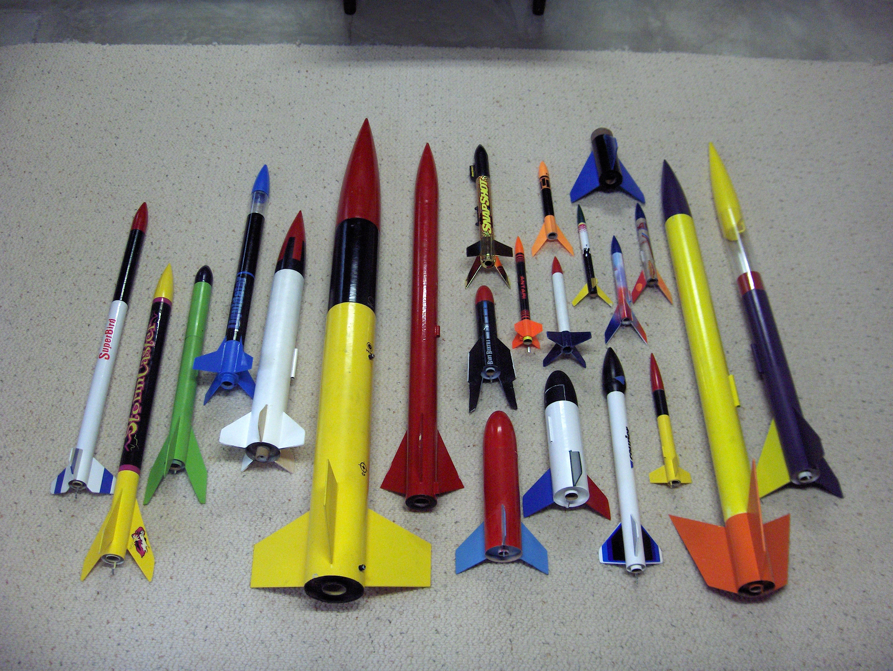

Slide 7
Role of Avionics
Control of recovery system
  Ability to deploy at apogee
  Ability to deploy at a defined altitude
Collection of flight data
  Max altitude – how high did it go?
  Max acceleration – did we break Mach?
  Acceleration and altitude profiles for more thorough analysis of vehicle and motor performance
Radio link to ground
  Position and health information, possibility of control

Slide 8
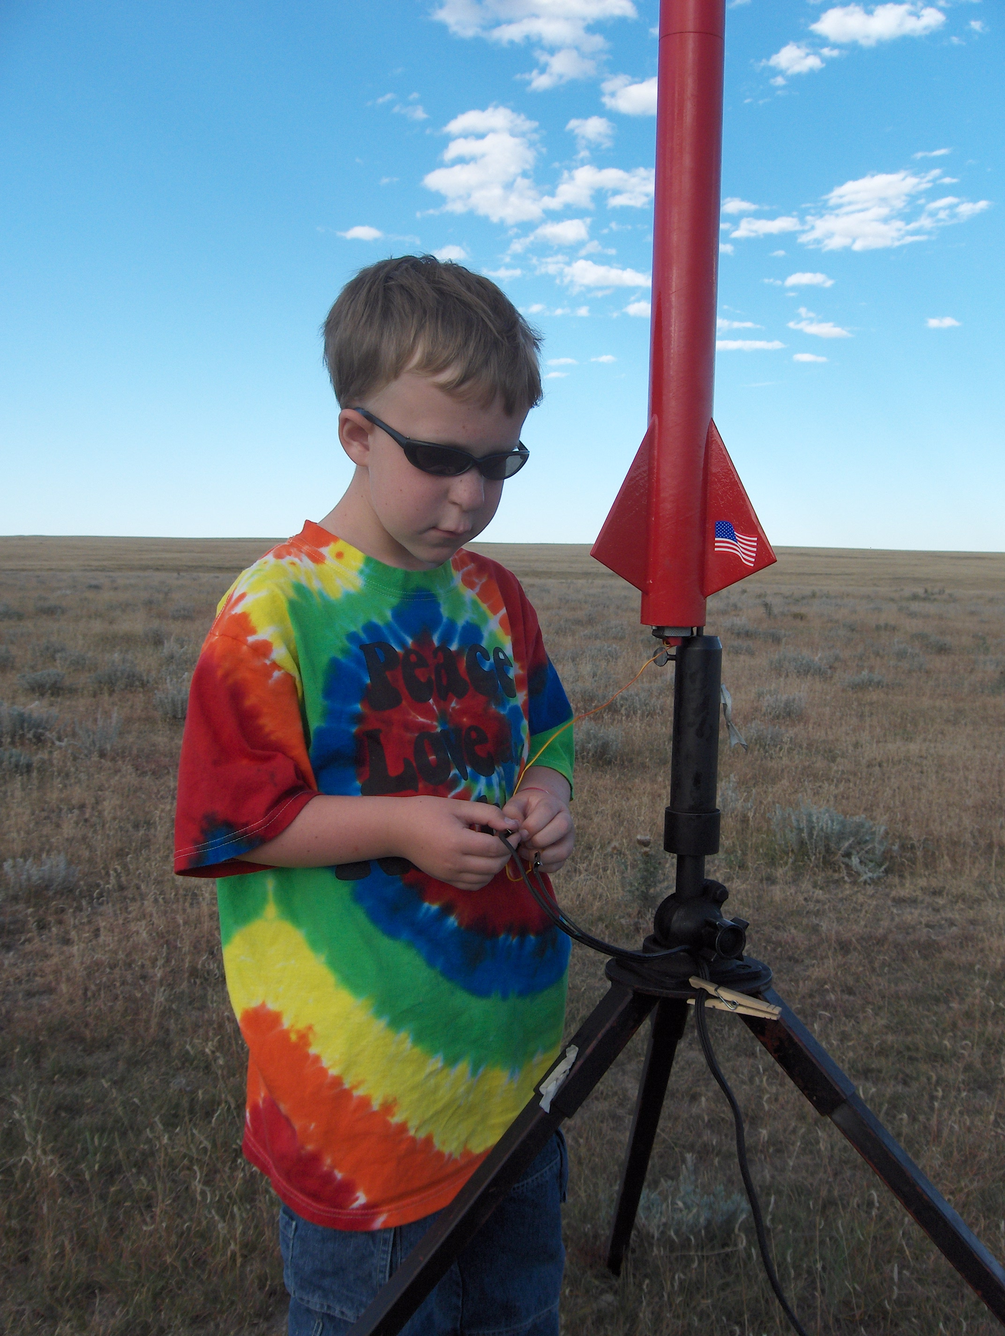
Even Simple Flight Data is Fun!
LOC/Precision “Lil Nuke” with added payload bay
Motor-based ejection
PicoAlt
Robert's first “big” rocket ... E-G motors!
Max recorded altitude 610 meters, G77R-M

Slide 9
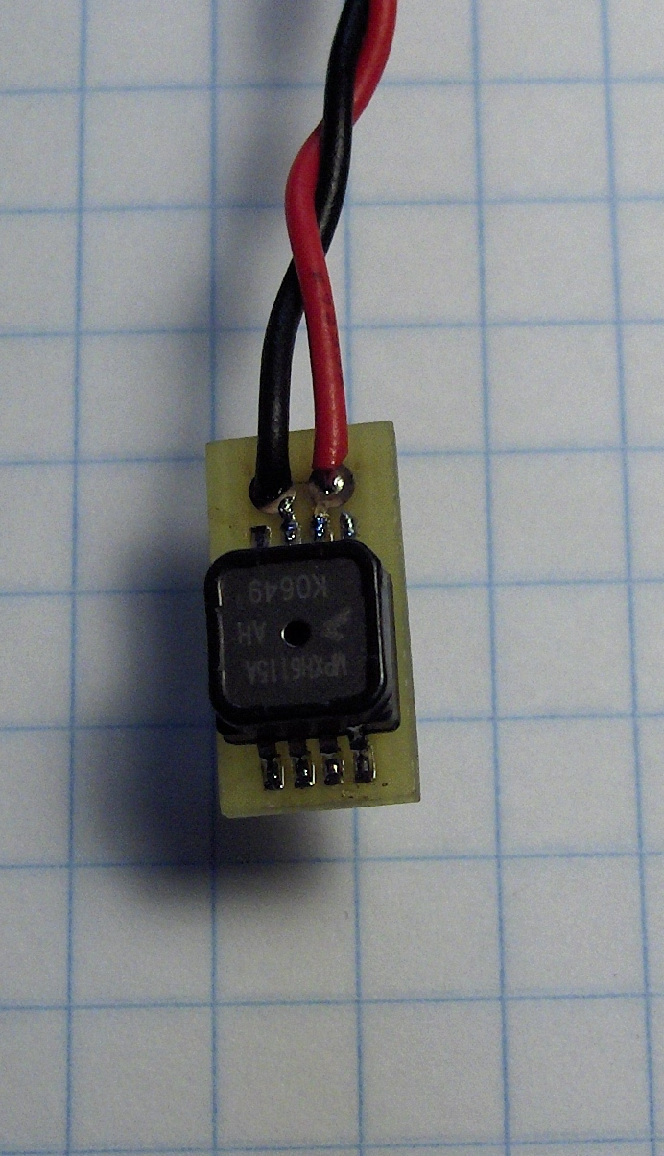
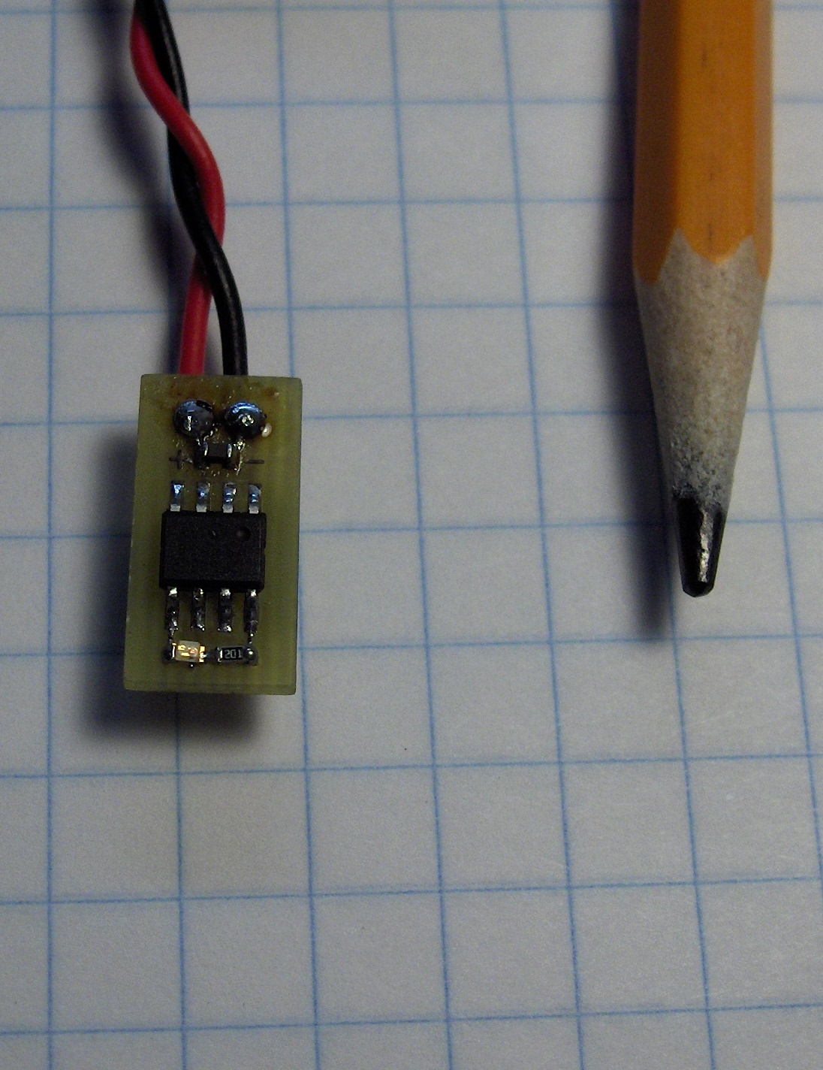
PicoAlt

Slide 10
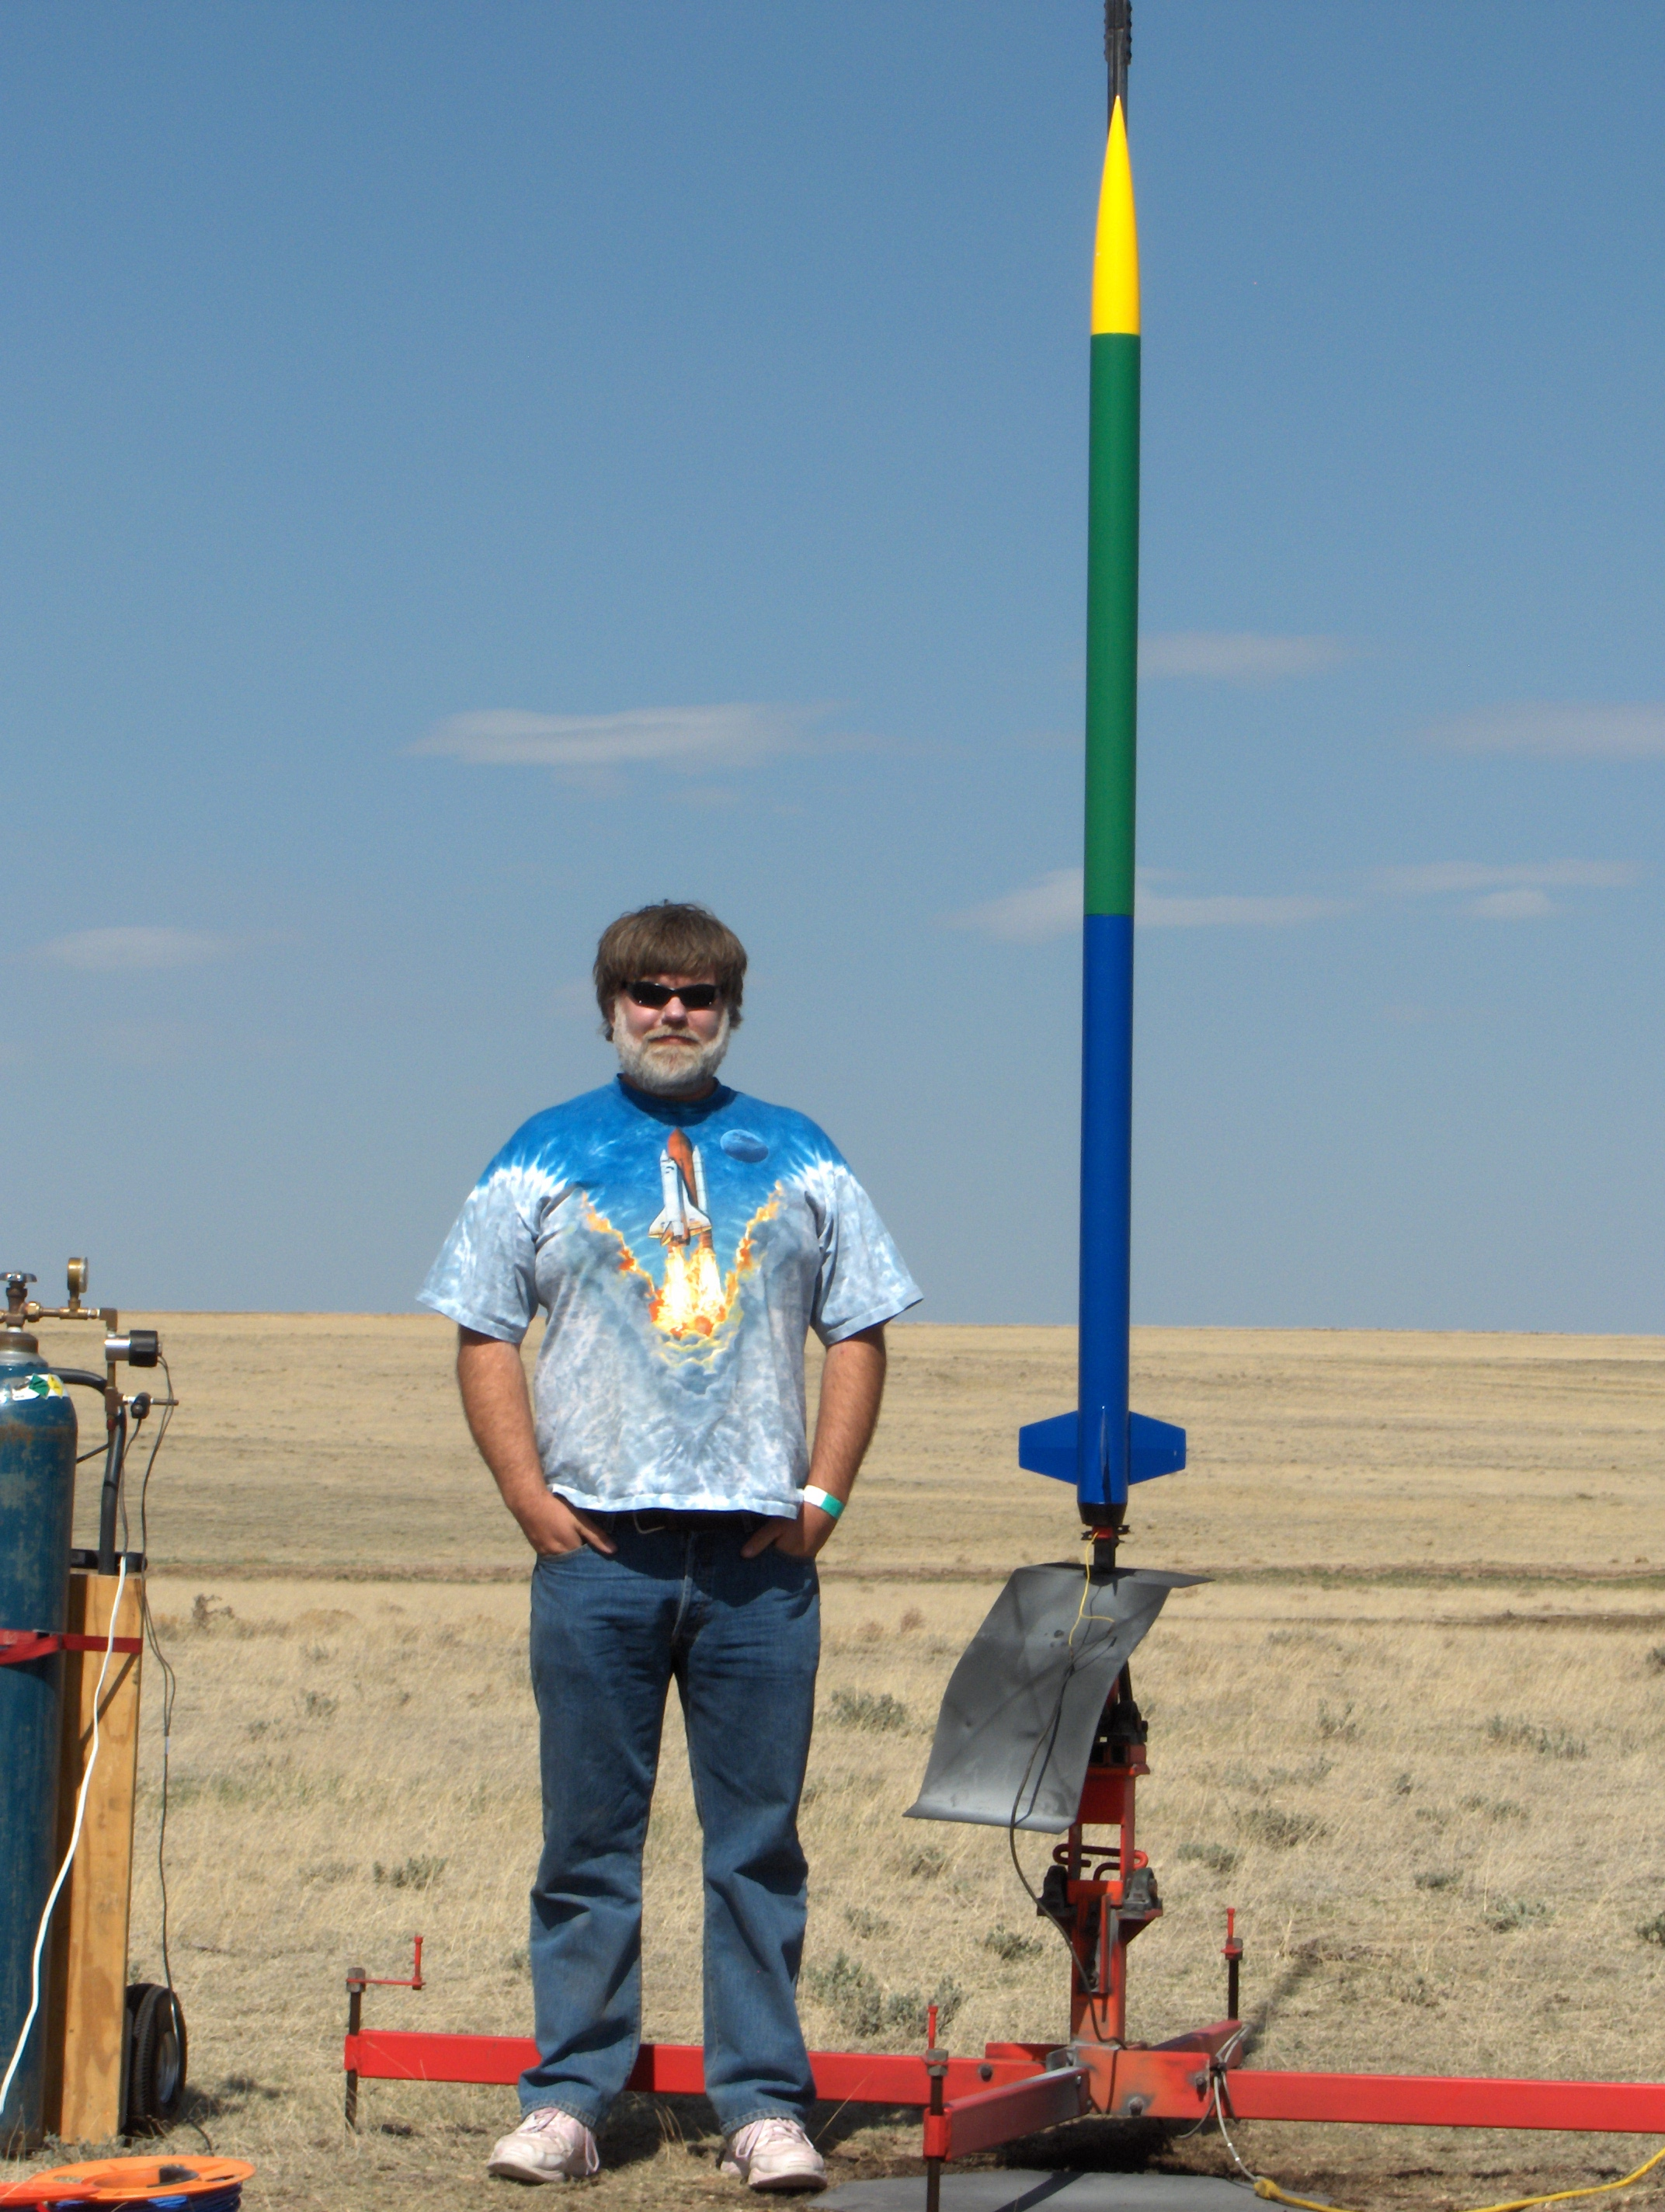
Dual Deploy – 4351 meters AGL
Largest-motor “good” flight to date, an L730 in a 75mm “Vertical Assault” kit airframe
Able to visually track through apogee event
RF beacon to find it...
Upper level winds carried the airframe 2.4 km downrange even on a tiny drogue

Slide 11
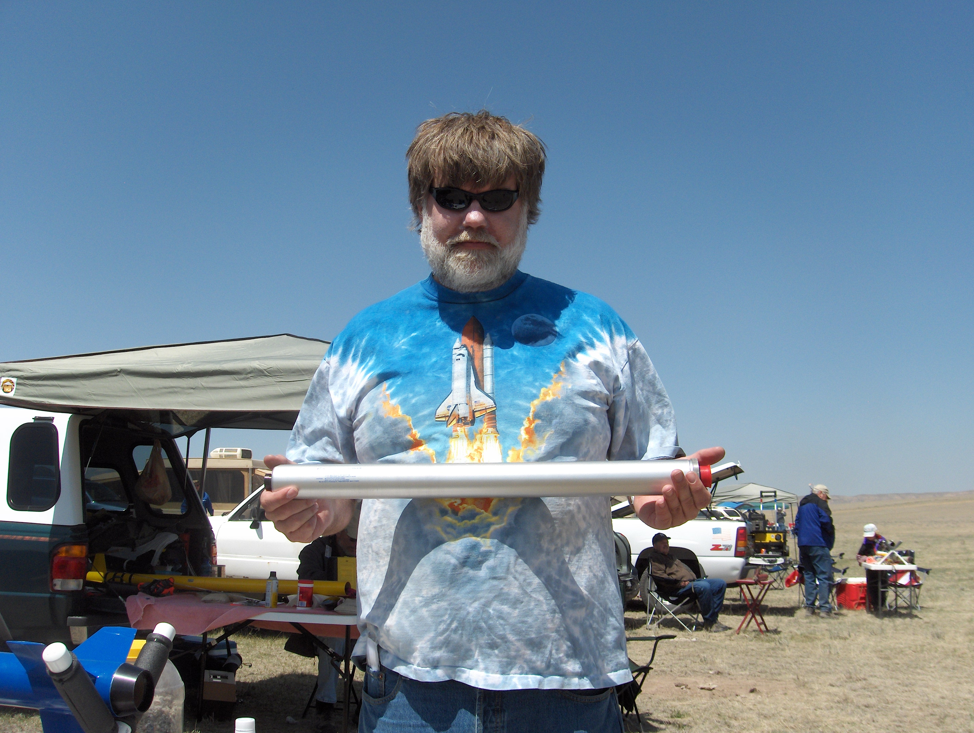

Slide 12
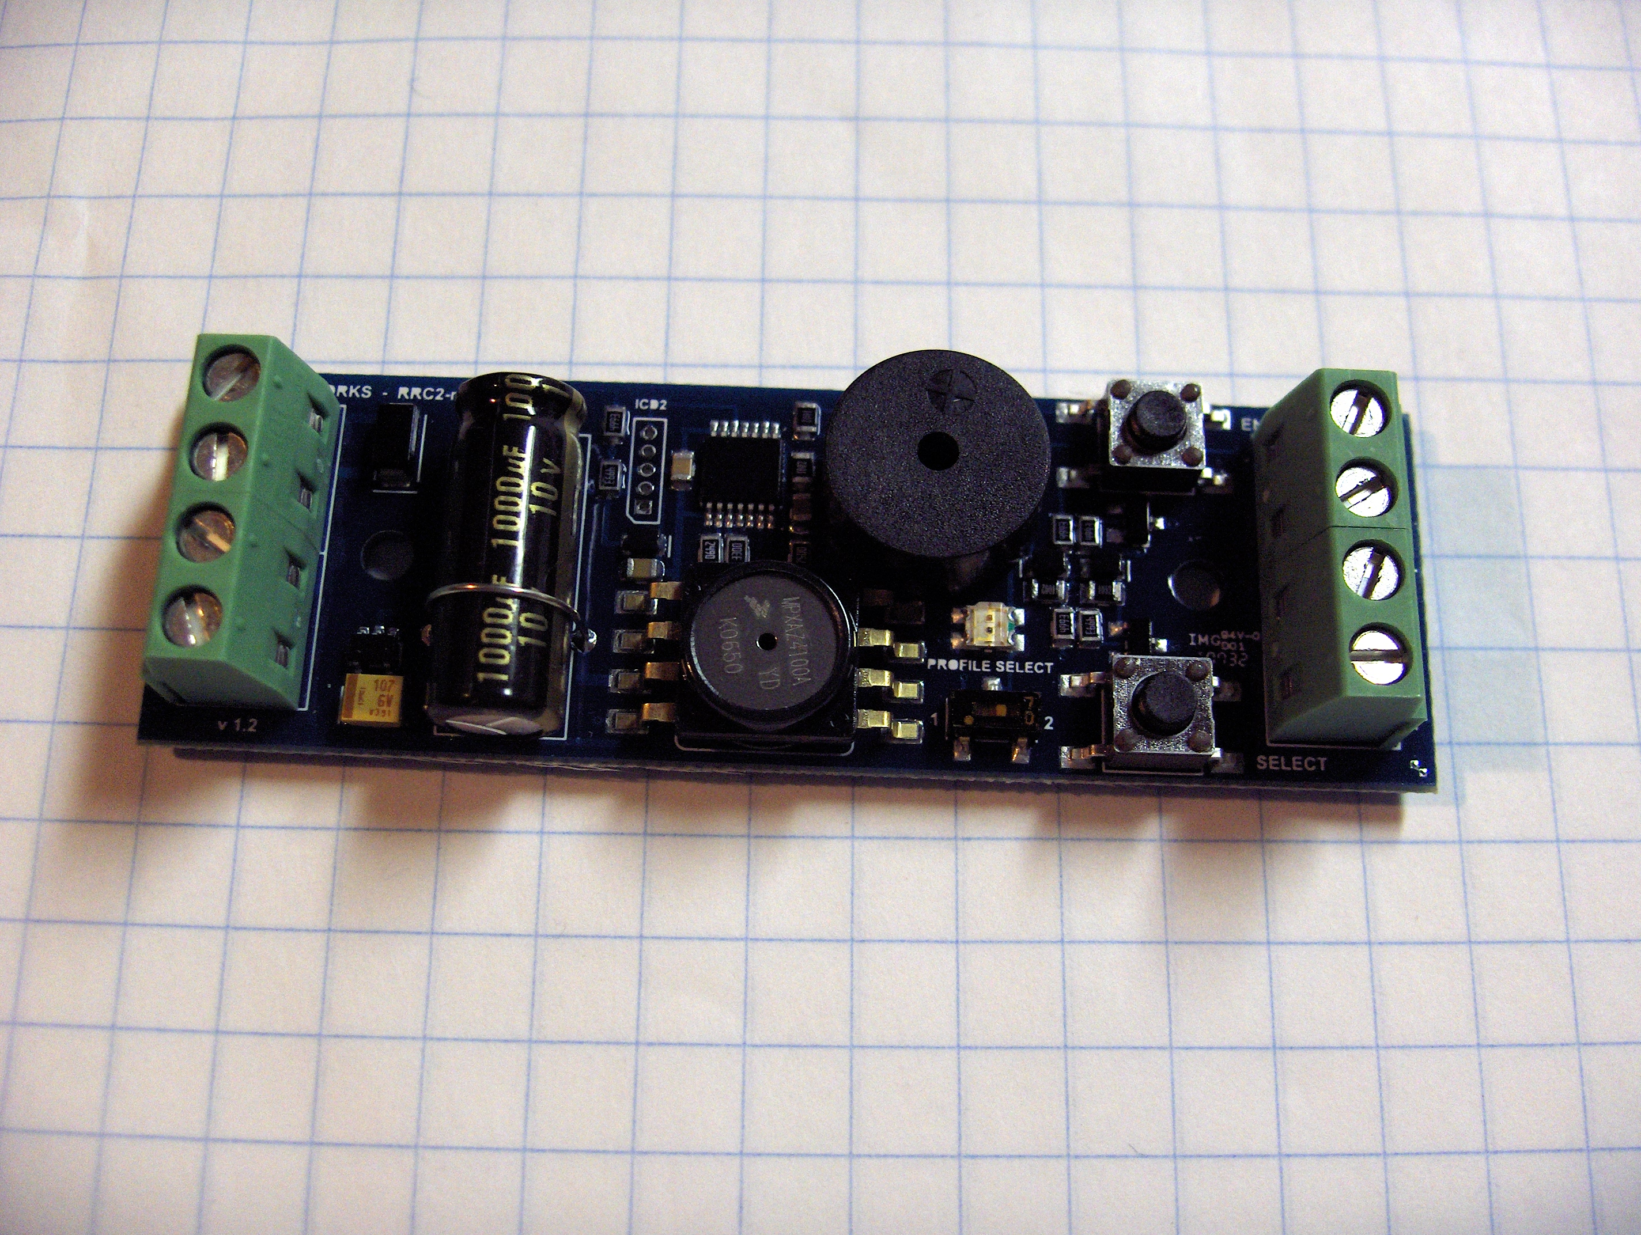
Missile Works Mini-RRC2

Slide 13
Making Custom Rocket Parts
Kits are fun, but making custom parts rocks!
Combining hobbies, started writing Python to emit g-code to drive my milling machine
  Current small desktop mill is completely proprietary, and limited in capacity
  My new big mill will be 100% open software, and all the motion control is open hardware!
Vacuum-bagged, carbon-fiber laminations using a kitchen “food saver” appliance

Slide 14
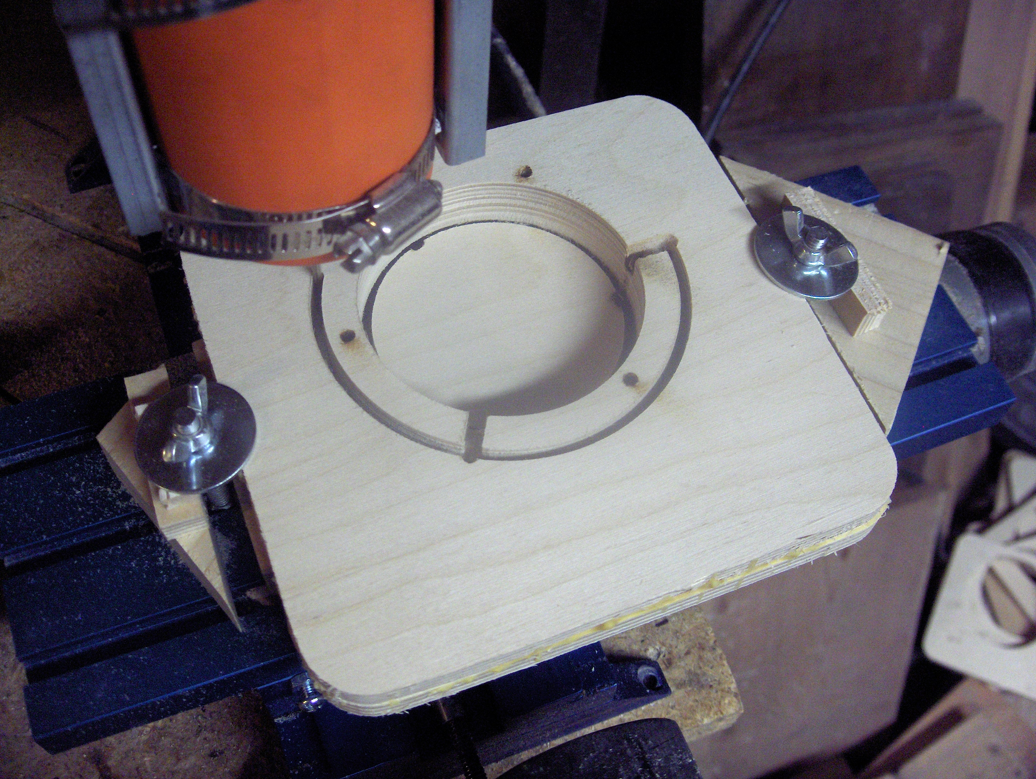

Slide 15
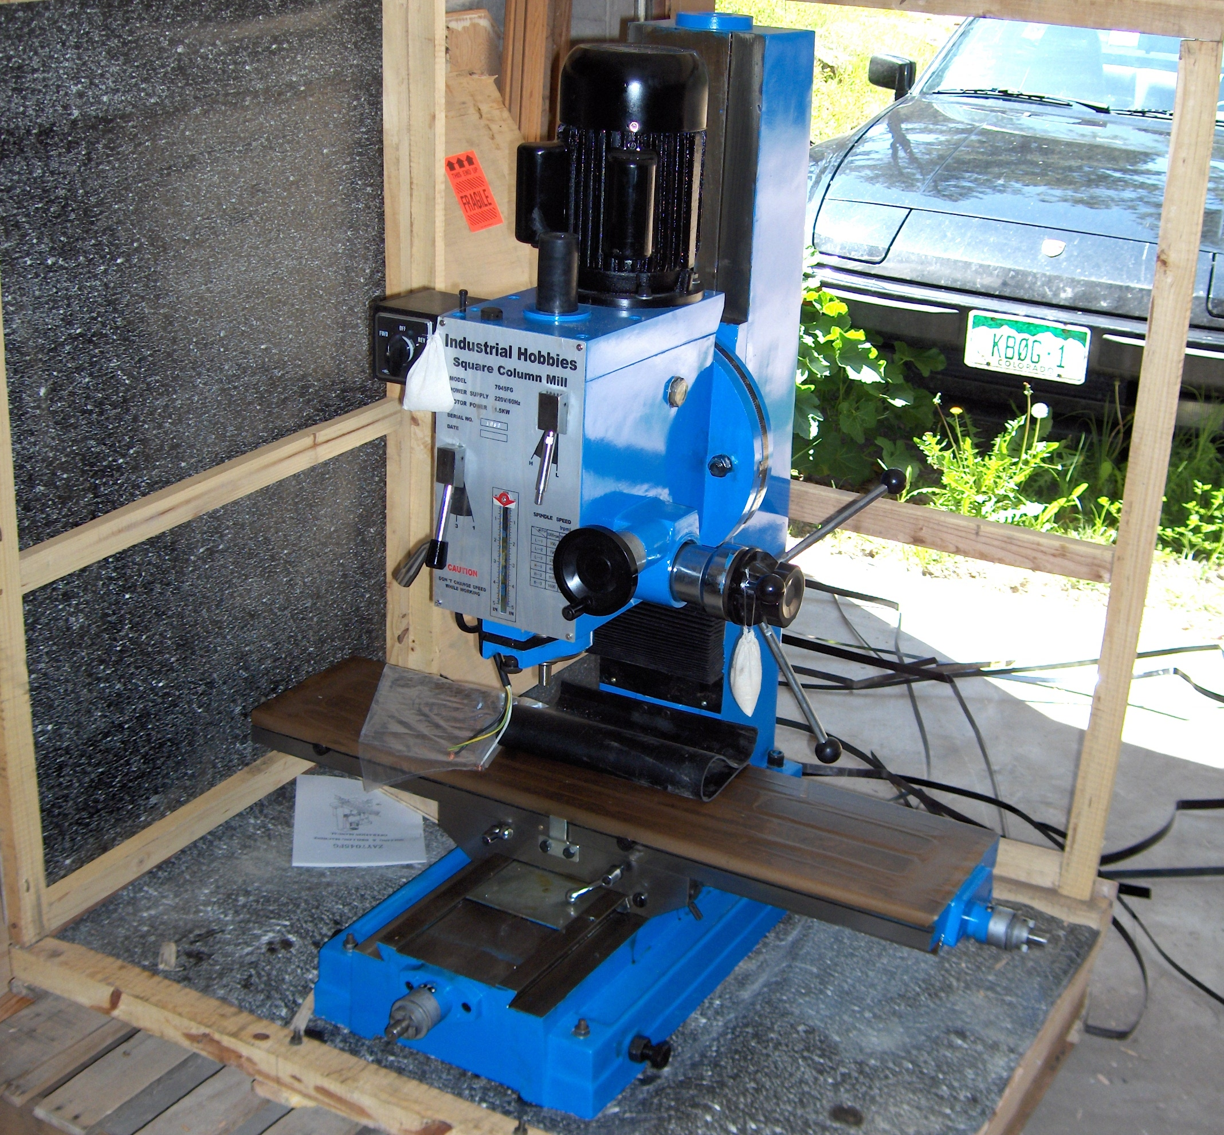

Slide 16
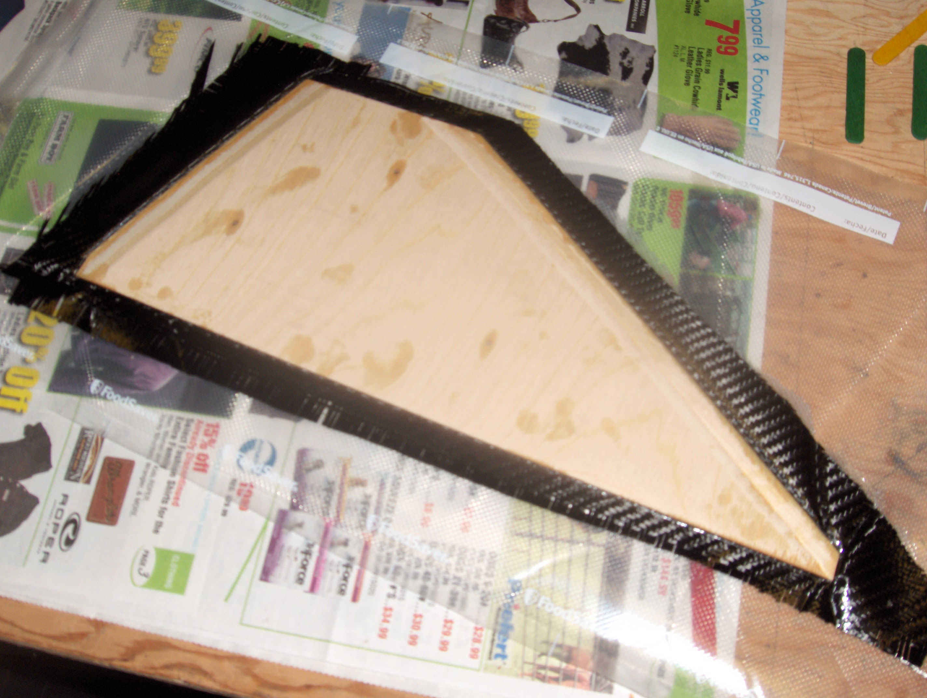

Slide 17
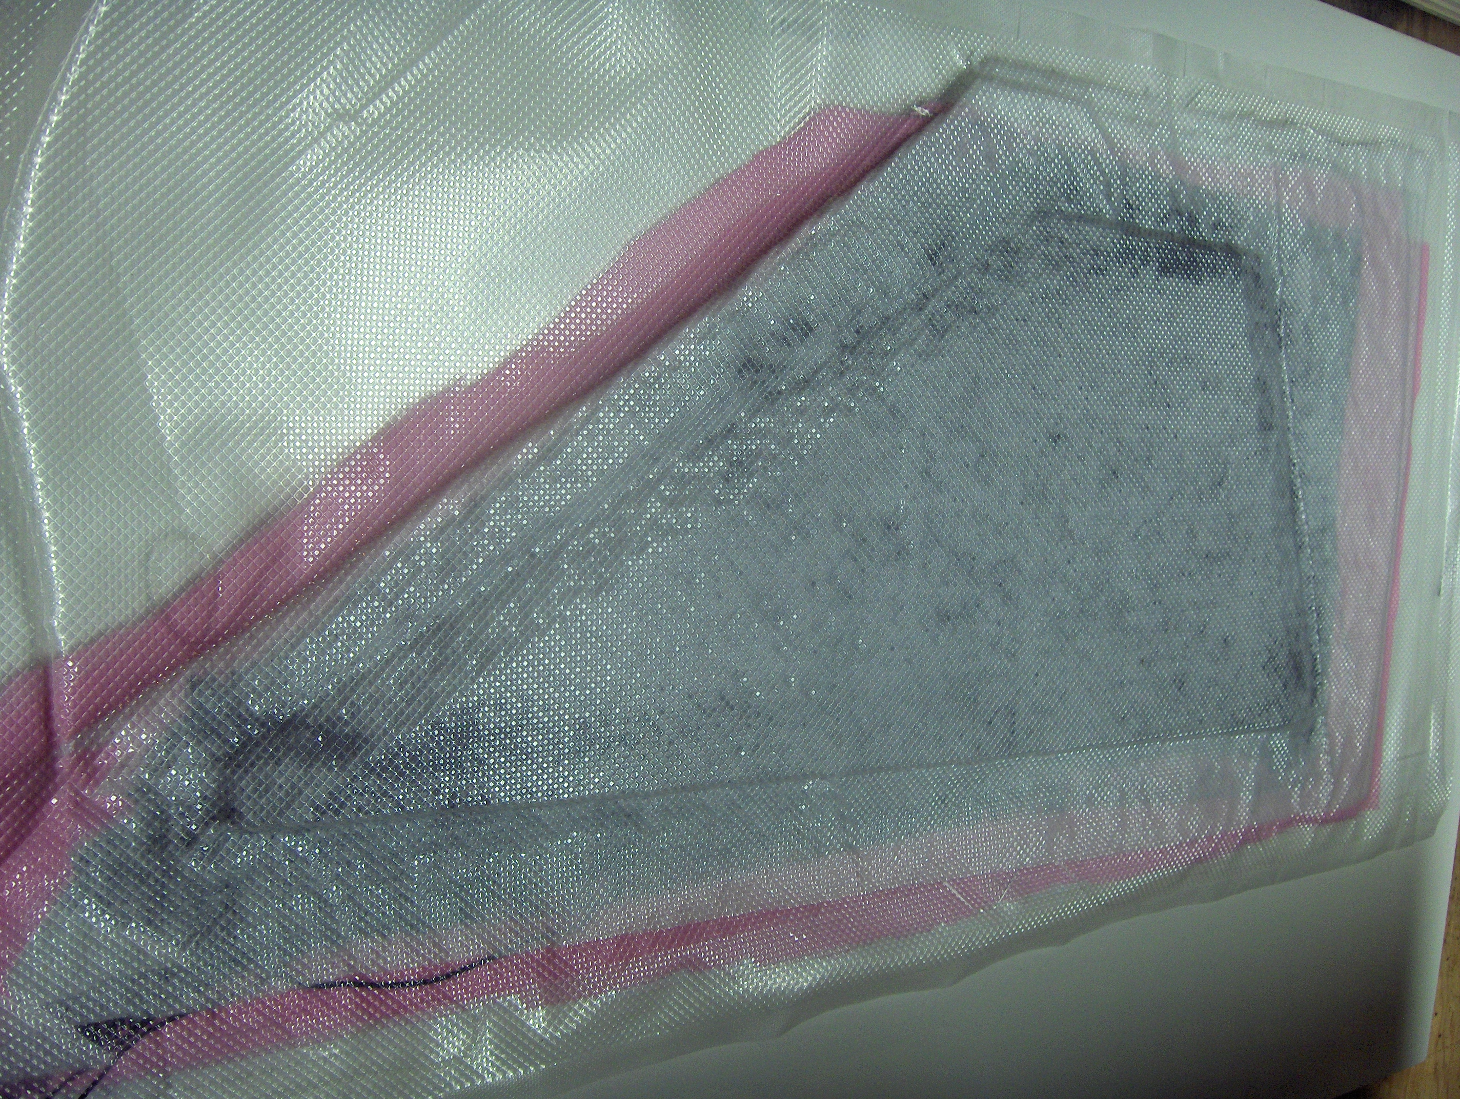

Slide 18
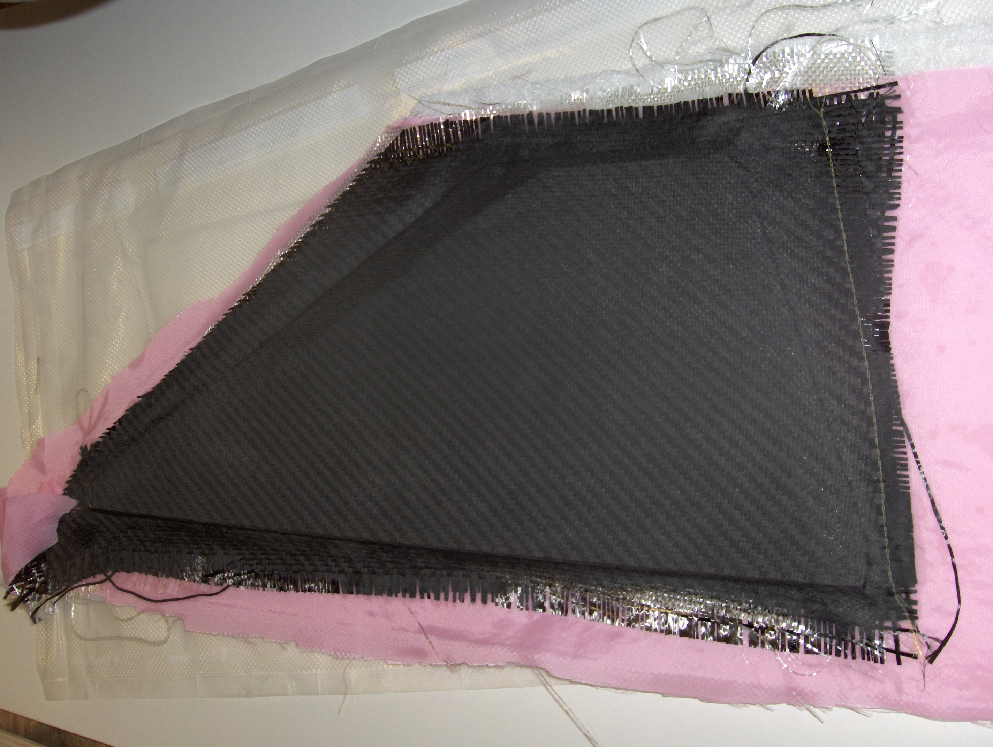

Slide 19
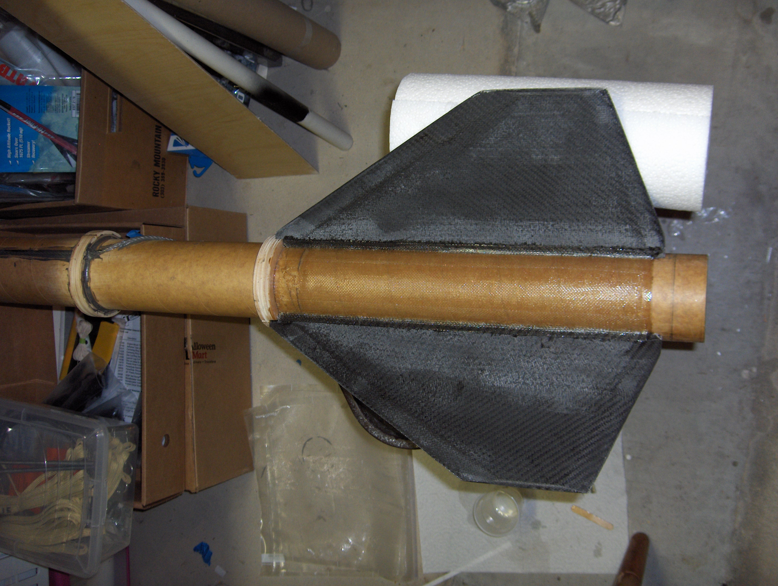

Slide 20
Simulating Motors
Marc Slabbinck wrote a motor simulator and released a binary for Linux
In an email discussion, he suggested that if someone wrote a GUI, he'd be willing to release the sourecode under the GPL
Keith agreed to write such a GUI, has the sources, and intends to deliver a Debian package once it's working

Slide 21
<Motor>
<Propellant>propellants/kner.xml</Propellant>
<NozzleDiameter>0.635</NozzleDiameter>
<RSEDirectory>rse</RSEDirectory>
<ENGDirectory>eng</ENGDirectory>
<HardwareLenght>183.00</HardwareLenght>
<HardwareDiameter>38</HardwareDiameter>
<Grain>
<GrainType>B</GrainType>
<OutsideDiameterEnglish>1.274</OutsideDiameterEnglish>
<CoreDiameterEnglish>0.500</CoreDiameterEnglish>
<GrainLenghtEnglish>1.8</CoreDiameter>
<PropellantWeight>54</PropellantWeight>
<Number>4</Number>
</Grain>
</Motor>

Slide 22
Propellant : propellants/kner.xml
Nozzle diameter : 0.635 cm (0.250") (16/64")
Number of grains : 4
L/D ratio : 5.651
Port-to-throat ratio : 4.000
Mass Flux : 0.478 lbs/inch^2
Mach number : 0.527
Propellant length : 18.288 cm (7.200")
Web Thickness (max) : 0.983 cm (0.387")
Burn rate : 0.443 cm/s (0.174"/s) (a=0.004"/s; n=0.640)
Total propellant weight: 216.00 g (7.619 oz/0.476 lbs)
Average grain weight : 54.00 g (1.905 oz)
Theoretical density : 1.820 g/cm3 (0.066 lb/in3)
Actual density : 1.698 g/cm3 (0.061 lb/in3)
Density ratio : 93.280%
Specific impulse (Isp) : 135.000 s (estimated)
Initial Thrust : 124.99 N (28.10 lbs)
Peak Thrust : 152.98 N (34.39 lbs) at 34.00% (0.75 s)
Kn Ini : 406.15 (403.86 psi)
Kn Max : 433.46 (483.86 psi)
Kn Fin : 334.62 (235.79 psi)
Kn Avg : 408.35 (409.95 psi)
Total Impulse : 285.768 Ns (78.61% H)
Burn Duration : 2.218 s
Average Thrust : 128.822 N
Motor : H129

Slide 23
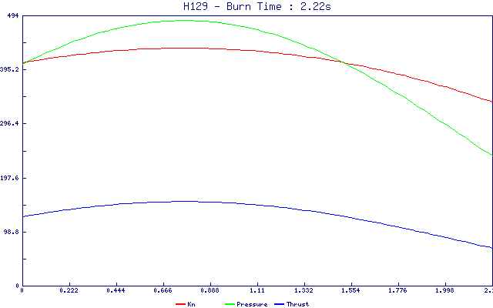

Slide 24
Motor Static Testing
Most EX motors are tested on stands where the data is collected by DataQ modules or the equivalent that attach with RS-232
David Steeman in Belgium published design for a PIC-based board with GPL firmware and USB
Bdale introduced David to the TAPR OHL
StaticMetrum is our derivative design with a different analog amplifier
First proto is awaiting spring thaw for testing

Slide 25
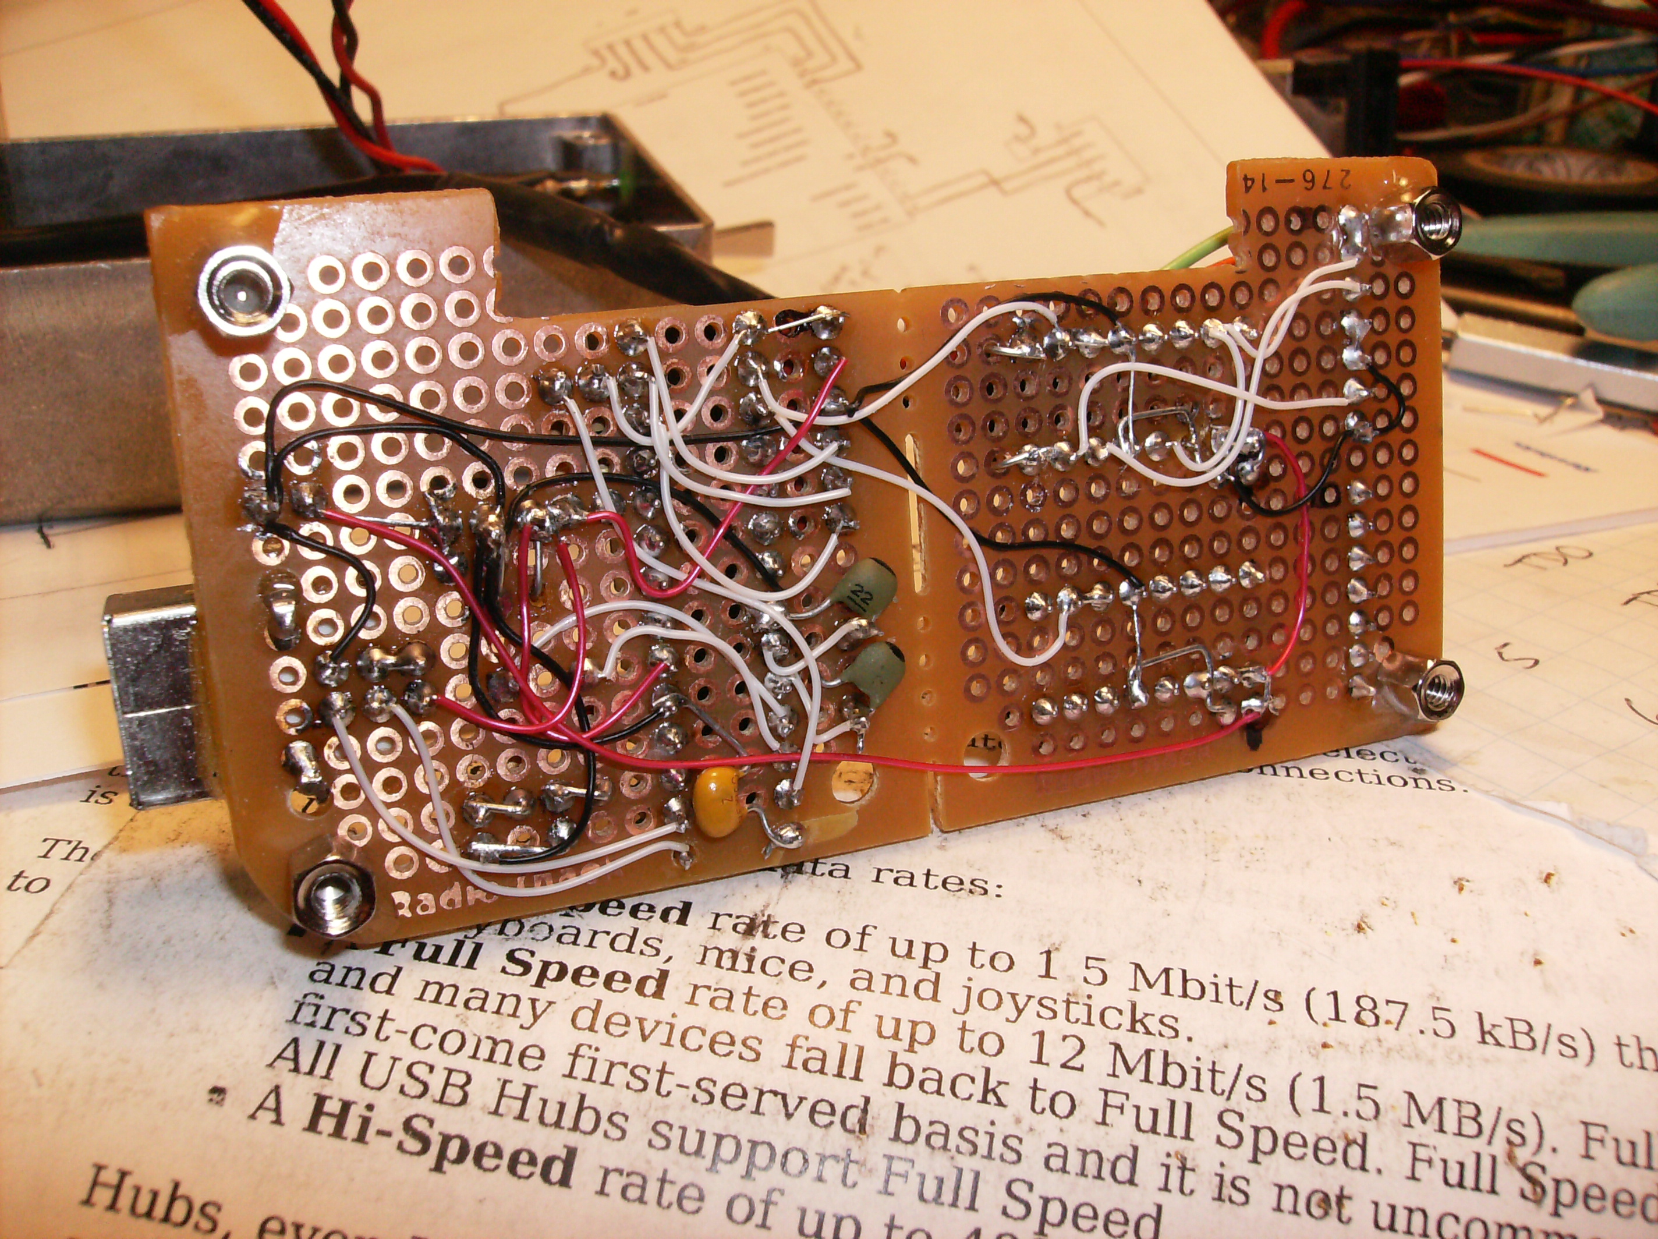

Slide 26
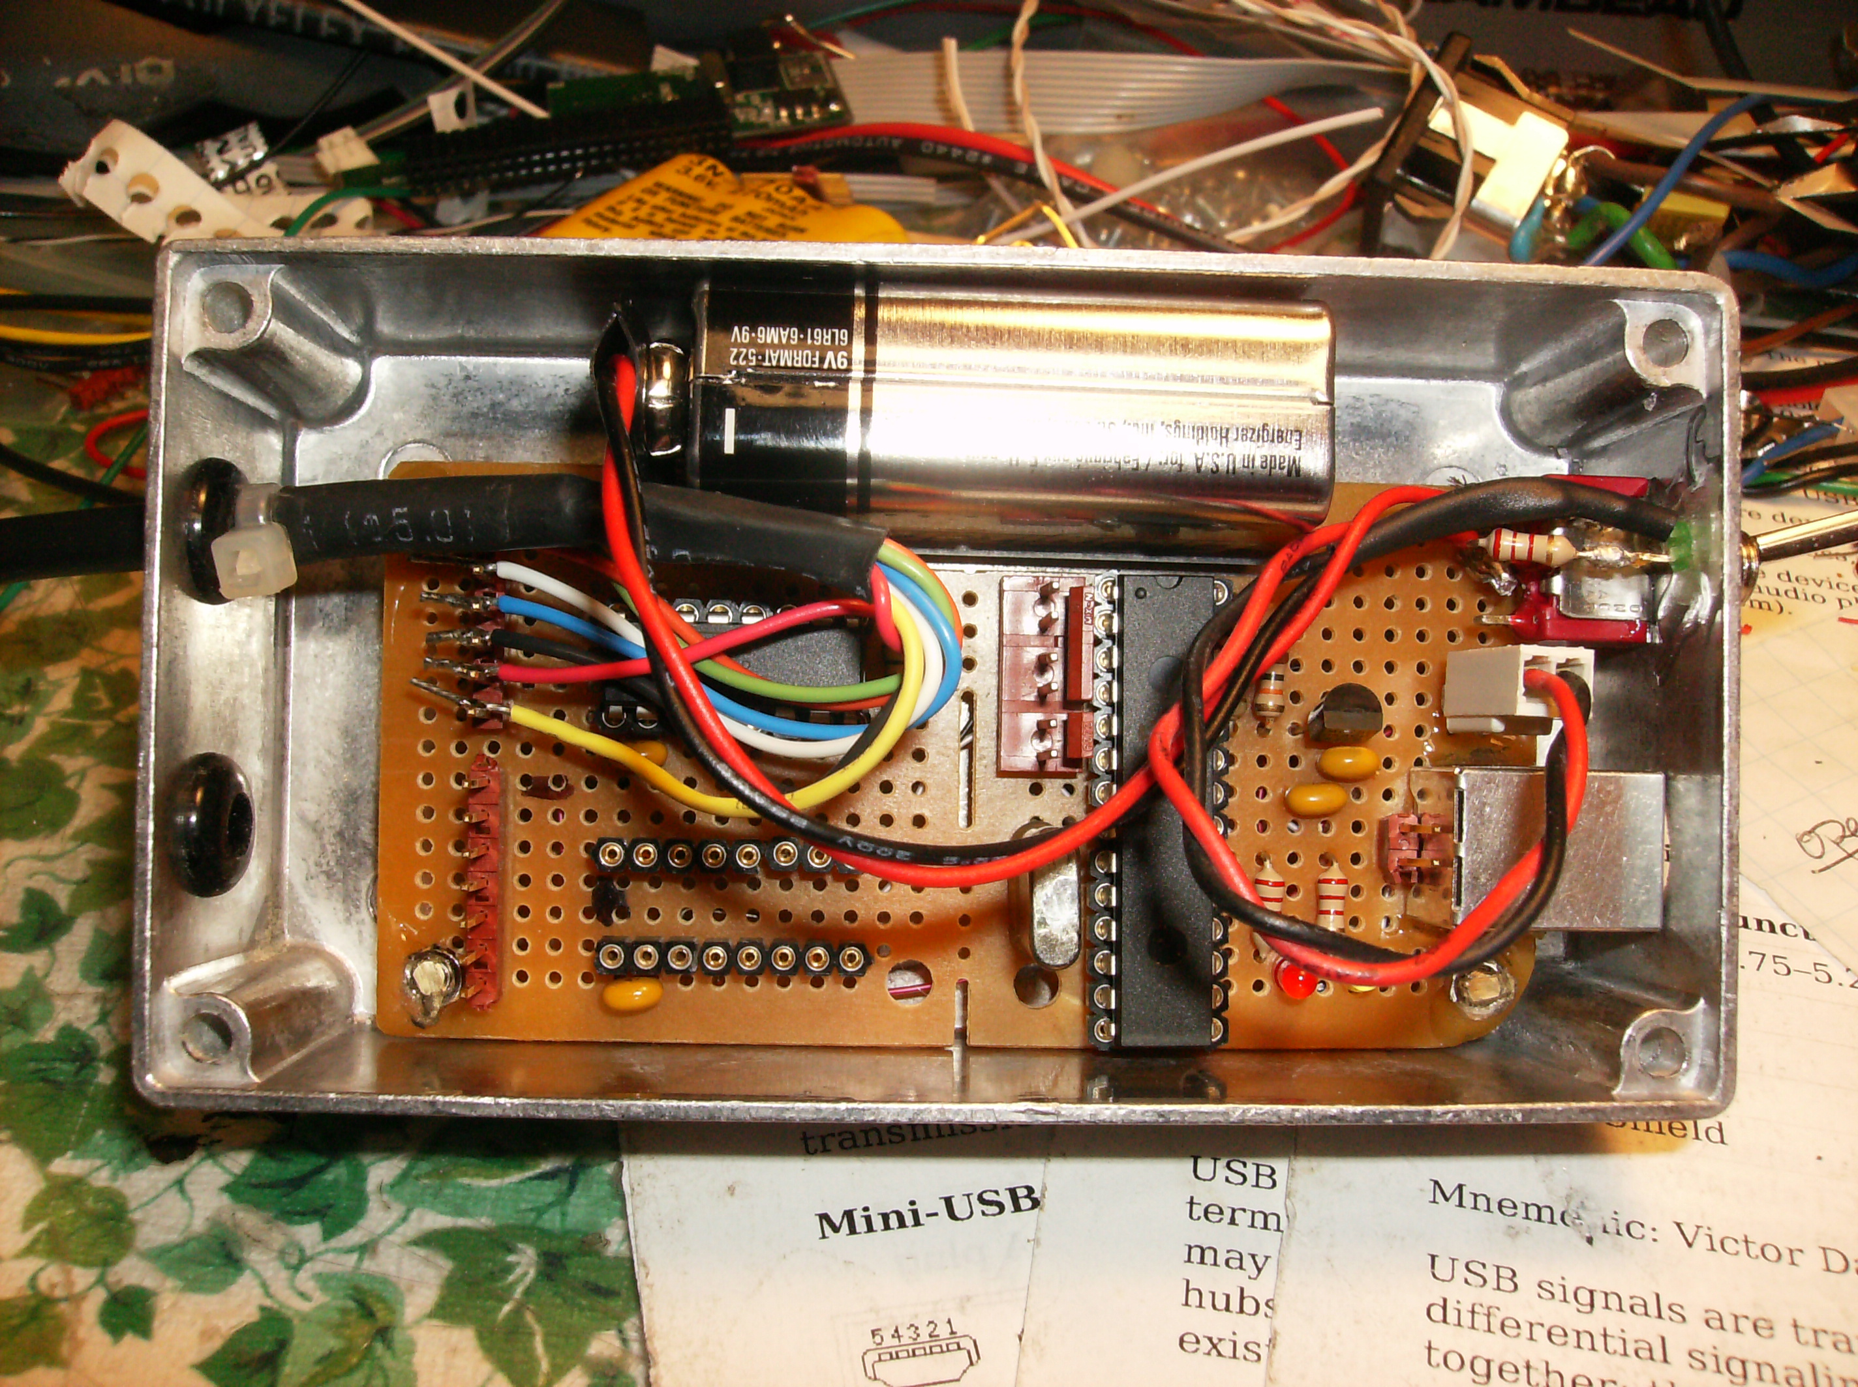

Slide 27
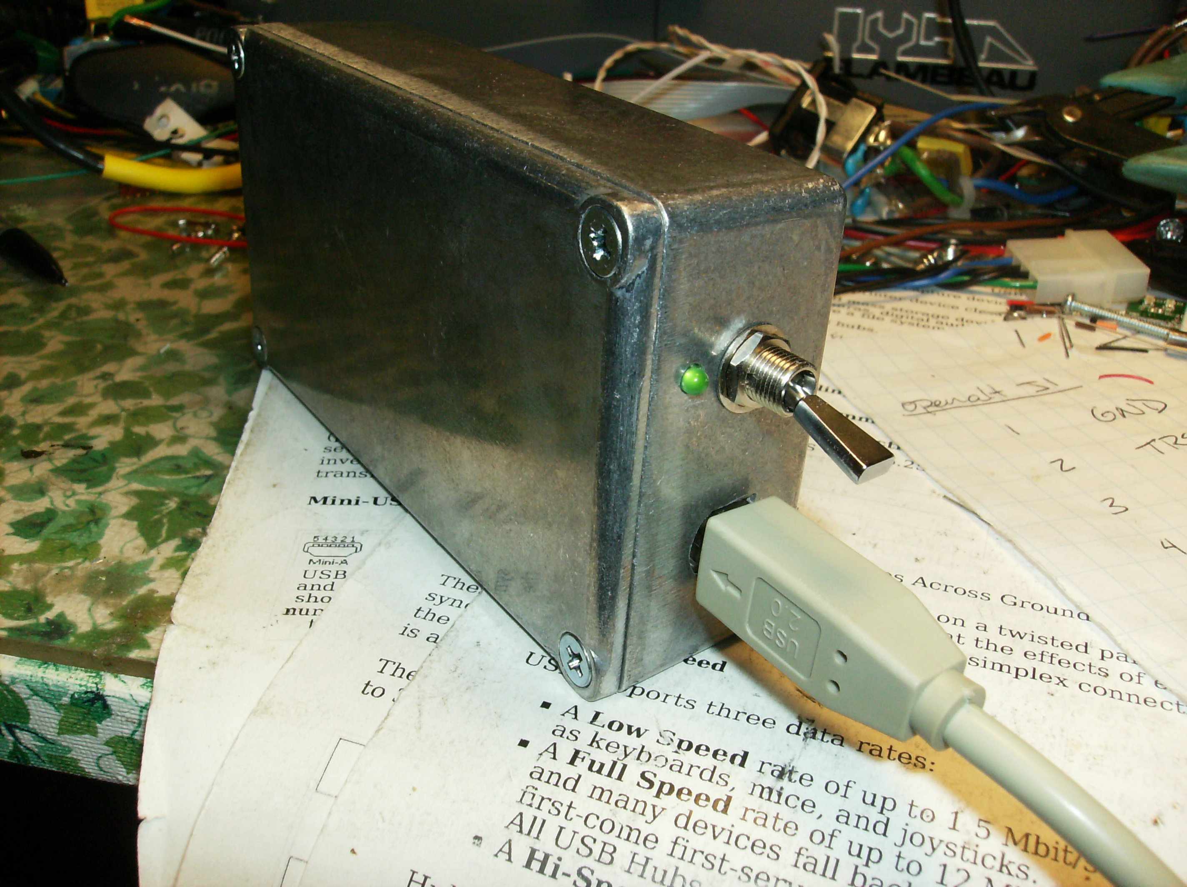

Slide 28
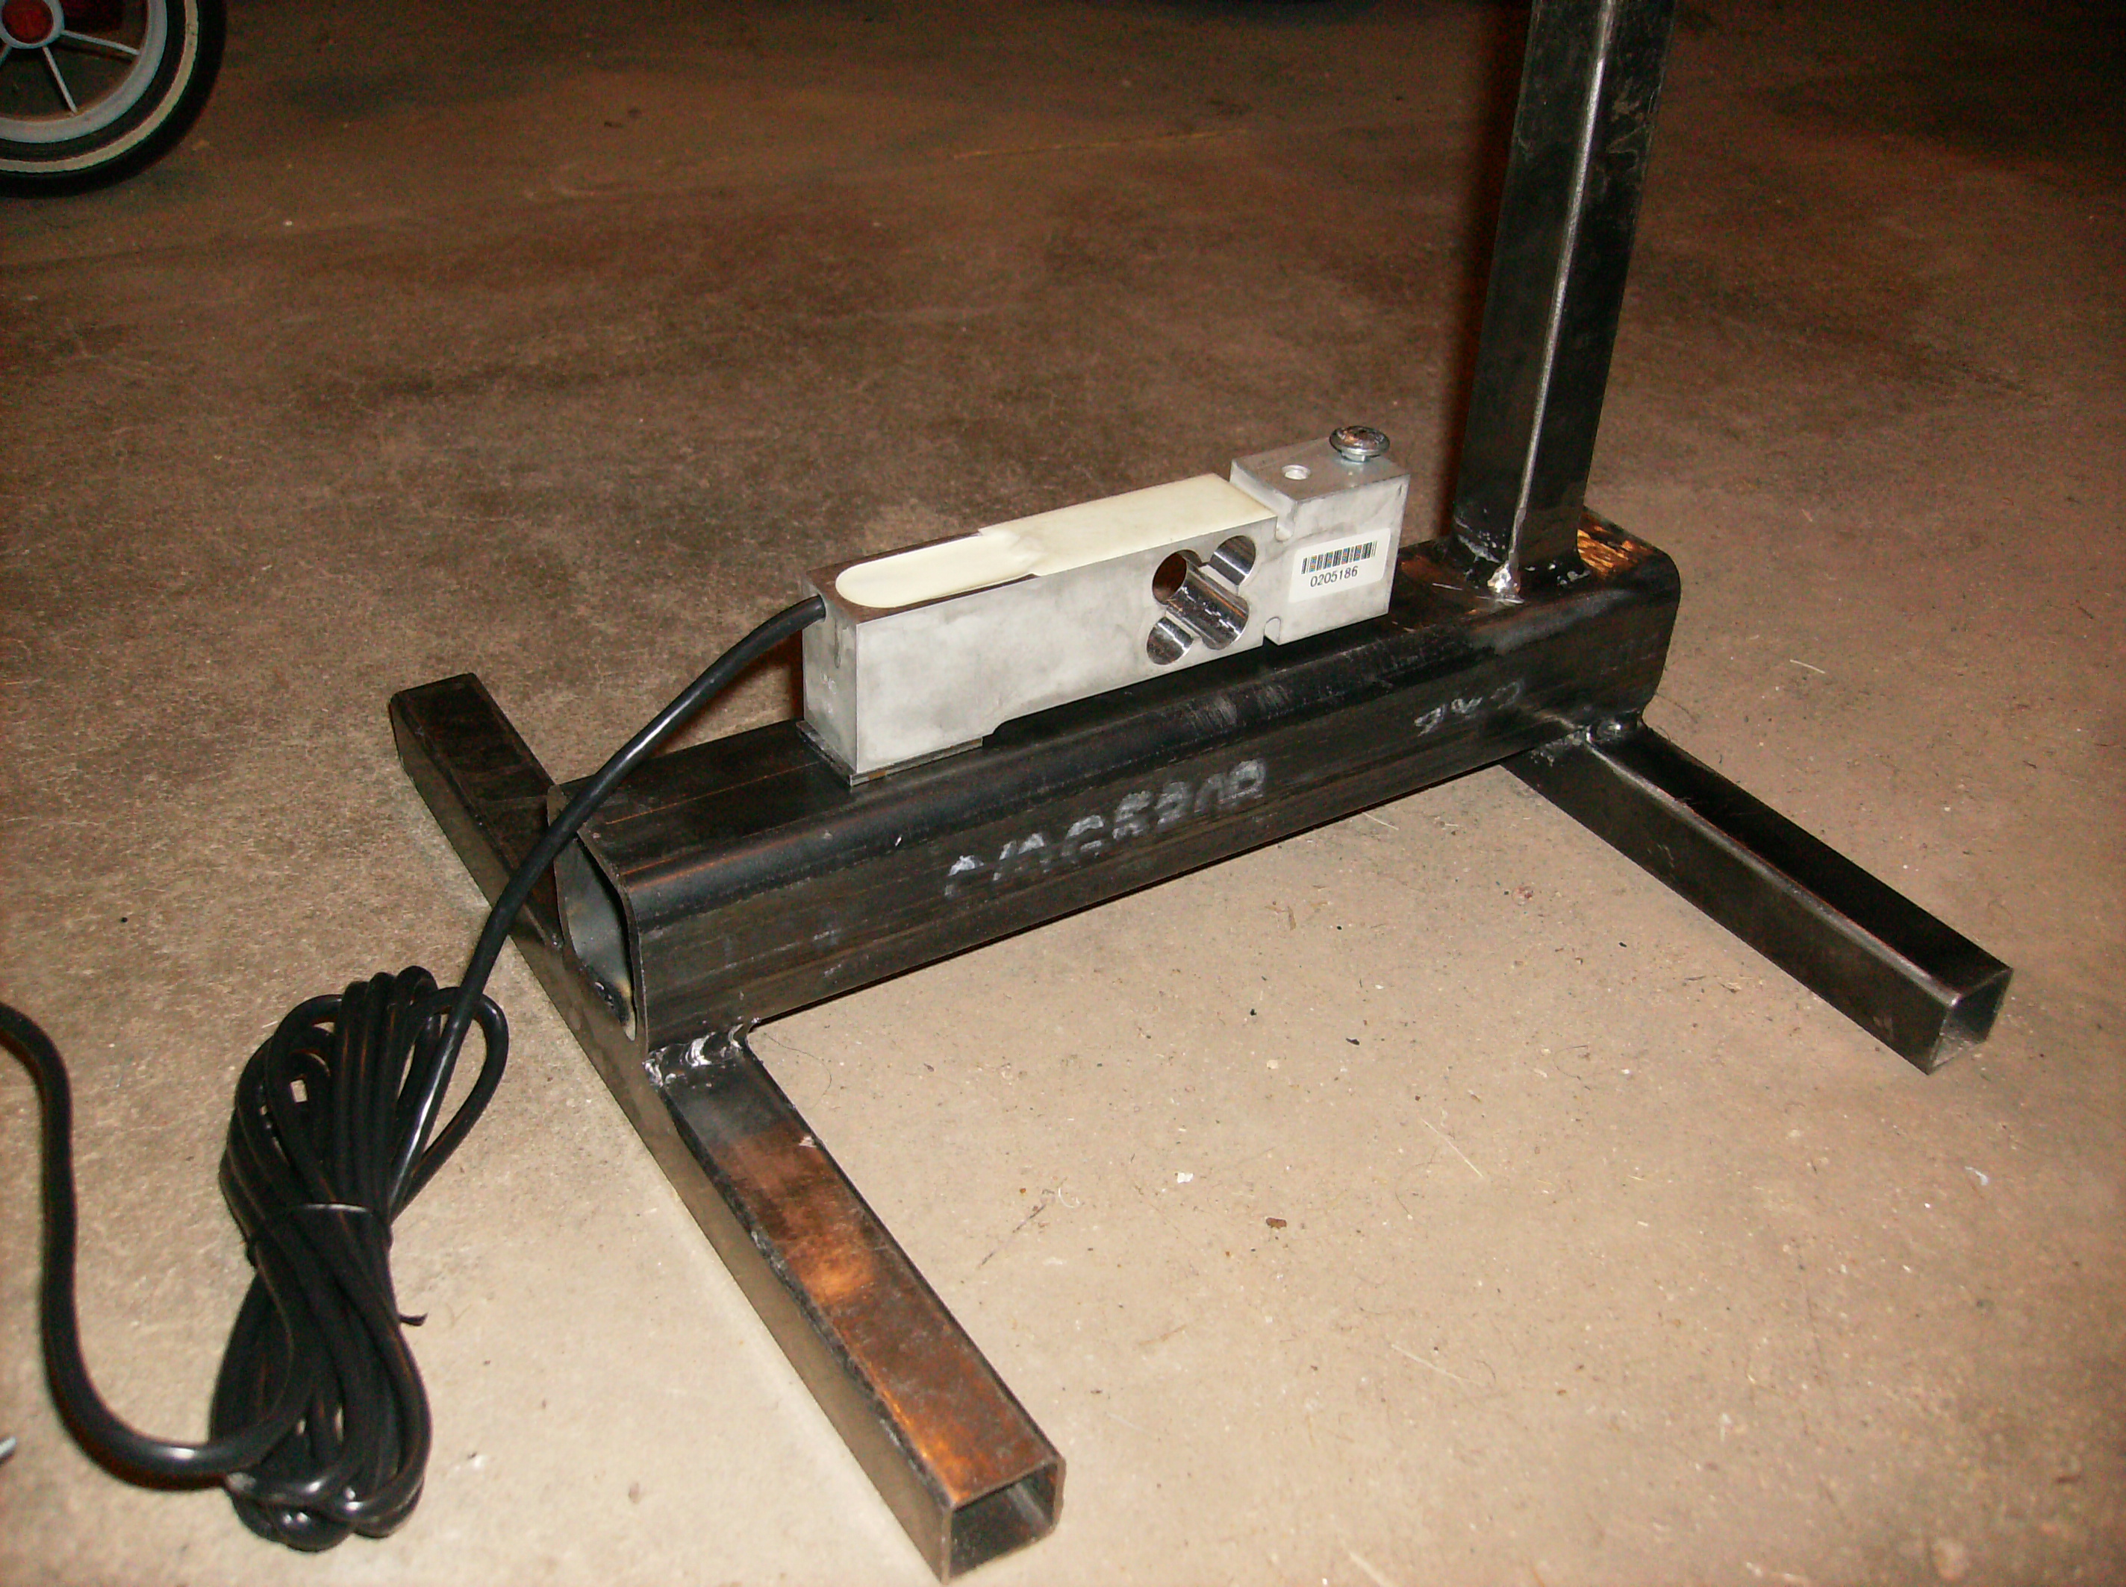

Slide 29
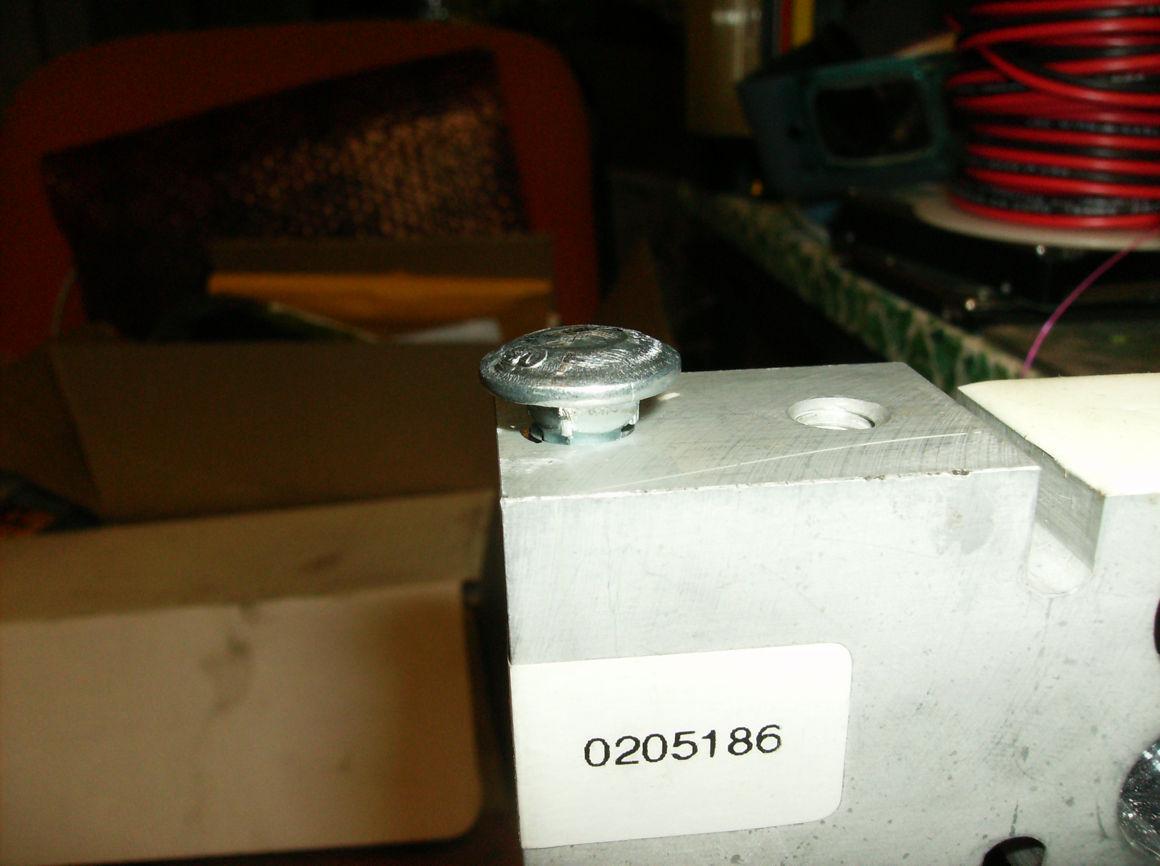

Slide 30
Why AltusMetrum?
Most altimeters are completely proprietary!
  Application-oriented documentation only!
  No schematics...
  No source code for firmware...
  Therefore... no real ability to modify behavior.
Some non-commercial projects exist, but...
  Designs typically aren't well published
  Choices / compromises don't match our needs

Slide 31
Last Year - Altus Metrum v0.1
Design for a completely open (hardware and software) recording altimeter for model rockets
  Designed to fit 24mm tube, flexible battery choices
  Primary operations based on pressure sensor
  Flight profile, not just peak altitude
  Support for dual deploy (can fire 2 ejection charges)
  USB for data recovery and post-flight power source
Include enough “cool stuff” to make things fun...
  Accelerometer, temperature sensor
  Support for GPS receiver with serial interface
  Support for RF link to ground via serial interface

Slide 32
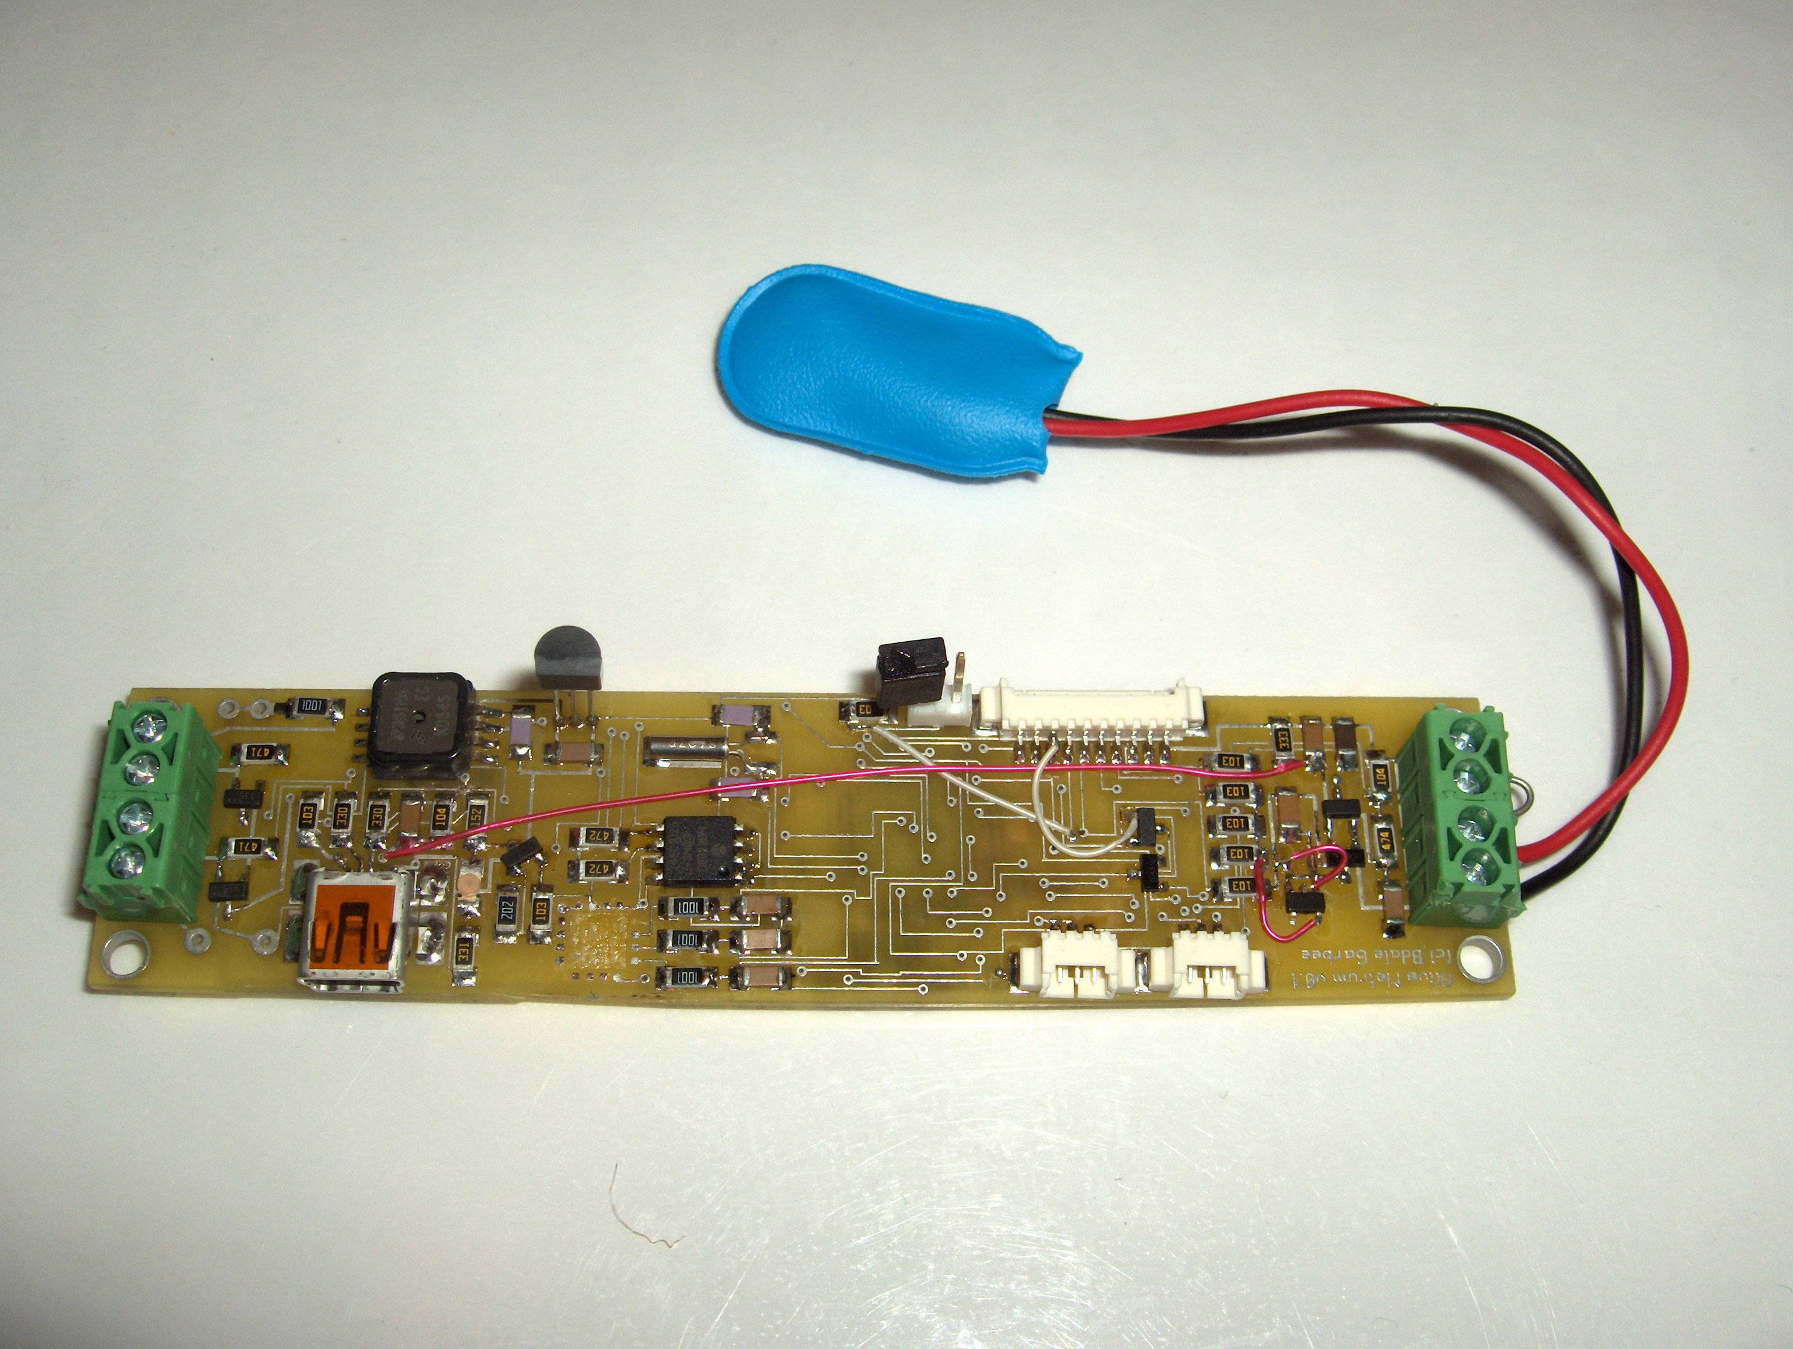

Slide 33
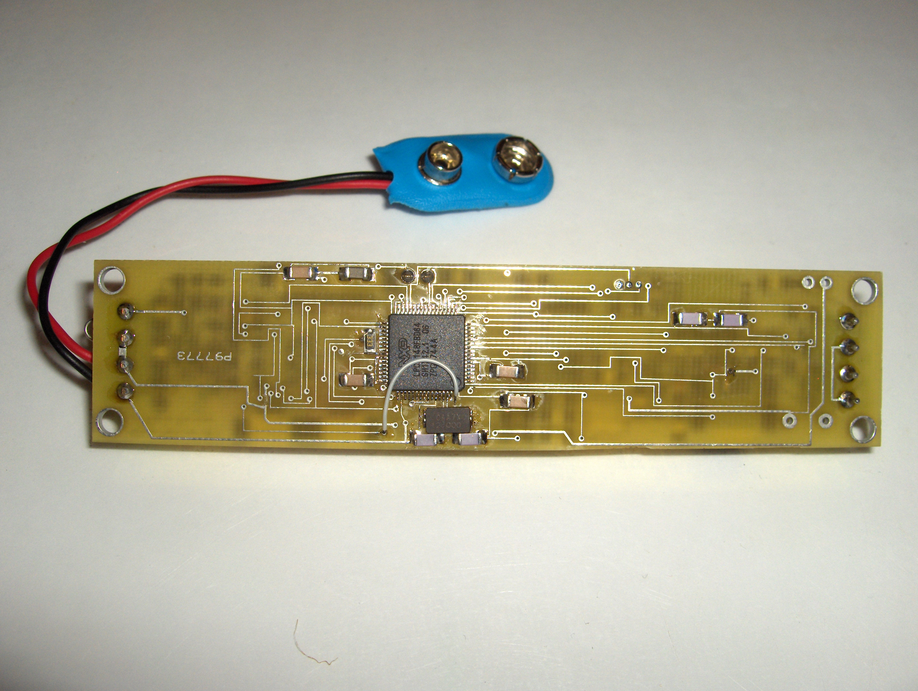

Slide 34
Plans for AltusMetrum v0.2
Fix all known design problems with v0.1
Likely move to smaller SMT passive parts
Make the board slightly wider, 24mm tubing target turns out to be irrelevant and difficult!
Move to LiPo battery technology
  Include MAX155x USB LiPo charge controller
  Replace screw terminals with pads & JST connector
Include a beeper and/or LED status indicator
Integrate GPS receiver and RF link

Slide 35
A Funny Thing Happened...
Keith and I both have BeeLine trackers...
We decided to work on a better RF beacon also using the TI CC1050 transmitter that could be used as a downlink for AltusMetrum
A mutual friend showed us the newer CC1111, which integrates a CPU and RF system... in one chip that's only $7 US in single quantities!
We realized we could build an integrated altimeter system with RF link for about the same price as a beacon...

Slide 36
TeleMetrum Key Hardware Features
TI CC1111F32 RF System on Chip
  Sub-1 Ghz transceiver
  8051 MCU, 32k Flash memory, 4k RAM
  USB plus lots of analog, digital, and serial I/O
Microchip 25LC1024 128kx8 SPI EEPROM
Various Sensors
  Freescale MP3H6115A pressure sensor
  Freescale MMA2202EG 50g accelerometer
  Microchip MCP9700A temperature sensor
Full LiPo battery support with USB charging

Slide 37
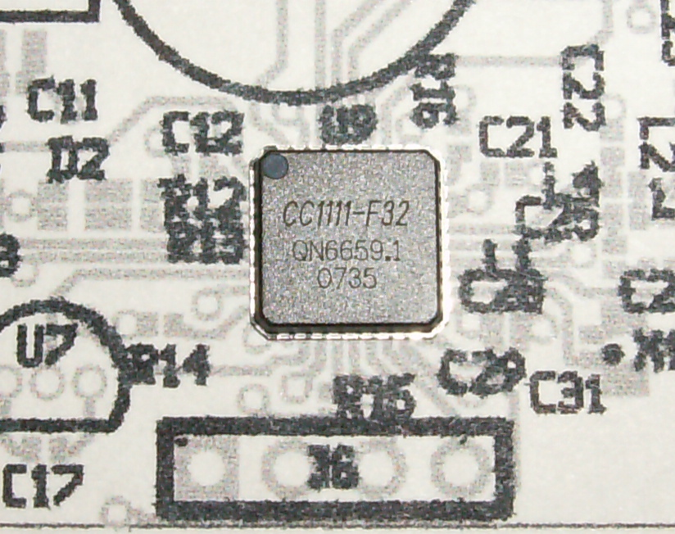

Slide 38
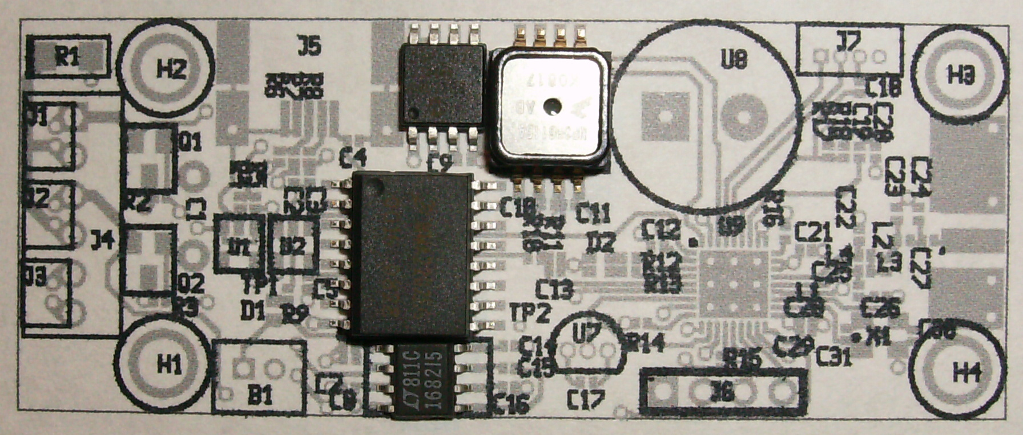

Slide 39
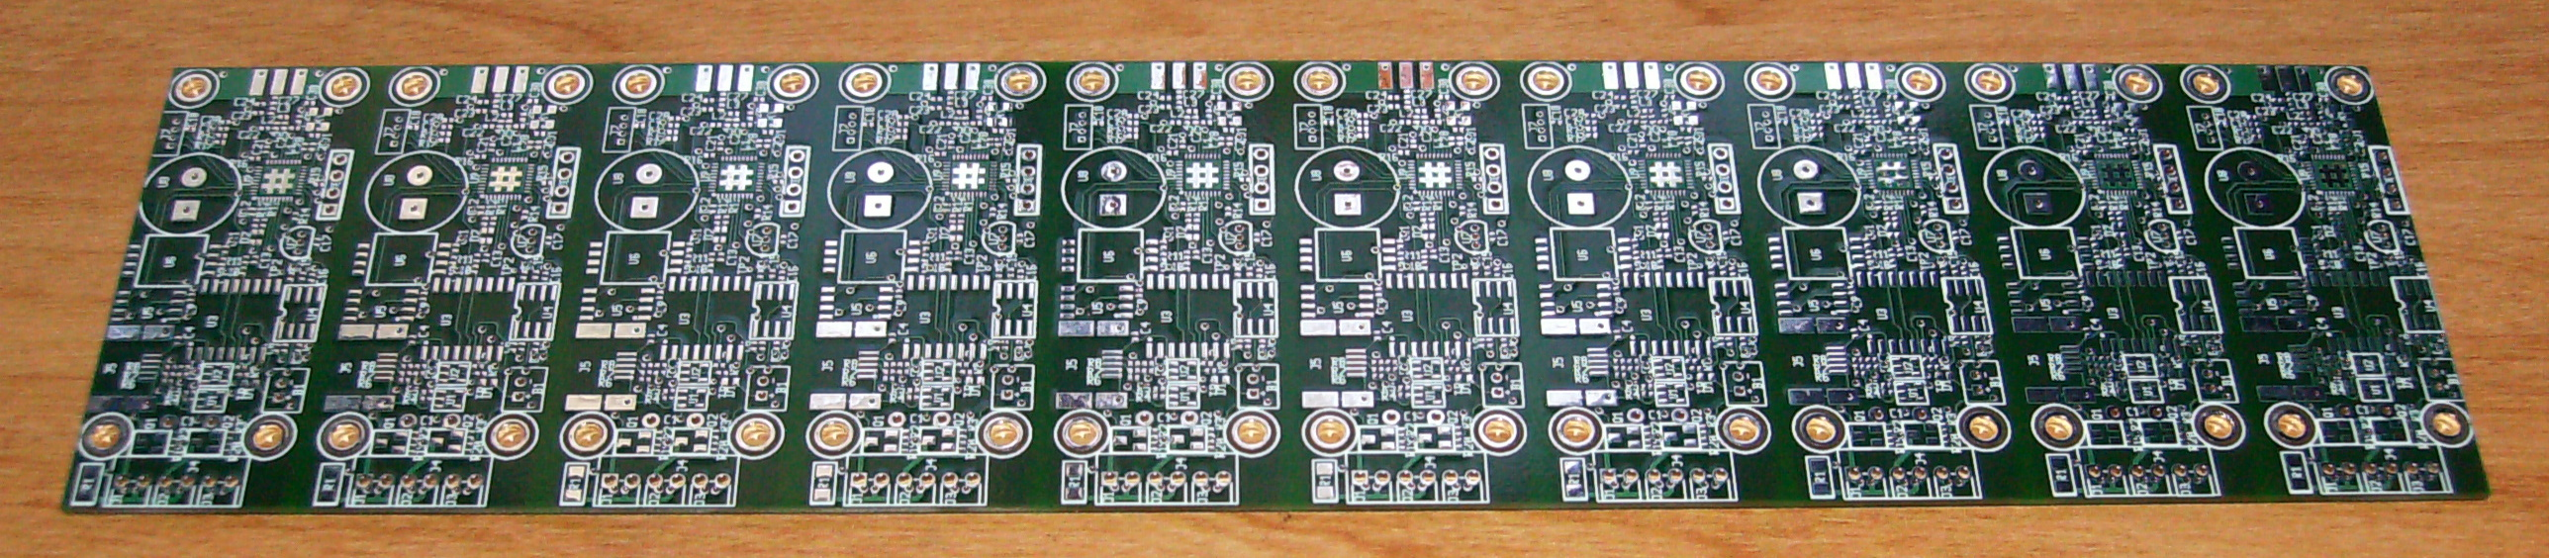
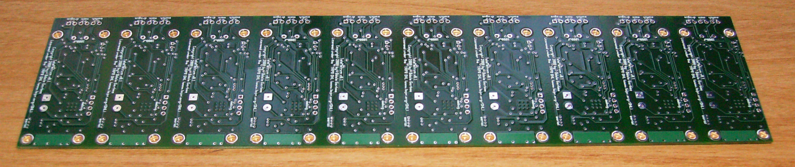

Slide 40
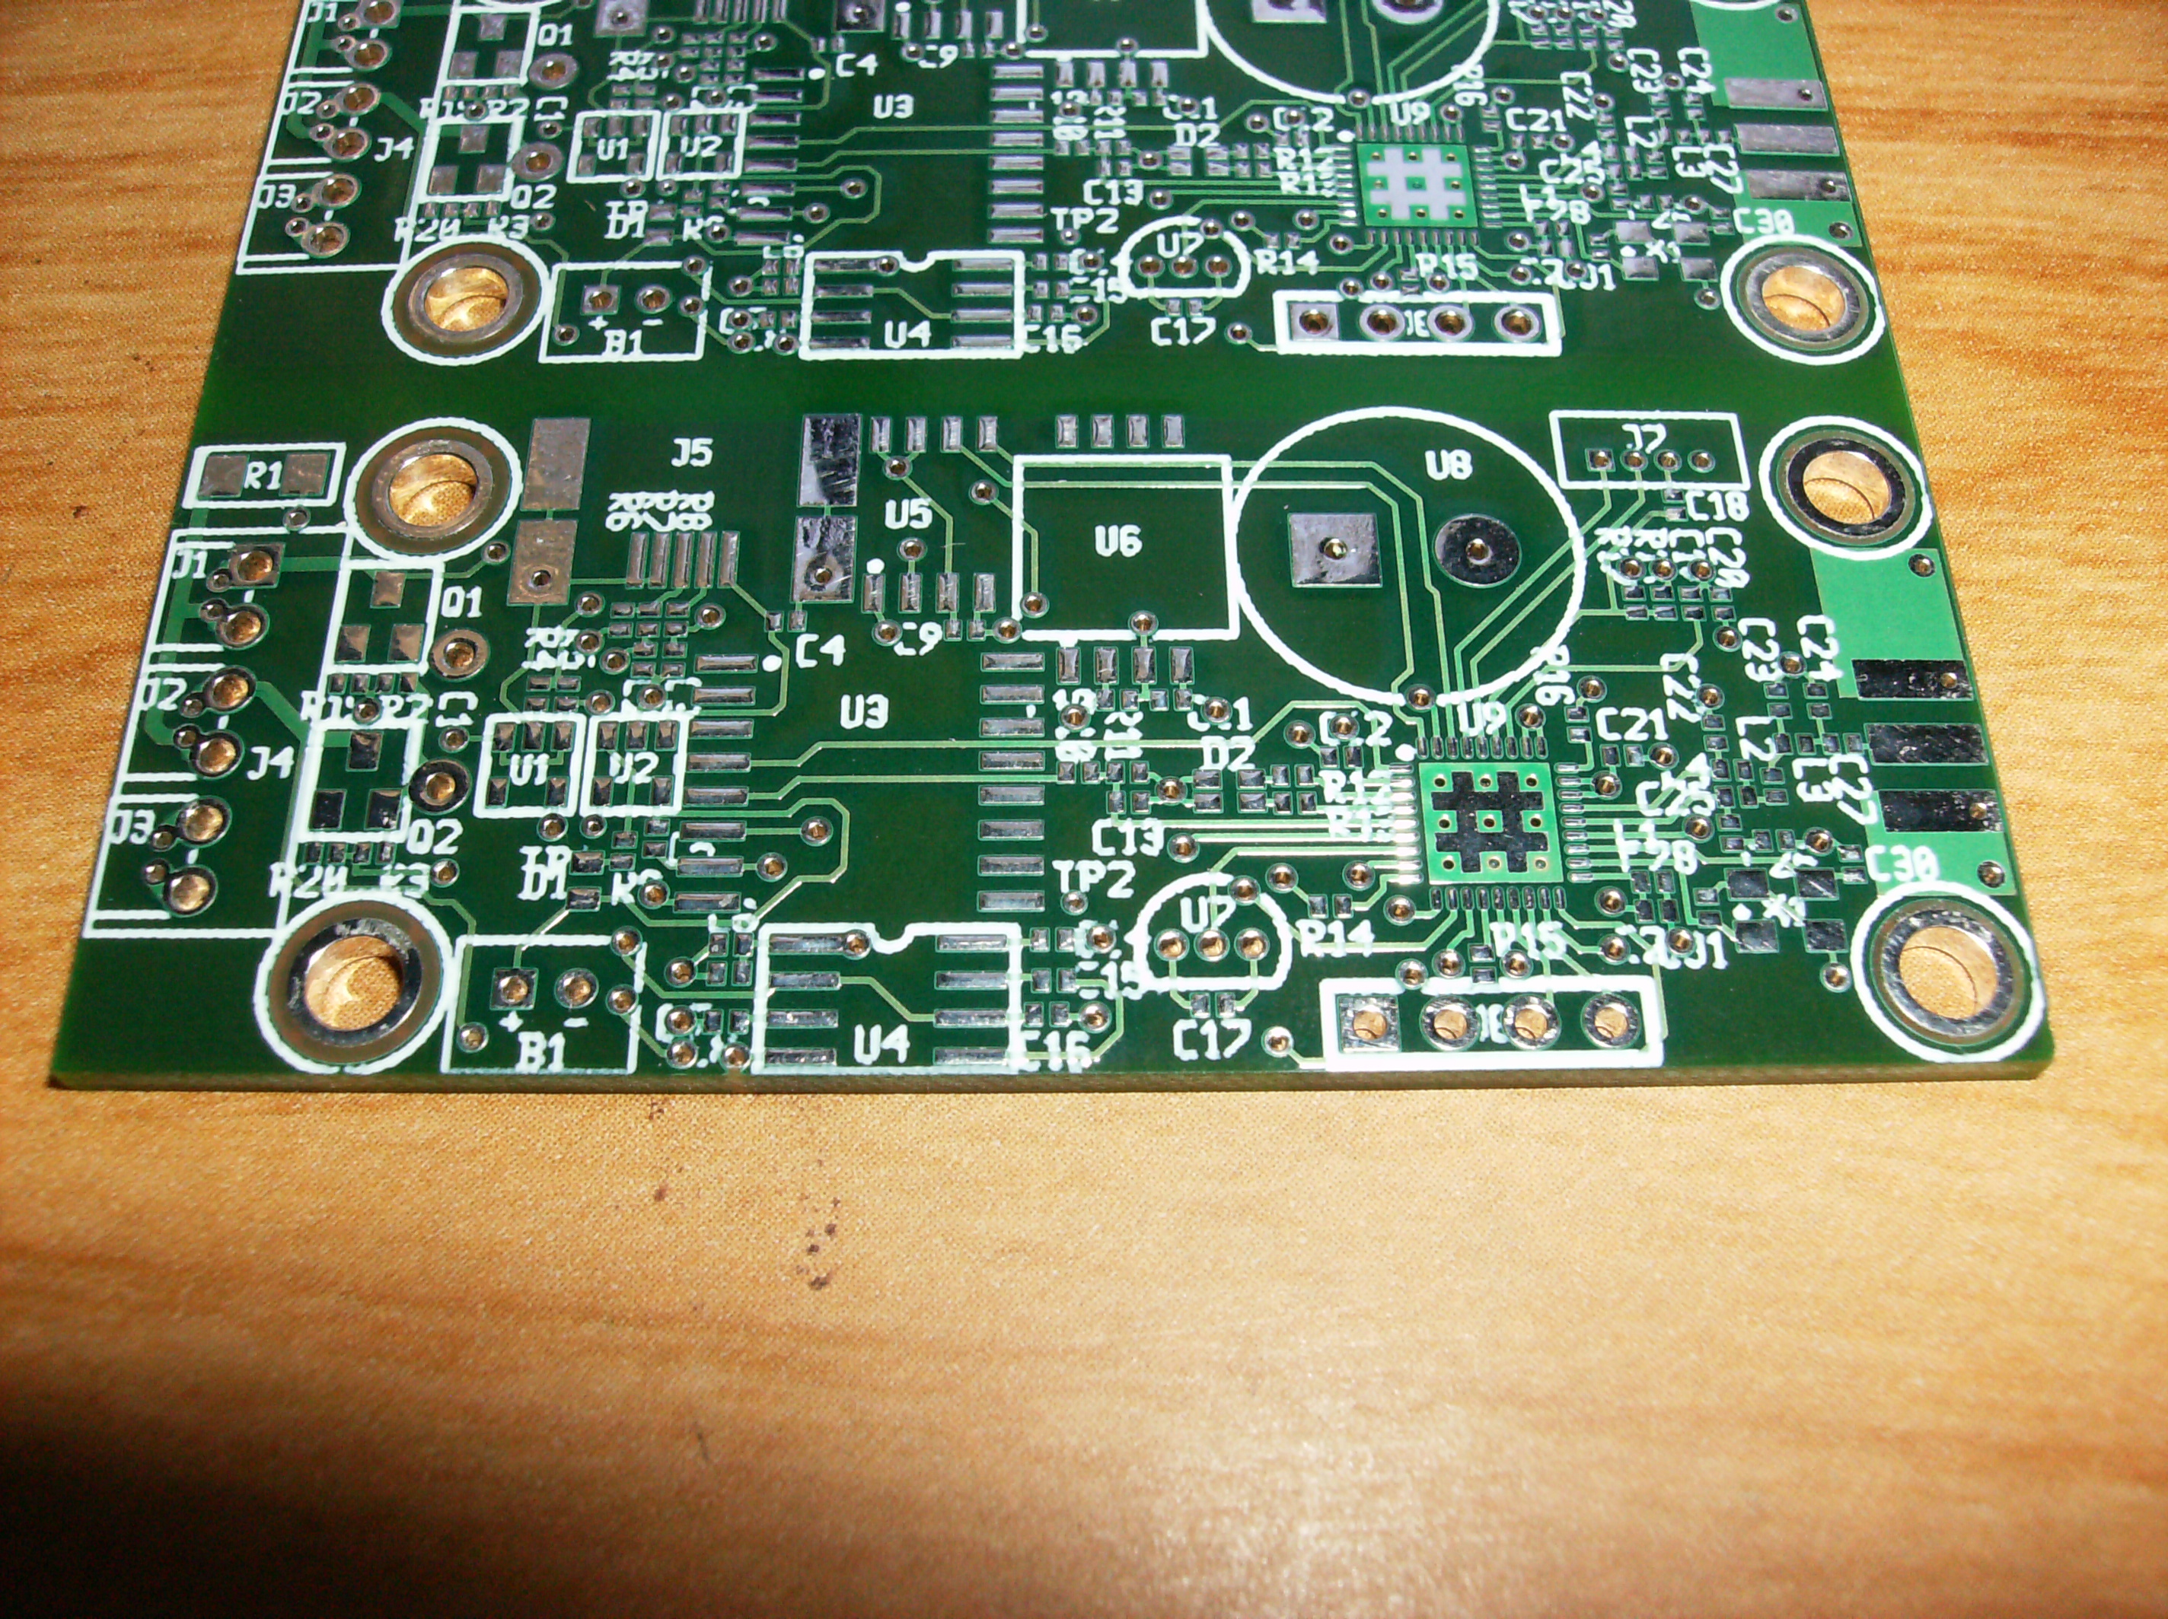

Slide 41
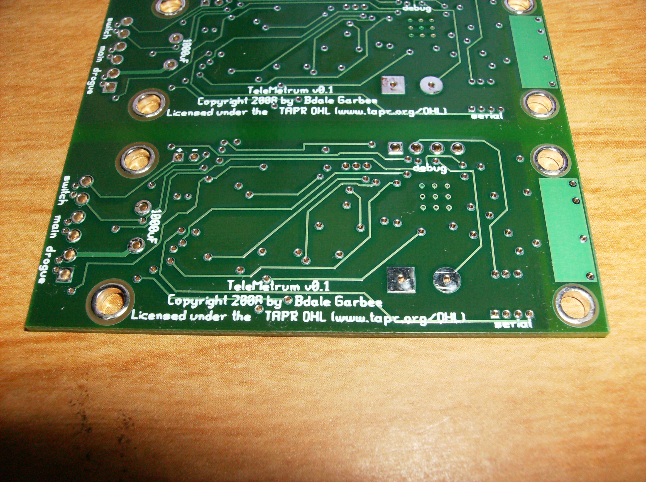

Slide 42
Tools Used
Hardware design
  gEDA, including gschem and pcb
  DigiKey.com for parts selection and data sheets
  Gerbv and FreeDFM.com for verification
  66each.com for 4-layer PCB fabrication
Software development
  SDCC toolchain for 8051
  Source debugger interface to bit-banged 3-wire debug interface

Slide 43
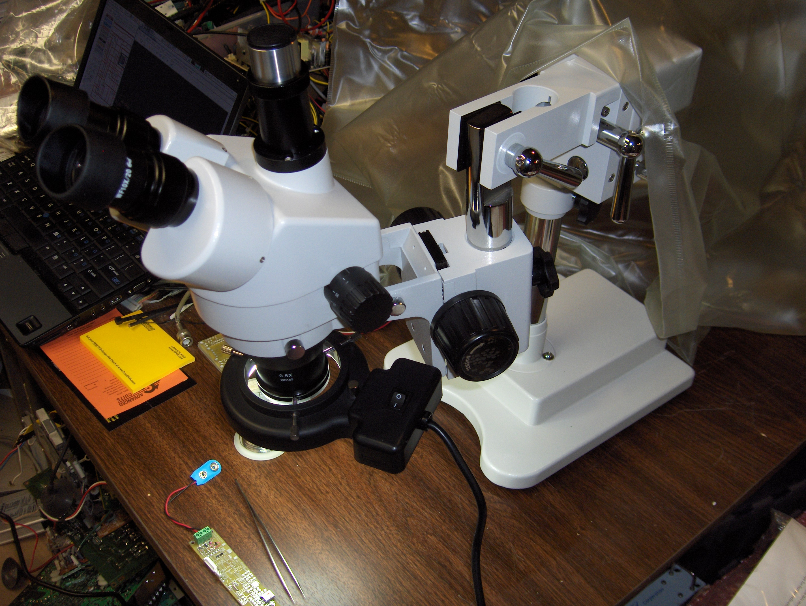

Slide 44
TeleMetrum Software
Keith volunteered to write the firmware
“Starting from sand”, he now has C source debugging working over the 3-wire debug port using SDCC
The only non-open source piece is the 8051 assembler in SDCC (a known problem), and upstream is working to resolve that
Expect to hear more from Keith ...

Slide 45
Licenses
The hardware designs carry the TAPR Open Hardware License (OHL), which was created to be “GPL-like” for hardware designs.
Our software is licensed GPL “v2 or later”.

Slide 46
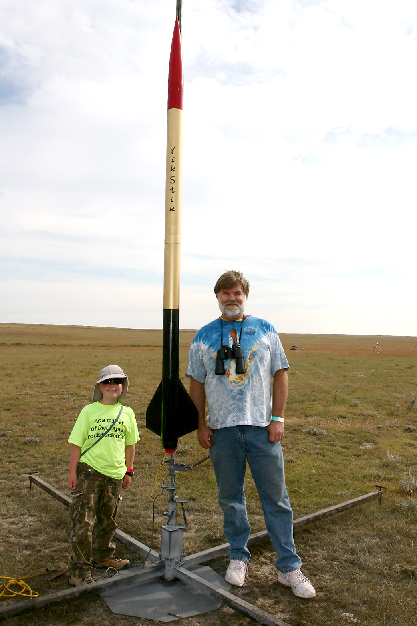
YikStik
Level 3 cert attempt on 4 October 2008
Full custom design, carbon fiber fins, body is 98mm x 3m
M1297W motor
Stunningly beautiful launch and ascent
The black and gold bits are still missing...

Slide 47
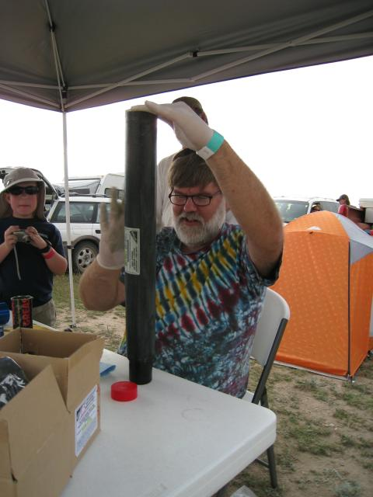
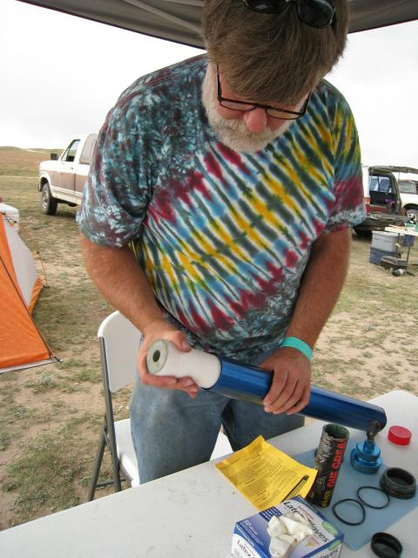
Building an M1297W

Slide 48
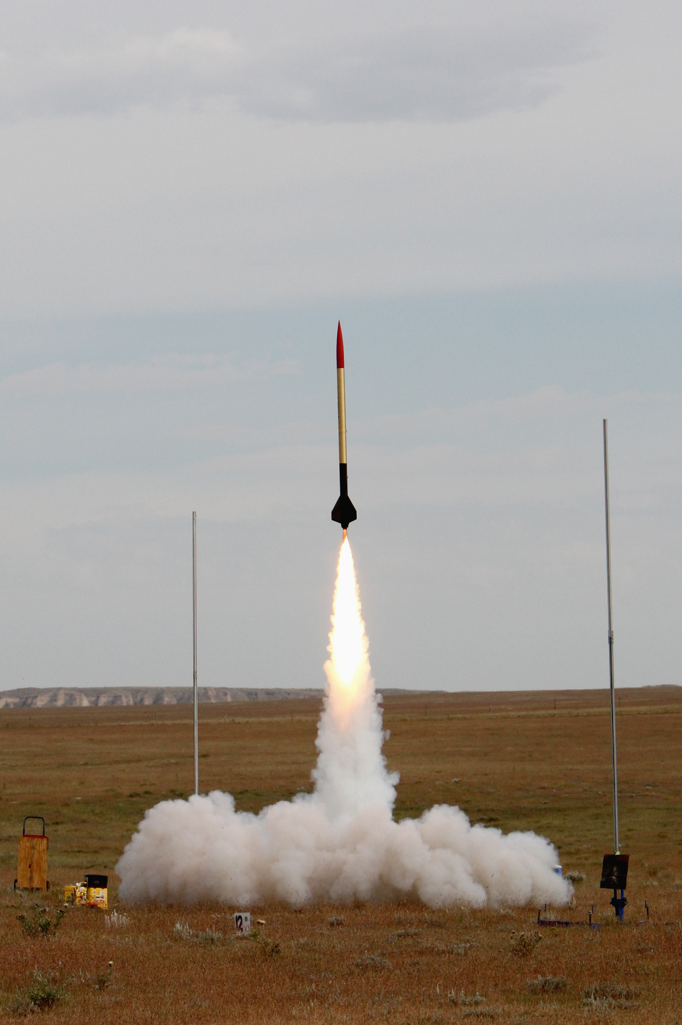
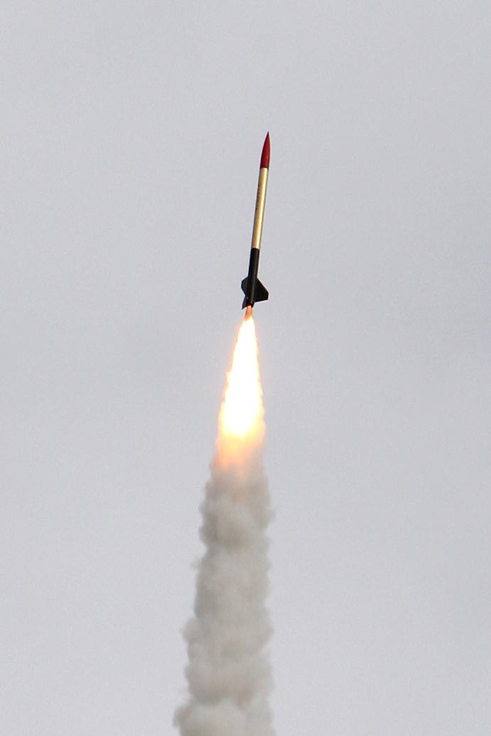

Slide 49
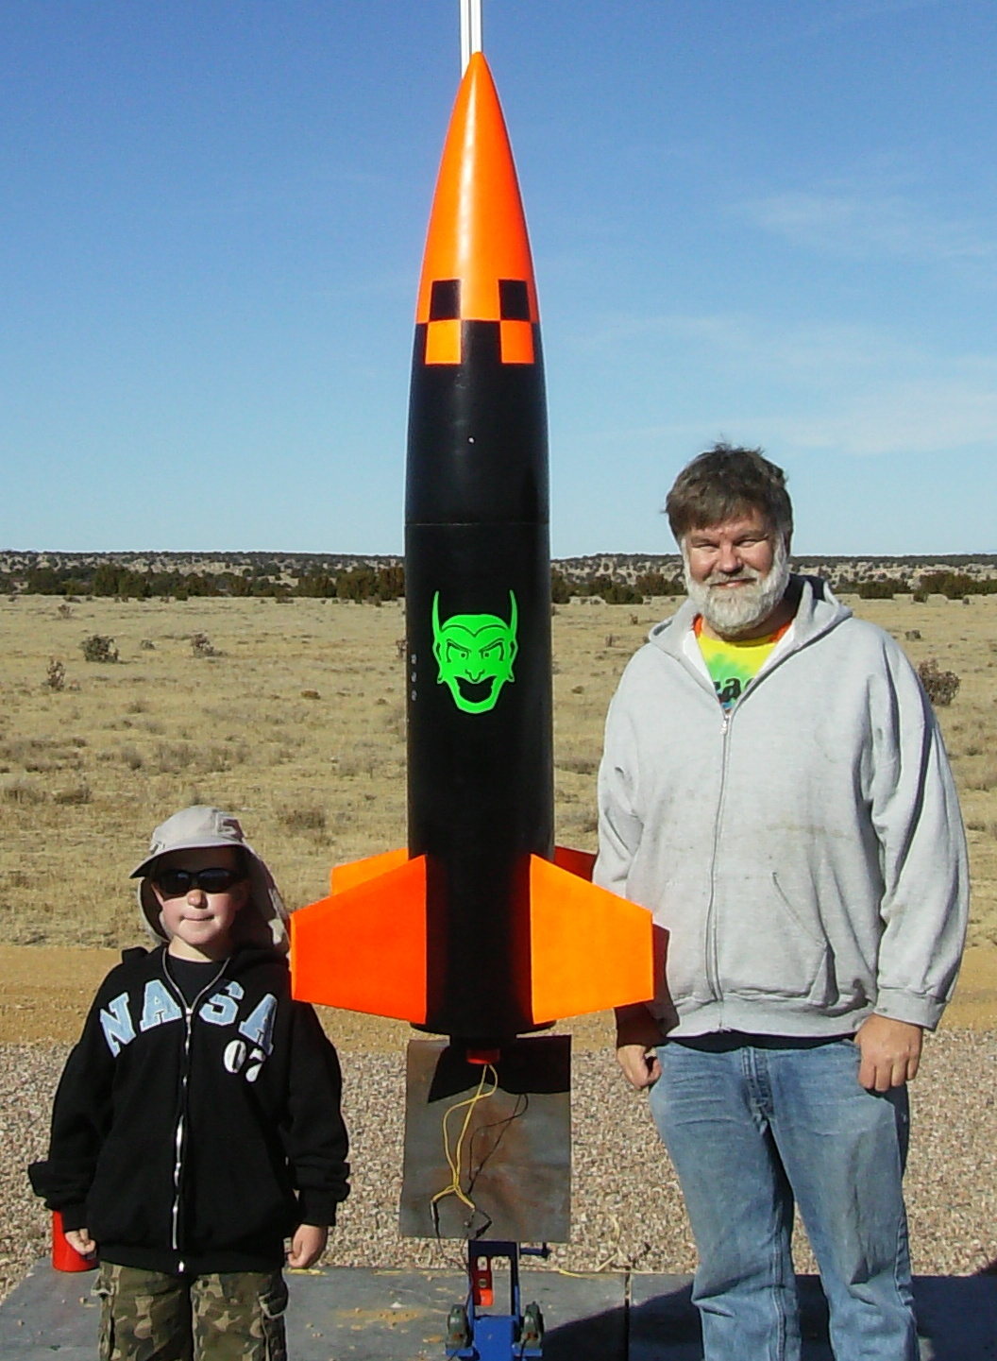
Goblin 10
Level 3 cert achieved 15 November 2008
Modified kit design, glassed fins, body is 265mm x 1.7m
M1297W motor
Successful recovery!
  Main out at apogee
  Descent rate anomaly
  Battery retention failed on touch-down

Slide 50
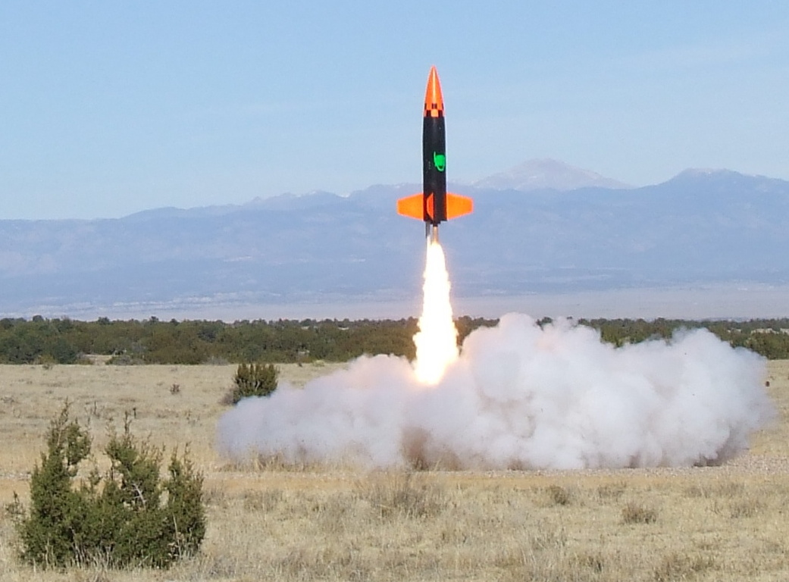

Slide 51
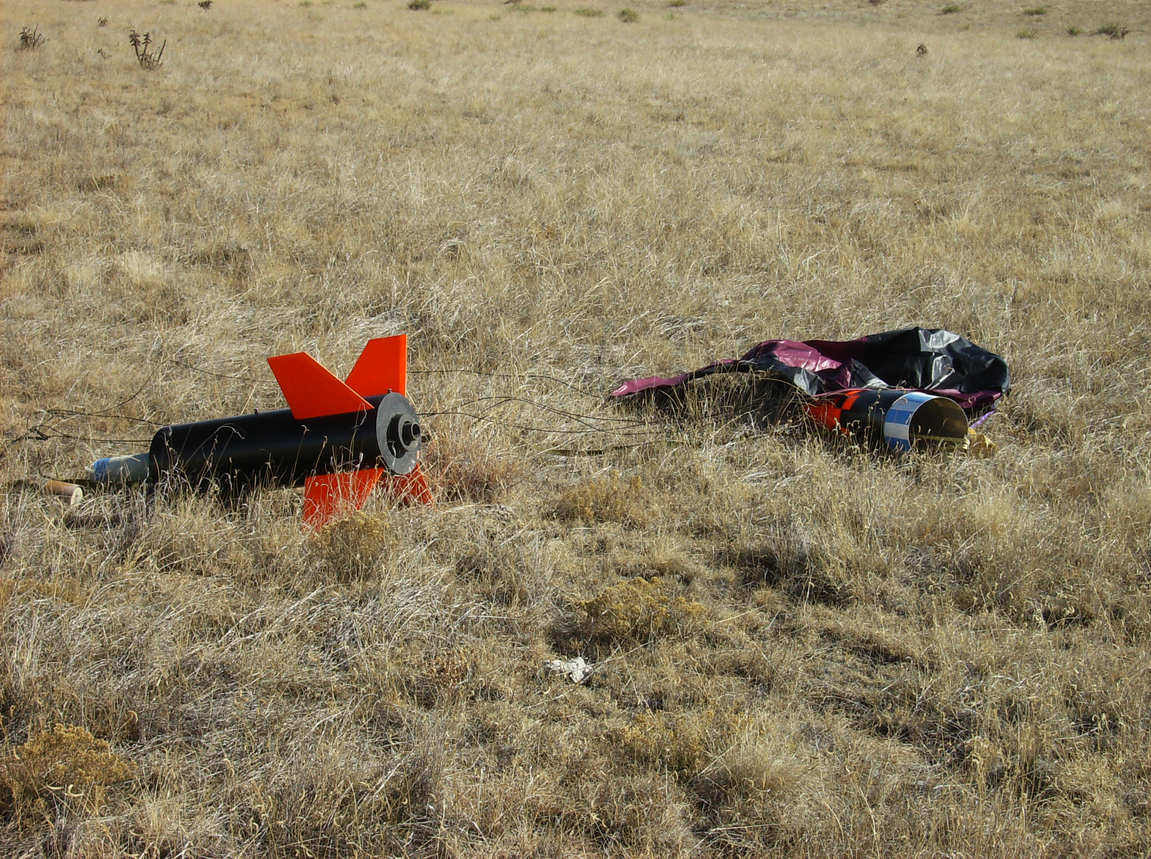

Slide 52
Questions?
Hardware projects are at altusmetrum.org
  The AltusMetrum v0.1 design is available, but should be considered purely of historical interest
  TeleMetrum hardware design is available now
  StaticMetrum will be published once snow melts!
TeleMetrum software at keithp.com/rockets
Other information at gag.com/rockets
TAPR OHL info at tapr.org/ohl

