Slide 1

Factoring it up
By: Brian Keith Skinner, Eduard Bolanos & Joshua Chapin
Don’t you guys have phones???
Team Diablo Immortal brought to you by
the original Team Lil windex

Slide 2

objective
“Write a parallel program to factorize a large multiple of two prime numbers. The program should take several large numbers as inputs and output their two prime factors.”
- Prof. Scott Feister
Scott’s pie inspiration in background

Slide 3
Algorithm O(n)
The algorithm that we choose allowed us to provide calculated efficiency.
The algorithm we used was a simple linear search starting at 5 and ending at sqrt(n) checking our iterator and iterator+2 (because 2 is a good number) and then incrementing our iterator by 6.

Slide 4
Algorithm O(n)
Why do we need this or care?
Many of the other algorithms we saw were trying to solve 2 separate problems and compose the answer
The first being how do you make a prime number generator, and the second being how to efficiently look through those primes for probable numbers
They were trying to limit their definition of n, because their problem space was larger

Slide 5
Algorithm O(n)
Efficiency doesn’t have to come from big O
We chose to reduce our constants
O(n) = An + B so we focused on A and B
This will be a slower algorithm for bigger numbers but we’re not taking this to n → ∞

Slide 6




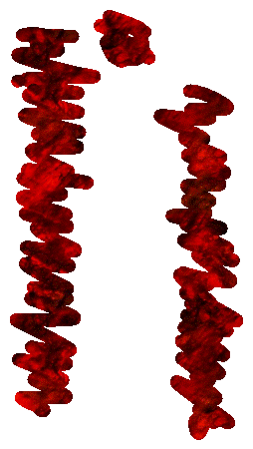
Why Base 6?
0 | 1 | 2 | 3 | 4 | 5
6 | 7 | 8 | 9 | 10 | 11
12 | 13 | 14 | 15 | 16 | 17
18 | 19 | 20 | 21 | 22 | 23
24 | 25 | 26 | 27 | 28 | 29
30 | 31 | 32 | 33 | 34 | 35
36 | 37 | 38 | 39 | 40 | 41
First let’s specify 2 and 3 as prime
Then lets remove all the columns that
can only have multiples of 2 in them
(making them not prime)
Finally lets remove the columns that can only have multiples of 3
THAT’S 2/3 OF THE PROBLEM SPACE GONE.

Slide 7
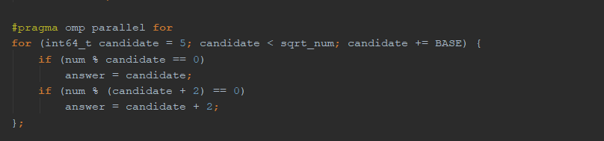
Code snippet
This is only but a small fragment of how we coded our algorithm.
Code for sale on pateron, $2,000. Grantee A+

Slide 8



