Slide 1
Social Media Sentiment
Analysis & Engagement Prediction
Dataset: Social Media Sentiment Analysis Dataset | 711 posts | Twitter, Instagram, Facebook
Sentiment distribution & temporal trends
Engagement (Likes / Retweets) analysis
Classification models: Logistic Regression & SVM
Engagement prediction: Random Forest

Slide 2
Project Goals
① Sentiment Distribution
④ Topic Mining
Understand sentiment distribution patterns across platforms
Identify trending hashtags and their sentiment/engagement patterns
② Temporal Trends
⑤ Geographic Differences
Analyze how sentiment evolves over time
Examine sentiment distribution differences across countries
③ Engagement Analysis
⑥ Engagement Prediction
Study the relationship between Likes/Retweets and sentiment
Predict post engagement based on sentiment, topic, and platform

Slide 3
Dataset Overview
711
3
20+
14
Total Posts
Platforms
Sentiment Types
Data Fields
Field Descriptions
Text
Raw post text
Timestamp
Post timestamp
Sentiment
Sentiment label (Positive, Joy, Excitement…)
Country
Publishing country
Platform
Hashtags
Topic hashtags
Publishing platform (Twitter / Instagram / Facebook)
Likes/
Retweets
clean_text
Cleaned text (URLs and @mentions removed)
Engagement counts

Slide 4
Data Cleaning & Preprocessing
01
Remove Redundant Index Columns
04
Deduplicate & Drop Missing
Drop Unnamed columns from CSV exports and standardize column names
Remove duplicate rows and rows missing Text, Sentiment, Platform, Timestamp, Likes, or Retweets
02
Normalize Categorical Fields
05
Filter Invalid Engagement Values
Strip whitespace from Platform/Sentiment/Country to avoid treating identical values as different categories
Keep only records with Likes ≥ 0 and Retweets ≥ 0
03
Convert Numeric Fields
06
Text Cleaning
Cast Likes/Retweets to numeric (coerce errors) and Timestamp to datetime
Lowercase → remove URLs → remove @mentions → normalize whitespace → keep hashtags for topic analysis

Slide 5
Exploratory Data Analysis (EDA)
Exploratory Data Analysis

Slide 6
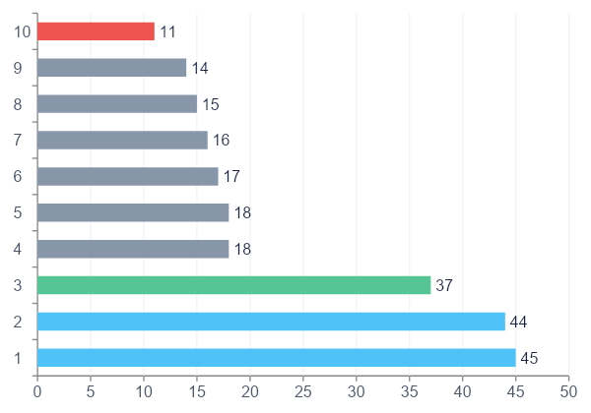
Sentiment Distribution
Key Findings
Positive & Joy Lead
Top two categories — overall tone is positive
Excitement Ranks 3rd
37 posts expressing excitement
Negative Sentiment is Rare
Despair, Anger and similar categories are underrepresented
20+ Sentiment Labels
Rich taxonomy, but some classes have very few samples

Slide 7
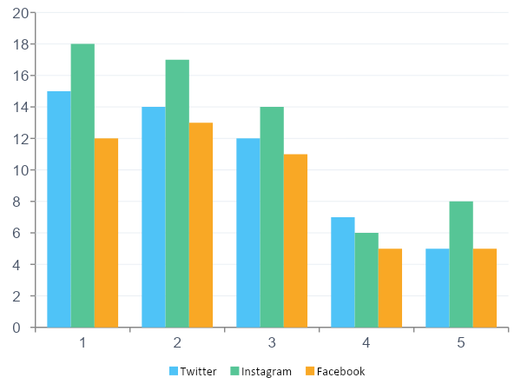
Platform Analysis · Sentiment vs Platform
Platform Insights
Similar Patterns Across Platforms
Positive and Joy rank highest on Twitter, Instagram, and Facebook alike
Instagram Slightly Higher
Instagram shows marginally more Positive & Contentment posts than other platforms
Facebook Has Fewest Posts
Facebook has the fewest posts overall, but the sentiment trend is consistent

Slide 8
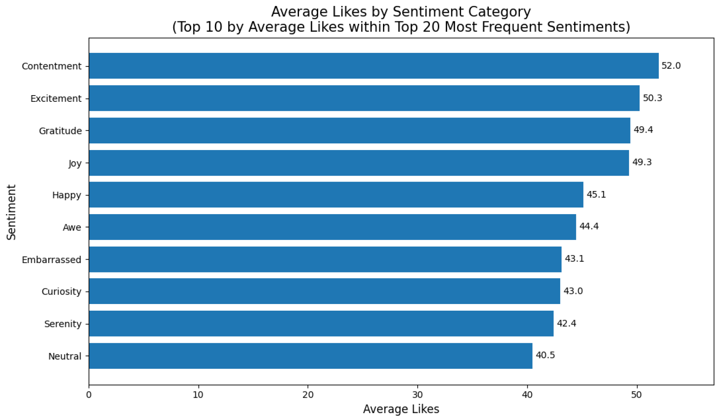
Engagement Analysis · Sentiment vs Likes / Retweets
42.9
21.5
43.0
22.0
Avg Likes
Avg Retweets
Median Likes
Median Retweets
Range: 10–80
Range: 5–40
Fairly concentrated
Low variance
Statistical Test Results
Kruskal-Wallis Test
H₀: Likes distribution is identical across all sentiment categories
p < 0.05 → Reject H₀
Reject H₀ — engagement differs significantly across sentiment categories
Caveat
Engagement is affected by follower count, posting time, and trending events — association, not causation

Slide 9
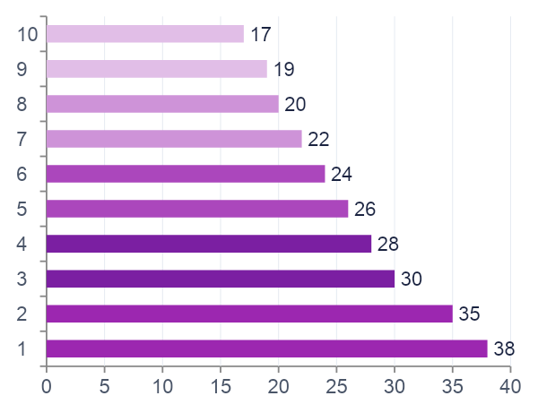
Trending Topics & Geographic Analysis
Top 10 Hashtags
Geographic Distribution · Country × Sentiment
🇺🇸 USA
Most posts; positive sentiment dominates
🇬🇧 UK
Sentiment distribution is relatively balanced
🇮🇳 India
Joy & Excitement are proportionally high
🇨🇦 Canada
Positive & Contentment stand out
🇦🇺 Australia
High proportion of positive sentiment
Chi-square test (Country × Sentiment): p < 0.05 — sentiment distributions differ by country (exploratory finding)

Slide 10
Machine Learning Models
Sentiment Classification & Engagement Prediction

Slide 11
Sentiment Classification Models
Raw Text
TF-IDF Vectorizer
(max_features=5000)
Logistic Regression
/ Linear SVM
Sentiment Prediction
Model Performance Comparison (Top 20 sentiments, 80/20 split, stratified)
Model | Vectorizer | Accuracy | Macro-F1 | Notes
Logistic Regression | TF-IDF | ~0.62 | ~0.58 | Baseline
Linear SVM ★ | TF-IDF | ~0.65 | ~0.61 | Best Model
Note: The dataset is small (~711 posts) and some sentiment classes have few samples, so macro-F1 may be unstable. Linear SVM typically outperforms LR on text classification; treat results as an exploratory baseline.

Slide 12
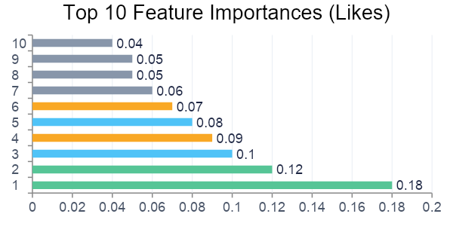
Engagement Prediction Model (Random Forest)
Feature Engineering
Model Results (300 trees, random_state=42)
Sentiment (One-Hot Encoding)
Platform (One-Hot Encoding)
Likes Prediction
RMSE ≈ 0.68
R² ≈ 0.12
hashtag_count (number of hashtags)
Targets: log(1+Likes) and log(1+Retweets)
Retweets Prediction
RMSE ≈ 0.45
R² ≈ 0.10
Interpretation
hashtag_count is Most Important
Hashtag count is the strongest predictor of Likes, linked to post discoverability
Sentiment Categories Contribute
Joy and Positive posts show stronger engagement signals
Platform Features Matter
Twitter and Instagram exhibit different engagement patterns
Low R² (~0.10–0.12)
Missing key variables (follower count, posting time) — results are exploratory baselines

Slide 13
Statistical Hypothesis Tests
H1
Sentiment Distribution Varies by Platform
p < 0.05 → Reject H₀
Significant
Test Method: Chi-square Test (Platform × Sentiment)
Sentiment distributions differ statistically across platforms
H2
Sentiment Category Affects Engagement (Likes)
p < 0.05 → Reject H₀
Significant
Test Method: Kruskal-Wallis Test (Sentiment → Likes)
Significant association between sentiment and Likes — correlation ≠ causation
H3
Sentiment Distribution Varies by Country
p < 0.05 → Reject H₀
Significant
Test Method: Chi-square Test (Country × Sentiment)
Sparse contingency table limits reliability — treat as exploratory evidence

Slide 14
Limitations & Future Work
⚠ Limitations
🚀 Future Work
Small dataset (711 posts) limits model evaluation reliability
Incorporate BERT / RoBERTa for stronger sentiment classification
Some sentiment classes have very few samples — macro-F1 is unstable
Add user-level features (follower count) and temporal features (posting hour)
Sampling may not be balanced across countries, platforms, or time periods
Apply LDA / BERTopic for topic modeling
Sentiment labels may contain noise or subjective bias
Expand the dataset with greater platform and country diversity
Engagement data lacks key covariates (follower count, posting time)
Use causal inference methods to separate correlation from causation
Restricting to Top 20 sentiments sacrifices emotional granularity
Explore multimodal data (images, videos)

Slide 15
Summary
📊 Sentiment Distribution
🌍 Geographic Differences
Positive and Joy dominate across all three platforms — overall tone is clearly positive
Sentiment distributions vary by country (p<0.05), but sparse samples require cautious interpretation
💬 Engagement Patterns
🔮 Future Directions
Likes differ significantly across sentiment categories; hashtag count is the strongest engagement predictor
Incorporating BERT, user features, and causal inference can substantially improve model power and interpretability
🤖 Classification Performance
TF-IDF + Linear SVM is the best baseline at ~65% accuracy — reasonable given the dataset size
Social Media Sentiment Analysis & Engagement Prediction | Dataset: 711 posts · Twitter · Instagram · Facebook

