Slide 1
A: Getting Organized

Slide 2
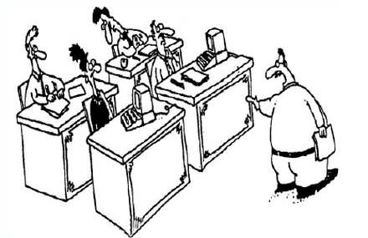
The Fuzzy Front End
Sometimes a development effort starts like this:
You lot start coding!
I’ll go and find out what they want.

Slide 3

The Fuzzy Front End
And sometimes it starts with a formal, complete specification containing
charter,
context, and
theory of operation.
Every requirement is:
Identified
Unique
Coherent
Unambiguous
Testable
Functional
Specification

Slide 4

Abstraction
To build models, you have to be able to gather enough information to make good abstractions.
Learning
Doing
Planning

Slide 5
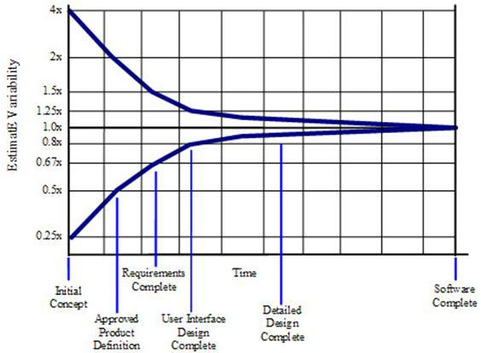
Cone of Uncertainty
Software Development's Cone of Uncertainty
Steve McConnell, Construx Software
Notes:
#ConeofUncertainty
Indicates the upper and lower bounds of estimate variability.
Early in the project, the actual size of the project could be anywhere between
¼ and 4x as large as you think it is.
As you progress through the project, estimates become more and more accurate.

Slide 6
Levels of Commitment
Consequently, we must commit incrementally.
Natural language and informal diagrams
Use cases
Activity diagrams
Sequence diagrams
Structural models
Components & Interfaces
Class models
Data types
Behavioral models
State models
Activities
}
This course

Slide 7
Requirements Clarification Process
The process is:
Find all your people, resources, practices, etc.
Find out what the system-as-a-whole does
Determine the precise behavior of each use case
Bound the problem through the functional specification
But it’s really all about learning about the problem.
Get Organized
Use Cases
Activity Diagrams
Sequence Diagrams

Slide 8
Requirements Clarification Process
We’ll show you how to:
determine what you have, and
gather information to build executable models
investigate questionable use cases
organize information required to build executable models
It’s an iterative process
Get Organized
Use Cases
Activity Diagrams
Sequence Diagrams

Slide 9
Why Are You Here?
Depends.
System and project managers need to understand the process, even if they do not need to know all the details.
Architects need to understand the problem space.
Designers and programmers need to understand what they will receive as inputs to building executable models.

Slide 10
Table of Contents
Getting Organized
Infrastructure
Team
Overview
Understanding (II)
Activity Diagram
Sequence Diagram
Functional Specification
Packaging the Materials
Understanding (I)
Assimilation
Use Cases
Finding Use Cases
Defining Use cases
Factoring Use Cases
Wrap Up
What We Did
What's Next

Slide 11
1. Infrastructure
1

Slide 12
Infrastructure
We assume you have all the necessary infrastructure.
This includes at least:
Version control and configuration management
Issue tracker
Modeling tools
Project planning facility
Documented engineering process
How to establish infrastructure is outside the scope of this course.

Slide 13
Issues Database
Capture:
Action Items
Questions for experts
Issues to be resolved
in an issues database.
You need an issue tracker and you need to use it!
In each issue, establish at least:
What needs to be done
Who owns it
Disposition
Issues
Each issue should be a single, cohesive actionable item

Slide 14
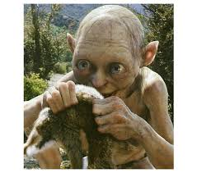

Transparency
Information needs to be public, because:
It belongs to the company, not you
It is expensive to find information in locked drawers
Duplication is less likely
Others can usually improve on what you have
It’s easier to start with something that exists already

Slide 15

2. Identifying the Team

Slide 16
Customer Team
The customer team comprises:
Product management
Systems engineering
Acceptance testing
Business/Product analysts
Marketing
Customer service specialist
etc etc etc
We want this.
The duty of the customer team is to speak with one voice.

Slide 17
Development Team
The development team comprises:
software engineers
hardware engineers
mechanical engineers
system engineers
The duty of the development team is to:
implement the features demanded by the customer
advise the customer team on feasibility
especially on dependencies

Slide 18
Experts
An expert is someone who knows the technical details of how something works.
They are often:
Hard to reach
Assume too much or too little
A little impatient
Sometimes you are the technical expert.
I know all about alarms
It does not change the process.
It just makes it a little easier.

Slide 19
3. Overview
3

Slide 20
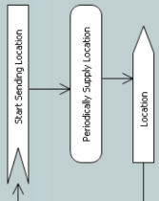
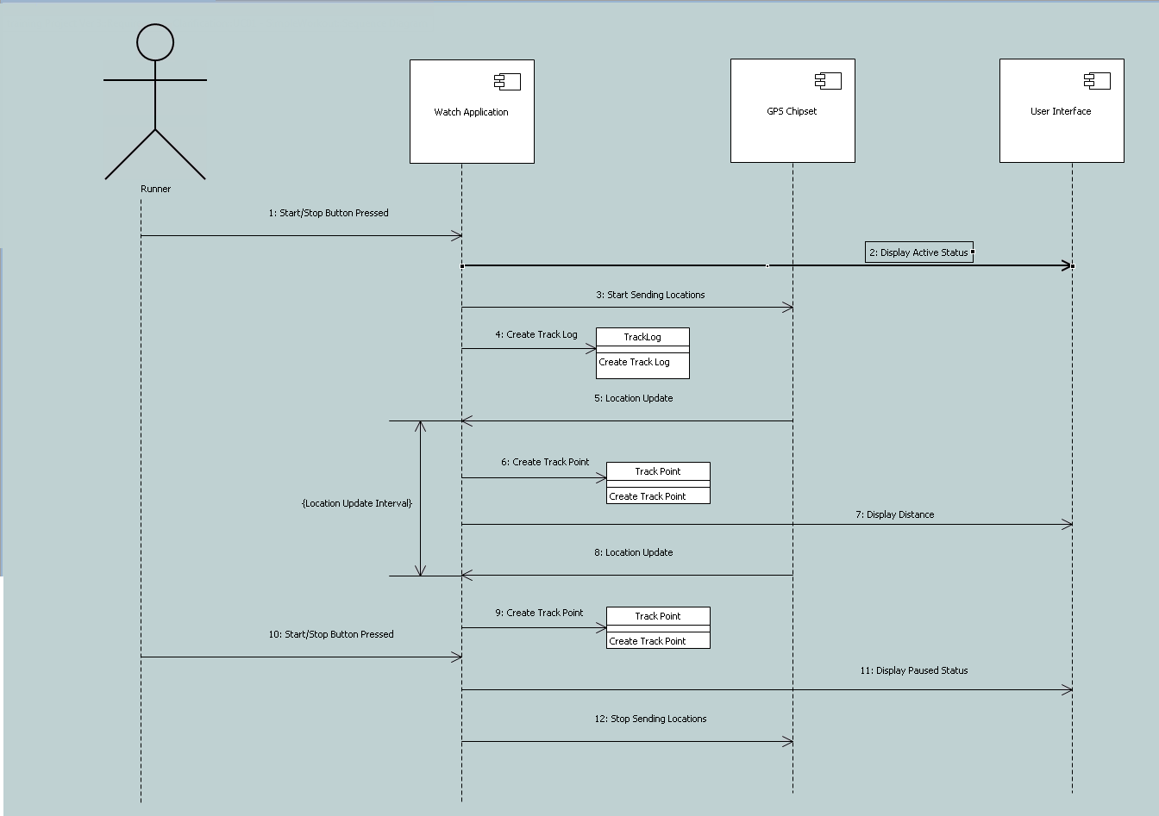
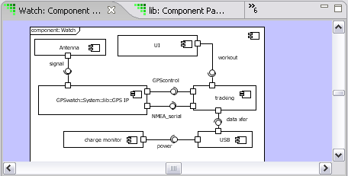
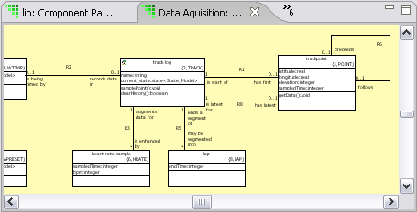

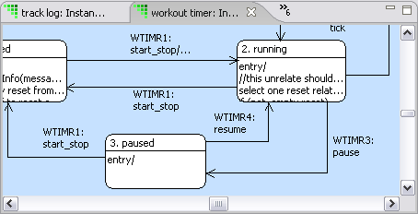
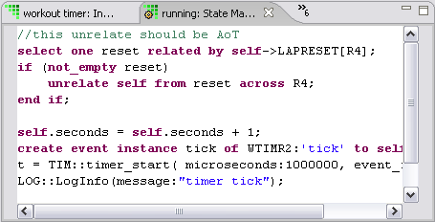
What Are We Doing?
Use
Case
Use
Case
Information about the problem space
Functional
Specification
Output of this course

Slide 21
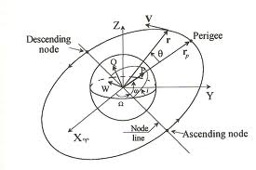
Information about the Problem Space
bk.1 ISO Standard xxx
bk.2 User Manual for xxx
bk.3 Code Listing for xxx
bk.4 Configuration file
Orbital Mechanics for Dummies
Functional
Specification
Identify and read background documents
Read any existing functional specification
Learn about the problem space
Talk to customers and experts

Slide 22

Requirements-Clarification Models
Requirements-clarification models comprise:
A set of use cases…
…each of which has an activity diagram,
and may have a sequence diagram too
Use Case Name/Number
Pre-conditions:
Post-conditions:
Scenario:

Slide 23
Use Cases
A use case says how a role uses a system to meet some goal.
Examples:
A passenger requests elevator
A passenger orders an elevator to a floor
A system administrator sets elevator mode
At 08:00, free elevators return to the ground floor.
The collection of use cases describes what the user needs from this release (and a few core, representative ones for future releases).

Slide 24
Activity and Sequence Diagrams
Activity and sequence diagrams provide detailed descriptions of the behavior of a single use case.

Slide 25
Functional Specification
The Functional Specification contains a set of requirements.
Every requirement is:
Identified
Unique
Coherent
Unambiguous
Testable
The functional specification bounds the contents of this release (and often lists capabilities intended for future releases).
Functional
Specification

Slide 26
Why Are We Doing This?
Use
Case
Use
Case
Functional
Specification

Slide 27
Sequence
Learn about the problem
Build requirements-clarification models
Build (or correct) the functional specification
Load it all in your brain
Build executable models
The process is iterative, and agile.
RC
FS

Slide 28
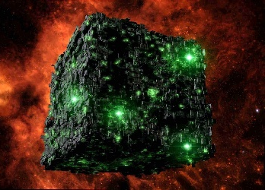
B: Understanding

Slide 29
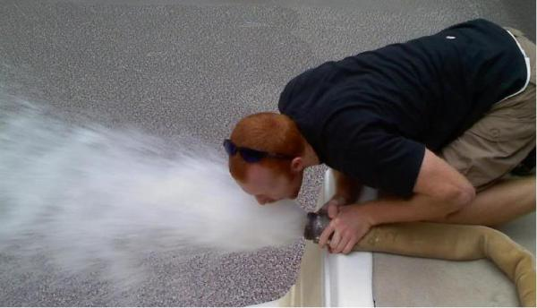
4. Assimilation
5
Notes:
http://www.scenicreflections.com/media/456071/Borg_Cube_Wallpaper/
http://coarpk.wordpress.com/2014/05/02/drinking-from-the-firehose/

Slide 30
Terms
To learn the vocabulary:
Identify existing
documents
files
listings
Identify experts
Make an inventory.
It may be helpful to visit the plant or see prior/similar systems
bk.1 ISO Standard xxx
bk.2 User Manual for xxx
bk.3 Code Listing for xxx
bk.4 Configuration file
Sven@myCo.co.se Elevator Expert
Mark@myVendor.com Knows I/O

Slide 31
Gathering Information
What do you do if you don’t have enough information?
Create an issue in the issue tracking database
Engage a customer or expert who can help
Walk through the use case as you understand it
Break the issue apart for easier understanding (and create new issues in the issue tracking database)
Confirm your revised understanding
Record it in the issue
So each robot has one arm that can move in two dimensions, not three? Right?

Slide 32
Technical Notes
Writing is not “extra.” It forces you to organize your thoughts.
Technical notes capture any topic of interest.
Informal
Short
Common understanding
Always incorporated into the executable models somehow
They will also avoid having the same interview again.
And again…. and again…. and again…. and again…. and ...
Orbital Mechanics for Dummies

Slide 33
Technical Notes
Descriptions drafted in the technical notes will end up in the executable models as:
Domain descriptions
Component descriptions
Class descriptions
Attribute descriptions
Association descriptions
Etc.
But, in the meantime, store them under configuration management, either as part of the requirements clarification models or associated with them.
Orbital Mechanics for Dummies

Slide 34
Intermediate Review
The customers/systems engineers/experts should review your:
technical notes
definitions of mysterious terms
use cases
and answer your questions as you proceed.
The cost of using faulty information is high and the cost increases exponentially the longer you continue to use faulty information!

Slide 35

Summary
To build requirements-clarification models:
Learn about the problem
Identify lots of use cases
Build activity diagram to make sure you understand it
Build a sequence diagram, if they’re helpful

Slide 36
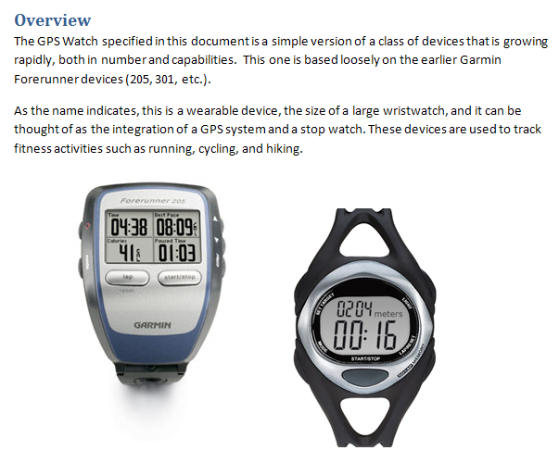
Workshop
Read the description for the case study.
Identify the requirements,
and decide if they are:
Identified
Unique
Coherent
Unambiguous
Testable
If not, open an issue for each question so that when you have the subject-matter expert cornered, you can rapidly resolve them. Be prepared to present your issues list to the class.

Slide 37
5. Use Cases
5

Slide 38
Use Cases
A use case says how a role uses a system to meet some goal.
Examples:
A passenger requests elevator
A passenger orders an elevator to a floor
A system administrator sets elevator mode
At 08:00, free elevators return to the ground floor.
aka
“usage case”

Slide 39
Actors
An actor is anything that interacts with the system:
people
machines and sensors
other systems
timers
We name the role, not the person or thing.
Fred → Administrator
Fred → Passenger
Mary → Passenger

Slide 40
Interaction
An interaction between an actor and system is shown as an association, thus:
It crosses the system boundary and consists of:
data flows
control flows
or a complex interaction comprising multiple flows
Other relationships exist within the system boundary.

Slide 41
Use Case
The use case is everything the system does for the actor.
A passenger requests elevator → Bring an elevator to the requesting floor
A system administrator sets elevator mode → Change mode from ‘Normal’ to ‘Evening’
At 08:00, free elevators return to the ground floor →
Change mode from ‘Evening’ to ‘Morning’
When the door reaches the floor, the door opens →
Open the door
It can include complex interactions back and forth

Slide 42
Use Case Diagram
Request
Elevator
Initiate
Close Door
Initiate
Open Door
Passenger
Order Elevator

Slide 43
6: Finding Use Cases
6

Slide 44
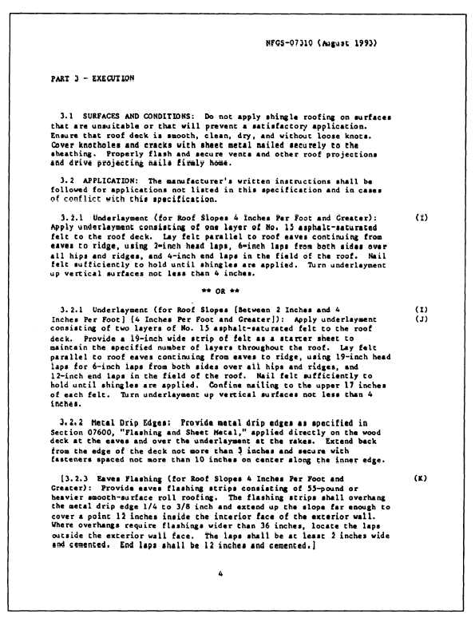

Read the Materials!
Functional
Specification
15
1
16
11
12
41
31
Notes:
http://www.q-lab.com/resources/standards/

Slide 45
Identify Personnel
The people that know the subject matter best are usually the experts and the customers.
Invite them to the initial sessions, and be prepared to ask them for more detail later.

Slide 46
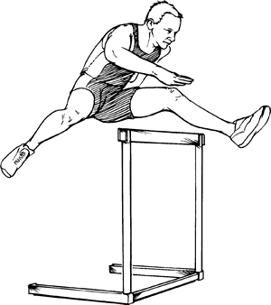

Blitz
A blitz is a technique for getting started.
Write down the ones you know.
There are no wrong answers.
We don’t categorize
We don’t organize
We don’t evaluate
We just enumerate
The purpose is to provide a starting point.

Slide 47
Actors
Who or what interacts with the system?
People (as roles)
Machines and devices
Other systems
Time
Ask what each one wants to do.
Passenger
Administrator

Slide 48
Interaction
Look for data and control inputs to the system.
Keep your mind on the logical intent of the interaction, not the specific physical flows.
Request
Elevator
Initiate
Close Door
Initiate
Open Door
Passenger
Order Elevator

Slide 49
Scope
Be clear about your scope.
The business and environment
What you are building
Just the software
Work
Requirements Gathering
Requirements Clarification
Product Construction
System
✔
Software

Slide 50
Feature vs Function
✔
Features Functions
Request
Elevator
Initiate
Close Door
Request
Elevator
Stop Elevator
Initiate
Open Door
Initiate
Open Door
Order Elevator
Move
Elevator

Slide 51
Back-and-Forth
Generally, a use case involves “back-and-forth” across the system boundary.
This suggests alternate paths:
What if the door fails to close?
What if a passenger requests an intervening floor?
Order Elevator to Floor
Close door
When door closed, accelerate
On approach to specified floor, slow down
On arrival at floor, open door

Slide 52
Alternatives
Consider what can “go wrong.”
Build them as separate use cases.
Order Elevator to Floor with Idiot in Door
Close door
If blocked, reopen door
When completely reopened (and <3 tries, go to Step 1)
If 3 tries, make annoying beeping sound
……

Slide 53
Workshop
Identify and name the use cases in the Case Study.
Draw a diagram, if you want.

Slide 54
7. Defining Use Cases
7

Slide 55
Defining Use Cases
To define a use case, follow this pattern:
<Use Case Number>: <Use Case Name>
Pre-conditions: What must be true before the use case can execute
Post-conditions: What must be true after the use case has executed
Scenario: A description of just what happens

Slide 56
Pre- and Post-Conditions
Pre- and post-conditions say what must be true:
before some use case, and
after the use case is completed.
Elevator arrives at floor
Precondition: Door closed and elevator stopped
Postcondition: Door open
Idiot in Door
Precondition: Door closing and obstruction detected
Postcondition: Door open

Slide 57
Pre- and Post-Conditions
Pre- and post-conditions say what must be true:
before some use case, and
after the use case is completed.
Request elevator to stop at floor
Precondition: Passenger inside cabin
Postcondition: Stop request acknowledged
Deliver passengers to specified floor
Precondition:
Stop request for specified floor exists
Postconditions:
Cabin stopped at specified floor
Doors open

Slide 58
Scenario
A scenario is a list of steps describing the interaction between an actor and the system to effect some goal.
Write down the scenario in natural language.
Scenario: Passenger Enters Elevator
Create order for elevator to floor
Close door
Elevator moves
Elevator arrives at floor
Open door
Scenario: Passenger requests Elevator
Select elevator in requested direction
Create order for elevator to floor
Close door
Move elevator
Elevator arrives at floor
Open door

Slide 59
Scenario
A scenario is a list of steps describing the interaction between an actor and the system to effect some goal.
WARNING: Scenarios are procedural and can lead to brittle systems if implemented directly.
They are used to elucidate the system’s response ONLY.

Slide 60
Test Cases
Most test cases should take the form:
establish pre-conditions
inject stimulus to initiate
verify actual post-conditions against expected
issue a pass/fail indication
Hmmm….
Where would I find these?
Test Harness

Slide 61
Workshop
Write:
Pre-conditions
Post-conditions
Scenario
for
1: Simple Workout
2: Multi-Lap Workout
3: Achieve Pace Over Distance Goal

Slide 62
8. Factoring Use Cases
8

Slide 63
The Whole
Now that we have the use cases, it pays to look at them as a whole to see if we can find:
inconsistencies in terms
inconsistencies in abstraction level
duplication of requirements
elements that can be factored out

Slide 64
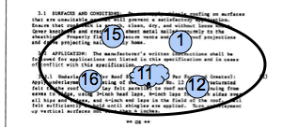
Size Matters
A single use case may encompass several of the original candidate requirements.

Slide 65
This One’s Just Right
Use cases can be:
Very big, involving multiple elements
Big, involving a single, complex interaction
Single requirement
Very small (and very useless)
}
want to be
We are here

Slide 66
Feature vs Function
✔
Features Functions
Request
Elevator
Initiate
Close Door
Request
Elevator
Stop Elevator
Initiate
Open Door
Initiate
Open Door
Order Elevator
Move
Elevator

Slide 67
Inconsistent Abstraction Level
Check that terms used in the use cases are at the same abstraction level.
4
8
Passenger pushes button.
3
7
2
6
Passenger orders elevator to floor.
1
5
閉
開

Slide 68
Duplication and Refactoring
A focus on gaining an understanding of the subject matter may have led to duplication in the use cases. Does it matter?
Reasons to refactor use cases include:
You wish to maintain the use cases throughout the lifetime of the project, and duplication is a maintenance issue
Likelihood that the common piece will change
Frequency of commonality
Readability
Factoring is optional

Slide 69
Factor Out Common Elements
When you find common elements, factor them out.
Scenario UC07: Passenger Enters Elevator
Create order for elevator to floor
Close door
Elevator moves
Elevator arrives at floor
Open door
Scenario UC14: Passenger requests Elevator
Select elevator in requested direction
Create order for elevator to floor
Close door
Move elevator
Elevator arrives at floor
Open door
UC07: Call any elevator to floor
UC14: Order selected elevator to floor

Slide 70
Normalize Terms
Ensure that the terms used in the use cases are either:
exactly those you have defined, or
can be replaced by those you have defined, or
you provide a definition
Correlate them to existing requirements for
identification
completeness
Open an issue for any term that must be defined or clarified.
Pace Workout
Lap Log
Multi-lap Heart-rate
Device
Track …..

Slide 71
Normalize Verbs
Ensure that the verbs used in the use cases are:
limited (i.e. there are but a few of them), and
clear, and if special to the subject matter…
… correlate them to existing requirements for
identification
completeness
Open an issue for any verb that must be defined or clarified.
Add Display
Delete Alert
Read Clear
Find Log
Show …..

Slide 72
Additional Constructs
Other relationships exist within the system boundary.
They are:
«includes»
«extends»
and generalizes (deprecated)

Slide 73
Includes
Scenario UC07: Passenger Enters Elevator
Create order for elevator to floor
Close door
Elevator moves
Elevator arrives at floor
Open door
UC07: Passenger Enters Elevator
«includes»
UC14: Passenger requests Elevator
Scenario UC14: Passenger requests Elevator
Select elevator in requested direction
Include UC07

Slide 74
Extends
Scenario UC07: Passenger Enters Elevator
Create order for elevator to floor
Close door
Elevator moves
Elevator arrives at floor
Open door
UC07: Passenger Enters Elevator
«extends»
UC24: Passenger Adds Order
Scenario UC24: Passenger Adds Order
Duplicates UC07 Steps 1~3
Create additional order, if not past floor
Repeat UC07 Steps 2~5 for each order

Slide 75
Workshop
Using <<extends>> and/or <<includes>>
factor the use cases you have specified thus far.
Be prepared to discuss the pros and cons of factoring.

Slide 76
9. Activity Diagram
9

Slide 77
Activity Diagrams
The purpose of building an activity diagram is to
capture shared understanding of sequencing and processing,
and make obvious the opportunity for concurrency.

Slide 78
Basics of Activities
Activity diagrams can show:
Activities
Transitions
Initial node
Final node
The transitions indicate the sequencing.
Drink Beer
Fall Over

Slide 79
Decisions
Activity diagrams may also make decisions.
Decision node (diamond) shows decision
[guards] indicate conditions that must be true
Decision node also used for merge
[Insensible?]
Drink Beer
Fall Over
Go Home
[Sensible?]

Slide 80
Parallel Activities
Several actions make take place in parallel.
Arrive in Pub
Synchronization Fork
Drink Beer
Play Snooker

Slide 81
Parallel Activities
Parallel activities may need to terminate before another activity can take place.
Arrive in Pub
Synchronization Fork
Drink Beer
Play Snooker
Synchronization Join
Fall Over

Slide 82
Swimlanes
To clarify actors’ roles, activities are aligned inside swimlanes.
Patron
Barkeep
Places Order
Takes Money
Drinks Beer
Pours Drink
Fall Over

Slide 83
Signals
Actions may send signals and accept the corresponding event.
Patron
Barkeep
Shout Order
Hears Order
Pours Drink

Slide 84
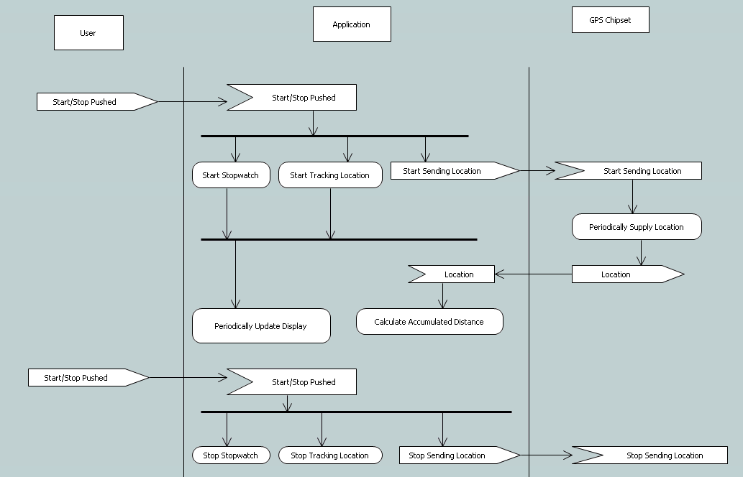
Activity Diagram

Slide 85
Workshop
Draw an activity diagram for use case #5.

Slide 86
10. Sequence Diagrams
10

Slide 87
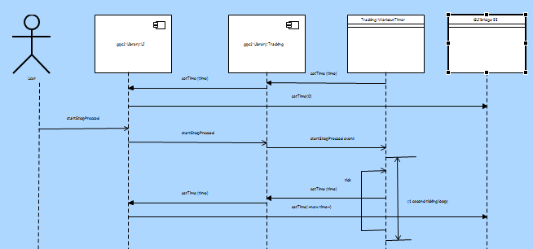
(Message) Sequence Diagrams
A sequence diagram shows how processes operate with one another and in what order.
Among other elements, a sequence diagram has:
Lifelines
Messages
Timing

Slide 88
Lifelines
Anything that has its own behavior, that can occur concurrent with others, can be said to have a lifeline.
The lifeline shows how its owner behaves over time.
A lifeline can be a:
Actor
Component
Instance
External Entity
Class
It can send messages to others.
These are informal, though they may be connected to formal things later.

Slide 89
Messages
Messages can be
Synchronous (wait for return )
Return ( )
Asynchronous (send and forget )

Slide 90
Timing
Timing elements include:
Marks and
Spans
Mark
Span
10 ms
20 ms

Slide 91
Sequence Diagrams
Build a sequence diagram if it helps detail your understanding.

Slide 92
Workshop
Draw a sequence diagram for use case #5.

Slide 93
11. Functional Specification
11
Functional
Specification

Slide 94
Functional Specification
The purpose of the functional specification is to
bound the problem …. so you
can build executable models
RC
FS
Notes:
http://blog.hubspot.com/customers/bid/124007/Pouring-In-the-Ideas-at-HUGS-2011-Customer-Story

Slide 95
Building the Functional Specification
Complete the requirements-clarification models
Find any existing functional specification
Refine each requirement whether it’s
non-existent,
unclear, or
poorly factored
until it’s good
Then build executable models
This course provides criteria for a good requirements specification, but it does not seek to teach how to build one in detail

Slide 96
Find Requirements
Read the specification to find requirements.
They must be:
Identified
Unique
Coherent
Unambiguous
Testable
If they’re not, rewrite as necessary.
Functional
Specification

Slide 97
Find & Identify Your Requirements
Find each requirement and ensure it’s identified.
Req’t 1: The door must open if it is obstructed.
Req’t 2: A passenger can get an elevator to a floor.
Req’t : A passenger can open the door.
Notes:
3rd: Not uniquely identified.
2nd: Not specific. (next slide shows an improvement)

Slide 98
Coherent and Unambiguous
Each requirement must be coherent and unambiguous.
Req’t 1: The door must open if it is obstructed.
Req’t 2.A: A passenger can order the elevator he occupies to a particular floor.
Req’t 2.B: A passenger can summon to the floor he occupies an elevator that will then travel in a specified direction.
Req’t 3: A passenger can open the door.

Slide 99
Testable
Each requirement should be testable.
You must be able to know if the requirement has been met.
Req’t 10: The administrator can define a mode.
Req’t 10: The administrator can switch between modes.
Req’t 10A: “AM mode” takes all unused elevators to the lobby
Req’t 10B: “PM mode” takes all unused elevators to the top floor.
Req’t 11: The elevator can service many floors
Req’t 11: The elevator can service a maximum of 100 floors.
Notes:
1st Req 10: It’s not clear what defining a mode means.
Req 11: Does not specify many. Could be two.

Slide 100
Testable
Each requirement must be testable. You must be able to say:
what is true before the requirement executes
what is true after the requirement has executed
Req’t 1: The door must open if it is obstructed.
Pre: Obstruction in door
Post: Door open
Req’t 2: A passenger can order the elevator he occupies to a specific floor.
Pre: None
Post: Order to move elevator to floor queued

Slide 101
Completing the Functional Specification
Load the functional specification and the requirements-clarification models into your brain.
Use
Case
Use
Case
Functional
Specification

Slide 102
12. Packaging the Materials
12

Slide 103
Organizing the Elements
The result of all this work is mostly
UNDERSTANDING
but the work must be packaged up for
review and
ease of access.

Slide 104
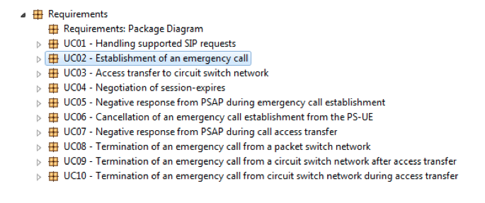
Requirements
Create a package named “Requirements”. Within that package create a package for each use case.

Slide 105
Use Cases
Each use case shall contain:
a description
an activity diagram, and optionally
a sequence diagram
Use Case Name/Number
Pre-conditions:
Post-conditions:
Scenario:

Slide 106
Use Case Description
The use case description shall contain:
Pre-conditions
Post-conditions
Scenario
and could cross-reference to the requirements it implements.
Use Case Name/Number
Pre-conditions:
Post-conditions:
Scenario:
15
1
16
11
12

Slide 107
Activity Diagram
The Activity Diagram captures the sequencing and processing.

Slide 108
Sequence Diagram
And the Sequence Diagram captures detailed message flow.

Slide 109
Review
All of this needs to be reviewed by the customers and their experts.
Use Case Name/Number
Pre-conditions:
Post-conditions:
Scenario:

Slide 110
Lifespan
Executable models are the solution to the problem stated in the requirements-clarification models and functional specification.
Changes:
in the executable models do not require changes to the requirements-clarification models
in the requirements will cause you to iterate in an agile manner, updating the requirements-clarification models and the functional specification before changing the executable models

Slide 111
Workshop
Build a complete use case specification, activity diagram, and optionally a sequence diagram for all remaining uses cases.
Build them without factoring them, with a goal of gaining understanding.
Open issues for questions or clarification required from the subject-matter expert.
Be prepared to present to the class:
Issues you uncovered, along with the resolutions
At least one of your use cases
If you have time, consider factoring the use cases, make a decision about whether to do it, and plan to discuss your rationale with the class.

Slide 112
C: Wrap Up

Slide 113
13. What We Did
13

Slide 114
Levels of Commitment
We must commit incrementally.
Natural language and informal diagrams
Use cases
Activity diagrams
Sequence diagrams
Structural models
Components & Interfaces
Class models
Data types
Behavioral models
State models
Activities
}
This course

Slide 115
Requirements Clarification Process
The process is:
Find all your people, resources, practices, etc.
Find out what the system-as-a-whole does
Determine the precise behavior of each use case
And establish how it communicates with others
But it’s really all about learning about the problem.
Get Organized
Use Cases
Activity Diagrams
Sequence Diagrams

Slide 116
Requirements Clarification Process
We showed you how to:
determine what you have, and
gather information to build executable models
investigate questionable use cases
organize information required to build executable models
It’s an iterative process
Get Organized
Use Cases
Activity Diagrams
Sequence Diagrams

Slide 117
14. What’s Next
14

Slide 118
Abstraction
Now that we have approved use cases, and it’s all in our heads, it time to:
THINK
From that thinking, we create abstractions.

Slide 119
Levels of Commitment
Build executable models to capture those abstractions:
Natural language and informal diagrams
Use cases
Activity diagrams
Sequence diagrams
Structural models
Components & Interfaces
Class models
Data types
Behavioral models
State models
Activities
}
Next course

Slide 120
THE END

