Slide 1

EE 559 Python Instruction
session I
Shuai Xu
02/02/2022
Modified based on Min Zhang’s slides
Shuai Xu

Slide 2


Contents for today
Python
Anaconda
IDEs
Jupyter Notebook and Google Colab
Examples
Shuai Xu

Slide 3
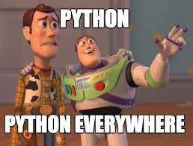
Why Python?
Pros:
Easy to learn
Less programming overhead
Interactive python console
Full modularity, supporting hierarchical packages
Widely used by Data Scientists and ML community
Extend your C++ libraries on Python using Python API
→ Prototyping in Python
Cons:
Natively Slow → Implementation time versus execution time
Requires more testing as errors show up at run-time
Shuai Xu
Notes:
Don’t need to state the types of the variables; Pseudocode;

Slide 4

Python Installation
macOS
brew install python3
Ubuntu
Ships with both Python 2 and Python 3 installed
Windows
IDE’s like PyCharm, Spyder
Tips:
Use online resources to download and install python.
Don’t spend significant time on figuring out how to install python.
Package Installation and Management
pip install PACKAGE based on the virtual environment
Shuai Xu

Slide 5
See cheat sheet for today’s demonstration at the last page
Demonstration
-- Terminal/Console
Shuai Xu

Slide 6
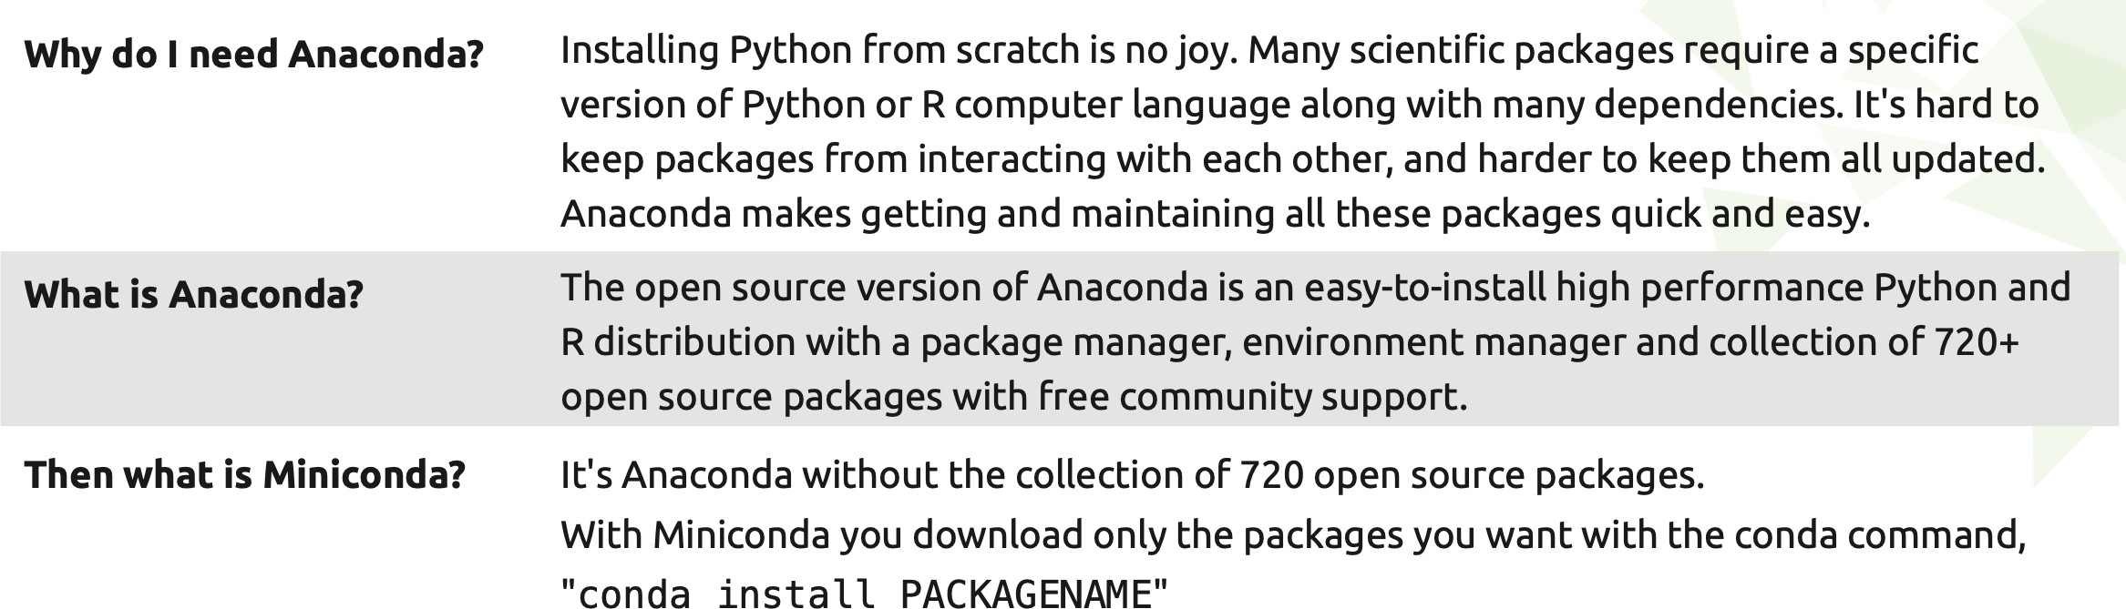


Why Anaconda?
Anaconda Cheat Sheet
Shuai Xu

Slide 7
Demonstration
-- Anaconda
Anaconda Installation
Environment Management
Package Management
Shuai Xu
Notes:
Show some conda commmands
1. set environment after we install the Anaconda

Slide 8

Editors
All major editors that are used for programming, provide Python modes (such as Vim, Sublime Text), some Integrated Development Enviroments (IDEs) come with their own editor (Spyder, Pycharm).
Which of these is best, is partly a matter of choice.
For beginners, Spyder seems a sensible choice as it provides an IDE, allows execution of chunks of code in an interpreter session and is easy to pick up.
Shuai Xu

Slide 9


IDEs
Demonstration
Pycharm/Spyder/Visual Studio Code
powerful interactive development environments for the Python language with advanced editing, interactive testing, debugging and introspection features and a numerical
computing environment
Jupyter Notebook (formly IPython Notebook)
write and execute Python code locally in your web browser
execute, store, load, re-execute a sequence of Python commands, and to include
explanatory text, images and other media in between; easy to tinker with code and execute it in bits and pieces
A good tool for documenting calculations and data processing, support learning and teaching, widely used in scientific computing
Shuai Xu

Slide 10

IDEs
Demonstration
Google Colab (will use it in next week’s tutorial)
Google's flavor of Jupyter notebooks that is particularly suited for machine learning and data analysis and that runs entirely in the cloud.
free, requires no setup, comes pre-installed with many packages, is easy to share with the
world, and benefits from free access to hardware accelerators like GPUs and TPUs (with some caveats).
Shuai Xu

Slide 11
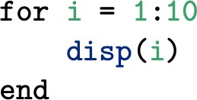


From Matlab to Python
Chapter 10 of Hans Fangohr’s book
Recommend reading before next tutorial
The for-loop:
Matlab: the end key-word at the end of the block belonging to the for-loop
Python: colon (“:”) at the end of the for-line; the commands to be executed within the for-loop to be indented
Matlab’s indexing of matrices and vectors starts a 1, whereas Python’s indexing starts at 0 (similar to C).
Shuai Xu

Slide 12
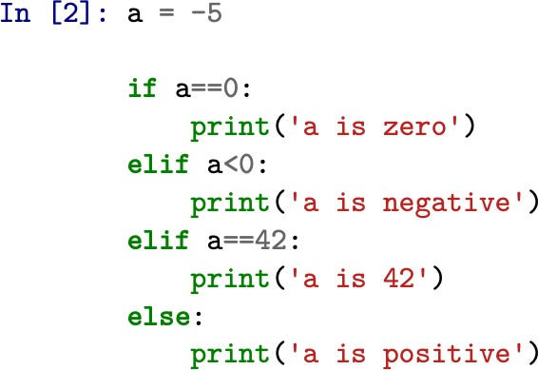
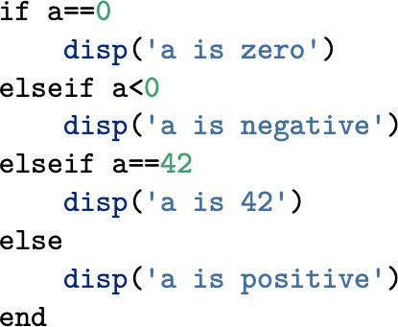


From Matlab to Python
Chapter 10 of Hans Fangohr’s book
The if-then statement:
Matlab: the end key-word at the end of the block belonging to the if-then-else statement
Python: colon (“:”) after every condition; the commands to be executed within each part of the if-then-else statement to be indented
Shuai Xu

Slide 13
Next week
Fundamentals of Python Coding including data types, control flow, input/output, reading from and writing to files, functions, modules, etc
Shuai Xu

Slide 14
Commands Cheat Sheet
pwd
ls
mkdir xx
cd
touch xxx.py
nano/vim xxx.py
python xxx.py
which python
python
1/2=0
which python3
Python3
conda create --name 559 python=3.6
conda info --envs / conda env list
conda activate 559
conda search numpy
conda install numpy
conda uninstall numpy
conda list
conda deactivate
conda remove --name 559 –all
pip install PACKAGE
pip uninstall PACKAGE
pip list
1/2=0.5
Shuai Xu

Slide 15
Thank You!
Shuai Xu

