Slide 1
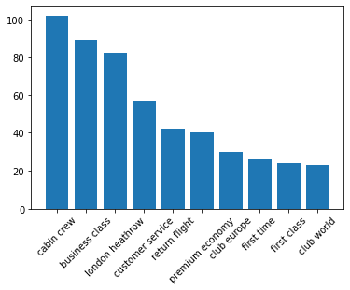
Positive: 52.9%
Neutral: 0.5%
Negative: 46.6%
Top 10 Phrases

